Slide 1
SPORTS ANALYTICS
Quality Monitoring and Injury Risk
Module 10 · The Course's Signature Module
Week 10
Undergraduate · 3-hour session
Built from the instructor's own published research:
Muritala, Brown & Haller (2026), Research in Sports Medicine.

Slide 2
BEFORE WE START
What's Coming Up
Due This Week
-- update before class --
Coming Up
-- update before class --
Office Hours
-- update before class --

Slide 3
RECAP
Where We Left Off
Module 9 pulled back the curtain on the BasketballAnalyzeR package itself and sent you out with the full real toolkit this course has built all term. Today I am handing you one more real tool, and it comes from a different place than the rest of this course: my own published research on quality monitoring and reinjury risk.
Same course, same habit of real data and real code, one new statistical idea.

Slide 4
OUTLINE FOR THE DAY
Where We're Headed
I
Segment 1
II
Segment 2
What a control chart is, and building one from scratch on a real NBA player
The real research this module is built on, and what quality monitoring means in professional sports
III
Segment 3
IV
Before Next Class
The Acute:Chronic Workload Ratio, its real documented weaknesses, and closing out the course
Lab 10, the Module 10 quiz, and the practice questions

Slide 5
LEARNING OBJECTIVES
By the End of Today, You Will Be Able To
1
Explain what a control chart is and what its center line and control limits represent.
2
Compute a real I-MR control chart's center line, moving range, and control limits by hand from real data.
3
Build a real control chart in R from real NBA shot-log data and identify out-of-control signals.
4
Explain why a flagged signal is a prompt for investigation, not proof of a causal relationship.
5
Describe the Acute:Chronic Workload Ratio and name its real, documented statistical weaknesses.

Slide 6
CONCEPT · SEGMENT 1
A Module Built From My Own Research
Every other module this term built on Zuccolotto and Manisera's textbook. This one builds on a question I study myself: can you tell, from an athlete's own real performance and workload data, when something has quietly drifted out of its normal range, before it turns into an injury?
Muritala, Brown & Haller (2026), Research in Sports Medicine. https://doi.org/10.1080/15438627.2026.2632610

Slide 7
NEW TERM · PLAIN LANGUAGE
A Control Chart: Watching a Number Over Time
Take a repeated real measurement of something, and plot it in order over time. Compute its real average and call that the center line. Then figure out how much it naturally bounces around, and set two outer limits. As long as a point stays inside those limits, it is ordinary variation. The moment it crosses outside, you have a real signal worth a second look.

Slide 8
WATCH BEFORE WE CONTINUE
Control Charts Simply Explained
▶
numiqo (YouTube)
https://www.youtube.com/watch?v=iOJDBpOa3Ko
Runtime not independently confirmed; chapter markers run at least 9 minutes.
Watch for: how a center line and two control limits turn a plain-looking line chart into a decision tool.

Slide 9
NEW TERM · THE FORMULA
The I-MR Control Chart, Step by Step
center line (x-bar) = mean of the baseline measurements
moving range (MR) = |difference between consecutive points|
mean moving range (MR-bar) = average of all moving ranges
sigma-hat = MR-bar / 1.128
UCL = x-bar + 3 * sigma-hat
LCL = x-bar - 3 * sigma-hat
1.128 is the standard I-MR chart constant (d2) for a moving range of two consecutive points.

Slide 10
LET'S RUN THIS TOGETHER
Let's open RStudio and build Joel Embiid's real per-game shot count.
Pull up your own session. We'll run it line by line and look at the real output together.

Slide 11
WORKED EXAMPLE, STEP 1
Building a Real Per-Game Workload Series
shots <- read.csv("shotdetail_2023.csv")
emb <- shots[shots$PLAYER_NAME == "Joel Embiid", ]
by_game <- aggregate(SHOT_ATTEMPTED_FLAG ~ GAME_ID + GAME_DATE,
data = emb, FUN = sum)
names(by_game)[3] <- "FGA"
by_game <- by_game[order(by_game$GAME_DATE), ]
Run this yourself on the real 2023-24 shot log in this module's Coding_Exercise folder.

Slide 12
LET'S RUN THIS TOGETHER
Now let's compute his real center line and control limits together.
Pull up your own session. We'll run it line by line and look at the real output together.

Slide 13
WORKED EXAMPLE, STEP 2
Computing the Real Control Limits
preinjury <- by_game[by_game$GAME_DATE <= 20240130, ]
xbar <- mean(preinjury$FGA)
mr_bar <- mean(abs(diff(preinjury$FGA)))
sigma_hat <- mr_bar / 1.128
UCL <- xbar + 3 * sigma_hat
LCL <- max(0, xbar - 3 * sigma_hat)
We stop at January 30, 2024, his last game before his real reported knee procedure.

Slide 14
WORKED EXAMPLE, STEP 3
Embiid's Real Baseline, in Numbers
22.18
3.95
34.02
10.33
center line
(mean FGA)
estimated
sigma
upper control
limit
lower control
limit
Computed from 34 real pre-injury games, 2023-24 NBA season. Module10_control_chart.R.

Slide 15
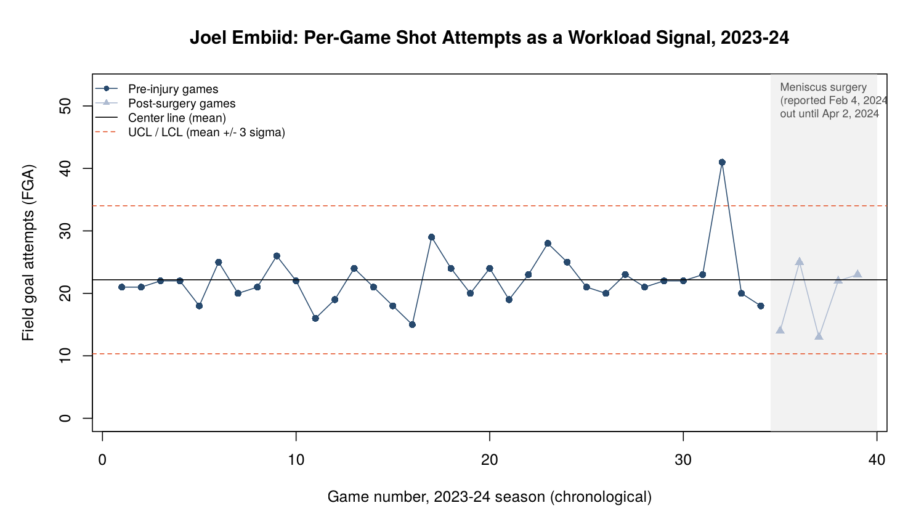
WORKED EXAMPLE, STEP 4
The Full Real Chart
Real 2023-24 NBA shot log (shufinskiy/nba_data). Gray band marks games missed after the reported Feb 4, 2024 procedure.

Slide 16
CONCEPT · READING THE SIGNAL HONESTLY
One Real Signal, Eight Days Before His Last Game
What this shows: a real, honest statistical signal the chart would have flagged the moment it happened.
What this does not show: that the spike caused his later knee procedure. One case demonstrates a method; it does not establish causation.
41
real field goal attempts,
January 22, 2024, the only
out-of-control game in his
pre-injury baseline
Notes:
Discussion: ask the class what additional real information an NBA team's sports science staff would want before treating this one flagged game as a concern (wellness questionnaires, soreness reports, practice-load data). Push on the difference between a statistical signal and a medical diagnosis. Also note for the class: this is exactly the kind of overclaiming the course's methodological-rigor literature (Davis et al., 2024) warns against.

Slide 17
INTERACTIVE ACTIVITY
What Would You Want to Know Next?
You are the team's data analyst. The chart just flagged Embiid's January 22 game.
1. Name two pieces of real information, beyond shot attempts, you would want before raising this with the training staff.
2. Would you flag it immediately, or wait to see if another signal follows? Defend your answer.

Slide 18
RECAP · SEGMENT 1
Control Charts, Covered
Covered
Next
What a control chart is, the I-MR formula, and a full real chart built on Joel Embiid's 2023-24 workload, including its one honest signal.
Segment 2 looks at the real research this method comes from, and what quality monitoring means in professional sports.

Slide 19
10-Minute Break
Back at the top of the hour. Next: the real research behind this module.

Slide 20
CONCEPT · SEGMENT 2
Quality Monitoring, Applied to MLB Pitchers
Muritala, Brown & Haller (2026)
"A Quality Monitoring Approach to Evaluating Reinjury Likelihood to Major League Baseball Pitchers," Research in Sports Medicine. This paper applies statistical process control, the same real family of methods you just used on Embiid, to a real pitcher's own workload and performance data across a season, looking for the same kind of real, honest signal: a point where the data drifts outside the pitcher's own established normal range.
https://doi.org/10.1080/15438627.2026.2632610

Slide 21
WATCH BEFORE WE CONTINUE
Pineda Has UCL Tear in Elbow
▶
MLB.com (Milwaukee Brewers, official)
https://www.mlb.com/brewers/video/pineda-has-ucl-tear-in-elbow-c1603774083
Confirmed runtime: approximately 23 seconds.
Watch for: the real, in-game moment this entire research thread exists to catch earlier, if it can.

Slide 22
CONCEPT · SEGMENT 2
This Method Is Bigger Than One Paper
West, Ward, Plisky and colleagues' 2026 tutorial in the Journal of Strength and Conditioning Research makes the broader case directly: sport organizations now collect enormous amounts of athlete monitoring data, and statistical process control gives practitioners a disciplined, reproducible way to flag when that data has drifted, instead of relying on gut feel.
West et al. (2026). Journal of Strength and Conditioning Research, 40(2), e202-e210. https://doi.org/10.1519/JSC.0000000000005341

Slide 23
INTERACTIVE ACTIVITY
Pick Your Own Real Workload Signal
Get into pairs. Pick any real player you know missed time to injury recently.
1. Name one real, publicly available statistic for that player that could serve as a workload or performance signal.
2. In one sentence, explain why a control chart on that statistic might have been informative.

Slide 24
RECAP · SEGMENT 2
The Research, Covered
Covered
Next
Where this method comes from, the real MLB pitcher reinjury research it is built on, and why it generalizes well beyond one sport.
Segment 3 looks at the most popular alternative framework in this space, and why its own math has real, documented problems.

Slide 25
10-Minute Break
Back at the top of the hour. Next: the Acute:Chronic Workload Ratio.

Slide 26
NEW TERM · PLAIN LANGUAGE · SEGMENT 3
The Acute:Chronic Workload Ratio (ACWR)
If you read about athlete workload monitoring anywhere outside this course, you will run into the ACWR far more often than you will run into control charts. It compares an athlete's recent workload, typically the last week, against their longer-term average, typically the last four weeks, and flags risk when that ratio climbs too high too fast.

Slide 27
NEW TERM · THE FORMULA
How the ACWR Is Actually Computed
acute load = total workload, most recent 7 days
chronic load = average weekly workload, trailing 28 days
ACWR = acute load / chronic load
Kanwal, Ahsan, Khan & Khan (2025). Premier Journal of Science, 11, 100088.

Slide 28
NEW TERM · SEGMENT 3
Weakness 1: Mathematical Coupling
The acute window (the last 7 days) is mathematically part of the chronic window's calculation in most common ACWR formulas, since the most recent week is included in the trailing four-week average. This shared data can manufacture a statistical relationship between the two numbers that exists because of how the ratio is built, not because of any real underlying physiological signal.

Slide 29
SEGMENT 3
Weaknesses 2 and 3: Arbitrary Windows, Weak Early Evidence
Arbitrary Windows
Weak Early Evidence
The choice of window length and averaging method (a simple rolling average versus an exponentially weighted moving average) both change the real result, with no settled, principled reason to pick one over another.
Early studies supporting the ACWR often used small, retrospective samples, a design prone to overstating a real predictive relationship that a larger, better-controlled study might not confirm.

Slide 30
CONCEPT · THE STRONGEST EVIDENCE AGAINST IT
A Real Randomized Controlled Trial Found No Effect
The finding: no significant reduction in real injury or health problems from ACWR-guided training compared to normal training.
Why it matters: a real RCT directly tests whether an intervention causes an outcome. A null result here is stronger evidence against a confident claim than a small association study is evidence for one.
10
real months, elite youth
football, ACWR-guided
training vs. usual training
Notes:
Discussion: note that the review itself is balanced, some researchers still use the ACWR as a crude heuristic alongside other metrics rather than calling for it to be abandoned outright. Ask the class: does a documented statistical weakness mean a tool is useless, or does it mean the tool needs to be used with appropriate caution? Tie back to the course's running theme of checking a framework's own math.

Slide 31
INTERACTIVE ACTIVITY
Brief the Front Office
Get into small groups. I'll assign your group one of the three real ACWR weaknesses from today: mathematical coupling, arbitrary windows, or weak early evidence.
Prepare a thirty-second real explanation of your weakness, as if you are briefing a front office that is considering adopting the ACWR. Be ready to present.

Slide 32
RECAP · SEGMENT 3
The ACWR, Covered
Covered
Next
The ACWR's formula and its three real documented weaknesses, including a real null RCT result that challenges confident use of its thresholds.
We close out the course: the throughline this module completes, and what to carry forward.

Slide 33
THROUGHLINE · INJURY DETECTION & PREDICTION
Where This Course's Injury Thread Lands
The question:
Can real, ordinary performance data, tracked over time, give an honest early warning before an injury happens?
This module is this course's deepest answer to that question. It will not be the last time you encounter this kind of thinking. Any career in sports analytics will eventually ask you to monitor something over time, not just compute it once, and the habit of checking whether a signal is real, and what it does and does not prove, will serve you in every one of those situations.

Slide 34
PRACTICE
Read Your Own Real Chart
Look back at Embiid's full control chart.
1. How many real games fall between the center line and the upper control limit versus between the center line and the lower control limit?
2. Does that balance surprise you? What would a perfectly symmetric real process look like on this chart?

Slide 35
SUMMARY
What to Carry Forward
A control chart turns a repeated real measurement into a center line and control limits, flagging real signals worth a second look.
Embiid's real 2023-24 shot-attempt data produced exactly one out-of-control game, eight days before his last pre-surgery appearance, a real pattern worth noticing, not proof of causation.
This method comes directly from my own published quality-monitoring research on MLB pitcher reinjury risk, and from a broader real literature making the same case across sport science.
The ACWR, the field's most common workload tool, carries real, documented statistical weaknesses, including a null result from a real randomized controlled trial.

Slide 36
CLOSING OUT THE COURSE
Two Things Before We Close This Out
Do
Reflect
Complete Lab 10 (your own real player's control chart), the practice questions, and the Module 10 quiz on D2L.
This closes the ten-module sequence. Your Final Project is where everything from Module 1 through today comes together.

Slide 37
FULL READING LIST
References Cited Today
Muritala, F., Brown, A. R., & Haller, A. (2026). A quality monitoring approach to evaluating reinjury likelihood to Major League Baseball pitchers. Research in Sports Medicine.
West, S., Ward, P., Plisky, P., et al. (2026). Getting the most from your data: Using statistical process controls for data quality assurance in sport science data. Journal of Strength and Conditioning Research, 40(2), e202-e210.
Kanwal, S., Ahsan, M. T., Khan, R. N., & Khan, A. (2025). Load management and injury prevention in elite athletes: A narrative review. Premier Journal of Science, 11, 100088.
shufinskiy (2026). nba_data: NBA play-by-play and shot detail data [Data repository]. GitHub.

Slide 38
That's the Course.
Ten modules, real data every time. Final Project next.

