Slide 1
SPORTS ANALYTICS
Season Segments and Final Rankings
Module 04 . The Race to the Finish
Graduate
3-hour session
Maps to Chapter 4:
Zuccolotto, P., Manisera, M., & Sandri, M. (2026). Advanced Basketball Data Science: With Applications in R. CRC Press.
Notes:
Open by naming the shift from Module 3's within-game clutch split to today's across-season split. Keep this short; the real content starts on the outline slide.

Slide 2
BEFORE WE START
What's Coming Up
Due This Week
-- update before class --
Coming Up
-- update before class --
Office Hours
-- update before class --

Slide 3
OUTLINE FOR THE DAY
Where We're Headed
I
Segment 1
II
Segment 2
A season in two acts: building real per-game box scores and comparing GSW's real first half to its second half
Adjusted ratings, the AdjRtg() formula, and a real result that computes to exactly zero
III
Segment 3
IV
Before Next Class
A real CART tree, a real alluvial diagram, and the PhD-track methodology thread
Lab 4, the Module 4 quiz, and the practice questions

Slide 4
LEARNING OBJECTIVES
By the End of Today, You Will Be Able To
1
Explain what a season segment is and why splitting a season chronologically asks a different question than a clutch/general split does.
2
Explain, in your own words, what an opponent-adjusted rating corrects for that a plain offensive or defensive rating does not.
3
Diagnose why an adjustment method can degenerate on a hub-and-spoke schedule, using GSW's real 2017-18 data as the case.
4
Fit and interpret a real CART tree as an exploratory tool, not a validated predictive model, on a small real sample.
5
Read a real alluvial diagram and trace how a team's segment-1 ratings connect to its real wins in a sample.

Slide 5
RECAP
Where We Left Off
Last time, I split a team's performance by game situation: clutch minutes against everything else. Today I'm keeping the same basic move, comparing one real subset of a season against another, but changing what defines the split. Instead of splitting by time and score within a game, I'm splitting by time across an entire season: the first half of a team's real schedule against the second half.
Notes:
Ask the room: does a team's form in the season's first act actually predict how the season ends, or can the picture change enough between the two acts that an early read is misleading? Don't answer it yet, let it sit as today's open question.

Slide 6
CONCEPT . SEGMENT 1
Why Season Segments Matter
A single full-season rating number flattens a team's whole year into one line. That's useful for a final standings table, but it hides real movement. A team can get healthier or more banged up, tighten its rotation, or simply draw a softer or harder run of opponents in one half of the schedule. A model trained only on segment-1 data is implicitly betting that the rest of the season looks like the part already observed, and this module gives us a real, concrete case where that bet is only partly safe.

Slide 7
NEW TERM . SEGMENT 1
Season Segment: A Season in Two Acts
A season segment is a chronological slice of a team's real schedule: not a game situation like clutch time, but a real stretch of calendar and games. This module treats the first and second halves of a team's real schedule as two acts, and asks whether act one is a reliable preview of act two.
This is the real question Zuccolotto, Manisera & Sandri's Chapter 4, "the race to the finish," is built to ask.

Slide 8
A METHODOLOGICAL NOTE ON OUR DATA
Why We're Not Using the Textbook's Own File
Chapter 4's own worked example is built from a private 2022-23 Italian Basketball League play-by-play file, paired with a supplementary AdjRtg() function the textbook distributes only through its own non-public companion files. Neither is available to us. So, exactly as we did for the clutch chapter, I'm reproducing this chapter's real methodology on real, freely available data instead. I implemented AdjRtg() directly from the textbook's own published equations (4.1 and 4.2), applied to real per-game box scores built the same way we've built them before, with BasketballAnalyzeR's own TOPboxes()/fourfactors() pipeline, this time run one real game at a time across an entire season.

Slide 9
TODAY'S REAL DATA
PbP.BDB: A Different Real Dataset Than Last Time
BasketballAnalyzeR::PbP.BDB needs its own introduction, because it's a different real dataset than the one we used last time. Checking its own data_set field and each team's real game count confirms it: this is the complete, real 2017-18 NBA regular-season play-by-play record for the Golden State Warriors specifically. Every other team in the file appears only in its own real regular-season games against GSW, two to four games each, never against each other. That's a genuinely different shape of data than a normal league season, and it turns out to matter a great deal for this module's adjusted-rating results.
Notes:
Foreshadow, without fully explaining yet: this one-team-plus-one-off-opponents shape is why the adjusted rating result later this session comes out exactly zero for GSW. Don't give it away yet, just plant the flag.

Slide 10
LET'S RUN THIS TOGETHER
Let's confirm this dataset together.
Pull up your own session. We'll run it line by line and look at the real output together.

Slide 11
WORKED EXAMPLE, STEP 1
What the Real Data Actually Confirms
Team covered
Golden State Warriors, every one of its 82 real 2017-18 games
Date range
October 17, 2017 to April 11, 2018
Opponent shape
Roughly 25-30 other real teams, each appearing only in its own 2-4 real games against GSW
A real game inside it
The real Christmas Day game against Cleveland, which GSW really won 99-92
Confirmed via PbP$data_set and length(unique(PbP$game_id)); BasketballAnalyzeR::PbP.BDB.

Slide 12
LET'S RUN THIS TOGETHER
Let's build our real per-game box scores together, one game at a time.
Pull up your own session. We'll run it line by line and look at the real output together.

Slide 13
WORKED EXAMPLE, STEP 2
One Real Game at a Time
TOP <- TOPboxes(gdat, team = home)
FF <- fourfactors(TOP$Tbox, TOP$Obox)
# repeated once for each of GSW's 82 real games,
# then stacked into games_info
This is the same TOPboxes()/fourfactors() approach we've used before, just run once per real game and stacked into one season-long table.

Slide 14
VIDEO . REAL GAME FOOTAGE
See a Real Game From Segment 1
Warriors vs Cavaliers Christmas Day Full Highlights | Dec 25, 2017
https://www.youtube.com/watch?v=jxb7RhLlp4w
Real game footage from the real Christmas Day 2017 game that sits inside our own dataset, game number 10, which Golden State really won 99-92. This is the exact game whose real box-score numbers feed the segment-1 totals on the next slide.
Notes:
Exact channel name and runtime were not independently confirmed when this was added; verify before assigning. This is the only game-footage video for this module and belongs to segment 1's real game count.

Slide 15
WORKED EXAMPLE, STEP 3
Golden State's Real Season, in Two Acts
 | Record | ORtg | DRtg | Net Rating
Full season | 58-24 | 112.07 | 104.39 | +7.68
Segment 1 (games 1-41) | 30-11 | 111.89 | 102.03 | +9.86
Segment 2 (games 42-82) | 28-13 | 112.26 | 106.79 | +5.47
Offense held essentially steady across the whole real season. Defense measurably loosened in the second half.
Real 2017-18 GSW season, computed from BasketballAnalyzeR::PbP.BDB via TOPboxes()/fourfactors().
Notes:
Discussion: read the four numbers together. Offensive rating barely moves (111.89 to 112.26); defensive rating jumps almost five full points (102.03 to 106.79), and net rating falls from +9.86 to +5.47. Ask the room: does this mean the team collapsed? No, both halves still describe a 58-win team that went on to win the title that year. Ask what real, non-alarming explanations could produce this shape (fatigue, opponent strength, rotation changes) before moving to the adjusted-rating section, which starts to separate 'played weaker opponents' from 'actually got worse.'

Slide 16
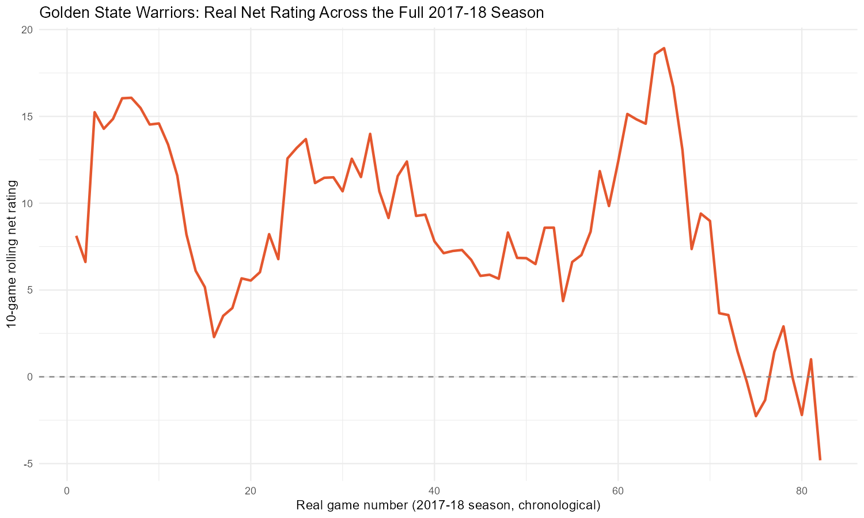
WORKED EXAMPLE, STEP 4
Real Net Rating, Game by Game, All Season
Notes:
This is a real 10-game rolling net rating across all 82 real GSW games. Point out the second-half stretch where the rolling line dips toward and briefly below zero (around games 74-82), and contrast it with the peak near game 65. Ask: does the second-half defensive erosion from the previous slide show up here as a steady decline, or as more of a late-season dip? Also point to the real Christmas Day game (game 10, from the video) and note it sits inside an early rising stretch of the rolling line.

Slide 17
INTERACTIVE ACTIVITY
Does an Early Read Hold Up?
Look back at the real two-segment table.
1. If you only had segment-1 data, what would you have predicted about GSW's second half?
2. Which side of the game, offense or defense, actually moved, and does that match what you would have guessed?

Slide 18
RECAP . SEGMENT 1
A Season in Two Acts, Covered
Covered
Next
What a season segment is, why our textbook's own dataset isn't available and what we substituted, and GSW's real two-segment split: steady offense, loosening defense.
Segment 2 asks a fairer question: adjusted for opponent strength, did GSW's rating really move? And it turns up a genuinely strange real number.

Slide 19
10-Minute Break
Back at the top of the hour. Next: adjusted ratings, and a real surprise.

Slide 20
NEW TERM . SEGMENT 2
What "Adjusted" Adds to a Rating
A plain offensive or defensive rating treats every opponent the same. If a team plays an unusually weak or unusually strong slate of opponents in one stretch of the season, its plain rating in that stretch will look better or worse than its true level of play, purely because of who it happened to play. An adjusted offensive or defensive rating, AORtg and ADRtg, corrects for exactly that.

Slide 21
FORMULA . SEGMENT 2
AdjRtg(): How the Adjustment Actually Works
1. For every pair of teams that played, compute each team's real scoring rate against that specific opponent.
2. A team's plain ORtg/DRtg is the possession-weighted average of those pairwise rates across every opponent it faced.
3. For each opponent, ask: how much better or worse did this team actually score against them, compared to what that opponent's own average defensive rating predicts?
4. Average that gap across every opponent, weighted by possessions. That's AORtg. ADRtg is built the same way from the other side.
Notes:
This is equations 4.1-4.2 from the textbook, in words rather than symbols. Emphasize step 3: the correction is always relative to the opponent's OWN rating built from ITS games, not a league average. That detail is exactly what breaks later for GSW.

Slide 22
LET'S RUN THIS TOGETHER
Let's implement AdjRtg() from the textbook's own formulas, together.
Pull up your own session. We'll run it line by line and look at the real output together.

Slide 23
WORKED EXAMPLE, STEP 5
A Real, Non-Degenerate Adjusted Rating: Portland
Portland also appears in this dataset only playing GSW, yet its adjusted rating is a real, meaningful number: how much better or worse Portland scored against GSW than the league-wide average opponent did.
13.55
Portland's real AORtg
in the full-season table
Data: AdjRtg(games_info), real 2017-18 season, BasketballAnalyzeR::PbP.BDB.
Notes:
Hold this genuine example up before showing GSW's own number in a few slides. Portland works because the adjustment subtracts GSW's OWN defensive rating, and GSW's defensive rating is built from roughly 25-30 different real opponents, a genuine outside benchmark. Keep this contrast in mind, we come back to it directly.

Slide 24
VIDEO . REAL CONCEPT EXPLAINER
Where Opponent Adjustment Comes From
Ken Pomeroy Explains KenPom Rankings and Smarter March Madness Bracket Picks
https://www.youtube.com/watch?v=qaMPOl9FZxI
A real concept explainer, from the creator of one of the best-known opponent-adjusted rating systems in basketball, covering how strength-of-schedule adjustment works and why a raw rating can mislead without it. This grounds our own AdjRtg() formula in the same real idea before we push it further.
Notes:
Exact channel branding and runtime were not independently confirmed when this was added; verify before assigning.

Slide 25
NEW TERM . SEGMENT 2
Hub and Spoke: A Different Shape of Schedule
The textbook's own Italian league dataset is a genuine round robin: every team plays every other team repeatedly. Our real dataset is not. GSW is the hub, connected to roughly 25-30 spoke opponents, and none of those spokes ever play each other. That's a genuinely different graph shape, and adjustment methods built assuming a round robin can behave strangely once you hand them a hub-and-spoke schedule instead.

Slide 26
VISUAL . SEGMENT 2
Two Real Schedule Shapes, Side by Side
Our real data: hub and spoke
Textbook's data: round robin
GSW
Notes:
Left: GSW is the hub, connected to about 25-30 spoke opponents that never connect to each other (only 10 spokes drawn for legibility). Right: a genuine round robin, every team connected to every other team, which is the shape the textbook's own Italian league dataset has. Ask the room: in the left diagram, if you wanted an independent outside benchmark for one spoke team's rating, where would it have to come from? The answer is nowhere else in this dataset, which is exactly the mechanism on the next slide.

Slide 27
FORMULA . THE CANCELLATION MECHANISM
Why the Adjustment Can Cancel Itself Out
For a one-off opponent (say, Portland), Portland's defensive rating is built entirely from its own games, all of which are against GSW.
So when we adjust GSW's offense against Portland, the 'opponent's average defense' we subtract is not an independent benchmark for GSW. It's identical to how GSW itself scored against Portland.
Subtracting a number from itself leaves zero, for every one-off opponent GSW has. Averaging a column of zeros still gives zero.

Slide 28
LET'S RUN THIS TOGETHER
Let's run AdjRtg() on GSW itself and see what actually comes out.
Pull up your own session. We'll run it line by line and look at the real output together.

Slide 29
A REAL, GENUINELY IMPORTANT FINDING
GSW's Adjusted Rating Computes to Exactly Zero
This is not a bug. It's a real, explainable methodological finding: almost all of GSW's opponents in this dataset appear only in their own 1-2 games against GSW, so each opponent's own rating is built almost entirely from that same game, canceling the adjustment out.
The habit to build: a result of exactly zero, repeated across every segment, should make you go check the mechanism rather than report it at face value.
0.00
real AORtg and ADRtg for GSW,
in the full season and
in both segments separately
Notes:
Ask the room to propose explanations before walking through the mechanism, per the session plan. Then walk through the matrix computation: P and Poss matrices, the sweep() calls, and where exactly the subtraction becomes self-referential for a one-off opponent. This is the intellectual centerpiece of the module; do not rush it.

Slide 30
WORKED EXAMPLE, STEP 6
Same Dataset, Two Different Outcomes
GSW
Portland
AORtg = ADRtg = 0.00. GSW is the hub, adjusted against ~25-30 one-off spoke opponents whose own ratings collapse to GSW's own performance against them.
Real AORtg = 13.55. Portland is a spoke, adjusted against GSW's defensive rating, which is built from roughly 25-30 different real opponents, a genuine outside benchmark.

Slide 31
PHD / ADVANCED PROJECT TRACK
A Bridge to the Methodological-Rigor Thread
This callout is for anyone considering the larger independent project track; it is not core material for the rest of this course. The lesson above, that a widely used statistical method can carry a hidden assumption about the structure of the data it's applied to, and can quietly fail in a specific, explainable way when that assumption breaks, is exactly the kind of question I return to in Module 10's injury-detection thread. There, the acute:chronic workload ratio is a widely used method in applied sports science that carries its own documented statistical problems under certain real conditions. If you found the GSW degeneracy interesting, that's the same kind of question, applied to a different method and a different context, and it's a genuine methodological bridge worth exploring once we reach Module 10.

Slide 32
RECAP . SEGMENT 2
Adjusted Ratings, Covered
Covered
Next
What AdjRtg() corrects for, a genuine non-degenerate example (Portland), and the real hub-and-spoke mechanism behind GSW's own exact-zero result.
Segment 3 turns to the rest of the real teams in this dataset, where the adjustment does not collapse, and asks what their segment-1 ratings say about real wins.

Slide 33
10-Minute Break
Back at the top of the hour. Next: CART, the alluvial figure, and the literature.

Slide 34
NEW TERM . SEGMENT 3
CART: An Exploratory Decision Tree
The other twenty-some real teams in this dataset, each with only two to four real games, still produce genuine, non-degenerate adjusted ratings in their segment-1 numbers, since their opponent pool composition differs from GSW's. A classification and regression tree (CART) is a way to let the data itself find a natural split point, rather than us guessing one. Here, we ask it to split teams on their real segment-1 AORtg and ADRtg to see what relates to real wins in this small sample.

Slide 35
FORMULA . SEGMENT 3
How rpart() Picks a Split
tree <- rpart(
wins_in_sample ~ AORtg1 + ADRtg1,
data = cart_df,
control = rpart.control(minsplit = 4, cp = 0.05)
)
rpart() searches every possible cut point on AORtg1 and ADRtg1 and keeps the one that most reduces variance in real wins_in_sample. minsplit and cp keep the tree small given how few real games most teams contribute.

Slide 36
LET'S RUN THIS TOGETHER
Let's fit this real tree together and see where it splits.
Pull up your own session. We'll run it line by line and look at the real output together.

Slide 37
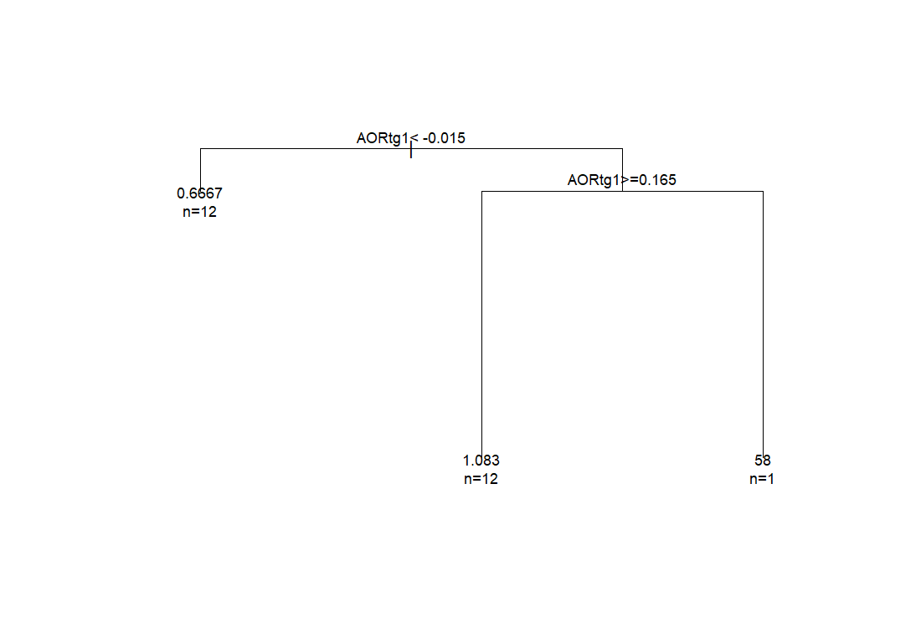
WORKED EXAMPLE, STEP 7
The Real Tree's First Split
Notes:
Real first split: AORtg1 < -0.015. Read this as: teams whose real segment-1 adjusted offensive rating was positive tended to record more real wins in this sample than teams whose segment-1 adjusted offensive rating was negative. Emphasize, per the textbook's own use of CART in this chapter, that this is exploratory and data-driven, not a validated predictive model. Most teams here contribute only 2-4 real games; this tree demonstrates the method on a small, honestly noisy sample, not a general claim about what predicts winning basketball.

Slide 38
NEW TERM . SEGMENT 3
Alluvial Diagrams: Following a Path Through Categories
An alluvial, or Sankey-style, diagram traces how observations flow from one categorical grouping to the next, with the width of each ribbon showing how much weight travels along that path. Here, each team's segment-1 AORtg category flows into its segment-1 ADRtg category, which flows into the team itself, with ribbon width scaled by real wins recorded in this sample, in the spirit of the textbook's own Figure 4.3.

Slide 39
FORMULA . SEGMENT 3
Building the Real Alluvial Figure
alluv_df <- cart_df %>% mutate(
AORtg1cat = ifelse(AORtg1 < median(AORtg1),
"Below median", "Above median"),
ADRtg1cat = ifelse(ADRtg1 < median(ADRtg1),
"Below median", "Above median"))
ggplot(alluv_df, aes(axis1 = AORtg1cat, axis2 = ADRtg1cat,
axis3 = team, y = wins_in_sample)) +
geom_alluvium(aes(fill = AORtg1cat)) + geom_stratum()

Slide 40
LET'S RUN THIS TOGETHER
Let's build this real figure together and see it take shape.
Pull up your own session. We'll run it line by line and look at the real output together.

Slide 41
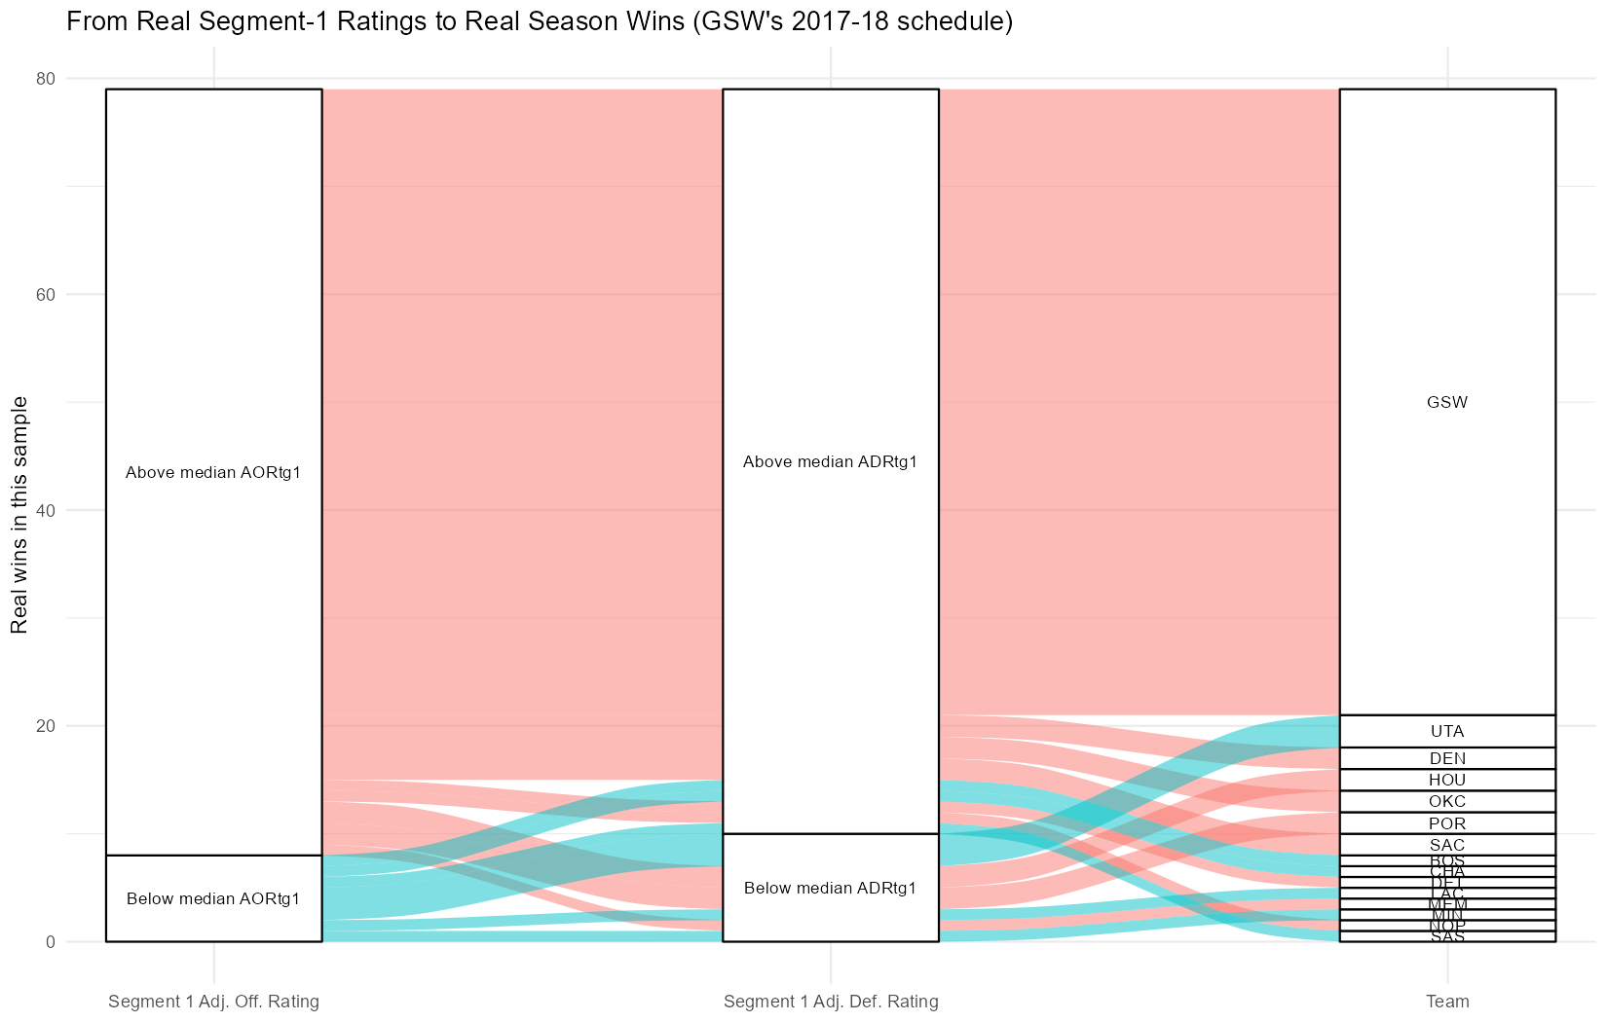
WORKED EXAMPLE, STEP 8
From Real Segment-1 Ratings to Real Wins
Notes:
Ask a few students to pick one team whose ribbon is easy to trace across all three columns and describe what its path tells us. This is a small, real, honestly noisy sample; the value here is seeing at a glance which combination of segment-1 offensive and defensive adjusted rating tended to travel with more real wins in this specific dataset, not settling the general question.

Slide 42
INTERACTIVE ACTIVITY
Trace One Team's Real Path
Get into small groups. I'll ask each group to pick one team from the alluvial figure and trace its ribbon across all three columns.
1. Which segment-1 AORtg and ADRtg category did your team land in?
2. Based on its path, would you have predicted its real wins in this sample before looking?

Slide 43
RECAP . SEGMENT 3
CART and the Alluvial Figure, Covered
Covered
Next
A real, exploratory CART split (AORtg1 < -0.015) and a real alluvial diagram connecting segment-1 ratings to real wins in this sample, plus the PhD-track methodology bridge.
We close today by pulling the whole module's real lesson together, then look ahead to spatial dynamics and tracking data.

Slide 44
SUMMARY
What to Carry Forward
A season segment splits a schedule chronologically. GSW's real offense held steady across 2017-18 while its real defense measurably loosened in the second half.
An adjusted rating corrects for opponent strength, but only when the data has an independent benchmark to correct against.
GSW's real AORtg and ADRtg computing to exactly 0.00 is not an error; it's a hub-and-spoke schedule breaking a method built for a round robin.
A CART tree and an alluvial diagram are exploratory tools for a small, honestly noisy sample, not validated predictive claims.
Every number in this module came from BasketballAnalyzeR::PbP.BDB, reproducible by running module4_season_segments.R.

Slide 45
BEFORE MODULE 05
Two Things Before Next Class
Read
Do
Advanced Basketball Data Science, Ch. 5 (spatial dynamics and tracking data).
Complete Lab 4 (season segments and final rankings), the practice questions, and the Module 4 quiz.

Slide 46
FULL READING LIST
References Cited Today
Zuccolotto, P., Manisera, M., & Sandri, M. (2026). Advanced Basketball Data Science: With Applications in R, Ch. 4. CRC Press / Chapman & Hall.
Kubatko, J., Oliver, D., Pelton, K., & Rosenbaum, D. T. (2007). A starting point for analyzing basketball statistics. Journal of Quantitative Analysis in Sports, 3(3).
BasketballAnalyzeR (R package): PbPmanipulation(), TOPboxes(), fourfactors(), and the PbP.BDB dataset. Zuccolotto, Manisera & Sandri. CRAN.
Therneau, T., & Atkinson, B. rpart: Recursive Partitioning and Regression Trees (R package). CRAN.
ggalluvial (R package). CRAN.

Slide 47
See You in Module 05
Spatial Dynamics and Tracking Data

