Slide 1
SPORTS ANALYTICS · GRADUATE
Advanced Basketball Data Science
Module 03 · Clutch Performance and Situational Splits
Week 3
Graduate · 3-hour session
Maps to Chapter 3:
Zuccolotto, P., Manisera, M., & Sandri, M. (2026). Advanced Basketball Data Science: With Applications in R. CRC Press/Chapman & Hall.

Slide 2
BEFORE WE START
What's Coming Up
Due This Week
-- update before class --
Coming Up
-- update before class --
Office Hours
-- update before class --

Slide 3
RECAP
Where We Left Off
Module 2 took you beyond individual box scores into lineups: how a team's real performance shifts depending on which five players share the floor. Today we apply that same situational thinking to time and score instead of personnel -- because a team's real performance is not one fixed number across 48 minutes.
Same rigor as every module: a precise, reproducible definition, real play-by-play data, real numbers.

Slide 4
OUTLINE FOR TODAY
Where We're Headed
I
Segment 1
II
Segment 2
Defining clutch precisely, and real team-level splits
Scoring inequality: who takes over in the clutch
III
Segment 3
IV
Before Next Class
Player-level indices, the literature, and a PhD-track connection
Lab 3, the Module 3 quiz, and the practice questions

Slide 5
LEARNING OBJECTIVES
By the End of Today, You Will Be Able To
1
State the precise, reproducible definition of a clutch situation used throughout this module.
2
Build the TOPboxes() input pipeline from raw play-by-play data, including the oreb/dreb/turnover/PF indicators it requires.
3
Compute and interpret real Clutch-versus-General Four Factors splits for two real NBA teams.
4
Compute the Gini coefficient for scoring concentration and interpret a real shift between two situational splits.
5
Compute and interpret the player-level clutch indices (SP, SPc, Diff, Pr_c, MINcp) from Zuccolotto et al. (2018).

Slide 6
CONCEPT · SEGMENT 1
"Clutch" Needs a Precise Definition
Broadcast commentary uses "clutch" impressionistically -- whatever moment felt tense. For this to be a reproducible analysis, we need a mechanical rule applied identically to every game, every team, every player.
This module follows the exact rule used in Zuccolotto, Manisera & Sandri's Advanced Basketball Data Science, Chapter 3.

Slide 7
CONCEPT · SEGMENT 1
The Real Clutch Definition
totalTime_c = 2580 seconds
Fewer than 5 minutes remain in a 48-minute game (48 × 60 = 2880; 2880 - 2580 = 300 seconds = 5 minutes), including overtime.
scorediff_c = 5 points
The score is within 5 points either way.
Everything else is labeled "General."

Slide 8
LET'S WATCH THIS TOGETHER
What Does the NBA Actually Mean by "Clutch Time"?
"What Are The Official NBA Rules For 'Clutch Time'?" (Basketball Stats Central, YouTube)
▶
A concept explainer on how clutch time is officially defined and measured, grounding this module's own precise definition in the real-world convention before we apply it in code.

Slide 9
CONCEPT · A METHODOLOGICAL NOTE
Reproducing the Method on Different Real Data
The textbook builds its Chapter 3 example from a private play-by-play file covering the Celtics' and Warriors' 2021-22 regular season and playoffs. That specific file is not part of the public BasketballAnalyzeR package. This module reproduces the identical PbPmanipulation/TOPboxes/fourfactors/inequality pipeline, and the same clutch indices, on real, freely available data instead: PbP.BDB, the entire real 2017-18 NBA playoffs, still using the Celtics and Warriors as our two case-study teams.

Slide 10
LET'S RUN THIS TOGETHER
Let's build the TOPboxes() input pipeline together.
Pull up your own session. We'll run it line by line and look at the real output together.

Slide 11
WORKED EXAMPLE, STEP 1
Building the Variables TOPboxes() Requires
`%~%` <- function(x, pattern) grepl(pattern, x, fixed = TRUE)
TOPPbP <- PbP %>%
mutate(across(c(game_id, ShotType, result, team, ...), as.character)) %>%
mutate(
oreb = type %~% "rebound offensive",
dreb = type %~% "rebound defensive",
turnover = event_type == "turnover",
PF = (event_type == "foul") & !(type %~% "technical")
)
Run this yourself. TOPboxes() will error with a clear message if any of these are missing.

Slide 12
WORKED EXAMPLE, STEP 2
Filtering to Real Clutch Possessions
totalTime_c <- 2580
scorediff_c <- 5
TOPPbPc <- TOPPbP %>%
mutate(scorediff = abs(home_score - away_score)) %>%
filter(scorediff <= scorediff_c & totalTime > totalTime_c)
TOP <- TOPboxes(TOPPbP, team = "GSW")
TOPc <- TOPboxes(TOPPbPc, team = "GSW")
TOP holds the General split; TOPc holds the Clutch split. Same pipeline for team = "BOS".

Slide 13
CONCEPT · SEGMENT 1
The Four Factors, Split by Situation
fourfactors() works identically whether you feed it a full season or a one-row clutch split -- it just needs box scores in, Team labels attached. That lets us stack a Clutch row and a General row for the same team and compare them directly.
Pace, ORtg, DRtg, and all eight offensive/defensive factors -- now computed separately for each situation.

Slide 14
LET'S RUN THIS TOGETHER
Let's compute Golden State's real Clutch-vs-General split.
Pull up your own session. We'll run it line by line and look at the real output together.

Slide 15
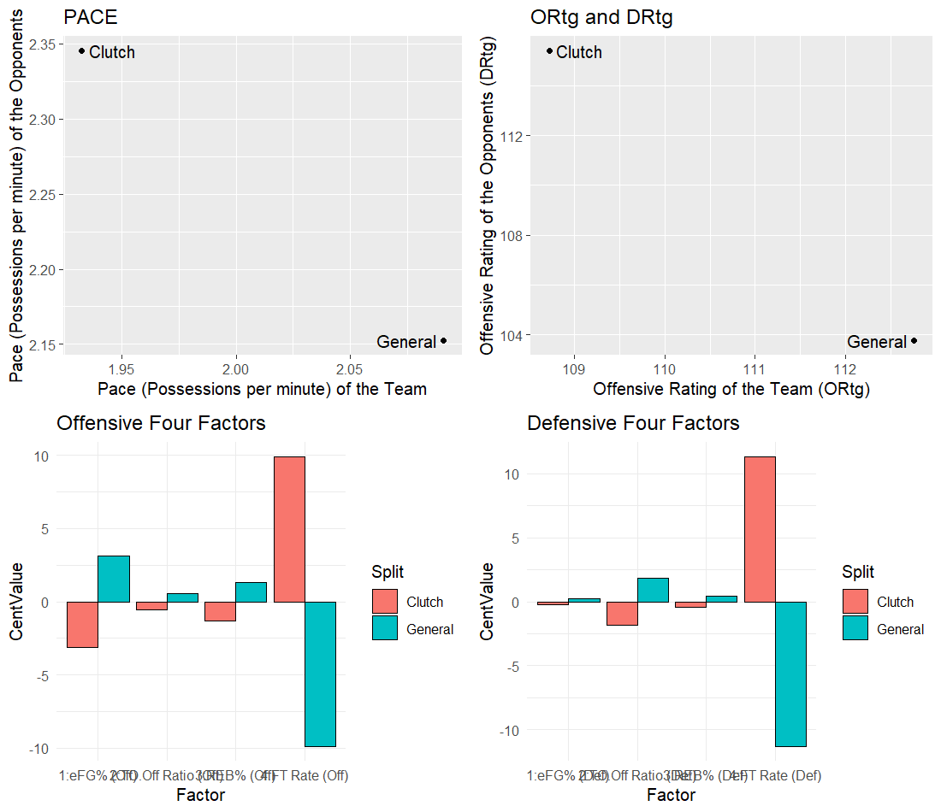
WORKED EXAMPLE, STEP 3
Golden State Warriors: Real Clutch vs. General
fourfactors(Tboxes, Oboxes), Team=Clutch/General. Data: PbP.BDB, 2017-18 NBA playoffs.
Notes:
Discussion: ask the class to read the Defensive Four Factors panel first. Push toward: Golden State's clutch eFG% allowed (2:TO.Off Ratio, 3:REB%) shifted noticeably. Then reveal the real ORtg/DRtg numbers on the next slide.

Slide 16
CONCEPT · A REAL SURPRISE
Even a Champion's Defense Can Slip in the Clutch
Context: this is the real 2017-18 Golden State Warriors -- the team that went on to win the title that same postseason.
The lesson: "clutch" is a situational split, not a value judgment. A great team's defense can still measurably worsen in these specific real, high-leverage minutes.
+11.6
points -- Golden State's real
defensive rating increase,
General (103.8) to Clutch (115.4)

Slide 17
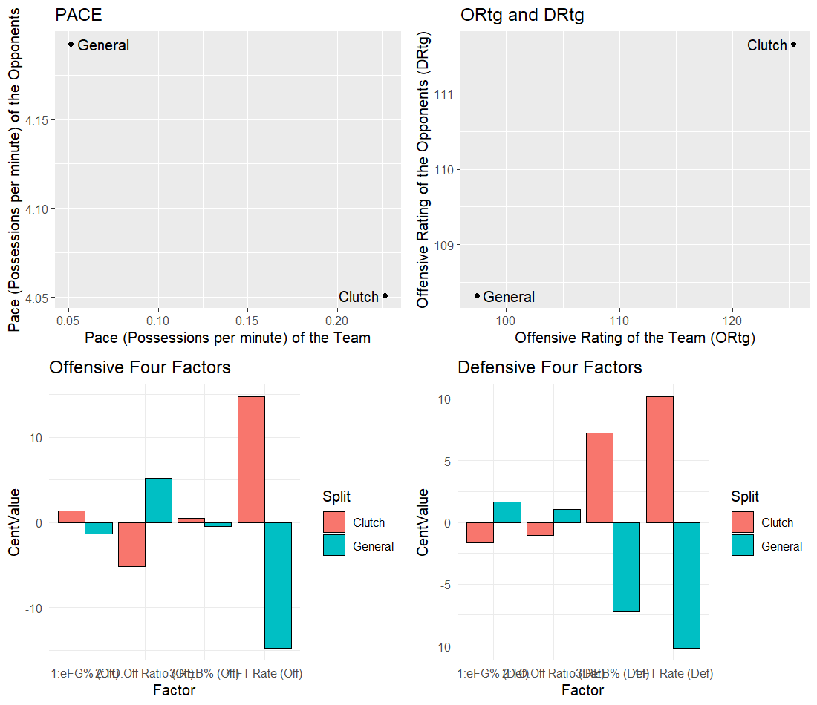
WORKED EXAMPLE, STEP 4
Boston Celtics: Real Clutch vs. General
fourfactors(Tboxes, Oboxes), Team=Clutch/General. Data: PbP.BDB, 2017-18 NBA playoffs.

Slide 18
CONCEPT · THE OPPOSITE DIRECTION
Boston's Real Split Moved the Other Way
The real pattern: Golden State's offense held roughly steady while their defense worsened. Boston's offense improved sharply in the clutch while their defense worsened only slightly.
Why this matters: "clutch performance" is not one universal shift. It is team-specific, and only a real, computed split tells you which direction a given team actually moves.
97.4 → 125.4
Boston's real offensive rating,
General to Clutch, 2018 playoffs

Slide 19
INTERACTIVE ACTIVITY
Two Teams, Two Real Directions
In pairs.
1. Golden State's clutch shift was mostly defensive; Boston's was mostly offensive. Propose one real, testable hypothesis for why two different real teams would show two different patterns.
2. What additional real data (beyond what we've computed so far) would you want to test your hypothesis?

Slide 20
RECAP · SEGMENT 1
Team Splits, Two Real Directions
Covered
Next
The precise clutch definition, the TOPboxes() pipeline, and real Clutch-vs-General Four Factors splits for two 2018 playoff teams moving in two different real directions.
Segment 2 asks who, specifically, takes over a team's offense once the game gets close -- measured directly with the Gini coefficient.

Slide 21
10-Minute Break
Back at the top of the hour. Next: who takes over in the clutch.

Slide 22
CONCEPT · SEGMENT 2
Inequality: A Concept Borrowed From Economics
The Gini coefficient was originally developed to measure wealth concentration within countries. Zuccolotto & Manisera (2020) translated the same idea to basketball: how concentrated is a team's scoring among its players? This module applies it to a Clutch-versus-General comparison.

Slide 23
CONCEPT · SEGMENT 2
Reading the Gini Coefficient
Given N players, ordered by points scored, with Si the cumulative fraction of total points scored by the first i players and Fi = i/N the cumulative fraction of players:
G = sum(Fi - Si) / sum(Fi), for i = 1 to N-1
G = 0% means every player scored an equal share (perfect equality). G = 100% means one player scored everything (maximum inequality). The Lorenz curve plots Si against Fi -- the larger the gap between the curve and the 45-degree line, the greater the inequality.

Slide 24
LET'S RUN THIS TOGETHER
Let's compute the real Gini coefficient for both splits.
Pull up your own session. We'll run it line by line and look at the real output together.

Slide 25
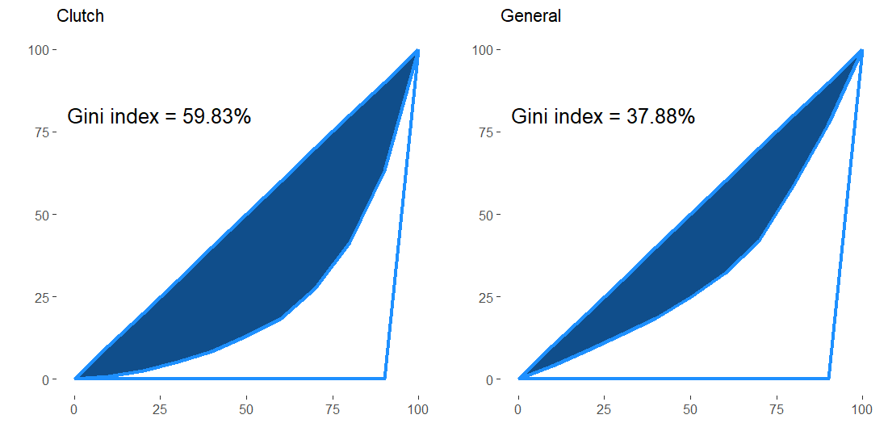
WORKED EXAMPLE, STEP 5
Golden State's Real Scoring Concentration
inequality(Pbox$PTS, nplayers). Data: PbP.BDB, 2017-18 NBA playoffs.
Notes:
Discussion: 37.88% General to 59.83% Clutch. Ask: is a rise in scoring concentration in the clutch a sign of a problem, or exactly what you would expect from a well-run offense? Push toward: it depends entirely on who the ball is going to -- concentration around your best shooter is very different from concentration by default.

Slide 26
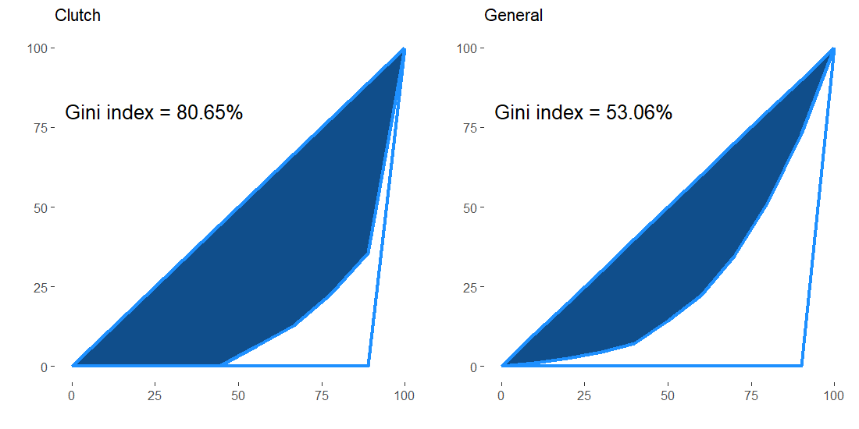
WORKED EXAMPLE, STEP 6
Boston's Real Scoring Concentration
inequality(Pbox$PTS, nplayers). Data: PbP.BDB, 2017-18 NBA playoffs.

Slide 27
CONCEPT · COMPARING TWO REAL SHIFTS
Both Teams Concentrated Scoring -- Boston Far More
Team | General Gini | Clutch Gini | Real Shift
Golden State Warriors | 37.88% | 59.83% | +21.95 pts
Boston Celtics | 53.06% | 80.65% | +27.59 pts
Boston's real clutch offense concentrated more heavily than Golden State's -- driven largely by Kyrie Irving's real usage spike, which the player-level indices in Segment 3 will make precise.

Slide 28
LET'S WATCH THIS TOGETHER
Watching Concentration Happen, in Real Footage
"Warriors BIG 3 Full Game 2 Highlights vs Cavaliers (2018 NBA Finals) -- Stephen Curry, Durant & Klay!" (YouTube)
▶
Real footage from the same 2018 postseason this module's data comes from. Watch for which three players the offense actually runs through in the closing minutes.

Slide 29
INTERACTIVE ACTIVITY
Predict Before You Compute
Small groups (3-4).
1. Before looking ahead to Segment 3's player table, predict which Golden State player you think had the largest real drop in shooting performance specifically in the clutch, and which one improved.
2. Write down your prediction and your one-sentence reasoning. We'll check it against the real numbers next.

Slide 30
RECAP · SEGMENT 2
Concentration, Measured Two Real Ways
Covered
Next
The Gini coefficient and Lorenz curve, and a real comparison showing Boston's clutch offense concentrated more sharply than Golden State's.
Segment 3 goes player by player: who specifically improves, who declines, and what the wider literature says about why.

Slide 31
10-Minute Break
Back at the top of the hour. Next: player-level clutch indices.

Slide 32
CONCEPT · SEGMENT 3
Five Indices, One Player at a Time
SP / SPc Shooting performance, general and clutch, weighted by shot type relative to the team's own splits.
Diff = SPc - SP Whether a player's shooting improves, worsens, or holds steady in the clutch.
Pr_c Propensity to shoot in the clutch, relative to clutch minutes played.
MINcp Percentage of team clutch minutes the player was on the floor.
Framework: Zuccolotto, Manisera & Sandri (2018).

Slide 33
LET'S RUN THIS TOGETHER
Let's build the real player clutch index table together.
Pull up your own session. We'll run it line by line and look at the real output together.

Slide 34
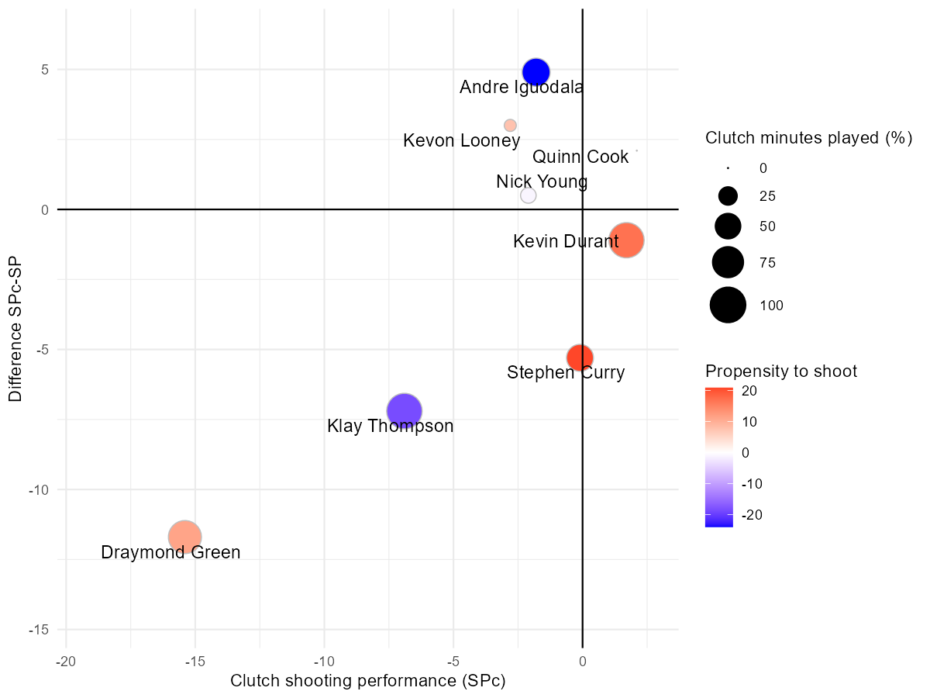
WORKED EXAMPLE, STEP 7
Golden State's Real Player Clutch Indices
bubbleplot(): x=SPc, y=Diff, color=Prc, size=MINcp. Data: PbP.BDB, 2017-18 NBA playoffs.

Slide 35
WORKED EXAMPLE, STEP 8
Reading Three Real Players' Real Numbers
Player | SPc | Diff | Pr_c
Kevin Durant | 1.7 | -1.1 | 16.9
Draymond Green | -15.4 | -11.7 | 11.3
Stephen Curry | -0.1 | -5.3 | 20.9
Durant's Diff barely moves -- a stable shooter. Green's Diff is sharply negative despite an above-average Pr_c -- he kept shooting more even as his efficiency dropped. Curry's Pr_c jumped, a real increase in clutch shot-taking, alongside a real efficiency dip.

Slide 36
WORKED EXAMPLE, STEP 9
Boston's Real Player Clutch Indices
Player | MINc | ASc | SPc | Diff | Pr_c | MINcp
Al Horford | 10 | 4 | 9.6 | 0.1 | -13.8 | 9.2%
Kyrie Irving | 10 | 21 | 10.5 | 2.6 | 189.8 | 9.2%
Only two Boston players cleared this module's minimum clutch-attempt threshold -- a real, honest consequence of using a smaller, playoffs-only sample (see the methodological note from Segment 1).

Slide 37
CONCEPT · ONE REAL NUMBER WORTH PAUSING ON
189.8: Boston's Offense Ran Through One Player
What it means: Irving's real share of Boston's clutch shot attempts was dramatically larger than his share of clutch minutes -- and his Diff was still positive (+2.6), a real clutch improvement, not just added volume.
Worth naming: this is a real number from a real, smaller sample. It is exactly the kind of concentration the Gini coefficient in Segment 2 already flagged.
189.8
Kyrie Irving's real Pr_c --
his clutch shot share versus
his clutch minute share

Slide 38
CONCEPT · THE LITERATURE BEHIND THIS MODULE
Where These Indices Actually Come From
Zuccolotto, Manisera & Sandri (2018), published in the International Journal of Sports Science & Coaching, used Classification and Regression Trees on real high-pressure shooting data (Italian Serie A2 and Rio 2016 Olympic data) to model scoring probability under pressure directly, and proposed the SP/SPc/Diff/Pr_c/MINcp framework this module builds by hand. This is not a textbook exercise invented for teaching -- it is the real, published methodological paradigm the textbook chapter itself cites.

Slide 39
CONCEPT · A SUPPLEMENTARY REAL SOURCE
Goldman & Rao (2012): Pressure Is Asymmetric
"Effort vs. Concentration: The Asymmetric Impact of Pressure on NBA Performance," MIT Sloan Sports Analytics Conference (2012), argues pressure does not affect every player the same way: some respond with more effort (offensive rebounding, drawing fouls), while others show measurably reduced shooting efficiency as defensive pressure intensifies late in close games.
That asymmetry is a real, testable explanation for exactly the kind of Diff/Pr_c split our real Golden State numbers show.

Slide 40
INTERACTIVE ACTIVITY
Sort the Real Roster: Effort or Efficiency?
Using the real Golden State cindex table from Step 7-8.
1. Sort each of the eight real players into "more effort" (high Pr_c, small or positive Diff) or "less efficient" (notably negative Diff) based on Goldman & Rao's framework.
2. Was your prediction from the Segment 2 activity correct?

Slide 41
PHD / ADVANCED PROJECT CALLOUT
From Situational Splits to Workload Monitoring
For students considering the larger independent project track: the logic used all module -- splitting a real data stream by game context and comparing distributions across the split -- is structurally related to the workload and injury-risk monitoring methods this course returns to in Module 10, built from the instructor's own published control-chart methodology. There, the split is healthy-versus-elevated-risk rather than clutch-versus-general. If a situational-performance-to-athlete-monitoring project interests you, this is a genuine methodological bridge worth exploring once we reach Module 10.

Slide 42
RECAP · SEGMENT 3
Player Indices and the Wider Literature
Covered
Next
Built real player-level clutch indices for both teams, connected them to Goldman & Rao's asymmetric-pressure argument, and previewed a PhD-track connection to Module 10.
Module 4 moves from single-game situational splits to season-long segments and how they relate to final rankings.

Slide 43
SUMMARY
What to Carry Forward
A precise, reproducible clutch definition (under 5 minutes remaining, score within 5 points) is what makes any of this analysis meaningful.
Team-level clutch shifts are real but team-specific -- Golden State's defense worsened while Boston's offense improved, in the same real postseason.
Scoring concentration (Gini) rose for both real teams in the clutch, but Boston's rose further, driven by one player's real usage spike.
Every number in this module came from PbP.BDB, real 2017-18 NBA playoff play-by-play data, reproducible by running Coding_Exercise/module3_clutch_splits.R.

Slide 44
BEFORE MODULE 04
Two Things Before Next Class
Read
Do
Advanced Basketball Data Science, Ch. 4 (season segments and final rankings).
Complete Lab 3 (clutch performance and situational splits), the practice questions, and the Module 3 quiz on D2L.

Slide 45
FULL READING LIST
References Cited Today
Zuccolotto, P., Manisera, M., & Sandri, M. (2026). Advanced Basketball Data Science: With Applications in R, Ch. 3. CRC Press/Chapman & Hall.
Zuccolotto, P., Manisera, M., & Sandri, M. (2018). Big data analytics for modeling scoring probability in basketball. International Journal of Sports Science & Coaching, 13(4), 569-589.
Goldman, M., & Rao, J. M. (2012). Effort vs. concentration: The asymmetric impact of pressure on NBA performance. MIT Sloan Sports Analytics Conference.
Zuccolotto, Manisera & Sandri. BasketballAnalyzeR (R package) and the PbP.BDB dataset. CRAN.

Slide 46
See You in Module 04
Season Segments and Final Rankings

