Slide 1
SPORTS ANALYTICS · GRADUATE
Advanced Basketball Data Science
Module 07 · Ball Trajectories and Object Detection
Week 7
Graduate · 3-hour session
Maps to Chapter 7:
Zuccolotto, P., Manisera, M., & Sandri, M. (2026). Advanced Basketball Data Science: With Applications in R. CRC Press/Chapman & Hall.

Slide 2
BEFORE WE START
What's Coming Up
Due This Week
-- update before class --
Coming Up
-- update before class --
Office Hours
-- update before class --

Slide 3
RECAP
Where We Left Off
Last module asked what a player's body does, moment to moment, using pose estimation to track the athlete directly. Today I want to point the same family of computer vision technique at a much harder real target: the ball itself. A player is large and rarely leaves the frame. A basketball is small, spins fast, and constantly disappears behind hands, rims, and other players.

Slide 4
OUTLINE FOR THE DAY
Where We're Headed
I
Segment 1
II
Segment 2
Object detection: how YOLO finds a ball in a frame, and why the ball is a genuinely hard real case
The real physics of a trajectory: minimum-speed launch angle, and why real shooters use more arc than that
III
Segment 3
IV
Before Next Class
Connecting the physics to real 2017-18 field goal percentage, and the PhD/advanced-project link
Lab 7, the practice questions, and the Module 7 quiz

Slide 5
LEARNING OBJECTIVES
By the End of Today, You Will Be Able To
1
Explain how single-pass object detection (YOLO) works and why a basketball is a harder real detection target than a player.
2
Read and interpret real precision, recall, and mAP figures from a current peer-reviewed object-detection paper.
3
Derive and apply the real minimum-speed projectile trajectory formula to a basketball shot at any real distance.
4
Explain the real gap between the theoretical minimum-speed launch angle and real published shooting angles, using rim and ball geometry.
5
Connect real shot-distance trajectory physics to real 2017-18 field goal percentage, and to the course's injury-risk PhD track.

Slide 6
CONCEPT · SEGMENT 1
Object Detection, In Plain Language
Pose estimation, from last module, assumes a person is present and asks where their joints are. Object detection has to first decide whether the object of interest is present at all in a region of the frame, then draw a bounding box and assign a confidence score, all in a single forward pass through the network. That single-pass design is where YOLO, "You Only Look Once," gets its name.
Now: why is a basketball a genuinely hard real case for this?

Slide 7
CONCEPT · SEGMENT 1
A Small, Fast, Frequently Hidden Target
A basketball is small in the frame relative to a player, it blurs across a single video frame during a fast release, and it is frequently and briefly occluded by hands, rims, and other players. A real, current 2025 paper, Liang et al., built a purpose-made model, BGS-YOLO, specifically because a generic YOLOv8 model struggles with exactly these three problems.
Let's look at their real reported numbers.

Slide 8
WATCH BEFORE WE LOOK AT THE NUMBERS
How Single-Pass Object Detection Actually Works
▶
What is YOLO algorithm? | Deep Learning Tutorial 31 (Tensorflow, Keras & Python)
codebasics • runtime not independently confirmed
https://www.youtube.com/watch?v=ag3DLKsl2vk
A concept-explainer on how single-pass object detection works, the same family of technique behind this module's real BGS-YOLO basketball detection results.

Slide 9
WORKED EXAMPLE, STEP 1
Real Detection Performance, Liang et al. (2025)
Model | Real precision | Real recall | Real mAP
Baseline YOLOv8n | 93.1% | 83.4% | 90.5%
Purpose-built BGS-YOLO | 96.9% | 89.7% | 93.2%
Recall (finding every real ball that is actually there) moved less than precision (correctly labeling what the model does flag), even after purpose-building the model.
Liang, Z., Wang, J., Huang, T., Sang, Z., & Zhang, J. (2025). Basketball detection based on YOLOv8. PLOS ONE, 20(8), e0326964.
Notes:
Discussion: ask the class why recall would be the harder number to move here. Push toward: recall requires finding every instance, including the hardest, most occluded or blurred frames, while precision only has to be right about the detections the model chooses to make. Ask what a lower real recall costs you specifically when trying to reconstruct a full, continuous shot trajectory versus tagging a single highlight frame. Timing: about 5 minutes.

Slide 10
INTERACTIVE ACTIVITY
Diagnose the Detection Gap
Small groups (3-4).
1. Pick one of the three real difficulties named on the last concept slide (small size, motion blur, occlusion).
2. Propose one real, concrete way a research team might address it (more training data of that specific case, a different network architecture, higher frame-rate video, and so on).
3. Be ready to defend your proposal to the class.

Slide 11
RECAP · SEGMENT 1
Detecting the Ball, Covered
Covered
Next
How single-pass object detection works, why a basketball is a genuinely hard real target, and a real current paper's actual precision, recall, and mAP numbers.
Segment 2 asks: once you can detect the ball across frames, what does the resulting trajectory actually look like, physically?

Slide 12
10-Minute Break
Back at the top of the hour. Next: the real physics of a shot's trajectory.

Slide 13
CONCEPT · SEGMENT 2
From a Detected Path to a Real Trajectory
A detected ball position across a real sequence of frames gives you the ball's actual real path through the air, not just where a shot started and ended. That path is projectile motion. Brancazio, P. J. (1981), "Physics of basketball," American Journal of Physics, is the real, seminal paper applying classical projectile-motion mechanics specifically to a basketball shot, and it is still the anchor citation behind essentially every later trajectory paper, including the object-detection work from Segment 1.

Slide 14
CONCEPT · THE MINIMUM-SPEED RESULT
The Least Energy a Shot Can Use to Reach the Rim
theta_min = 45° + 0.5 × arctan(y / x)
v_min = √[ g × (x + √(x² + y²)) ]
x = real horizontal distance to the rim
y = real net vertical rise (rim height minus release height)
g = 9.8 m/s²
A standard classical-mechanics result, applied specifically to basketball by Brancazio (1981).

Slide 15
LET'S RUN THIS TOGETHER
Let's open our R package and compute the real trajectory table together.
Pull up your own session. We'll run it line by line and look at the real output together.

Slide 16
WORKED EXAMPLE, STEP 2
Computing the Real Trajectory Table
g <- 9.8; rim_h <- 3.048; release_h <- 2.1336
y_rise <- rim_h - release_h
dist_ft <- c(4, 10, 15, 19.75, 23.75, 28)
dist_m <- dist_ft * 0.3048
theta_min <- 45 + 0.5*(180/pi)*atan(y_rise / dist_m)
v_min_ms <- sqrt(g * (dist_m + sqrt(dist_m^2 + y_rise^2)))
data.frame(dist_ft, theta_min, v_min_mph = v_min_ms * 2.23694)
Real rim height 10 ft (3.048 m); real release height 7 ft (2.1336 m), Coach Dave Love.

Slide 17
WORKED EXAMPLE, STEP 3
Six Real Representative Distances
Shot | Real distance | Real θ_min | Real v_min | Real hang time
At the rim | 4 ft | 63.4° | 11.6 mph | 0.53 s
Real mid-range | 10 ft | 53.3° | 17.5 mph | 0.65 s
Free throw line | 15 ft | 50.7° | 21.3 mph | 0.76 s
Long two | 19.75 ft | 49.3° | 24.4 mph | 0.85 s
NBA three-point line | 23.75 ft | 48.6° | 26.7 mph | 0.92 s
Deep three | 28 ft | 48.1° | 29.0 mph | 0.99 s
Computed with the minimum-speed trajectory formula, real rim and release heights, PbP.BDB distance conventions.

Slide 18
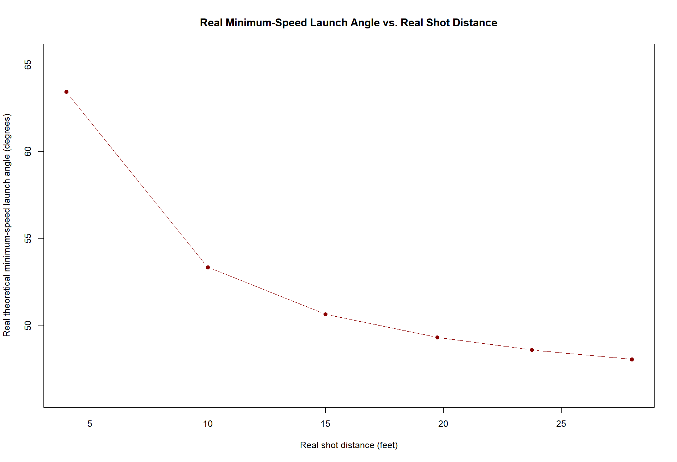
WORKED EXAMPLE, STEP 4
The Real Angle Converges Toward 45°
Real theta_min vs. real shot distance, six representative real distances.

Slide 19
SEE THE RELEASE
What a Real Release Actually Looks Like
▶
Steph Curry - Complete Shooting Form Breakdown
YouTube (channel not independently confirmed) • runtime not independently confirmed
https://www.youtube.com/watch?v=qh9Ko-Wi9JQ
Real footage breaking down a jump-shot release in detail, useful for seeing the real launch angle and follow-through this module's trajectory physics describes mathematically, before looking at the real theory-versus-practice gap next.

Slide 20
CONCEPT · THE REAL HONEST GAP
Why Real Shooters Use More Arc Than the Minimum
The minimum-speed trajectory only guarantees the ball reaches the target point. It says nothing about the angle at which the ball then arrives at a rim only slightly larger than the ball itself. A shallow entry angle leaves a real, narrow window to fall through without deflecting off the iron, so real shooters trade extra effort for a real, more forgiving entry angle.
Let's put a real number on that gap.

Slide 21
CONCEPT · THEORY VS. REAL PRACTICE
A 15.5-Degree Real Gap at the Three-Point Line
Also at the free throw line: 50.7° theoretical minimum vs. 55.2° real published, a smaller but still real gap.
Source note: the 55.2° and 64.1° figures come from an applied shooting-analysis resource (Coach Dave Love), not a peer-reviewed paper. I'm flagging that distinction on purpose -- it matters at the graduate level.
48.6° vs 64.1°
real theoretical minimum vs.
real published launch angle,
NBA three-point line
Notes:
Discussion: push the class on why the gap is bigger from three (15.5 degrees) than at the free throw line (4.5 degrees). One real, defensible answer: as distance grows, the theoretical minimum angle keeps dropping toward 45 degrees, but the entry-angle requirement for a makeable shot does not relax nearly as fast, so the real gap between the two widens. Ask what this predicts about how launch angle discipline should differ between a free throw and a three, and whether that matches what elite shooters are coached to do. Timing: about 6 minutes.

Slide 22
INTERACTIVE ACTIVITY
Defend the Gap
Pair up.
1. Using rim and ball geometry, explain in your own words why a shallow entry angle is riskier than a steep one, even when both technically reach the hoop.
2. Why would this gap matter more, practically, for research using ball-tracking data to evaluate shot quality than it would for a coach just watching makes and misses?

Slide 23
RECAP · SEGMENT 2
The Real Physics, Covered
Covered
Next
Derived and computed the real minimum-speed trajectory at six real distances, and found a real, widening gap against published shooting-angle figures.
Segment 3 checks whether any of this shows up in real 2017-18 outcomes, and previews the PhD/advanced-project connection.

Slide 24
10-Minute Break
Back at the top of the hour. Next: does the physics show up in real outcomes?

Slide 25
LET'S RUN THIS TOGETHER
Let's build the real FG%-by-distance curve together.
Pull up your own session. We'll run it line by line and look at the real output together.

Slide 26
WORKED EXAMPLE, STEP 5
Building the Real FG%-by-Distance Curve
FGA <- subset(PbP.BDB, event_type %in% c("shot","miss") & !is.na(shot_distance))
FGA$made <- as.integer(FGA$event_type == "shot")
FGA$dist_ft <- as.numeric(as.character(FGA$shot_distance))
FGA <- subset(FGA, !is.na(dist_ft))
FGA$bucket <- cut(FGA$dist_ft, breaks = seq(0, 34, by = 2))
fg_by_dist <- aggregate(made ~ bucket, FGA, mean)
14,355 real field goal attempts with a valid real distance, 2017-18 season.

Slide 27
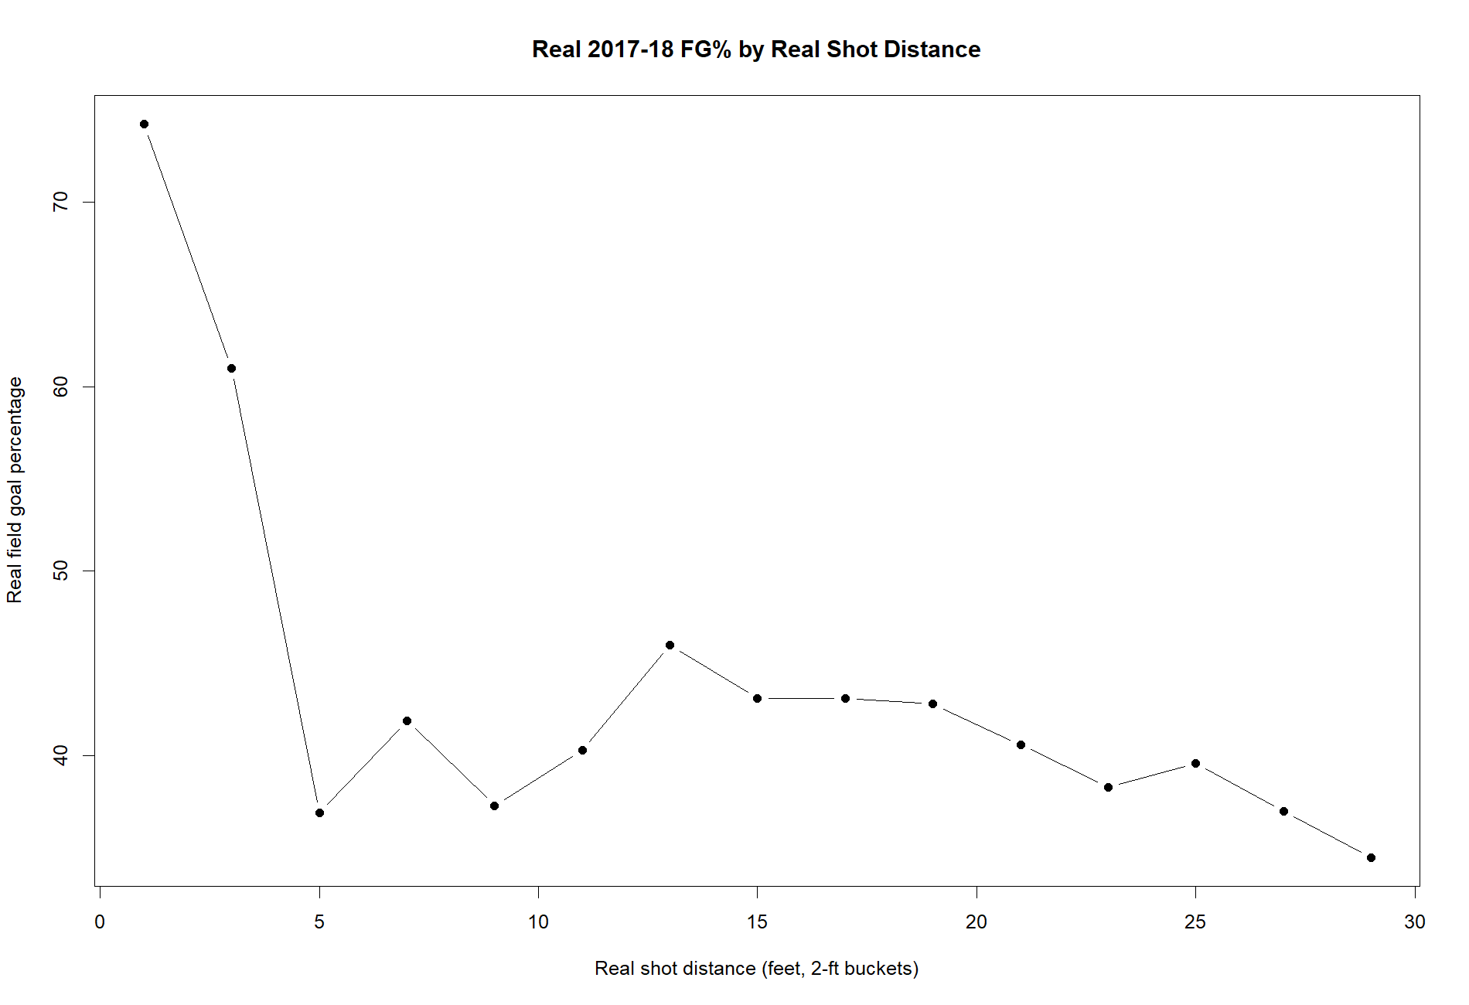
WORKED EXAMPLE, STEP 6
Real 2017-18 FG% by Real Shot Distance
Real PbP.BDB play-by-play data, 2017-18 NBA season, BasketballAnalyzeR, 2-ft distance buckets, n >= 100.

Slide 28
CONCEPT · PHYSICS MEETS OUTCOMES
The Real Mid-Range Dip, Explained Two Ways
Real FG% drops from 74.2% at the rim to as low as 36.9% in the real 4-14 ft mid-range, then stays roughly flat through the rest of the two-point range. That real mid-range window is exactly where the real required launch angle and speed are changing fastest with distance, on top of the well documented real strategic reasons (shot value relative to a three) that range has fallen out of favor.
Notes:
Discussion: be careful here to keep both explanations honest and separate. The physics explains why that range is mechanically harder to repeat consistently; it does NOT by itself explain the strategic abandonment of the mid-range, which is really about shot value (points per attempt) relative to a three-pointer. Ask the class to articulate both explanations without collapsing them into one. Timing: about 5 minutes.

Slide 29
PHD / ADVANCED-PROJECT CONNECTION
Trajectory Tracking as a Biomechanical Indicator
A shooter's real launch angle and real release speed, tracked consistently across an entire real season rather than computed once from a physics formula, is exactly the kind of subtle, athlete-specific signal that could flag a real mechanical change worth investigating well before it shows up in a box score. This is the same honest argument last module made for pose-estimation-based joint tracking, and it is the kind of indicator students doing a larger independent project can connect directly to the instructor's own signature research (Muritala, Brown & Haller, 2026; West et al., 2026) developed fully in the Module 10 PhD track.

Slide 30
PRACTICE
Read the Real Curve Yourself
Look back at the real FG%-by-distance chart.
1. Identify the real distance range with the steepest decline.
2. Using today's real trajectory table, name what is physically changing fastest across that same real range.
3. What real, non-physical (strategic) factor also affects shot selection in that range?

Slide 31
INTERACTIVE ACTIVITY
Design a Real Trajectory Quality Metric
Small groups (3-4). Imagine you have real, frame-by-frame ball-tracking data for every shot in a real season, not just the make/miss outcome.
1. Propose one real metric you would compute from that data (entry angle, release consistency, hang-time variance, and so on).
2. Explain what a coach or an injury-risk researcher could each do with it that they cannot do with box score data alone.

Slide 32
RECAP · SEGMENT 3
Outcomes and the PhD Link, Covered
Covered
Next
Built the real FG%-by-distance curve, connected the real mid-range dip to today's trajectory physics, and previewed the PhD/advanced-project link to Module 10.
Module 8 turns from a single point (the ball's landing spot) to full performance maps and court segmentation.

Slide 33
SUMMARY
What to Carry Forward
Detecting a basketball is a genuinely hard real computer-vision problem; even a purpose-built model (BGS-YOLO) trades off precision against recall.
The real minimum-speed trajectory formula (Brancazio, 1981) gives a real physics floor, not a description of how real shooters actually play.
Real shooters use substantially more arc than the physics minimum, especially from three, to buy a forgiving real entry angle at the rim.
Real 2017-18 FG% by distance lines up with this physics: the mid-range, where required angle and speed change fastest, is the hardest range to shoot consistently.

Slide 34
BEFORE MODULE 08
Two Things Before Next Class
Read
Do
Advanced Basketball Data Science, Ch. 8 (performance maps and court segmentation).
Complete Lab 7 (ball trajectories and object detection), the practice questions, and the Module 7 quiz on D2L.

Slide 35
FULL READING LIST
References Cited Today
Zuccolotto, P., Manisera, M., & Sandri, M. (2026). Advanced Basketball Data Science, Ch. 7. CRC Press/Chapman & Hall.
Liang, Z., Wang, J., Huang, T., Sang, Z., & Zhang, J. (2025). Basketball detection based on YOLOv8. PLOS ONE, 20(8), e0326964.
Brancazio, P. J. (1981). Physics of basketball. American Journal of Physics, 49(4), 356-365.
BasketballAnalyzeR (R package), the PbP.BDB dataset. Zuccolotto, Manisera & Sandri. CRAN.
Coach Dave Love. "Launch Angle and Velocity in Basketball Shooting" (applied resource, not peer-reviewed).

Slide 36
See You in Module 08
Performance Maps and Court Segmentation

