Slide 1
SPORTS ANALYTICS
Basketball Data Science
Module 01 · Introduction to Basketball Analytics
Week 1
Undergraduate · 3-hour session
Built on one text:
Zuccolotto, P., & Manisera, M. (2020). Basketball Data Science: With Applications in R. Chapman & Hall/CRC.

Slide 2
WELCOME
Let's Get Into It
This course looks at basketball the way a real analytics department would: describing team and player performance honestly, discovering patterns in real NBA data, grouping players by statistical profile, and modeling relationships between the numbers. We work from one real textbook and real data all semester, not just methods in the abstract.
Glad to have you here. Let's get started.
— FM

Slide 3
OUTLINE FOR THE DAY
Where We're Headed
I
Admin
II
Today's Plan
Office hours: by appointment, email to schedule
Preferred contact: D2L or email, as used this semester
Three segments, about three hours total:
Orientation (~45 min) → Worked Example (~60 min) → Five Throughlines (~45 min)
III
Before Next Class
IV
Notes
Read the assigned textbook section, complete Lab 1, and take the Module 1 quiz
Bring a laptop if you can. R and RStudio installation is part of today's class.

Slide 4
LEARNING OBJECTIVES
By the End of Today, You Will Be Able To
1
Explain what sports analytics is and why teams and researchers use it, citing at least one real historical example.
2
Name this course's five throughlines and the single textbook this course is built around.
3
Install and load the BasketballAnalyzeR package and describe the structure of its real 2017-18 NBA datasets.
4
Compute a simple, honest descriptive statistic from real team data and explain what it does and does not tell you.
5
Describe the four-step analytics workflow (get data, describe, model, communicate) this course follows all semester.

Slide 5
CONCEPT
Five Throughlines, Not Ten Topics
This course is organized around five recurring analytical questions. Every module returns to at least one of them.
1
2
3
4
5
Injury Detection
& Prediction
Player Performance
Analysis
Positioning &
Shifting
Salary Structure
Analysis
Game Analysis
Which signals actually warn of injury risk, and which just correlate with it?
How good is a player, once you account for role, opponent, and context?
Where players stand, and how that changes what a play can become.
How pay relates, or does not, to measurable production.
Reading a single game's real data to explain what actually happened.
Each throughline is grounded in real, cited data or a published methodology.

Slide 6
CONCEPT
One Textbook, Three Parts
Part I: Basic Analyses
Part II: Discovering Patterns
Part III: The R Package
Pace, ratings, the Four Factors, and comparison plots (Modules 2-4).
Correlation, networks, clustering, and regression (Modules 5-8).
BasketballAnalyzeR pulled together as one applied toolkit (Module 9).
Zuccolotto, P., & Manisera, M. (2020). Basketball Data Science: With Applications in R. Chapman & Hall/CRC Data Science Series, CRC Press. A signature module (10) built from the instructor's own published research on quality monitoring and injury risk closes the course.

Slide 7
THE QUESTION THIS COURSE KEEPS ASKING
Description vs. Prediction
Description
Prediction
What actually happened, summarized honestly. A team's points per game, a player's shooting percentage.
What is likely to happen next, or what a number implies beyond the game it came from. Description done well is what makes prediction possible.

Slide 8
EXAMPLE 1
A Team Scored the Most Points Per Game
Suppose a team leads the league in points scored per game this season.
Does that number by itself tell us this is the best team in the league?

Slide 9
EXAMPLE 1, CONTINUED
No. A Descriptive Number Is Not the Whole Story
A high points-per-game average can come from a fast pace that also gives up more points, from a weak schedule, or from genuine offensive quality. The number alone cannot tell those apart.
This is exactly the distinction Module 2's Four Factors framework exists to sharpen, and it is a running theme all semester, not a one-time warning.

Slide 10
PRACTICE · THINK-PAIR-SHARE (5 MIN)
Write One Descriptive Question, One Predictive Question
Pick a player or team you follow.
1. Write one descriptive question about their season so far.
2. Write one predictive question about their next game or season.
3. With a partner: could either question actually be answered with data you know exists?

Slide 11
RECAP · SEGMENT A
Where We've Been, Where We're Going
Covered
Next
Five throughlines instead of a broad survey. One textbook as the course's spine. A descriptive number is not a full evaluation, and that gap is a running theme.
Segment B moves from framing to a real dataset: 2017-18 NBA season data, pulled and analyzed live in R.

Slide 12
10-Minute Break
Back at the top of the hour. Next: real data, real R code, real output.

Slide 13
CONCEPT · SEGMENT B
What's in BasketballAnalyzeR?
The course textbook's companion R package bundles real, complete 2017-18 NBA season data.
Pbox
605 players. One row per player, season box score totals.
Tbox
30 teams. One row per team, season box score totals.
Obox / Tadd / PbP.BDB
Opponent box scores, advanced team addenda, and play-by-play data used in later modules.
BasketballAnalyzeR (Zuccolotto, Manisera & Sandri, CRAN). No data is copied into this course repository; it loads directly from the package.

Slide 14
CONCEPT · SEGMENT B
Points Per Game: A Simple, Real Metric
Points per game is total points scored divided by games played. It is purely descriptive: it summarizes what happened, without claiming to explain why.
Module 2 builds on this same idea with Dean Oliver's Four Factors framework, published in Basketball on Paper (2004): effective field goal percentage, turnover rate, offensive rebound rate, and free throw rate.

Slide 15
EXAMPLE 2
The 2017-18 NBA Regular Season
30 teams · 82 games each · real box score totals
Every team's full-season box score totals are in BasketballAnalyzeR's Tbox dataset. We're about to pull this table ourselves and look at it directly.

Slide 16
EXAMPLE 2, STEP 1
Pulling the Team Data
library(BasketballAnalyzeR)
data(Tbox)
Tbox$PPG <- round(Tbox$PTS / Tbox$GP, 1)
top5 <- Tbox[order(-Tbox$PPG),
c("Team","GP","W","L","PPG")][1:5, ]
print(top5)
Run this yourself. You should get the same table on the next slide.

Slide 17
EXAMPLE 2, STEP 2
What the Numbers Show
Team | GP | W | L | PPG
Golden State Warriors | 82 | 58 | 24 | 113.5
Houston Rockets | 82 | 65 | 17 | 112.4
New Orleans Pelicans | 82 | 48 | 34 | 111.7
Toronto Raptors | 82 | 59 | 23 | 111.7
Cleveland Cavaliers | 82 | 50 | 32 | 110.9
The top five scoring teams by points per game, real 2017-18 season data. Being top-5 in scoring did not guarantee the most wins: a real fact about this season, not a general rule.
Data: Tbox, BasketballAnalyzeR (Zuccolotto & Manisera, 2020).

Slide 18
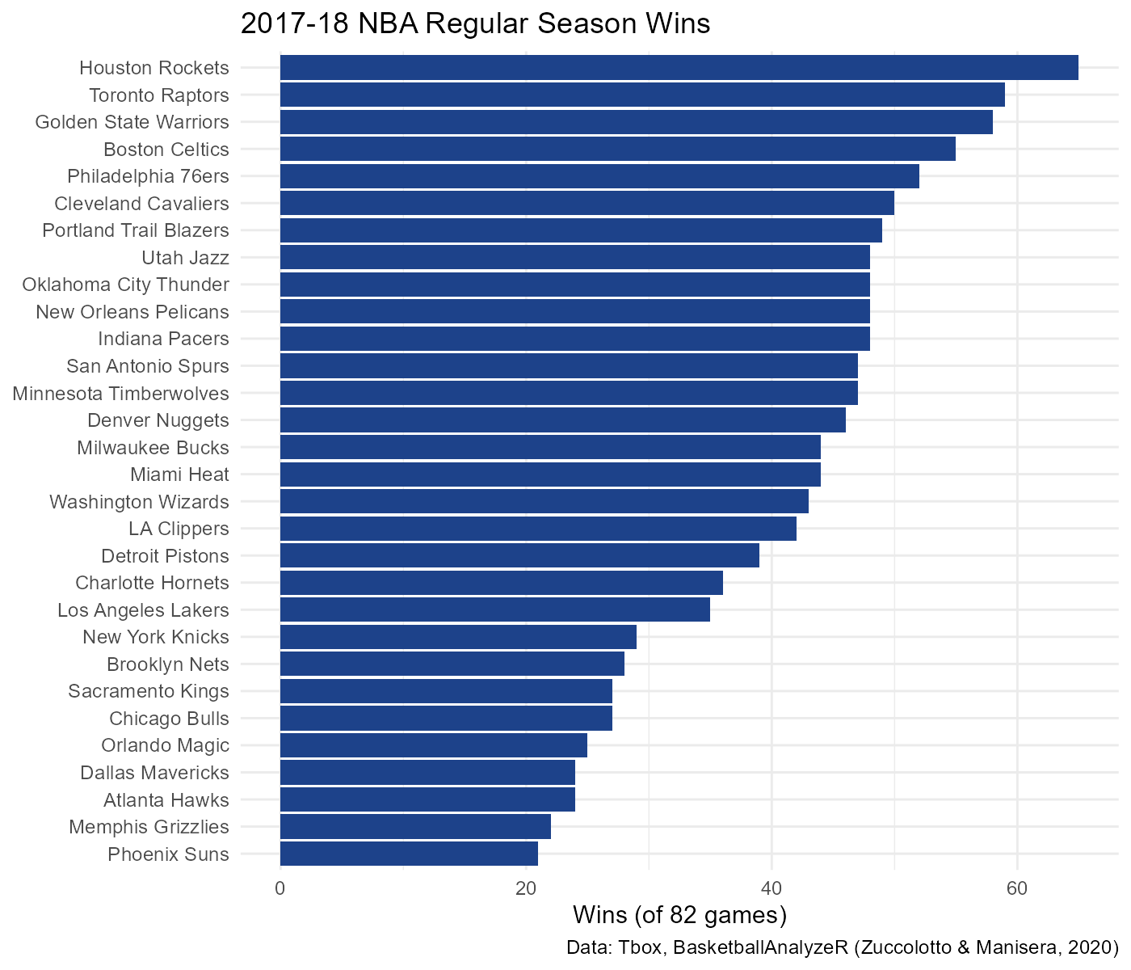
EXAMPLE 2, STEP 3
Every Team's Win Total, Plotted
Data: Tbox, BasketballAnalyzeR (Zuccolotto & Manisera, 2020). Built with ggplot2 from the table on the previous slide.

Slide 19
CONCEPT · READING THE NUMBER
PPG and Wins Are Correlated. That's Not the Whole Story.
What this tells us: teams that scored more per game also tended to win more, across this real season.
What this does NOT tell us: that scoring more itself causes wins. Defense, pace, and opponent strength are missing from this one number entirely.
0.70
correlation between a team's
points per game and its wins,
across all 30 teams
Computed with cor() in R on the real Tbox table. Module 2 builds a more complete picture with the Four Factors.

Slide 20
INTERACTIVE ACTIVITY (8 MIN)
What Else Would You Need to Know?
In groups of 3, discuss:
1. Besides points per game, what else would you want to know before calling a team good?
2. Could you design a better single number using only what's already in Tbox?
3. What does points per game still usefully tell you, even though it is incomplete?

Slide 21
PRACTICE (5 MIN)
Read the Chart Yourself
Pick one team on the chart. Was their season better or worse than you expected, based on what you already knew about them? Justify your answer using the chart alone.

Slide 22
RECAP · SEGMENT B
From Framing to Real Data
Covered
Next
Installed and loaded BasketballAnalyzeR. Pulled real 2017-18 season data. Computed a real correlation and were careful about what it does and does not claim.
Segment C walks through each of the five throughlines individually, then previews the signature module this course builds toward.

Slide 23
10-Minute Break
Back at the top of the hour. Next: the five throughlines, one at a time.

Slide 24
THROUGHLINE 1 OF 5
Injury Detection & Prediction
The question:
Which signals actually warn of injury risk, and which just correlate with it?
This course builds toward a real, published monitoring method (control charts) built on game-by-game pitching data, developed in explicit contrast with a widely used but statistically criticized industry ratio. Full detail in Module 10.
Muritala, F., Brown, A. R., & Haller, A. (2026). Research in Sports Medicine.

Slide 25
THROUGHLINE 2 OF 5
Player Performance Analysis
The question:
How good is a player, once you account for role, opponent, and how playing time was earned?
Modules 3, 5, 6, and 7 build the applied methods this course uses to answer that question, including comparison plots, correlation, and clustering.
Zuccolotto & Manisera (2020), Basketball Data Science, Chapman & Hall/CRC.

Slide 26
THROUGHLINE 3 OF 5
Positioning & Shifting
The question:
Where players stand, and how that changes what a play can become.
Module 4's shot charts are a first, accessible pass at this. The same spatial thinking returns when the course looks at surface area dynamics in Module 8.
Zuccolotto & Manisera (2020), Basketball Data Science, Chapman & Hall/CRC.

Slide 27
THROUGHLINE 4 OF 5
Salary Structure Analysis
The question:
How pay relates, or does not, to measurable production.
A recurring case study for the same correlation and visualization skills used elsewhere in this course, revisited whenever the data supports it honestly.
Zuccolotto & Manisera (2020), Basketball Data Science, Chapman & Hall/CRC.

Slide 28
THROUGHLINE 5 OF 5
Game Analysis
The question:
Reading a single game's real numbers to explain what actually happened.
Today's worked example was a first pass at this, at the season level. Later modules go deeper into event-level and lineup-level game analysis.
BasketballAnalyzeR, Zuccolotto, Manisera & Sandri (CRAN).

Slide 29
CONCEPT · A FIRST LOOK AHEAD
Where This Course Ends Up
Module 10 is built from the instructor's own published methodology: process-monitoring control charts applied to real MLB pitcher workload and injury data, taught in direct contrast with a widely used but statistically criticized industry ratio. It is this course's most advanced module, and the direct bridge to graduate-level research.
Muritala, F., Brown, A. R., & Haller, A. (2026). A Quality Monitoring Approach to Evaluating Reinjury Likelihood to Major League Baseball Pitchers. Research in Sports Medicine.

Slide 30
RECAP · SEGMENT C
Five Throughlines, One Shared Course
Covered
Next
Walked through each of the five throughlines and which module develops it. Previewed the signature quality-monitoring module this course builds toward.
Module 02 puts the data-collection half of this course into practice, pulling real data reproducibly. It's code you'll take a distinct look at for one throughline of your choice.

Slide 31
SUMMARY
What to Carry Forward
Sports analytics, in this course, means five specific questions, not a broad survey.
A descriptive number and an evaluative claim are different things. Confusing them is the single most common mistake this course will keep correcting.
The 2017-18 season numbers, the correlation, the win chart: all of it came from data you can pull and check yourself.
One textbook carries the applied spine of this course, chapter by chapter, all semester.

Slide 32
BEFORE MODULE 02
Two Things Before Next Class
Read
Do
Basketball Data Science, Ch. 1 (getting your environment ready to pull real data).
Complete Lab 1 (environment setup and first look at real data) and take the Module 1 quiz on D2L.

Slide 33
FULL READING LIST
References Cited Today
Zuccolotto, P., & Manisera, M. (2020). Basketball Data Science: With Applications in R. Chapman & Hall/CRC.
Smithsonian Lemelson Center. Sports Analytics Before Moneyball. invention.si.edu
Opta Analyst. How Advanced Analytics Have Changed Basketball. theanalyst.com
Oliver, D. (2004). Basketball on Paper: Rules and Tools for Performance Analysis. Potomac Books.
Lewis, M. (2003). Moneyball: The Art of Winning an Unfair Game. W. W. Norton.
Research.com. Sports Analytics Careers: Skills, Education, Salary and Job Outlook.
Muritala, F., Brown, A. R., & Haller, A. (2026). Research in Sports Medicine.
BasketballAnalyzeR (R package). Zuccolotto, Manisera & Sandri. CRAN.

Slide 34
See You in Module 02
Pace, Ratings, and the Four Factors

