Slide 1
SPORTS ANALYTICS
Discovering Patterns: Correlation and Player Networks
Module 05 - Correlation and Player Networks
Week 5
Undergraduate - 3-hour session
Maps to Chapter 3A:
Zuccolotto, P., & Manisera, M. (2020). Basketball Data Science: With Applications in R. Chapman & Hall/CRC.

Slide 2
RECAP
Where We Left Off
Module 4 gave us a new variable, location, and showed that a single shooting percentage hides where a player actually gets his points. Today I want us to step back from any one variable and ask a different question: when I have several box score numbers for the same player, how do they move together? A player who grabs a lot of offensive rebounds, does he also block a lot of shots? A player who racks up a lot of assists, does he also turn the ball over more?
Correlation is the tool for answering exactly that question.

Slide 3
BEFORE WE START
What's Coming Up
Due This Week
-- update before class --
Coming Up
-- update before class --
Office Hours
-- update before class --

Slide 4
OUTLINE FOR THE DAY
Where We're Headed
I
Segment 1
II
Segment 2
What a correlation coefficient is, and building a real 7-by-7 correlation matrix from 2017-18 per-minute rates
Reading the strongest real correlations, then moving from stats that move together to players who connect to each other
III
Segment 3
IV
Before Next Class
Building real assist networks for Houston and Cleveland, and comparing two very different real offenses
Lab 5, the Module 5 quiz, and the practice questions

Slide 5
LEARNING OBJECTIVES
By the End of Today, You Will Be Able To
1
Explain what a correlation coefficient measures and what values close to 1, -1, and 0 each tell you.
2
Build real per-minute rate variables from BasketballAnalyzeR::Pbox and explain why a minutes filter matters.
3
Compute and read a real 7-by-7 correlation matrix with corranalysis() and identify the strongest pairs.
4
Explain, in real basketball terms, why offensive/defensive rebounding, assists/turnovers, and rebounds/blocks each correlate the way they do.
5
Build a real assist network with assistnet() and use it to tell the difference between a distributed offense and a hub-and-spoke offense.

Slide 6
CONCEPT - SEGMENT 1
From One Variable to Many
So far this course has mostly looked at one number at a time, or one number plotted against wins. Real players produce many numbers at once every game: points, assists, turnovers, rebounds, blocks. Today's question is how those numbers relate to each other across an entire league of real players.
That's what a correlation matrix is built to show.

Slide 7
CONCEPT - SEGMENT 1
What Is a Correlation Coefficient?
A correlation coefficient is a single number between -1 and 1 that tells you how closely two variables move together across a group of players. If one variable tends to be high whenever the other is high, the correlation is positive. If one tends to be high when the other is low, the correlation is negative. If knowing one variable tells you nothing about the other, the correlation sits near zero.
The real value shows up when you run this across every pair of stats at once, which is exactly what a correlation matrix does.

Slide 8
WORKED EXAMPLE, STEP 1
Reading the -1 to 1 Scale
-1
0
1
Perfectly opposite
No relationship
Perfectly together
In this module I'll set a threshold of 0.5: any pair of stats with a correlation at or above that in absolute value gets drawn as a connection when I plot the matrix. Anything weaker gets left off the picture so the strongest real patterns stand out.

Slide 9
VIDEO - SEGMENT 1
See Correlation Before We Compute It
Correlation - The Basic Idea Explained
YouTube (channel not confirmed - verify before class)
https://www.youtube.com/watch?v=qC9_mohleao
A short, non-basketball walkthrough of what a correlation coefficient actually means, before we build our own real 7-by-7 matrix from 2017-18 NBA per-minute rates.

Slide 10
CONCEPT - SEGMENT 1
Building Fair Rate Variables
Why per-minute?
Why filter to 500+ minutes?
A player who plays 35 minutes a night will always out-total a player who plays 15, on almost every counting stat. Dividing every stat by minutes played puts every player on the same clock before we ask how the stats relate.
A player who logs only 40 total minutes can post a wild per-minute rate off a tiny sample. Restricting to real players with at least 500 minutes played keeps the correlation honest.

Slide 11
LET'S RUN THIS TOGETHER
Let's build the real per-minute rates and filter Pbox together.
Pull up your own session. We'll run it line by line and look at the real output together.

Slide 12
WORKED EXAMPLE, STEP 2
Filtering to Players Who Played Enough to Trust
605
361
total real players in Pbox,
2017-18 NBA season
real players left after
filtering to 500+ minutes played
Data: BasketballAnalyzeR::Pbox, 2017-18 NBA season.

Slide 13
CONCEPT - SEGMENT 1
One Function, Every Pair of Stats at Once
With seven real per-minute rates (points, assists, turnovers, offensive rebounds, defensive rebounds, steals, blocks), there are 21 possible pairs to compare. Rather than running cor() 21 separate times, BasketballAnalyzeR::corranalysis() computes the full matrix in one call, and can plot only the pairs that clear a threshold we choose, so the strongest real patterns are easy to spot.

Slide 14
WORKED EXAMPLE, STEP 3
Computing the Real Correlation Matrix
rates <- Pbox %>%
filter(MIN >= 500) %>%
mutate(PTSpm = PTS/MIN, ASTpm = AST/MIN, TOVpm = TOV/MIN,
OREBpm = OREB/MIN, DREBpm = DREB/MIN,
STLpm = STL/MIN, BLKpm = BLK/MIN) %>%
select(Player, PTSpm, ASTpm, TOVpm, OREBpm, DREBpm, STLpm, BLKpm)
cc <- corranalysis(rates %>% select(-Player), threshold = 0.5)
Run this yourself. You should get the same matrix on the next slide.

Slide 15
VIDEO - CODING SYNTAX
See the R Syntax in Action
How to Create Correlation Plots in R
YouTube (channel not confirmed - verify before class)
https://www.youtube.com/watch?v=X12BoYpIjyw
A supplementary coding-syntax walkthrough on building and reading correlation plots in R, alongside our own live corranalysis() demonstration.

Slide 16
LET'S RUN THIS TOGETHER
Let's run corranalysis() together and look at the real output.
Pull up your own session. We'll run it line by line and look at the real output together.

Slide 17
WORKED EXAMPLE, STEP 4
The Real 7-by-7 Correlation Matrix
 | PTSpm | ASTpm | TOVpm | OREBpm | DREBpm | STLpm | BLKpm
PTSpm | 1.00 | 0.28 | 0.52 | -0.03 | 0.18 | -0.01 | 0.02
ASTpm | 0.28 | 1.00 | 0.69 | -0.31 | -0.17 | 0.34 | -0.25
TOVpm | 0.52 | 0.69 | 1.00 | 0.05 | 0.20 | 0.23 | 0.08
OREBpm | -0.03 | -0.31 | 0.05 | 1.00 | 0.73 | -0.15 | 0.63
DREBpm | 0.18 | -0.17 | 0.20 | 0.73 | 1.00 | -0.15 | 0.58
STLpm | -0.01 | 0.34 | 0.23 | -0.15 | -0.15 | 1.00 | -0.03
BLKpm | 0.02 | -0.25 | 0.08 | 0.63 | 0.58 | -0.03 | 1.00
Data: corranalysis() on real per-minute rates, BasketballAnalyzeR::Pbox, 2017-18 NBA season, 361 players with 500+ minutes.
Notes:
Point out the diagonal of 1.00s is trivial (every stat correlates perfectly with itself). Ask the class to scan for the largest off-diagonal numbers before I reveal the plotted version.

Slide 18
LET'S RUN THIS TOGETHER
Now let's plot this matrix together and see it as a picture.
Pull up your own session. We'll run it line by line and look at the real output together.

Slide 19
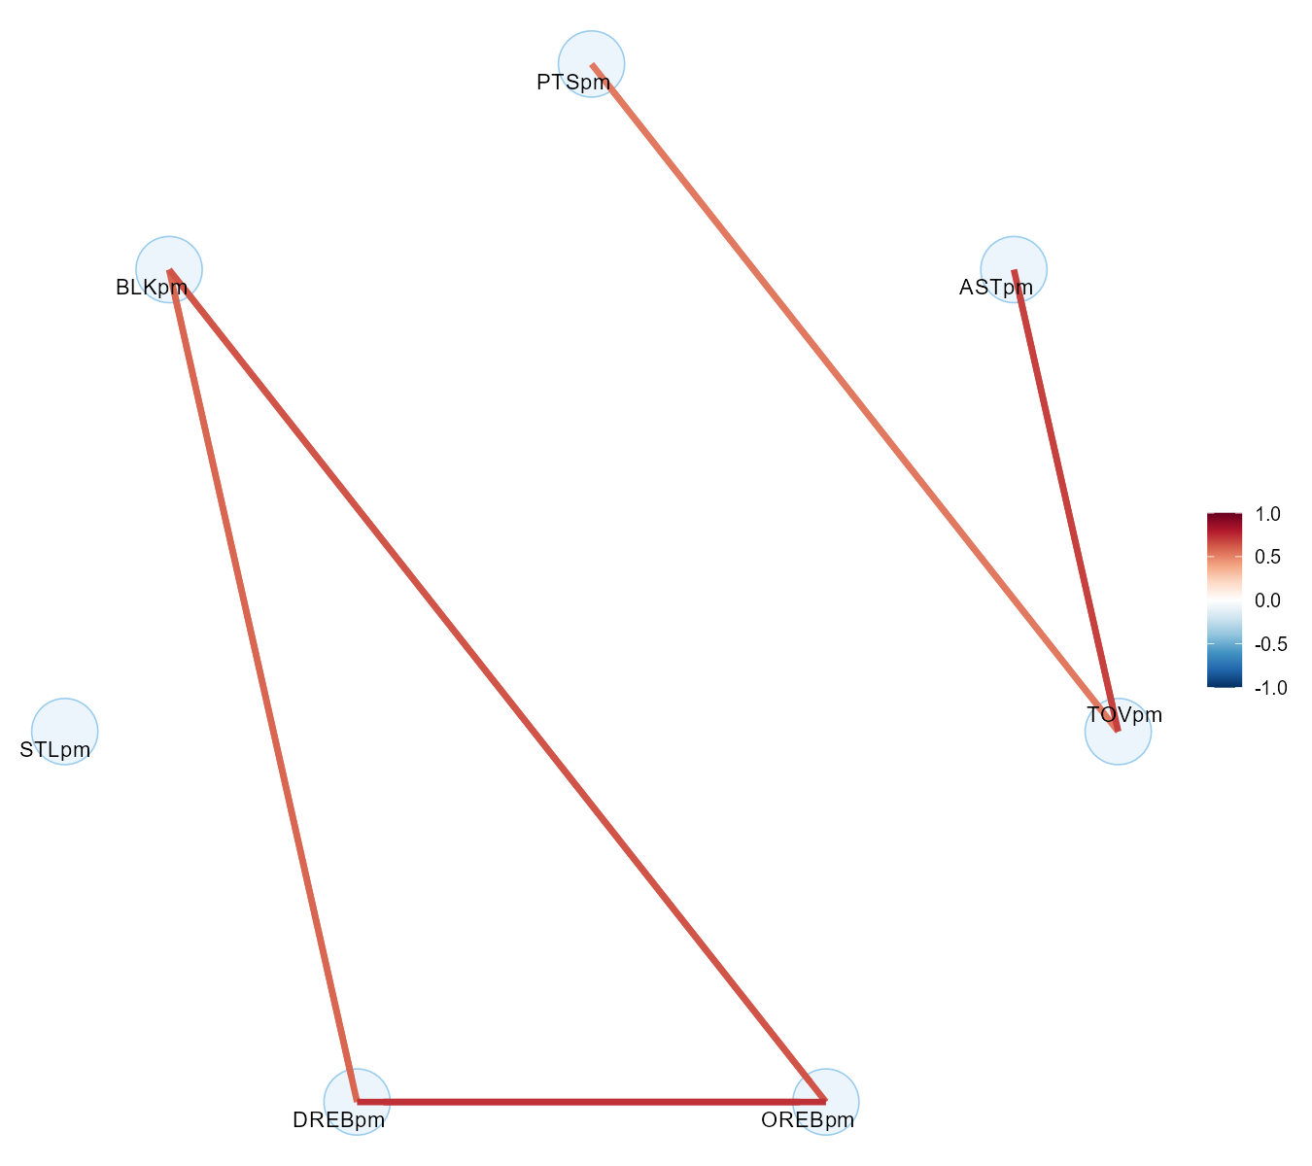
WORKED EXAMPLE, STEP 5
The Matrix, Thresholded at 0.5
plot(cc), BasketballAnalyzeR's corranalysis() output. Only pairs at or above 0.5 in absolute value are drawn.
Notes:
Ask the class: which node has no connections at all (STLpm), and what does that tell you about steals relative to the other six stats? Note the five connections drawn: OREB-DREB, OREB-BLK, DREB-BLK, AST-TOV, PTS-TOV.

Slide 20
INTERACTIVE ACTIVITY
Find the Three Strongest Correlations
Turn to a partner. Look back at the real matrix and the plotted version.
1. Find the three strongest real correlations, positive or negative.
2. For each one, write one sentence guessing why those two stats might move together on a real basketball floor.
3. Be ready to share before I walk through what each one actually means.

Slide 21
RECAP - SEGMENT 1
Correlation, Covered
Covered
Next
A correlation coefficient measures how closely two variables move together, from -1 to 1. We built real per-minute rates, filtered to 361 players with 500+ minutes, and computed a full 7-by-7 real correlation matrix.
Segment 2 reads the strongest real correlations one at a time, then moves from stats that move together to players who connect to each other.

Slide 22
10-Minute Break
Back at the top of the hour. Next: reading what these real correlations actually mean.

Slide 23
CONCEPT - SEGMENT 2
Reading the Real Correlations
Three real pairs out of our 7-by-7 matrix are worth sitting with. Each one has a real basketball reason behind it, not just a number.

Slide 24
THE STRONGEST PAIR IN THE MATRIX
Offensive and Defensive Rebounding
The strongest real correlation in the whole matrix.
Why: think about what actually produces a rebound: size, positioning near the rim, and physical strength on the glass. A player built to grab a defensive rebound is, almost by definition, built to grab an offensive one too.
0.729
correlation between offensive
rebounds per minute and defensive
rebounds per minute
Data: corranalysis() on real per-minute rates, BasketballAnalyzeR::Pbox, 2017-18 NBA season.

Slide 25
CONCEPT - SEGMENT 2
One Skill, Two Numbers
This isn't one stat causing the other. It's both stats being driven by the same real underlying trait: winning position under the basket. A center who boxes out well and plays physically near the rim will show up high on both offensive and defensive rebound rate, because both numbers are really just two different readings of the same skill.
Notes:
This is a good place to raise correlation-versus-causation without using that exact jargon phrase as a slide bullet: ask the class whether OREB causes DREB, or whether some third thing (size, position, strength) causes both.

Slide 26
A NUMBER THAT LOOKS BACKWARDS AT FIRST
Assists and Turnovers
Shouldn't a good passer turn the ball over less?
The real explanation: usage. A player who handles the ball constantly and threads difficult, high-value passes into tight windows racks up real assists specifically because he's taking those risks, and that same ball-handling volume also produces more chances for a pass to be picked off or thrown away.
0.687
correlation between assists
per minute and turnovers
per minute
Data: corranalysis() on real per-minute rates, BasketballAnalyzeR::Pbox, 2017-18 NBA season.

Slide 27
CONCEPT - SEGMENT 2
A "Good" Stat and a "Bad" Stat, Same Player
Point guards who run an offense generate both assists and turnovers together. Players who rarely touch the ball generate neither. The lesson isn't that turnovers are secretly good; it's that a single stat can't be judged in isolation from how much a player actually handles the ball.

Slide 28
THE THIRD STRONGEST REAL PAIR
Offensive Rebounds and Blocks
Both of these depend on the same real thing: being tall, long, and stationed near the basket rather than out on the perimeter.
The connection: a player chasing blocks is protecting the rim, and a player chasing offensive boards is fighting for position at the rim. Both stats are really two different readings of how much of a player's game happens close to the basket.
0.630
correlation between offensive
rebounds per minute and
blocks per minute
Data: corranalysis() on real per-minute rates, BasketballAnalyzeR::Pbox, 2017-18 NBA season.

Slide 29
CONCEPT - SEGMENT 2
Living Near the Rim
None of these three real pairs is a coincidence, and none of them proves that one stat causes the other. What they show is that certain box score numbers cluster together because they're driven by the same underlying role or skill set on the floor. Once you can see that clustering in a real correlation matrix, you stop treating each stat as if it lived in its own separate world.

Slide 30
WORKED EXAMPLE, STEP 6
A Few More Pairs Worth Noticing
Pair | Correlation | Quick Read
Defensive rebounds and blocks | 0.581 | Same rim-protection skill as OREB/BLK
Points and turnovers | 0.524 | High scorers also touch the ball more, so more chances to give it away
Assists and offensive rebounds | -0.308 | Perimeter passers and rim-area rebounders tend to be different players
Data: corranalysis() on real per-minute rates, BasketballAnalyzeR::Pbox, 2017-18 NBA season.

Slide 31
INTERACTIVE ACTIVITY
Propose Your Own Pair
Look back at the full matrix from Step 4. Propose one more real pair of stats you think might be correlated, and tell me why you think so before we check the real number together.
Notes:
Cold-call two or three volunteers. Pull up the printed matrix from Step 4 and verify their guess against the real number live, whether it confirms or contradicts their intuition.

Slide 32
CONCEPT - SEGMENT 2
What a Correlation Matrix Can't Tell You
A correlation matrix answers "which stats move together." It does not answer a question that matters just as much to a coach or a scout: on this specific team, who is actually setting up whom? Two teams can have similar team-wide assist totals while one runs its offense through a single ball-handler and the other spreads playmaking across four or five players, and a correlation matrix built from season totals cannot tell the two situations apart.

Slide 33
CONCEPT - SEGMENT 2
What Is an Assist Network?
An assist network turns every real assisted basket into a connection between the player who passed and the player who scored. Each player is a node. Each real assist is an edge, drawn from the passer to the scorer, with the number of assists between them setting how strong that connection looks. Instead of asking how variables relate to each other, an assist network asks how players relate to each other.
Built with BasketballAnalyzeR::assistnet().

Slide 34
WORKED EXAMPLE, STEP 7
Reading a Player's Row in the Network
Column | What It Means | Chris Paul's Real Row
AST | Real assists this player gave to teammates | 27
ASTPTS | Real points created by those assists | 68
FGM | This player's own real made shots | 22
FGM_AST | Of those makes, how many a teammate assisted | 4
FGM_ASTp | Percent of his own makes that were assisted | 18.2%
Notice the two directions here: AST and ASTPTS describe Chris Paul as a passer. FGM, FGM_AST, and FGM_ASTp describe him as a scorer. Only 18.2% of his own makes were assisted, meaning most of his scoring was self-created, exactly what you'd expect from a lead ball-handler.

Slide 35
VIDEO - SEGMENT 2
See What an Assist Chain Looks Like
What Is A Hockey Assist In College Basketball?
College Basketball Insiders
https://www.youtube.com/watch?v=m0fzhcJTSdc
A concept explainer on the pass that sets up the pass that leads to a score, useful for seeing that an assist network is really a chain of connected decisions on the floor, not just a single box score number.

Slide 36
RECAP - SEGMENT 2
From Stats to Players
Covered
Next
Walked through the real basketball reasons behind offensive/defensive rebounding (0.729), assists/turnovers (0.687), and offensive rebounds/blocks (0.630). Introduced the assist network: nodes are players, edges are real assists.
Segment 3 builds two real assist networks, Houston and Cleveland, and compares how differently their offenses actually worked.

Slide 37
10-Minute Break
Back at the top of the hour. Next: two real teams, two very different offenses.

Slide 38
CASE STUDY - SEGMENT 3
Houston Versus Cleveland: Two Real Networks
We're going to build a real assist network for Houston and a real assist network for Cleveland, using real 2017-18 regular-season games, and see how differently each offense actually distributed playmaking.

Slide 39
CONCEPT - SEGMENT 3
The Dataset: Built Around Golden State's Schedule
BasketballAnalyzeR::PbP.BDB is real, event-level play-by-play data built around the Golden State Warriors' full 82-game 2017-18 regular season schedule. Every other team's rows in it are that team's own real regular-season games against Golden State specifically, not a playoff series. That's an important distinction to get right: this is regular-season data, and it only includes each opponent's games against Golden State.
Notes:
This distinction matters: make sure the class hears clearly that these are regular-season games against Golden State only, not a playoff run, before we look at the real assist totals.

Slide 40
WORKED EXAMPLE, STEP 8
Two Real, Different-Sized Samples
Houston Rockets
Cleveland Cavaliers
3 real 2017-18 regular-season games against Golden State, including the real season opener on October 17, 2017, which Houston won at Golden State 122-121, on the way to a 2-1 real record in this sample.
2 real 2017-18 regular-season games against Golden State, including the real, nationally televised Christmas Day game, which Golden State won 99-92, on the way to a real 2-0 sweep of Cleveland in this sample.

Slide 41
VIDEO - REAL GAME FOOTAGE
See a Distributed Offense on the Floor
The 2017 Warriors Had Such ELITE Ball Movement
YouTube (channel not confirmed - verify before class)
https://www.youtube.com/watch?v=5xav-WV0tWo
Real game footage of the Golden State Warriors' 2017-18 ball movement, the same team and season this module's assist-network data is built around, before we compare Houston's and Cleveland's real networks.

Slide 42
LET'S RUN THIS TOGETHER
Let's build Houston's real assist network together, live.
Pull up your own session. We'll run it line by line and look at the real output together.

Slide 43
WORKED EXAMPLE, STEP 9
Houston's Real Playmakers
Player | AST | ASTPTS | Share of Team's 67 AST
Chris Paul | 27 | 68 | 40.3%
James Harden | 18 | 41 | 26.9%
Eric Gordon | 10 | 26 | 14.9%
Trevor Ariza | 5 | 11 | 7.5%
Ryan Anderson | 4 | 10 | 6.0%
Data: assistnet(subset(PbP, team == "HOU")), 3 real 2017-18 regular-season games vs. Golden State. Team total: 67 real assists.
Notes:
Point out that three different real players (Paul, Harden, Gordon) each contributed double-digit assists here, before we contrast this with Cleveland.

Slide 44
LET'S RUN THIS TOGETHER
Now let's plot Houston's real network and see the shape of it.
Pull up your own session. We'll run it line by line and look at the real output together.

Slide 45
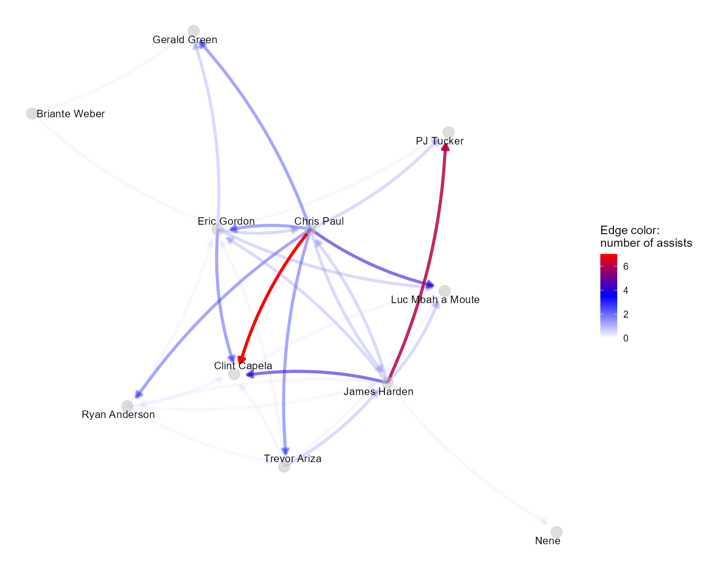
WORKED EXAMPLE, STEP 10
Houston's Real Assist Network
plot(anet_hou), BasketballAnalyzeR::assistnet(). Edge color/weight = number of real assists between two players.
Notes:
Ask the class to look at how many players have thick, dark edges connecting to Chris Paul, Harden, and Gordon, rather than everything running through one node.

Slide 46
HOUSTON, DISTRIBUTED
No Single Player Dominates the Ball
Chris Paul led the team with 27 real assists worth 68 real points created.
But: James Harden (18 assists, 41 points created) and Eric Gordon (10 assists, 26 points created) both contributed heavily too. Houston's playmaking was real and distributed across three genuine ball-handlers.
40%
of Houston's 67 real assists
came from Chris Paul, the
team's real assist leader
Data: assistnet(subset(PbP, team == "HOU")), BasketballAnalyzeR::PbP.BDB.

Slide 47
LET'S RUN THIS TOGETHER
Let's build Cleveland's real assist network the same way.
Pull up your own session. We'll run it line by line and look at the real output together.

Slide 48
WORKED EXAMPLE, STEP 11
Cleveland's Real Playmakers
Player | AST | ASTPTS | Share of Team's 38 AST
LeBron James | 12 | 31 | 31.6%
Dwyane Wade | 9 | 23 | 23.7%
JR Smith | 5 | 12 | 13.2%
Isaiah Thomas | 4 | 9 | 10.5%
Kevin Love | 3 | 6 | 7.9%
Data: assistnet(subset(PbP, team == "CLE")), 2 real 2017-18 regular-season games vs. Golden State. Team total: 38 real assists.
Notes:
Contrast with the Houston table: LeBron's 31.6% is the single largest individual share on either table, and the gap down to the second player (Wade at 23.7%) is smaller than Houston's gap.

Slide 49
LET'S RUN THIS TOGETHER
Let's plot Cleveland's real network next to Houston's.
Pull up your own session. We'll run it line by line and look at the real output together.

Slide 50
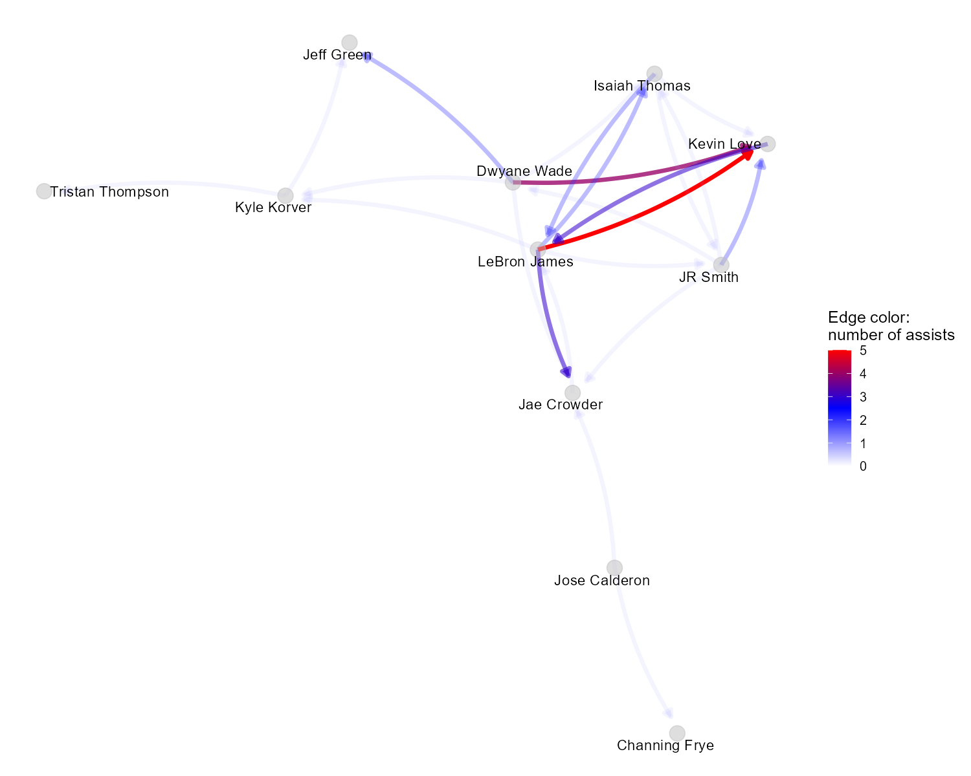
WORKED EXAMPLE, STEP 12
Cleveland's Real Assist Network
plot(anet_cle), BasketballAnalyzeR::assistnet(). Edge color/weight = number of real assists between two players.
Notes:
Ask the class to compare this picture to Houston's: notice how many of the thickest edges here point directly at or away from LeBron James, compared to Houston's more spread-out thick edges.

Slide 51
CLEVELAND, HUB AND SPOKE
One Player Runs the Offense
LeBron James recorded 12 real assists out of Cleveland's 38 total in this sample.
The contrast: Cleveland's playmaking told the opposite story from Houston's. The ball, and the offense's actual creation, ran through one player far more than any other.
31.6%
of Cleveland's 38 real assists
came from LeBron James alone,
the team's real assist leader
Data: assistnet(subset(PbP, team == "CLE")), BasketballAnalyzeR::PbP.BDB.

Slide 52
THE BIG REVEAL
Distributed Versus Hub-and-Spoke
Houston: Distributed
Cleveland: Hub and Spoke
Chris Paul: 27 AST, 68 pts created (40.3%)
James Harden: 18 AST, 41 pts created (26.9%)
Eric Gordon: 10 AST, 26 pts created (14.9%)
Three real playmakers sharing the load.
LeBron James: 12 AST, 31 pts created (31.6%)
Dwyane Wade: 9 AST, 23 pts created (23.7%)
Rest of team: shared remainder
One central playmaker, everyone else spoked around him.
Notes:
This is the centerpiece comparison of the whole module. Let it sit for a moment before moving on: same league, same season, same opponent (Golden State), two genuinely different real offensive structures.

Slide 53
INTERACTIVE ACTIVITY
Small Groups: Compare the Two Real Networks
Get into groups of 3-4.
1. Using the real assist share numbers, decide together whether Houston's or Cleveland's offense looks more "hub and spoke" versus distributed.
2. Write one sentence per team describing its real playmaking identity.
3. Be ready to report your group's answer to the class.

Slide 54
THROUGHLINE - PLAYER PERFORMANCE & GAME ANALYSIS
Why This Matters Beyond One Comparison
The question:
What does a team's real playmaking structure tell you about its risk?
A team whose offense depends this heavily on one player is more exposed if that player is off the floor, injured, or having an off night, while a team that distributes playmaking across several real, capable ball-handlers has more paths to a good possession when any one of them isn't clicking. This is also a real bridge to how teams get built and paid: a roster built around one true offensive hub carries a very different kind of real risk, and a very different real salary allocation problem, than a roster built to distribute playmaking across several players.

Slide 55
RECAP - SEGMENT 3
Two Real Offenses, Two Real Structures
Covered
Next
Built real assist networks for Houston (distributed, three real playmakers) and Cleveland (hub and spoke, centered on LeBron James), using real 2017-18 regular-season games against Golden State.
We close today by connecting this to real roster construction and salary questions, then preview Module 6.

Slide 56
PRACTICE
Read a Real Network Yourself
Look back at either the Houston or Cleveland network image.
1. Find the player with the most, and the thickest, edges pointing away from him.
2. In one sentence, describe that player's real role in the offense.
3. Does your one-sentence description match his real assist share from the table?

Slide 57
SUMMARY
What to Carry Forward
A correlation coefficient measures how closely two variables move together, from -1 to 1, and a full matrix lets you scan every pair of stats at once.
Offensive/defensive rebounding (0.729), assists/turnovers (0.687), and offensive rebounds/blocks (0.630) each cluster together because they share a real underlying skill, not because one causes the other.
An assist network answers a different question than correlation: not which stats move together, but which real players connect to each other.
Houston's real offense was distributed across three genuine playmakers; Cleveland's ran through one hub, LeBron James, far more heavily.
Every number in this module came from corranalysis() and assistnet() on real, freely available BasketballAnalyzeR data, reproducible by anyone who runs the script.

Slide 58
BEFORE MODULE 06
Two Things Before Next Class
Read
Do
Basketball Data Science, Chapter 3, part A (correlation and player networks) if you haven't already, and skim ahead to part B on event density.
Complete Lab 5 (correlation and player networks), the practice questions, and the Module 5 quiz.

Slide 59
FULL READING LIST
References Cited Today
Zuccolotto, P., & Manisera, M. (2020). Basketball Data Science: With Applications in R, Chapter 3, part A ("Discovering Patterns"). Chapman & Hall/CRC.
Zuccolotto, Manisera & Sandri. BasketballAnalyzeR (R package): corranalysis() and assistnet() functions, with the Pbox and PbP.BDB datasets. CRAN.
"Temporal passing network in basketball: the effect of time pressure on the dynamics of team organization at micro and meso levels." Psychology of Sport and Exercise (Elsevier), 2025. PubMed ID 40403945; preprint arXiv 2506.04808.
Every real number in this module is reproducible by running Coding_Exercise/module5_correlation_networks.R.

Slide 60
See You in Module 06
Event Density and Shooting Under Pressure

