Slide 1
SPORTS ANALYTICS
Basketball Data Science
Module 03 · Visualizing Team and Player Profiles
Week 3
Undergraduate · 3-hour session
Maps to Chapter 2B:
Zuccolotto, P., & Manisera, M. (2020). Basketball Data Science: With Applications in R. Chapman & Hall/CRC.
Notes:
Chapter reference is to Ch. 2, second half (comparison plots and team/player profile visualization). This build did not have a page-indexed source for the textbook, so slide notes in this deck cite the chapter only, not a specific page -- see the private Instructor Notes for a note to Faruk about closing that gap once the textbook access link is available again.

Slide 2
RECAP
Where We Left Off
Module 2 showed that net rating (ORtg minus DRtg) predicts wins far better than any single shooting stat -- 0.96 versus 0.77 for effective field goal percentage alone. That was still one number at a time, compared to one other number. Today we look at several numbers about a player or team at once, and learn how to compare their shapes.
Same textbook, same real 2017-18 data, same BasketballAnalyzeR package.

Slide 3
OUTLINE FOR THE DAY
Where We're Headed
I
Segment 1
II
Segment 2
Standardizing stats and building radial player profiles (~50 min)
Bar-line plots: shooting splits and playing time together (~50 min)
III
Segment 3
IV
Before Next Class
Variability, weighted consistency, and team-level profiles (~50 min)
Lab 3, the Module 3 quiz, and the practice questions

Slide 4
LEARNING OBJECTIVES
By the End of Today, You Will Be Able To
1
Write the z-score formula from memory and explain what standardizing a variable actually does to it.
2
Build a standardized, multi-variable player profile from real per-minute data and read a radialprofile() chart correctly.
3
Explain at least one documented criticism of radar charts, and how checking raw z-scores protects against it.
4
Build a bar-line chart comparing a categorical breakdown against a continuous variable using real team data.
5
Compute and interpret a weighted coefficient of variation, and explain why weighting by volume matters.

Slide 5
CONCEPT · SEGMENT 1
One Number at a Time Stops Working
A player's assist rate on its own tells you almost nothing about whether they are a distributor, a scorer, or a rebounder. The moment you want several stats side by side, on scales that have nothing to do with each other, a table of raw numbers stops being readable.
Visualizing a profile means putting several variables on one shared, comparable scale.

Slide 6
CONCEPT · SEGMENT 1
Putting Every Variable on the Same Scale
Two-point makes per 36 minutes and turnovers per 36 minutes are not measured the same way, so you cannot just compare the raw numbers side by side. Standardization rescales every variable into the same units: how many standard deviations above or below its own average a value is.
This is exactly what BasketballAnalyzeR's radialprofile() function does internally, by default (std = TRUE).
Notes:
Basketball Data Science with R, Ch. 2 (second half) covers this standardization step as part of building comparison plots; page reference not yet available for this build -- see private Instructor Notes.

Slide 7
CONCEPT · THE FORMULA
The Z-Score
z = (x − x̄) / s
x is one player's raw value (for example, three-point makes per 36 minutes). x̄ is the average of that variable across the comparison group. s is the standard deviation of that variable across the group. The result, z, says how many standard deviations above or below average that one player is on that one variable -- and because every variable is now measured in the same units (standard deviations), you can plot several of them on one chart.
This is what R's scale() function computes for every column of a data frame, and what radialprofile() applies before it draws a radar chart.
Notes:
Work one column by hand on the board before running scale() in R, so the class sees the formula is not a black box. Pick a variable with an intuitive spread, like three-point makes.

Slide 8
WORKED EXAMPLE, STEP 1
Five Real Players, Five Per-Minute Rates
library(BasketballAnalyzeR)
data(Pbox)
stars <- c("Russell Westbrook","James Harden","LeBron James",
"Giannis Antetokounmpo","Stephen Curry")
P5 <- Pbox[Pbox$Player %in% stars, ]
X <- data.frame(P5$P2M, P5$P3M, P5$OREB+P5$DREB, P5$AST, P5$TOV) / P5$MIN
names(X) <- c("P2M","P3M","REB","AST","TO")
round(X * 36, 2)
Five real, high-usage 2017-18 players, chosen for very different offensive roles. Multiplying by 36 puts every rate on the familiar "per 36 minutes" scale.

Slide 9
WORKED EXAMPLE, STEP 2
Per-36-Minute Rates, 2017-18
Player | P2M | P3M | REB | AST | TO
LeBron James | 8.42 | 1.77 | 8.43 | 8.89 | 4.13
Stephen Curry | 4.77 | 4.68 | 5.76 | 6.84 | 3.38
James Harden | 5.45 | 3.74 | 5.49 | 8.89 | 4.45
Giannis Antetokounmpo | 9.13 | 0.56 | 9.84 | 4.72 | 2.91
Russell Westbrook | 8.15 | 1.20 | 9.93 | 10.13 | 4.71
Giannis leads in two-point makes and rebounds; Curry leads by far in three-point makes; Westbrook leads in assists and turnovers together.
Data: Pbox, BasketballAnalyzeR (Zuccolotto & Manisera, 2020).

Slide 10
WORKED EXAMPLE, STEP 3
Standardizing the Table
Z <- as.data.frame(scale(X))
round(Z, 3)
scale() applies z = (x - mean(x)) / sd(x) to every column at once. Run this yourself and compare your table to the next slide.

Slide 11
WORKED EXAMPLE, STEP 4
Standardized Profiles (Z-Scores)
Player | P2M | P3M | REB | AST | TO
LeBron James | 0.64 | -0.35 | 0.25 | 0.47 | 0.29
Stephen Curry | -1.24 | 1.31 | -0.99 | -0.49 | -0.72
James Harden | -0.89 | 0.77 | -1.11 | 0.47 | 0.71
Giannis Antetokounmpo | 1.00 | -1.05 | 0.90 | -1.49 | -1.34
Russell Westbrook | 0.50 | -0.68 | 0.95 | 1.05 | 1.06
Curry's three-point rate is +1.31 standard deviations above this group's average; Giannis's is -1.05 below it. Every column now sits on the same scale.
Computed with scale() in R on the real Pbox data.

Slide 12
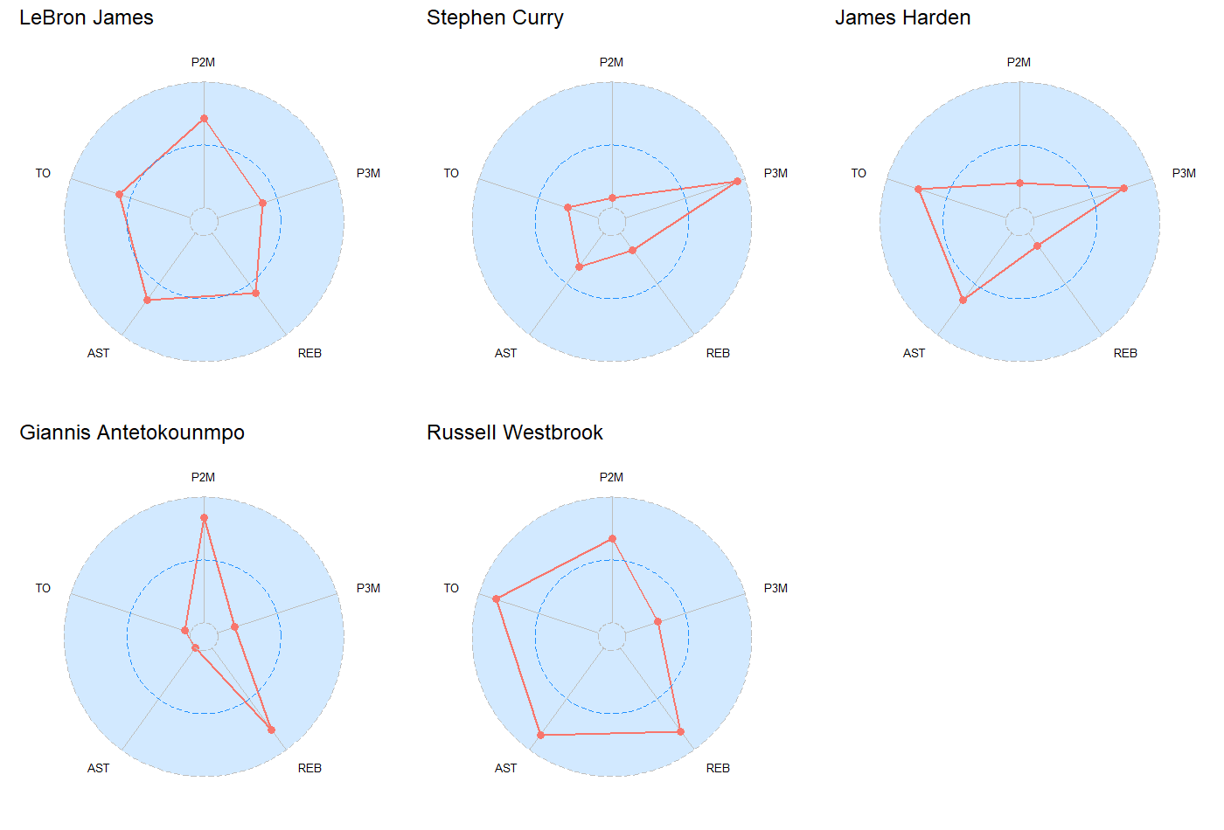
WORKED EXAMPLE, STEP 5
Five Player Profiles, One Chart Type
radialprofile(data = X, ncol.arrange = 3), BasketballAnalyzeR. Data: Pbox, 2017-18 NBA season.
Notes:
Walk the room through Giannis's chart first (most visually extreme, easiest to read) before Westbrook's more balanced shape.

Slide 13
CONCEPT · READING THE CHART HONESTLY
Radar Charts Have Real Critics
The criticism: NBA analytics leaders including Daryl Morey and Luke Bornn have argued radar charts are misleading, because the area enclosed by the shape draws the eye even though area is not a meaningful quantity when the axes are unrelated variables on different scales.
The habit to build: before drawing a conclusion from a profile chart's shape, check the actual z-score behind whichever "spike" caught your eye.
Whitehead, T. (2017). Nylon Calculus: Bravely staring down the radar chart backlash. FanSided.
Notes:
This is the module's honest-reading moment, matching Module 2's turnover-rate surprise. Read Morey's objection aloud before revealing the class's own radar chart on the previous slide was already shown -- the point is to inoculate against overreading shape alone.

Slide 14
INTERACTIVE ACTIVITY (10 MIN)
Describe a Player From the Shape Alone
Look back at the five radial profiles.
1. Pick one player's chart, without looking at the z-score table, and describe their role in one sentence.
2. Now check your description against the real z-score table. Did the shape mislead you on anything?

Slide 15
RECAP · SEGMENT 1
Standardizing and Profiles, Covered
Covered
Next
The z-score formula, standardized player profiles, and one documented criticism of radar charts -- plus the habit of checking real numbers behind a chart's shape.
Segment 2 compares a categorical breakdown against a continuous variable in one bar-line chart, using the real Houston Rockets roster.

Slide 16
10-Minute Break
Back at the top of the hour. Next: bar-line plots.

Slide 17
CONCEPT · SEGMENT 2
Two Kinds of Information, One Chart
A shooting percentage on its own does not tell you whether a player earned it on heavy minutes or a handful of garbage-time shots. A bar-line chart stacks a categorical breakdown as bars and overlays a separate continuous variable as a line, so both are visible at once.
BasketballAnalyzeR's barline() function builds exactly this chart.
Notes:
Basketball Data Science with R, Ch. 2 (second half) introduces this comparison-plot approach; page reference not yet available for this build -- see private Instructor Notes.

Slide 18
WORKED EXAMPLE, STEP 6
Houston Rockets: Shooting and Minutes Together
dts <- subset(Pbox, Team=="Houston Rockets" & MIN>=500)
barline(data=dts, id="Player",
bars=c("P2p","P3p","FTp"), line="MIN",
order.by="MIN",
labels.bars=c("2P%","3P%","FT%"),
title="Houston Rockets, 2017-18")
The same 12 real Rockets players from Module 2's case study (500+ minutes played), this time compared by shooting mix instead of Four Factors.

Slide 19
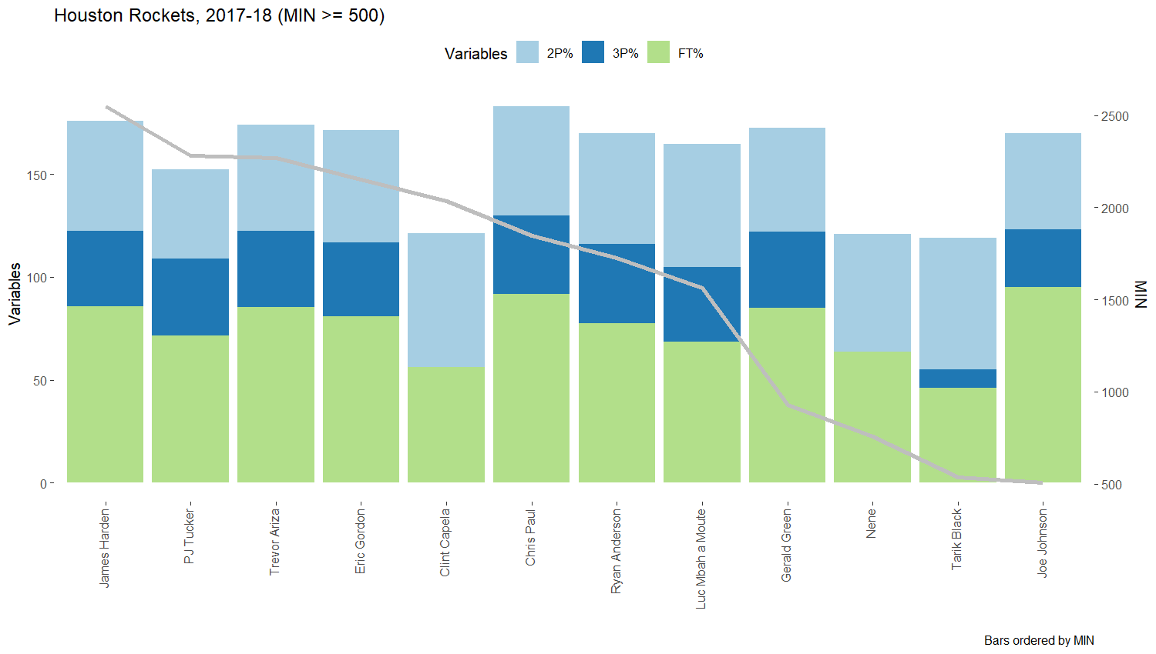
WORKED EXAMPLE, STEP 7
Reading the Bar-Line Chart
barline(), BasketballAnalyzeR. Data: Pbox, 2017-18 NBA season, Houston Rockets (MIN >= 500).
Notes:
Point out James Harden and Chris Paul (highest minutes, on the left) versus Tarik Black (lowest minutes shown, far right) -- the volume-versus-efficiency pattern described in the Student Notes.

Slide 20
INTERACTIVE ACTIVITY (15 MIN · SMALL GROUPS)
Volume or Efficiency?
In groups of 3-4, your instructor will assign your group two Rockets players from the chart.
1. Does each player's shooting efficiency match what their minutes would predict?
2. Name one player whose numbers surprised you, and propose one basketball reason why.

Slide 21
RECAP · SEGMENT 2
Bar-Line Plots, Covered
Covered
Next
Built a bar-line chart comparing three real shooting percentages against playing time for the Houston Rockets, and read volume against efficiency together.
Segment 3 asks a different question: not what a stat averages, but how consistent it is -- and scales the same profile thinking up to whole teams.

Slide 22
10-Minute Break
Back at the top of the hour. Next: variability and team profiles.

Slide 23
CONCEPT · SEGMENT 3
An Average Hides How Spread Out It Is
A shooting percentage is itself an average across a season. Two players can have the same average percentage while one is far more erratic from game to game than the other. Measuring that spread is a different question than measuring the average.
The coefficient of variation (CV) measures relative spread: how large the standard deviation is compared to the mean.

Slide 24
CONCEPT · THE FORMULA
Coefficient of Variation
CV = s / x̄
s is the standard deviation of a variable across a group of players; x̄ is that same variable's mean. Dividing the two produces a ratio, not a raw number, so it can be compared fairly across variables with very different averages -- a two-point percentage around 55% and a free-throw percentage around 75% are not directly comparable by standard deviation alone, but their CVs are. BasketballAnalyzeR's variability() function can also weight this by shot volume, so a low-attempt bench player's percentage does not distort the result as much as it would unweighted.
Multiply by 100 to read CV as a percentage of the mean.
Notes:
This is the second equation slide -- keep it brief and move to the R code quickly, since the class already worked through the z-score derivation in Segment 1.

Slide 25
WORKED EXAMPLE, STEP 8
Weighted Variability in R
Pbox.HR <- subset(Pbox, Team=="Houston Rockets" & MIN>=500,
select=c("Player","P2p","P3p","FTp","P2A","P3A","FTA"))
vc <- variability(data=Pbox.HR,
data.var=c("P2p","P3p","FTp"),
size.var=c("P2A","P3A","FTA"), weight=TRUE)
print(vc)
size.var weights the calculation by real shot attempts (P2A, P3A, FTA), so James Harden's 727 two-point attempts count for more than Tarik Black's 116.

Slide 26
CONCEPT · THE CORE IDEA OF THIS SEGMENT
Free Throws Are the Least Consistent Shot Here
Compare that to: three-point percentage's weighted CV of only 6.6%, and two-point percentage's 10.4%.
Why this surprises people: free throws are usually treated as the "easy," low-variance shot in casual conversation. The real, attempt-weighted 2017-18 Rockets data says the opposite -- free-throw shooting varied more across this roster than three-point shooting did.
16.2%
weighted CV of free-throw
percentage, Houston Rockets,
2017-18 (MIN >= 500)
Computed with variability() in R on the real Pbox data, weighted by P2A/P3A/FTA.
Notes:
This is this module's version of Module 2's turnover-rate surprise -- let the room guess the ranking before revealing it.

Slide 27
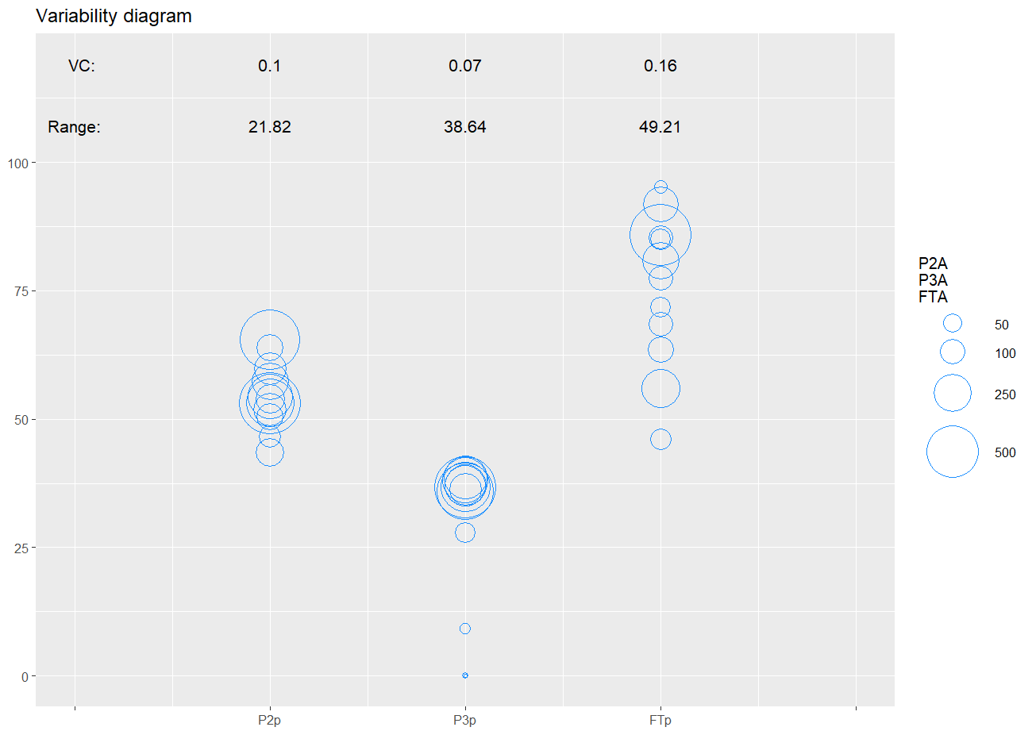
WORKED EXAMPLE, STEP 9
The Variability Diagram
plot(vc), BasketballAnalyzeR. Circle size reflects shot volume (P2A, P3A, FTA); data: Pbox, 2017-18 NBA season.

Slide 28
CONCEPT · SCALING UP TO TEAMS
The Same Profile Thinking, at the Team Level
Profiles do not have to be about players. Comparing every team's assists per game against its turnovers per game is the same idea: two related variables, plotted together instead of read one table at a time.
scatterplot(TT, data.var=c("AST_pg","TOV_pg"), z.var="W")

Slide 29
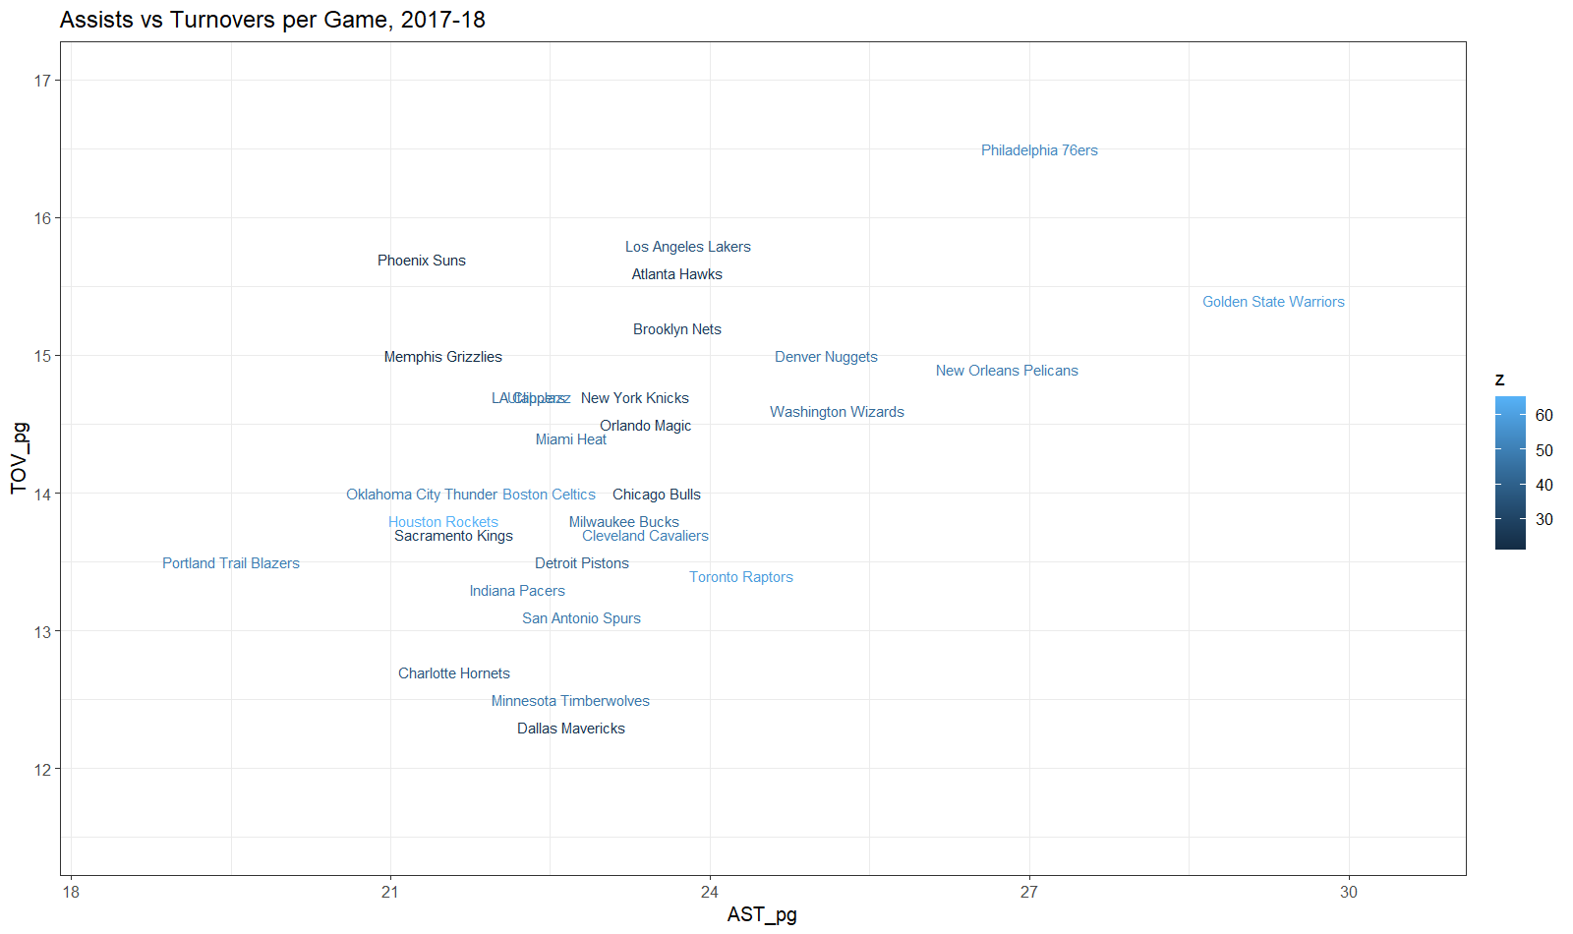
WORKED EXAMPLE, STEP 10
Assists vs. Turnovers, All 30 Teams
scatterplot(), BasketballAnalyzeR, colored by wins (W). Data: Tbox, 2017-18 NBA season.
Notes:
Golden State Warriors led the league in assists per game (29.3) and also won 58 games, but point out this is one data point, not proof of a strong relationship -- the next slide gives the real correlation.

Slide 30
CONCEPT · READING THE NUMBER HONESTLY
Ball Movement Alone Is a Weak Predictor
0.25
-0.15
correlation between assists
per game and wins
correlation between turnovers
per game and wins
Both are far weaker than net rating's 0.96 correlation with wins from Module 2. Reading a team's passing profile tells you how they play, not nearly as much about whether that style wins games.

Slide 31
THROUGHLINE · PLAYER PERFORMANCE ANALYSIS
Describing a Player, Beyond One Box-Score Number
The question:
How do you describe what a specific player or team actually does, not just how much they scored?
Standardized radar profiles, bar-line comparisons, and weighted variability are real tools scouts and analytics departments use to build exactly this kind of description. Module 4 adds one more variable to the profile: where on the court a shot happened.

Slide 32
SUMMARY
What to Carry Forward
Standardizing a variable (z = (x - mean) / sd) puts different-scale stats on one comparable axis, which is what makes a multi-variable profile chart readable.
Radar charts have real, documented critics -- check the z-scores behind a shape before trusting it.
A bar-line chart shows a categorical breakdown and a continuous variable together, without building two separate tables.
Coefficient of variation (CV = sd / mean) measures consistency, not just average -- and weighting by volume changes the answer, sometimes surprisingly.

Slide 33
BEFORE MODULE 04
Two Things Before Next Class
Read
Do
Basketball Data Science, Ch. 2C (shot charts and spatial data).
Complete Lab 3 (player and team profiles), the practice questions, and the Module 3 quiz on D2L.

Slide 34
FULL READING LIST
References Cited Today
Zuccolotto, P., & Manisera, M. (2020). Basketball Data Science: With Applications in R, Ch. 2. Chapman & Hall/CRC.
Whitehead, T. (2017). Nylon Calculus: Bravely staring down the radar chart backlash. FanSided.
BasketballAnalyzeR (R package), radialprofile(), barline(), variability(), scatterplot() functions. Zuccolotto, Manisera & Sandri. CRAN.

Slide 35
See You in Module 04
Shot Charts and Spatial Data

