Slide 1
SPORTS ANALYTICS
Basketball Data Science
Module 04 · Shot Charts and Spatial Data
Week 4
Undergraduate · 3-hour session
Maps to Chapter 2C:
Zuccolotto, P., & Manisera, M. (2020). Basketball Data Science: With Applications in R. Chapman & Hall/CRC.

Slide 2
BEFORE WE START
What's Coming Up
Due This Week
-- update before class --
Coming Up
-- update before class --
Office Hours
-- update before class --

Slide 3
RECAP
Where We Left Off
Module 3 was about putting several numbers on one shared, standardized scale so you could compare a player's or team's whole profile at once, not just one stat at a time. Today we add a variable we have not touched yet: where on the court something happened. Location turns out to be one of the richest variables in the entire sport.
Same real approach as every module so far: real play-by-play data, real coordinates, real teams.

Slide 4
OUTLINE FOR THE DAY
Where We're Headed
I
Segment 1
II
Segment 2
Turning raw shot coordinates into a real shot chart, live
Distance zones, real 2018 playoff data, and the Moreyball question
III
Segment 3
IV
Before Next Class
Two real players, two real shot profiles, side by side
Lab 4, the Module 4 quiz, and the practice questions

Slide 5
LEARNING OBJECTIVES
By the End of Today, You Will Be Able To
1
Explain why shot location is a variable in its own right, not just a detail attached to a make or a miss.
2
Transform raw play-by-play shot coordinates into the half-court, centered format shotchart() requires, and explain why that transformation is necessary.
3
Build a real shot chart from real 2018 playoff data using BasketballAnalyzeR's shotchart() function.
4
Split real shots into four distance zones and compute field goal percentage and points per shot for each one.
5
Explain, using real data you compute yourself, what "Moreyball" means as a shot-selection strategy, not just a nickname.

Slide 6
CONCEPT · SEGMENT 1
One Shooting Percentage Can Hide Two Different Players
A player who shoots 45% overall could be a mediocre three-point shooter carried by a great inside game, or an elite three-point shooter who occasionally forces a bad long two. One number cannot tell these two players apart.
Spatial data -- where a shot came from -- is what lets you tell them apart.

Slide 7
CONCEPT · SEGMENT 1
Real Shots, Real Games: PbP.BDB
Every chart in this module comes from BasketballAnalyzeR's PbP.BDB dataset: real, event-level play-by-play data from the entire 2018 NBA playoffs. 82 real games. 14,354 real field goal attempts. Every shot's exact x-y coordinates, recorded as it happened.
This is playoff data, not a full regular season -- a real, honest fact about the sample we'll return to later in this module.

Slide 8
LET'S WATCH THIS TOGETHER
What Is a Shot Chart, Really?
"NBA Shot Charts: A Basketball Data Visualization" (YouTube)
▶
About 3 minutes. A concept walkthrough of how shot chart visualizations are built and read, before we build our own from real data.

Slide 9
CONCEPT · SEGMENT 1
Why Raw Coordinates Don't Plot Directly
shotchart() expects half-court coordinates centered on the basket, with y always zero or negative. Our real data's converted_x/converted_y columns are full-court coordinates, spanning both baskets, because teams switch ends every other quarter.
So a shot at the "far" basket has to be folded onto the same half-court view as a shot at the "near" basket.

Slide 10
LET'S RUN THIS TOGETHER
Let's build real half-court coordinates together.
Pull up your own session. We'll run it line by line and look at the real output together.

Slide 11
WORKED EXAMPLE, STEP 1
Folding Every Shot Onto One Half-Court
shots <- PbP %>%
filter(event_type %in% c("shot","miss")) %>%
mutate(cx = as.numeric(as.character(converted_x)),
cy = as.numeric(as.character(converted_y))) %>%
mutate(yc = ifelse(cy <= 47, cy - 47, 47 - cy),
xc = ifelse(cy <= 47, cx - 25, 25 - cx))
Run this yourself. Every shot now has an xc/yc pair that shotchart() can actually plot.

Slide 12
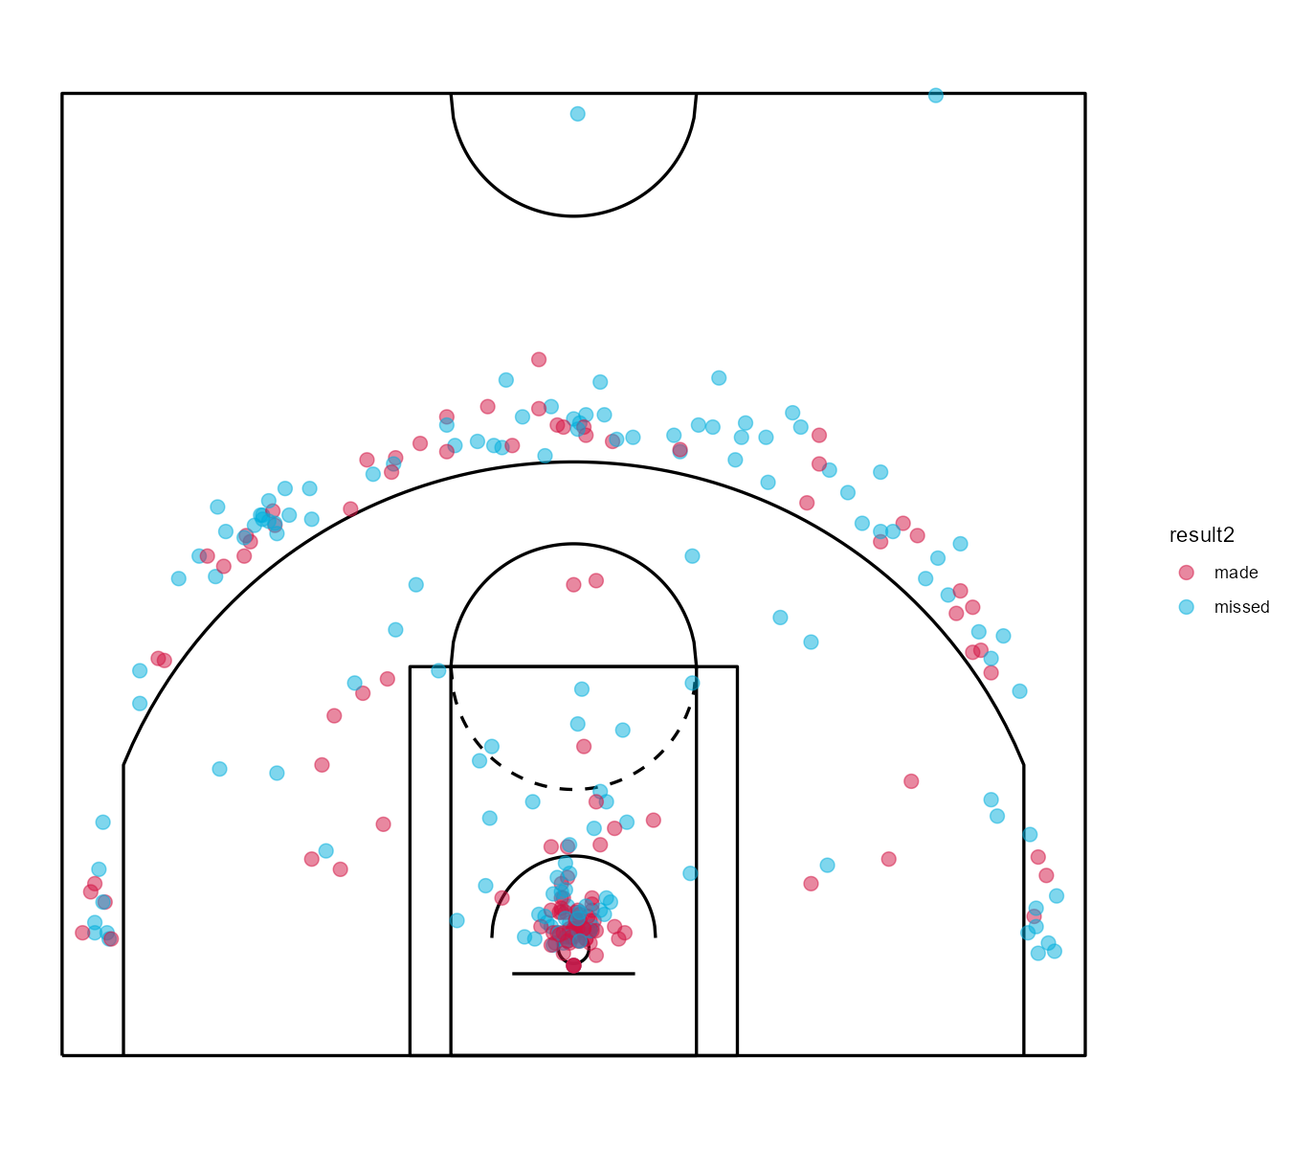
WORKED EXAMPLE, STEP 2
Houston Rockets: 273 Real 2018 Playoff Attempts
shotchart(hou, x="xc", y="yc", z="result2", scatter=TRUE). Data: PbP.BDB, 2018 NBA playoffs.
Notes:
Discussion: ask the class where the makes and misses cluster, before you say anything. Push toward: tight at the rim, and along the three-point arc -- almost nothing in between. Ask why that gap might exist before revealing the zone breakdown in Segment 2.

Slide 13
INTERACTIVE ACTIVITY
Describe What You See, Before I Tell You
Turn to a partner.
1. Where do Houston's makes and misses cluster on the floor?
2. Is there an area of the half-court that looks nearly empty?
3. What would you guess is happening in that empty area, before we compute anything?

Slide 14
LET'S RUN THIS TOGETHER
Now let's see the same shots as a density map.
Pull up your own session. We'll run it line by line and look at the real output together.

Slide 15
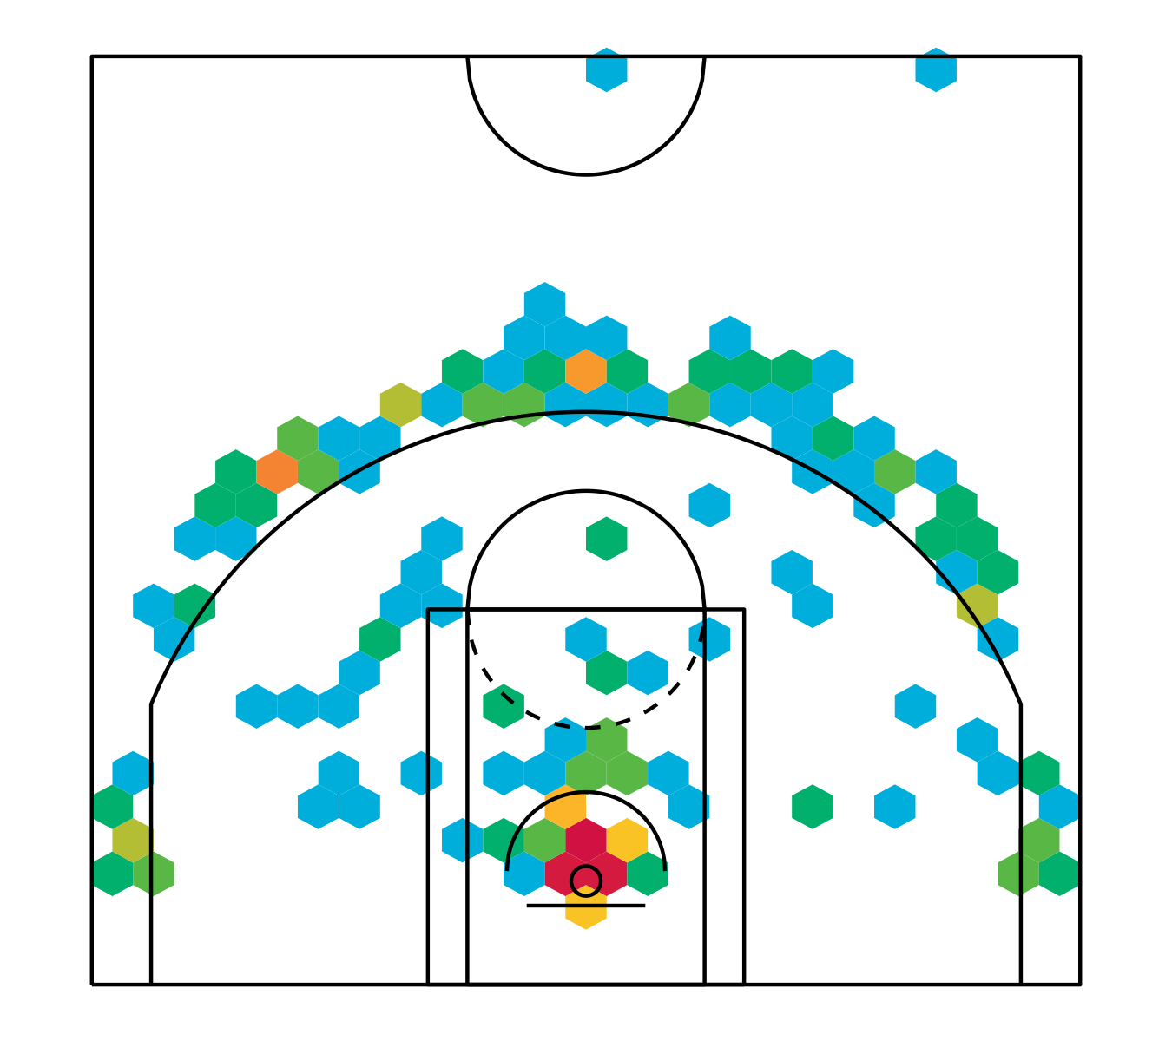
WORKED EXAMPLE, STEP 3
The Same Shots, as a Density Map
shotchart(hou, x="xc", y="yc", type="density-hexbin", nbins=24). Data: PbP.BDB, 2018 NBA playoffs.
Notes:
A density map makes volume easier to read than a scatter of individual dots once you have hundreds of shots. Ask: does this change your answer to the previous slide's question about the 'empty' area of the floor?

Slide 16
RECAP · SEGMENT 1
From Coordinates to a Real Shot Chart
Covered
Next
Why raw coordinates need a half-court transform, and built a real shot chart and density map from Houston's 273 real 2018 playoff attempts.
Segment 2 turns that visual gap in the middle of the floor into a real, computed set of distance zones -- and asks why teams avoid it.

Slide 17
10-Minute Break
Back at the top of the hour. Next: distance zones and Moreyball.

Slide 18
CONCEPT · SEGMENT 2
Turning a Scatter of Dots Into a Comparison
A shot chart is compelling to look at, but it is hard to compare two players or two teams by eye alone. To make a real comparison, this module splits the court into four distance zones, computed directly from each shot's real shot_distance value.
Same habit as every module: turn a picture into a number you can actually compare.

Slide 19
CONCEPT · SEGMENT 2
Four Real Distance Zones
Rim
0-4 feet from the basket.
Short/Mid
5-14 feet -- floaters, short jumpers.
Long Two
15-21 feet -- the mid-range jump shot.
Three
22 feet or more -- behind the arc, no upper bound.
Computed directly from shot_distance in PbP.BDB using case_when() in R.

Slide 20
LET'S RUN THIS TOGETHER
Let's compute the real leaguewide zone table together.
Pull up your own session. We'll run it line by line and look at the real output together.

Slide 21
WORKED EXAMPLE, STEP 4
All 14,354 Real 2018 Playoff Attempts, by Zone
Zone | Attempts | Share | FG%
Rim (0-4 ft) | 4,513 | 31.4% | 64.4%
Short/Mid (5-14 ft) | 2,770 | 19.3% | 41.8%
Long Two (15-21 ft) | 2,128 | 14.8% | 41.7%
Three (22+ ft) | 4,943 | 34.4% | 37.5%
The long two is the smallest share of any zone leaguewide -- only 14.8% of every real attempt.
Data: PbP.BDB, 2018 NBA playoffs, all 30 teams, computed in module4_shot_charts.R.

Slide 22
CONCEPT · THE CORE IDEA OF THIS MODULE
The Long Two Is Disappearing From the Real Game
Why it matters: the long two converts at 41.7%, lower than the rim's 64.4%, and is worth the same two points as a much easier rim shot -- no extra point the way a made three earns.
The takeaway: a shot can have a perfectly respectable field goal percentage and still be a bad shot to take, once you account for what it is worth.
14.8%
of all real 2018 playoff
attempts came from the
long two -- the smallest
share of any zone
Notes:
Discussion: ask why a 41.7% shot could be worse than a 37.5% shot. Push toward points per shot: 0.834 expected points for the long two (0.417 x 2) versus 1.125 for the three (0.375 x 3). Timing: about 5 minutes.

Slide 23
CONCEPT · SEGMENT 2
Field Goal Percentage Is Not the Whole Story
Points per shot (PPS) accounts for both whether a shot goes in and how many points it is worth when it does. A zone can have a lower field goal percentage than another zone and still be the better zone to shoot from, once the extra point from three is priced in.
PPS = FG% × points per make (2 or 3).

Slide 24
WORKED EXAMPLE, STEP 5
Points Per Shot, Rim vs. Long Two vs. Three
Zone | FG% | Points Per Make | Points Per Shot
Rim (0-4 ft) | 64.4% | 2 | 1.29
Long Two (15-21 ft) | 41.7% | 2 | 0.83
Three (22+ ft) | 37.5% | 3 | 1.13
Even with the lowest field goal percentage of the three, the three-point shot beats the long two on real expected value.
Points per shot computed from the leaguewide zone table, PbP.BDB, 2018 NBA playoffs.

Slide 25
LET'S WATCH THIS TOGETHER
Seeing a Three-Heavy Attack in Real Game Footage
"Stephen Curry Full Game 1 Highlights vs Cavaliers, 2018 NBA Finals -- 29 Pts, 9 Ast, CLUTCH!" (YouTube)
▶
Real footage from the same 2018 postseason our data comes from. Watch for how many of Golden State's shots come from the rim or from three.

Slide 26
CONCEPT · SEGMENT 2
"Moreyball": A Real Shot-Selection Strategy
Houston Rockets general manager Daryl Morey built his roster and offense around one real, data-driven principle: take shots at the rim or from three, and avoid the long two whenever a better option exists. Reporters and fans nicknamed this "Moreyball." It is not just a nickname -- it is a real, testable shot-selection pattern, and this module's zone tables let us test it directly.

Slide 27
LET'S RUN THIS TOGETHER
Let's test Moreyball on two real teams together.
Pull up your own session. We'll run it line by line and look at the real output together.

Slide 28
WORKED EXAMPLE, STEP 6
Two Real 2018 Playoff Teams, Zone by Zone
Zone | HOU Share | HOU FG% | CLE Share | CLE FG%
Rim | 35.5% | 67.0% | 28.6% | 53.8%
Short/Mid | 10.6% | 37.9% | 22.5% | 34.1%
Long Two | 6.2% | 47.1% | 11.5% | 19.0%
Three | 47.6% | 35.4% | 37.4% | 36.8%
Data: PbP.BDB, 2018 NBA playoffs. Houston Rockets (273 real attempts) vs. Cleveland Cavaliers.

Slide 29
CONCEPT · READING THE REAL NUMBERS
Moreyball, Confirmed by the Real Data
82.2%
66.0%
of Houston's real shots came
from the rim or from three
of Cleveland's real shots came
from the rim or from three
Rim share + three share, each team, PbP.BDB 2018 playoffs.
Notes:
Discussion: this is a real, measurable 16-point gap between two 2018 playoff teams. Ask: does this prove Houston's approach is 'correct'? Push toward: it shows the strategy is real and measurable, not that it guarantees winning -- Cleveland reached the Finals that same year.

Slide 30
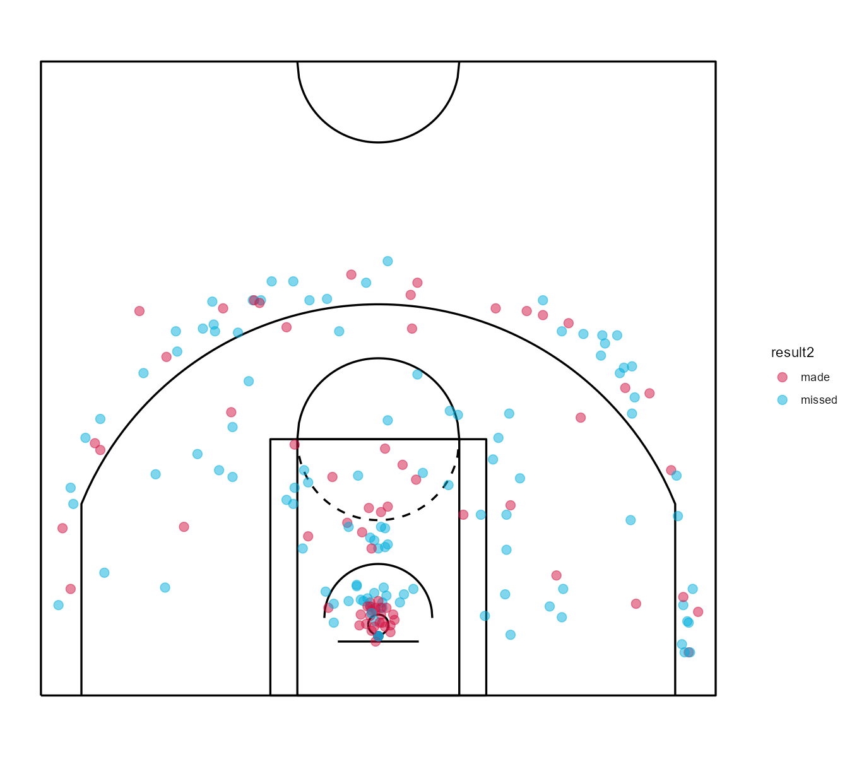
WORKED EXAMPLE, STEP 7
Cleveland Cavaliers: a More Spread-Out Real Profile
shotchart(cle, x="xc", y="yc", z="result2", scatter=TRUE). Data: PbP.BDB, 2018 NBA playoffs.

Slide 31
INTERACTIVE ACTIVITY
Test Moreyball on a Team I Assign You
Get into groups of 3-4. I'll assign your group one more real 2018 playoff team.
1. Build that team's real zone table using the same code we just ran.
2. Compute their combined rim-plus-three share.
3. Does your team look more like Houston's profile or Cleveland's? Be ready to report your number to the class.

Slide 32
RECAP · SEGMENT 2
Zones and Moreyball, Covered
Covered
Next
Four real distance zones, points per shot versus field goal percentage, and a real, measurable comparison between Houston's and Cleveland's 2018 shot profiles.
Segment 3 moves from team-level shot selection down to two real, individual players.

Slide 33
10-Minute Break
Back at the top of the hour. Next: two real players, side by side.

Slide 34
CONCEPT · SEGMENT 3
The Same Zone Thinking, One Player at a Time
Everything we just did at the team level works identically for one player. Filter the real shot data to one player's real attempts, and you get their own shot chart and their own zone table -- their real shot selection, not their team's.

Slide 35
LET'S RUN THIS TOGETHER
Let's pull two real players' shots and chart them.
Pull up your own session. We'll run it line by line and look at the real output together.

Slide 36
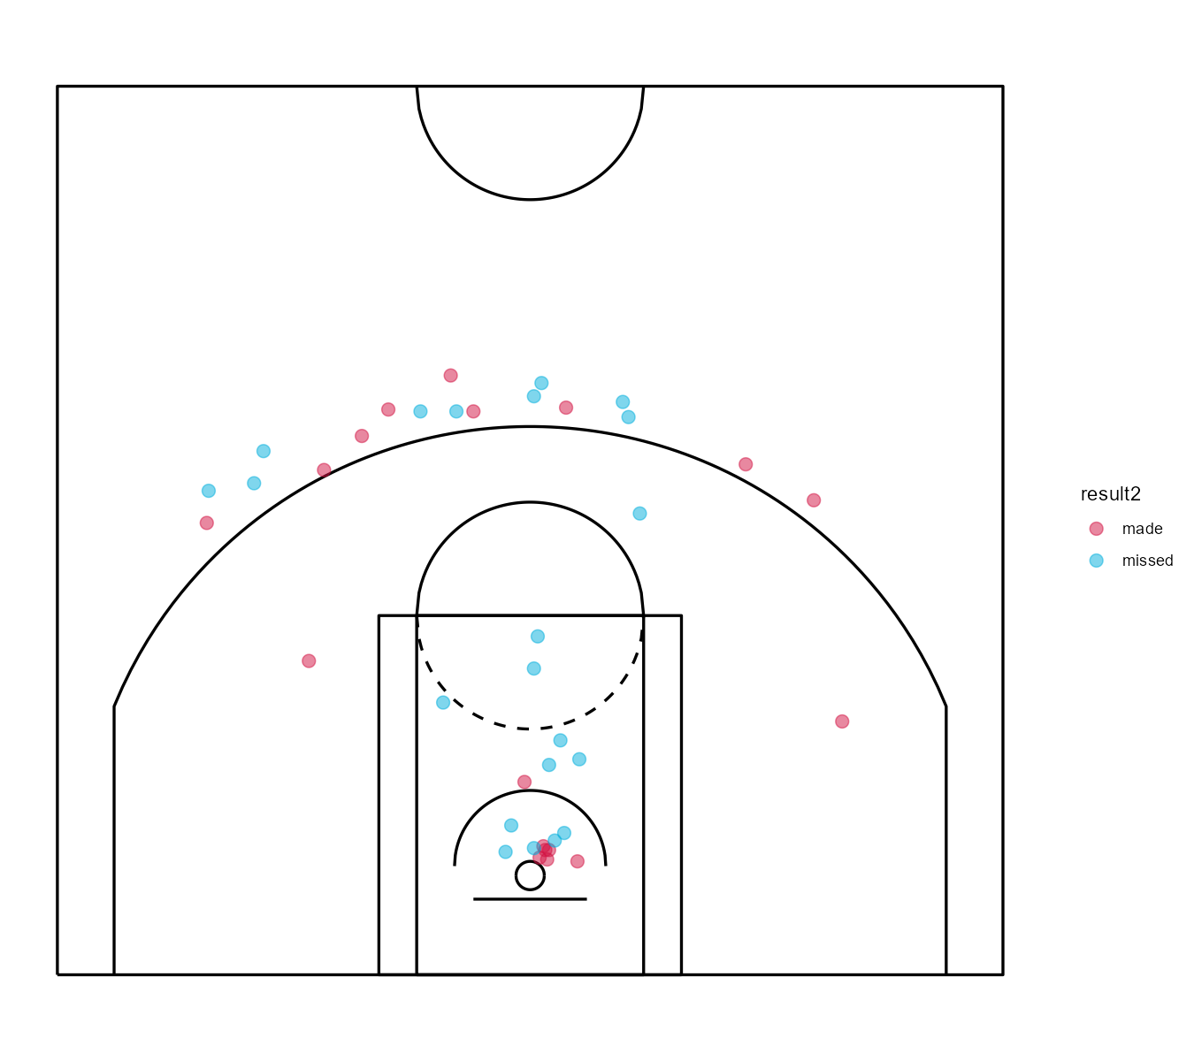
WORKED EXAMPLE, STEP 8
James Harden: 39 Real Attempts vs. Cleveland
Data: PbP.BDB, 2018 NBA playoffs, Houston vs. Cleveland.

Slide 37
WORKED EXAMPLE, STEP 9
James Harden's Real Zone Breakdown
Zone | Share | FG%
Rim | 28.2% | 54.5%
Short/Mid | 17.9% | 14.3%
Long Two | 7.7% | 66.7%
Three | 46.2% | 50.0%
Overall field goal percentage: 46.2%. Notice how little that one number tells you on its own.

Slide 38
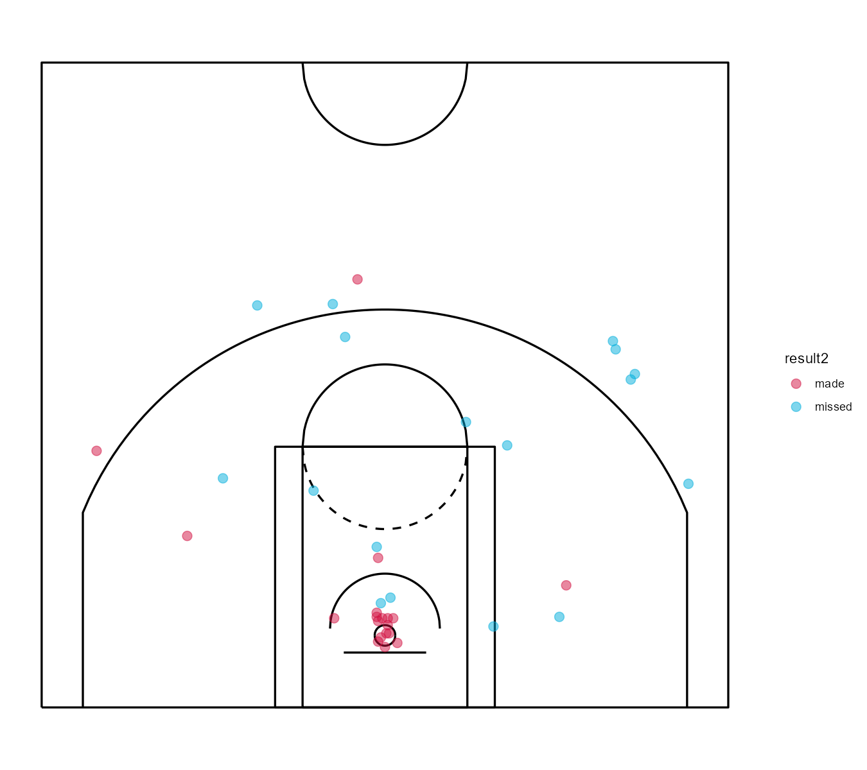
WORKED EXAMPLE, STEP 10
LeBron James: 36 Real Attempts vs. Houston
Data: PbP.BDB, 2018 NBA playoffs, Cleveland vs. Houston.

Slide 39
WORKED EXAMPLE, STEP 11
LeBron James's Real Zone Breakdown
Zone | Share | FG%
Rim | 44.4% | 87.5%
Short/Mid | 16.7% | 33.3%
Long Two | 11.1% | 25.0%
Three | 27.8% | 20.0%
Overall field goal percentage: 52.8%. A very different real shot profile from Harden's.

Slide 40
CONCEPT · ONE REAL NUMBER WORTH PAUSING ON
87.5% at the Rim, in Real Playoff Minutes
For context: the leaguewide rim average across the entire 2018 playoffs was 64.4%. LeBron's real sample here is well above that.
Worth naming: this is a real but small sample (16 total rim attempts). A single hot or cold stretch can move a percentage like this a lot -- always check the attempt count.
87.5%
LeBron James's real
field goal percentage
at the rim in this sample

Slide 41
CONCEPT · SEGMENT 3
Reading a Shot Chart Honestly
A shot chart with a lot of dots clustered at the rim looks impressive. But a cluster built from twelve total attempts tells a very different, far less reliable story than the same-looking cluster built from two hundred real attempts across a full season.
Always check the real attempt count behind a visually striking cluster before you trust it.

Slide 42
THROUGHLINE · POSITIONING & SHIFTING
Location Is the Foundation of Spatial Analytics
The question:
Where did this happen on the floor, and how does that change what the number means?
Shot location is the most direct, literal form of positioning data in this course. Every later spatial technique builds on it: Module 6 studies event density and shooting under defensive pressure using this same coordinate data, and Module 8 fits a regression model of scoring probability by location.
Morey, D. (Houston Rockets front office philosophy, widely reported since the mid-2010s).

Slide 43
PRACTICE
One More Real Chart, On Your Own
Look back at Cleveland's shot chart from Segment 2.
1. Compare it, by eye, to Houston's chart from Segment 1.
2. Which chart has more shots in the middle of the floor?
3. Does that match the real zone table numbers we computed?

Slide 44
INTERACTIVE ACTIVITY
A Broadcast Scout vs. a Front-Office Analyst
Broadcast Scout
Front-Office Analyst
Is scouting one upcoming playoff opponent and has one afternoon. Which of today's tools -- shot chart or zone table -- gets them a usable answer fastest?
Is deciding whether to build next year's roster around a Moreyball-style offense. Which of today's real numbers matters most to that decision?

Slide 45
RECAP · SEGMENT 3
Two Real Players, Two Real Profiles
Covered
Next
Built real shot charts and zone tables for James Harden and LeBron James, and practiced reading a shot chart honestly, attempt counts and all.
Module 5 moves from one variable at a time (location) into correlation and player networks -- how players' real numbers relate to each other.

Slide 46
SUMMARY
What to Carry Forward
Shot location is its own variable -- spatial data lets you break a single shooting percentage apart by where it actually happened.
Points per shot (0.83 for the long two vs. 1.13 for three, in real 2018 playoff data) can rank two zones in the opposite order that field goal percentage alone would suggest.
"Moreyball" is a real, measurable pattern: Houston's real 82.2% rim-plus-three share versus Cleveland's 66.0% is direct evidence of two different real shot-selection philosophies.
Every number in this module came from PbP.BDB, real 2018 NBA playoff play-by-play data, reproducible by anyone who runs the script.

Slide 47
BEFORE MODULE 05
Two Things Before Next Class
Read
Do
Basketball Data Science, Ch. 3 (the first half, on correlation and player networks).
Complete Lab 4 (shot charts and spatial data), the practice questions, and the Module 4 quiz on D2L.

Slide 48
FULL READING LIST
References Cited Today
Zuccolotto, P., & Manisera, M. (2020). Basketball Data Science: With Applications in R, Ch. 2. Chapman & Hall/CRC.
Zuccolotto, Manisera & Sandri. BasketballAnalyzeR (R package), shotchart() function and the PbP.BDB dataset (2017-18 NBA playoffs). CRAN.
Digital Innovation and Transformation, Harvard Business School (2023). "Houston Rockets and 'Moreyball.'"

Slide 49
See You in Module 05
Discovering Patterns: Correlation and Player Networks

