Slide 1
SPORTS ANALYTICS
Basketball Data Science
Module 02 · Pace, Ratings, and the Four Factors
Week 2
Undergraduate · 3-hour session
Maps to Chapter 2A:
Zuccolotto, P., & Manisera, M. (2020). Basketball Data Science: With Applications in R. Chapman & Hall/CRC.

Slide 2
RECAP
Where We Left Off
Module 1 made one point over and over: a descriptive number, on its own, is not an evaluation. Points per game correlated with wins at about 0.70 across the 2017-18 season, but plenty was still missing from that one number -- pace, defense, and schedule, to name three. Today we build the tools that actually account for those gaps.
Same textbook, same real 2017-18 data, same BasketballAnalyzeR package.

Slide 3
OUTLINE FOR THE DAY
Where We're Headed
I
Segment 1
II
Segment 2
Pace and ratings: putting every team's raw stats on the same clock (~50 min)
Dean Oliver's Four Factors, computed on real data in small groups (~50 min)
III
Segment 3
IV
Before Next Class
Net rating, the whole-league picture, and one team case study (~50 min)
Lab 2, the Module 2 quiz, and the practice questions

Slide 4
LEARNING OBJECTIVES
By the End of Today, You Will Be Able To
1
Explain what pace measures and why you need both a team's box score and its opponents' to compute it.
2
Compute offensive and defensive rating from real team data and explain why they beat raw scoring averages.
3
Name Dean Oliver's Four Factors, define each one, and state his original relative weighting.
4
Compute all four factors, offense and defense, for every NBA team using BasketballAnalyzeR's fourfactors() function.
5
Explain, using a real correlation you compute yourself, why net rating predicts wins better than any single factor.

Slide 5
CONCEPT · SEGMENT 1
Same Points, Different Number of Chances
A team that scores 110 points a game by playing fast is not automatically a better offense than a team that scores 105 a game slowly. Before comparing any two teams on offense or defense, you first have to know how many possessions each one actually used.
That's what pace measures.

Slide 6
CONCEPT · SEGMENT 1
Pace: Possessions Per 48 Minutes
A possession ends with a make, a defensive rebound, a turnover, or the end of a free-throw trip. Because a possession is only fully defined by what BOTH teams did, computing pace correctly requires a team's own box score AND its opponents' box score together.
This is exactly why BasketballAnalyzeR's fourfactors() function takes two arguments: TEAM and OPP.

Slide 7
WORKED EXAMPLE, STEP 1
Computing Pace and the Four Factors
library(BasketballAnalyzeR)
data(Tbox)
data(Obox)
FF <- fourfactors(Tbox, Obox)
FF$Team <- Tbox$Team
FF$W <- Tbox$W
FF$Pace48 <- round(FF$PACE.Off * 48, 1)
FF[order(-FF$Pace48), c("Team","Pace48","W")][1:5, ]
Run this yourself. You should get the same table on the next slide.

Slide 8
WORKED EXAMPLE, STEP 2
The Five Fastest Teams, 2017-18
Team | Pace (per 48 min) | Wins
Phoenix Suns | 102.9 | 21
Los Angeles Lakers | 102.6 | 35
New Orleans Pelicans | 102.3 | 48
Philadelphia 76ers | 101.7 | 52
Brooklyn Nets | 101.3 | 28
League average pace was 99.6 possessions per 48 minutes, ranging from 97.1 to 102.9 across all 30 teams. Notice the fastest teams span the entire standings, from 21 wins to 52 wins.
Data: fourfactors(Tbox, Obox), BasketballAnalyzeR (Zuccolotto & Manisera, 2020).

Slide 9
CONCEPT · SEGMENT 1
Ratings: Points Per 100 Possessions
Once you know how many possessions a team used, you can ask a fairer question than "how many points did they score": how many points did they score per possession? Offensive rating (ORtg) and defensive rating (DRtg) scale this to points per 100 possessions.
Same idea as pace: this puts every team's offense and defense on the same footing, regardless of how fast they play.

Slide 10
WORKED EXAMPLE, STEP 3
Best Offenses and Best Defenses, 2017-18
Top 5 Offensive Rating
Top 5 Defensive Rating (lowest)
Team | ORtg
Golden State Warriors | 112.3
Houston Rockets | 112.2
Toronto Raptors | 111.0
Minnesota Timberwolves | 110.8
Cleveland Cavaliers | 110.6
Team | DRtg
Boston Celtics | 101.5
Utah Jazz | 101.6
Philadelphia 76ers | 102.0
San Antonio Spurs | 102.5
Toronto Raptors | 103.4
The Toronto Raptors show up on both lists -- exactly what you would expect from a 59-win team.
Data: fourfactors(Tbox, Obox), BasketballAnalyzeR (Zuccolotto & Manisera, 2020).

Slide 11
CONCEPT · THE CORE IDEA OF THIS MODULE
Net Rating Beats Any Single Shooting Stat
Compare that to: effective field goal percentage alone correlates with wins at only 0.77.
Why the gap: net rating combines both ends of the floor and reflects everything that contributes to scoring and preventing points, not just one dimension of performance.
0.96
correlation between net rating
(ORtg minus DRtg) and wins,
across all 30 teams
Computed with cor() in R on the real fourfactors(Tbox, Obox) output.

Slide 12
INTERACTIVE ACTIVITY (10 MIN)
Does Playing Fast Mean Winning More?
Look back at the pace table from Step 2. The five fastest teams ranged from 21 wins to 52 wins.
1. Based on that alone, does pace predict winning?
2. What would you need to know about a team, beyond its pace, before saying whether playing fast is working for them?

Slide 13
RECAP · SEGMENT 1
Pace and Ratings, Covered
Covered
Next
Pace puts every team's raw stats on the same clock. Ratings put scoring and defense on a per-possession basis. Net rating already beats any single shooting stat at predicting wins.
Segment 2 breaks net rating apart into Dean Oliver's Four Factors, and you'll compute them yourselves in small groups.

Slide 14
10-Minute Break
Back at the top of the hour. Next: Dean Oliver's Four Factors.

Slide 15
CONCEPT · SEGMENT 2
Dean Oliver's Four Factors
Basketball on Paper (2004)
Oliver's Weights
Dean Oliver, the NBA's first full-time analyst (hired by Seattle in 2004), broke offensive performance into four measurable factors and proposed a rough weighting for how much each matters.
Shooting: 40%
Turnovers: 25%
Rebounding: 20%
Free Throw Rate: 15%
The same four factors apply to defense, using what a team allows instead of what it does.

Slide 16
CONCEPT · SEGMENT 2
The Four Factors, Defined
eFG%
Effective field goal %. Shooting efficiency, adjusted so a three-pointer counts for more than a two-pointer.
TOV rate
Turnover rate. Turnovers as a share of possessions used -- possessions given away for free.
ORB / DRB rate
Rebound rate. The share of available rebounds a team actually grabs, on offense or defense.
FT rate
Free throw rate. How often a team gets to the line relative to its field goal attempts.
fourfactors(Tbox, Obox) returns all eight of these (four offensive, four defensive) in one call.

Slide 17
WORKED EXAMPLE, STEP 4
Which Factor Matters Most, In This Data?
c(
eFG = cor(FF$F1.Off, FF$W),
TOVrate = cor(FF$F2.Off, FF$W),
ORBrate = cor(FF$F3.Off, FF$W),
FTrate = cor(FF$F4.Off, FF$W)
)
Run this in your small group for the offensive factors, then again with F1.Def through F4.Def for the defensive factors.

Slide 18
WORKED EXAMPLE, STEP 5
The Four Offensive Factors, Ranked by Wins Correlation
Factor | Correlation with Wins
Effective field goal % (eFG%) | 0.769
Free throw rate | 0.397
Offensive rebound rate | 0.251
Turnover rate | -0.143
Shooting efficiency comes out on top, matching Oliver's 40% weight. But turnover rate -- weighted second-highest by Oliver at 25% -- barely correlates with wins at all in this specific season.
Data: fourfactors(Tbox, Obox), 2017-18 NBA season, BasketballAnalyzeR.

Slide 19
CONCEPT · READING THE NUMBER HONESTLY
A Framework's Weights Don't Have to Match Reality
This is not an error. Oliver's weights came from a different era of data. A framework proposed once does not automatically hold in every season or league.
The habit to build: check a rule of thumb against the data in front of you, every time, rather than repeating it from memory.
-0.14
correlation between turnover
rate and wins, this season --
weaker than the 25% weight
Oliver assigned it

Slide 20
INTERACTIVE ACTIVITY (20 MIN · SMALL GROUPS)
Give Two Teams a Statistical Identity
In groups of 3-4, your instructor will assign your group two teams from FF$Team.
1. Pull each team's full row of offensive and defensive factors.
2. Write one sentence per team describing its identity as a team, based only on the numbers.
3. Be ready to report your two teams and their win totals to the class.

Slide 21
RECAP · SEGMENT 2
The Four Factors, Covered
Covered
Next
Oliver's Four Factors and his original weighting. Computed and ranked all four offensive factors by their real correlation with wins, and found one surprise along the way.
Segment 3 puts pace, ratings, and the Four Factors together in one team's full profile, and looks at the whole league at once.

Slide 22
10-Minute Break
Back at the top of the hour. Next: one team, all the way through.

Slide 23
CASE STUDY · SEGMENT 3
One Team, All the Way Through: Houston Rockets
Wins
65 (most in the league)
eFG%
55.1%
Pace
99.7 possessions per 48 min (about league average)
Turnover rate
13.8%
Offensive Rating
112.2 (2nd in the league)
Offensive rebound rate
21.3%
Defensive Rating
103.8 (middle of the pack)
Free throw rate
23.3%
Data: fourfactors(Tbox, Obox), 2017-18 NBA season, BasketballAnalyzeR. No single factor made this team -- the combination did.

Slide 24
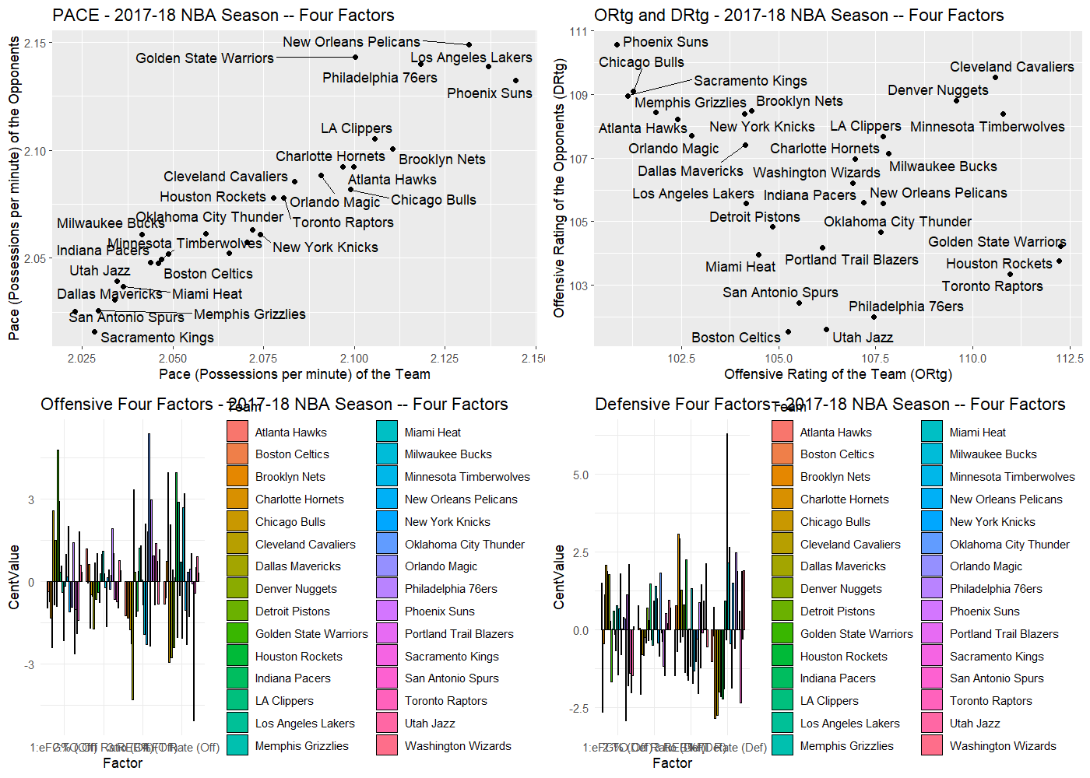
WORKED EXAMPLE, STEP 6
All 30 Teams, Four Panels at Once
plot(FF), BasketballAnalyzeR's built-in Four Factors chart. Data: fourfactors(Tbox, Obox), 2017-18 NBA season.

Slide 25
THROUGHLINE · GAME ANALYSIS
Reading Why a Team Won or Lost
The question:
Reading a team's real data to explain what actually happened, not just reporting the final score.
Pace, ratings, and the Four Factors are the standard toolkit NBA front offices and broadcast analysts use to explain a team's season, one possession-based number at a time, rather than pointing at the scoreboard alone. Module 6 goes further, into event-level and clutch-time game analysis.
Oliver, D. (2004). Basketball on Paper. Potomac Books.

Slide 26
PRACTICE (5 MIN)
Read the Four-Panel Chart Yourself
Look back at the plot(FF) chart.
1. Pick one team and find it in all four panels.
2. In one sentence, describe that team's identity: fast or slow, efficient or not, strong or weak on the boards.
3. Does your one-sentence identity match their actual win total?

Slide 27
INTERACTIVE ACTIVITY (10 MIN)
A Broadcast Analyst vs. a Front-Office Analyst
Broadcast Analyst
Front-Office Analyst
Has one game, live, and needs a number the audience can understand in seconds. Which of today's numbers works for that, and which doesn't?
Has a full season of data and needs to explain why a trade or lineup change would help. Which of today's numbers works best for that, and why?

Slide 28
RECAP · SEGMENT 3
Everything, Together
Covered
Next
Walked one real team (Houston Rockets) through pace, ratings, and all four factors, then saw the whole league at once in a single chart.
Module 3 moves from single-number summaries to visualizing entire team and player profiles side by side.

Slide 29
SUMMARY
What to Carry Forward
Pace and ratings put every team's offense and defense on the same, fair footing.
Net rating (ORtg minus DRtg) predicts wins far better than any single factor -- 0.96 versus 0.77 for shooting alone, in this real season.
Dean Oliver's Four Factors break performance into shooting, turnovers, rebounding, and free throw rate -- but his original weights do not always match a given season's real data, and that's worth checking, not assuming.
Every number in this module came from fourfactors(Tbox, Obox), reproducible by anyone who runs the script.

Slide 30
BEFORE MODULE 03
Two Things Before Next Class
Read
Do
Basketball Data Science, Ch. 2 (the second half, on comparison plots and visualizing team and player profiles).
Complete Lab 2 (Four Factors and team ratings), the practice questions, and the Module 2 quiz on D2L.

Slide 31
FULL READING LIST
References Cited Today
Zuccolotto, P., & Manisera, M. (2020). Basketball Data Science: With Applications in R, Ch. 2. Chapman & Hall/CRC.
Oliver, D. (2004). Basketball on Paper: Rules and Tools for Performance Analysis. Potomac Books.
BasketballAnalyzeR (R package), fourfactors() function. Zuccolotto, Manisera & Sandri. CRAN.
Wikipedia contributors. Three-point revolution. Background on NBA pace and shot-selection trends.

Slide 32
See You in Module 03
Visualizing Team and Player Profiles

