Slide 1
SPORTS ANALYTICS
Basketball Data Science
Module 06 · Event Density and Shooting Under Pressure
Week 6
Undergraduate · 3-hour session
Maps to Chapter 3B:
Zuccolotto, P., & Manisera, M. (2020). Basketball Data Science: With Applications in R. Chapman & Hall/CRC.

Slide 2
BEFORE WE START
What's Coming Up
Due This Week
-- update before class --
Coming Up
-- update before class --
Office Hours
-- update before class --

Slide 3
RECAP
Where We Left Off
Module 5 asked how box score stats and players relate to each other, using a real correlation matrix and real assist networks built from season-long totals. Both of those tools flatten time out of the picture. Today we put time back in and ask whether when a shot happens changes how likely it is to go in.
Same textbook, same real play-by-play data, same BasketballAnalyzeR package.

Slide 4
OUTLINE FOR THE DAY
Where We're Headed
I
Segment 1
II
Segment 2
Event density: where shot attempts pile up across the shot clock
Turning "late in the clock" into a real, computed pressure number
III
Segment 3
IV
Before Next Class
Clutch time: real game-pressure shooting and who takes those shots
Lab 6, the Module 6 quiz, and the practice questions

Slide 5
LEARNING OBJECTIVES
By the End of Today, You Will Be Able To
1
Explain what an event density plot shows and build one from real play-by-play data with densityplot().
2
Define shot-clock pressure using playlength and compute real field goal percentage across pressure buckets.
3
Apply the NBA's own real clutch-time definition to play-by-play data and compute a real clutch shooting split.
4
Read a real player-level clutch attempts table and reason about volume versus efficiency under pressure.
5
Explain why a lower shooting percentage under pressure does not, by itself, prove a player performs worse when it counts.

Slide 6
CONCEPT · SEGMENT 1
A Shot Is Not Just a Shot
Every tool we've used so far, box score totals, ratings, correlations, assist networks, treats every shot the same regardless of when it happened. A wide-open shot 4 seconds into a possession gets averaged in with a rushed, contested shot with 1 second left on the clock. That hides something real.
Today's question: does when a shot happens change how likely it is to go in?

Slide 7
CONCEPT · SEGMENT 1
Event Density: Where the Action Piles Up
An event density plot smooths real event counts (like every field goal attempt) into a curve over a time variable. Instead of one average number, it shows you the whole shape: where events cluster, where they thin out, and whether there's a second cluster you would have missed.
BasketballAnalyzeR::densityplot(data, var, shot.type) builds this directly from real play-by-play data.

Slide 8
WATCH FIRST
See It Before You Calculate It
Every Iconic NBA Buzzer Beater Explained in 1 Minutes
RULES (YouTube)
A short highlight reel of real shot-clock and game-clock buzzer beaters. Watch for what the player's decision-making looks like when the clock is the real constraint, not just a number on a slide.
https://www.youtube.com/watch?v=ookQ-WD7ZM0
Notes:
Play the clip if internet allows. Ask: what do these shots have in common physically (rushed release, off-balance, contested)? That's the real behavior behind the late-clock bucket we build next.

Slide 9
LET'S RUN THIS TOGETHER
Let's build a real density plot together.
Pull up your own session. We'll run it line by line and look at the real output together.

Slide 10
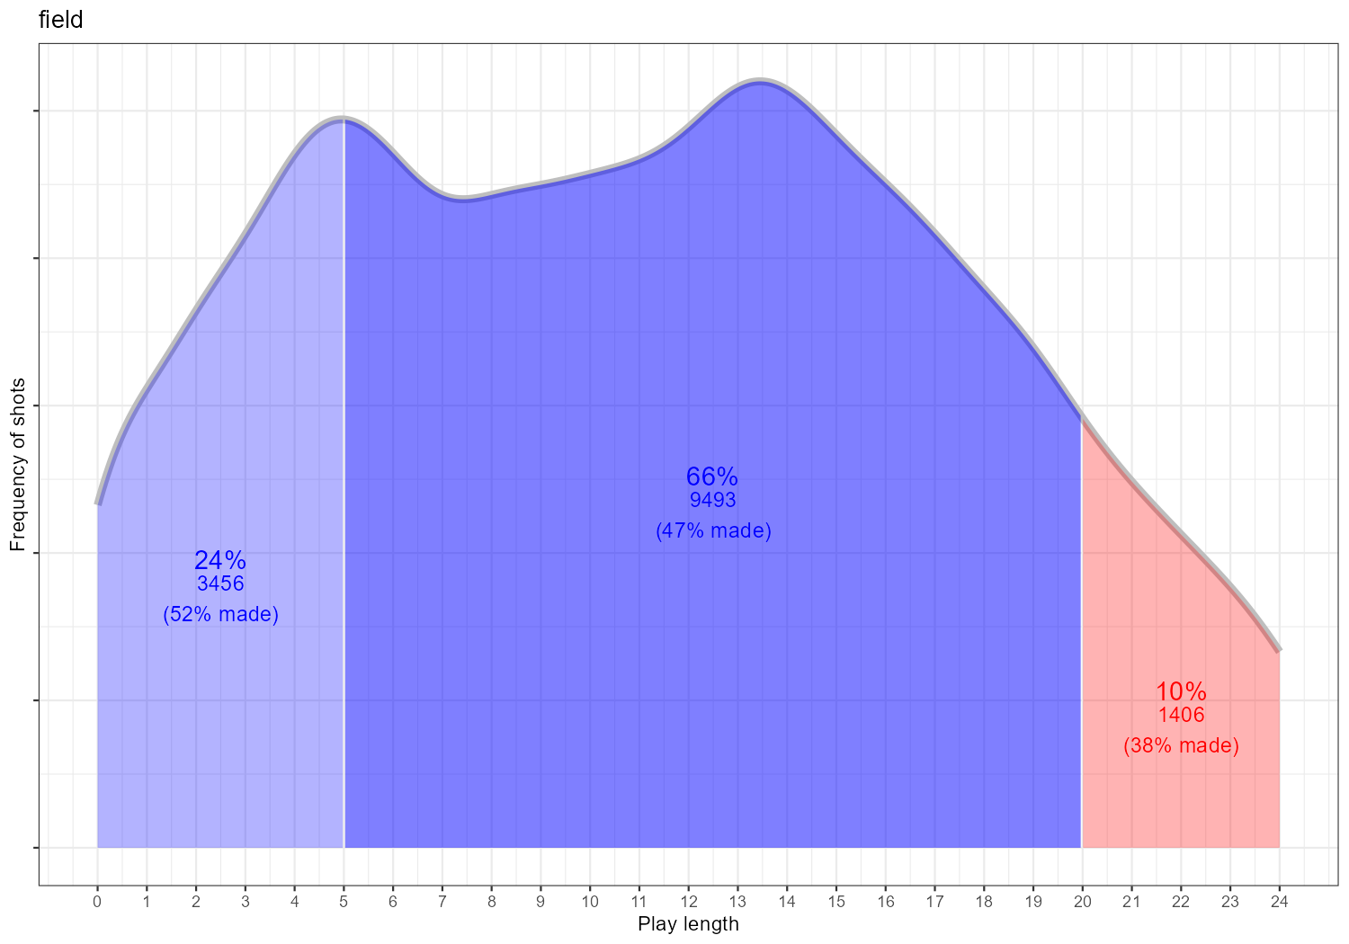
WORKED EXAMPLE, STEP 1
Real Shot Density Across the Shot Clock
densityplot(FG, var="playlength", shot.type="field"). Data: PbP.BDB, 14,355 real field goal attempts, BasketballAnalyzeR.
Notes:
Discussion: where does the curve peak? Point out the smaller second cluster later in the clock. Ask the class what real possession behavior produces that second bump (broken plays, late kick-outs, shot-clock violations narrowly avoided).

Slide 11
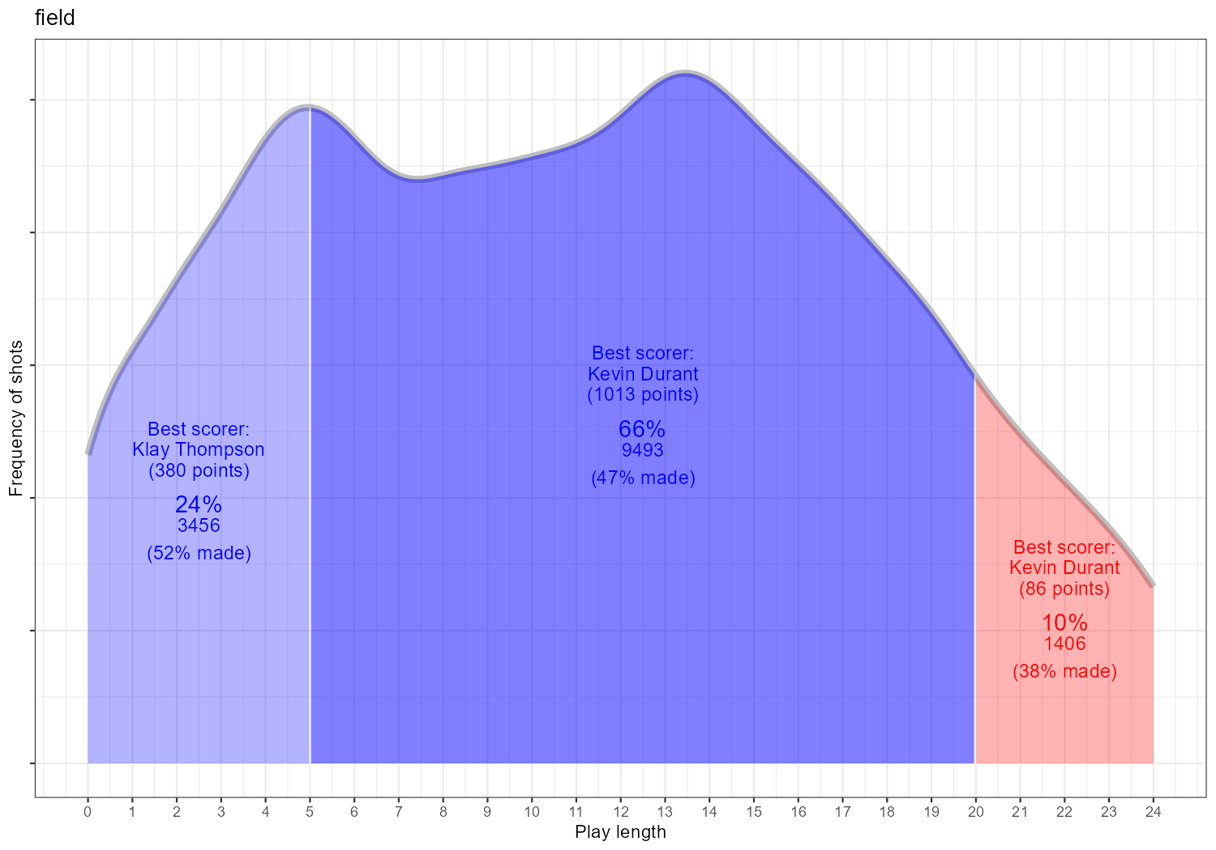
WORKED EXAMPLE, STEP 2
Who Is Taking the Highest-Density Shots?
densityplot(FG, var="playlength", shot.type="field", best.scorer=TRUE). Data: PbP.BDB, BasketballAnalyzeR.
Notes:
Discussion: the best.scorer overlay labels the leading scorer in each time interval. Ask whether the same player shows up across multiple intervals, and what that implies about a team's offensive role structure.

Slide 12
INTERACTIVE ACTIVITY
Read the Curve With a Partner
Turn to the person next to you and look back at the density plot.
1. Where does the curve peak, and what does that tell you about when most shots happen in a possession?
2. Point to the smaller late-clock bump. Name one real, specific in-game situation that could produce it.

Slide 13
RECAP · SEGMENT 1
Event Density, Covered
Covered
Next
Built a real density plot of field goal attempts across the shot clock and found a second, later cluster beyond the early peak.
Segment 2 turns that late-clock cluster into a real, computed shooting percentage question.

Slide 14
10-Minute Break
Back at the top of the hour. Next: turning "late in the clock" into a real number.

Slide 15
CONCEPT · SEGMENT 2
Three Real Shot-Clock Buckets
Early clock
playlength < 12 seconds elapsed
Mid clock
playlength 12-17 seconds elapsed
Late clock, high pressure
playlength 18+ seconds elapsed

Slide 16
LET'S RUN THIS TOGETHER
Let's build the real shot-clock pressure table together.
Pull up your own session. We'll run it line by line and look at the real output together.

Slide 17
WORKED EXAMPLE, STEP 3
Real Field Goal Percentage by Shot-Clock Bucket
Shot-clock bucket | Attempts | Makes | FG%
Early clock (<12s elapsed) | 7,346 | 3,643 | 49.6%
Mid clock (12-17s elapsed) | 4,157 | 1,952 | 47.0%
Late clock, high pressure (18s+) | 2,852 | 1,210 | 42.4%
Every real field goal attempt in PbP.BDB, split by seconds elapsed in the possession when the shot was taken.
Data: PbP.BDB, 14,355 real field goal attempts, BasketballAnalyzeR.
Notes:
Discussion: ask the class to name the size of the drop (7.2 points) before you show the next slide. Push on whether this alone proves pressure causes worse shooting, or whether shot quality could be confounded with clock time.

Slide 18
CONCEPT · THE CORE NUMBER OF THIS SEGMENT
A Real 7.2 Point Drop
What this does NOT prove: that the clock itself causes worse shooting. Late-clock shots are also more likely to come from a broken play, not a designed one.
What it does show: real, measurable evidence that pressure situations and shot quality move together, worth investigating further.
-7.2
percentage points, real FG%,
early clock (49.6%) to
late clock (42.4%)

Slide 19
LET'S RUN THIS TOGETHER
Now let's isolate three-point shooting the same way.
Pull up your own session. We'll run it line by line and look at the real output together.

Slide 20
WORKED EXAMPLE, STEP 4
Three-Point Shooting by Shot-Clock Bucket
Shot-clock bucket | Attempts | Makes | 3P%
Early clock (<12s elapsed) | 2,542 | 943 | 37.1%
Mid clock (12-17s elapsed) | 1,300 | 529 | 40.7%
Late clock, high pressure (18s+) | 918 | 307 | 33.4%
Notice this pattern is not a straight line down. Mid clock is the best three-point bucket, not the worst.
Data: PbP.BDB, real 3-point attempts only, BasketballAnalyzeR.

Slide 21
CONCEPT · READING THE NUMBER HONESTLY
Worst at Both Ends, Not Just Late
Early Clock, 37.1%
Late Clock, 33.4%
Quick transition or semi-set three-point looks taken before the defense is organized can still be lower-percentage shots, even with time on the clock.
The lowest of the three, exactly where the pressure story predicts: a rushed, often contested look as the clock runs out.

Slide 22
INTERACTIVE ACTIVITY
Propose a Real Explanation
Small groups (3-4 students).
1. Mid-clock three-point shooting (40.7%) beats both early clock (37.1%) and late clock (33.4%). Propose one real, specific basketball reason mid-clock threes might be the best-quality shots.
2. Be ready to defend your explanation using what you know about how NBA offenses are designed to run.

Slide 23
RECAP · SEGMENT 2
Shot-Clock Pressure, Covered
Covered
Next
A real 7.2 point drop in overall FG% from early to late clock, and a non-monotonic pattern in three-point shooting that resists a simple story.
Segment 3 moves from shot-clock pressure inside one possession to clutch-time pressure across the whole game.

Slide 24
10-Minute Break
Back at the top of the hour. Next: clutch time.

Slide 25
CONCEPT · SEGMENT 3
A Second Kind of Pressure
Shot-clock pressure is about one possession running out of time. Clutch-time pressure is about the entire game running out of time, with the outcome still in doubt. Analysts and the NBA itself have a specific, real definition for when a game enters "clutch time."

Slide 26
CONCEPT · SEGMENT 3
The NBA's Own Real Clutch-Time Definition
Last 5 minutes of the 4th period or overtime,
score within 5 points.
period >= 4 & periodTime >= 420 & abs(home_score - away_score) <= 5
This is the exact definition NBA.com's own advanced stats use for clutch-time leaderboards.

Slide 27
WATCH FIRST
How the League Itself Defines Clutch
How Is 'Clutch Time' Officially Defined In The NBA?
Basketball Stats Central (YouTube)
A concept-explainer walking through the league's own clutch-time definition, the same one we just wrote as a real filter on play-by-play data.
https://www.youtube.com/watch?v=2XNk6dd1zYg

Slide 28
WATCH SECOND
What a Real Clutch Shot Looks Like
Forgotten Clutch Shots & Game Winners
CLASSIC NBA (YouTube)
Real game footage of real clutch shots. Watch how tightly defended these possessions are compared to an early-clock, early-game look.
https://www.youtube.com/watch?v=0Ld7iV6NQak
Notes:
Discussion: ask students to notice the defense in these clips specifically, not just the shot. This sets up the next segment's point about why clutch defenses can play differently.

Slide 29
LET'S RUN THIS TOGETHER
Let's build the real clutch-time split together.
Pull up your own session. We'll run it line by line and look at the real output together.

Slide 30
WORKED EXAMPLE, STEP 5
Real Clutch vs. Non-Clutch Field Goal Percentage
Situation | Attempts | Makes | FG%
Non-clutch | 14,007 | 6,660 | 47.5%
Clutch (last 5 min, margin <= 5) | 348 | 145 | 41.7%
Same method as every other table today: result == "made" on real, filtered play-by-play rows.
Data: PbP.BDB, 14,355 real field goal attempts, BasketballAnalyzeR.

Slide 31
CONCEPT · THE CORE NUMBER OF THIS SEGMENT
A Real 5.8 Point Drop, Under the Brightest Lights
Why the gap is smaller than shot-clock pressure: clutch shots are still deliberate, designed plays, just against a defense that knows exactly who is getting the ball.
Sample size caution: only 348 real clutch attempts in this dataset. Small samples make percentages noisier.
-5.8
percentage points, real FG%,
non-clutch (47.5%) to
clutch (41.7%)

Slide 32
LET'S RUN THIS TOGETHER
Now let's find out who actually takes these real clutch shots.
Pull up your own session. We'll run it line by line and look at the real output together.

Slide 33
WORKED EXAMPLE, STEP 6
Who Takes the Real Clutch Shots?
Player | Attempts | Makes | FG%
Kevin Durant | 42 | 20 | 47.6%
Klay Thompson | 28 | 9 | 32.1%
Stephen Curry | 27 | 11 | 40.7%
Draymond Green | 23 | 7 | 30.4%
Players with at least 5 real clutch attempts. Because PbP.BDB centers on Golden State's schedule, this list skews Warriors.
Data: PbP.BDB, real clutch-time field goal attempts (period>=4, periodTime>=420, margin<=5), BasketballAnalyzeR.
Notes:
Discussion: point out that even Kevin Durant's real clutch FG% (47.6%) is close to a typical non-clutch league-average number, while his teammates' real clutch numbers are noticeably lower. Ask: is that about shot difficulty, shooter, or both?

Slide 34
CASE STUDY · SEGMENT 3
Volume Is Its Own Signal: Kevin Durant
Real clutch attempts
42 (most of any player in this sample)
Real clutch makes
20
Real clutch FG%
47.6%
What this tells us
Coaching staff trust, independent of any single shot's outcome
Data: PbP.BDB, real 2017-18 regular-season clutch-time attempts, BasketballAnalyzeR. Being trusted with the ball and making the shot are two separate real questions.

Slide 35
THROUGHLINE · PLAYER PERFORMANCE & GAME ANALYSIS
Reading a Shooting Percentage Honestly
The question:
Whether a raw shooting percentage hides when and under what pressure the shots actually happened.
A player's season shooting percentage is a single number built from thousands of shots taken under wildly different real conditions. Two players with the same season percentage can have completely different real distributions of easy versus pressured attempts. Module 7 goes further, into grouping players and teams by their statistical profiles as a whole.

Slide 36
PRACTICE
Read the Real Density Plot Again
Look back at today's density plot.
1. Estimate, just from the shape of the curve, roughly what share of shots happen in the first half of the shot clock versus the second half.
2. Now check your estimate against the real bucket table. How close were you?

Slide 37
INTERACTIVE ACTIVITY
Is a Lower Clutch Percentage a Worse Player?
Case for: yes
Case for: no
If a player's job is to make winning plays, a real, consistently lower percentage in exactly those moments is a real performance gap, whatever the explanation.
Clutch shots are drawn from a harder, more contested population of shots to begin with, so comparing that percentage to an easier population isn't a fair test of the player.
Notes:
Split the room into two sides for a short structured debate. Push each side to use the real numbers on the slide (42.4% late clock, 41.7% clutch, KD's 47.6%) rather than opinions about specific players.

Slide 38
RECAP · SEGMENT 3
Clutch Time, Covered
Covered
Next
Applied the NBA's own real clutch-time definition to play-by-play data, found a real 5.8 point FG% drop, and saw who actually takes the shots.
Module 7 moves from timing-based pressure splits to grouping entire players and teams by their statistical profiles.

Slide 39
SUMMARY
What to Carry Forward
Event density plots reveal the full shape of when shots happen, including clusters a single average would hide.
Real field goal percentage drops 7.2 points from early to late shot clock, and three-point shooting is worst at both extremes, not just late.
The NBA's own real clutch-time definition (last 5 min, margin within 5) shows a real 5.8 point FG% drop under real game pressure.
Every number in this module came from BasketballAnalyzeR::PbP.BDB, reproducible by anyone who runs the script.

Slide 40
BEFORE MODULE 07
Two Things Before Next Class
Read
Do
Basketball Data Science, Ch. 4 (finding groups: clustering players and teams).
Complete Lab 6 (event density and shooting under pressure), the practice questions, and the Module 6 quiz.

Slide 41
FULL READING LIST
References Cited Today
Zuccolotto, P., & Manisera, M. (2020). Basketball Data Science: With Applications in R, Ch. 3 (part B). Chapman & Hall/CRC.
BasketballAnalyzeR (R package), densityplot() function and the PbP.BDB dataset. Zuccolotto, Manisera & Sandri. CRAN.
NBA Advanced Stats (NBA.com/stats). Official clutch-time definition: last 5 minutes of the 4th period or overtime, score within 5 points.

Slide 42
See You in Module 07
Finding Groups: Clustering Players and Teams

