Slide 1
SPORTS ANALYTICS
Basketball Data Science
Module 08 · Modeling Relationships, Regression and Surface Area Dynamics
Week 8
Undergraduate · 3-hour session
Maps to Chapter 5:
Zuccolotto, P., & Manisera, M. (2020). Basketball Data Science: With Applications in R. Chapman & Hall/CRC.

Slide 2
BEFORE WE START
What's Coming Up
Due This Week
-- update before class --
Coming Up
-- update before class --
Office Hours
-- update before class --

Slide 3
RECAP
Where We Left Off
Module 7 asked what kind of player and team actually exist in the league, and let real clustering group them by statistical shape instead of trusting a position label. Today I want to ask a different question: how do two real numbers move together, and can I use one to honestly predict the other. Same real 2017-18 data, same BasketballAnalyzeR package.

Slide 4
OUTLINE FOR THE DAY
Where We're Headed
I
Segment 1
II
Segment 2
Does a team's Net Rating really predict its wins? A real regression, start to finish
A messier real relationship: assists, turnovers, and what a regression line can't tell you
III
Segment 3
IV
Before Next Class
Surface area dynamics: real variability as area, and a real correlation network
Lab 8, the practice questions, and the Module 8 quiz

Slide 5
LEARNING OBJECTIVES
By the End of Today, You Will Be Able To
1
Fit a simple linear regression with BasketballAnalyzeR::simplereg() and explain what R-squared measures.
2
Explain, using a real example, why a strong real relationship (Net Rating and Wins) looks different from a moderate one (assists and turnovers).
3
Build and read a real mean-variability ("surface area") bubble diagram with variability(), and explain what a larger bubble means.
4
Build and read a real correlation network with corranalysis(), and explain what a threshold does to the displayed matrix.
5
Connect today's real modeling results to positioning and shifting and to game analysis.

Slide 6
CONCEPT · SEGMENT 1
From "What Groups Exist" to "What Predicts What"
Clustering, from Module 7, answers "what kind of player or team is this." Regression answers a different question: if I know one real number about a team or player, how well can I predict another real number from it. That's what modeling relationships means, and it's the foundation for almost every predictive model later in this field.
We'll start with the strongest real relationship in this course so far.

Slide 7
CONCEPT · SEGMENT 1
A Regression Line, In Plain Language
A simple linear regression draws the single straight line that best fits a scatter of real points, one x-value predicting one y-value. R-squared tells you how much of the real up-and-down variation in y is explained by that line, from 0% (the line explains nothing) to 100% (every point sits exactly on it).
In R, this is BasketballAnalyzeR::simplereg(x, y, type = "lin").

Slide 8
WATCH BEFORE WE COMPUTE
What Does Net Rating Actually Measure?
▶
What Is Net Rating (NetRtg) In Basketball Analytics?
Basketball Stats Central • runtime not independently confirmed
https://www.youtube.com/watch?v=A1wZ6_IajNw
A concept-explainer covering exactly what Net Rating measures and why it combines offensive and defensive rating into one number, before we build it ourselves from real 2017-18 data.

Slide 9
LET'S RUN THIS TOGETHER
Let's open our R package and build real Net Rating together.
Pull up your own session. We'll run it line by line and look at the real output together.

Slide 10
WORKED EXAMPLE, STEP 1
Building Real Net Rating
library(BasketballAnalyzeR)
data(Tbox)
data(Obox)
FF <- fourfactors(Tbox, Obox)
NetRtg <- FF$ORtg - FF$DRtg
W <- Tbox$W
mod_lin <- simplereg(x = NetRtg, y = W, type = "lin")
mod_lin$R2
Run this yourself. You should get the same real R-squared on the next slide.

Slide 11
WORKED EXAMPLE, STEP 2
Real Net Rating and Real Wins, Top and Bottom
Team | Real Net Rating | Real Wins
Houston Rockets | +8.47 | 65
Golden State Warriors | +8.04 | 58
Toronto Raptors | +7.60 | 59
Atlanta Hawks | -5.79 | 24
Chicago Bulls | -7.81 | 27
Phoenix Suns | -9.71 | 21
The best and worst real Net Rating teams are also, in order, the most and fewest real wins in the league.
Data: fourfactors(Tbox, Obox), 2017-18 NBA season, BasketballAnalyzeR.

Slide 12
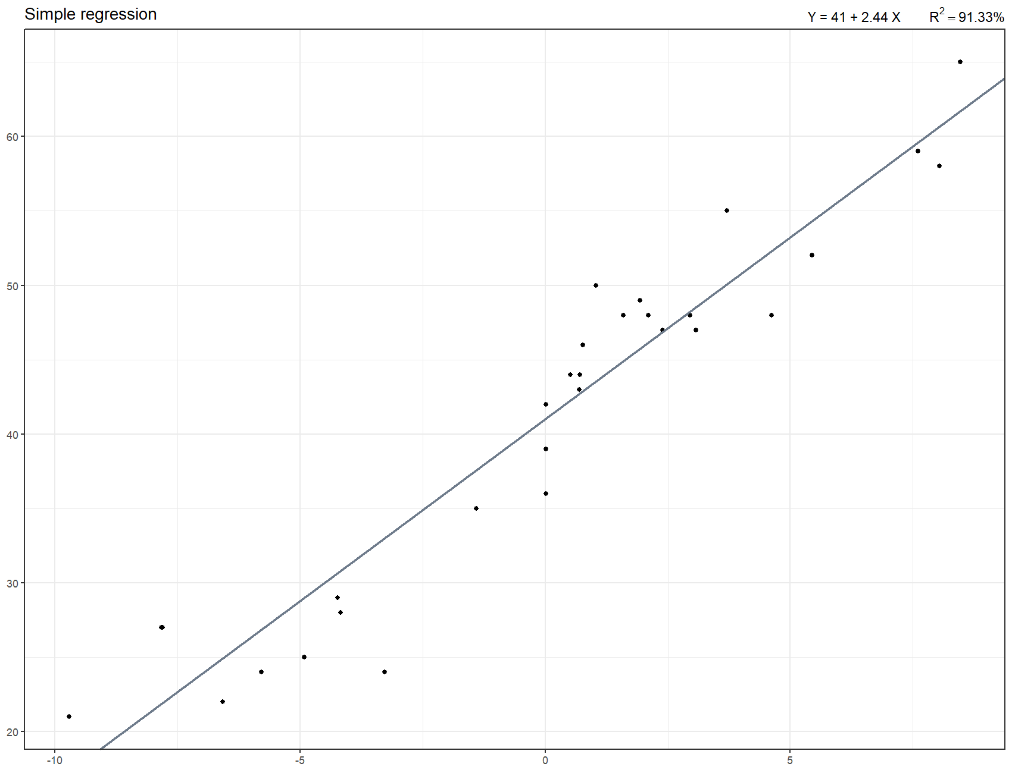
WORKED EXAMPLE, STEP 3
The Real Fitted Line
simplereg(x = NetRtg, y = W, type = "lin"), 30 real NBA teams, 2017-18 season.

Slide 13
CONCEPT · READING THE FIT
91.3% of Real Win Variation, Explained by One Number
What this means: 91.3% of the real variation in how many games a 2017-18 team won is explained by one single number, its point differential per hundred possessions.
Worth asking: is this relationship this strong because Net Rating causes wins, or because wins and point differential are almost definitionally linked?
R² = 0.9133
Wins = 40.998 + 2.444 × Net Rating
Notes:
Discussion: point out that wins are mechanically close to point differential (outscoring opponents IS winning), so part of this R-squared's strength is structural, not a proof that regression always finds relationships this clean. Ask the class for a real variable pair where they would expect a weaker fit before we look at one next. Timing: about 4 minutes.

Slide 14
SEE IT ON THE COURT
What a +8.47 Net Rating Season Actually Looked Like
▶
James Harden's Epic 17-18 MVP Season Highlights (Part 1)
GOAT SZN • runtime not independently confirmed
https://www.youtube.com/watch?v=tm87jrJ1BTE
Real game footage from the real 2017-18 Houston Rockets, this module's highest Net Rating team (+8.47) and most wins (65). Watch what that real number looked like on the floor before we move to the next real relationship.

Slide 15
CONCEPT · SEGMENT 1
Does a Curve Fit Better Than a Straight Line?
simplereg() can also fit a local polynomial curve instead of a straight line, using type = "pol". If the real relationship truly bends, a curve should raise R-squared noticeably. If it's already close to a straight line, the curve should barely help.
Let's check it on the same real data.

Slide 16
WORKED EXAMPLE, STEP 4
Real Linear Fit vs. Real Curved Fit
Model | Real R-squared
Linear (simplereg type = "lin") | 0.9133
Local polynomial, degree 2 (type = "pol") | 0.9527
The real improvement is small, about 4 percentage points. That tells us the true real relationship between Net Rating and Wins is close to a straight line across most of the league, with only a little real curvature at the extremes.

Slide 17
INTERACTIVE ACTIVITY
Is the Curve Worth It?
Turn to the person next to you.
1. Using only the real numbers on the last slide, decide together whether the extra complexity of the curved model is worth a 4-point real gain in R-squared.
2. What would make you change your answer: a bigger real gain, a smaller one, or something about how the model will actually be used?

Slide 18
RECAP · SEGMENT 1
A Strong Real Relationship, Covered
Covered
Next
Built a real linear regression of Wins on Net Rating (R-squared 0.9133), compared it to a real curved fit (0.9527), and discussed why the fit is this strong.
Segment 2 looks at a much messier real relationship, one where the regression line only tells part of the story.

Slide 19
10-Minute Break
Back at the top of the hour. Next: assists, turnovers, and a messier real relationship.

Slide 20
CONCEPT · SEGMENT 2
Not Every Real Relationship Is This Clean
Ball-handling responsibility should raise turnover risk, but not perfectly and not identically for every player. Let's look at real assists per minute against real turnovers per minute for every 2017-18 rotation player with at least 500 real minutes played, 361 of the league's 605 real players.

Slide 21
WATCH BEFORE WE COMPUTE
What Assists and Turnovers Together Actually Tell You
▶
What Is Assist To Turnover Ratio?
The Basketball Xpert • runtime not independently confirmed
https://www.youtube.com/watch?v=dwW9JZSMCfg
A concept-explainer on assists and turnovers together, useful before we build the real regression between the two rates ourselves.

Slide 22
LET'S RUN THIS TOGETHER
Let's build the real assist-turnover regression together.
Pull up your own session. We'll run it line by line and look at the real output together.

Slide 23
WORKED EXAMPLE, STEP 5
Building the Real Assist-Turnover Regression
Pbox.sel <- subset(Pbox, MIN >= 500)
X <- Pbox.sel$AST / Pbox.sel$MIN
Y <- Pbox.sel$TOV / Pbox.sel$MIN
Pl <- Pbox.sel$Player
mod <- simplereg(x = X, y = Y, type = "lin")
mod$R2
This is BasketballAnalyzeR's own documented example for simplereg(). Run it yourself.

Slide 24
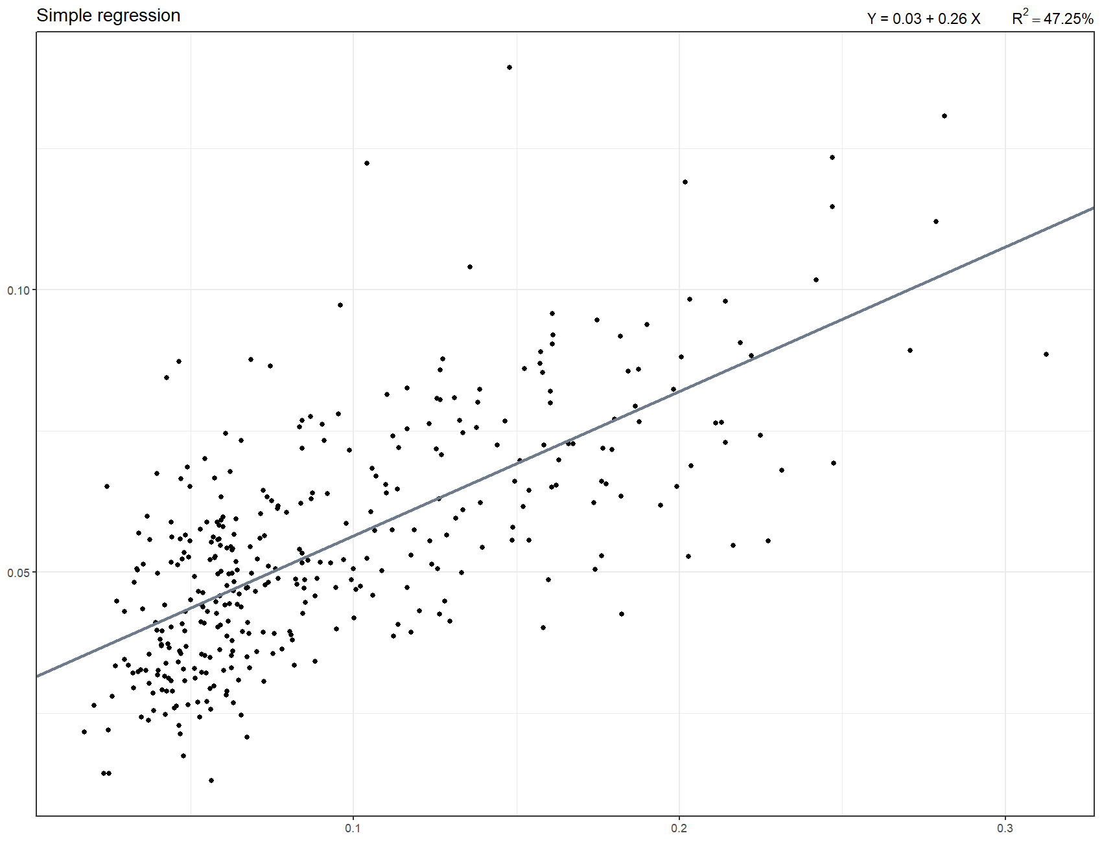
WORKED EXAMPLE, STEP 6
The Real Fitted Line, 361 Real Rotation Players
simplereg(x = AST/MIN, y = TOV/MIN, type = "lin"), real 2017-18 rotation players, MIN >= 500.

Slide 25
CONCEPT · READING A MODERATE FIT
Less Than Half the Real Story, and That's Still Useful
What this means: less than half of the real variation in turnover rate is explained by assist rate. That's still a real, meaningful relationship; it just leaves plenty of real room for an individual player to differ from it.
Compare: 0.4725 here versus 0.9133 for Net Rating and Wins. Same method, two very different real strengths of relationship.
R² = 0.4725
TOV/min = 0.031 + 0.255 × AST/min
Notes:
Discussion: ask the class why we would expect this relationship to be weaker than Net Rating/Wins. Push toward: turnovers depend on more than just how often a player passes -- decision-making, defensive pressure, and role all matter too. Ask what a coach or front office analyst should and should not conclude from an R-squared this size. Timing: about 5 minutes.

Slide 26
WORKED EXAMPLE, STEP 7
Real Point Guards on the Same Chart
Player | Real AST/min | Real TOV/min
Russell Westbrook | 0.281 | 0.131
John Wall | 0.279 | 0.112
Chris Paul | 0.247 | 0.069
James Harden | 0.247 | 0.124
Stephen Curry | 0.190 | 0.094
Kyrie Irving | 0.159 | 0.073
Chris Paul and James Harden had nearly identical real assist rates. Look closely at their real turnover rates.
Data: Pbox, real 2017-18 NBA season, BasketballAnalyzeR, MIN >= 500.

Slide 27
CONCEPT · WHAT THE LINE CAN'T TELL YOU
Same Assist Rate, Very Different Turnover Rate
Chris Paul
James Harden
Real AST/min: 0.247
Real TOV/min: 0.069
Real AST/min: 0.247
Real TOV/min: 0.124
Notes:
Discussion: Chris Paul's real turnover rate is close to half of Harden's on almost the exact same real assist rate. Ask the class: what does that gap represent that the regression line alone cannot capture? Push toward individual decision-making, shot creation demands, and offensive role, not measurement error. This is the single best moment in the module to reinforce that a regression line describes an average tendency, not a guarantee about any one real player. Timing: about 5 minutes.

Slide 28
INTERACTIVE ACTIVITY
Find Your Own Real Pair
Pair up.
1. Using the real per-player output from Part 2 of today's code, find your own second real pair of players with a similar real assist rate but a different real turnover rate.
2. In one real sentence, name what you think explains the gap between your two players.

Slide 29
RECAP · SEGMENT 2
A Moderate Real Relationship, Covered
Covered
Next
Built a real regression of turnover rate on assist rate (R-squared 0.4725) and used Chris Paul versus James Harden to see what the line alone can't tell you.
Segment 3 turns from relationships between two variables to real variability as a visual surface, plus a real correlation network.

Slide 30
10-Minute Break
Back at the top of the hour. Next: real variability as a surface, and a real correlation network.

Slide 31
CONCEPT · SEGMENT 3
Surface Area Dynamics: Variability as Area
So far we've measured how two variables relate. Now let's measure how much a single variable actually varies from player to player, and picture that spread as a real bubble, where the bubble's real area is its weighted standard deviation. That's where this module's title comes from.
In R, this is BasketballAnalyzeR::variability().

Slide 32
CONCEPT · SEGMENT 3
Why Weight the Spread by Shot Volume?
A player with 11 real three-point attempts (Tarik Black, 2017-18) should not swing a shooting-percentage chart as much as a player with 722 real attempts (James Harden). Weighting the real standard deviation by real shot attempts keeps small, noisy samples from dominating the picture.
variability(data, data.var, size.var, weight = TRUE) does this automatically.

Slide 33
WATCH BEFORE WE COMPUTE
Why Free Throw Shooting Varies So Much Between Players
▶
Why Shooting 95% From the Free-Throw Line Is Almost Impossible (ft. Steve Nash)
WIRED • runtime not independently confirmed
https://www.youtube.com/watch?v=BKIOqbx3sbU
A concept-explainer on why free throw percentage varies so much from player to player, real, unguarded, mechanics-driven shooting. This sets up today's finding that free throw percentage produced the real largest bubble in our variability diagram.

Slide 34
LET'S RUN THIS TOGETHER
Let's build the real Houston Rockets variability diagram together.
Pull up your own session. We'll run it line by line and look at the real output together.

Slide 35
WORKED EXAMPLE, STEP 8
Building the Real "Surface" Diagram
Pbox.BC <- subset(Pbox, Team == "Houston Rockets" & MIN >= 500,
select = c("Player","P2p","P3p","FTp","P2A","P3A","FTA"))
list_variability <- variability(data = Pbox.BC,
data.var = c("P2p","P3p","FTp"),
size.var = c("P2A","P3A","FTA"), weight = TRUE)
plot(list_variability, max.circle = 30)
This is BasketballAnalyzeR's own documented example for variability(), applied to our own real team.

Slide 36
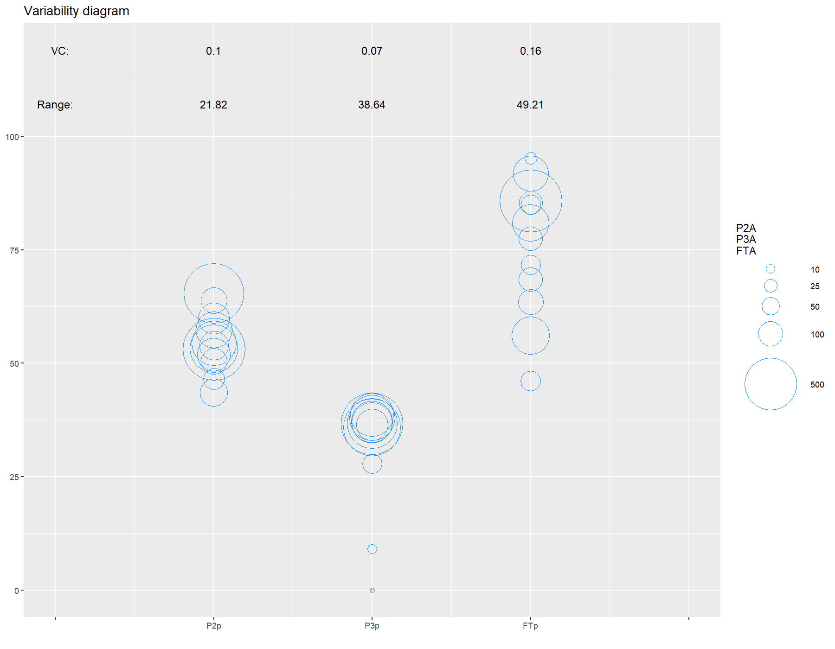
WORKED EXAMPLE, STEP 9
The Real Houston Rockets Variability Diagram
variability(), real 2017-18 Houston Rockets rotation (12 players, MIN >= 500), weighted by real shot attempts.

Slide 37
WORKED EXAMPLE, STEP 10
Which Real Shooting Split Varies Most?
Shooting split | Real weighted SD (Rockets) | Real weighted SD (league)
Two-point percentage | 5.81 | 5.53
Three-point percentage | 2.41 | 4.46
Free throw percentage | 12.64 | 9.52
Free throw percentage produced the real largest bubble on both charts, from Tarik Black's real 46.0% to Joe Johnson's real 95.2% on the very same roster.
Data: Pbox, real 2017-18 NBA season, BasketballAnalyzeR.

Slide 38
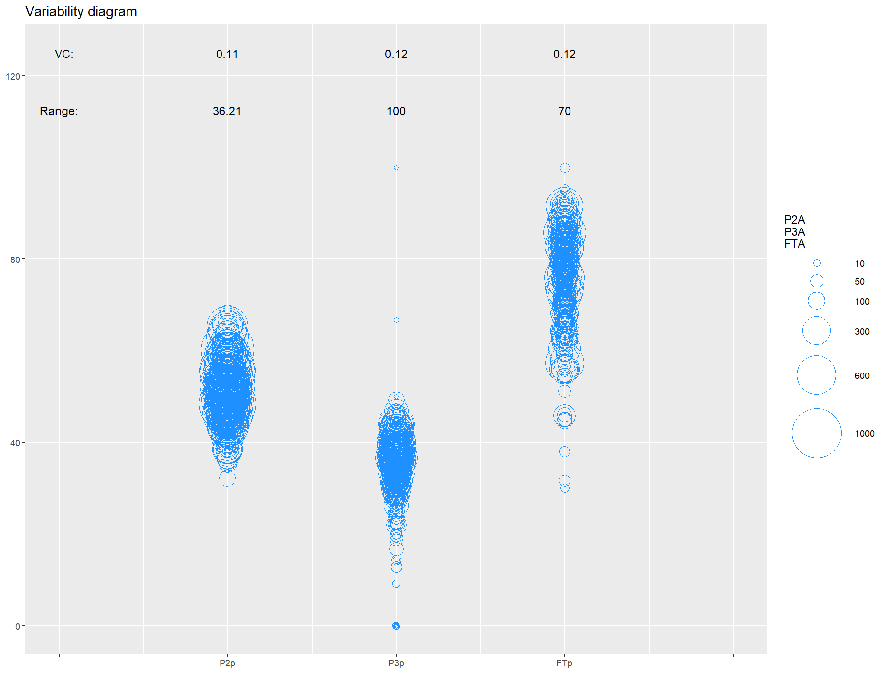
WORKED EXAMPLE, STEP 11
The Same Real Diagram, League-Wide
variability(), real 2017-18 rotation players league-wide (361 players, MIN >= 500), weighted by real shot attempts.

Slide 39
CONCEPT · A REAL ROSTER-BUILDING SIGNATURE
One Real Number That Doesn't Match the League
The Rockets' real three-point weighted SD (2.41) was noticeably tighter than the real league-wide three-point weighted SD (4.46), the opposite direction from free throw and two-point percentage, which stayed close to the league pattern.
Notes:
Discussion: ask the class what real roster decision could produce a tighter three-point spread on one specific team than the league at large. Push toward deliberate roster construction: a team built around three-point shooting will recruit and play rotation players who all shoot a similar, high real percentage from three, narrowing that one variable's spread relative to a more randomly assembled roster. Timing: about 4 minutes.

Slide 40
INTERACTIVE ACTIVITY
Try a Different Real Team
Get into small groups (3-4 students). I'll assign your group a different real 2017-18 team.
1. Swap Team == "Houston Rockets" for your team and rerun Part 4 of today's code.
2. Which real shooting split has the largest bubble on your team? Does it match the Rockets, or is it different?
3. Report your team's real largest bubble back to the class.

Slide 41
RECAP · SURFACE AREA DYNAMICS
Real Variability as Area, Covered
Built a real weighted variability diagram for the Rockets and for the league, found free throw percentage produces the real largest bubble both times, and found one real number, three-point spread, where the Rockets clearly differ from the league.

Slide 42
CONCEPT · SEGMENT 3
One Last Real Tool: A Correlation Network
corranalysis() computes a real correlation matrix across several variables at once, then draws it as a network, connecting only the pairs whose real correlation clears a threshold you set. It's a fast way to see which real relationships in a whole dataset are actually worth a closer look.
We'll use a threshold of 0.5: anything weaker gets zeroed out of the display.

Slide 43
LET'S RUN THIS TOGETHER
Let's build the real correlation network together.
Pull up your own session. We'll run it line by line and look at the real output together.

Slide 44
WORKED EXAMPLE, STEP 12
Building the Real Correlation Network
data_permin <- data.frame(Pbox$PTS, Pbox$P3M, Pbox$P2M,
Pbox$OREB + Pbox$DREB, Pbox$AST, Pbox$TOV,
Pbox$STL, Pbox$BLK) / Pbox$MIN
names(data_permin) <- c("PTS","P3M","P2M","REB","AST","TOV","STL","BLK")
data_permin <- subset(data_permin, Pbox$MIN >= 500)
out_corr <- corranalysis(data_permin, threshold = 0.5)
plot(out_corr)
This is BasketballAnalyzeR's own documented example for corranalysis(). Run it yourself.

Slide 45
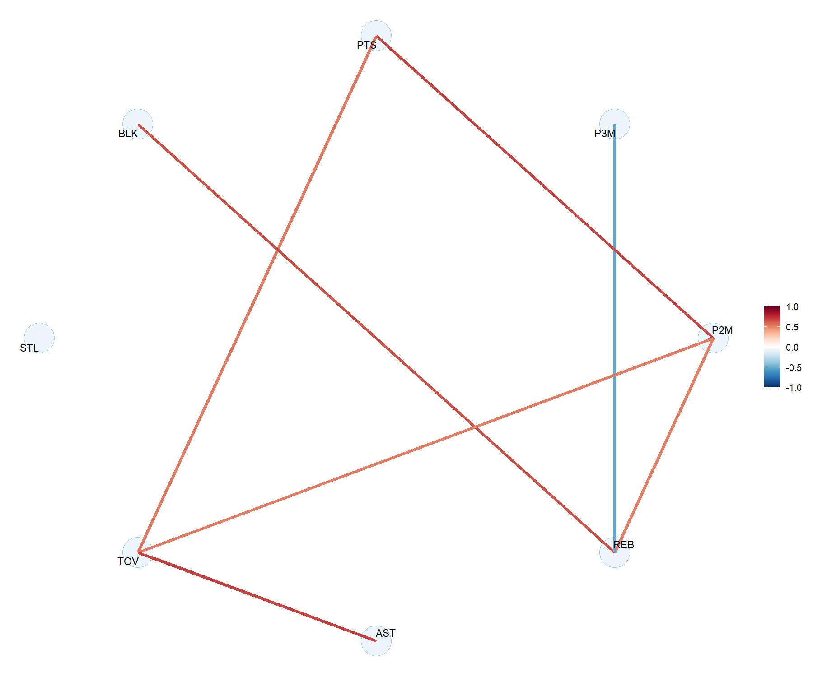
WORKED EXAMPLE, STEP 13
The Real Network, 361 Real Rotation Players
corranalysis(data_permin, threshold = 0.5), real per-minute rates, 2017-18 NBA season, MIN >= 500.

Slide 46
CONCEPT · CONFIRMING SEGMENT 2, AT SCALE
The Strongest Real Pair in the Whole Network
Why this matters: this is the same real pattern from Segment 2's Chris Paul versus Harden comparison, now confirmed across all 361 real rotation players, not just eight point guards.
Also in the network: rebounds and blocks correlate at a real 0.640, while three-pointers made correlate negatively with both rebounds (-0.518) and blocks (-0.469).
0.687
real correlation between
assists and turnovers,
per minute, league-wide
Notes:
Discussion: ask the class what real basketball story the negative correlation between three-pointers made and both rebounds and blocks tells. Push toward: the league statistically sorts itself into perimeter shooters and interior rebounders/shot-blockers, two different kinds of real players who rarely do both at a high rate. Ask whether any current real player breaks this pattern, and why that would be considered valuable. Timing: about 5 minutes.

Slide 47
CODING SYNTAX TUTORIAL
A Second Walkthrough of Fitting a Regression in R
▶
Simple Linear Regression in R | R Tutorial 5.1
MarinStatsLectures • runtime not independently confirmed
https://www.youtube.com/watch?v=66z_MRwtFJM
A real coding-syntax tutorial on fitting and reading a simple linear regression in R, useful alongside today's live coding for anyone who wants a second walkthrough of lm()-style fitting before or after seeing simplereg() in class.

Slide 48
THROUGHLINE · POSITIONING AND SHIFTING, GAME ANALYSIS
Reading Roles and Games from Real Relationships
The question:
Using real relationships between variables to understand how a player's role is built and how a single game or season actually unfolds.
The real correlation network's split between perimeter shooters and interior rebounders and shot-blockers is a statistical picture of positioning: where a player operates on the floor shapes which real numbers move together for them. The real Net Rating and Wins relationship is squarely game and season analysis, a front office or broadcast tool for explaining outcomes with one honest number instead of a scoreboard alone.

Slide 49
PRACTICE
Read the Real Network Yourself
Look back at the real correlation network.
1. Find one real pair of variables connected by a line.
2. In one sentence, give a real basketball explanation for why that pair moves together.
3. Would you expect that same real pair to correlate this strongly in a different season? Why or why not?

Slide 50
INTERACTIVE ACTIVITY
Defend a Real Correlated Pair
Small groups (3-4 students). I'll assign your group one real correlated pair from today's network: assists and turnovers, rebounds and blocks, or three-pointers made against rebounds and blocks.
Write one real basketball explanation for why your pair moves together, and be ready to defend it to the class using today's actual numbers.

Slide 51
RECAP · SEGMENT 3
Surface Area and the Network, Covered
Covered
Next
Built real variability diagrams for a team and the league, and a real correlation network across eight per-minute stats, confirming Segment 2's pattern at league scale.
Module 9 puts everything from Modules 1 through 8 into one applied BasketballAnalyzeR toolkit workflow.

Slide 52
SUMMARY
What to Carry Forward
Net Rating predicts real Wins extremely well (R-squared 0.9133), and a curved fit barely improves on the straight line.
Assists predict turnovers only moderately (R-squared 0.4725) -- a regression line is an honest average, not a guarantee about any one real player.
variability() turns real spread into a visual surface; free throw percentage produced the real largest bubble, on the Rockets and league-wide.
corranalysis() confirmed, at full league scale, the same assist-turnover pattern first seen in eight individual real players.

Slide 53
BEFORE MODULE 09
Two Things Before Next Class
Read
Do
Basketball Data Science, Ch. 6 (the BasketballAnalyzeR applied toolkit).
Complete Lab 8 (modeling relationships and surface dynamics), the practice questions, and the Module 8 quiz on D2L.

Slide 54
FULL READING LIST
References Cited Today
Zuccolotto, P., & Manisera, M. (2020). Basketball Data Science: With Applications in R, Ch. 5. Chapman & Hall/CRC.
BasketballAnalyzeR (R package), simplereg(), variability(), and corranalysis() functions. Zuccolotto, Manisera & Sandri. CRAN.
NBA.com official 2017-18 team and player statistics, used to cross-check real win totals and player identities.

Slide 55
See You in Module 09
The BasketballAnalyzeR Package: Applied Toolkit

