Slide 1
SPORTS ANALYTICS
Basketball Data Science
Module 07 · Finding Groups: Clustering Players and Teams
Week 7
Undergraduate · 3-hour session
Maps to Chapter 4:
Zuccolotto, P., & Manisera, M. (2020). Basketball Data Science: With Applications in R. Chapman & Hall/CRC.

Slide 2
BEFORE WE START
What's Coming Up
Due This Week
-- update before class --
Coming Up
-- update before class --
Office Hours
-- update before class --

Slide 3
RECAP
Where We Left Off
Module 6 asked whether a shot's timing changes how likely it is to go in, and found real field goal percentage fell from 49.6% early in the shot clock to 42.4% late, and real clutch shooting fell to 41.7% from 47.5%. That module was about one shot in one moment. Today I zoom all the way out: what kinds of players, and what kinds of teams, actually exist in this league once I let the real data group them for itself.
Same real 2017-18 season, same BasketballAnalyzeR package, new question: finding groups.

Slide 4
OUTLINE FOR THE DAY
Where We're Headed
I
Segment 1
II
Segment 2
Why clustering, how it works, and how we pick the number of groups honestly
Building real player clusters, reading a dendrogram, and comparing two methods
III
Segment 3
IV
Before Next Class
A 2D map of player similarity, then clustering real NBA teams
Lab 7, the Module 7 quiz, and the practice questions

Slide 5
LEARNING OBJECTIVES
By the End of Today, You Will Be Able To
1
Explain what clustering does and why standardizing every variable first matters.
2
Use a real variance-explained curve to choose a defensible number of clusters, and explain your reasoning out loud.
3
Build and read a real dendrogram from BasketballAnalyzeR's hclustering() function, and describe a cluster's identity from its real profile.
4
Compare hierarchical clustering to k-means clustering on the same real data and explain where and why two methods agree or disagree.
5
Cluster real NBA teams by their Four Factors identity and connect a team's statistical cluster to its real win total.

Slide 6
CONCEPT · SEGMENT 1
Grouping Things That Look Alike
Think about every restaurant in a city. You could group them by price and by distance from campus without anyone telling you their category names in advance. Cheap and close restaurants naturally end up in one group. Expensive and far ones end up in another. Nobody labeled them first; the natural groups showed up once you looked at the numbers.
Clustering does exactly that, with real player and team statistics instead of price and distance.

Slide 7
CONCEPT · SEGMENT 1
Clustering Only Knows Numeric Distance
Clustering measures how far apart every pair of players sits across several real variables at once, then groups together whoever sits closest. It does not know what a “point guard” is. It only knows numbers.
Problem: points, assists, and blocks are measured on completely different real scales. Without adjusting for that, points (bigger raw numbers) would swamp blocks (smaller raw numbers) in every distance calculation, for no basketball reason at all.
Fix: standardize first. z = (x - mean) / standard deviation, for every real variable, before measuring any distance.
Both hclustering() and kclustering() perform this standardization automatically before clustering.

Slide 8
CONCEPT VIDEO
Watch the Mechanism Before We Build It
▶
What Is Hierarchical Clustering and How Does It Work?
Channel: StatQuest with Josh Starmer
https://www.youtube.com/watch?v=7xHsRkOdVwo
A real, verified concept-explainer showing exactly how a dendrogram builds itself by repeatedly merging the two closest points. Channel confirmed; exact runtime not independently confirmed, so verify before assigning.

Slide 9
CONCEPT · SEGMENT 1
Two Ways to Build the Same Kind of Groups
Hierarchical (hclustering)
K-means (kclustering)
Starts with every player as their own group, then repeatedly merges the two closest groups until everyone belongs to one final group. You can stop the merging at any number of clusters and see the whole merge history in a dendrogram.
Starts by guessing k center points, assigns every player to the nearest center, then moves each center to the average of its assigned players and repeats until the groups stop changing.

Slide 10
LET'S RUN THIS TOGETHER
Let's build the real player dataset and scan for k together.
Pull up your own session. We'll run it line by line and look at the real output together.

Slide 11
WORKED EXAMPLE, STEP 1
The Real Dataset: 183 Rotation Players
library(BasketballAnalyzeR)
data(Pbox)
sel <- Pbox$MIN >= 1500
Xp <- with(Pbox, data.frame(PTS, P3M, REB = OREB + DREB,
AST, TOV, STL, BLK, PF))
Xp <- subset(Xp, sel)
IDp <- Pbox$Player[sel]
hclu_scan <- hclustering(Xp, labels = IDp, nclumax = 10)
plot(hclu_scan)
605 real players played in 2017-18. Filtering to MIN >= 1500 keeps 183 real rotation players with enough of a real season to compare fairly.

Slide 12
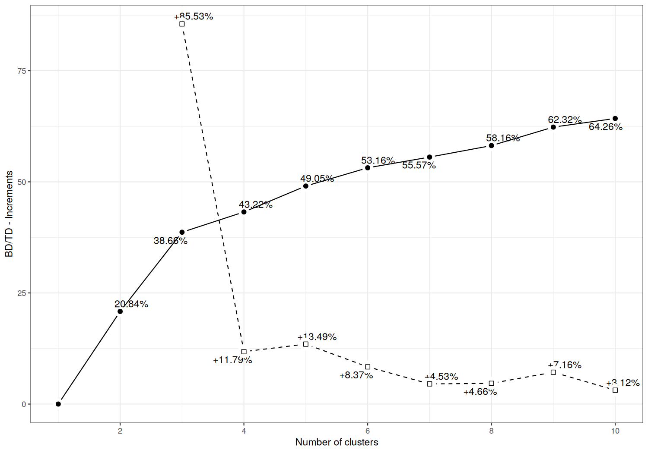
WORKED EXAMPLE, STEP 2
The Real Variance-Explained Curve
plot(hclustering(Xp, labels=IDp, nclumax=10)), real 183-player 2017-18 data, BasketballAnalyzeR.
Notes:
Discussion: ask the class where the curve's slope flattens the most. Point out the huge jump from k=2 to k=3 (+17.8 points) versus the much smaller jump from k=6 to k=7 (+2.4 points). Ask: does anyone see a case for a different k? Let a few students argue for k=5 or k=6 before I explain my own choice on the next slide. Timing: about 6 minutes.

Slide 13
WORKED EXAMPLE, STEP 3
Choosing k = 7, Honestly
k | Real variance explained | Real gain
5 | 49.1% | +5.8
6 | 53.2% | +4.1
7 | 55.6% | +2.4
8 | 58.2% | +2.6
I picked k=7 because the real gain from adding a seventh cluster (+2.4 points) is the smallest gain up to that point in the curve, a real sign of diminishing returns. It also matches the exact k used in BasketballAnalyzeR's own documented player-clustering example. Picking k is a judgment call informed by real evidence, not a fixed rule, and I want you to see me make that call out loud.
Data: hclustering(Xp, labels=IDp, nclumax=10)$VarianceBetween, real 2017-18 data.

Slide 14
INTERACTIVE ACTIVITY
Would You Have Picked a Different k?
Look back at the real curve.
1. If you had to defend a different number of clusters using only that real curve, what k would you pick and why?
2. Is there a wrong answer here, or only a better-defended and worse-defended one?

Slide 15
RECAP · SEGMENT 1
Clustering and Choosing k, Covered
Covered
Next
What clustering does, why we standardize first, the two main methods, and how to use a real variance-explained curve to defend a choice of k.
Segment 2 builds the actual real k=7 player clustering, reads a dendrogram, and compares hierarchical clustering to k-means.

Slide 16
10-Minute Break
Back at the top of the hour. Next: building the real player clusters.

Slide 17
CONCEPT · SEGMENT 2
How to Read a Dendrogram
A dendrogram is a tree of every real merge the algorithm made. Two players whose branches join low, near the bottom, were among the very first pairs merged, meaning they looked extremely similar in the real data. Two players (or two clusters) whose branches only join up near the top were similar enough to eventually group together, but only after nearly everyone else had already merged first. Cutting the tree at a chosen height is exactly how a value of k turns into real cluster assignments.

Slide 18
LET'S RUN THIS TOGETHER
Let's build the real k=7 clustering and look at the dendrogram together.
Pull up your own session. We'll run it line by line and look at the real output together.

Slide 19
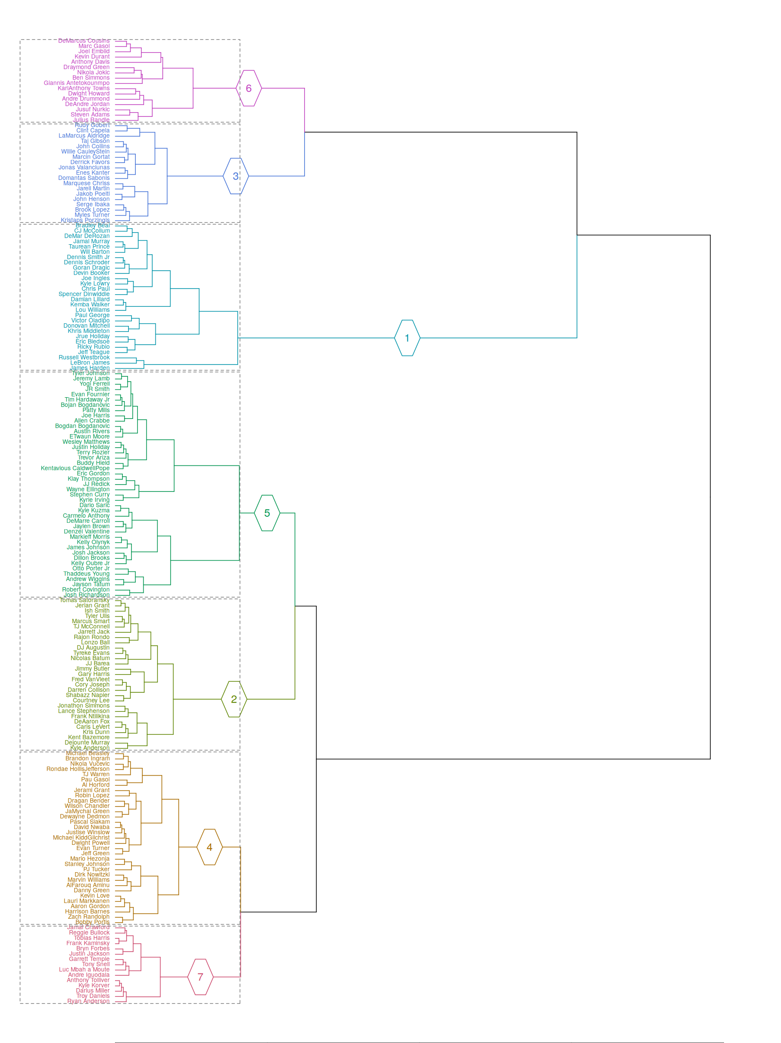
WORKED EXAMPLE, STEP 4
The Real Dendrogram, 183 Players, k = 7
plot(hclustering(Xp, labels=IDp, k=7)), colored by real cluster. Run it yourself to zoom into any player's name.
Notes:
Discussion: point out the seven colored blocks. Ask students to find one star player they recognize and guess which cluster color they landed in before I reveal the star-player table on the next slides. Timing: about 5 minutes.

Slide 20
WORKED EXAMPLE, STEP 5
Where Did the Real Stars Land?
Player | Real cluster
LeBron James | 1
James Harden | 1
Russell Westbrook | 1
Damian Lillard | 1
Stephen Curry | 5
Kevin Durant | 6
Draymond Green | 6
Giannis Antetokounmpo | 6
Anthony Davis | 6
Rudy Gobert | 3
Data: hclu$Subjects, real hclustering(Xp, labels=IDp, k=7) output.

Slide 21
WORKED EXAMPLE, STEP 6
Reading a Real Cluster's Identity: CHI
CHI (cluster heterogeneity index) measures how spread out the real players inside one cluster still are. A CHI near 1.0 groups together players who share a real, distinctive shape but are not identical to each other. A CHI near 0.2 groups together players who genuinely look alike.
Real cluster | Real CHI | Real identity
6 | 0.95 | Versatile do-everything forwards (Durant, Draymond, Giannis, A. Davis)
1 | 0.77 | Primary ball-handling engines
5 | 0.37 | Perimeter shooting wings
4 | 0.30 | Balanced, moderate role players
7 | 0.19 | Limited-role bench players

Slide 22
REAL GAME FOOTAGE
What a Real Rim Protector Looks Like
▶
Rudy Gobert - Rugged Rim Protector 16/17 (Block Party)
Channel: as listed on YouTube search result
https://www.youtube.com/watch?v=3hc5uitfYjk
Real game footage grounding Cluster 3 (“rim-protecting bigs,” far below-average P3M, far above-average blocks). Confirmed to exist via web search; channel name and runtime not independently confirmed, so verify before assigning.

Slide 23
REAL GAME FOOTAGE / CONCEPT
What a Real “Versatile Forward” Looks Like
▶
The Evolution of Positionless Basketball
Channel: as listed on YouTube search result
https://www.youtube.com/watch?v=TdKHVK9EQ9Q
Grounds Cluster 6 (Durant, Draymond, Giannis, A. Davis; real CHI = 0.95) in real game context before we look at that cluster's varied statistical profile. Confirmed to exist via web search; channel name and runtime not independently confirmed, so verify before assigning.

Slide 24
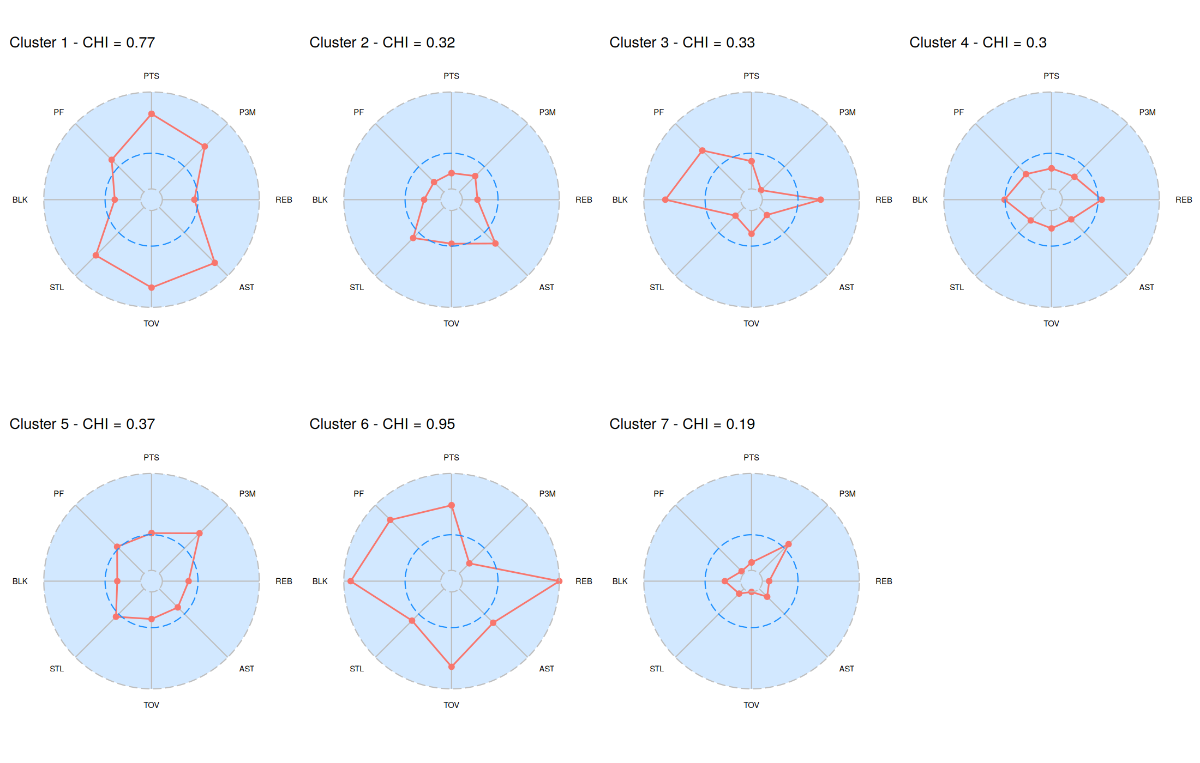
WORKED EXAMPLE, STEP 7
All Seven Real Cluster Profiles at Once
plot(hclu, profiles=TRUE), real 2017-18 data. Each spoke is one real, standardized box score variable.

Slide 25
CONCEPT · READING THE NUMBER HONESTLY
The Most Varied Group Also Has the Biggest Stars
Compare that to: Cluster 7's real CHI of 0.19, the most uniform group of all seven.
Why this makes sense: Cluster 6's real members (Durant, Draymond, Giannis, Anthony Davis) all share a versatile, do-everything shape, but they are still four very different players. Cluster 7's real members are simply similar to each other in a much narrower, more limited way.
0.95
Cluster 6's real CHI,
the highest of all seven
real player clusters

Slide 26
CODING-SYNTAX TUTORIAL
A Second Walkthrough of K-Means on Real NBA Data
▶
Identifying NBA Player Archetypes Using KMeans Clustering - Part One
Channel: Nick's Niche
https://www.youtube.com/watch?v=-FjW5E0U8gY
A real coding-syntax tutorial applying k-means clustering to real NBA player data, useful alongside today's own live coding. Channel confirmed by fetching the tutorial's own companion article, which embeds this exact video; exact runtime not independently confirmed, so verify before assigning.

Slide 27
LET'S RUN THIS TOGETHER
Let's build the real k-means clustering on the same data.
Pull up your own session. We'll run it line by line and look at the real output together.

Slide 28
WORKED EXAMPLE, STEP 8
The Same Real Players, a Different Method
kclu <- kclustering(Xp, labels = IDp, k = 7, nruns = 25)
sapply(kclu$ClusterList, length)
Real k-means cluster sizes: 36, 47, 14, 13, 27, 23, 23 (compare to hierarchical clustering's real 28, 29, 19, 33, 43, 16, 15). Same k, same real data, a genuinely different set of group sizes, because the two methods build groups in different ways.
Data: kclustering(Xp, labels=IDp, k=7, nruns=25), real 2017-18 data, BasketballAnalyzeR.

Slide 29
WORKED EXAMPLE, STEP 9
Do the Two Real Methods Agree?
I cross-tabulated the real hierarchical cluster against the real k-means cluster for all 183 players, then took, for each hierarchical cluster, whichever k-means cluster captured the largest share of its members.
That is real agreement on the big picture, not a perfect match. The two methods build groups differently, so they draw slightly different boundaries even when they broadly agree on the shapes in the data.
67.8%
of real players land in the
same modal group under
both real methods
Data: table(Hierarchical=hclu$Subjects$Cluster, Kmeans=kclu$Subjects$Cluster), real 2017-18 data.

Slide 30
CONCEPT · READING THE NUMBER HONESTLY
Agreement Is Not Even Across Clusters
89.5%
51.2%
real agreement for Cluster 3,
the rim-protecting bigs, a
statistically distinctive group
real agreement for Cluster 5,
the perimeter shooters, a
fuzzier statistical middle
Notes:
Discussion: ask why a distinctive group like rim protectors would be easier for two different algorithms to agree on than a group like perimeter shooters. Push toward: distinctive players sit far from everyone else in the real numeric space, so almost any reasonable method finds them, while players near the middle of the distribution are close to several groups at once and can tip either way. Timing: about 6 minutes.

Slide 31
INTERACTIVE ACTIVITY
Find a Real Boundary-Case Player
Get into groups of 3-4. Using the real cross-tabulation and cluster profiles, pick one real player you think is a genuine “boundary case,” likely to shift clusters depending on the exact method or exact variables used.
1. Name the player and their real cluster under each method.
2. Explain, using their real box score profile, why they sit close to two different groups at once.

Slide 32
RECAP · SEGMENT 2
Real Player Clusters, Covered
Covered
Next
Built the real k=7 hierarchical clustering, read a dendrogram, met all seven real cluster identities, and compared results against real k-means (67.8% overall agreement).
Segment 3 maps real player similarity in 2D, then clusters real NBA teams by their statistical identity.

Slide 33
10-Minute Break
Back at the top of the hour. Next: mapping similarity, then clustering real teams.

Slide 34
CONCEPT · SEGMENT 3
Flattening Many Variables Into a 2D Map
A dendrogram shows merge order. A map shows distance directly: players who look alike sit close together on the page, players who look different sit far apart. `MDSmap()` compresses our real eight-variable player data down into just two dimensions we can actually plot, using multidimensional scaling. Compressing eight real dimensions into two always loses some information; the real stress index tells you how much.

Slide 35
LET'S RUN THIS TOGETHER
Let's build the real 2D similarity map together.
Pull up your own session. We'll run it line by line and look at the real output together.

Slide 36
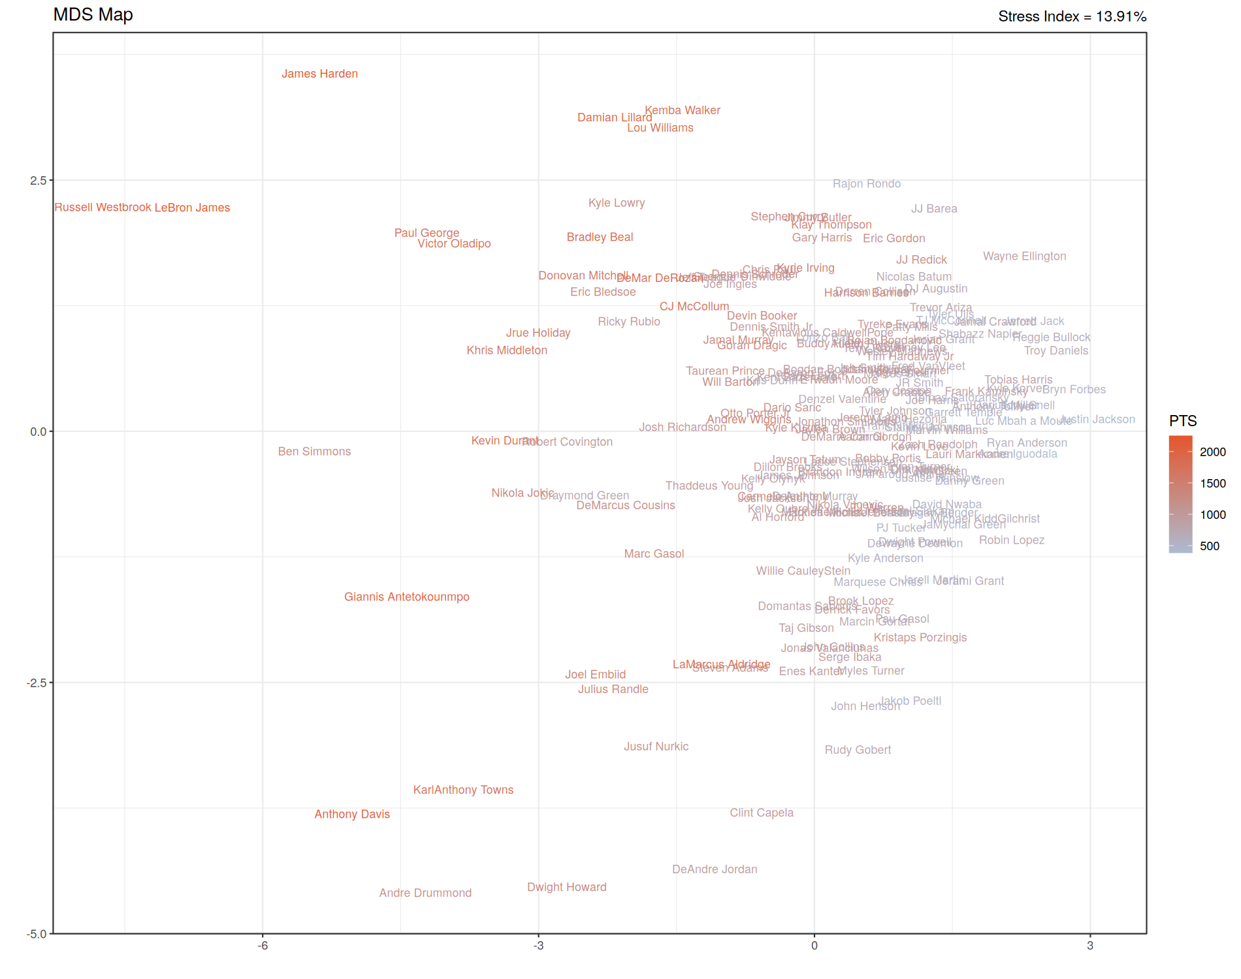
WORKED EXAMPLE, STEP 10
The Real 2D Map of Player Similarity
plot(MDSmap(Xp)), real stress = 13.9%. Color reflects real season points.
Notes:
Discussion: find Russell Westbrook, LeBron James, and James Harden together at one edge, and the tallest rim-protecting centers (Gobert, DeAndre Jordan, Andre Drummond, Dwight Howard) together at another. Ask the class: does this match the same structure from the dendrogram, just drawn differently? Timing: about 5 minutes.

Slide 37
WORKED EXAMPLE, STEP 11
Reading the Real Stress Index
Rule of thumb: under 10% is usually considered a strong 2D fit; 13.9% is reasonable but imperfect.
What that means here: some real distance relationships get compressed or stretched to fit on a flat page. Two players who look close on the map are almost certainly similar in the real data; two players who look far apart might be less different than the map suggests.
13.9%
real MDS stress index for
this module's 183-player,
eight-variable real map

Slide 38
CONCEPT · SEGMENT 3
The Same Tools Work on Real Teams
Instead of eight real box score totals per player, I'll use each real team's Four Factors identity from fourfactors(Tbox, Obox): offensive and defensive rating, effective field goal percentage, turnover rate, rebound rate, and free throw rate, for and against. That's the exact same function from Module 2, now feeding into a clustering algorithm instead of a bar chart.

Slide 39
LET'S RUN THIS TOGETHER
Let's build the real 30-team clustering together.
Pull up your own session. We'll run it line by line and look at the real output together.

Slide 40
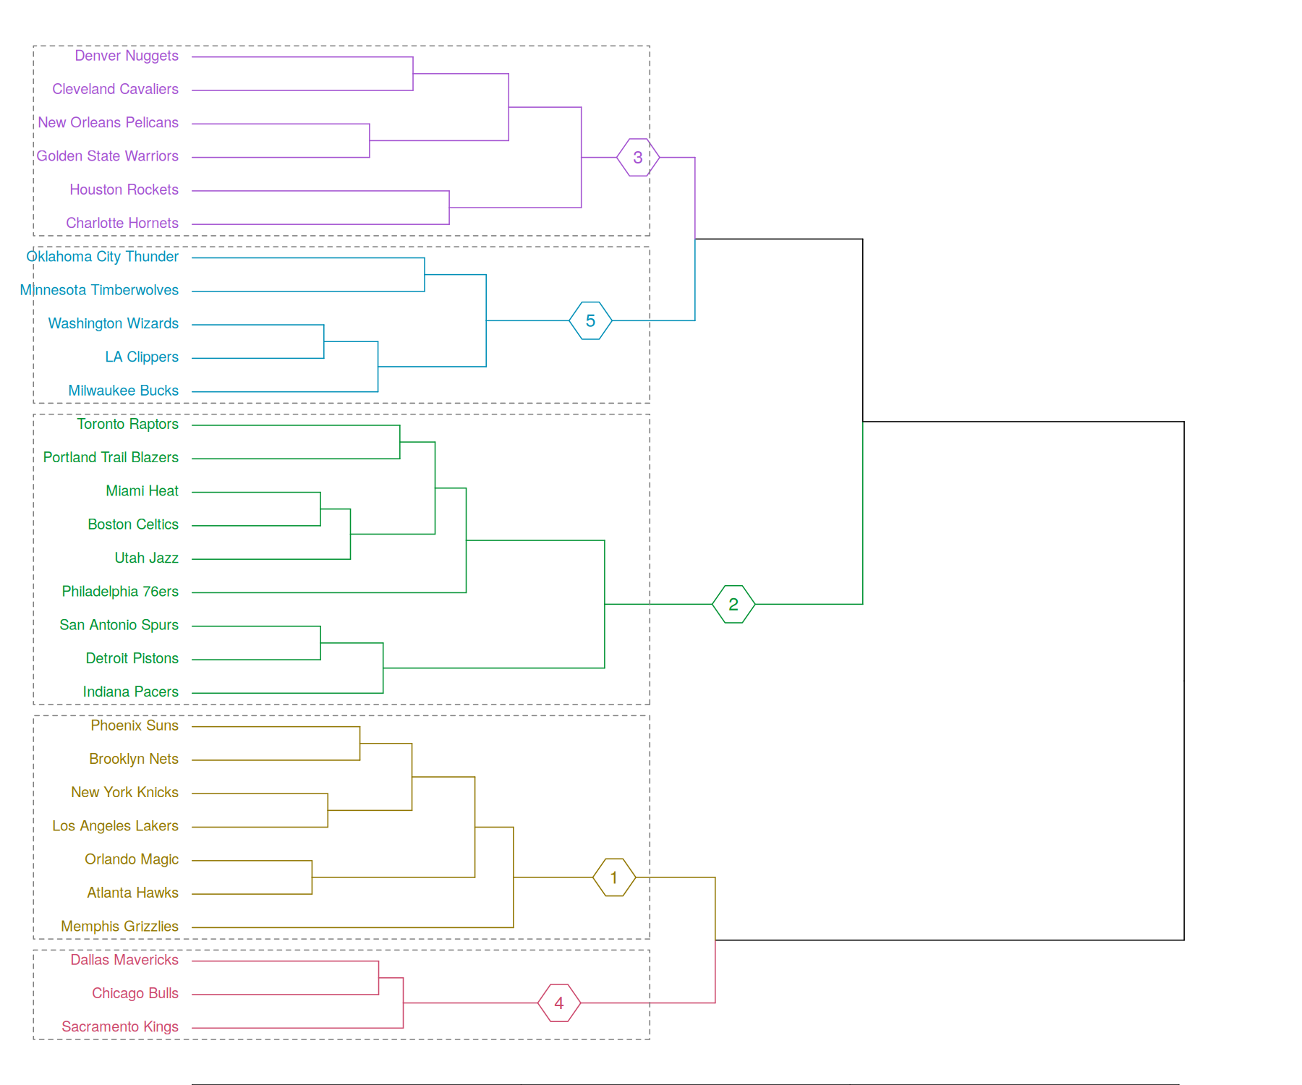
WORKED EXAMPLE, STEP 12
Real 2017-18 Teams, Grouped Into 5 Clusters
plot(hclustering(Xt, labels=IDt, k=5)), real Four Factors data, fourfactors(Tbox, Obox).

Slide 41
WORKED EXAMPLE, STEP 13
Real Statistical Identity vs. Real Win Total
Cluster | Teams | Real identity | Mean wins | Range
1 | 7 | Weak offense and defense | 26.3 | 21-35
2 | 9 | Strong defense, average offense | 49.0 | 39-59
3 | 6 | Elite, efficient shooting offense | 50.5 | 36-65
4 | 3 | Severely offense-limited | 26.0 | 24-27
5 | 5 | High rebounding, ball-hawking | 44.8 | 42-48
Data: module7_team_cluster_wins_summary.csv, real 2017-18 season, fourfactors(Tbox, Obox).

Slide 42
CONCEPT · THE PAYOFF OF THIS MODULE
Two Conference Finalists, One Real Cluster
Cluster 3: Houston Rockets (65 W), Golden State Warriors (58 W), Cleveland Cavaliers (50 W), New Orleans Pelicans (48 W), Denver Nuggets (46 W), Charlotte Hornets (36 W)
The real 2017-18 Western Conference Finals came down to Houston and Golden State, the two highest-win teams in this exact real cluster. Clustering by real Four Factors identity, not by win total, still grouped them together, because it found the same real underlying elite-shooting-offense shape the standings already reflected.

Slide 43
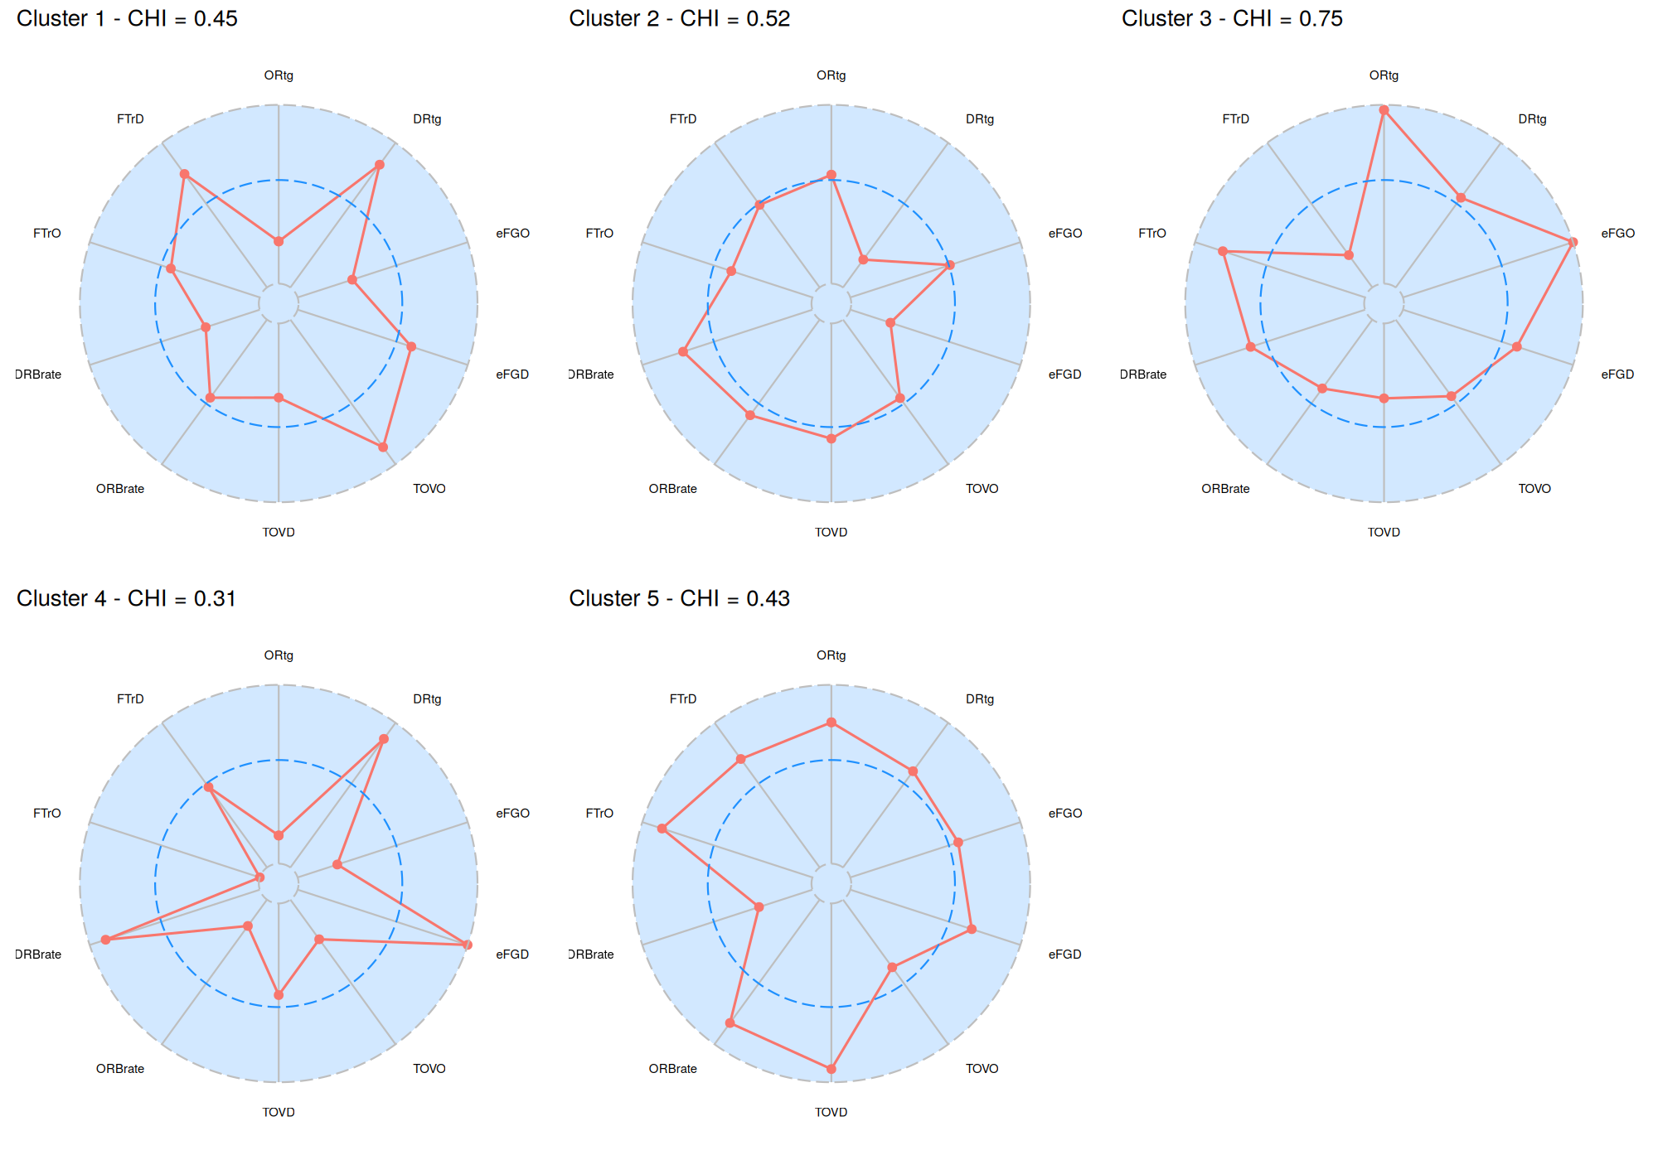
WORKED EXAMPLE, STEP 14
All Five Real Team Cluster Profiles
plot(hclu_t, profiles=TRUE), real Four Factors data, 2017-18 season.

Slide 44
INTERACTIVE ACTIVITY
Same Real Losses, Different Real Reasons
Real Cluster 1 (mean 26.3 wins) and real Cluster 4 (mean 26.0 wins) lost about the same number of games, but for different statistical reasons.
Get into groups of 3-4. Pick one real team from each cluster and use their real Four Factors numbers (module7_team_hclust_profiles.csv) to explain the difference: was it a weak team across the board, or a team with one specific, severe problem?

Slide 45
THROUGHLINE · PLAYER PERFORMANCE ANALYSIS
Groups a Roster Page Never Told You
The question:
What natural groups actually exist in real player and team data, without starting from a position label a roster page already assigned.
A front office deciding whether two players duplicate each other's role, or deciding what kind of player a roster is missing, is implicitly asking a clustering question, whether or not they ever run the actual algorithm. This connects directly to real player performance analysis and real positioning and lineup construction, and it sets up Module 8's shift toward modeling relationships between variables directly.

Slide 46
PRACTICE
Read a Real Cluster Yourself
Look back at the real player cluster profiles.
1. Pick one real cluster you have not already discussed today.
2. Write one sentence describing its real statistical identity, the way this module described Cluster 3 as “rim-protecting bigs.”
3. Does its real CHI value match how consistent that identity feels to you?

Slide 47
INTERACTIVE ACTIVITY
A Scout vs. a General Manager
A Scout
A General Manager
Is evaluating one draft prospect and wants to know which current real players that prospect resembles statistically. Which tool from today, the dendrogram or the MDS map, answers that faster?
Is deciding whether the roster has too many players in the same real cluster and not enough in another. Which of today's tools answers that question best, and why?

Slide 48
RECAP · SEGMENT 3
Maps and Real Teams, Covered
Covered
Next
Built a real 2D similarity map (13.9% stress) and clustered all 30 real 2017-18 teams by Four Factors identity into 5 real groups tied to real win totals.
Module 8 moves from grouping players and teams to modeling the relationships between variables directly, through regression.

Slide 49
SUMMARY
What to Carry Forward
Clustering groups players or teams by real numeric distance, not by a roster's position label, and standardizing every variable first is what makes that distance fair.
Picking a number of clusters is a defensible judgment call, informed by a real variance-explained curve, not a fixed formula with one right answer.
Hierarchical clustering and k-means largely agree on real, statistically distinctive groups (89.5% for rim protectors) but disagree more in the fuzzy middle (51.2% for perimeter shooters).
The same clustering tools that group real players also group real teams, and real Cluster 3 (Houston, Golden State, and four other teams) captured the same elite-shooting-offense identity the 2017-18 standings already showed.

Slide 50
BEFORE MODULE 08
Two Things Before Next Class
Read
Do
Basketball Data Science, Ch. 5 (modeling relationships: regression and surface dynamics).
Complete Lab 7 (clustering players and teams), the practice questions, and the Module 7 quiz on Microsoft Forms.

Slide 51
FULL READING LIST
References Cited Today
Zuccolotto, P., & Manisera, M. (2020). Basketball Data Science: With Applications in R, Ch. 4. Chapman & Hall/CRC.
Sandri, Zuccolotto & Manisera. BasketballAnalyzeR (R package, v0.8.1), hclustering(), kclustering(), and MDSmap() functions, and the Pbox, Tbox, and Obox datasets. CRAN.
NBA.com official 2017-18 team and player statistics, used to cross-check real win totals and player identities.

Slide 52
See You in Module 08
Modeling Relationships: Regression and Surface Dynamics

