Slide 1
SPORTS ANALYTICS
Basketball Performance Maps Based on Court Segmentation
Module 08 · Graduate · 3-hour session
Week 8
Graduate · 3-hour session
Zuccolotto, P., Manisera, M., & Sandri, M. (2026). Advanced Basketball Data Science: With Applications in R, Ch. 8. CRC Press / Chapman & Hall.

Slide 2
BEFORE WE START
What's Coming Up
Due This Week
-- update before class --
Coming Up
-- update before class --
Office Hours
-- update before class --

Slide 3
RECAP
Where We Left Off
Module 7 tracked the ball itself through the air, using object detection and the physics of a shot's minimum-speed trajectory. Today asks a related but different question: once you know where on the court a shot was taken from, how do you turn that single location into a defensible statement about how likely that shot was to go in? We build the answer in three stages: a sector-based performance map, a shot chart, and two data-driven maps built with Classification and Regression Trees, one on Cartesian shot coordinates and one on polar shot coordinates.
Data: BasketballAnalyzeR::PbP.BDB, 14,354 shot attempts with valid location and distance, 2017-18 NBA season.

Slide 4
OUTLINE FOR THE DAY
Where We're Headed
I
Segment 1
II
Segment 2
From sectors to a shot chart: the simplest performance map, then the ungrouped version
Letting a model find the boundaries itself: CART on Cartesian shot coordinates
III
Segment 3
IV
Before Next Class
The same question on polar coordinates, a model comparison, and wrap-up
Lab 8, the Module 8 quiz, and the practice questions

Slide 5
LEARNING OBJECTIVES
By the End of Today, You Will Be Able To
1
Build a sector-based performance map from normalized shot coordinates and compute field goal percentage within each cell.
2
Explain why expected points per shot, not raw field goal percentage, is the correct basis for comparing shot values.
3
Build and interpret a shot chart with drawNBAcourt() and connect its visual pattern back to the sector map.
4
Fit a CART model with rpart() on Cartesian shot coordinates, read the printed tree, and translate a split back into a physical basketball situation.
5
Fit the same model on polar coordinates, compare its accuracy and structure to the Cartesian model, and argue for one over the other given a stated goal.

Slide 6
CONCEPT · SEGMENT 1
From a Location to a Probability
A performance map answers one question at every point on the floor: given a shot taken from here, what is the probability it goes in? We will build four versions of that answer today, in increasing order of how much the data itself gets to decide the boundaries, from a map we design by hand to two maps a model discovers on its own.
We start with the version we design ourselves: sectors.

Slide 7
CONCEPT · SEGMENT 1
Segmenting the Court by Distance and Angle
The most direct way to segment a court is to bucket every shot by its distance from the hoop (rim, paint, mid-range, three) and its angle (left, center, right), then compute field goal percentage inside each resulting cell. Hoop distance is normalized to whichever basket is closer, since this half-court dataset mixes shots taken toward either end of a full court.
Methodology follows Zuccolotto, Manisera & Sandri (2026), Ch. 8, applied to data computed independently for this course.

Slide 8
LET'S RUN THIS TOGETHER
Let's normalize our shot coordinates and build the sector map together.
Pull up your own session. We'll run it line by line and look at the real output together.

Slide 9
WORKED EXAMPLE, STEP 1
Normalizing Coordinates and Building the Sector Map
sh <- PbPmanipulation(PbP.BDB)
sh <- sh[!is.na(sh$shot_distance) & !is.na(sh$x) & !is.na(sh$y), ]
sh$dist_band <- cut(sh$shot_distance, c(0,4,14,22,Inf),
labels = c("Rim","Paint","Mid-range","Three"))
sh$angle_sector <- cut(sh$angle_deg, c(-Inf,-15,15,Inf),
labels = c("Left","Center","Right"))
table(sh$dist_band, sh$angle_sector)
Run this yourself. We'll compare your table to the one on the next slide.

Slide 10
WORKED EXAMPLE, STEP 2
The Sector-Based Performance Map
Distance Band | Angle Sector | Attempts | FG%
Rim (0-4 ft) | Center | 4,513 | 64.4
Paint (4-14 ft) | Left | 370 | 47.8
Paint (4-14 ft) | Center | 2,052 | 40.9
Paint (4-14 ft) | Right | 348 | 40.5
Mid-range (14-22 ft) | Left | 842 | 39.5
Mid-range (14-22 ft) | Center | 792 | 43.8
Mid-range (14-22 ft) | Right | 700 | 41.1
Three (22 ft+) | Left | 1,890 | 37.1
Three (22 ft+) | Center | 1,003 | 38.1
Three (22 ft+) | Right | 1,844 | 37.3
Data: BasketballAnalyzeR::PbP.BDB, 14,354 shots with valid location, 2017-18 NBA season.

Slide 11
READING THE MAP HONESTLY
Why Is There No Rim-Left or Rim-Right Row?
At a distance of 0 to 4 feet, almost every attempt is close enough to center that this module's angle cutoff never separates one out. That absence is not a coding error. It is itself an honest finding about where shots that close to the basket actually happen on the floor.
Notes:
Common student issue: students may assume these rows are simply missing due to an error. Clarify this is a real, honest consequence of shot geography, not a bug in the cut() call.

Slide 12
CONCEPT · THE NUMBER TO SIT WITH
Higher Field Goal % Does Not Mean a Better Shot
43.8%
38.1%
Mid-range center FG%
Expected points: 2 x 0.438 = 0.876
Three-point center FG%
Expected points: 3 x 0.381 = 1.143
Notes:
Discussion: this is the single most important number in the module. Redirect every FG%-based claim back to expected points per shot. Push students to state why a lower-percentage shot can still be the better shot to take.

Slide 13
INTERACTIVE ACTIVITY
Why Modern Offenses Avoid the Mid-Range
You now have the two numbers that explain the three-point revolution in one comparison.
1. If mid-range shots go in more often, why would a front office still discourage taking them?
2. Is there a game situation where the higher-percentage, lower-value shot is still the correct one to take?

Slide 14
CONCEPT · SEGMENT 1
From Grouped Cells to Every Shot
A sector map compresses the court into a handful of cells. A shot chart keeps every shot's exact location. We plot all of Golden State's attempts from their complete 2017-18 season on a half-court, color-coded by make or miss.
Golden State is used here because it is the one team in PbP.BDB with a full, complete 82-game season, giving the densest, most representative sample.

Slide 15
LET'S RUN THIS TOGETHER
Let's build the Golden State shot chart together.
Pull up your own session. We'll run it line by line and look at the real output together.

Slide 16
WORKED EXAMPLE, STEP 3
Building the Shot Chart with drawNBAcourt()
sh.GSW <- subset(sh, team == "Golden State Warriors")
nrow(sh.GSW) # 6,978
mean(sh.GSW$made) # 0.503
drawNBAcourt(ylim = c(0,35))
points(sh.GSW$x, sh.GSW$y,
col = ifelse(sh.GSW$made, "dodgerblue", "tomato"),
pch = 19, cex = 0.5)
Run this together. We'll look at the pattern on the next slide.

Slide 17
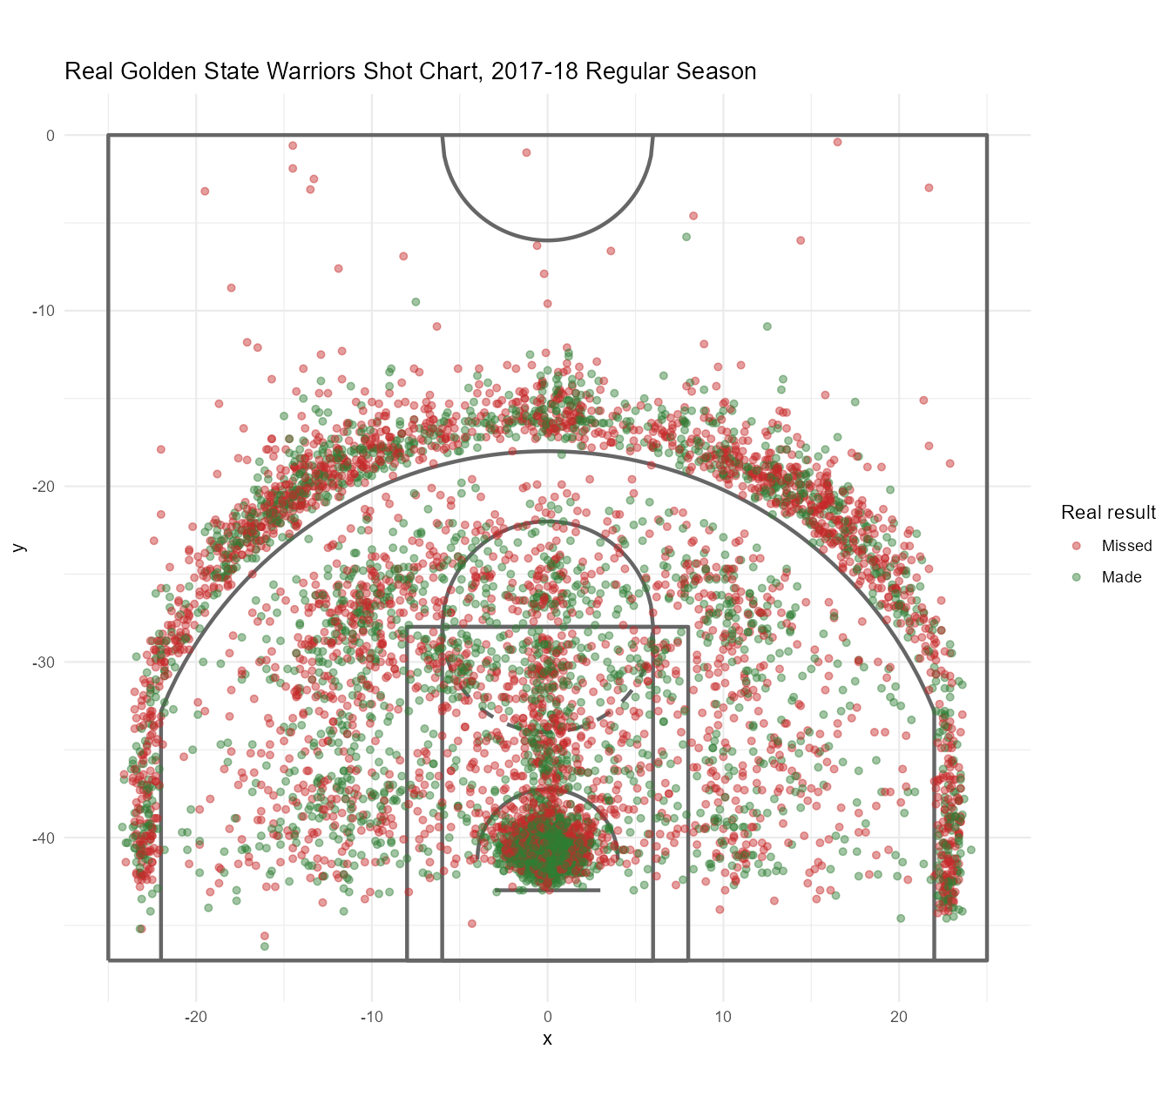
WORKED EXAMPLE, STEP 4
Golden State's Full 2017-18 Shot Chart
6,978 attempts, 50.3% field goal percentage. Data: PbP.BDB, Golden State Warriors, full 2017-18 season.

Slide 18
CONCEPT · SEGMENT 1
The Pattern a Sector Map Can Only Hint At
A dense cluster of makes right at the rim. A much sparser, more mixed cloud through the mid-range. Bands of attempts along the three-point line, heaviest above the break and in the corners. A shot chart is the ungrouped version of the same question the sector map already started answering.

Slide 19
RECAP · SEGMENT 1
Two Hand-Designed Maps, Covered
Covered
Next
A sector map by distance and angle, and a full shot chart for Golden State's complete season. Both are maps we designed ourselves, choosing the boundaries by hand.
Segment 2 lets a model find its own boundaries directly from the data, using Classification and Regression Trees.

Slide 20
10-Minute Break
Back at the top of the hour. Next: letting a model find the boundaries itself.

Slide 21
CONCEPT · SEGMENT 2
Classification and Regression Trees
A Non-Basketball Example First
The Same Idea Here
Picture a bank deciding loan approval. A tree might first split applicants by income, then split each income group again by credit score, repeating until the groups are as pure as possible.
CART repeats that same recursive splitting on shot coordinates instead of loan applicants, looking for the splits that best separate makes from misses.
Notes:
Do not rush the loan-approval analogy before showing any code. Several students will not have seen a classification tree before; the analogy is what makes the first real rpart() output legible.

Slide 22
LET'S RUN THIS TOGETHER
Let's fit the Cartesian CART model together and read the tree.
Pull up your own session. We'll run it line by line and look at the real output together.

Slide 23
WORKED EXAMPLE, STEP 5
Fitting CART on Cartesian Shot Coordinates
library(rpart)
library(rpart.plot)
cart_xy <- rpart(made ~ x_rel + y_rel, data = sh,
method = "class",
control = rpart.control(maxdepth = 4,
cp = 0.001, minbucket = 150))
rpart.plot(cart_xy)
printcp(cart_xy)
x_rel and y_rel are hoop-relative Cartesian coordinates. Run this and look at the printed tree.

Slide 24
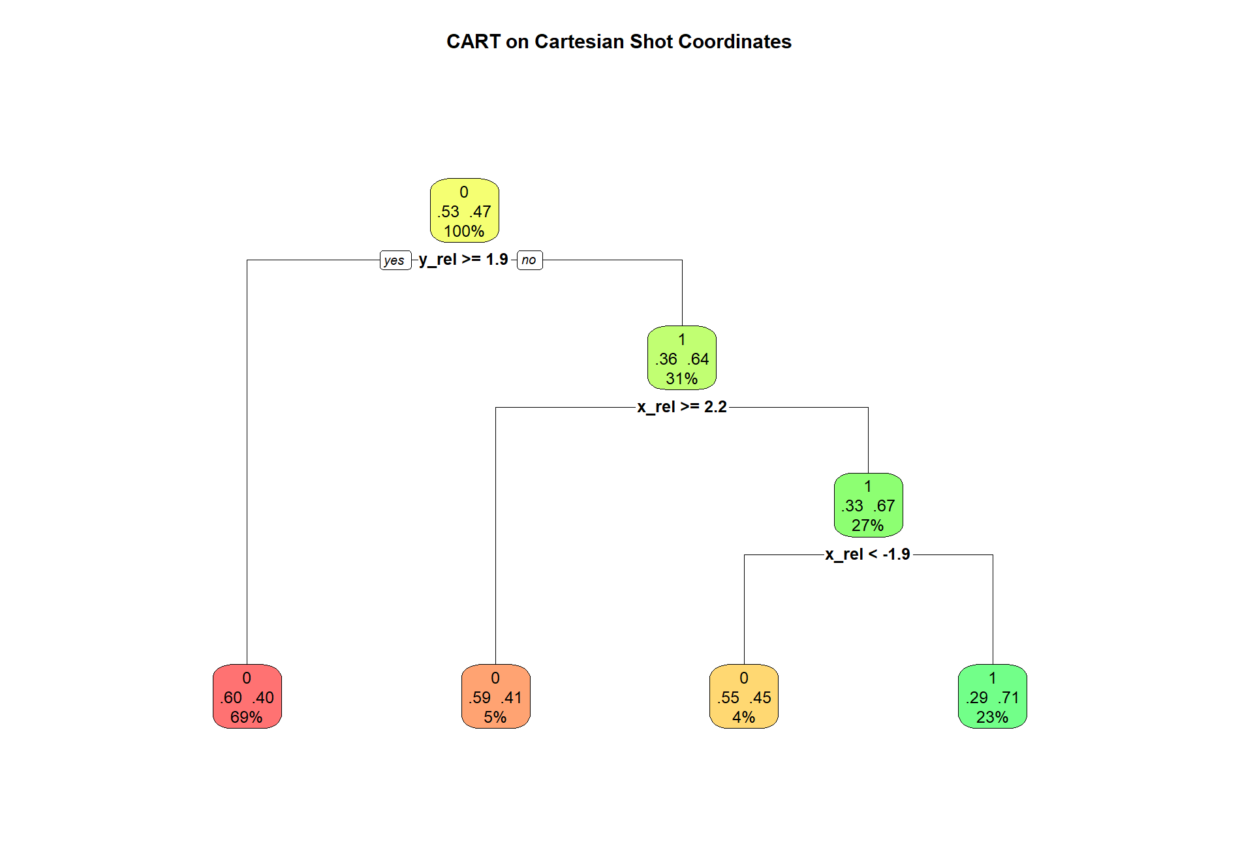
WORKED EXAMPLE, STEP 6
The Cartesian Tree, Four Terminal Nodes
rpart.plot(cart_xy). Data: PbP.BDB, 14,354 shots, 2017-18 NBA season.

Slide 25
WORKED EXAMPLE, STEP 7
Reading the Four Terminal Nodes
Node Condition | Attempts | Scoring Probability
y_rel >= 1.9 ft from the hoop | 9,888 (69%) | 40.1%
y_rel < 1.9 ft, x_rel >= 2.15 ft | 646 (4%) | 41.0%
y_rel < 1.9 ft, x_rel < 2.15 ft, x_rel < -1.95 ft | 536 (4%) | 45.1%
y_rel < 1.9 ft, x_rel < 2.15 ft, x_rel >= -1.95 ft | 3,284 (23%) | 71.0%
Training accuracy: 62.19%. Full node-by-node output is saved in module8_cart_cartesian_rules.txt.

Slide 26
INTERACTIVE ACTIVITY · DISCUSSION
What Basketball Situation Does This Split Describe?
Even among shots close enough to the rim to be in a high-percentage group, a sharp lateral angle (x_rel < -1.95, well off to one side, close to the baseline) drops scoring probability from 71.0% down to 45.1%. A smaller group on the opposite side (x_rel >= 2.15) lands at 41.0%, despite being just as close to the hoop.
1. What real shot does the 71.0%-to-45.1% split describe?
2. Why would a fixed distance-only sector rule, like the one from Segment 1, have missed this entirely?
Notes:
Target answer: a close shot taken from a sharp, tight angle near the baseline, a baseline floater or short runner that is close in distance but low-percentage because of the restricted finishing angle. This finding is the whole argument for letting CART find boundaries instead of fixing them by hand.

Slide 27
LET'S RUN THIS TOGETHER
Let's render the CART performance-map heat image together.
Pull up your own session. We'll run it line by line and look at the real output together.

Slide 28
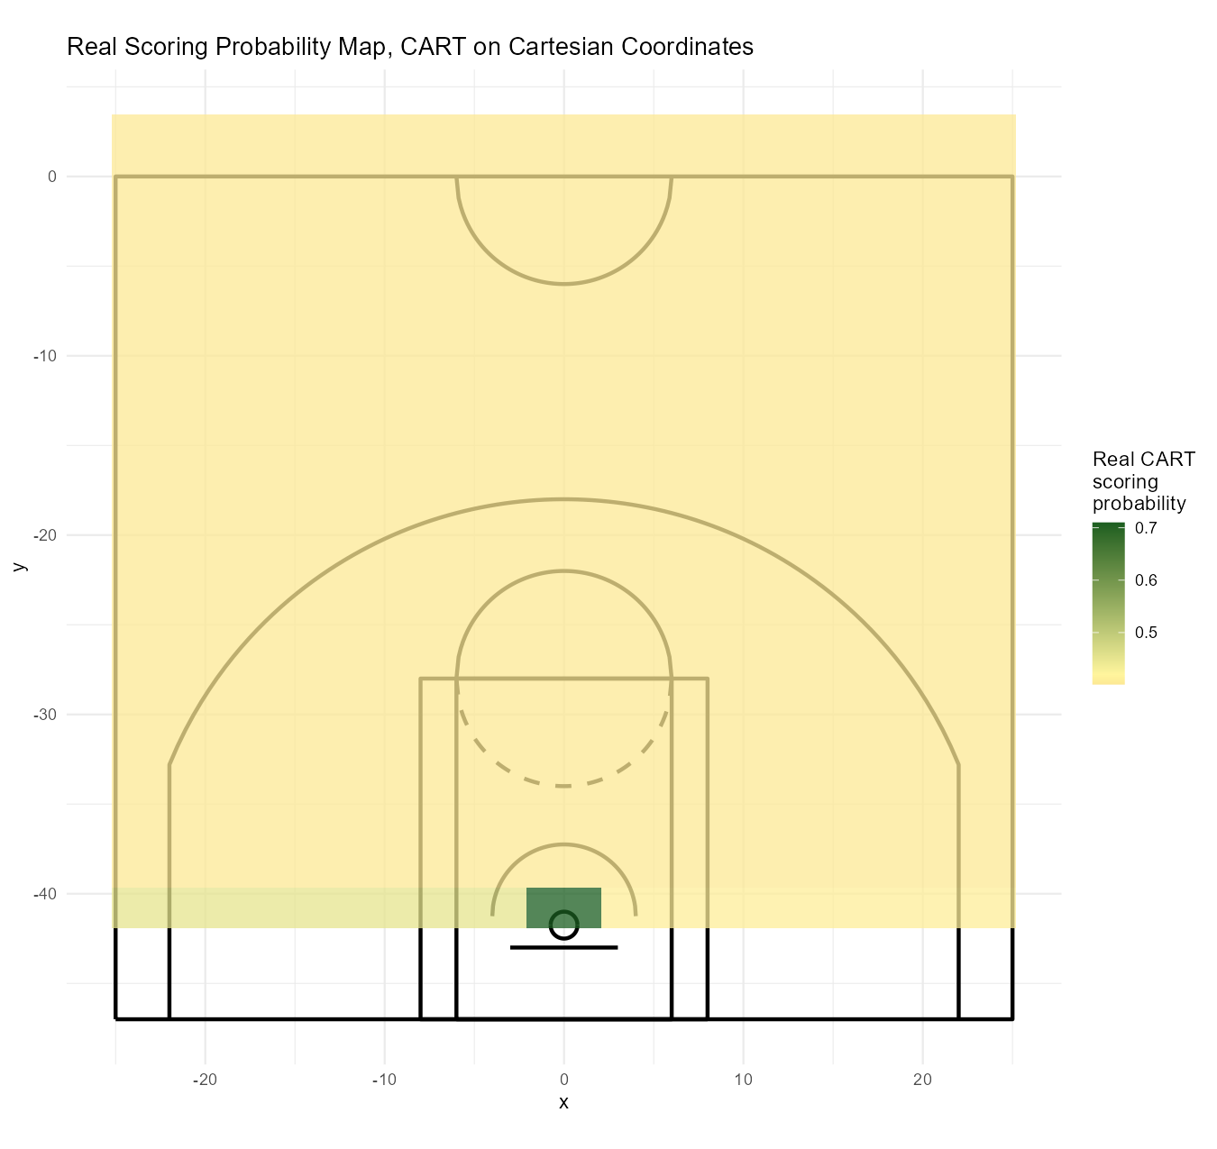
WORKED EXAMPLE, STEP 8
The Cartesian Model as a Performance-Map Heat Image
Scoring probability by location, predicted from cart_xy. Compare this directly to the Part 1 sector map.

Slide 29
CONCEPT · SEGMENT 2
A Model-Found Map vs. a Hand-Designed One
The sector map from Segment 1 used fixed, round-number boundaries we chose in advance: 4, 14, and 22 feet. The CART heat image found its own boundaries directly from the data, including the baseline-angle effect no fixed-distance rule could have found on its own.

Slide 30
RECAP · SEGMENT 2
A Model-Found Map, Covered
Covered
Next
A four-node CART model on Cartesian coordinates, 62.19% training accuracy, that found a close-range, sharp-angle split a fixed sector rule would have missed.
Segment 3 asks the same question using polar coordinates instead of Cartesian, and compares the two models directly.

Slide 31
10-Minute Break
Back at the top of the hour. Next: the same question on polar coordinates.

Slide 32
CONCEPT · SEGMENT 3
The Same Question, in Distance and Angle
Section 8.3 of this module's approach asks the same question using polar coordinates, distance and angle from the hoop, instead of x and y. The model is fit the same way, with the same control parameters, just on a different coordinate system.

Slide 33
LET'S RUN THIS TOGETHER
Let's fit the polar CART model together and compare accuracy directly.
Pull up your own session. We'll run it line by line and look at the real output together.

Slide 34
WORKED EXAMPLE, STEP 9
Fitting CART on Polar Shot Coordinates
cart_polar <- rpart(made ~ shot_distance + angle_deg,
data = sh, method = "class",
control = rpart.control(maxdepth = 4,
cp = 0.001, minbucket = 150))
rpart.plot(cart_polar)
printcp(cart_polar)
Run this and compare the printed tree's size to the Cartesian tree from Segment 2.

Slide 35
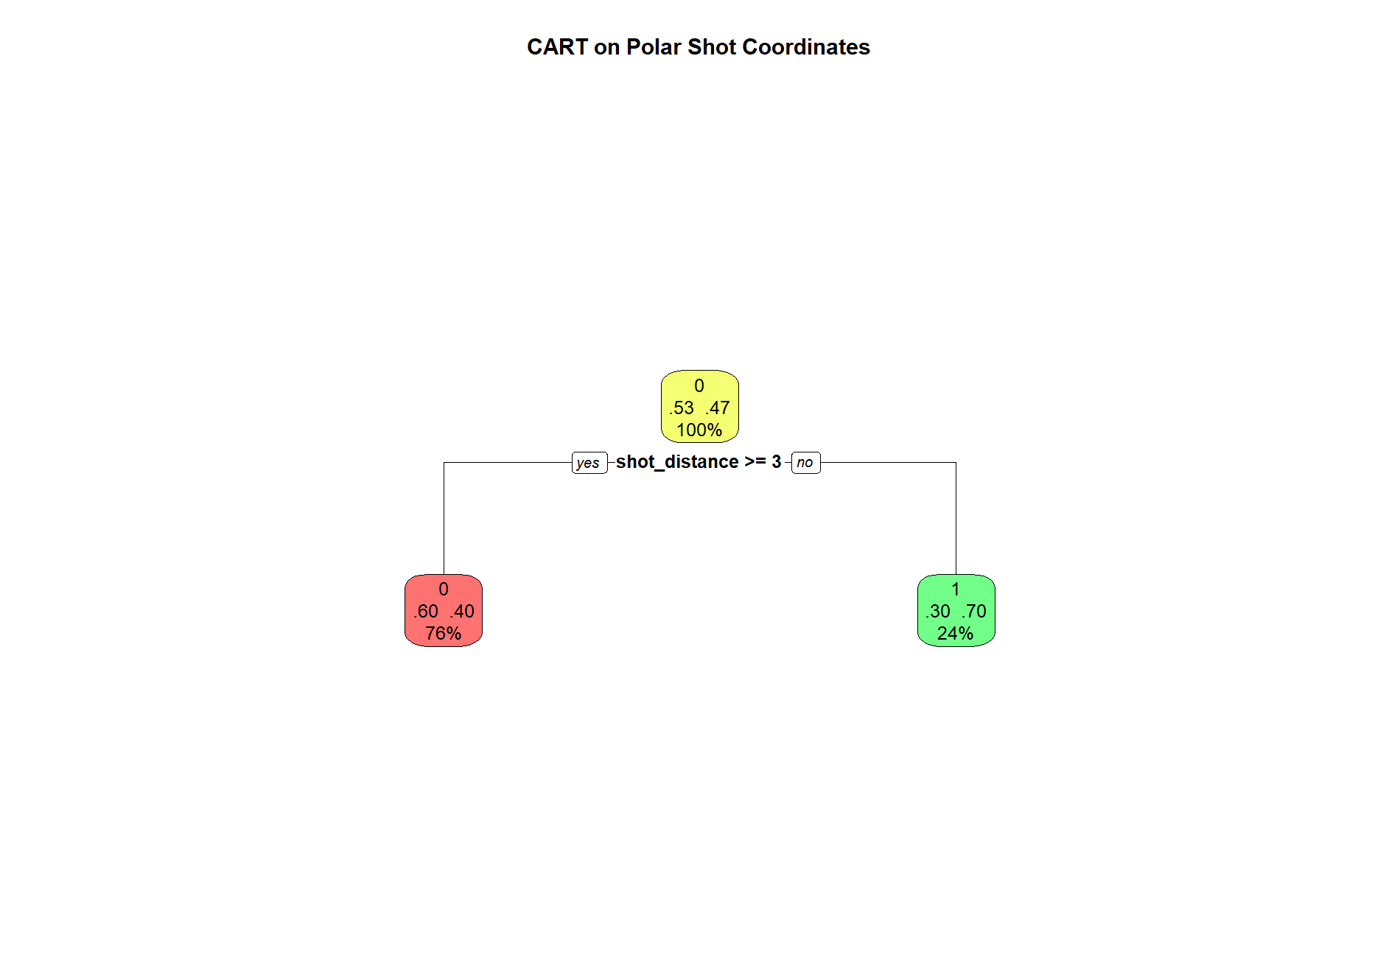
WORKED EXAMPLE, STEP 10
The Polar Tree: One Single Split
rpart.plot(cart_polar). Data: PbP.BDB, 14,354 shots, 2017-18 NBA season.

Slide 36
WORKED EXAMPLE, STEP 11
A Much Simpler Model, Nearly the Same Accuracy
Node Condition | Scoring Probability
shot_distance < 2.5 ft | 70.2%
shot_distance >= 2.5 ft | 40.2%
One single split, at exactly 2.5 feet from the hoop, with no angle information used at all.

Slide 37
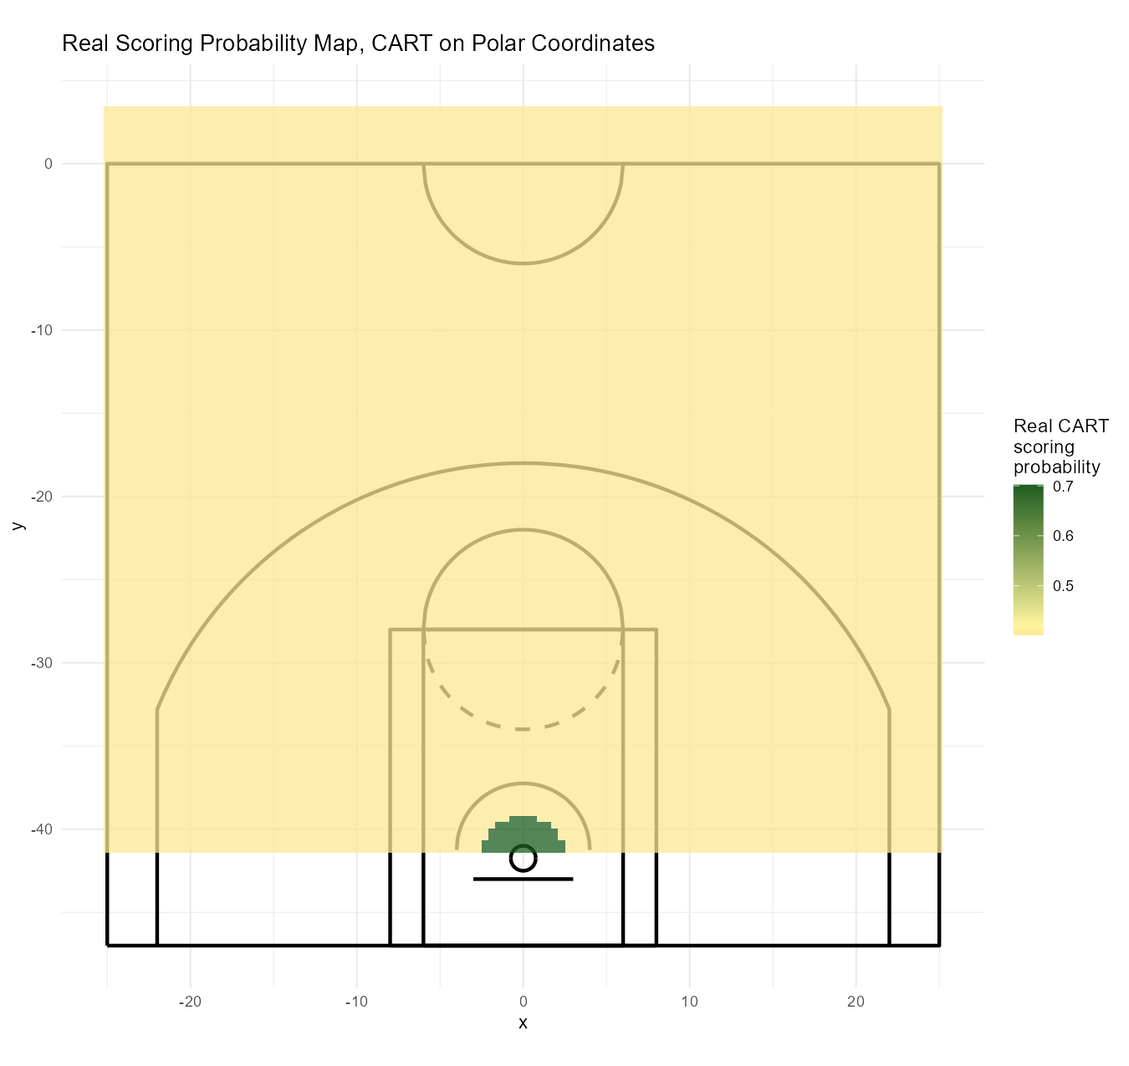
WORKED EXAMPLE, STEP 12
The Polar Model as a Performance-Map Heat Image
Scoring probability by location, predicted from cart_polar. A single ring around the hoop, not four distinct regions.

Slide 38
CONCEPT · THE COMPARISON THIS MODULE WANTS YOU TO CARRY
Distance Alone Captured Nearly All the Signal
62.19%
62.32%
Cartesian model
4 terminal nodes, x and y
Polar model
1 split, distance only
Distance from the hoop is the dominant signal in whether a shot goes in. The Cartesian model's extra nodes bought a small amount of nuance, the baseline-angle effect, not a large jump in overall accuracy.

Slide 39
CONCEPT · SEGMENT 3
Simplicity vs. Detail, Not Right vs. Wrong
Both models are valid, honestly computed performance maps. They make a different trade-off between simplicity and detail: the polar model is nearly as accurate and far easier to explain, while the Cartesian model captures one additional real effect the polar model cannot see at all.

Slide 40
INTERACTIVE ACTIVITY · SMALL GROUPS
Argue for One Model, to a Coaching Staff
Groups of 3-4. Half the groups argue for the Cartesian model, half for the polar model, as the one they would hand to a real coaching staff.
1. State your model's accuracy and structure.
2. State one concrete reason a coaching staff would prefer it over the other.
3. One group from each side presents its case to the class.

Slide 41
PHD / ADVANCED-PROJECT TRACK
The Same Model Structure, a Different Target
A CART-based performance map is exactly the kind of model structure the injury-risk track in Module 10 depends on: a model that takes a handful of measurable inputs and partitions them into interpretable groups. Here, the inputs are court coordinates and the groups are scoring-probability regions. In Module 10, the inputs are athlete workload indicators and the groups are risk categories.
Connects to the PhD track: Muritala, Brown & Haller (2026), Research in Sports Medicine; West et al. (2026), JSCR.

Slide 42
RECAP · SEGMENT 3
Cartesian vs. Polar, Covered
Covered
Next
A one-split polar model nearly matched a four-node Cartesian model's accuracy, and we connected this CART structure to the Module 10 injury-risk track.
Module 9 moves from CART-based scoring probability to full machine learning models: Random Forests, Oblique Random Forests, and Extremely Randomized Trees.

Slide 43
SUMMARY
What to Carry Forward
A sector map and a shot chart are performance maps we design by hand; CART models let the data find its own boundaries.
Expected points per shot, not raw field goal percentage, is the correct basis for comparing shot value: 0.876 for mid-range center versus 1.143 for three-point center.
The Cartesian CART model found a close-range, sharp-angle effect a fixed sector rule could not: 71.0% dropping to 45.1%.
The polar model's single distance-based split, at 2.5 feet, nearly matched the four-node Cartesian model's accuracy, 62.32% versus 62.19%, showing distance is the dominant signal.

Slide 44
BEFORE MODULE 09
Before Next Class
Do
Looking Ahead
Complete Lab 8 (sector maps, shot charts, and both CART models), the practice questions, and the Module 8 quiz.
Module 9: full machine learning scoring probability models, Random Forests, Oblique Random Forests, and Extremely Randomized Trees.

Slide 45
FULL READING LIST
References Cited Today
Zuccolotto, P., Manisera, M., & Sandri, M. (2026). Advanced Basketball Data Science: With Applications in R, Ch. 8. CRC Press / Chapman & Hall.
Sandri, M., Zuccolotto, P., & Manisera, M. BasketballAnalyzeR (R package): PbP.BDB, PbPmanipulation(), drawNBAcourt(). CRAN.
Therneau, T., & Atkinson, B. rpart (R package). Milborrow, S. rpart.plot (R package). CRAN.
All figures in this module were computed directly from the real PbP.BDB dataset and can be reproduced by running Coding_Exercise/module8_performance_maps.R.

Slide 46
See You in Module 09
Machine Learning Scoring Probability Models

