Slide 1
SPORTS ANALYTICS
The BasketballAnalyzeR Package, Applied as One Toolkit
Module 09 · Undergraduate · 3-hour session
Week 9
Undergraduate · 3-hour session
Zuccolotto, P., & Manisera, M. (2020). Basketball Data Science: With Applications in R. Chapman & Hall/CRC.
BasketballAnalyzeR (R package), Zuccolotto, Manisera & Sandri.

Slide 2
BEFORE WE START
What's Coming Up
Due This Week
-- update before class --
Coming Up
-- update before class --
Office Hours
-- update before class --

Slide 3
RECAP
Where We Left Off
Modules 2 through 8 each handed you one piece of the analyst's toolkit: pace and ratings, visual team and player profiles, shot charts, correlation and assist networks, clustering, and regression. I am not adding a brand new statistical idea today. I am pulling back the curtain on the toolkit itself and handing you four more real functions from BasketballAnalyzeR so you leave this course able to build a full scouting profile on any team, starting from nothing but raw play-by-play.
Every number today comes from the real 2017-18 NBA season: BasketballAnalyzeR::PbP.BDB, Pbox, and Tbox.

Slide 4
OUTLINE FOR THE DAY
Where We're Headed
I
Segment 1
II
Segment 2
Where a box score actually comes from: rebuilding it live with TOPboxes()
How evenly scoring is spread, with inequality(), plus the whole league at once with bubbleplot()
III
Segment 3
IV
Before Next Class
Whether a shot is good for this specific player, with expectedpts()
Lab 9, the Module 9 quiz, and the practice questions

Slide 5
LEARNING OBJECTIVES
By the End of Today, You Will Be Able To
1
Explain how BasketballAnalyzeR::TOPboxes() rebuilds a box score directly from raw play-by-play, and why a rebuilt total can honestly differ from the full-season Tbox total.
2
Compute and interpret a real Gini index of scoring concentration with inequality(), and state what a value near 0 versus near 100 means.
3
Build a four-statistic league-wide chart with bubbleplot() and read a team's position, color, and size together.
4
Compute expectedpts() for an individual player and explain how it differs from a single team-wide expected-points number.
5
Combine all four tools into one scouting-style profile for a team of your choosing.

Slide 6
CONCEPT · SEGMENT 1
Where Does a Box Score Actually Come From?
All course long I have handed you Tbox and Pbox as if they simply existed. They do not. Every column in those data frames was built by counting real events out of raw play-by-play, one shot, one rebound, one turnover at a time. BasketballAnalyzeR::TOPboxes() does exactly that counting for you, live, for any one team, straight from PbP.BDB.
Today we build a box score from scratch.

Slide 7
LET'S RUN THIS TOGETHER
Let's rebuild the Rockets' box score from raw play-by-play.
Pull up your own session. We'll run it line by line and look at the real output together.

Slide 8
WORKED EXAMPLE, STEP 1
Rebuilding a Box Score with TOPboxes()
PbP <- PbPmanipulation(PbP.BDB)
out_hou <- TOPboxes(PbP, team = "HOU")
out_hou$Tbox
out_hou$Pbox
Run this yourself. We'll compare the result to the built-in Tbox row on the next slide.

Slide 9
WORKED EXAMPLE, STEP 2
The Rebuilt Total vs. the Built-In Total
Source | Houston Rockets Points
Built-in Tbox (full 2017-18 season) | 9,213
Rebuilt with TOPboxes() from PbP.BDB | 352
That is not an error. PbP.BDB is built around Golden State's complete 82-game schedule. Every other team's rows, including the Rockets', are that team's own games against Golden State specifically, and only three such games exist in this dataset.
Data: TOPboxes(PbPmanipulation(PbP.BDB), team = "HOU") versus BasketballAnalyzeR::Tbox, 2017-18 season.

Slide 10
LET'S RUN THIS TOGETHER
Let's rebuild Golden State's box score the same way and compare.
Pull up your own session. We'll run it line by line and look at the real output together.

Slide 11
WORKED EXAMPLE, STEP 3
Confirming the Coverage Difference Directly
out_gsw <- TOPboxes(PbP, team = "GSW")
out_hou$Tbox$GP # 3
out_gsw$Tbox$GP # 82
Golden State's rebuilt game count should match its real, complete season. The Rockets' should not.

Slide 12
CONCEPT · READING A SMALL SAMPLE HONESTLY
A Small Real Sample Can Surprise You
This is not a contradiction. Harden was the real 2017-18 MVP and the league's leading scorer over the full season.
The lesson: a three-game sample can look nothing like an 82-game season, and the size of your sample should always travel with any number you report.
65 vs 49
Chris Paul's points vs. James
Harden's, across the 3 games
this dataset covers

Slide 13
WORKED EXAMPLE, STEP 4
The Rockets' Top Scorers, This 3-Game Sample
Player | GP (of 3) | PTS | 2P% | 3P%
Chris Paul | 3 | 65 | 44.0 | 44.0
Eric Gordon | 3 | 60 | 70.0 | 8.3
James Harden | 2 | 49 | 42.9 | 50.0
Clint Capela | 3 | 45 | 62.5 | --
Data: out_hou$Pbox from TOPboxes(PbPmanipulation(PbP.BDB), team = "HOU"), 3 games vs. Golden State, 2017-18 season.

Slide 14
INTERACTIVE ACTIVITY
What Would You Need to Trust This Table?
Turn to the person next to you.
1. If someone showed you only this table, with no label on the number of games, what conclusion might they wrongly draw about Chris Paul versus James Harden?
2. What is the minimum piece of information this table needs, right in the sentence reporting it, to stay honest?

Slide 15
RECAP · SEGMENT 1
Where Numbers Come From, Covered
Covered
Next
TOPboxes() rebuilds a box score directly from play-by-play. The Rockets' rebuilt total looked tiny next to the season total, for a real, honest, documented reason, not an error.
Segment 2 asks how evenly scoring is spread across a roster, then zooms out to the whole league at once.

Slide 16
10-Minute Break
Back at the top of the hour. Next: scoring inequality and the whole league at once.

Slide 17
CONCEPT · SEGMENT 2
How Evenly Is Scoring Actually Spread?
The Gini Index
Reading the Number
inequality() borrows the real Gini coefficient, the same tool economists use to measure income inequality, and points it at a team's own scoring distribution.
A Gini index near 0 means scoring is spread evenly across the roster. A Gini index closer to 100 means a small number of players account for most of the points.
Notes:
Discussion: before showing any code, ask the class which of this season's teams they think will have the HIGHEST scoring inequality, and why. Write two or three guesses on the board before moving on. Timing: about 3 minutes.

Slide 18
LET'S RUN THIS TOGETHER
Let's compute the Rockets' real Gini index together.
Pull up your own session. We'll run it line by line and look at the real output together.

Slide 19
WORKED EXAMPLE, STEP 5
Computing the Gini Index for the Rockets
data(Pbox)
Pbox.HOU <- Pbox[Pbox$Team == "Houston Rockets", ]
ineq_hou <- inequality(Pbox.HOU$PTS, nplayers = 8)
This uses the full-season Pbox, not the 3-game rebuild from Segment 1. Run it and read off the Gini index.

Slide 20
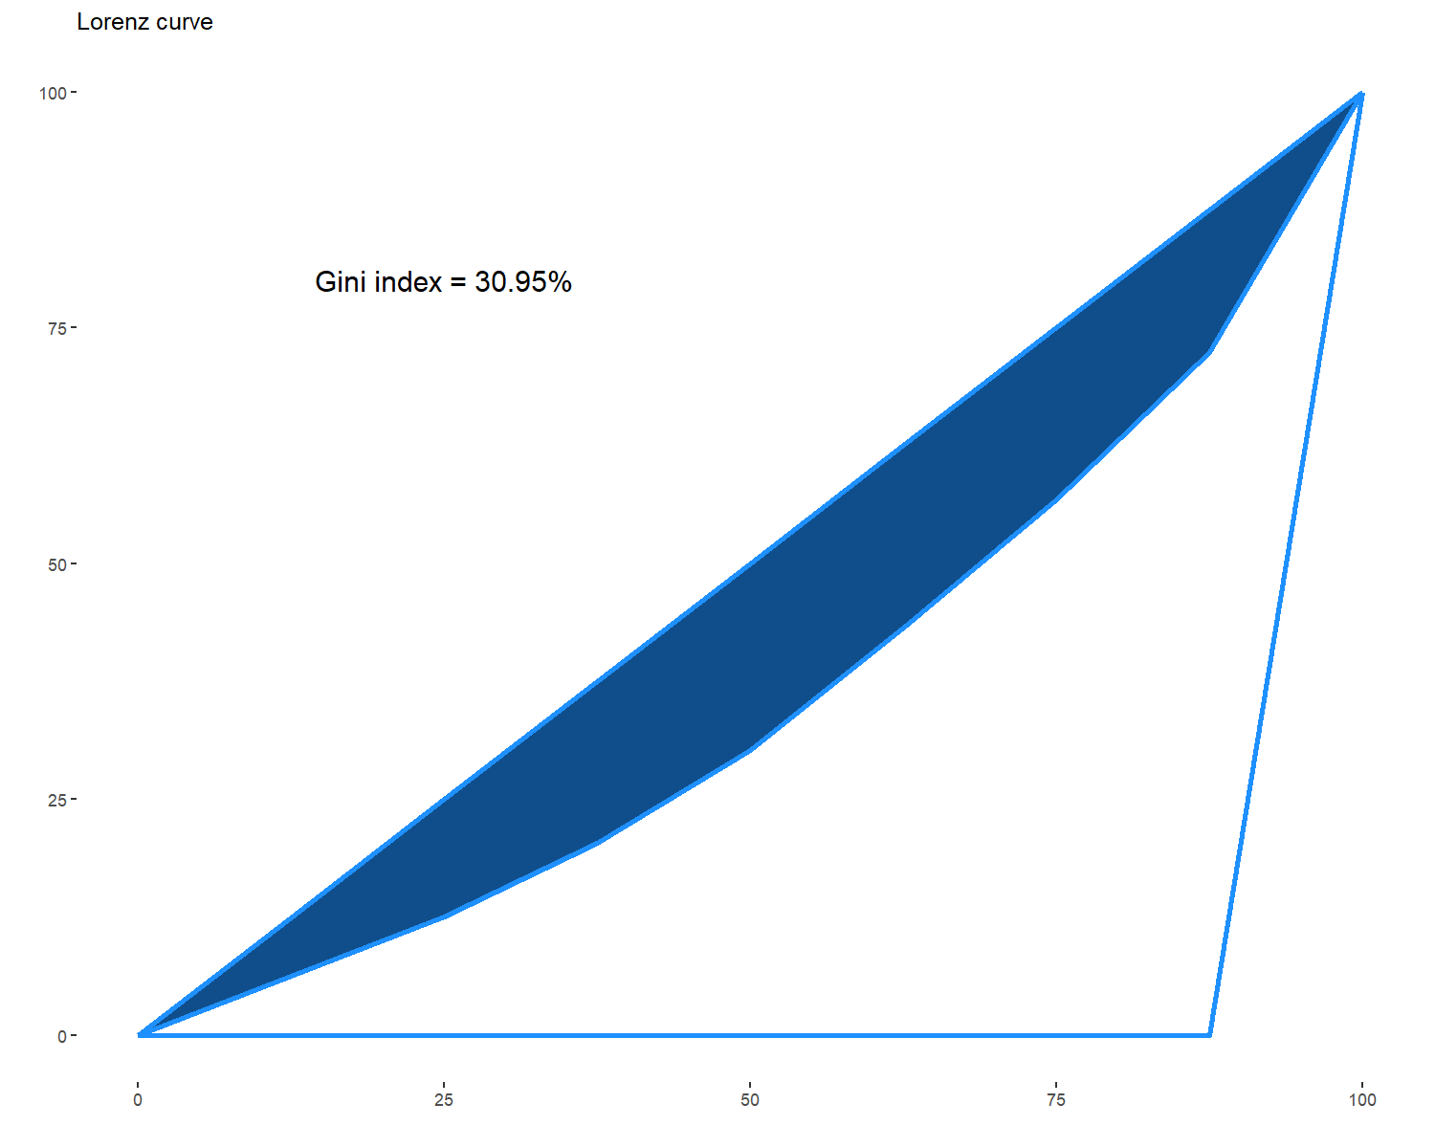
WORKED EXAMPLE, STEP 6
Houston's Scoring Concentration
30.95
Houston Rockets Gini index
(top 8 scorers, full 2017-18 season)
Data: inequality(Pbox.HOU$PTS, nplayers = 8), BasketballAnalyzeR, full 2017-18 season.

Slide 21
INTERACTIVE ACTIVITY · COLD CALL
Before I Reveal Golden State's Number
Houston's Rockets scored around one isolation-heavy superstar in James Harden. Golden State was famous for its egalitarian motion offense that season.
Will the Warriors' Gini index be higher or lower than Houston's 30.95? Raise your hand for higher, then for lower.

Slide 22
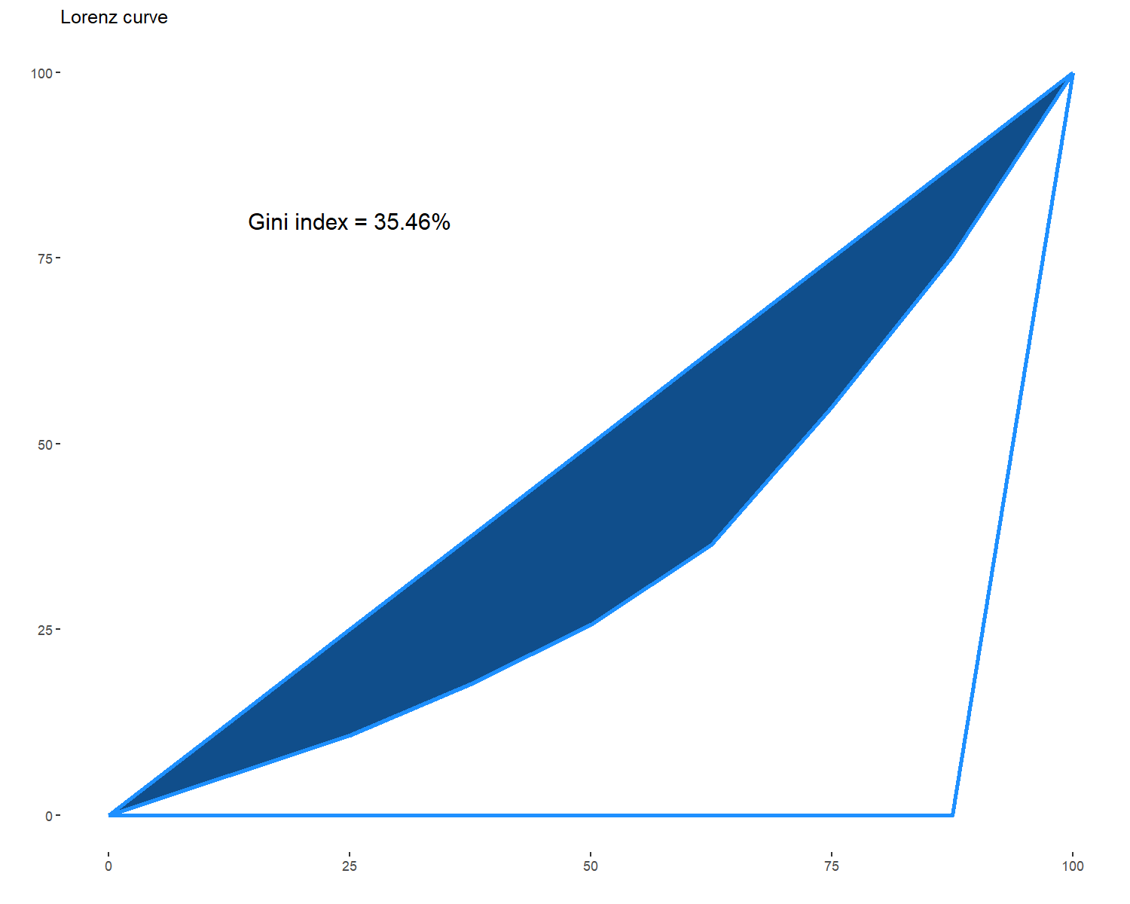
WORKED EXAMPLE, STEP 7
Golden State's Scoring Concentration
35.46
Golden State Warriors Gini index
(top 8 scorers, full 2017-18 season)
Data: inequality(Pbox.GSW$PTS, nplayers = 8), BasketballAnalyzeR, full 2017-18 season.

Slide 23
CONCEPT · A TEAM'S REPUTATION ISN'T ITS DATA
The Warriors Were the More Top-Heavy Team
I expected the opposite. I expected the Rockets, built around one isolation-heavy star, to show more scoring inequality than the Warriors, a team famous for ball movement. I was wrong.
The lesson: a team's offensive system and a team's reputation are not the same thing as what the numbers say, and the only way to know which one is true is to run the function and look.
35.46
> 30.95
Golden State's Gini index vs.
Houston's, top 8 scorers each

Slide 24
CONCEPT · SEGMENT 2
The Whole League, Four Numbers at Once
bubbleplot() puts four statistics on one chart at once: a team's position on the x and y axes, a team's color, and a team's bubble size. I built a league-wide version using 2-point percentage on the x-axis, 3-point percentage on the y-axis, free throw percentage as color, and total shots attempted as bubble size.
Not a new statistic. A better way to see several you already trust, together.

Slide 25
LET'S RUN THIS TOGETHER
Let's build the league-wide bubble chart together.
Pull up your own session. We'll run it line by line and look at the real output together.

Slide 26
WORKED EXAMPLE, STEP 8
Building the League-Wide Bubble Chart
data(Tbox)
attach(Tbox)
X <- data.frame(
P2M / P2A, P3M / P3A,
FTM / FTA, P2A + P3A
)
detach(Tbox)
labs <- c("2P%", "3P%", "FT%", "FGA")
bubbleplot(Tbox, id = "Team", x = "P2M", y = "P3M",
col = "FTM", size = "P2A", labels = labs)
Run this together, then find your own favorite team on the chart.

Slide 27
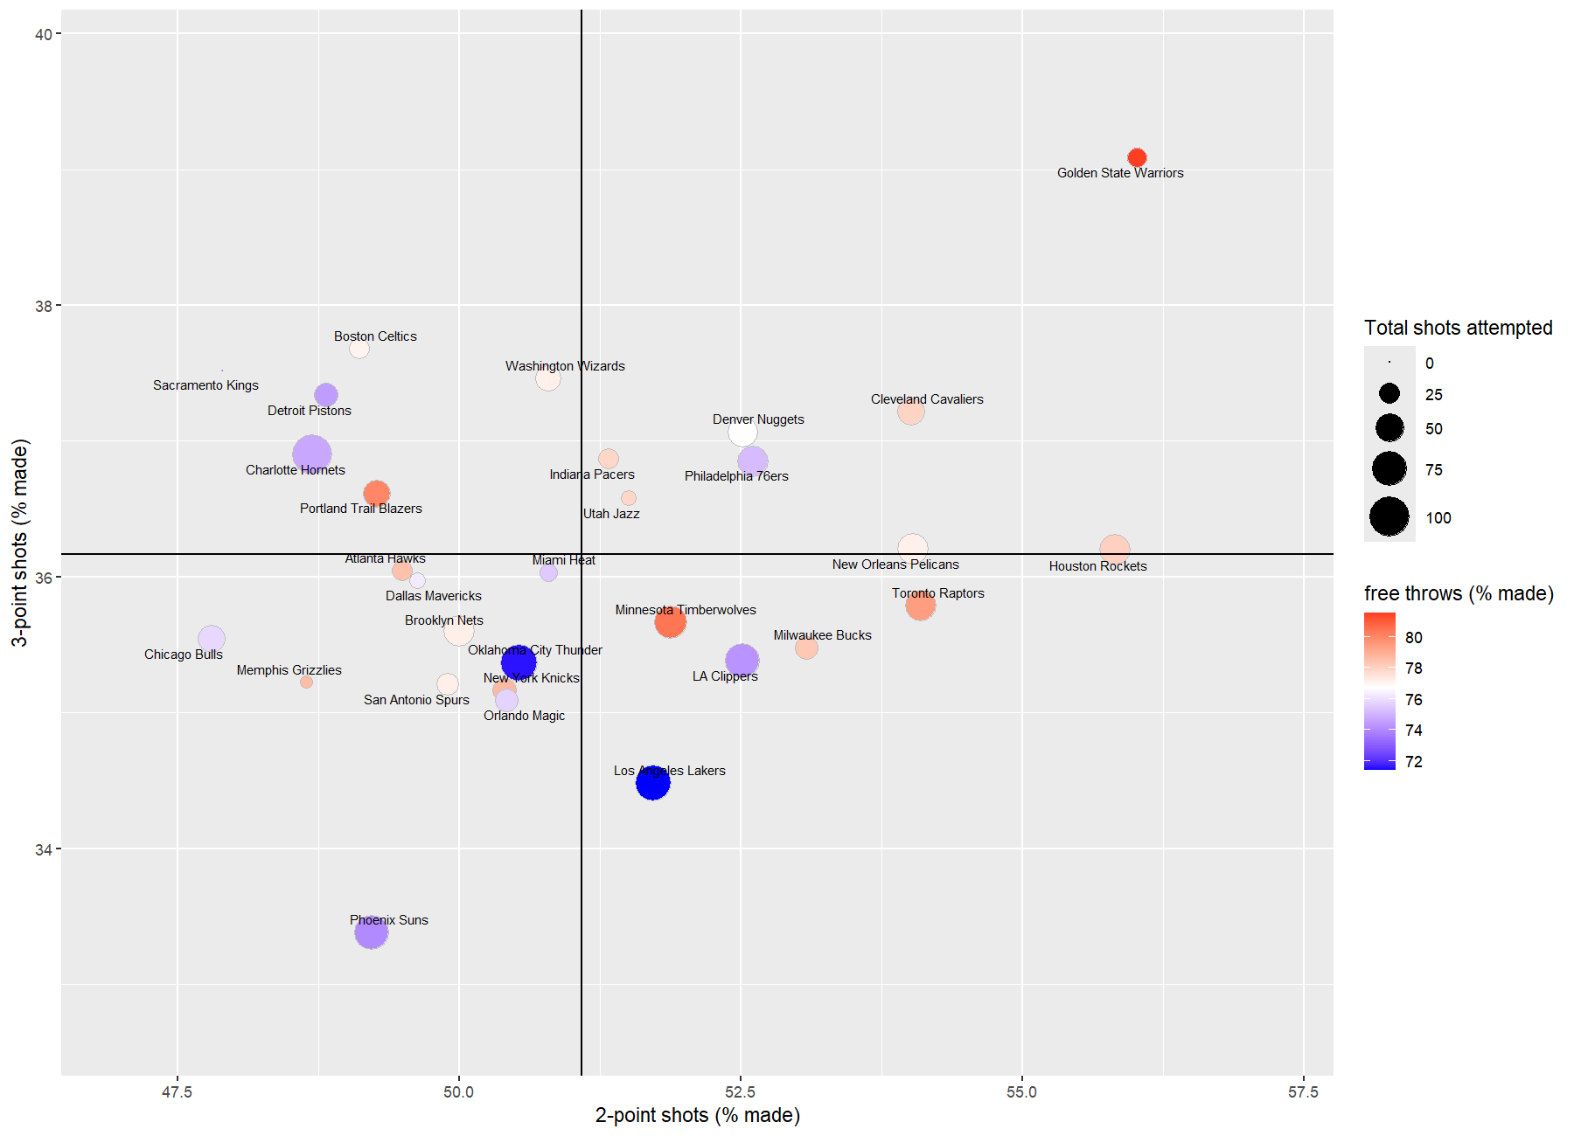
WORKED EXAMPLE, STEP 9
All 30 Teams, Four Statistics at Once
bubbleplot(), BasketballAnalyzeR. Data: Tbox, 2017-18 NBA season.

Slide 28
WORKED EXAMPLE, STEP 10
Finding the Rockets on the Chart
55.8% on 2-point shots
36.2% on 3-point shots
78.1% on free throws
Among the league's better combinations on all three at once.
Data: Tbox, Houston Rockets row, 2017-18 NBA season, BasketballAnalyzeR.

Slide 29
INTERACTIVE ACTIVITY
Give a Team a One-Sentence Identity
Pair up. I'll assign your pair one team from the bubble chart.
1. Find your team's position, color, and bubble size.
2. Write one sentence describing your team's shooting identity, using only what the chart shows.
3. Be ready to share your sentence with the class.

Slide 30
RECAP · SEGMENT 2
Spread and Scale, Covered
Covered
Next
inequality() measures scoring concentration with a real Gini index, and surprised us by showing Golden State more top-heavy than Houston. bubbleplot() showed the whole league on four statistics at once.
Segment 3 asks a sharper question than whether a shot is good: whether it is good for this specific player.

Slide 31
10-Minute Break
Back at the top of the hour. Next: is this shot good for this specific player?

Slide 32
CONCEPT · SEGMENT 3
Is This Shot Good for This Specific Player?
Beyond Shot Location
Relative to the Team
Module 4 gave you where a shot was taken. expectedpts() goes one step further: it asks whether a shot from a given distance is a good shot for one specific player.
It compares that player's shots to their own team's expected points at that same distance, not to a single league-wide number.

Slide 33
LET'S RUN THIS TOGETHER
Let's build the expected-points-by-distance chart for Harden and Paul together.
Pull up your own session. We'll run it line by line and look at the real output together.

Slide 34
WORKED EXAMPLE, STEP 11
Comparing Two Players to Their Team's Average
plrys <- c("James Harden", "Chris Paul")
expectedpts(data = PbP.HOU, bw = 10,
players = plrys,
col.team = "dodgerblue")
This uses the 3-game PbP.HOU subset from Segment 1. Run it and look at where each player's curve separates from the team average.

Slide 35
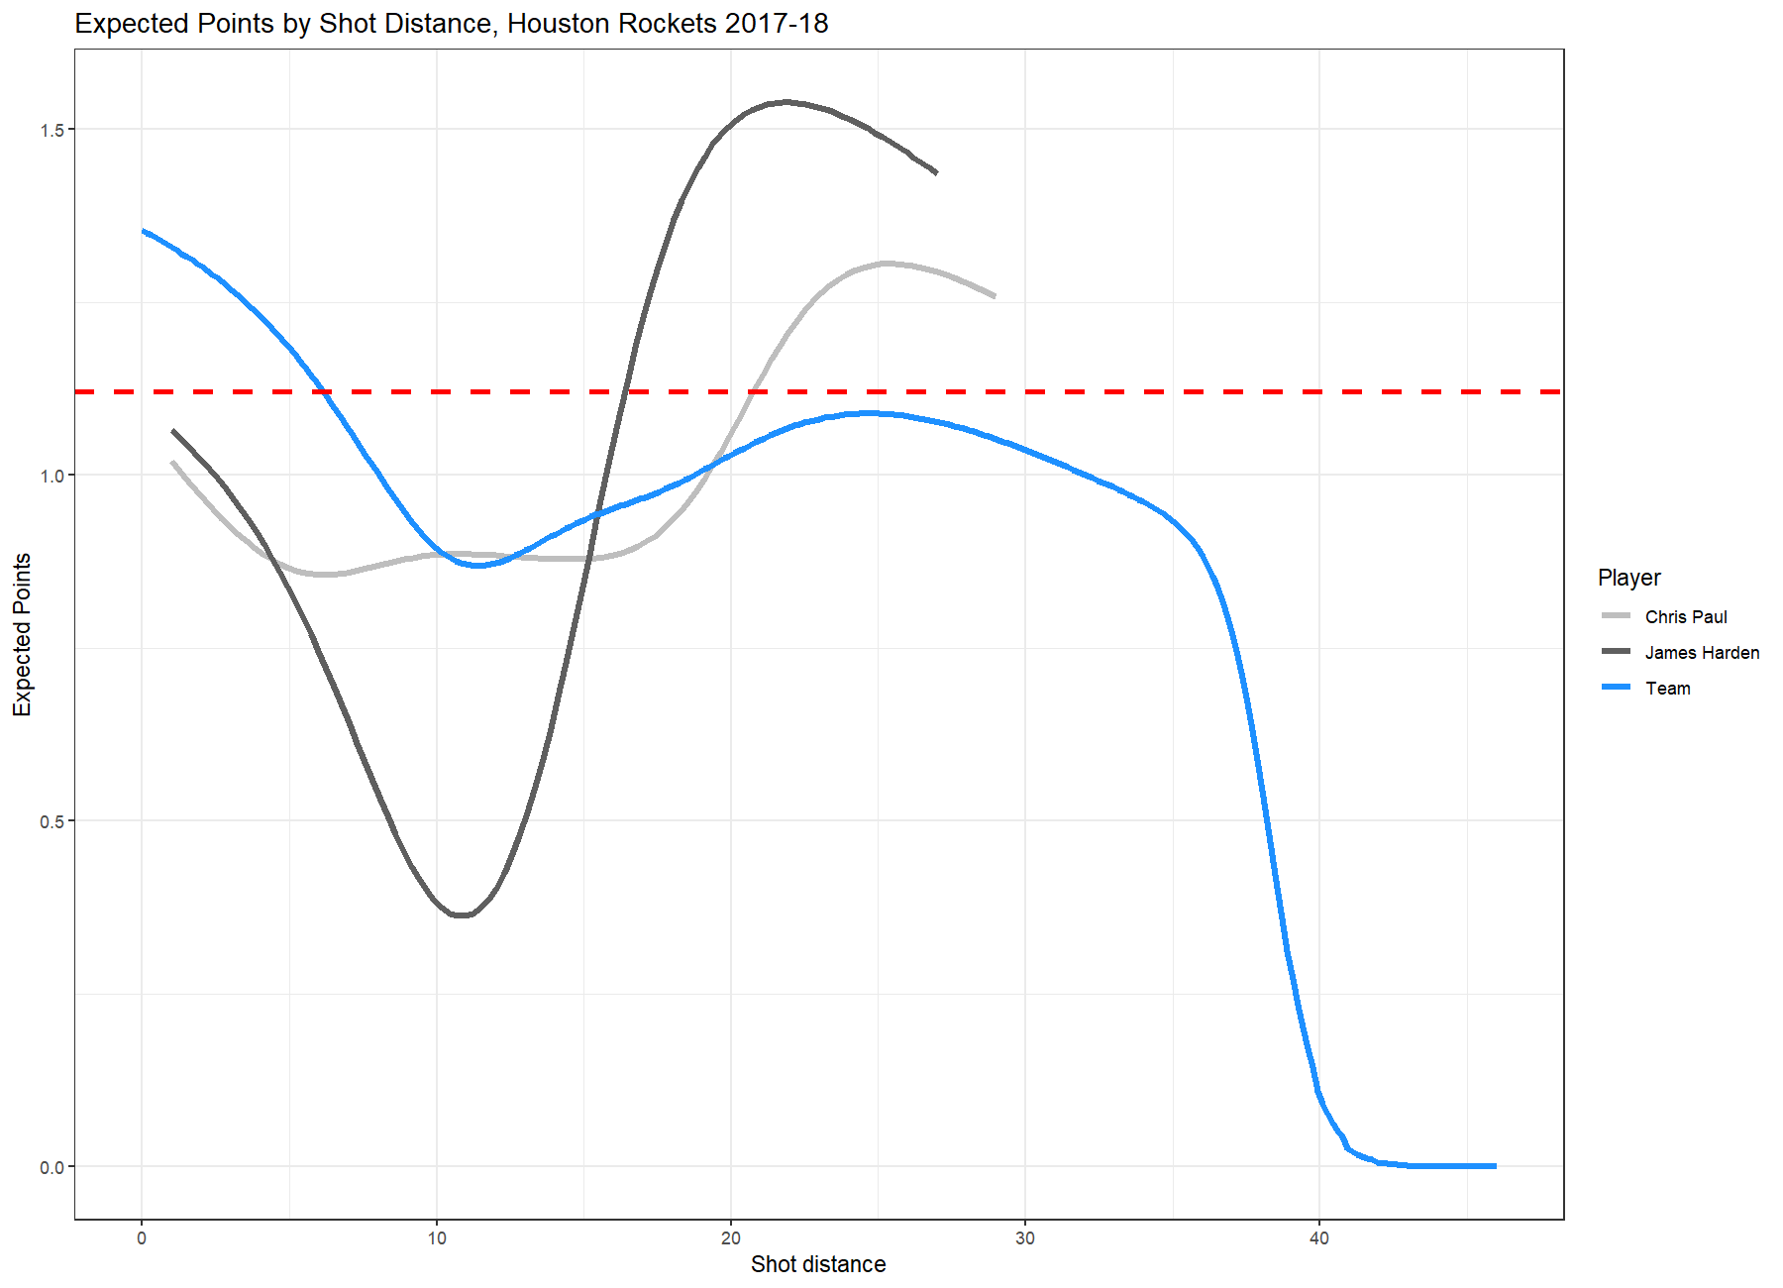
WORKED EXAMPLE, STEP 12
Harden and Paul vs. the Team Average
expectedpts(data = PbP.HOU, bw = 10, players = c("James Harden","Chris Paul")), BasketballAnalyzeR.

Slide 36
INTERACTIVE ACTIVITY
Where Do the Curves Separate?
Look at the chart on the previous slide.
1. At roughly what distance does each player's curve pull away from the team average?
2. What would a scout or coach actually do with this information that they couldn't do with a single team-wide expected-points number?
Notes:
Discussion: push students past 'it shows the player is good or bad' toward the actual coaching use case, shot selection for THIS player specifically. Ask: should a coach tell Harden and Paul to take the exact same shots? Why might the answer be no even though they're on the same team. Timing: about 5 minutes.

Slide 37
INTERACTIVE ACTIVITY · SMALL GROUPS
Build the Same Chart for a Different Team
Groups of 3-4. Each group picks a different pair of Golden State players.
1. Build the expectedpts() chart for your pair, using PbP.GSW.
2. Find one distance where your two players' curves separate from each other or from the team average.
3. Report your one finding back to the class.

Slide 38
CONCEPT · PULLING THE TOOLKIT TOGETHER
One Team, Four Tools, One Profile
TOPboxes()
Where the raw numbers come from, and how much game coverage actually backs them.
inequality()
Whether scoring is spread across the roster or concentrated in a few players.
bubbleplot()
How a team compares to the whole league on several statistics at once.
expectedpts()
Whether a specific player's shots are good shots for that player, not just in general.

Slide 39
INTERACTIVE ACTIVITY · WRAP-UP
Write a Scouting Profile, One Paragraph
Pick any team in Tbox. In one paragraph, using all four tools from today, describe:
1. How much of that team's data you could actually trust, and why.
2. Whether its scoring is concentrated or spread out.
3. Where it sits among the league on the bubble chart.
4. One thing you would want to know about an individual player's shot selection before trusting a team-wide number for them.
This paragraph is the starting point for the Lab 9 extension.

Slide 40
RECAP · SEGMENT 3
The Full Toolkit, Covered
Covered
Next
expectedpts() compares an individual player's shots to their own team's average, giving a sharper question than whether a shot is simply good.
Module 10 turns this same applied mindset toward quality monitoring and injury risk, using real statistical process control methods.

Slide 41
SUMMARY
What to Carry Forward
TOPboxes() rebuilds a box score directly from play-by-play, and a rebuilt total can honestly differ from a season total for a documented, real reason.
inequality() measures scoring concentration with a real Gini index -- a team's reputation and its real numbers are not always the same thing.
bubbleplot() puts several trusted statistics on one chart at once, for the whole league simultaneously.
expectedpts() asks a sharper question than whether a shot is good: whether it is good for this specific player, relative to their own team.

Slide 42
BEFORE MODULE 10
Before Next Class
Do
Looking Ahead
Complete Lab 9 (the four-tool scouting profile), the practice questions, and the Module 9 quiz.
Module 10: quality monitoring and injury risk, using real statistical process control methods on real data.

Slide 43
FULL READING LIST
References Cited Today
Zuccolotto, P., & Manisera, M. (2020). Basketball Data Science: With Applications in R. Chapman & Hall/CRC.
Sandri, M., Zuccolotto, P., & Manisera, M. BasketballAnalyzeR (R package): TOPboxes(), inequality(), bubbleplot(), expectedpts(). CRAN.
All figures in this module were computed directly from BasketballAnalyzeR::PbP.BDB, Pbox, and Tbox, 2017-18 NBA season, and can be reproduced by running Coding_Exercise/module9_applied_toolkit.R.

Slide 44
See You in Module 10
Quality Monitoring and Injury Risk

