Slide 1
ADVANCED SPORTS ANALYTICS
Advanced Basketball Data Science
Module 05 · Understanding Players' Spatial Dynamics
Week 5
Graduate · 3-hour session
Maps to Chapter 5:
Zuccolotto, Manisera & Sandri (2026). Advanced Basketball Data Science. CRC Press.

Slide 2
BEFORE WE START
What's Coming Up
Due This Week
-- update before class --
Coming Up
-- update before class --
Office Hours
-- update before class --

Slide 3
RECAP
Where We Left Off
Module 4 split a real season into two segments and asked whether early form predicts a final ranking. Every module so far has treated a player as a set of numbers. Today the unit of analysis changes: where on the real court does a player actually operate, and how does that spatial footprint differ from a teammate's?
Same real 2017-18 data, same BasketballAnalyzeR foundation, a genuinely new set of tools.

Slide 4
OUTLINE FOR THE DAY
Where We're Headed
I
Segment 1
II
Segment 2
Convex hulls: mapping each player's real shot territory
Voronoi tessellation: dividing the real floor by shooting tendency
III
Segment 3
IV
Before Next Class
Spatial distribution, real Gravity, and what tracking data would add
Lab 5, the Module 5 quiz, and the practice questions

Slide 5
LEARNING OBJECTIVES
By the End of Today, You Will Be Able To
1
Explain why this module uses real shot-location data instead of the textbook's own proprietary tracking data, and what that substitution can and cannot show.
2
Build a real convex hull from a player's shot locations and interpret its area as a real measure of floor coverage.
3
Build a real Voronoi tessellation from multiple players' shooting tendencies and explain what determines each player's region size.
4
Compare two players' real spatial shot distributions using kernel density and explain what shape reveals that a single percentage cannot.
5
Explain the NBA's real Gravity stat and why this course's real data can approximate, but not fully replicate, a tracking-based metric.

Slide 6
A NOTE BEFORE WE START
What Data This Module Actually Uses
The textbook's own Chapter 5 examples use proprietary, frame-by-frame optical player-tracking data, the kind the NBA collects through camera systems dozens of times per second. That feed is not publicly available to us.
What we do have: real event-level shot-location coordinates for every real 2017-18 field goal attempt in BasketballAnalyzeR::PbP.BDB. That's what this whole module is built on.

Slide 7
CONCEPT · SEGMENT 1
A Convex Hull: A Player's Real Shot Territory
A convex hull is the smallest polygon that contains every point in a set. Applied to a player's real shot locations across a season, it draws the actual boundary of where that player takes shots from.
Today's comparison: Stephen Curry versus Draymond Green, two real Warriors with very different roles.

Slide 8
WATCH FIRST
See the Real Territory Before We Map It
Steph Curry Gravitational Pull
YouTube
Real game footage of how defenses react to a player with real range across the whole floor. Watch how far defenders travel to contest him, well beyond where most players ever shoot from.
https://www.youtube.com/watch?v=Y0ylSKhDu44
Notes:
Discussion: ask students to name, just from watching, roughly how far from the basket Curry is operating compared to a traditional shooter. This primes the real convex hull comparison on the next slides.

Slide 9
LET'S RUN THIS TOGETHER
Let's build a real convex hull together.
Pull up your own session. We'll run it line by line and look at the real output together.

Slide 10
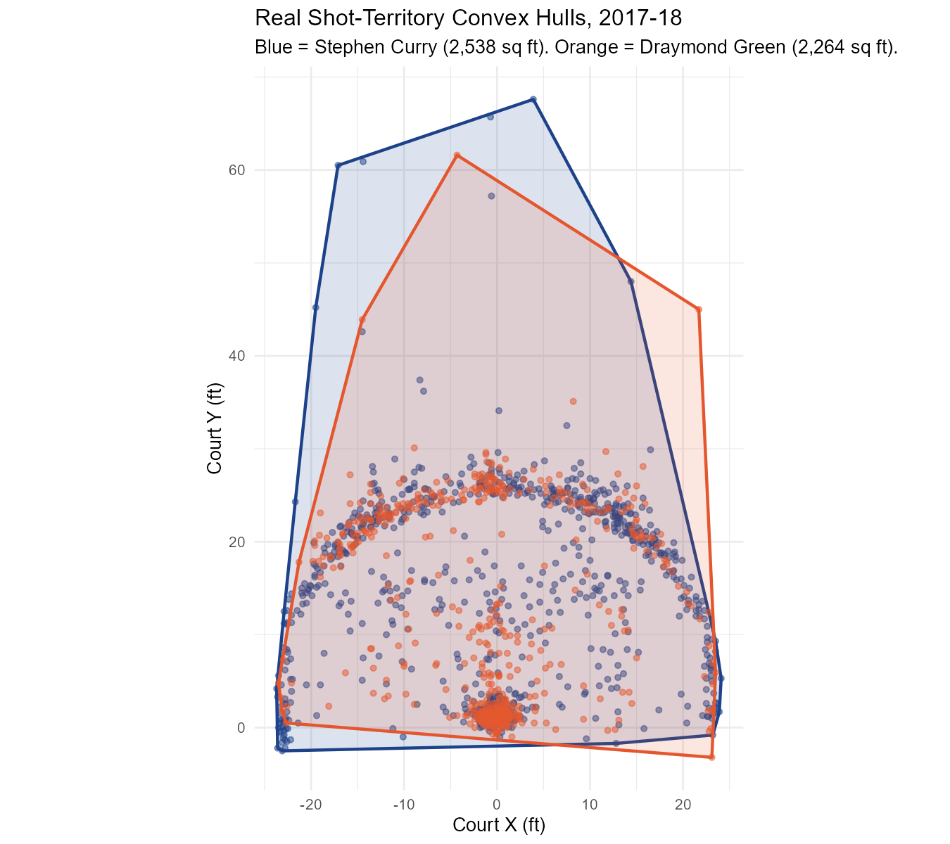
WORKED EXAMPLE, STEP 1
Real Shot-Territory Convex Hulls
chull() on real original_x/original_y shot coordinates, PbP.BDB, BasketballAnalyzeR. Data: 2017-18 GSW real shots.
Notes:
Discussion: point out where the two hulls overlap (near the rim) versus where they diverge (Curry's reach into both corners and well beyond the arc). Ask what each shape says about the two players' real roles.

Slide 11
CONCEPT · THE CORE NUMBERS OF THIS SEGMENT
2,538 vs. 2,264 Square Feet
Draymond Green: 2,264 sq ft from 619 real attempts, a smaller real territory concentrated closer to the basket and short midrange.
What this shows: not just how well two players shoot, but from where, drawn directly from real data rather than assumed from their reputations.
2,538
sq ft, Stephen Curry's real
shot-territory hull, from
864 real shot attempts

Slide 12
INTERACTIVE ACTIVITY
Read the Two Real Hulls
Turn to the person next to you and look back at the convex hull image.
1. Where do the two real hulls overlap most, and why does that make basketball sense?
2. Where do they diverge most, and what does that say about each player's real role?

Slide 13
WORKED EXAMPLE, STEP 2
Real Floor Coverage Is Not the Same as Real Shot Volume
Player | Real Shots | Real Hull Area (sq ft)
Klay Thompson | 1,178 | 2,599
Stephen Curry | 864 | 2,538
Kevin Durant | 1,221 | 2,018
Durant took the most real shots on the team, but from a smaller real area of the floor than Thompson or Curry.
Data: real 2017-18 shot locations, PbP.BDB, BasketballAnalyzeR.

Slide 14
RECAP · SEGMENT 1
Convex Hulls, Covered
Covered
Next
Built real convex hulls from shot locations and found that real floor coverage and real shot volume are two separate questions.
Segment 2 uses multiple players' real shooting tendencies at once to divide the whole floor.

Slide 15
10-Minute Break
Back at the top of the hour. Next: dividing the real floor by shooting tendency.

Slide 16
CONCEPT · SEGMENT 2
Voronoi Tessellation: Whose Floor Is It?
A Voronoi tessellation divides a plane into regions, one per seed point, where every location is closer to that region's seed than to any other.
Applied to real players' typical shooting locations, it produces a literal map of which part of the floor "belongs" to which shooter.

Slide 17
CONCEPT · SEGMENT 2
Choosing the Real Seed Point
Each player's seed is the real median location of their own three-point and long two-point attempts, excluding shots within 10 feet of the basket. Why exclude those? Nearly every player's single most common real shot is a rim attempt, which would collapse every seed to the same point.
median(x_ft), median(y_ft) where x_ft^2 + y_ft^2 > 10^2

Slide 18
WATCH
What Real Spacing Looks Like
Elite Spacing Isn't Just About Outside Shooting
YouTube
A concept-explainer on real floor spacing, directly relevant to why some players claim larger real regions on the Voronoi map than others.
https://www.youtube.com/watch?v=osY0NWe4M0w

Slide 19
LET'S RUN THIS TOGETHER
Let's build the real Voronoi tessellation together.
Pull up your own session. We'll run it line by line and look at the real output together.

Slide 20
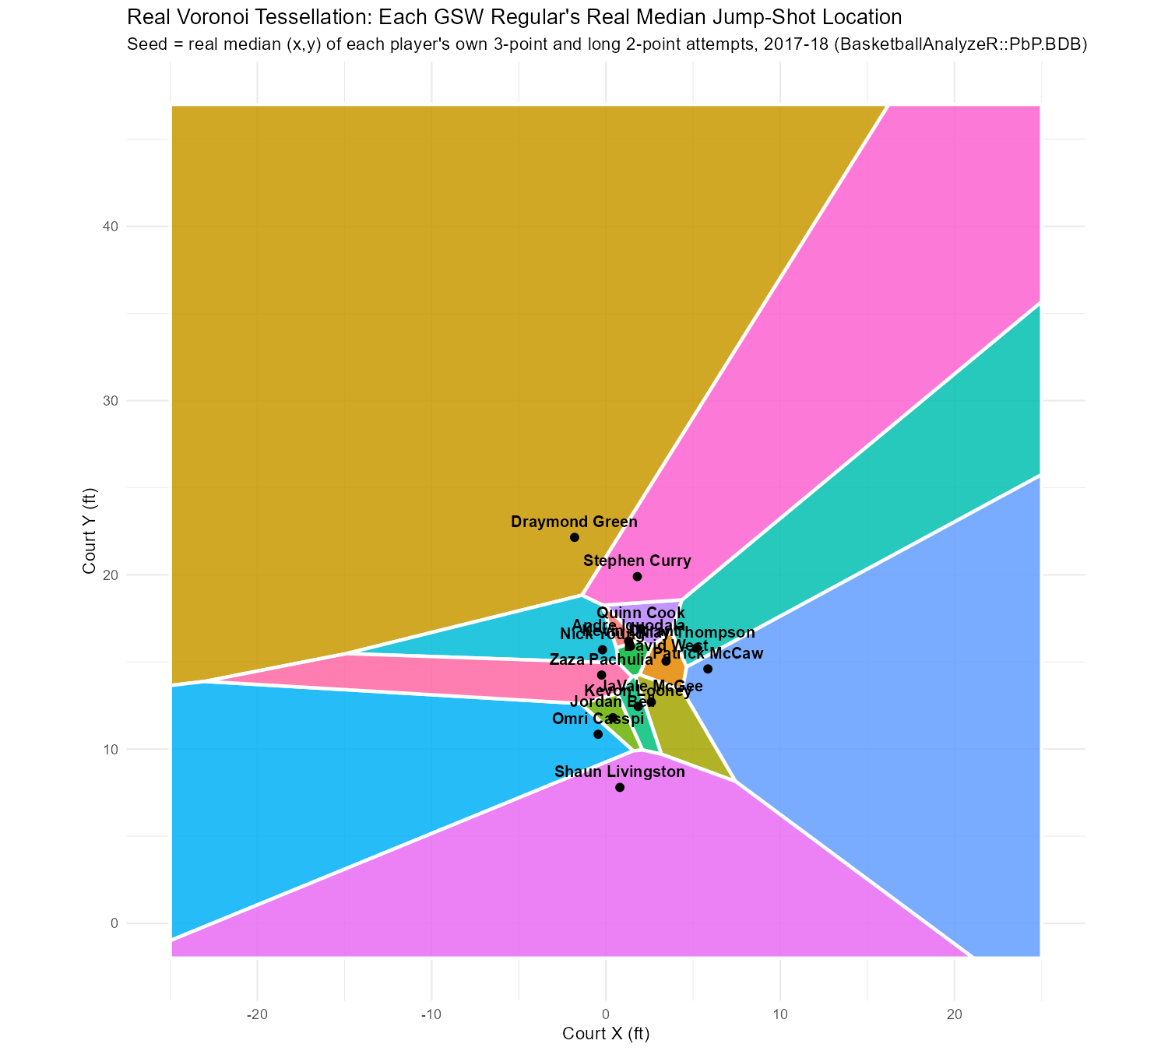
WORKED EXAMPLE, STEP 3
Real Voronoi Map of GSW's Rotation
deldir() on real median jump-shot locations (>10 ft from rim), PbP.BDB, BasketballAnalyzeR.
Notes:
Discussion: point out that Draymond Green and Stephen Curry get the two largest regions, while the bench rotation's real median locations cluster tightly near the free-throw line and split a much smaller region. Ask what real basketball reason explains that clustering.

Slide 21
INTERACTIVE ACTIVITY
Whose Region Would You Expect to Shrink?
Small groups (3-4 students).
1. If a new player joined this roster with a real median jump-shot location near Stephen Curry's, whose real Voronoi region would shrink the most?
2. Would that change tell you anything real about the two players' shooting, or only about where they happen to stand?

Slide 22
RECAP · SEGMENT 2
Voronoi Tessellation, Covered
Covered
Next
Built a real Voronoi map from median jump-shot locations and saw a spatial version of the star-versus-role-player pattern.
Segment 3 looks inside a player's own territory at the full shape of their shot distribution, then asks what real Gravity would add.

Slide 23
10-Minute Break
Back at the top of the hour. Next: spatial distribution and real Gravity.

Slide 24
CONCEPT · SEGMENT 3
Inside the Hull: Where Do Shots Concentrate?
A convex hull tells you the boundary of where a player shoots. It does not tell you where, inside that boundary, they shoot most often. A two-dimensional kernel density estimate fills in that missing shape.

Slide 25
LET'S RUN THIS TOGETHER
Let's build the real kernel density comparison together.
Pull up your own session. We'll run it line by line and look at the real output together.

Slide 26
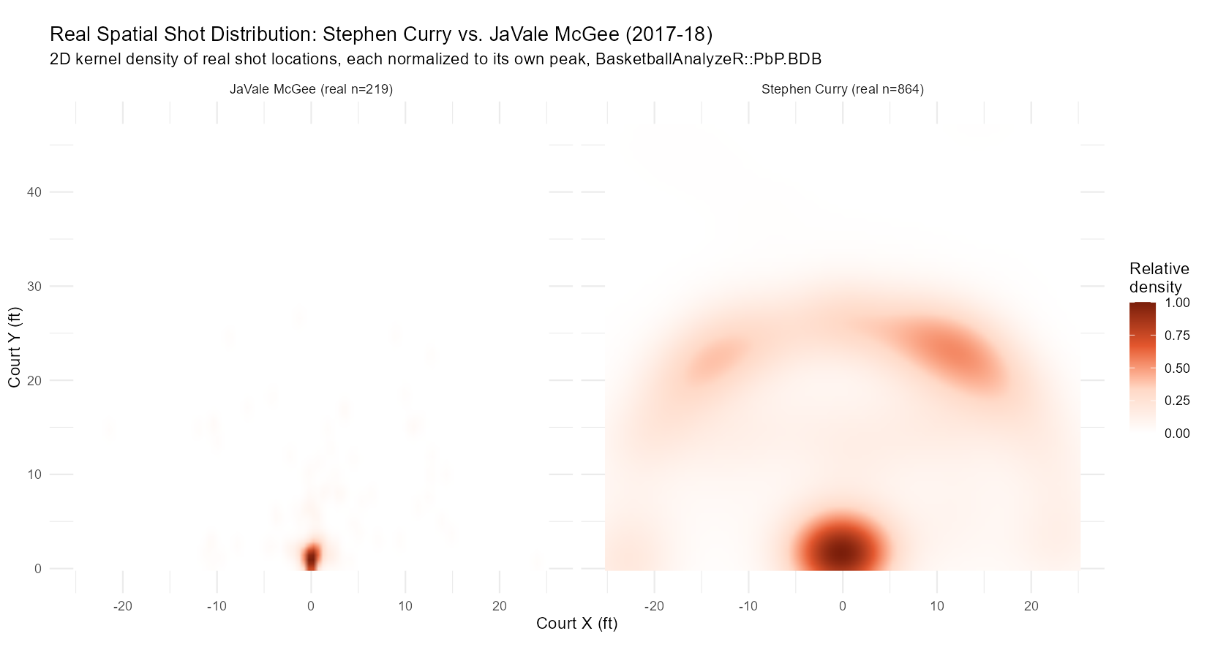
WORKED EXAMPLE, STEP 4
Real Spatial Shot Distribution: Curry vs. McGee
kde2d() on real shot coordinates, normalized to each player's own peak, PbP.BDB, BasketballAnalyzeR.
Notes:
Discussion: McGee's real distribution is a single sharp peak near the rim (mean distance 5.0 ft). Curry's shows a real rim peak plus a genuine second ridge along the arc (mean distance 18.9 ft). Ask what a single shooting percentage would have hidden about this difference.

Slide 27
CONCEPT · SEGMENT 3
The NBA's Real Gravity Stat
"Gravity" quantifies how much defensive attention a player draws, on and off the ball, using 3D pose detection tracking 29 points on every player's body, 60 times per second.
That is real, official, frame-by-frame tracking data. It is genuinely out of reach of the event-level shot data this module works with, and this course does not have access to it.

Slide 28
WATCH
The Real Technology Behind Gravity
How AI Cameras Are Deciding NBA Playoff Games: Hawk-Eye and the Rise of Computer Vision in Sports
YouTube
A real explainer on the NBA's actual optical tracking camera system, the technology base behind both the real Gravity stat and the frame-by-frame data this module's notes explain we do not have direct access to.
https://www.youtube.com/watch?v=mIMeFEA7ZCM

Slide 29
CONCEPT · A REAL, CURRENT JOURNAL FINDING
What Real Tracking Data Actually Shows
Barron, Sitaraman & Arias (2025), Scientific Reports: adapting density-functional fluctuation theory, a physics method for quantum systems, to real NBA tracking data.
Real finding: the gap between elite and poor real defensive positioning is worth approximately 3 points saved per game, and real centers defend 2-point shots well but 3-point shots poorly compared to real wings.
Barron, B., Sitaraman, N., & Arias, T. (2025). Scientific Reports. A real, current, peer-reviewed source.

Slide 30
PHD / ADVANCED PROJECT CALLOUT
Where This Leads: Spatial Data and Injury Risk
For students doing a larger independent project: the same convex-hull and density tools used here to describe where a player shoots are the same class of tool sports-medicine researchers use to describe how a player moves before connecting that movement pattern to real injury risk.
Module 10's signature research track (Muritala, Brown & Haller 2026; West et al. 2026; Kanwal et al. 2025) picks this thread back up in depth.

Slide 31
THROUGHLINE · POSITIONING & SPATIAL ANALYSIS
The Court as Data, Not Backdrop
The question:
Whether where a player operates on the real court reveals something a box score number cannot.
Spatial dynamics is where basketball analytics stops treating the court as a backdrop and starts treating it as data. Module 6 goes further, into the athletic motion and pose-estimation techniques that produce real tracking data in the first place.

Slide 32
PRACTICE
Read the Real Density Plot Again
Look back at the Curry-versus-McGee kernel density image.
1. Estimate, just from the shapes, which player's real shots concentrate in a smaller area.
2. Now check your estimate against the real mean-distance numbers (Curry 18.9 ft, McGee 5.0 ft). How close were you?

Slide 33
INTERACTIVE ACTIVITY
Does This Module's Data Prove "Gravity"?
Case for: yes, enough
Case for: no, not enough
A real shot territory and real Voronoi region this large necessarily forces defenders to cover more ground, which is functionally the same thing Gravity measures.
Shot location only shows where a player ends up shooting, not how defenders actually reacted before the shot. Real Gravity needs real tracking data to confirm defensive attention directly.
Notes:
Split the room for a short structured debate. Push both sides to use the real hull/Voronoi numbers on today's slides, not general reputation, and to be explicit about what tracking data would add that shot-location data cannot.

Slide 34
RECAP · SEGMENT 3
Spatial Distribution and Real Gravity, Covered
Covered
Next
Built real kernel density comparisons, learned the NBA's own real Gravity stat, and saw what a real 2025 tracking-based paper actually found.
Module 6 moves from static shot locations to the computer-vision techniques that produce real tracking data: pose estimation.

Slide 35
SUMMARY
What to Carry Forward
Convex hulls map a player's real shot territory; hull area is a real measure of floor coverage, separate from shot volume.
Voronoi tessellation divides the real floor by shooting tendency; region size reflects how far a player's real median location sits from teammates', not just shot count.
Kernel density reveals the full real shape of a shot distribution, not just its average location.
This module's real shot-location proxies approximate, but do not replace, the NBA's tracking-based real Gravity stat, and that honest limit is itself part of what you should carry forward.

Slide 36
BEFORE MODULE 06
Two Things Before Next Class
Read
Do
Advanced Basketball Data Science, Ch. 6 (athletic motion kinematics and pose estimation).
Complete Lab 5 (spatial dynamics), the practice questions, and the Module 5 quiz.

Slide 37
FULL READING LIST
References Cited Today
Zuccolotto, Manisera & Sandri (2026). Advanced Basketball Data Science, Ch. 5. CRC Press.
NBA Advanced Stats (NBA.com). "Intro to Gravity" (2025). Official real Gravity stat definition.
Barron, Sitaraman & Arias (2025). Analyzing NBA player positions with density-functional fluctuation theory. Scientific Reports.
BasketballAnalyzeR (R package), PbP.BDB dataset; deldir and MASS (R packages), Zuccolotto/Manisera/Sandri and CRAN.

Slide 38
See You in Module 06
Athletic Motion and Pose Estimation

