Slide 1
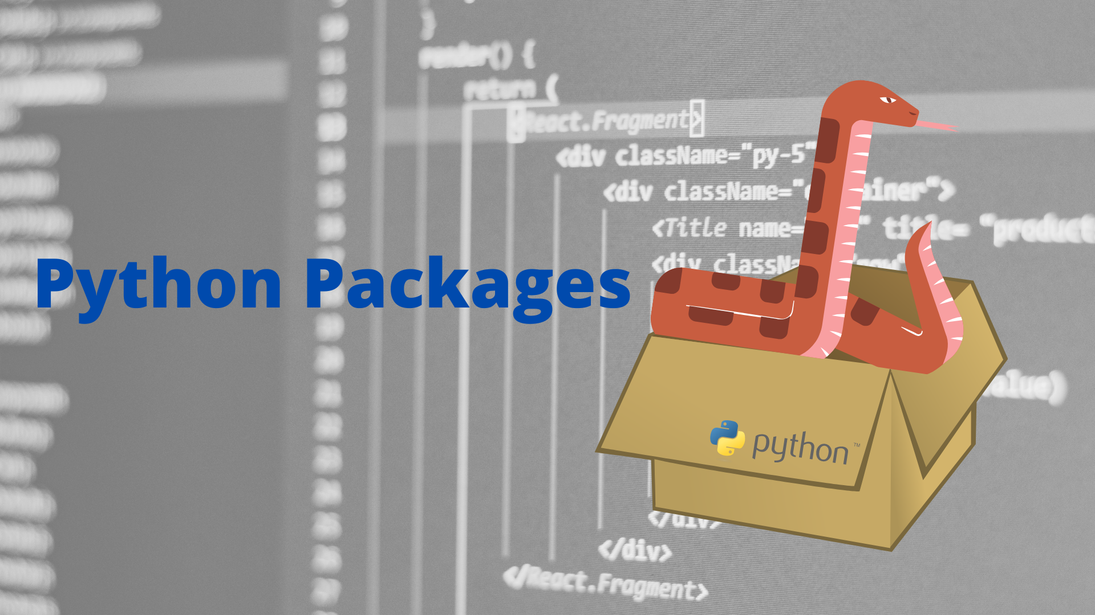
Group session #3

Slide 2
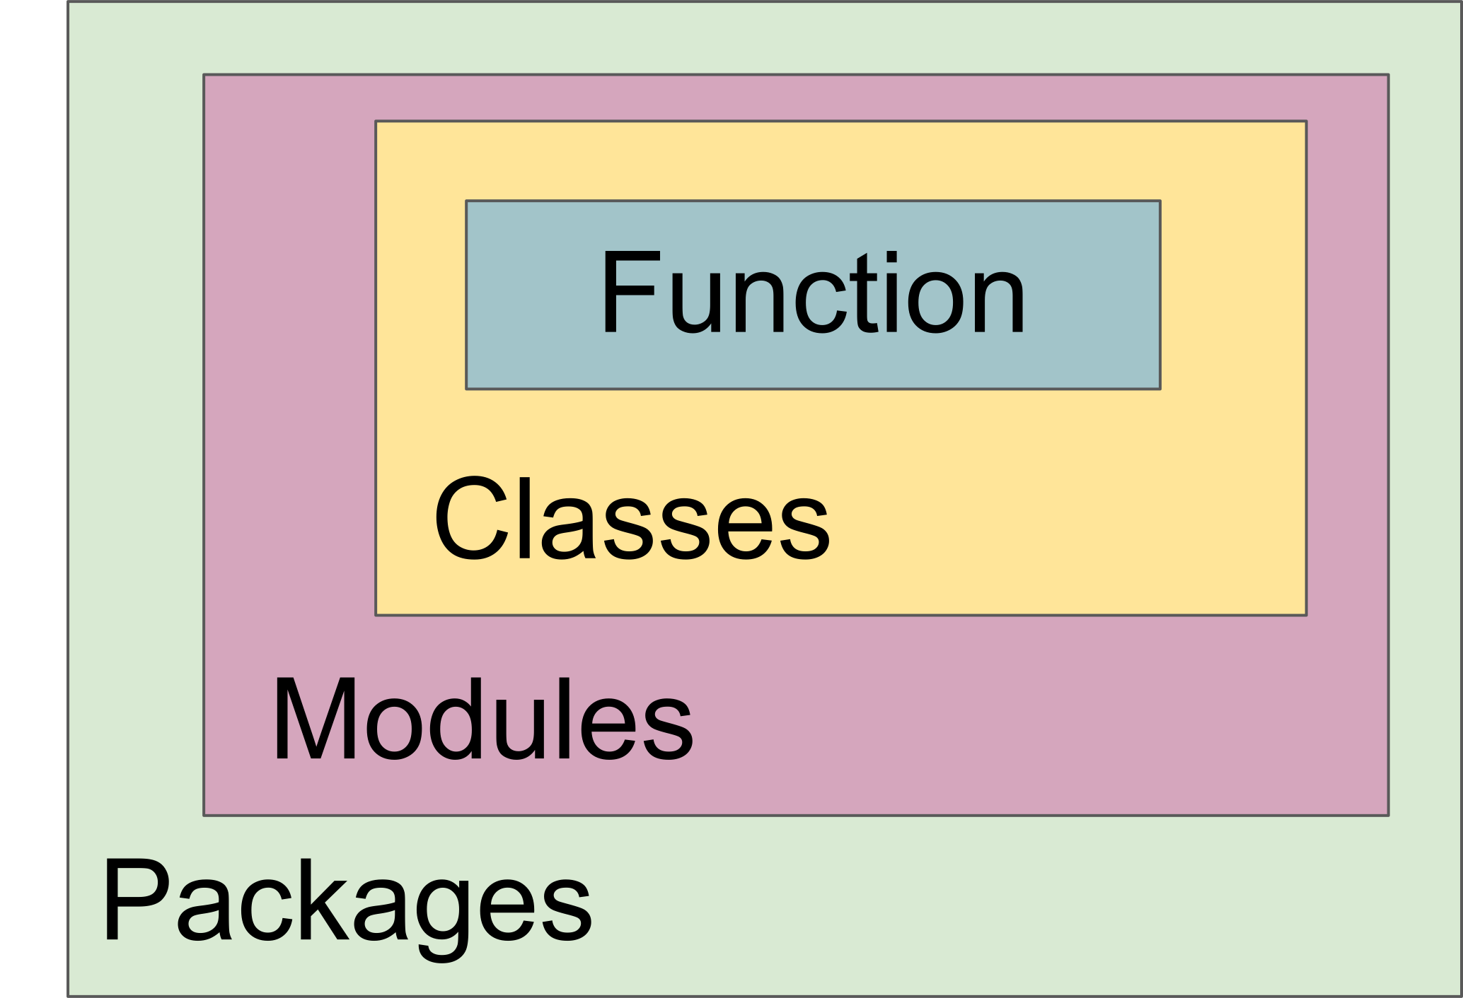
Python code structure

Slide 3
Python module
A module is a file consisting of Python code.
A module can define
Functions
Classes
Variables
A module can also include runnable code.
E.g. definitions from a module can be imported into other modules
https://nbviewer.org/github/UiO-IN3110/UiO-IN3110.github.io/blob/HEAD/lectures/03-python-part-2-fall22/packages_and_testing.ipynb

Slide 4
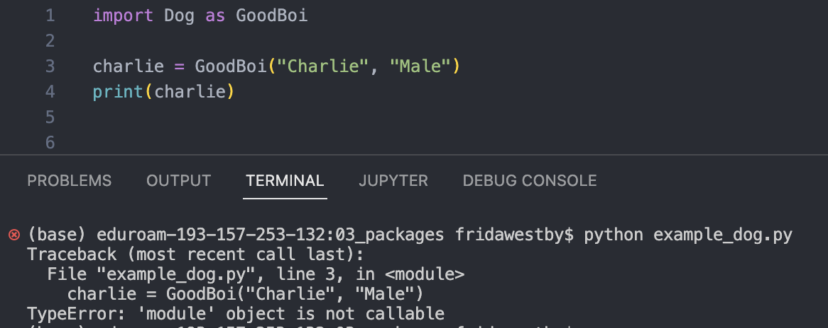
Example: Dog class from group session #2

Slide 5
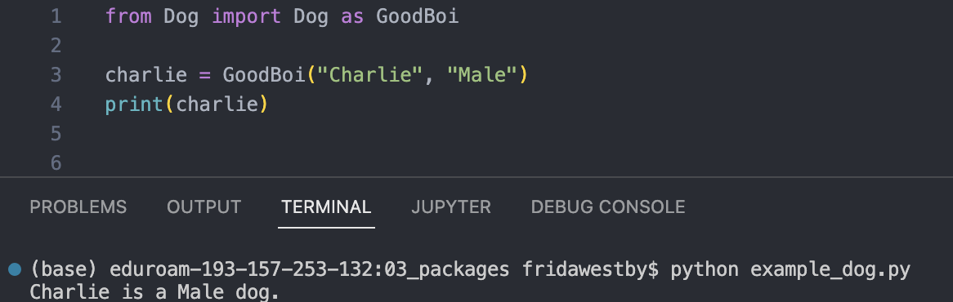
Isn´t Dog a module?
Yes, it is!
BUT Python could not find it ☹
So we have to tell it where to find it:

Slide 6
Python package
Packages are a way of structuring Python’s module namespace by using “dotted module names”.
For example, the module name matplotlib.pyplot designates a submodule named pyplot in a package named matplotlib.
Just like the use of modules saves the authors of different modules from having to worry about each other’s global variable names, the use of dotted module names saves the authors of multi-module packages like NumPy or Pillow from having to worry about each other’s module names.
https://docs.python.org/3/tutorial/modules.html

Slide 7
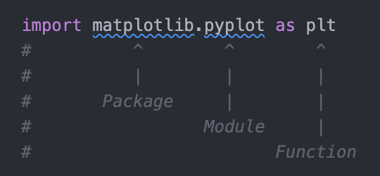
Why Packages?
Packages allow to organize modules and scripts into single environment
These can then easily be distributed and imported by name

Slide 8
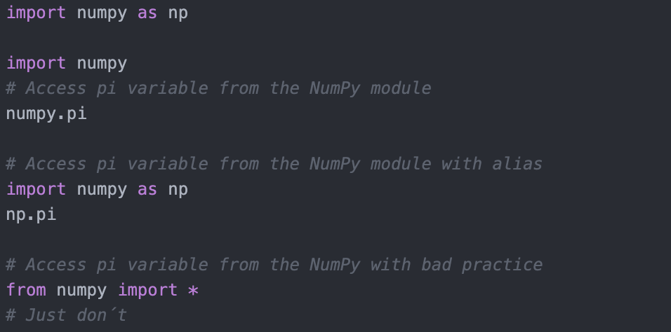
Example: NumPy
NumPy is a package for Python
The name is an acronym for "Numeric Python" or "Numerical Python"
It mostly written in C

Slide 9
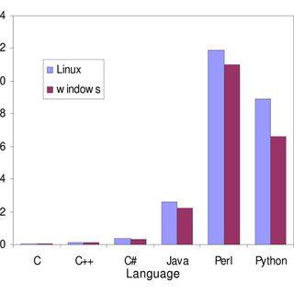
Why C?
Speed comparing for different programming languages (lower is better!)

Slide 10
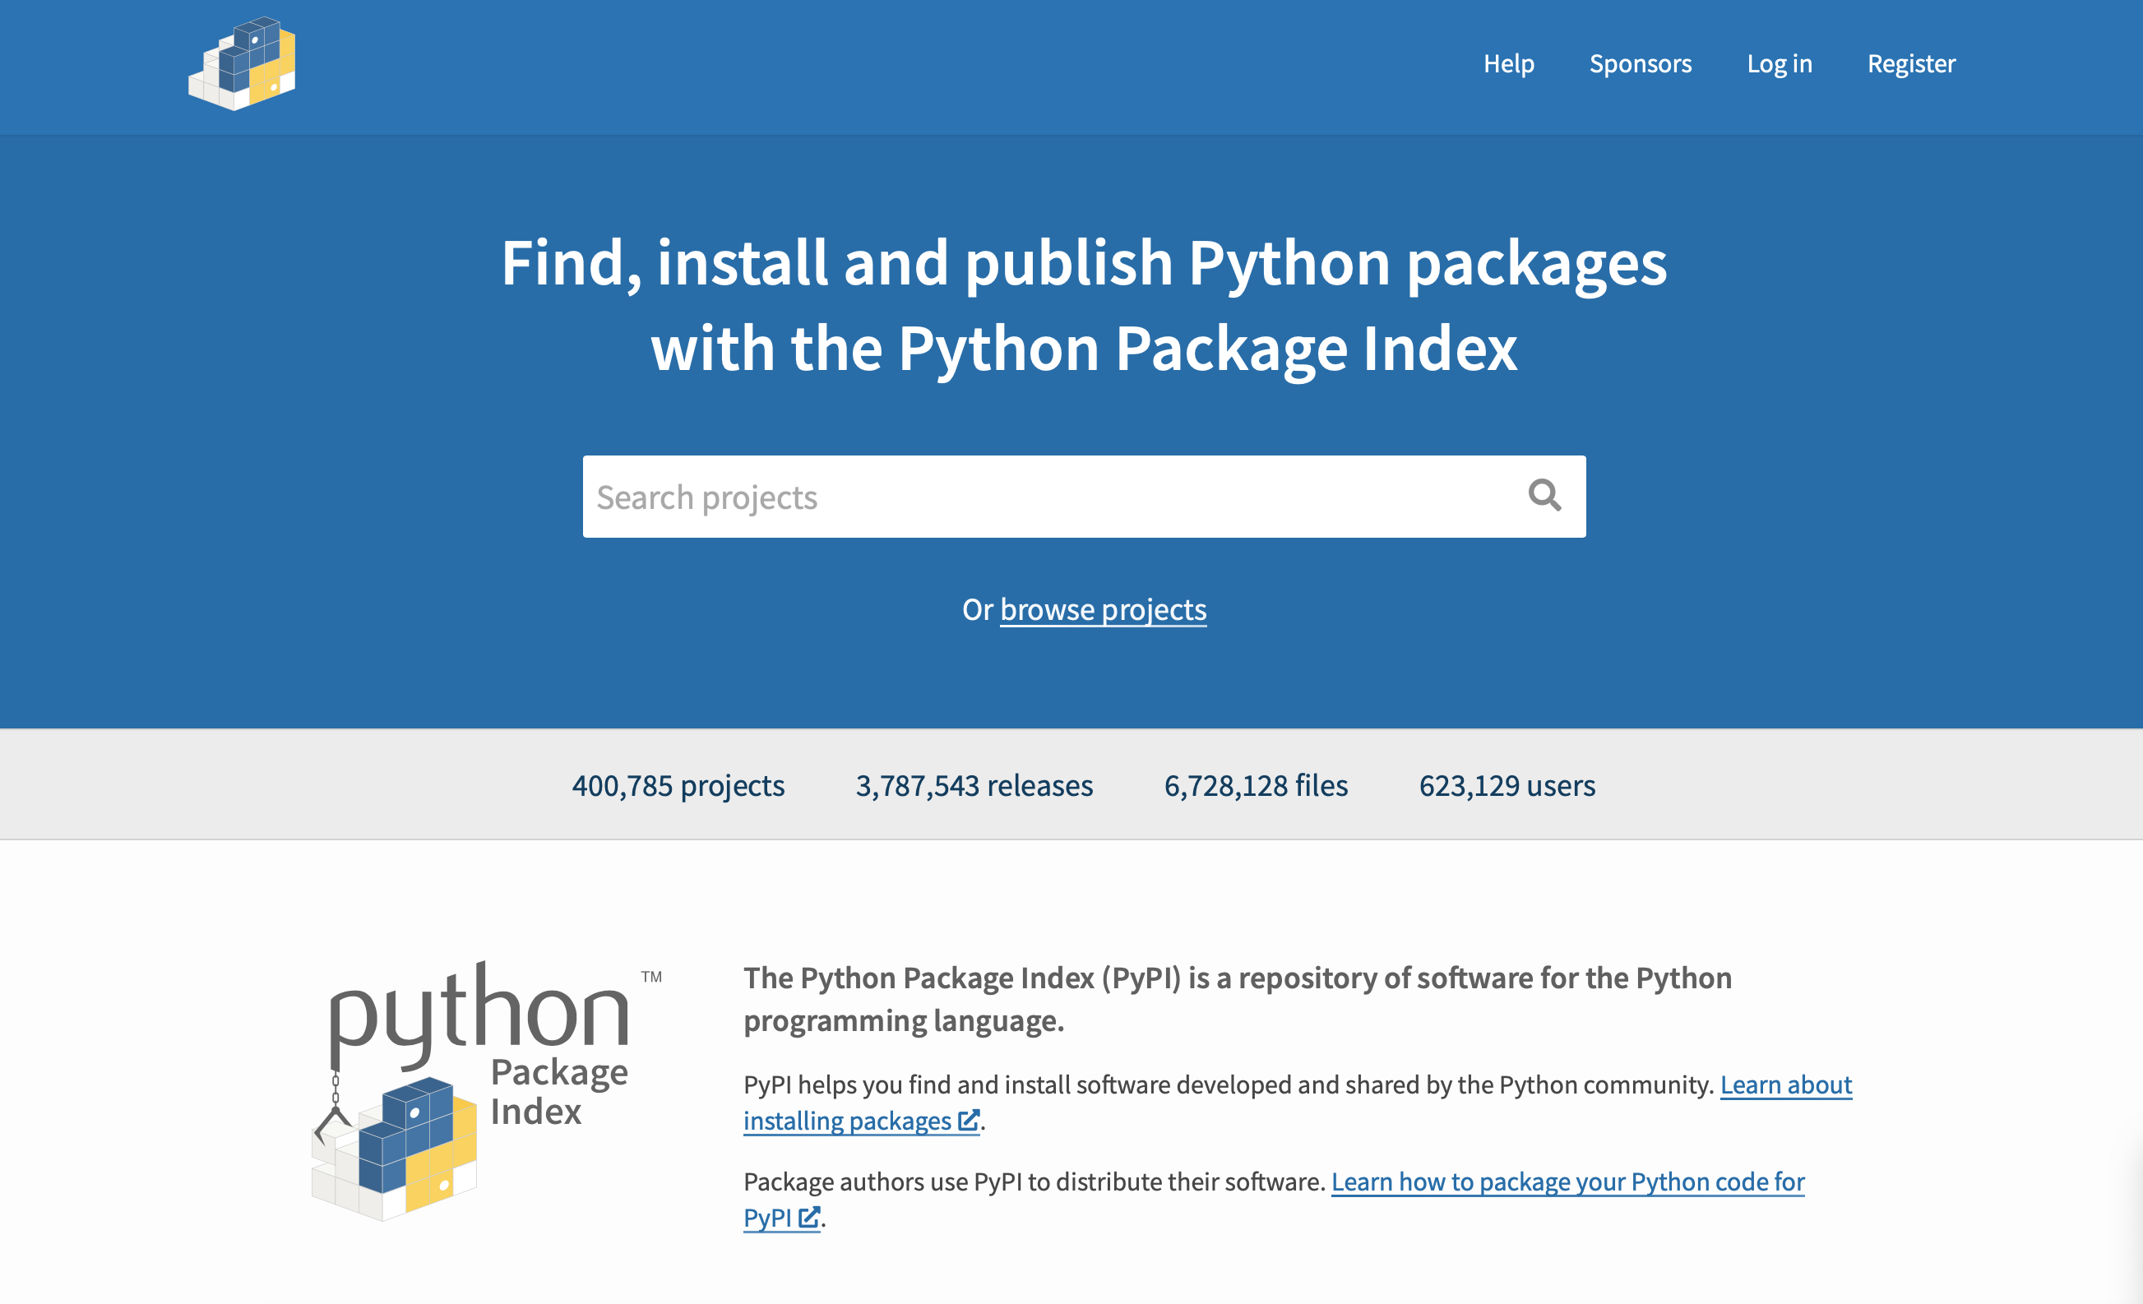
Python Package Index (PyPI)
https://pypi.org

Slide 11
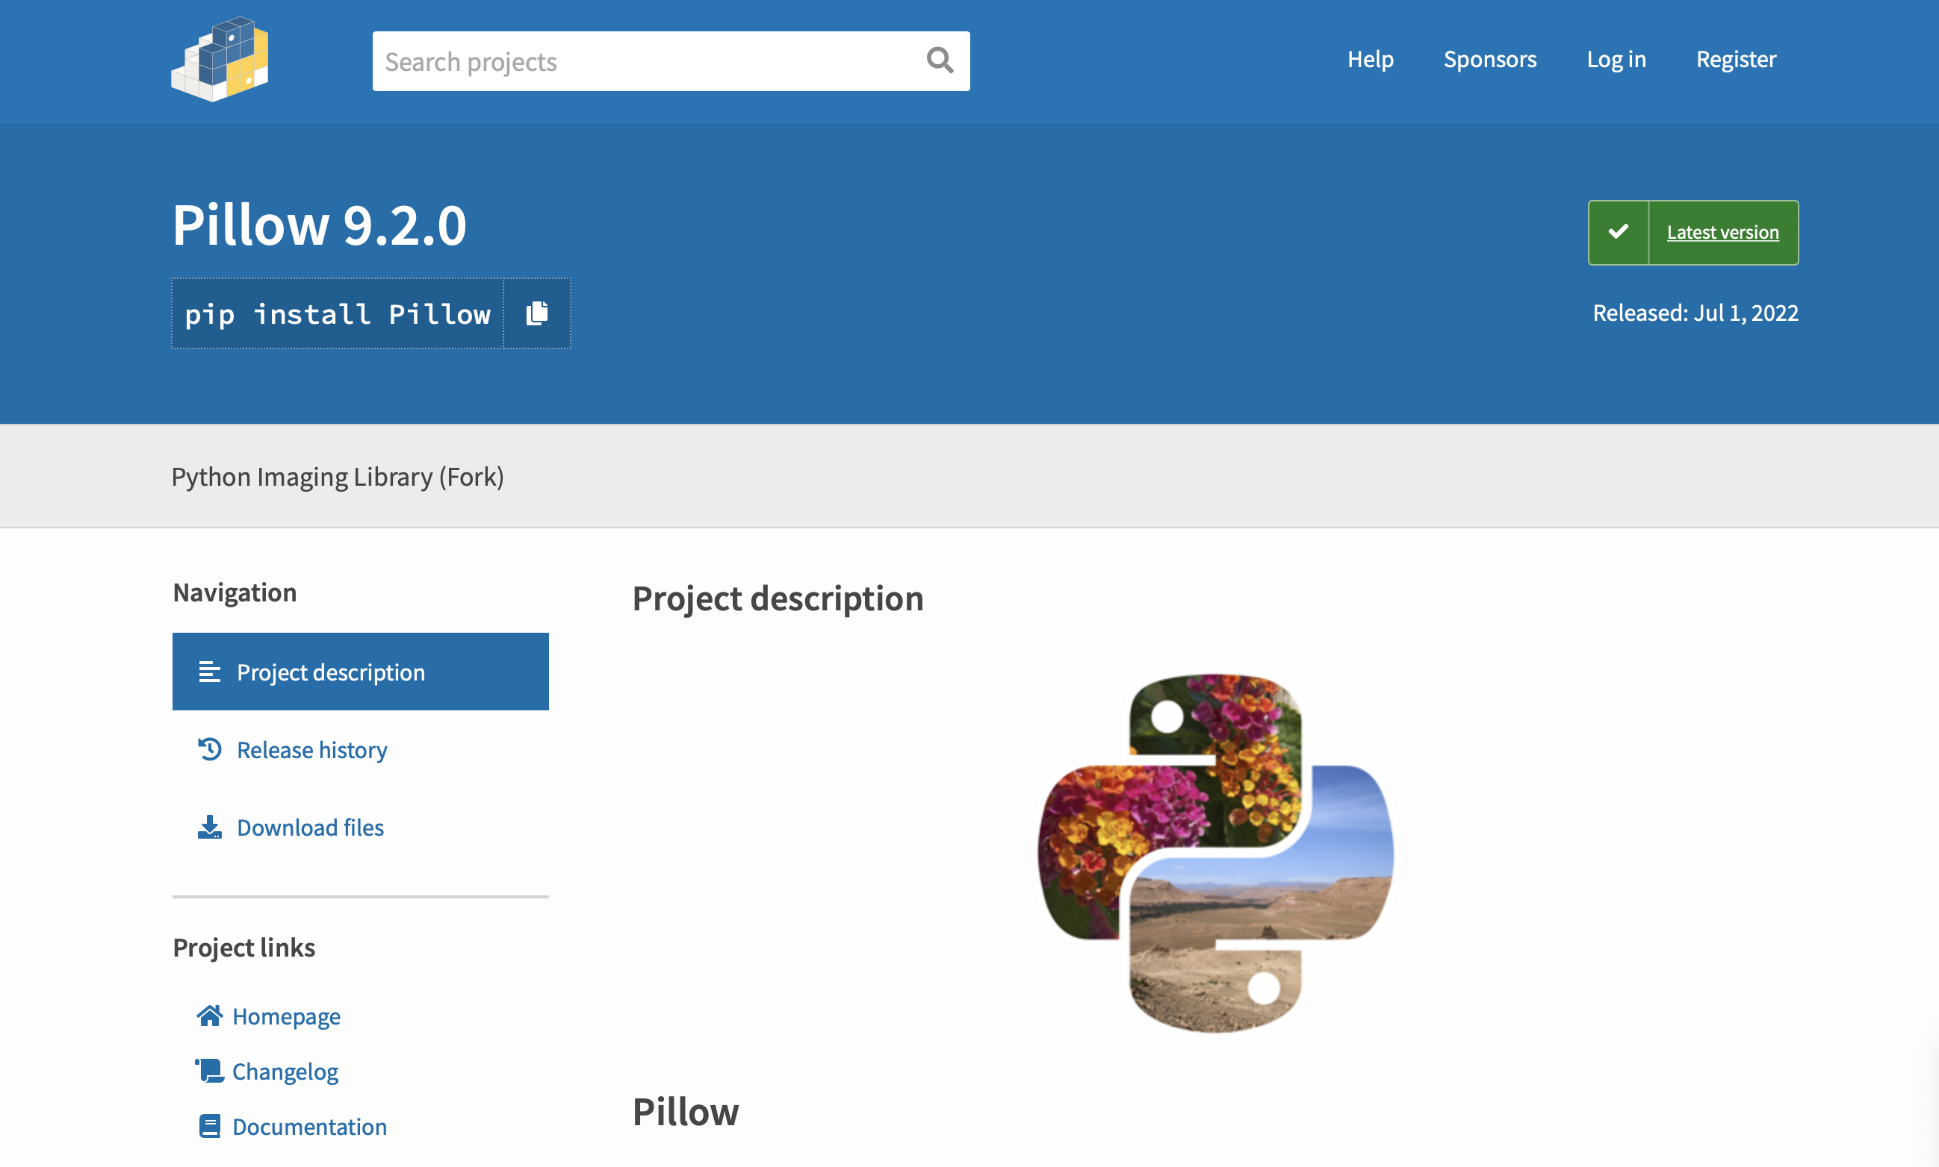
Python Package Index (PyPI)
https://pypi.org/project/Pillow/

Slide 12
pip
pip is a package manager for Python packages
pip --version # pip version installed
pip --upgrade <package_name> # update package
pip list # list installed packages
pip list --outdated # list outdated packages
pip install <package_name> # install <package_name>
pip install <package_name>==<version>
pip uninstall <package_name> # uninstall <package_name>

Slide 13
Make package editeble
Install your project in “editable” or “develop” mode while you’re working on it.
This will just link the package to the original location, basically meaning any changes to the original package would reflect directly in your environment.
pip install -e .
# install the current directory (i.e. your project) in editable mode.

Slide 14
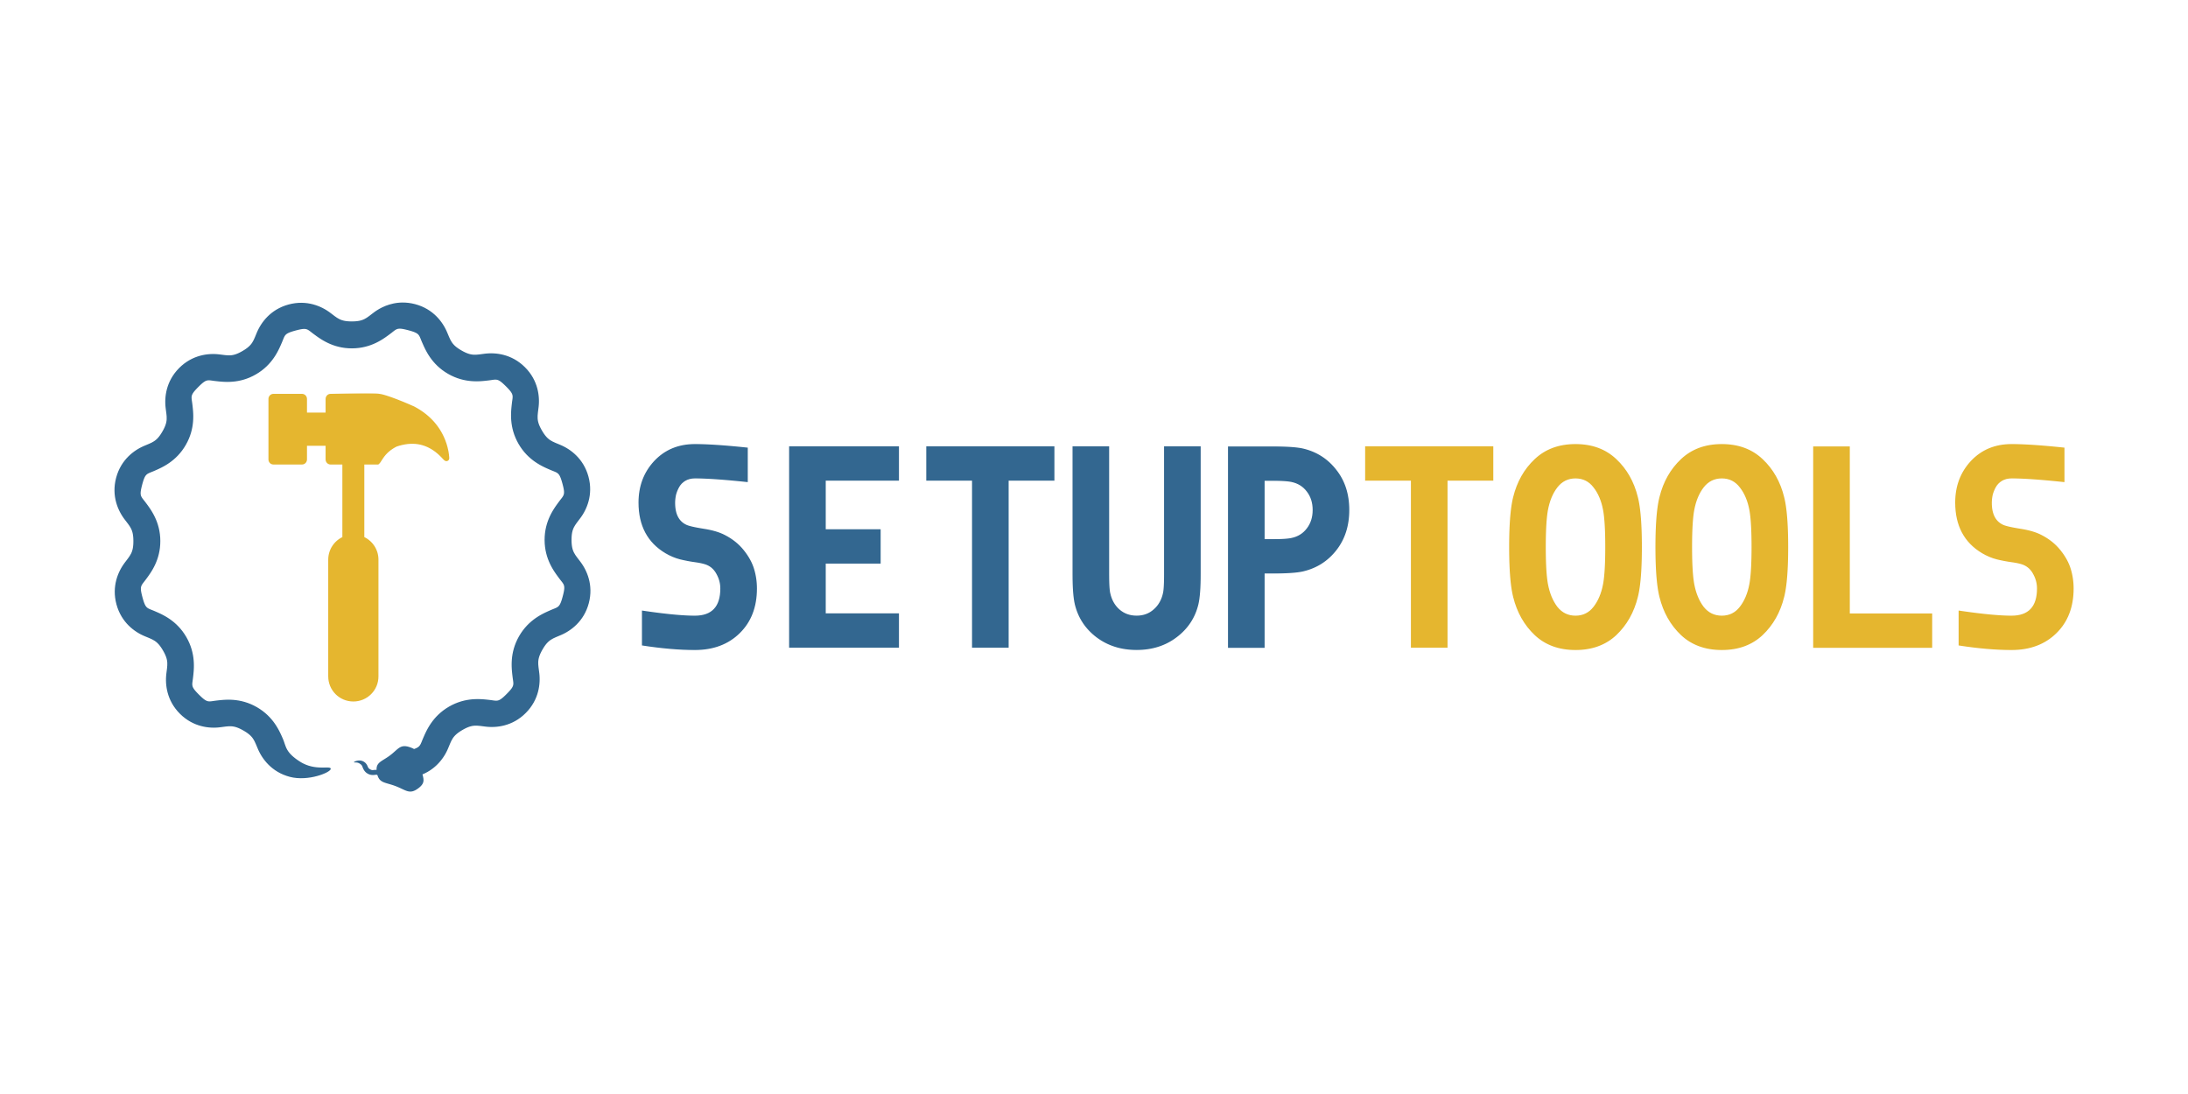
Starting with PEP 621 (22-Jun-2020), the Python community selected pyproject.toml as a standard way of specifying project metadata.
Setuptools is a fully-featured, actively-maintained, and stable library designed to facilitate packaging Python projects.
It helps developers to easily share reusable code (in the form of a library) and programs (e.g., CLI/GUI tools implemented in Python), that can be installed with pip and uploaded to PyPI.
https://setuptools.pypa.io/en/latest/index.html

Slide 15
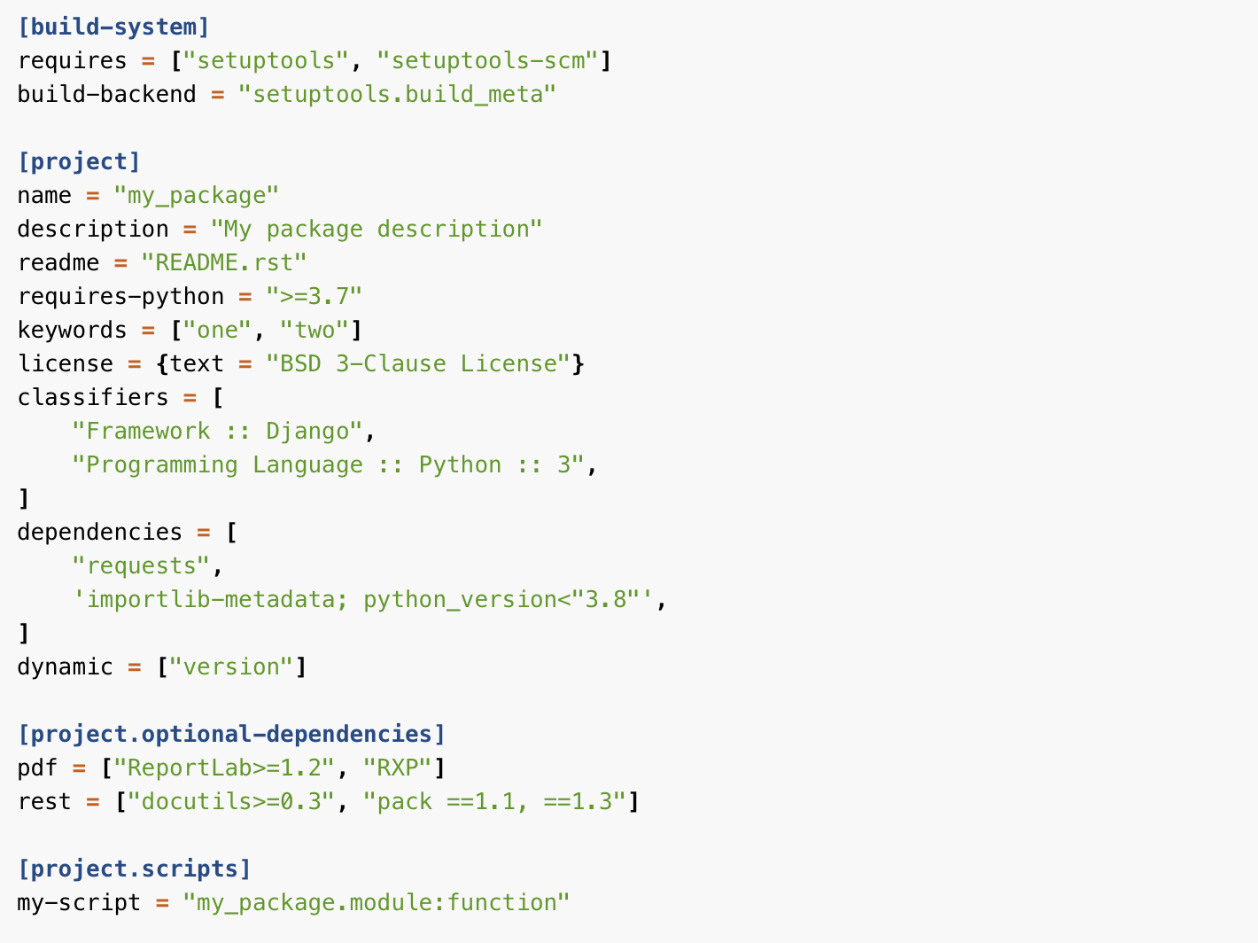

Slide 16
This section declares what are your build system dependencies, and which library will be used to actually do the packaging
This section is where the package configuration happens
This section is optional
When this project is installed, a cli-name executable will be created. cli-name will invoke the function some_func in the mypkg/mymodule.py file when called by the user. E.g. dog-script = ”dog.cli:main"

Slide 17
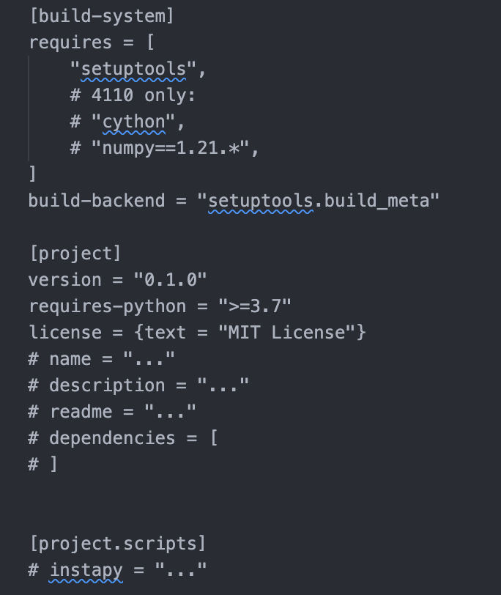
What you need for Assignment 3 ☺

Slide 18
build-system.requires vs project.dependencies
build-system.requires is what’s required to build the package from source and install it. Effectively, these are the dependencies of setup.py.
These are not required when you are using the package.
Most users of your package will not get these packages when you publish a package on PyPI.
project.dependencies are required when your package is actually used.
These are the dependencies (I.e. imports) of instapy.

Slide 19
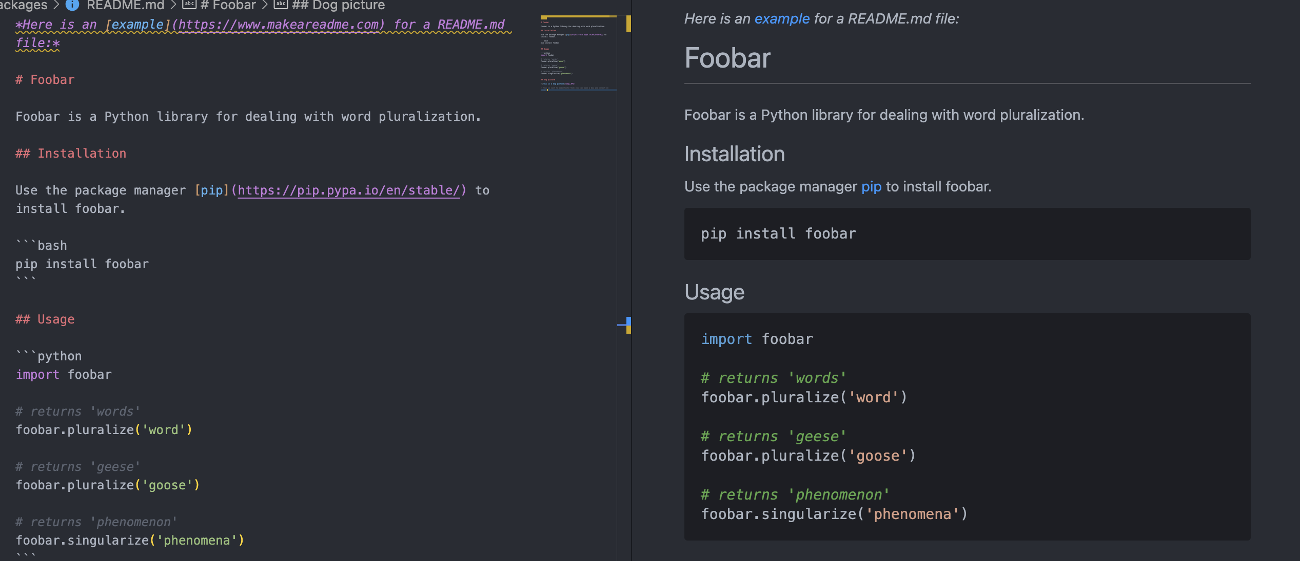
How to make a more readable README.md

