Slide 1

Fun with flags
Command-line Arguments

Slide 2
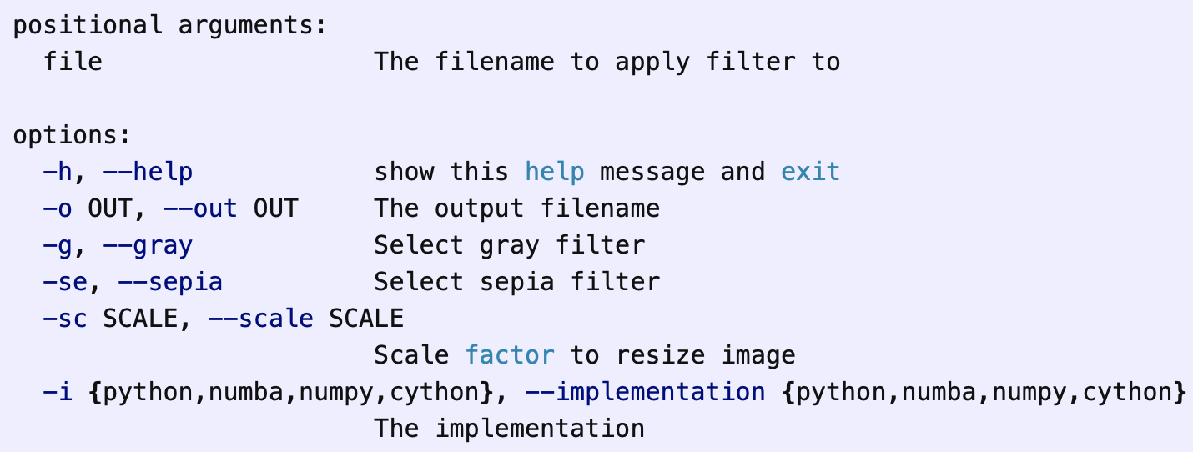
Flags: Command-line interface (cli)

Slide 3
Command Line Arguments
The command line interface (also known as CLI) is a means to interact with a command line script.
Python comes with several different libraries that allow you to write a command line interface for your scripts, but the standard way for creating a CLI in Python is currently the Python argparse library.
Flags are usually represented with a dash. E.g. -v

Slide 4
Command Line Arguments: Using argparse module
The argparse module makes it easy to write user friendly command line interfaces.
The program defines what arguments it requires, and argparse will figure out how to parse those out of sys.argv.
The argparse module also automatically generates help and usage messages and issues errors when users give the program invalid arguments.

Slide 5
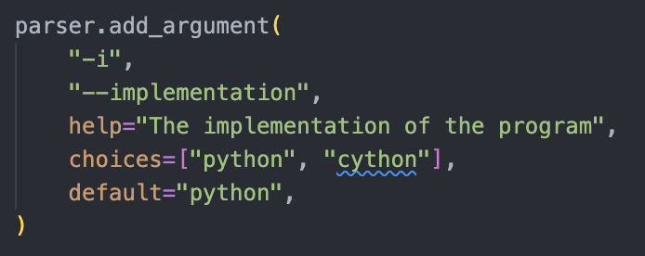
Command Line Arguments: Using argparse module - example

Slide 6
Command Line Arguments: Using argparse module
A good guide can be found here ☺
https://realpython.com/command-line-interfaces-python-argparse/
Ps. Don’t forget to tell the toml file to use the cli file (instapy.cli:main)

Slide 7
Run Example
Running the following from the terminal:
instapy rain.jpg -g -i numba -o rain_gs.jpg
This should result in a grayscale image of rain.jpg using the numba implementation with the filename “rain_gs.jpg”

