Slide 1
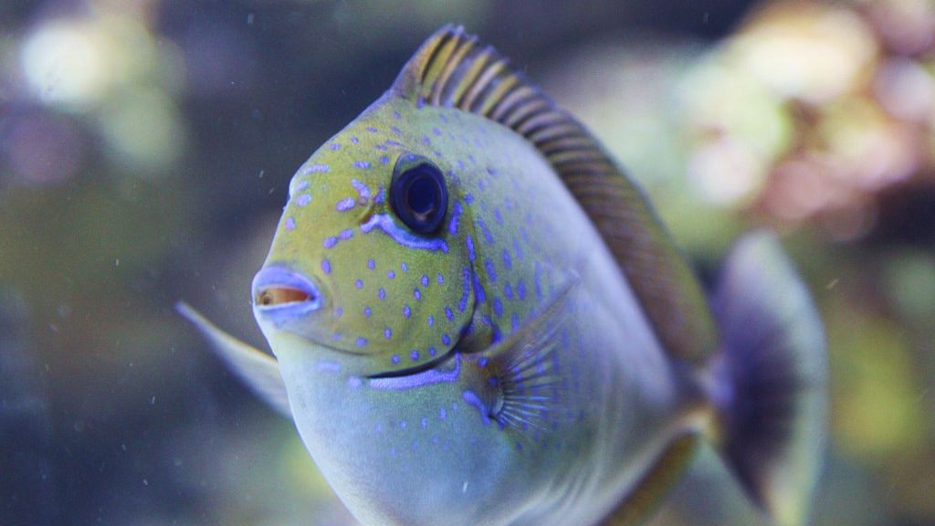
Images 101
A crash course in image processing
This Photo by Unknown Author is licensed under CC BY

Slide 2
Images can be represented as functions f(x, y)
For a grayscale image, each pixel would have an intensity between 0 and 255, with 0 being black and 255 being white.
https://ai.stanford.edu/~syyeung/cvweb/tutorial1.html

Slide 3
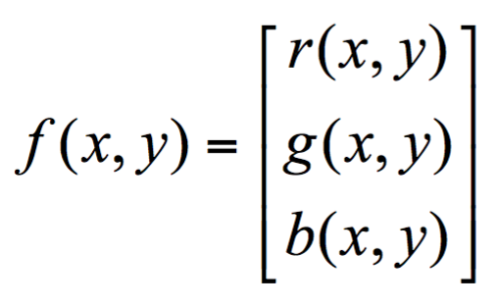
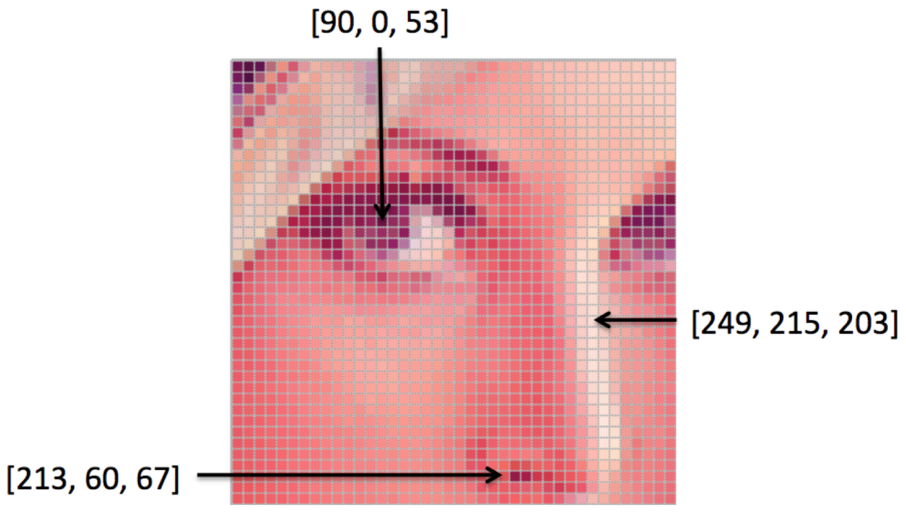
Images can be represented as functions f(x, y)
A color image is just a simple extension of this.
Using an RGB image as an example, the colors are constructed from a combination of Red, Green, and Blue (RGB).
Therefore, each pixel of the image has three channels and is represented as a 1x3 vector.
https://ai.stanford.edu/~syyeung/cvweb/tutorial1.html

Slide 4

A Python Imaging Library that adds image processing capabilities to your Python interpreter.
https://pillow.readthedocs.io/en/stable/index.html
Other (more advanced) alternatives for those who are interested:
OpenCV: https://opencv.org
scikit-image: https://scikit-image.org

Slide 5
Pro tip: start with small images!
Debugging images can be hard, so using a smaller image can be helpful if you need to debug.
So here is my go-to image (you can find it in the repo):

Slide 6
cleffa.png
dimentions: 28 × 29

Slide 7
(29, 28, 3)
(29, 28)

