Slide 1

Six degrees of separation
From theory to Wikipedia golf

Slide 2
Six degrees of separation
Six degrees of separation is the idea that all people are six or fewer social connections away from each other.
As a result, a chain of "friend of a friend" statements can be made to connect any two people in a maximum of six steps.
It is also known as the six handshakes rule.
https://en.wikipedia.org/wiki/Six_degrees_of_separation

Slide 3
Six Degrees of Wikipedia
Inspired by the concept of six degrees of separation, Six Degrees of Wikipedia traverses hyperlinks on Wikipedia to find the least number of clicks it takes to navigate between any of the nearly six million pages on the world's largest free online encyclopedia.
https://www.sixdegreesofwikipedia.com/

Slide 4
Wiki Race with URLs
5 bonus points and a prize for the winner!
If you have time, this is actually super fun!
You are going to from Nobel Pice Prize to Array (data structure)
This is what we get from Six Degrees of Wikipedia:
This is (thankfully) only three degrees!
Length from start to stop: 4 (start – a – b – stop)

Slide 5
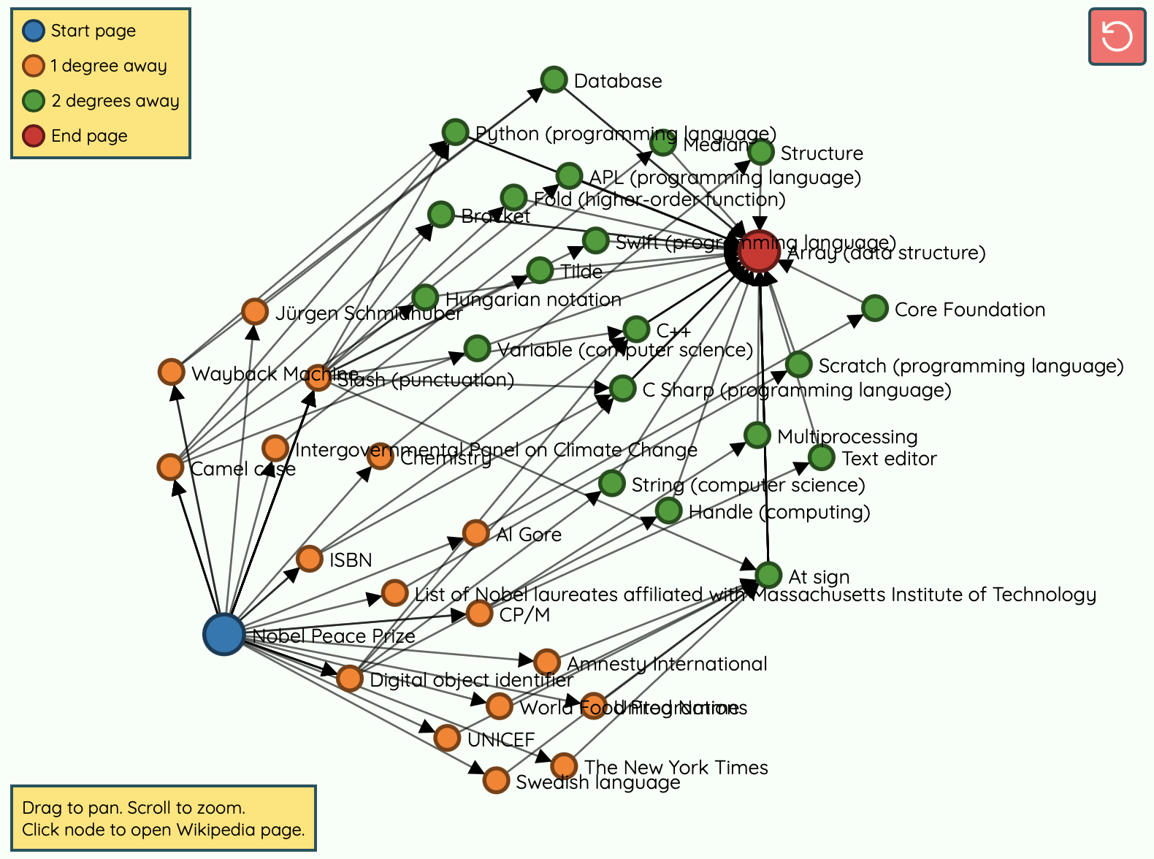

Slide 6
Life hack: start simple
As for the images in the last assignment, using something simpler might be a huge help!
Start with 1 degree (start -> stop)
Then 2 degrees (start -> a -> stop)
Then try to find a 3 degree example with fewer links on the page (more link == more time)

