Slide 1
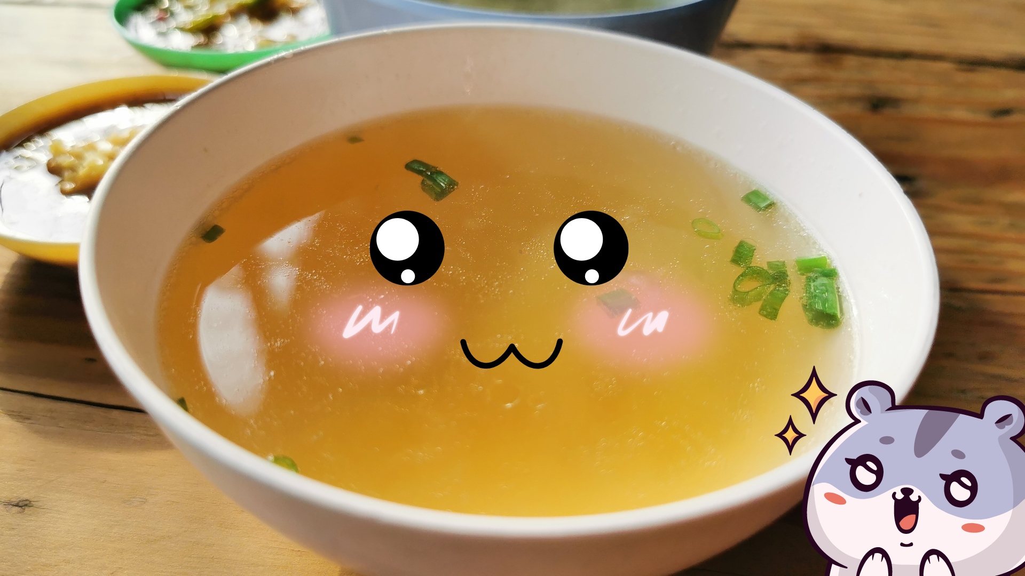
Beautiful Soup
“You didn't write that awful page. You're just trying to get some data out of it. Beautiful Soup is here to help.”
https://www.crummy.com/software/BeautifulSoup/

Slide 2

What is Beautiful Soup?
Beautiful Soup is a library that makes it easy to scrape information from web pages.
It sits atop an HTML or XML parser, providing Pythonic idioms for iterating, searching, and modifying the parse tree.
https://pypi.org/project/beautifulsoup4/

Slide 3

HyperText Markup Language (HTML)
While performing web scarping, we deal with html tags.
Thus, we must have good understanding of them.
HTML is the standard markup language for Web pages.
Markup language is a term used in computer text processing to refer to an organized annotation system (i.e. language) that marks certain parts or elements of a document as different from plain text.
Essentially, markup language is used in web documents or applications to format text and to give it a specific structure.
https://www.w3schools.com/html/
https://www.seobility.net/en/wiki/Markup_Language

Slide 4
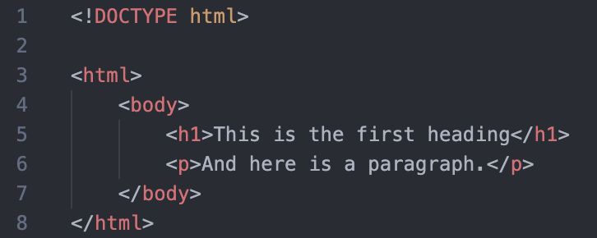
HTML – Tags
<!DOCTYPE html> : HTML documents must start with a type declaration
HTML document is contained between <html> and </html>
The visible part of the HTML document is between <body> and </body>
HTML headings are defined with the <h1> to <h6> tags
HTML paragraphs are defined with the <p> tag
https://www.analyticsvidhya.com/blog/2015/10/beginner-guide-web-scraping-beautiful-soup-python/

Slide 5
HTML – Tags
HTML links are defined with the <a> tag, for example: <a href=“http://www.uio.no”>This is a link for uio.no</a>
HTML tables are defined with <Table>, row as <tr> and rows are divided into data as <td>
HTML list starts with <ul> (unordered) and <ol> (ordered). Each item of list starts with <li>
https://www.analyticsvidhya.com/blog/2015/10/beginner-guide-web-scraping-beautiful-soup-python/

Slide 6
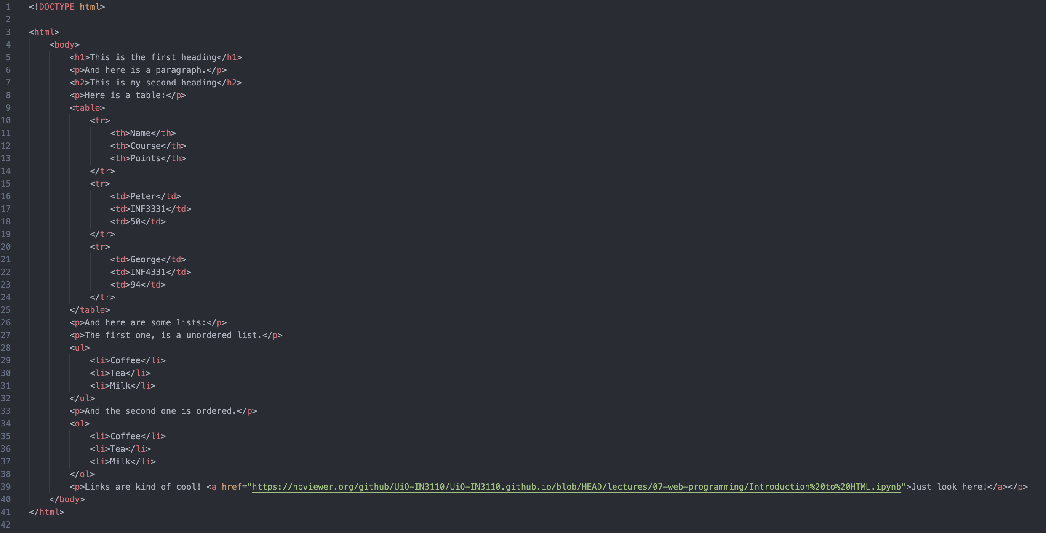

Slide 7
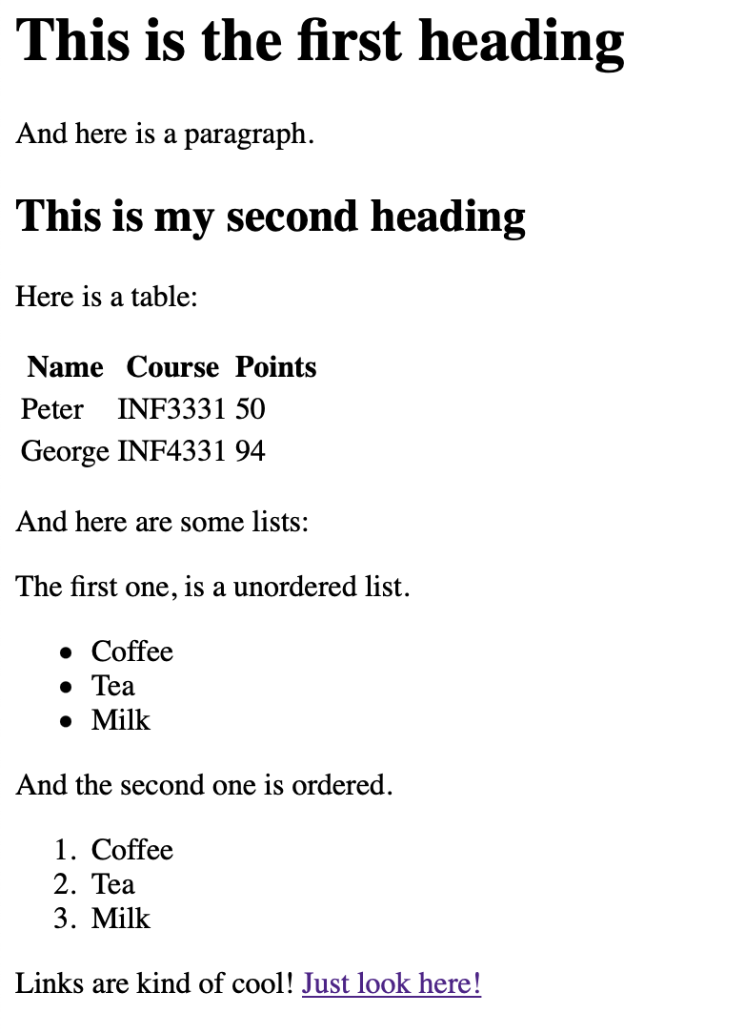
And the final result is this: tag.html

Slide 8
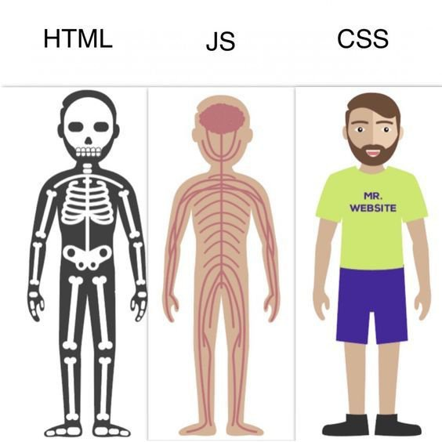
Why does it not look like a “normal” website?
HTML is Skeleton of your website.
CSS (or Cascading Style Sheets) gives all the nice fleshy covering to the website.
JavaScript (JS) provides basic functionality to the website to come alive.
Sounds intresting? Just wait to the next assignment! :D
https://www.quora.com/How-relevant-is-HTML-CSS-and-JavaScript-in-web-design

Slide 9
Why does it not look like a “normal” website?
The class an id attribute is often used to point to a class name in a style sheet.
It can also be used by a JavaScript to access and manipulate elements with the specific class name.
https://www.quora.com/How-relevant-is-HTML-CSS-and-JavaScript-in-web-design

Slide 10
Request
First, we must make a request, which will download the HTML contents of a given web page for us.
This will return a Response object
This object has a status_code property, which indicates if the page was downloaded successfully:
A status_code of 200 means that the page downloaded successfully.
A status code starting with a 2 generally indicates success, and a code starting with a 4 or a 5 indicates an error.
https://www.dataquest.io/blog/web-scraping-python-using-beautiful-soup/

Slide 11
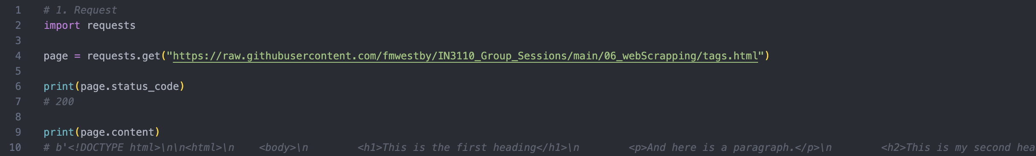
Request
We can print out the HTML content of the page using the content property.
But this looks messy ☹
https://www.dataquest.io/blog/web-scraping-python-using-beautiful-soup/

Slide 12
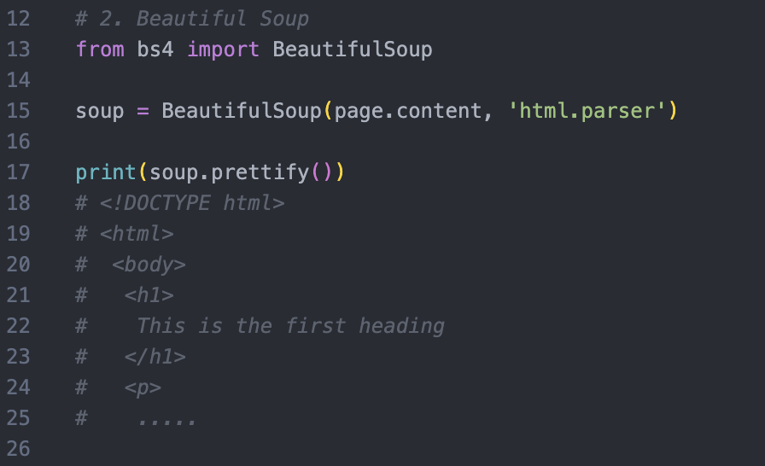
Beautiful Soup – The basics
Using the Beautiful Soup prettify() method makes it more readable!
https://www.dataquest.io/blog/web-scraping-python-using-beautiful-soup/

Slide 13
Beautiful Soup – Find the tags
If we want to extract a single tag, we can instead use the find_all method, which will find all the instances of a tag on a page and put it in a list.
https://www.dataquest.io/blog/web-scraping-python-using-beautiful-soup/

Slide 14
Beautiful Soup – find id and class
Beautiful Soup can also be used to find classes or id’s
soup.find_all(id=”id_name")
soup.find_all(class_=”class_name")
https://www.dataquest.io/blog/web-scraping-python-using-beautiful-soup/

Slide 15

Beautiful Soup (and Request) toturial
A good toturial can be found here: https://www.dataquest.io/blog/web-scraping-python-using-beautiful-soup/

Slide 16
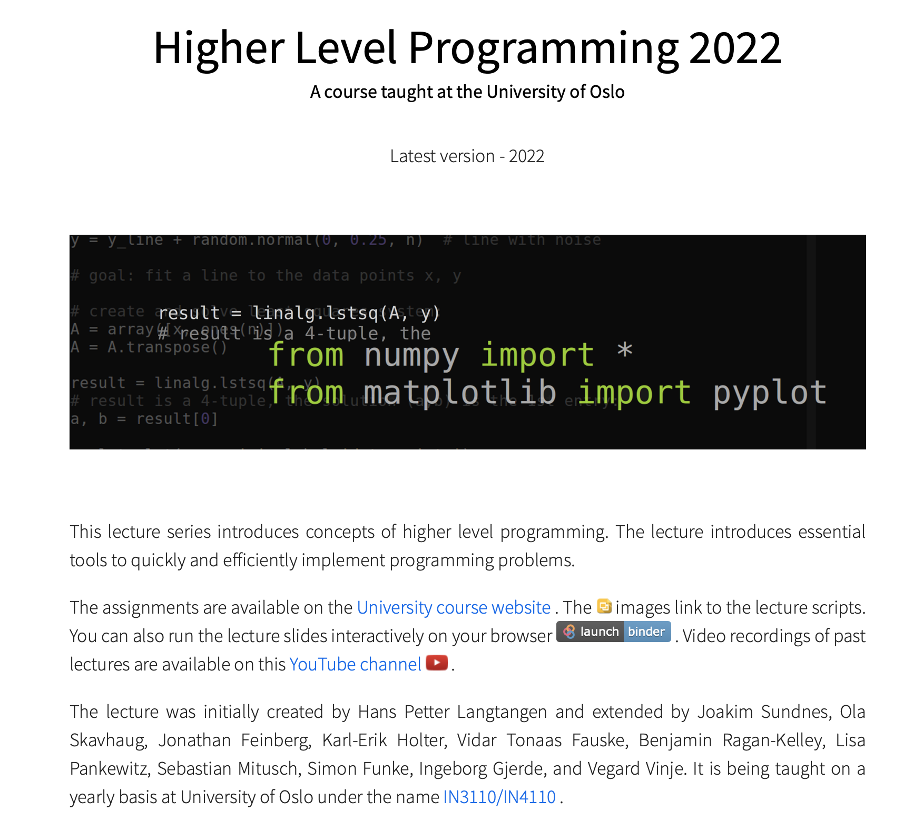

Remember!
On the Course homepage, you can find good resources!
There may also be some hints hiding there ☺
https://uio-in3110.github.io/

