Slide 1
Beautiful Soup
“You didn't write that awful page. You're just trying to get some data out of it. Beautiful Soup is here to help.”
https://www.crummy.com/software/BeautifulSoup/

Slide 2
What is Beautiful Soup?
Beautiful Soup is a library that makes it easy to scrape information from web pages.
It sits atop an HTML or XML parser, providing Pythonic idioms for iterating, searching, and modifying the parse tree.
https://pypi.org/project/beautifulsoup4/

Slide 3
HyperText Markup Language (HTML)
While performing web scarping, we deal with html tags.
Thus, we must have good understanding of them.
HTML is the standard markup language for Web pages.
Markup language is a term used in computer text processing to refer to an organized annotation system (i.e. language) that marks certain parts or elements of a document as different from plain text.
Essentially, markup language is used in web documents or applications to format text and to give it a specific structure.
https://www.w3schools.com/html/
https://www.seobility.net/en/wiki/Markup_Language

Slide 4
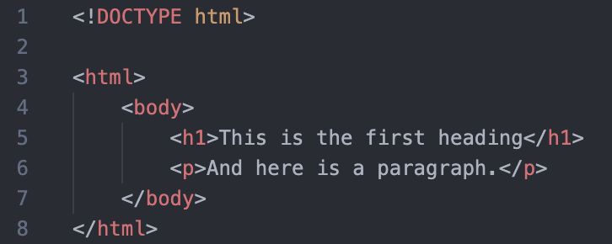
HTML – Tags
<!DOCTYPE html> : HTML documents must start with a type declaration
HTML document is contained between <html> and </html>
The visible part of the HTML document is between <body> and </body>
HTML headings are defined with the <h1> to <h6> tags
HTML paragraphs are defined with the <p> tag
https://www.analyticsvidhya.com/blog/2015/10/beginner-guide-web-scraping-beautiful-soup-python/

Slide 5
HTML – Tags
HTML links are defined with the <a> tag, for example: <a href=“http://www.uio.no”>This is a link for uio.no</a>
HTML tables are defined with <Table>, row as <tr> and rows are divided into data as <td>
HTML list starts with <ul> (unordered) and <ol> (ordered). Each item of list starts with <li>
https://www.analyticsvidhya.com/blog/2015/10/beginner-guide-web-scraping-beautiful-soup-python/

Slide 6
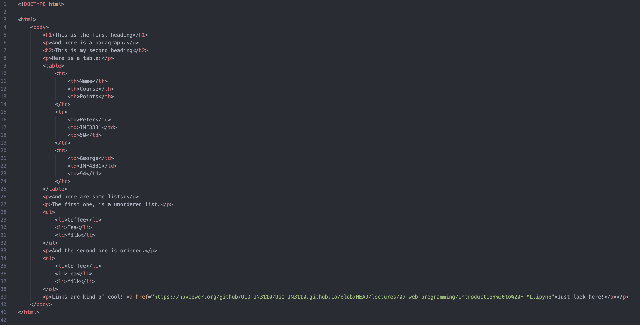

Slide 7
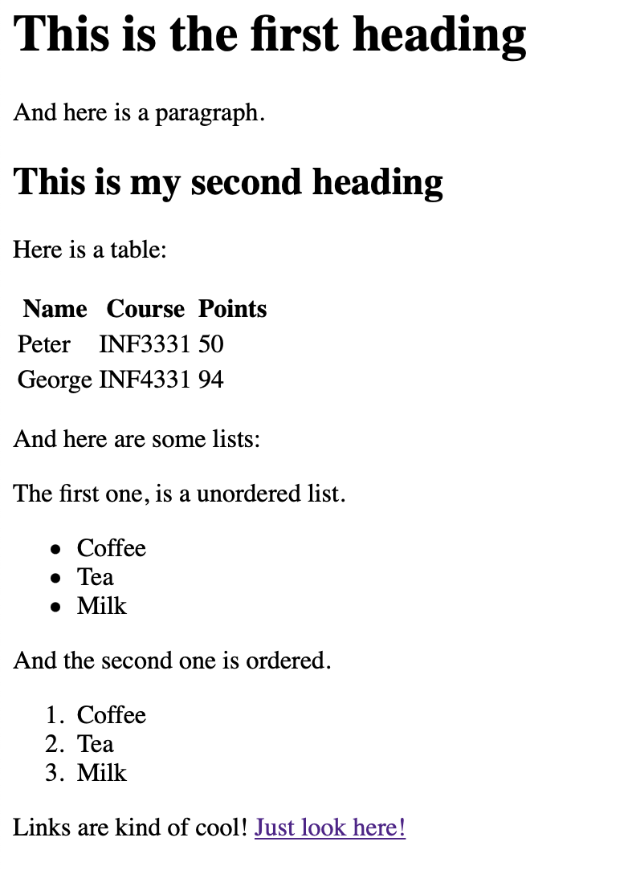
And the final result is this:

Slide 8
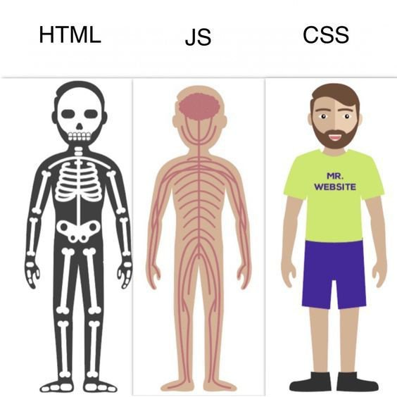
Why does it not look like a “normal” website?
HTML is Skeleton of your website.
CSS (or Cascading Style Sheets) gives all the nice fleshy covering to the website.
JavaScript (JS) provides basic functionality to the website to come alive.
Sounds intresting? Just wait to the next assignment! :D
https://www.quora.com/How-relevant-is-HTML-CSS-and-JavaScript-in-web-design

Slide 9
Back to Beautiful Soup

Slide 10
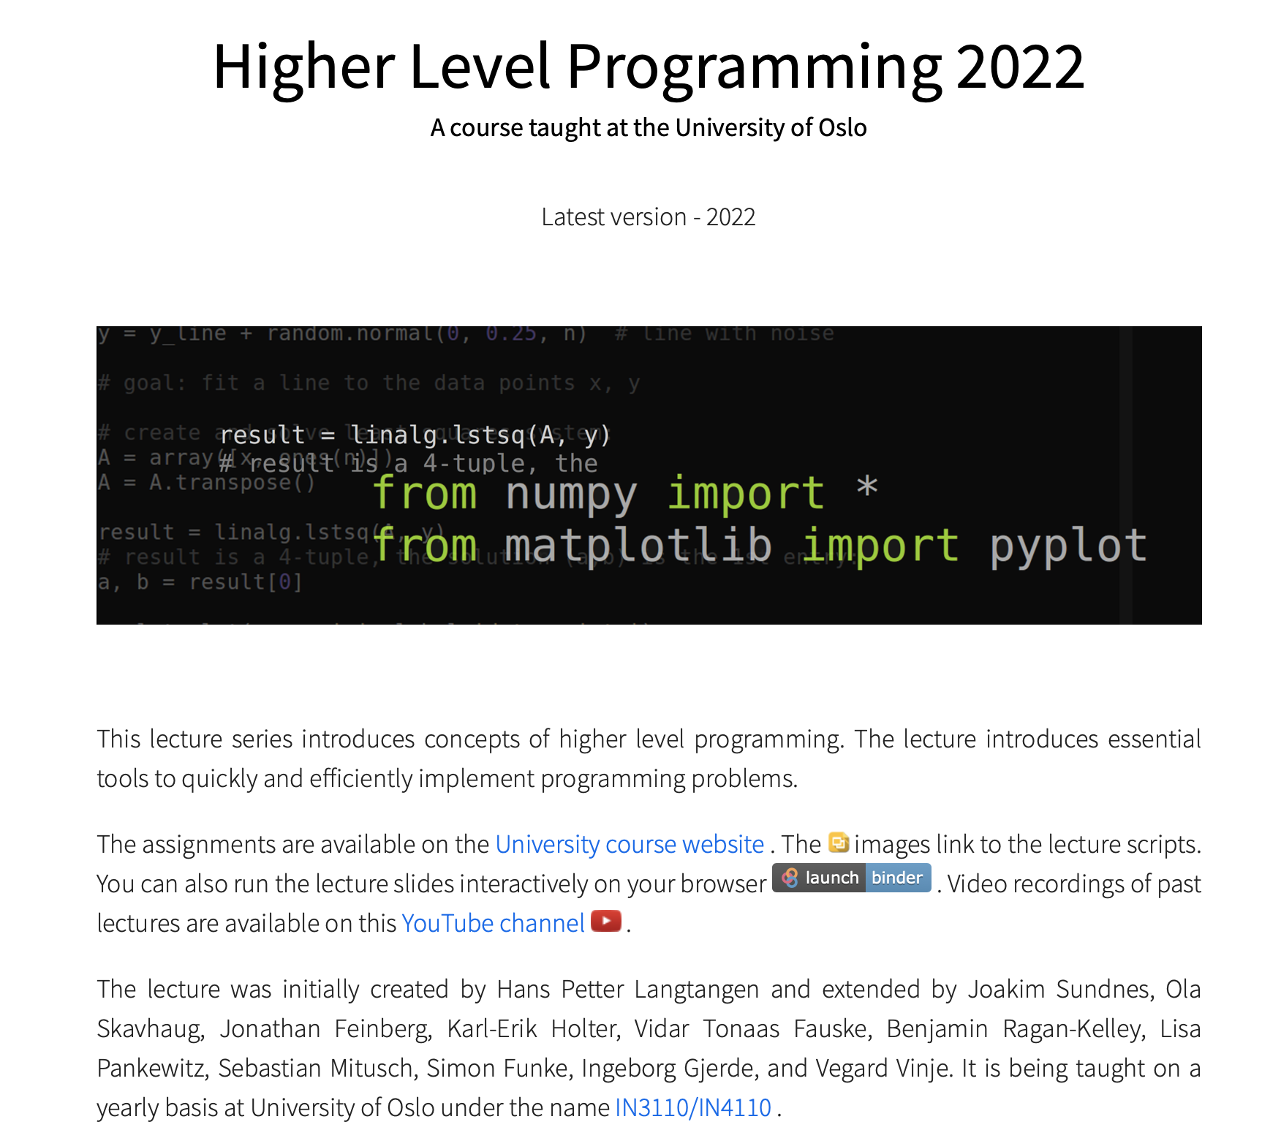
Remember!
On the Course homepage, you can find good resources
There may also be some hints hiding there;)
https://uio-in3110.github.io/

