Slide 1
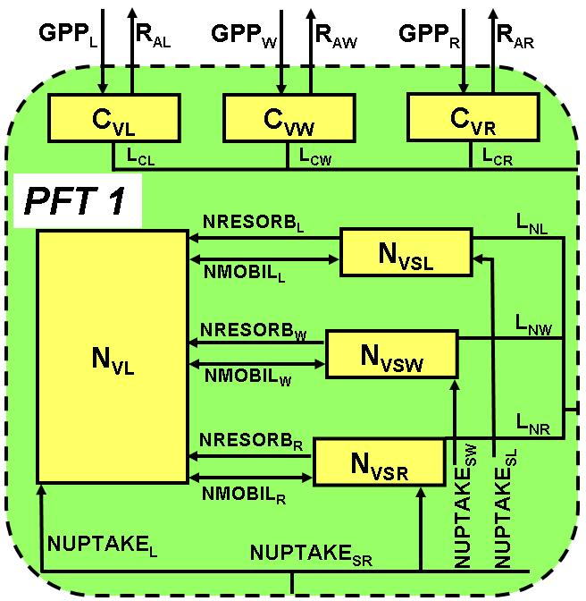
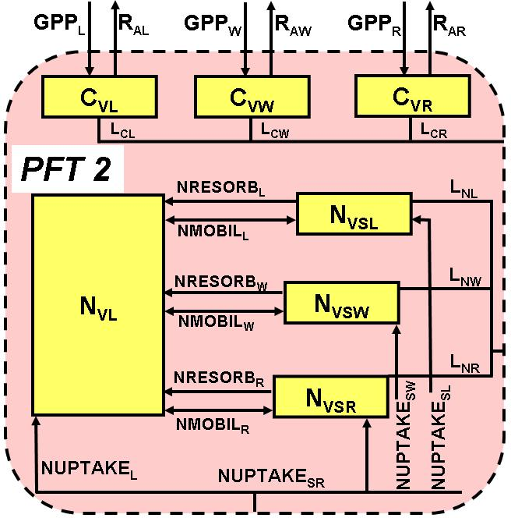
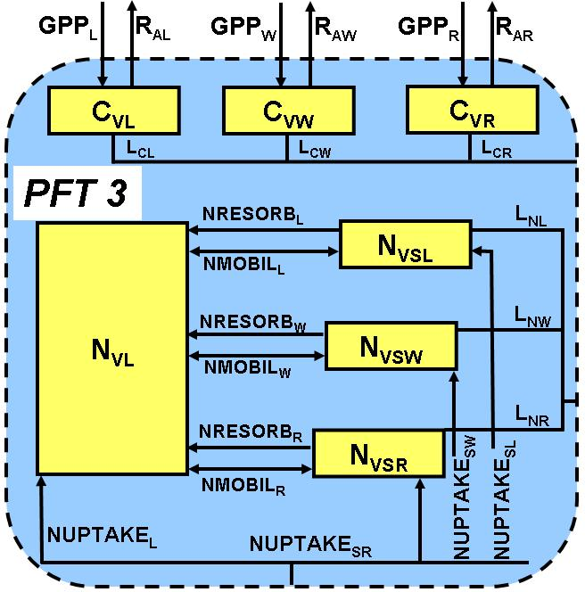
TEM-DVM
Dynamic Vegetation Model of the Terrestrial Ecosystem Model
Atmospheric Carbon Dioxide (CO₂)
R_{H}
Light
N_{AV}
Light
N_{AV}
NETNMIN
SOIL
C_{S}
N_{S}
N_{AV}
NLOST
N_{INPUT}
Linked to other submodels including a soil thermal model (permafrost dynamics; Zhuang et al., 2001) and hydrology model (snow dynamics; Euskirchen et al., 2007)
Euskirchen et al., 2009, Ecol. Applications

Slide 2
DOS-TEM
ATMOSPHERE
Vegetation
Linked to Fire Disturbance Module
Linked to Vegetation Module
Linked to Thermal & Hydrological Module
Snow
Coarse Material
Moss
CO2
Fibrous
CO2
SOM Components
Amorphous
Mineral
Active
Chemically-Resistant
Physically-Resistant

Slide 3
DVM-DOS-TEM
Overview

Slide 4
TEM Cores
Life cycle
/Landscape processes
Ecosystem Dimension & Structure
Biophysical processes
Biogeochemical
processes

Slide 5
Growth & Successional Module
Disturbance Effect Module
Life cycle/Landscape processes
ATMOSPHERE
Vegetation
PFT1
PFT3
Vegetation Biogeochemical Module
Micro-meteorological Module
PFT2
Snow
Thermal & Hydrological Module
Moss
Fibrous
Soil Biogeochemical Module
Amorphous
Mineral
Parent Material
Biophysical processes
Dimension & Structure
BGC processes

Slide 6
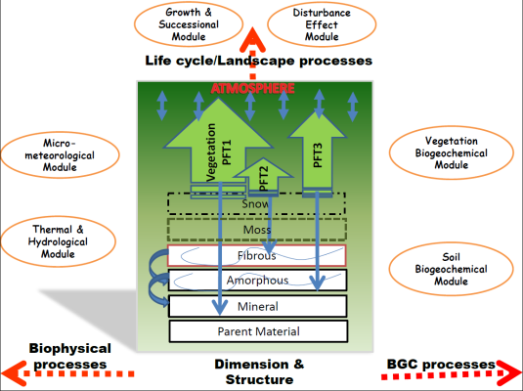


Geo-referenced Grids

Slide 7
INPUTS for TEM
1) Control file:
There are slightly different for Site-specific TEM run (we referred to ‘Siter’), and Regional (or, Multi-Site) TEM run (We referred to ‘Regner’). For ‘Regner’, the model can run in time series or spatially. If not specified, the model will search the following file, for Siter or Regner, respectively:
config/controlfile_site.txt
config/controlfile_regn.txt
2) regional data inputs
These inputs are for the whole region, i.e., no geographical variation.
3) gridded data inputs
Data for run TEM have geographic variations BUT static (no temporal variation). Basically “grid” means the geo-referred unit in a region.
4) cohort data inputs:
Data for running TEM with time-series, in addition to geographical variations
5) Cohort look-up inputs:
Parameters and initial values for running TEM

Slide 8
OUTPUTS for TEM
Detailed one-site run outputs:
- for testing or specific site analysis
There are 3 outputs from ‘Siter’, at daily/monthly/yearly timestep upon options:
cmtdim_dly/mly/yly-eq/sp/tr/sc.nc
cmtenv_dly/mly/yly-eq/sp/tr/sc.nc
cmtbgc_dly/mly/yly-eq/sp/tr/sc.nc
2) Regional run outputs:
- for the model’s primary purposes
A summarized output from a regional model run.
‘output-sp/tr/sc.nc’
Variables (79) and timestep to be output adjustable.
config/outvarlist.txt
3) Restart outputs:
- for resuming model run at desired points
‘restart-eq/sp/tr/sc.nc’ outputs when a cohort run is finished (always)
or, ‘restart-mly.nc’ outputs at monthly timestep when runs regionally in spatial series.

Slide 9
TEM Implementation
1) One-site run: switch “#define SITERUN” in TEM.cpp
There are 3 command options:
./DVMDOSTEM(.exe)
Default, ‘config/controlfile_site.txt’, chtid=‘1’
./DVMDOSTEM(.exe) controlfile.txt
Run with user-defined ‘controlfile.txt’, default chtid=‘1’
./DVMDOSTEM(.exe) controlfile.txt xx
Run with user-defined ‘controlfile.txt’, and user-defined chtid=‘xx’
2) Regional run: switch “#define REGNRUN” in TEM.cpp
./DVMDOSTEM(.exe)
Default, time-series run-mode, ‘config/controlfile_regn.txt’, default ‘chtid’ list from the files defined in controlfile
./DVMDOSTEM(.exe) controlfile.txt
time-series run-mode, user-defined ‘controlfile.txt’, default ‘chtid’ list from the files defined in controlfile
./DVMDOSTEM(.exe) controlfile.txt regner1/regner2
time-series OR spatial-series run-mode, user-defined ‘controlfile.txt’, default ‘chtid’ list from the files defined in controlfile

Slide 10
DVM-DOS-TEM
Code Briefing

Slide 11
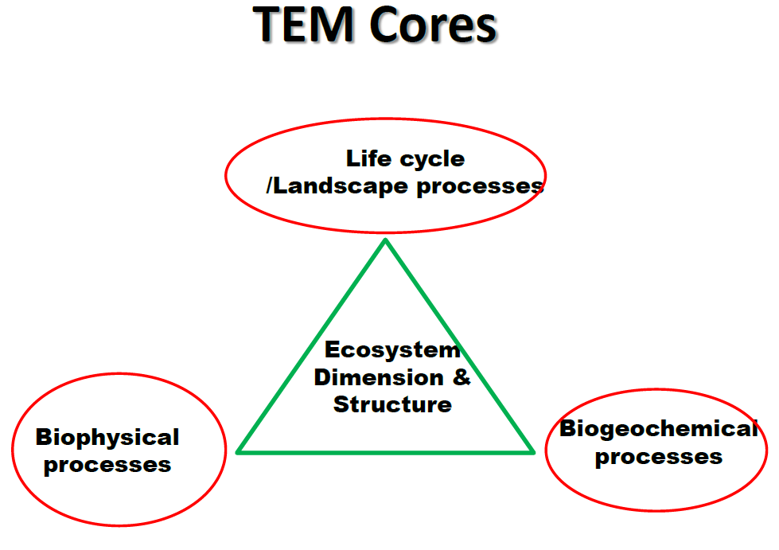
RunCohort
Inputs
C++
Java
RunRegion
COHORT
“cd”
C++
“ed”
“bd”
RunGrid
C++
Java
Outputs

Slide 12
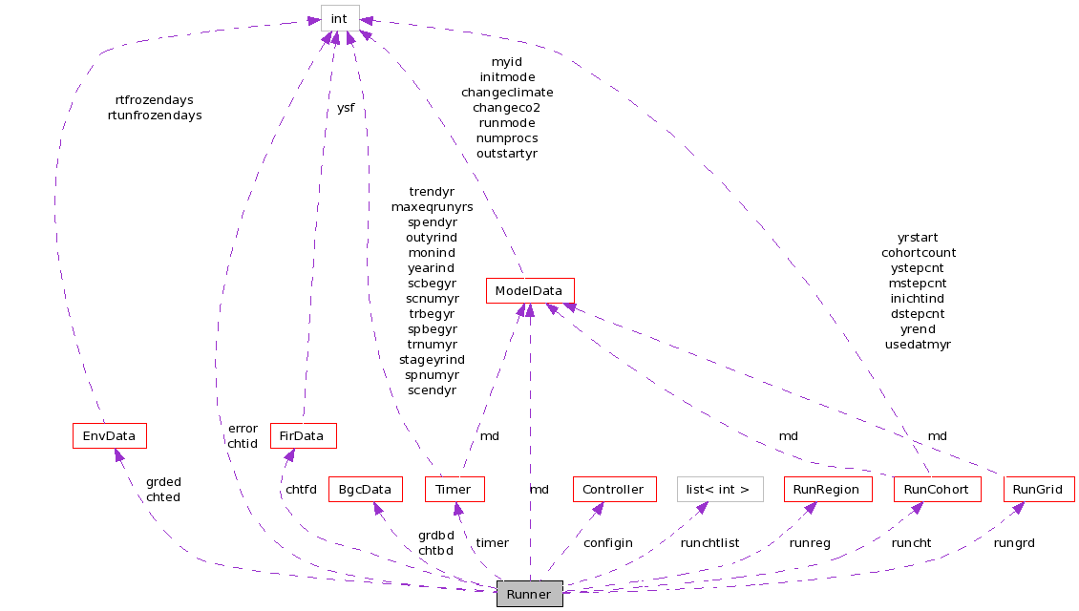
http://tobeycarman.com/temdocs/dvm-dos-tem/html/index.html

Slide 13
RunCohort
Inputs
COHORT
“cd”
“ed”
“bd”
Outputs

Slide 14
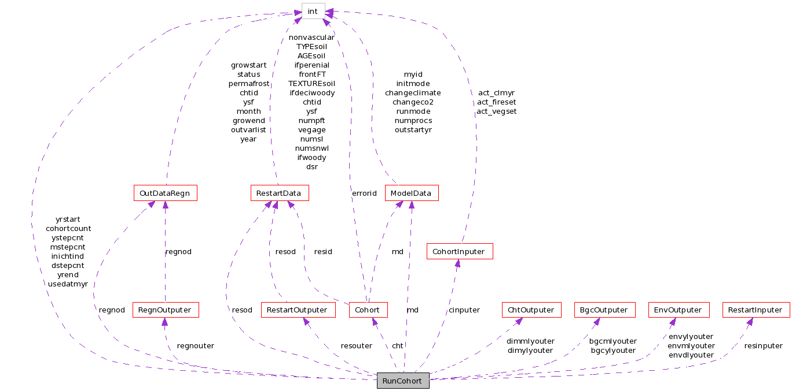
http://tobeycarman.com/temdocs/dvm-dos-tem/html/index.html

Slide 15
COHORT
“cd”
“ed”
“bd”

Slide 16
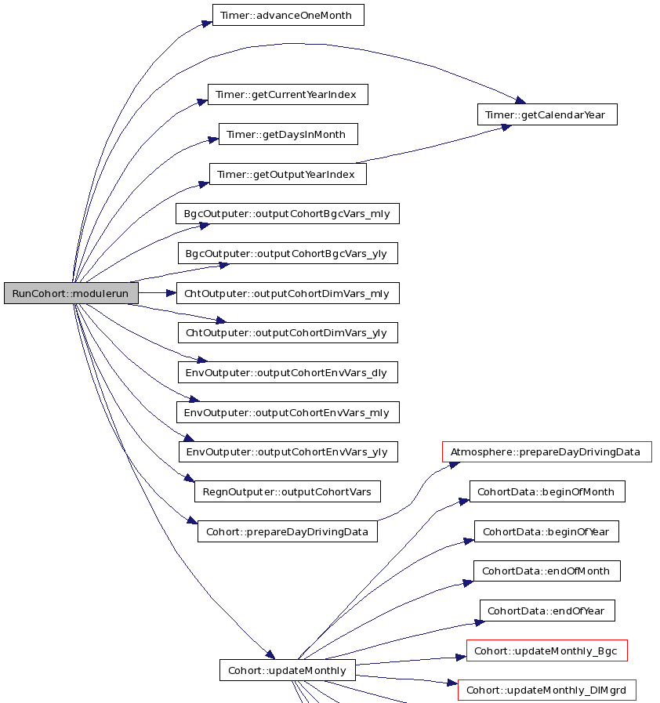
http://tobeycarman.com/temdocs/dvm-dos-tem/html/index.html

Slide 17
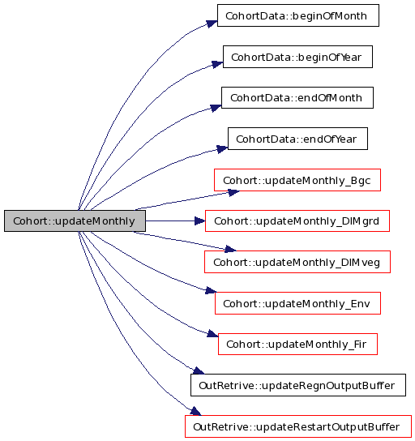
http://tobeycarman.com/temdocs/dvm-dos-tem/html/index.html

Slide 18
DVM-DOS-TEM
Quick Guide

Slide 19
Quick Guide I.
where to get code
https://github.com/fmyuan/dvm-dos-tem
LINUX/Cygwin:
usually the system provides command-line tools for git.
TOOLS:
git for Windows.
https://windows.github.com
Git-gui
http://git-scm.com/downloads
SourceTree.
https://www.atlassian.com/software/sourcetree/overview

Slide 20
Quick Guide II.
Setting-up in Linux OS – OIC as an example
LINUX/Cygwin:
C++: e.g., g++, mpic++(for paralleling).
git clone
Makefile
Compile the code
Run the code

