Slide 1
Smoking – A Harmful Habit (a silent killer)
Presented by: Mehak Fatima
Roll no: 78

Slide 2

Introduction
Smoking is a habit in which people inhale smoke from cigarettes or other tobacco products. It is very common among youth today, often started due to peer pressure, stress, or curiosity. Although some people think smoking helps them relax, in reality it causes serious harm to health, wealth, and character.

Slide 3

Why People Start Smoking
People usually start smoking due to:
Peer pressure and the influence of friends
Stress, anxiety, or sadness
Media and social trends
Lack of awareness about long-term effects
At a young age, many do not realize that smoking can turn into addiction.

Slide 4
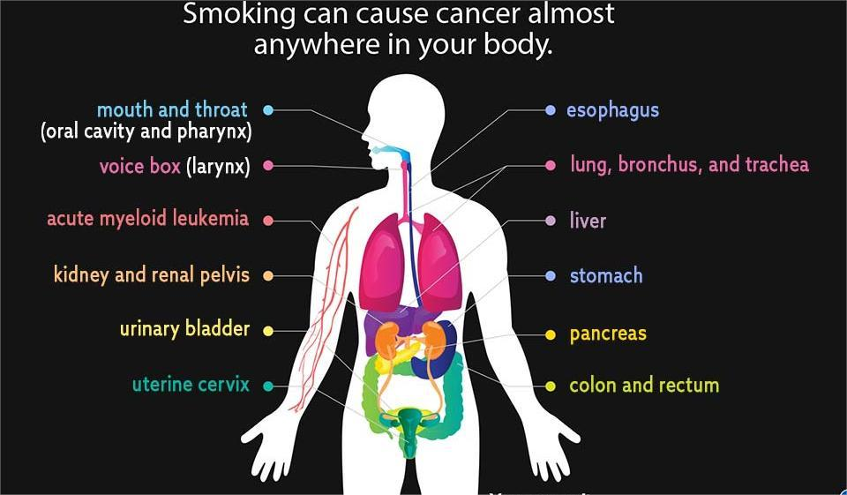
Health Effects of Smoking
Smoking damages almost every organ of the body. Some major harms include:
Lung diseases and breathing problems
Heart disease and weak immune system
Increased risk of cancer
Reduced physical strength and concentration

Slide 5

Smoking in the Light of Islam
Islam strongly emphasizes protection of life and health.
Allah says in the Qur’an:
“And do not throw yourselves into destruction.” (Surah Al-Baqarah 2:195)
Smoking clearly harms the body, which is an amanah (trust) from Allah.
Islam forbids self-harm and harming others.
Smoking wastes money, and Islam dislikes extravagance.
“Indeed, the wasteful are brothers of the devils.” (Surah Al-Isra 17:27)

Slide 6

Conclusion
Smoking is not just a health issue but also a moral and Islamic concern. Islam teaches us to protect our body, wealth, and society. By avoiding smoking, we follow the path of health, self-respect, and obedience to Allah.
“Your body has a right over you.” (Hadith)

Slide 7


