Slide 1
NUDGE · ENGAGE V2 · PROTOTYPE TESTING
Three Rounds of
Persona Usability Testing
Interactive prototype vs. Priya, Tom, and Amara — one fix shipped and verified after each interview.
Fictional course scenario · Nudge Engage v2 discovery cycle

Slide 2
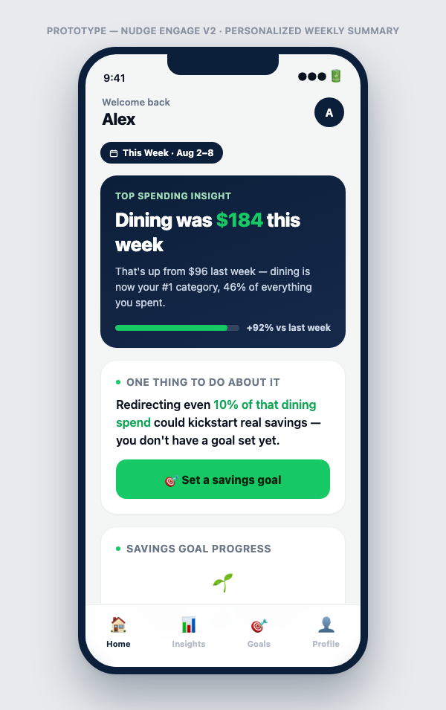
ROUND 0 — INITIAL BUILD
Prototype v1
Personalized weekly summary: top spending insight, one contextual nudge, savings goal progress.
👤
User: Alex — connected Chase 2 weeks ago, hasn't reopened the app since
🎯
State: no savings goal set — highest-churn cohort in the research
⚙️
Nudge doubles as the goal-setting action, tied to the week's spending insight
Slide 1 of 8 · Baseline before any persona feedback

Slide 3
ROUND 1 — PRIYA
P
Priya · 28, software engineer, SF — already has a Europe trip goal
“Why is it acting like I never set up my goal?”
“If it doesn’t know I have a goal, can I trust the $184 number either?”
MOST CONCERNING
Distrust generalized from one visible error to the entire data pipeline — not just a UX nitpick.
RECOMMENDED CHANGE
Add a real “has existing goal” state — branch the nudge and goal-progress card on actual goal state instead of assuming none exists.
Slide 2 of 8 · Round 1 interview + shipped fix

Slide 4
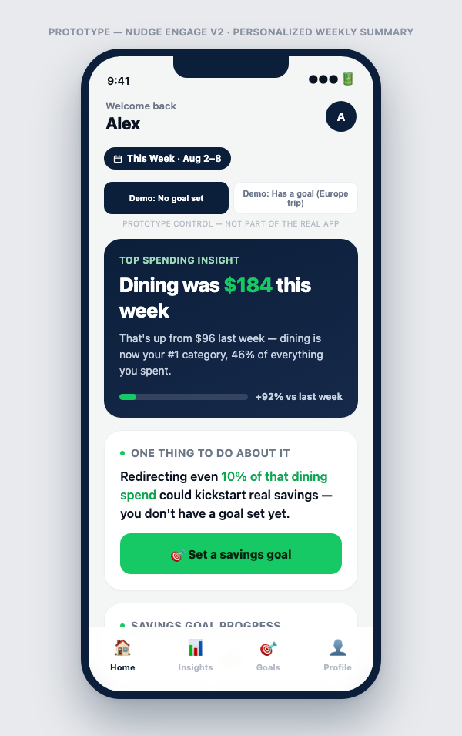
AFTER ROUND 1
Prototype v2
What changed:
Added a demo toggle + full “has a goal” state (Europe Trip)
Nudge and goal-progress card now branch on real goal state
New action: “Redirect $18 to Europe Trip” for existing-goal users
Slide 3 of 8 · Verified live in browser before moving to Round 2

Slide 5
ROUND 2 — TOM
T
Tom · 34, marketing manager, Chicago — abandoned 3 budgeting apps
“It doesn’t know anything about me yet and it’s already asking me to commit to something.”
“‘Redirect $18’ I could tap without thinking. ‘Set a savings goal’ feels like signing up for a whole thing.”
MOST CONCERNING
A full-commitment ask on first touch reads as the same failure pattern from apps he already abandoned.
RECOMMENDED CHANGE
Replace the full-commitment CTA with a one-tap starter action; demote full goal setup to an optional secondary link.
Slide 4 of 8 · Round 2 interview + shipped fix

Slide 6
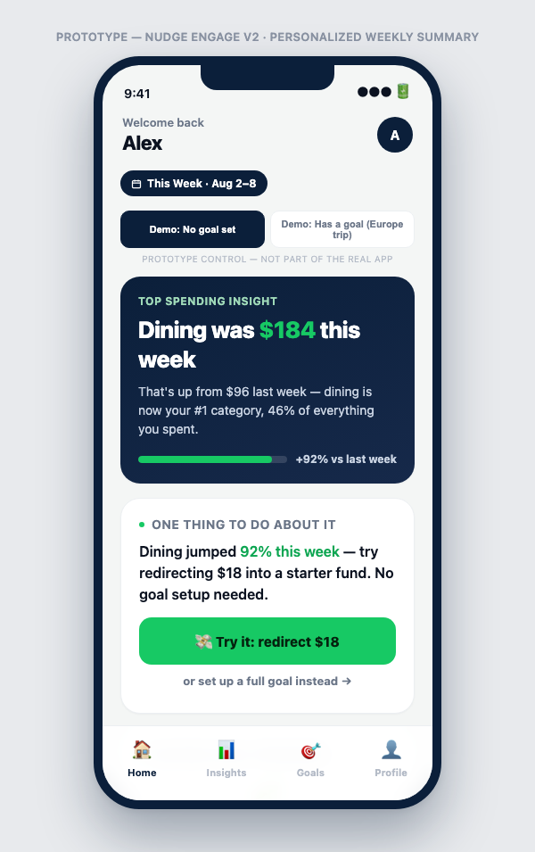
AFTER ROUND 2
Prototype v3
What changed:
“Set a savings goal” replaced by one-tap “Try it: redirect $18”
Full goal setup demoted to “or set up a full goal instead →”
Post-action upgrade path: “Turn this into a real goal →”
Slide 5 of 8 · Verified live in browser before moving to Round 3

Slide 7
ROUND 3 — AMARA
A
Amara · 41, operations lead, Atlanta — paying down credit card debt
“If I’ve got a card at 22% APR, putting $18 into savings instead of principal is the wrong move.”
“Is that a real sub-account, or just a number that doesn’t correspond to anything?”
MOST CONCERNING
The core recommendation could be objectively counterproductive for her situation — a credibility risk, not just low engagement.
RECOMMENDED CHANGE
Soften the nudge to a framed option, disclose it’s a real transaction, and acknowledge what the app doesn’t know (debt, other priorities).
Slide 6 of 8 · Round 3 interview + shipped fix

Slide 8

AFTER ROUND 3 — CURRENT BUILD
Prototype v4 (Final)
What changed:
Nudge reframed as an option, not a prescription
Fine-print discloses it’s a real, verifiable sub-account
Explicit acknowledgment of what the app doesn’t know yet
OPEN ITEM — NOT YET RESOLVED
Whether Engage v2 should incorporate debt-awareness into the nudge logic is a strategic question beyond this prototype's scope — flagged in strategy.md and the decision brief for Marcus.
Slide 7 of 8 · Current state of prototype/index.html

Slide 9
CROSS-ROUND PATTERN
Every fix addressed the same
root issue in a different form
The prototype kept assuming something about the user — no goal exists, ready to commit immediately, savings is the objectively correct move — that didn’t hold for that persona.
01
02
03
State branch
Smaller ask
Honest disclosure
Priya — don’t assume the goal doesn’t exist
Tom — don’t assume readiness to commit
Amara — don’t assume savings is always correct
Slide 8 of 8 · Full transcripts: research/prototype-usability-testing.md

