Slide 1
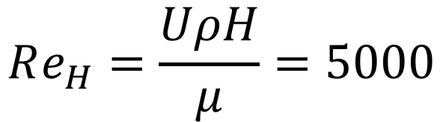
6H
U=1 m/s
90º
4H
H
P_{Gauge}=0 Pa
2H
4H
$$Re_{H}=\frac{UρH}{μ}=5000$$
Turbulent models: Spalart, Standard k-ε

Slide 2
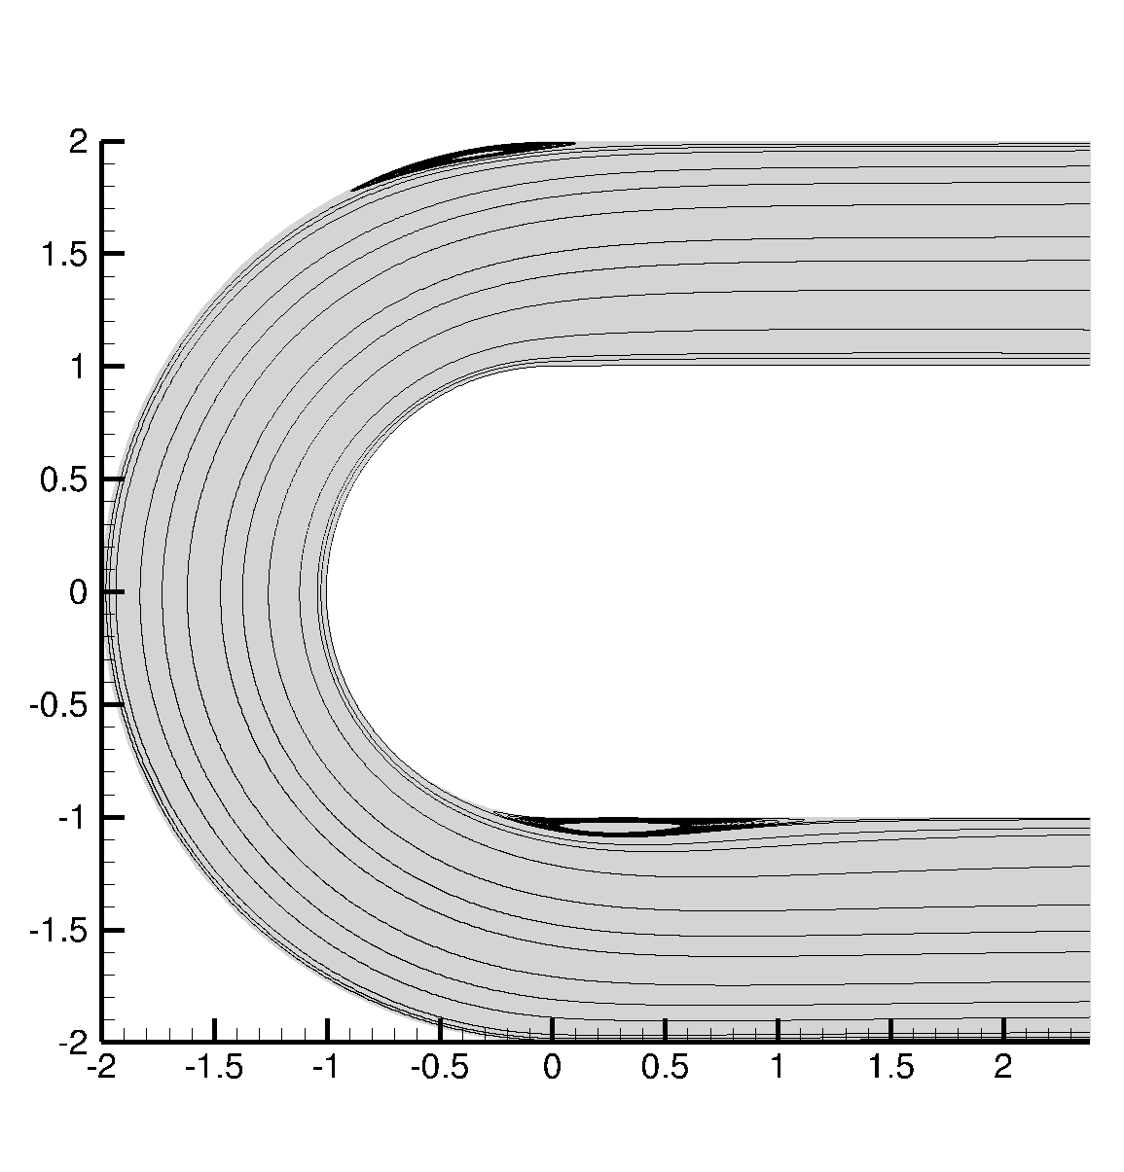
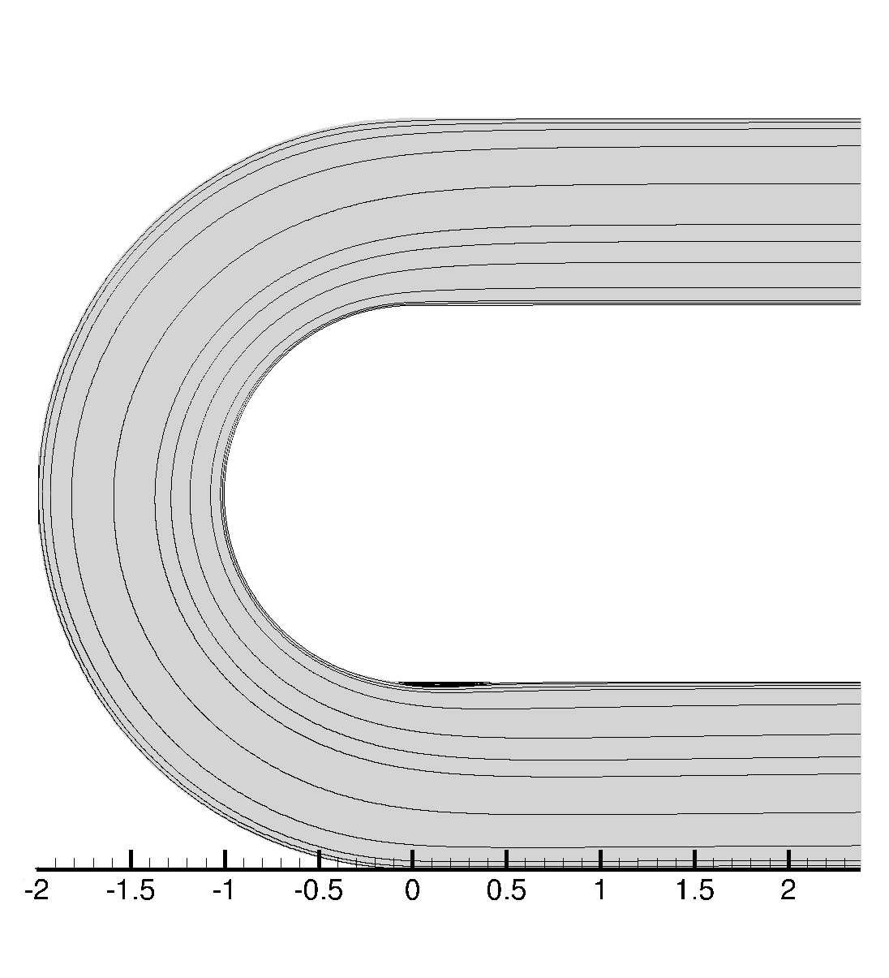
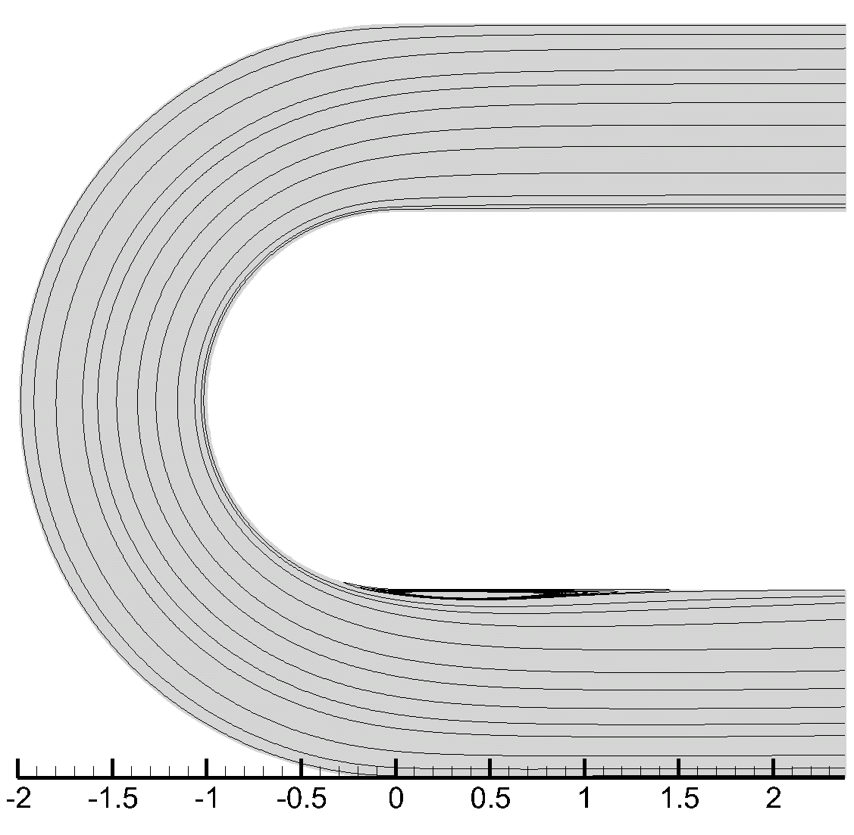
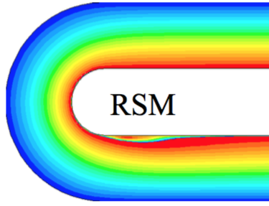
Spalart
Standard k-ε
k-⍵ SST
y/H
x/H
x/H
x/H

