Slide 1
Backward-facing step

Slide 2
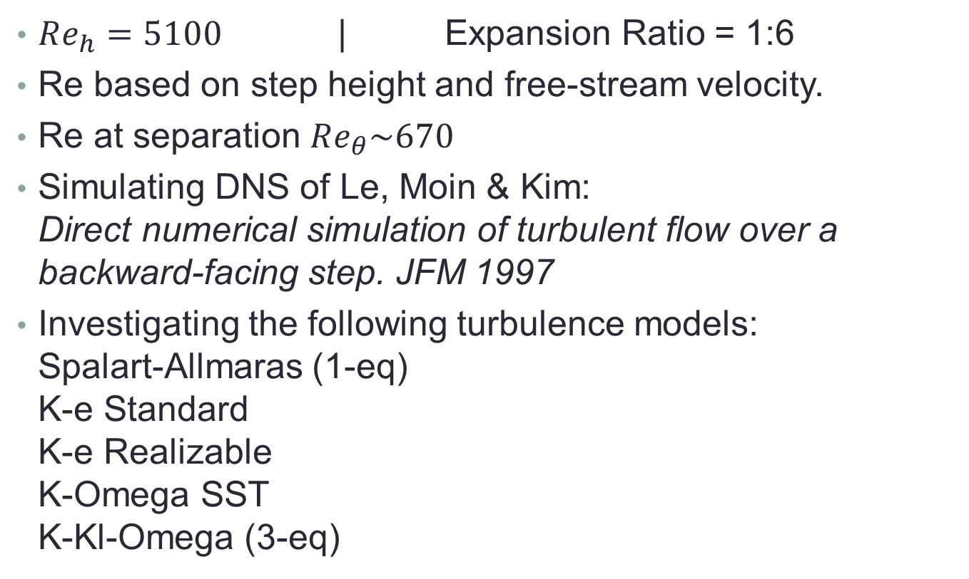
Parameters
$Re_{h}=5100$ | Expansion Ratio = 1:6
Re based on step height and free-stream velocity.
Re at separation $Re_{θ}\sim 670$
Simulating DNS of Le, Moin & Kim:
Direct numerical simulation of turbulent flow over a backward-facing step. JFM 1997
Investigating the following turbulence models:
Spalart-Allmaras (1-eq)
K-e Standard
K-e Realizable
K-Omega SST
K-Kl-Omega (3-eq)

Slide 3
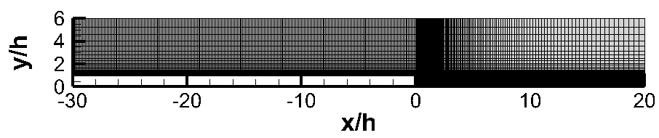
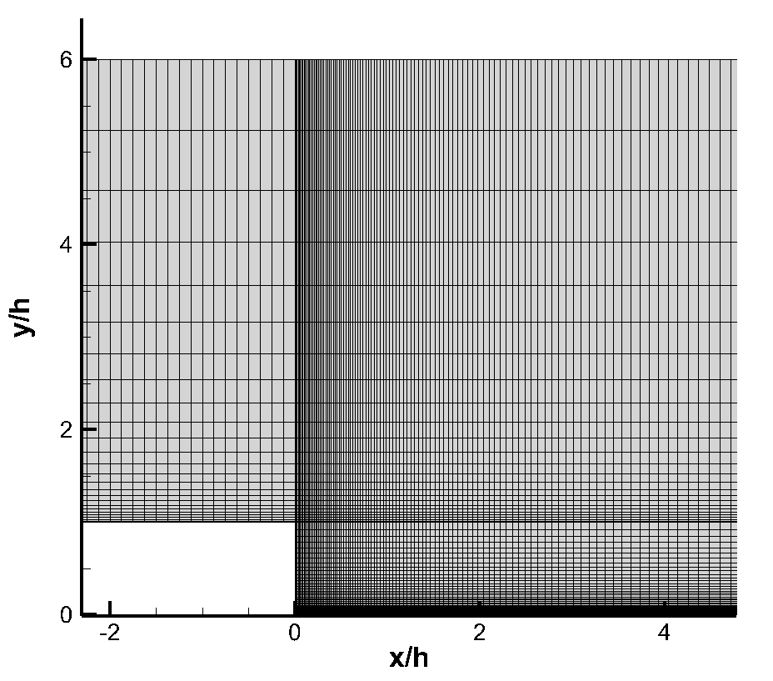
Mesh
16400 elements

Slide 4
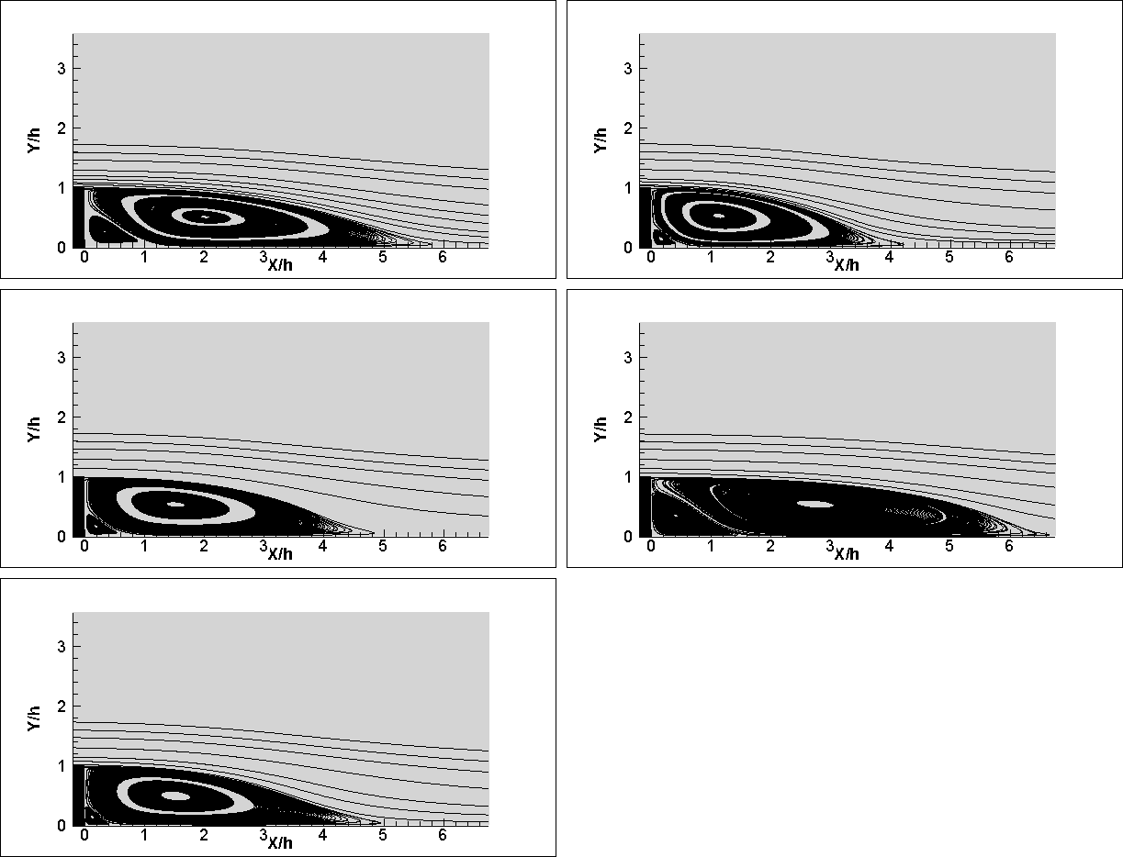
Results
Spalart-Allmaras
K-e
K-e Realizable
K-Omega SST
Kim et. al. report reattachment zone to be x/h=6.28 based on flow visualization.
K-w SST predicts reattachment better that others.
K-Kl-Omega

Slide 5
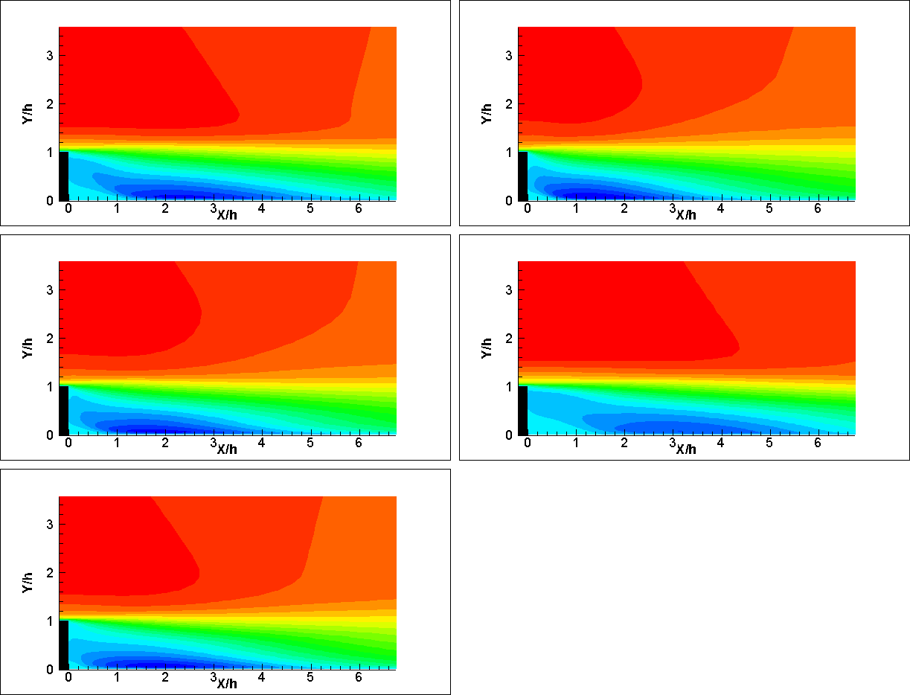
Results-Streamwise Velocity
Spalart-Allmaras
K-e
K-e Realizable
K-Omega SST
1 m/s
K-Kl-Omega
0 m/s

Slide 6
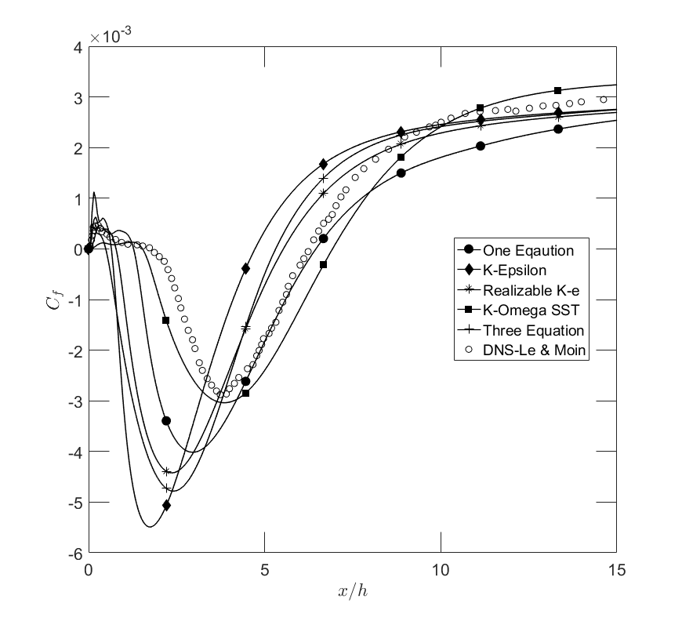
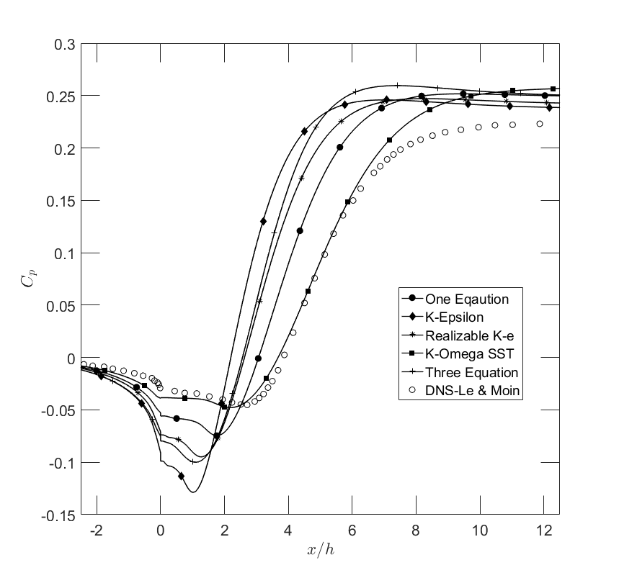
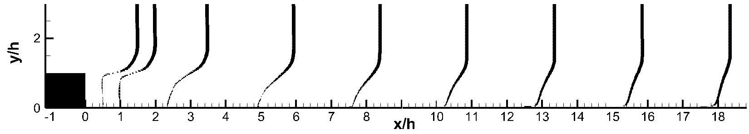
Results
U/Uo
K-Omega SST

Slide 7
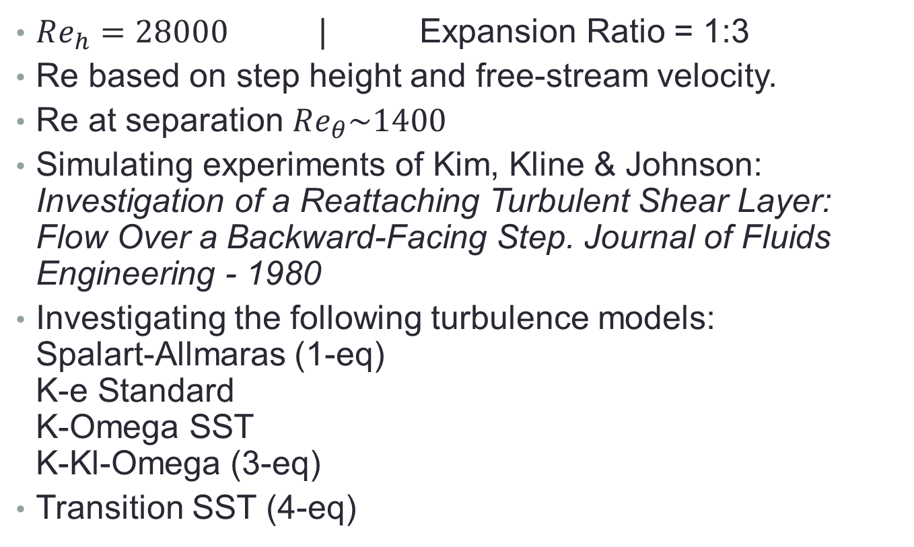
Parameters
$Re_{h}=28000$ | Expansion Ratio = 1:3
Re based on step height and free-stream velocity.
Re at separation $Re_{θ}\sim 1400$
Simulating experiments of Kim, Kline & Johnson:
Investigation of a Reattaching Turbulent Shear Layer: Flow Over a Backward-Facing Step. Journal of Fluids Engineering - 1980
Investigating the following turbulence models:
Spalart-Allmaras (1-eq)
K-e Standard
K-Omega SST
K-Kl-Omega (3-eq)
Transition SST (4-eq)

Slide 8
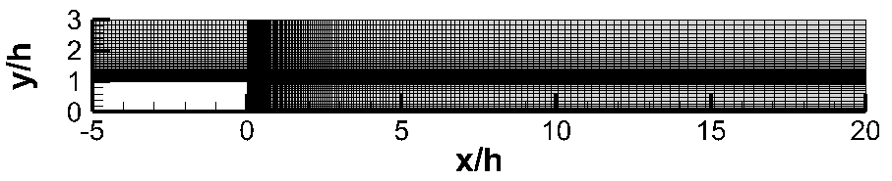
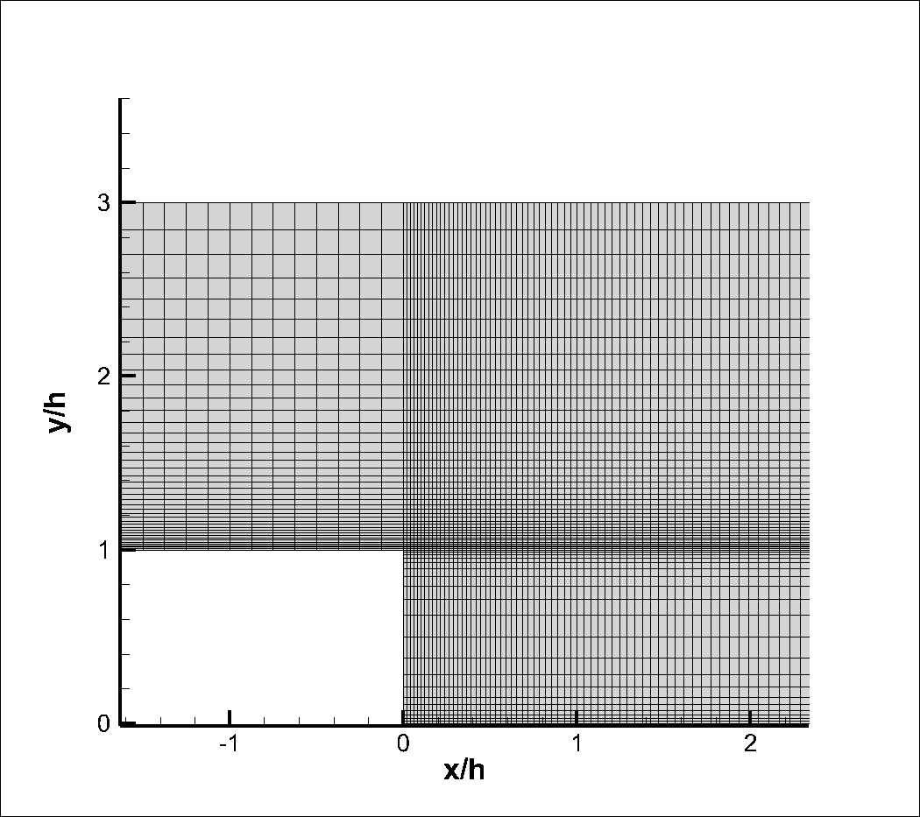
Mesh
11200 elements

Slide 9
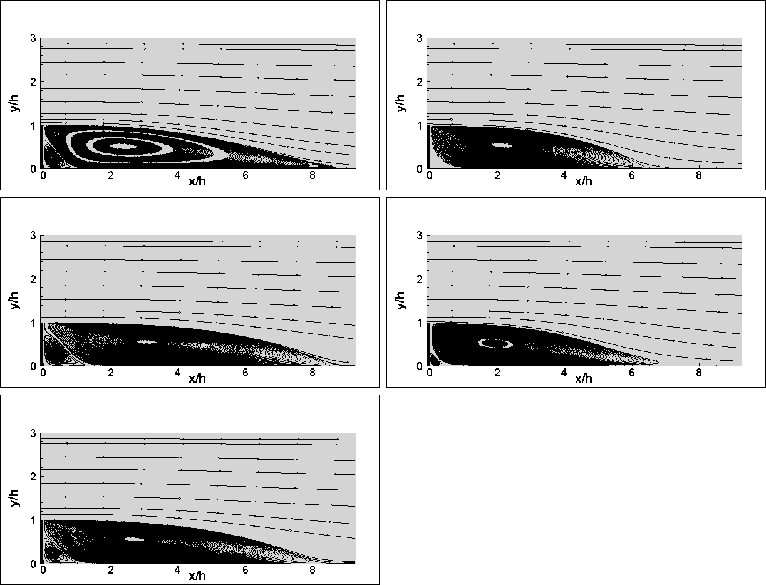
Results
Spalart-Allmaras
K-e
K-Omega SST
K-Kl-Omega
Kim et. al. report reattachment zone to be x/h=7±1 based on flow visualization. Since experiments do not give a definitive answer to where reattachment occurs exactly, it is difficult to measure the accuracy of the turbulent models this way although Spallart-Allmaras and K-w SST seen to overshoot.
Transition SST

Slide 10
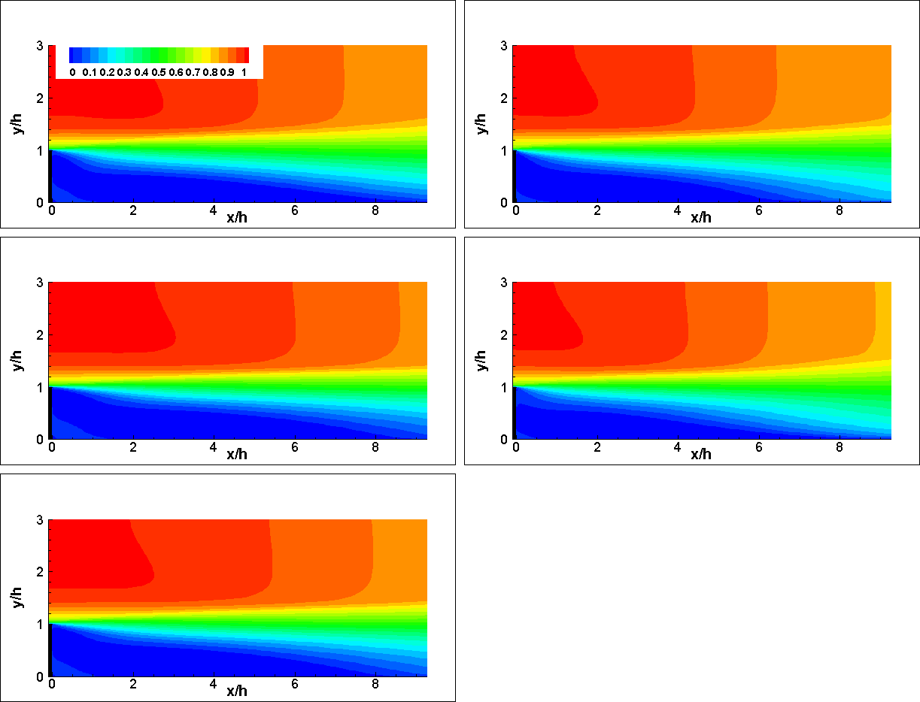
Results
Spalart-Allmaras
Spalart-Allmaras
K-e
K-e
K-Omega SST
K-Omega SST
K-Kl-Omega
K-Kl-Omega
1 m/s
Transition SST
Transition SST
0 m/s

Slide 11
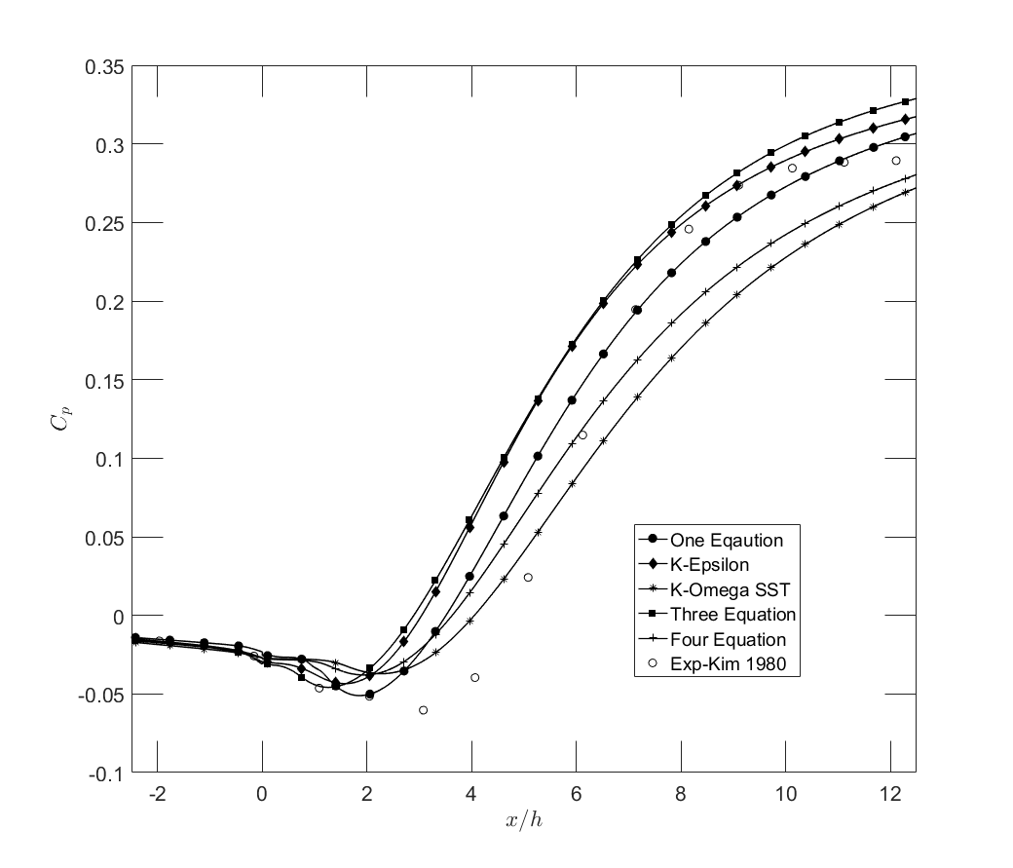
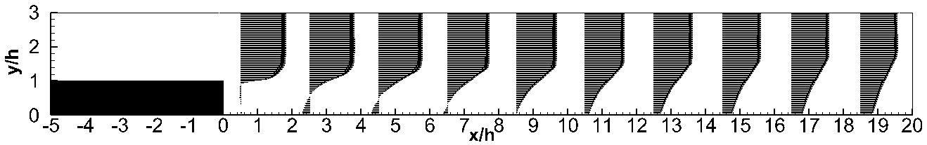
Results
U/Uo
K-Omega SST

