Slide 1

Backward-facing Step

Slide 2
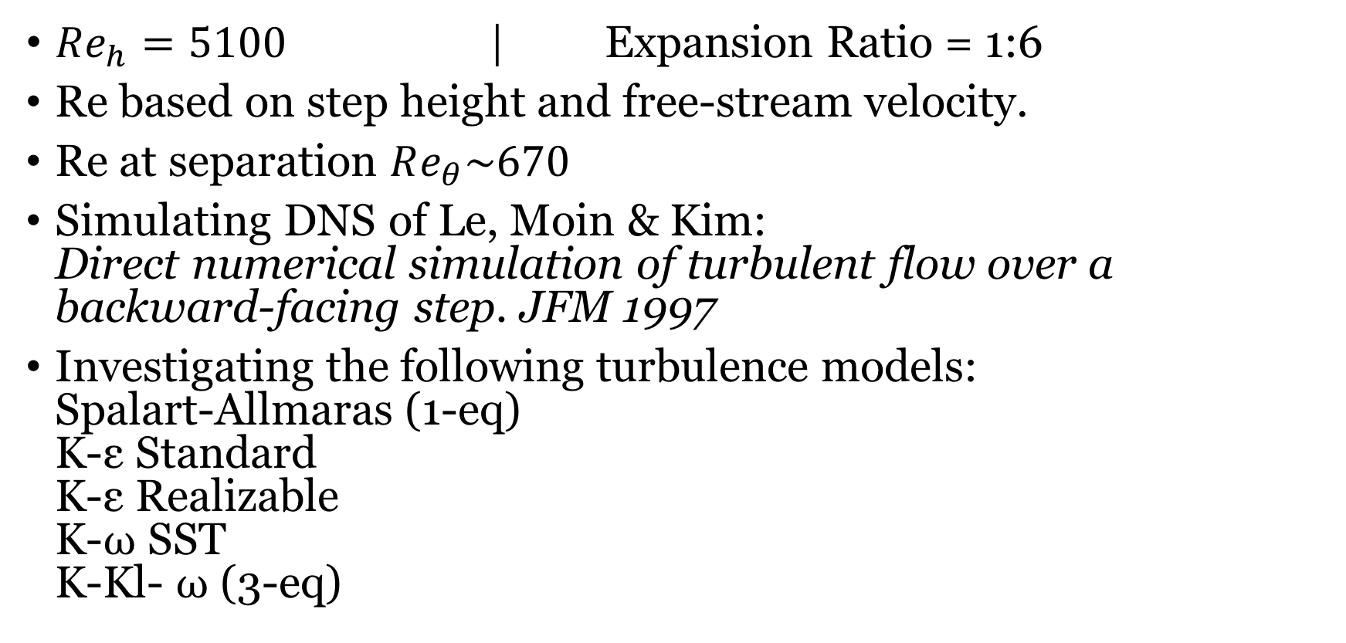
Case 1: Parameters
$Re_{h}=5100$ | Expansion Ratio = 1:6
Re based on step height and free-stream velocity.
Re at separation $Re_{θ}\sim 670$
Simulating DNS of Le, Moin & Kim: Direct numerical simulation of turbulent flow over a backward-facing step. JFM 1997
Investigating the following turbulence models: Spalart-Allmaras (1-eq) K-ε Standard K-ε Realizable K-⍵ SST K-Kl- ⍵ (3-eq)

Slide 3
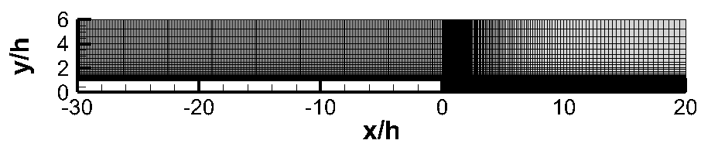
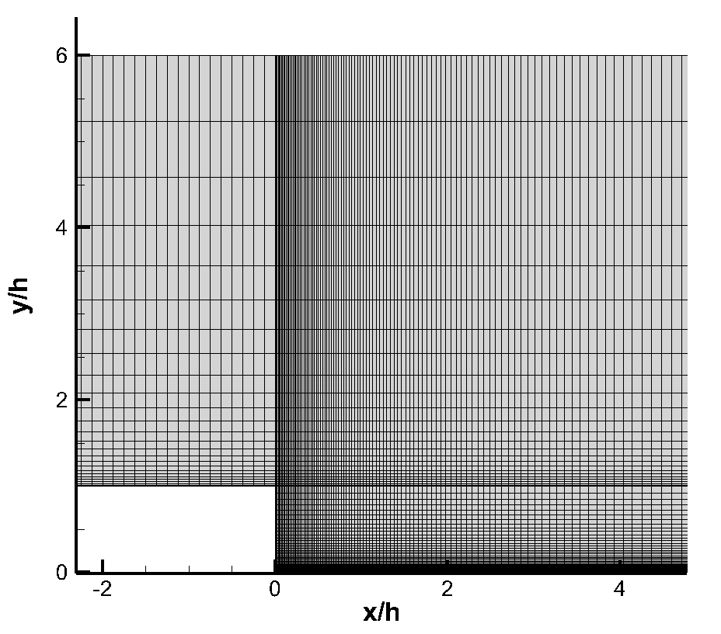
Case 1: Mesh
16400 elements

Slide 4
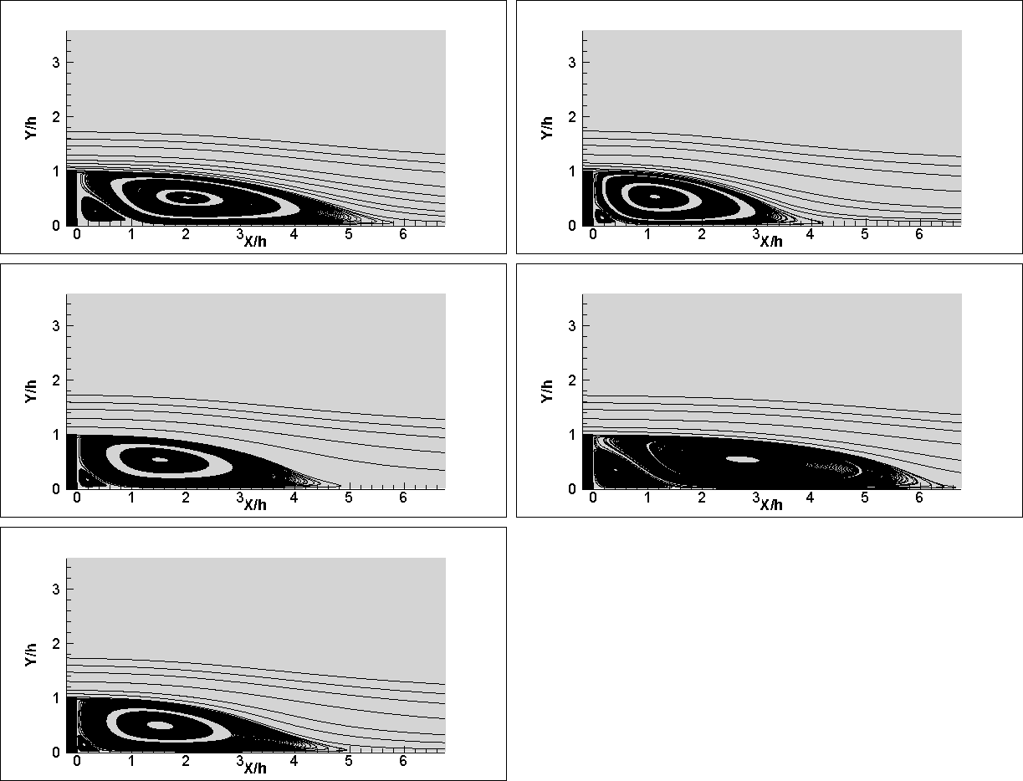
Case 1: Results-Streamlines
Spalart-Allmaras
K-ε
K-ε Realizable
K-⍵ SST
Le et. al. report reattachment zone to be x/h=6.28 based on flow visualization.
K-⍵ SST predicts reattachment better than others.
K-Kl-⍵

Slide 5
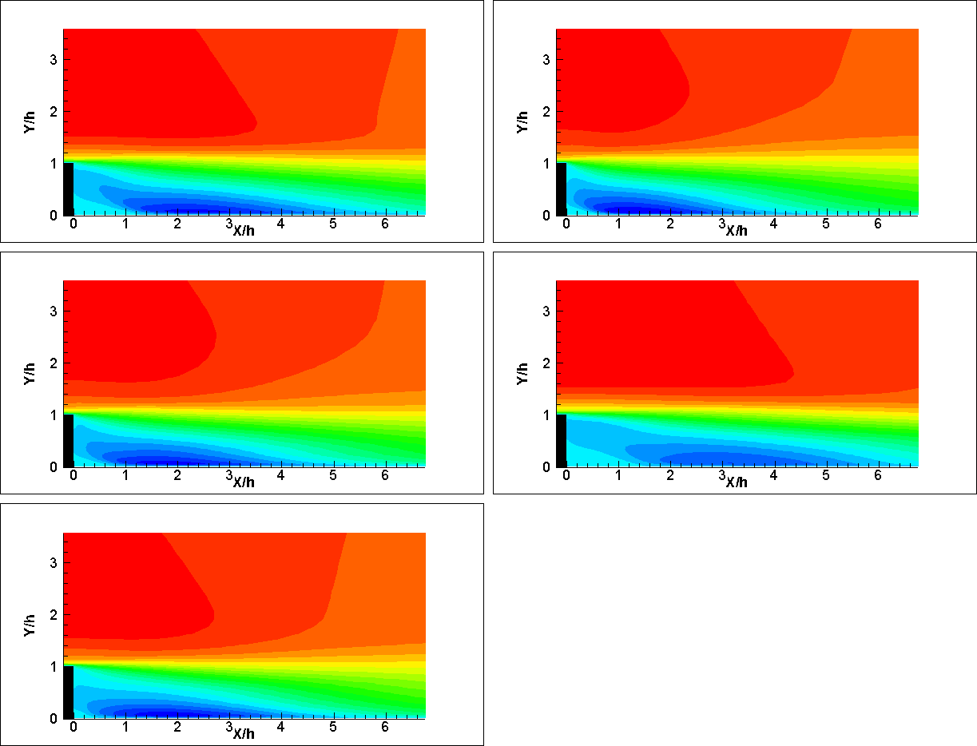
Case 1: Results-Streamwise Velocity Contours
Spalart-Allmaras
K-ε
K-ε Realizable
K-⍵ SST
1 m/s
K-Kl-⍵
0 m/s

Slide 6
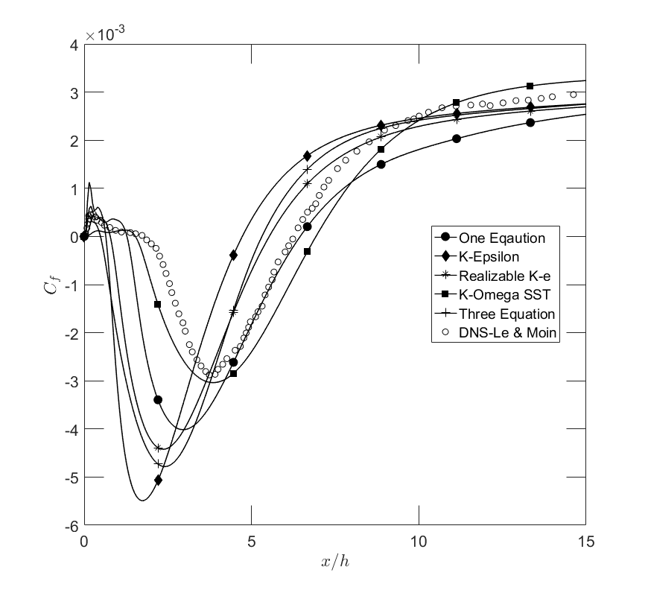
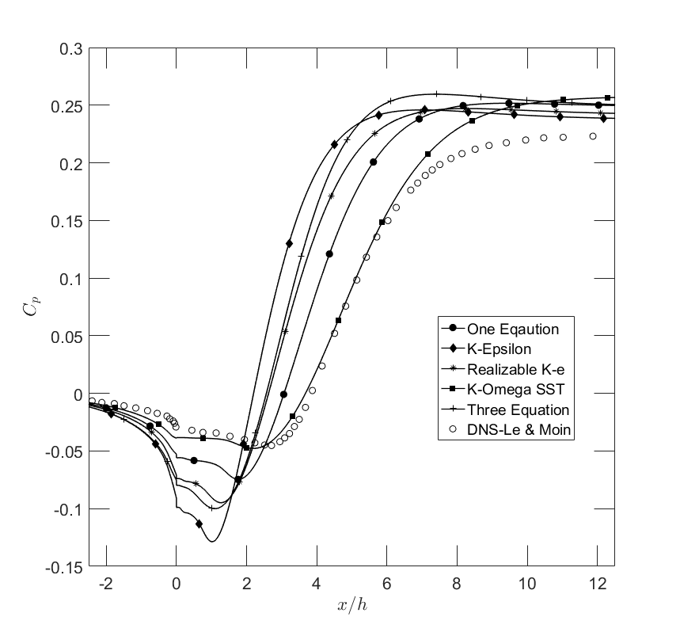
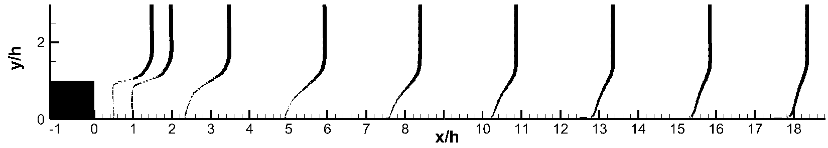
Case 1: Results
U/U_{o}
K-⍵ SST

Slide 7
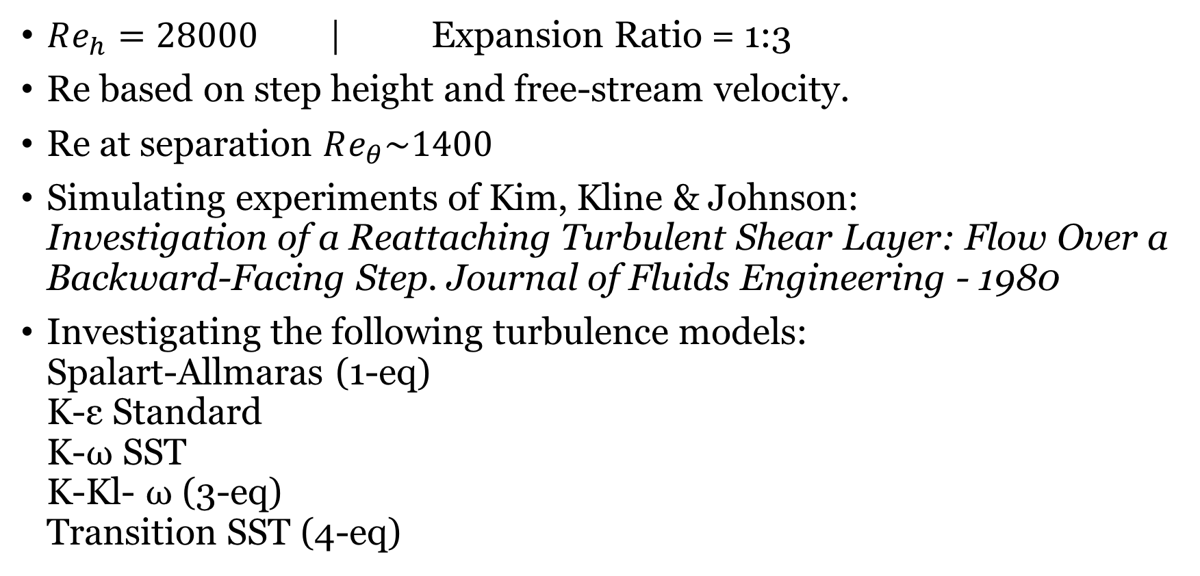
Case 2: Parameters
$Re_{h}=28000$ | Expansion Ratio = 1:3
Re based on step height and free-stream velocity.
Re at separation $Re_{θ}\sim 1400$
Simulating experiments of Kim, Kline & Johnson: Investigation of a Reattaching Turbulent Shear Layer: Flow Over a Backward-Facing Step. Journal of Fluids Engineering - 1980
Investigating the following turbulence models: Spalart-Allmaras (1-eq) K-ε Standard K-⍵ SST K-Kl- ⍵ (3-eq) Transition SST (4-eq)

Slide 8
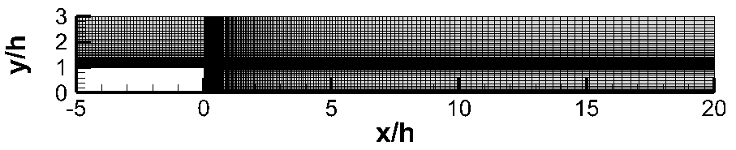
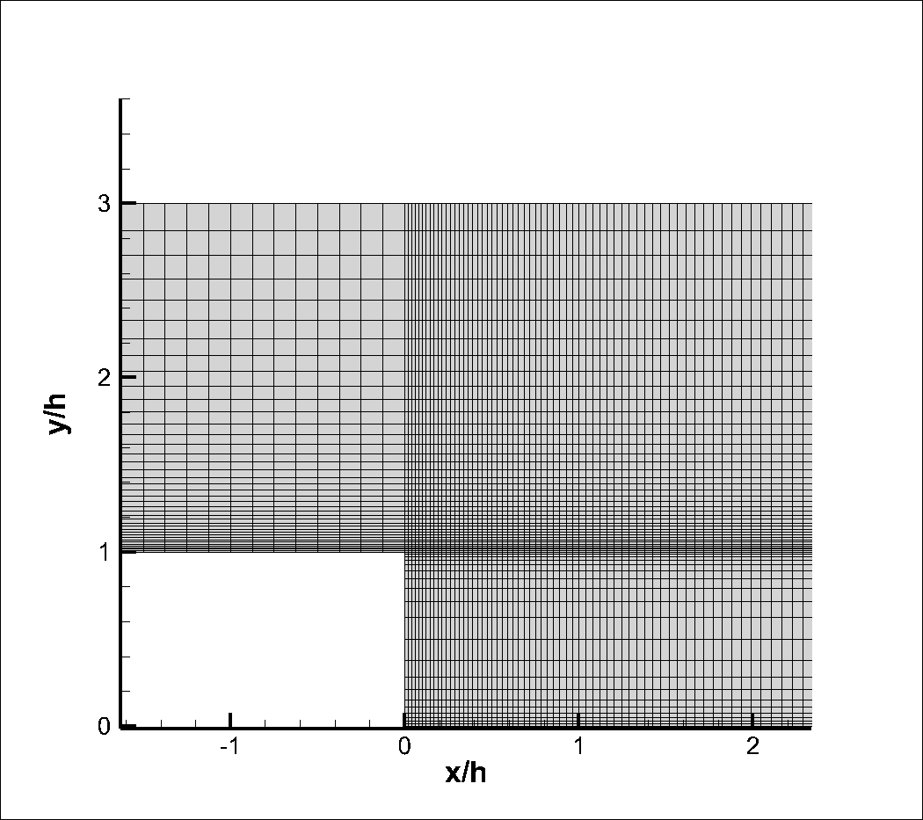
Case 2: Mesh
11200 elements

Slide 9
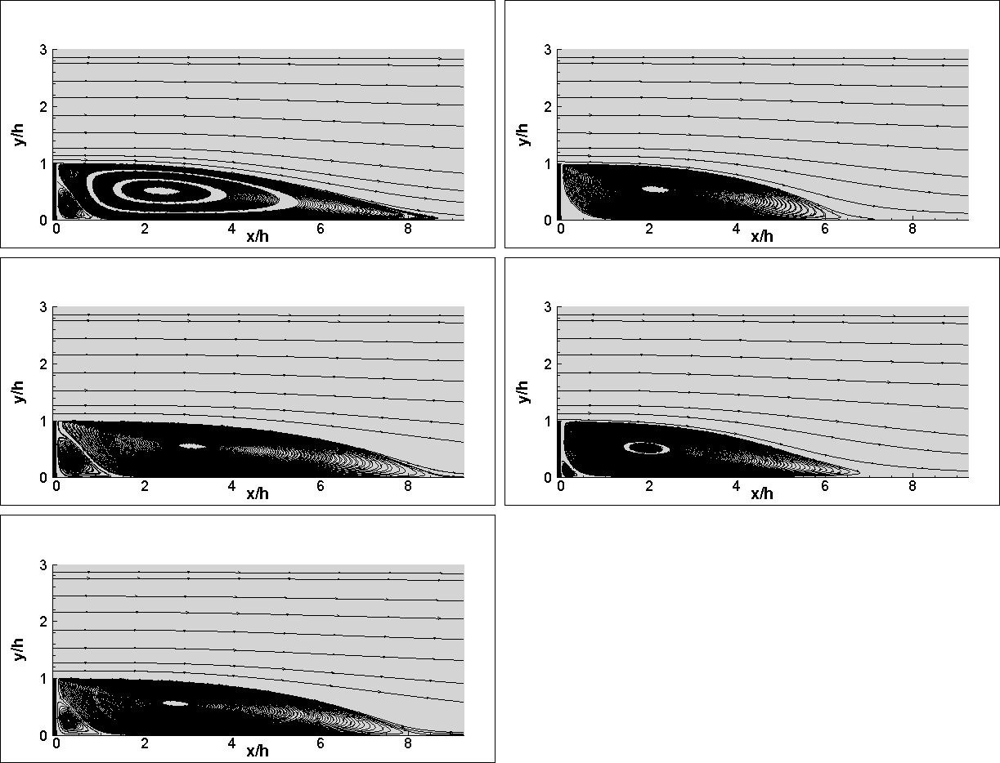
Case 2: Results-Streamlines
Spalart-Allmaras
K-ε
K-⍵ SST
K-Kl-⍵
Kim et. al. report reattachment zone to be x/h=7±1 based on flow visualization. Since experiments do not give a definitive answer to where reattachment occurs exactly, it is difficult to measure the accuracy of the turbulent models this way although Spallart-Allmaras and K-⍵ SST seem to overshoot.
Transition SST

Slide 10
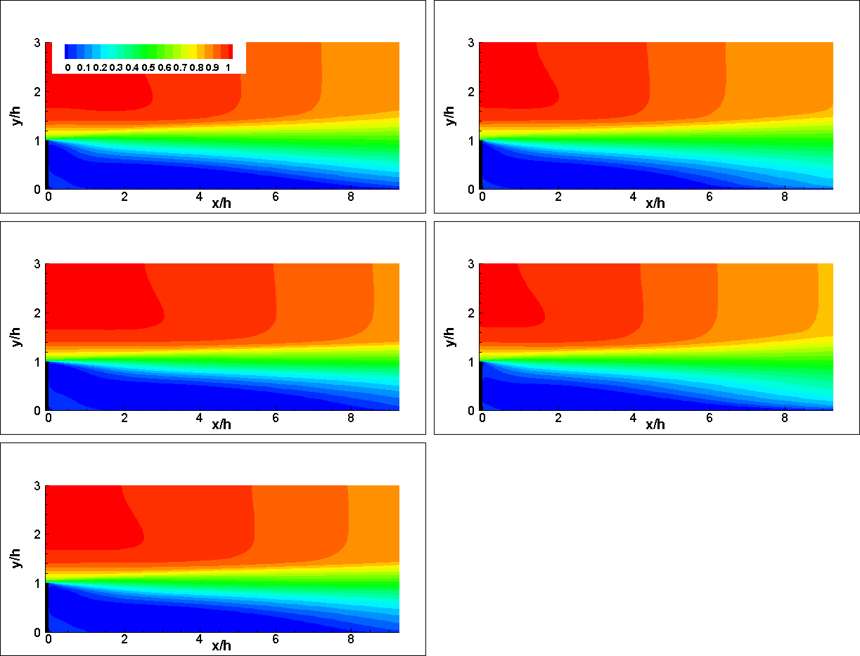
Case 2: Results-Streamwise Velocity Contours
Spalart-Allmaras
Spalart-Allmaras
K-ε
K-e
K-Omega SST
K-⍵ SST
K-Kl-Omega
K-Kl-⍵
1 m/s
Transition SST
Transition SST
0 m/s

Slide 11
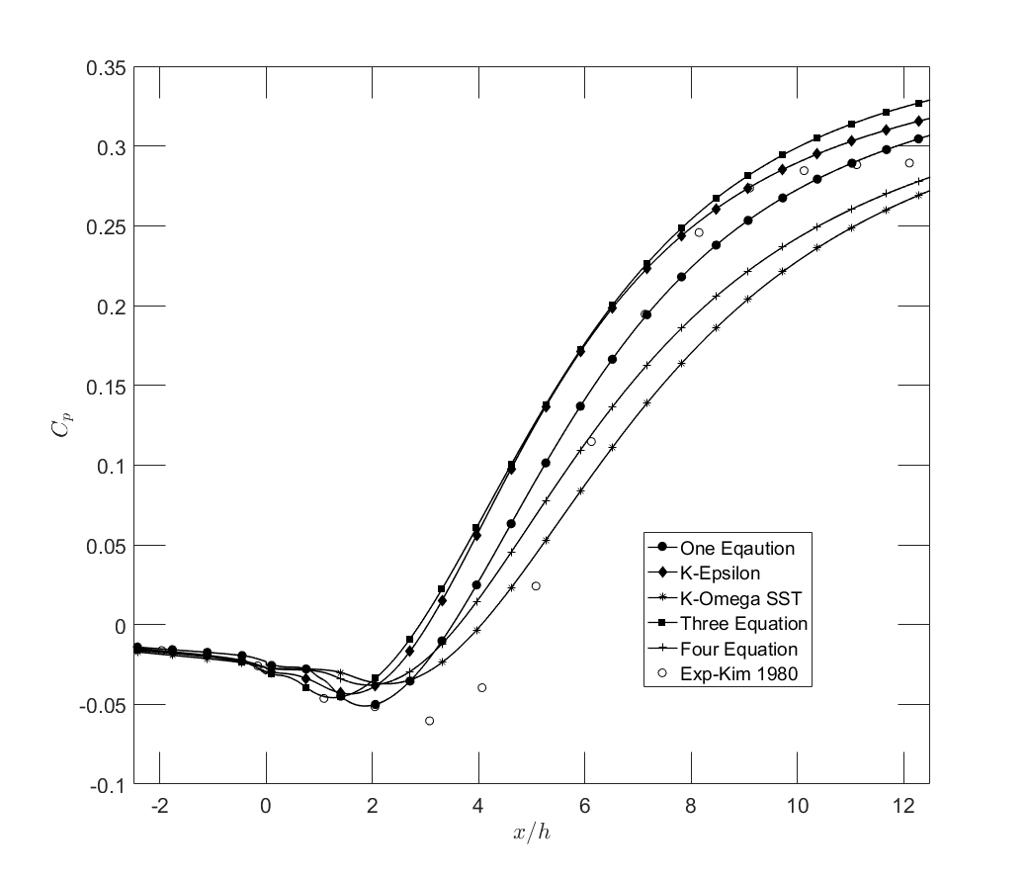
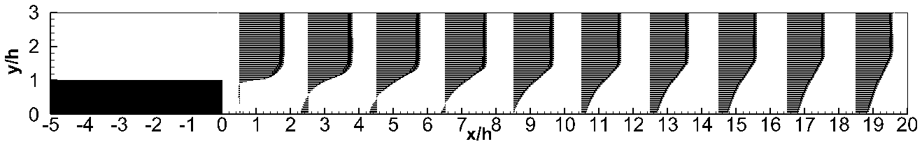
Case 2: Results
U/U_{o}
K-⍵ SST

