Slide 1
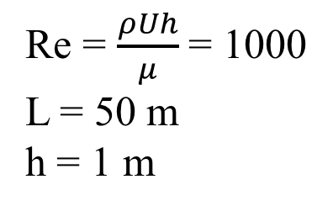
Re = $\frac{ρUh}{μ}$ = 1000
L = 50 m
h = 1 m
U=1 m/s
y
h
P=0 atm
x
L

Slide 2
y
FLOW
x
Domain

Slide 3
u_{surf}
u₂
u₁

Slide 4

20 m
Slip-wall
5m
D=1 m
Inlet (U=1 m/s, V=0)
10 m
Outlet (P=P_{atm})
5m
$$Re=\frac{ρUD}{μ}=20$$
Slip-wall

Slide 5
FLOW
Separation point
Reattachment

Slide 6
3 m
Inlet
Y
Pressure outlet
1 m
X=-5 m
O
X
X=20 m

Slide 7
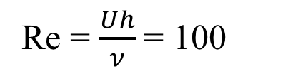
U=1 m/s
Re = $\frac{Uh}{ν}$ = 100
1 m
1 m

Slide 8
h
h
h
h
i-4
i-3
i-2
i-1
i
x=0
x=L
h
h
h
x₀
x₁
x₂
x₃

Slide 9
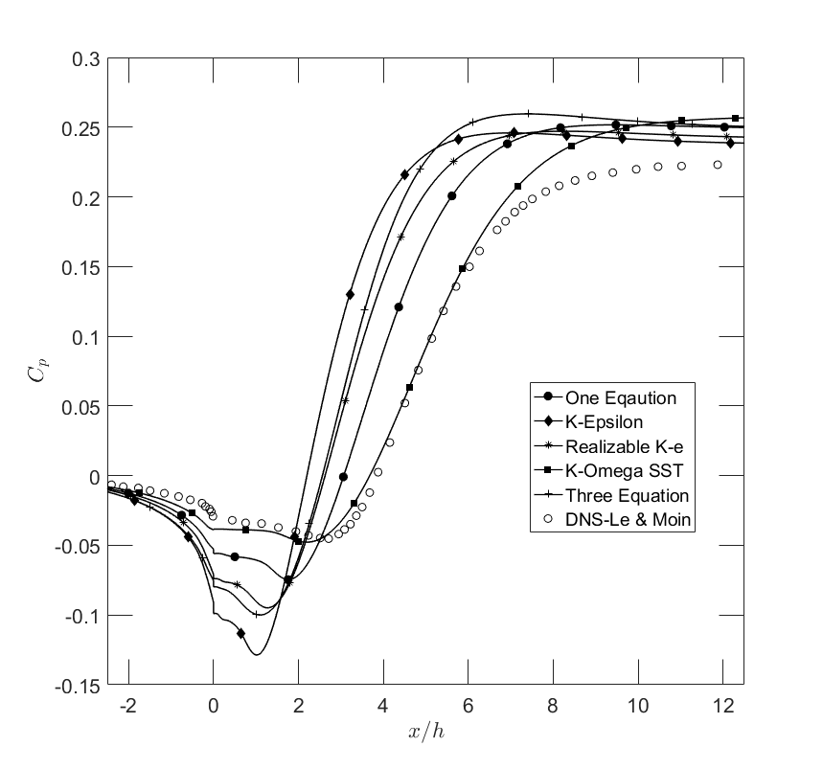
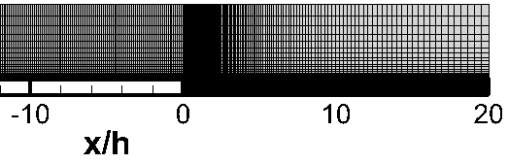

Slide 10
h
i+2
i-2
h
h
h
i-1
i
i+1

