Slide 1

ANSYS FLUENT
Applied Computational Fluid Dynamics
MAE 6220

Slide 2
Outline
Problem analysis
Creating geometry
Computational grid
FLUENT settings and model setup
Numerical solution
Results and post-processing
Validation

Slide 3
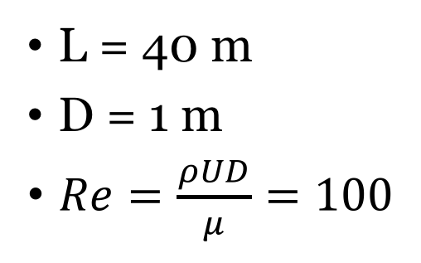
Problem analysis: Laminar fully developed pipe flow
L = 40 m
D = 1 m
$Re=\frac{ρUD}{μ}=100$
u=1 m/s
𝚹
r
z
D
p=1 atm
L
L
Domain geometry
Inlet
D/2
Outlet
Symmetry axis
Notes:
\frac{\partial}{\partial \theta}=0\\
u_\theta=0\\
u_r=0\\
\frac{\partial u_z}{\partial z}=0; u_z=u_z(r)\\
P=P(z)\\
u_{max}=\frac{\Delta P\times R^2}{4\mu L}

Slide 4
Creating geometry
Choosing problem dimensions (2D vs. 3D)
Create the outline
Set dimensions
Create surfaces
Specify fluid/solid volumes
Save project

Slide 5
Computational grid
Grid resolution requirements
Automatic mesh generation
Constrained mesh generation
Meshing edges
Meshing surfaces
Checking grid size
Labeling boundaries

Slide 6
FLUENT settings and model setup
Precision options
Parallel processing
Checking mesh

Slide 7
FLUENT settings and model setup
Solver options - Pressure-Based - Absolute velocity formulation -Axisymmetric -Gravity
Choosing solution model -Viscous model (Inviscid, Laminar, k-eps, LES, etc …)
Define fluid material
Set boundary conditions
Set reference values

Slide 8
Numerical solution
Set convergence criteria
Setup monitors
Iterate till convergence

Slide 9
Checking the results
Pressure contours
Velocity contours
Velocity profile
Export Results

Slide 10
Post-processing and validation
Calculate skin friction coefficient: Cf=f/4; f=Re/64
Velocity profile
Pressure distribution profile
Entrance length

