Slide 1
ANSYS Fluent
Applied Computational Fluid Dynamics
MAE 6220

Slide 2
Outline
Problem analysis
Creating geometry
Computational grid
FLUENT settings and model setup
Numerical solution
Results and post-processing
Validation

Slide 3
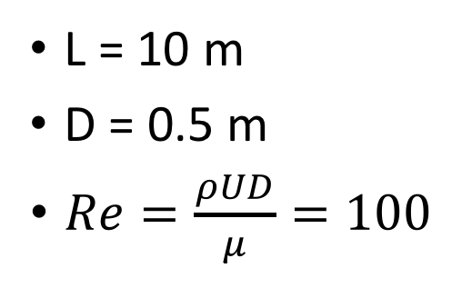
Problem analysis: Laminar fully developed pipe flow
L = 10 m
D = 0.5 m
$Re=\frac{ρUD}{μ}=100$
u=1 m/s
D
p=1 atm
L

Slide 4
Creating geometry
Choosing problem dimensions (2D vs. 3D)
Create the outline
Set dimensions
Create surface
Specify fluid/solid volume
Save project

Slide 5
Computational grid
Grid resolution requirements
Automatic mesh generation
Constrained mesh generation
Meshing edges
Meshing surfaces
Checking grid size
Labeling boundaries

Slide 6
FLUENT settings and model setup
Precision options
Parallel processing
Checking mesh

Slide 7
FLUENT settings and model setup
Solver options - Pressure-Based - Absolute velocity formulation -Axisymmetric -Gravity
Choosing solution model -Viscous model (Inviscid, Laminar, k-eps, LES, etc …)
Choose material
Set boundary conditions
Set reference values

Slide 8
Numerical solution
Set convergence criteria
Setup monitors
Iterate till convergence

Slide 9
Results and post-processing
Pressure contours
Velocity contours
Velocity profile

Slide 10
Validation
Calculate skin friction coefficient: Cf=f/4; f=Re/64
Velocity profile
Pressure distribution profile

