Slide 1

MESH GENERATION
Applied Computational Fluid Dynamics
MAE 6220

Slide 2
Outline
Types of mesh elements
General refinement settings
Why is mesh quality important?
Mesh statistics
Boundary layer treatment
Multi-zone mesh

Slide 3
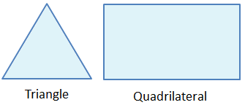
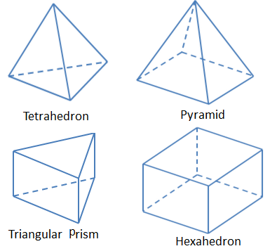
Types of mesh elements
2-D
3-D

Slide 4
Quadrilateral vs. Triangles
 | Pros | Cons
Quadrilateral | Errors made at opposite cell faces partially cancel Easier to follow streamlines | Slower mesh generation More difficult to handle complex geometries
Triangles | Fast mesh generation Can handle any geometry | Less accurate
Source: J.H Ferziger, M. Peric; Computational Methods for Fluid Dynamics; Springer

Slide 5
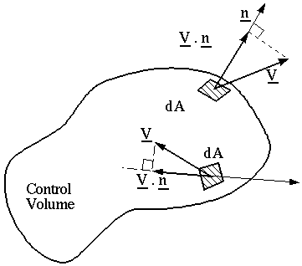
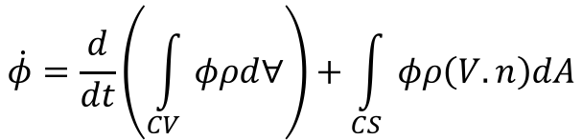
Why is mesh quality imortant?
Finite volume approach
$$\dot{φ}=\frac{d}{dt}\left(\int_{CV}{φρd∀}\right)+\int_{CS}{φρ\left(V.n\right)dA}$$
Velocity at the surface has to be interpolated
u_{surf}
u₂
u₁

Slide 6
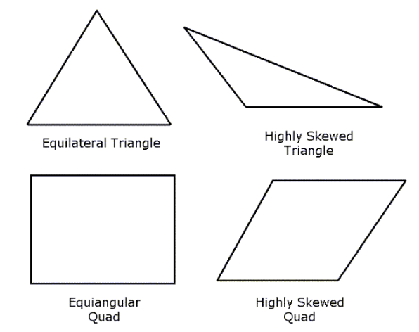
Mesh statistics
Element quality
Skewness
1 Perfect cube
0 Zero or negative volume
1 Degenerate
0 Equilateral or equiangular element

Slide 7
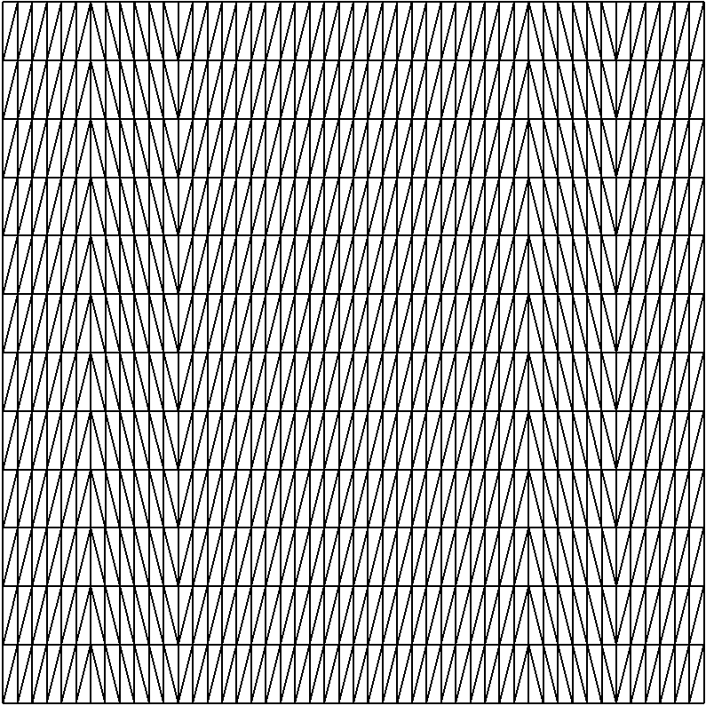
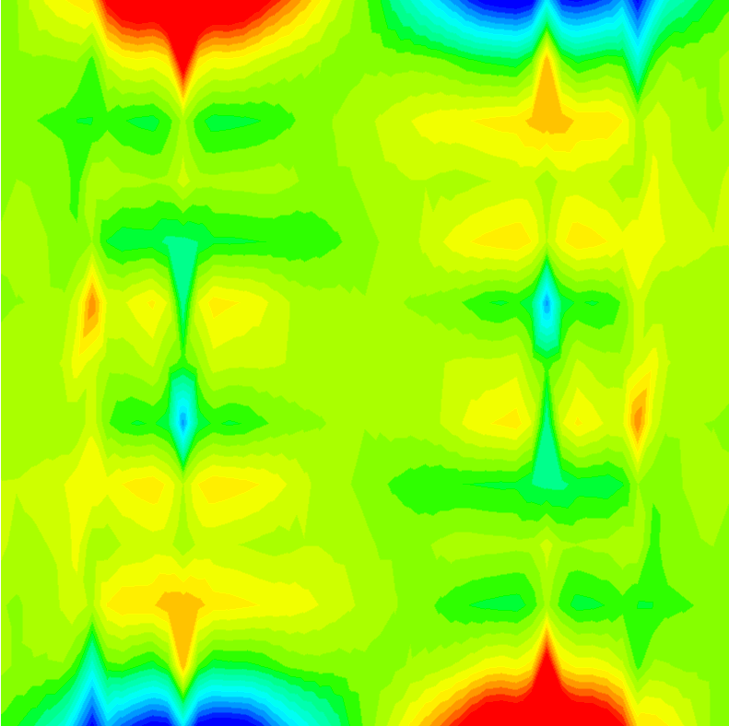
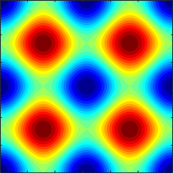
Mesh statistics
1152 elements (~32 x 32)
Highly skewed
Pressure

Slide 8
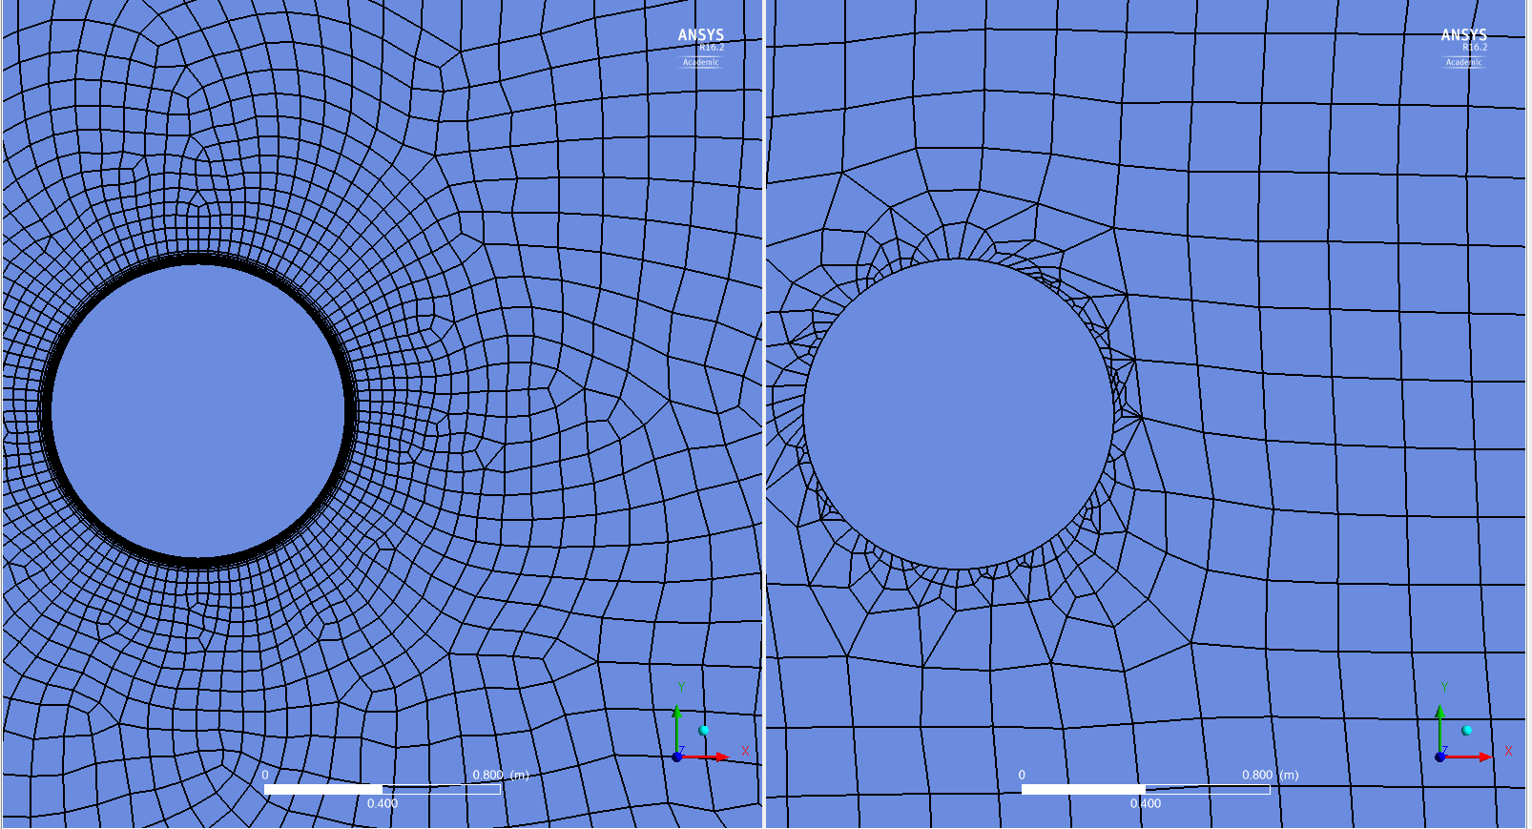
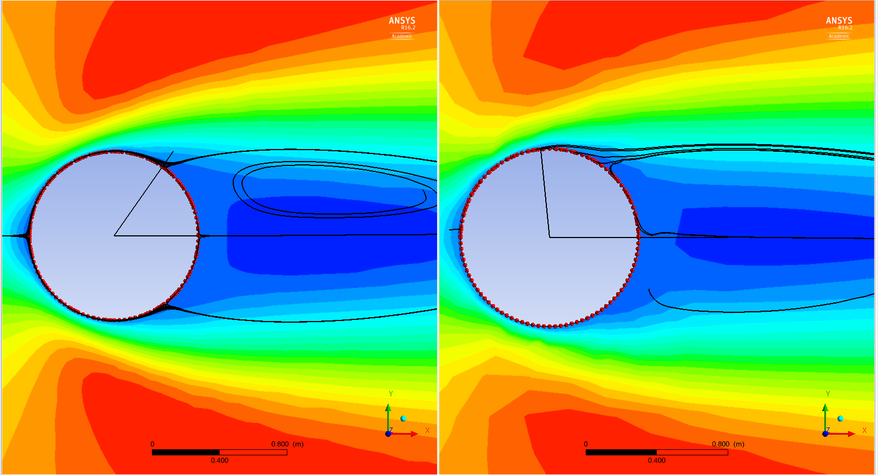
Boundary layer treatment
100 nodes on the cylinder in both cases
Asymmetric grid that does not follow streamlines cannot predict the separation point correctly.
X-Velocity Contours
Flow direction

Slide 9
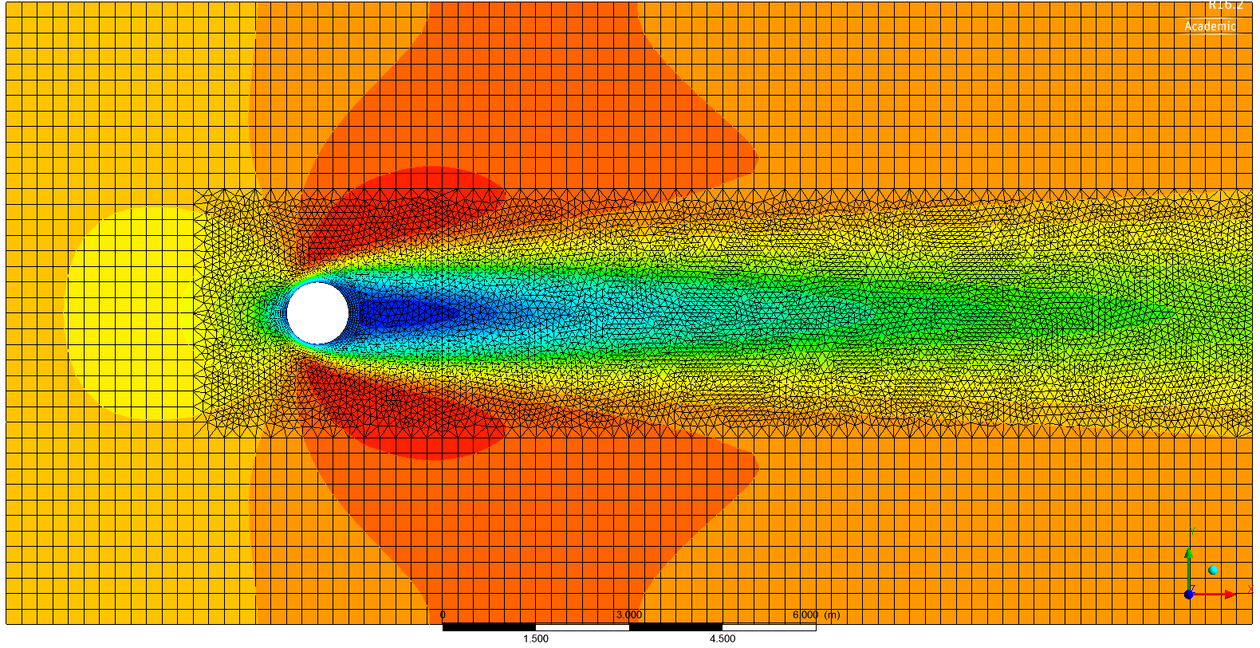
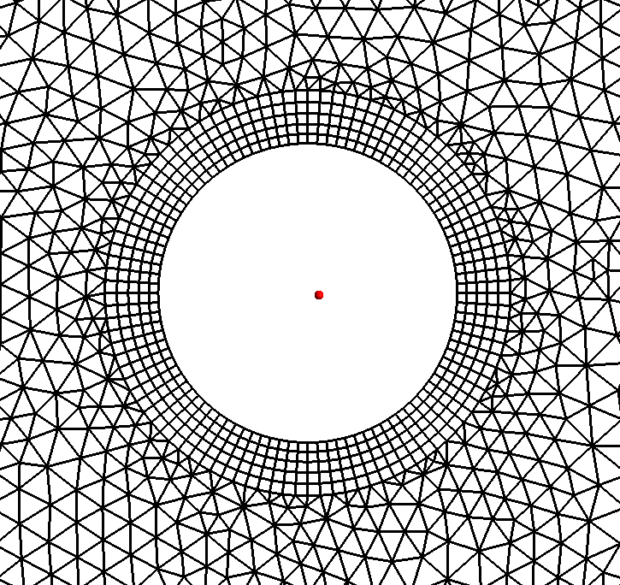
Multi-zone mesh
X-Velocity Contours
Boundary Layer
Wake

