Slide 1

TURBULENCE MODELING IN FLUET
Applied Computational Fluid Dynamics
MAE 6220

Slide 2
Outline
Laminar vs. turbulent flow
Simulating turbulence numerically
Overview of turbulence modeling
Reynolds-Averaged Navier-Stokes (RANS)
Turbulence models
Spalart-Allmaras model
Available turbulence models in FLUENT
Comparison of RANS turbulence models
Boundary conditions for turbulent models
Case study

Slide 3
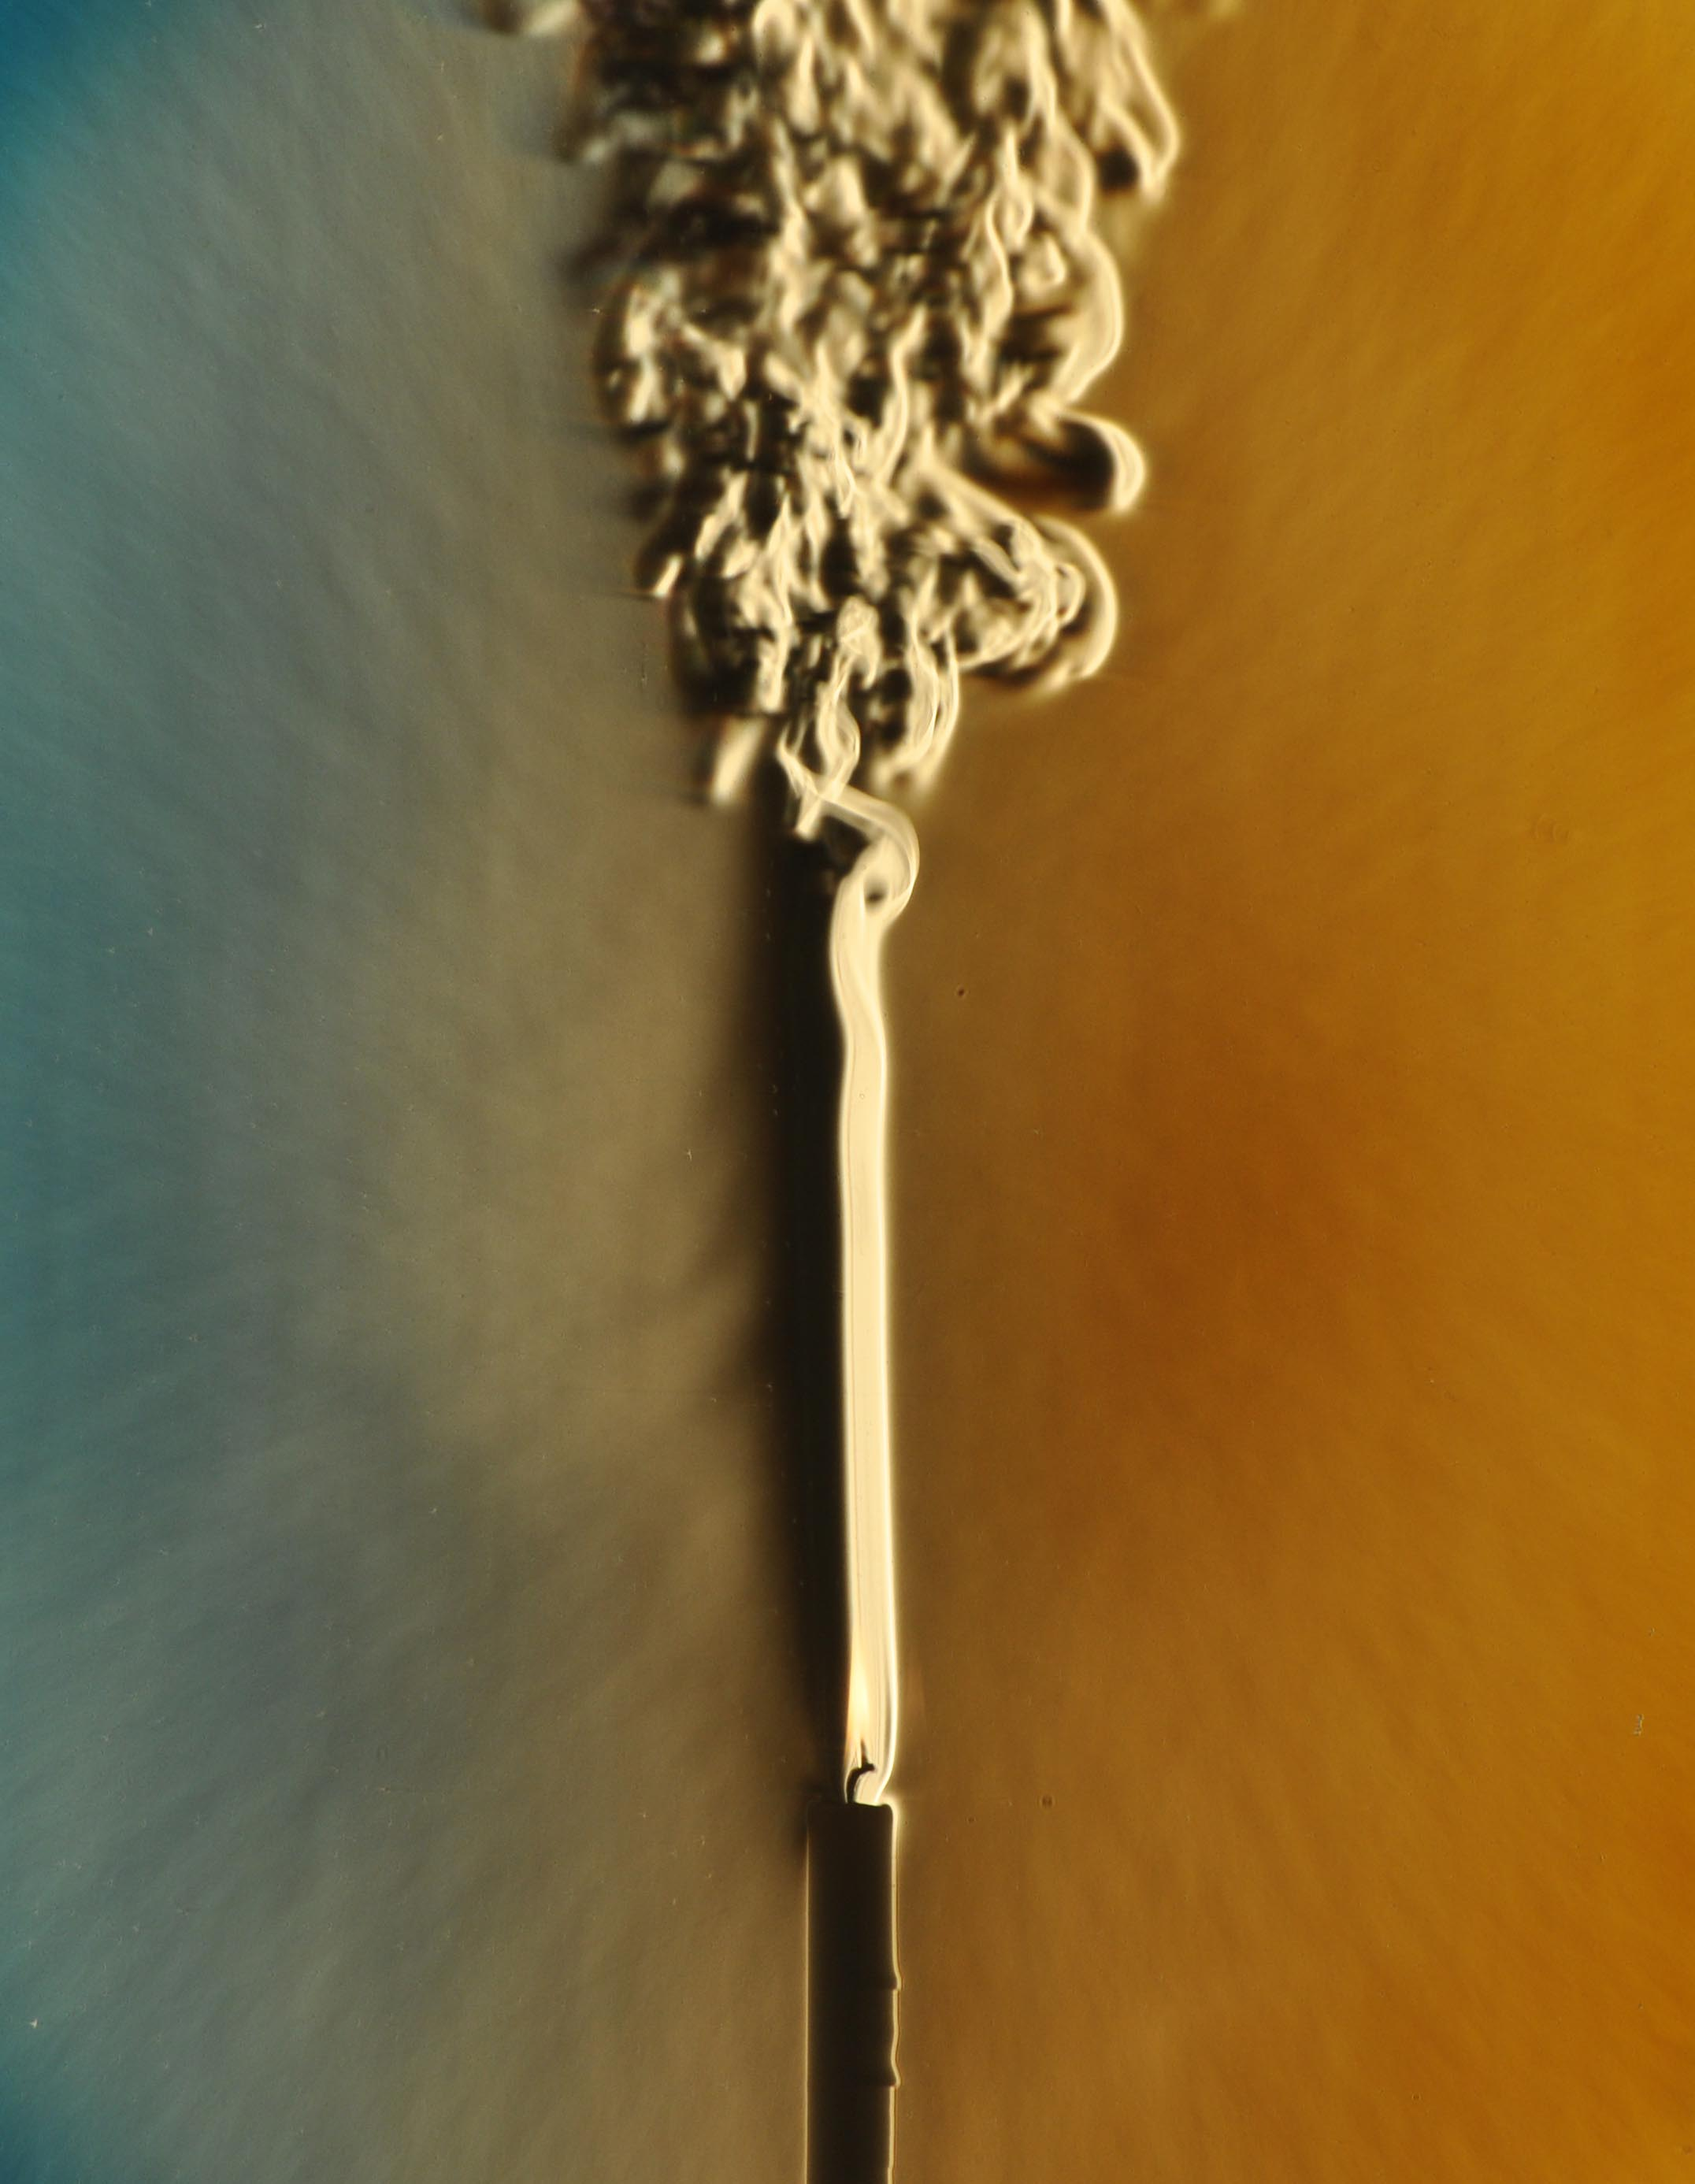
Laminar vs. turbulent flow
Chaotic motions
Turbulent
A range of length and time scales; some incredibly small.
DNS demands extremely high resolution requirements computational resources making it impractical for industrial purposes.
Ordered motions
Laminar

Slide 4
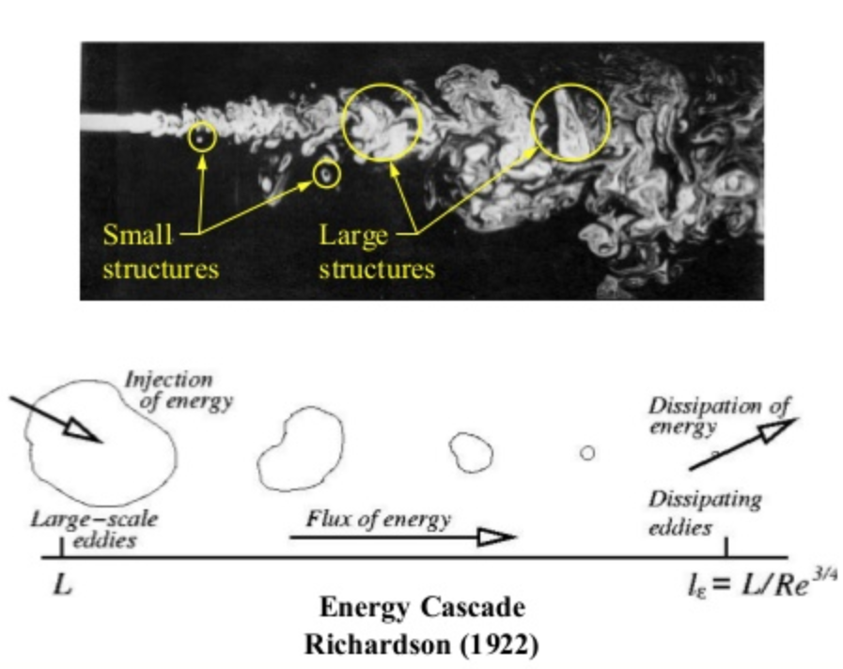
Laminar vs. turbulent flow

Slide 5
Simulating turbulence numerically
Smallest scales (eddies) need to be resolved in order to predict dissipation correctly.
Solving Navier-Stokes equations fully is called Direct Numerical Simulation (DNS).
Extremely costly
Limited commercial use
Used mostly in academia

Slide 6
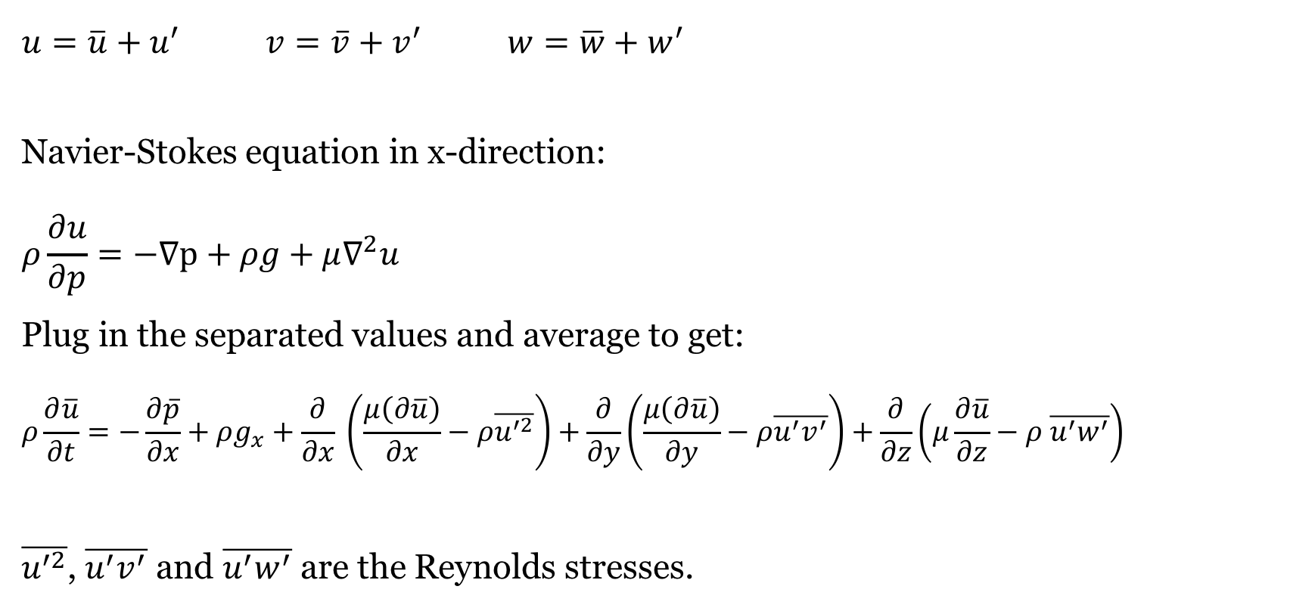
Reynolds-Averaged Navier-Stokes (RANS)
$$u=\overline{u}+u^{′} v=\overline{v}+v^{′} w=\overline{w}+w^{′}$$
Navier-Stokes equation in x-direction:
$$ρ\frac{∂u}{∂p}=−∇p+ρg+μ∇^{2}u$$
Plug in the separated values and average to get:
$$ρ\frac{∂\overline{u}}{∂t}=−\frac{∂\overline{p}}{∂x}+ρg_{x}+\frac{∂}{∂x} \left(\frac{μ\left(∂\overline{u}\right)}{∂x}−ρ\overline{u^{′2}}\right)+\frac{∂}{∂y}\left(\frac{μ\left(∂\overline{u}\right)}{∂y}−ρ\overline{u^{′}v^{′}}\right)+\frac{∂}{∂z}\left(μ\frac{∂\overline{u}}{∂z}−ρ \overline{u^{′}w^{′}}\right)$$
$\overline{u^{′2}}$, $\overline{u^{′}v^{′}}$ and $\overline{u^{′}w^{′}}$ are the Reynolds stresses.

Slide 7
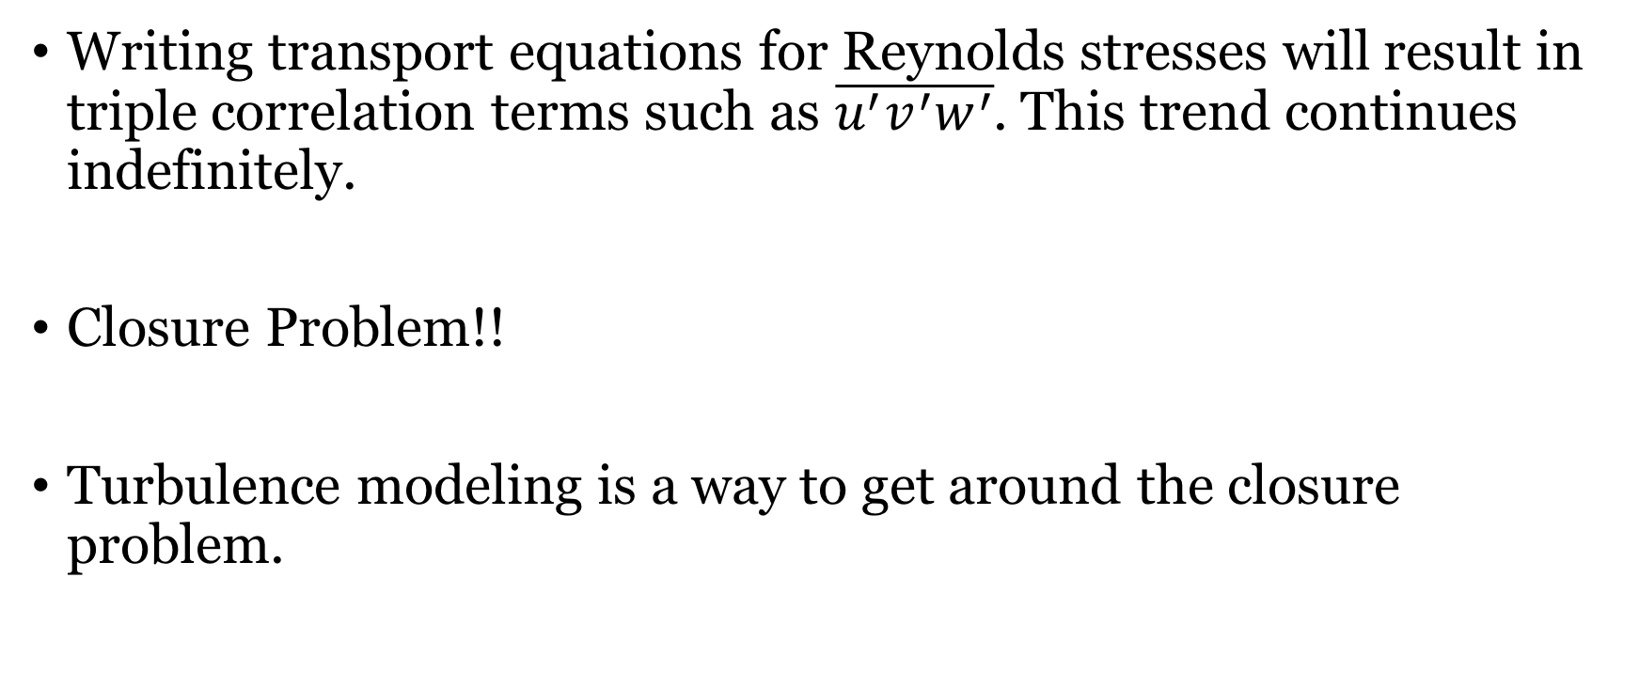
Reynolds-Averaged Navier-Stokes (RANS)
Writing transport equations for Reynolds stresses will result in triple correlation terms such as $\overline{u^{′}v^{′}w^{′}}$. This trend continues indefinitely.
Closure Problem!!
Turbulence modeling is a way to get around the closure problem.

Slide 8
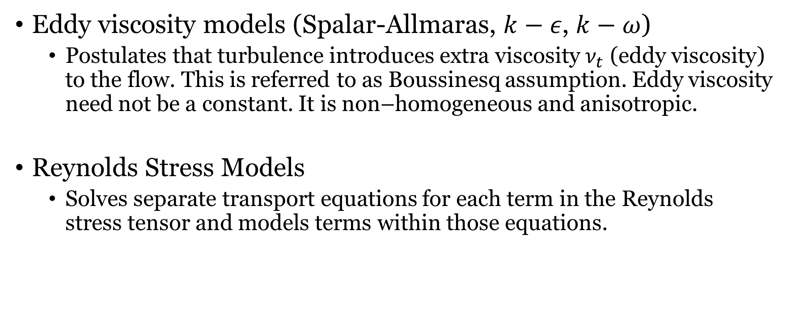
Turbulence models
Eddy viscosity models (Spalar-Allmaras, $k−ε$, $k−ω$)
Postulates that turbulence introduces extra viscosity $ν_{t}$ (eddy viscosity) to the flow. This is referred to as Boussinesq assumption. Eddy viscosity need not be a constant. It is non–homogeneous and anisotropic.
Reynolds Stress Models
Solves separate transport equations for each term in the Reynolds stress tensor and models terms within those equations.

Slide 9
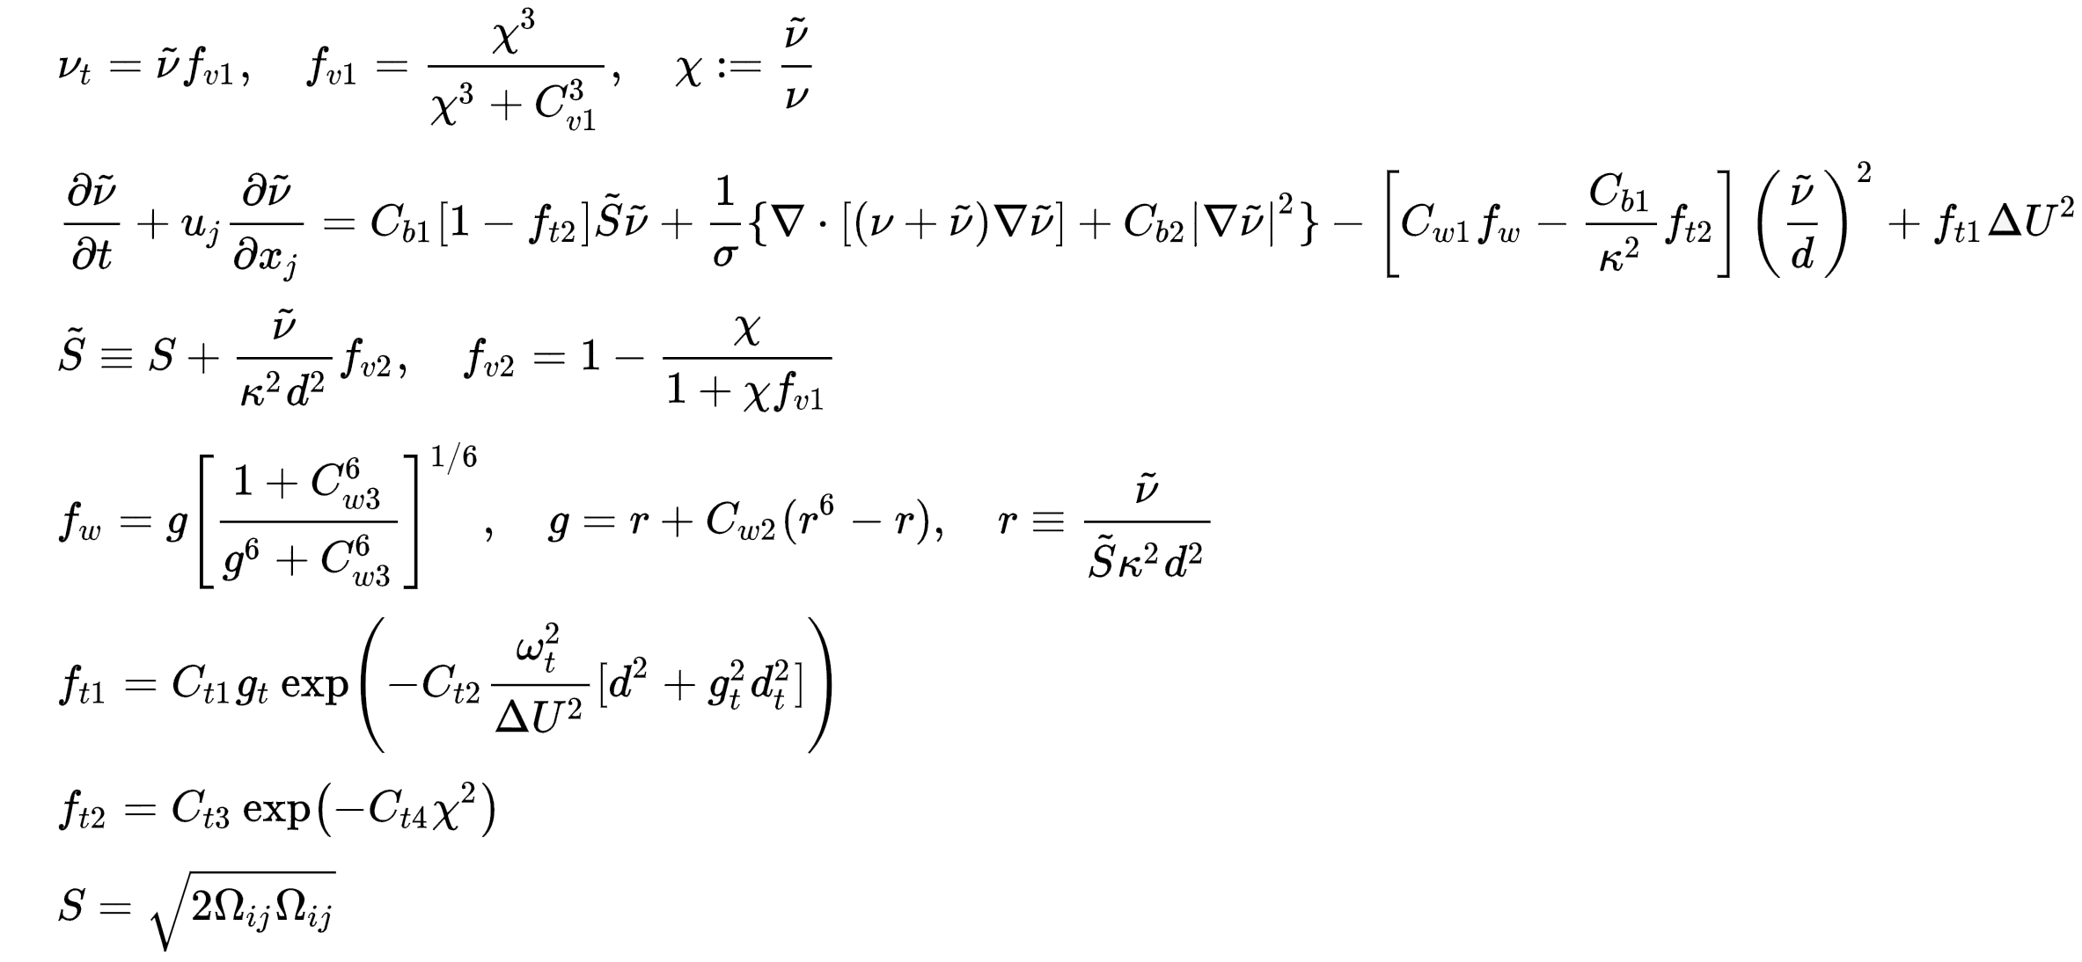
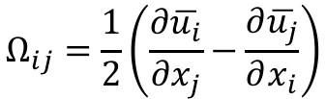
Spalart-Allmaras model
$$Ω_{ij}=\frac{1}{2}\left(\frac{∂\overline{u_{i}}}{∂x_{j}}−\frac{∂\overline{u_{j}}}{∂x_{i}}\right)$$

Slide 10
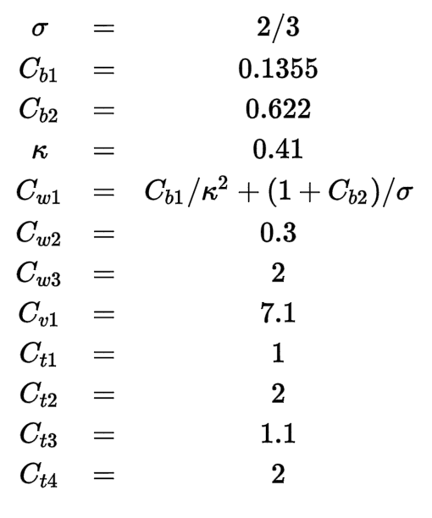
Spalart-Allmaras model

Slide 11

Available turbulence models in FLUENT
Spalart-Allmaras (1 eq.)
$k−ε$ (2 eq.)
$k−ω$ (2 eq.)
Transition $k−kl−ω$
Transition SST
RSM
Less expensive
More expensive

Slide 12

Available turbulence models in FLUENT
Spalart-Allmaras (1 eq.)
$k−ε$ (2 eq.)
$k−ω$ (2 eq.)
Transition $k−kl−ω$
Transition SST
RSM
Less expensive
More expensive

Slide 13
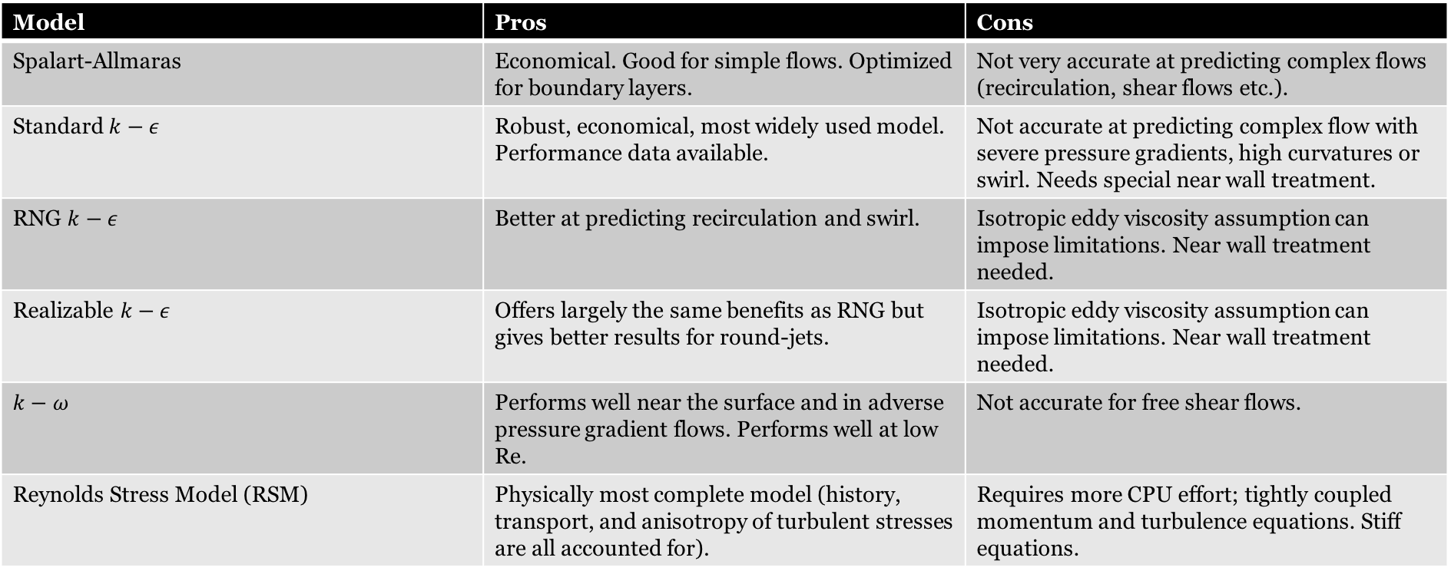
Comparison of RANS turbulence models
Model | Pros | Cons
Spalart-Allmaras | Economical. Good for simple flows. Optimized for boundary layers. | Not very accurate at predicting complex flows (recirculation, shear flows etc.).
Standard $k−ε$ | Robust, economical, most widely used model. Performance data available. | Not accurate at predicting complex flow with severe pressure gradients, high curvatures or swirl. Needs special near wall treatment.
RNG $k−ε$ | Better at predicting recirculation and swirl. | Isotropic eddy viscosity assumption can impose limitations. Near wall treatment needed.
Realizable $k−ε$ | Offers largely the same benefits as RNG but gives better results for round-jets. | Isotropic eddy viscosity assumption can impose limitations. Near wall treatment needed.
$$k−ω$$ | Performs well near the surface and in adverse pressure gradient flows. Performs well at low Re. | Not accurate for free shear flows.
Reynolds Stress Model (RSM) | Physically most complete model (history, transport, and anisotropy of turbulent stresses are all accounted for). | Requires more CPU effort; tightly coupled momentum and turbulence equations. Stiff equations.

Slide 14
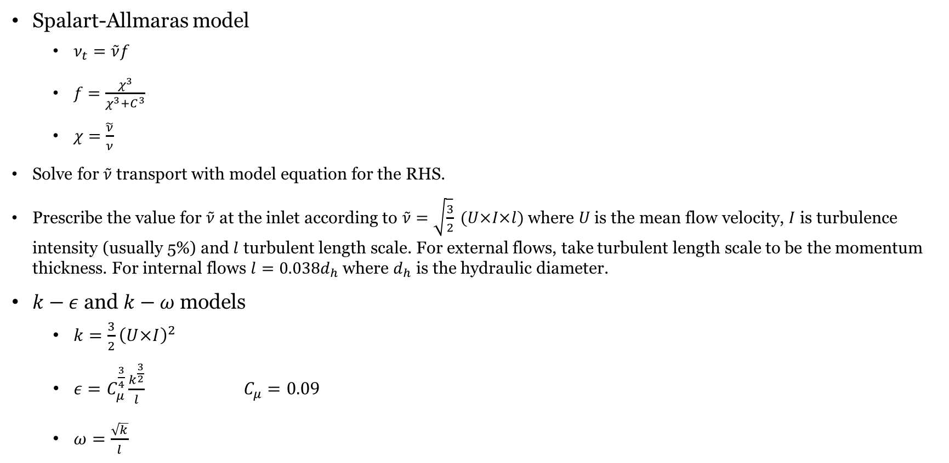
Boundary conditions for turbulent models
Spalart-Allmaras model
$ν_{t}=\tilde{ν}f$
$f=\frac{χ^{3}}{χ^{3}+C^{3}}$
$χ=\frac{\tilde{ν}}{ν}$
Solve for $\tilde{ν}$ transport with model equation for the RHS.
Prescribe the value for $\tilde{ν}$ at the inlet according to $\tilde{ν}=\sqrt{\frac{3}{2}} (U×I×l)$ where $U$ is the mean flow velocity, $I$ is turbulence intensity (usually 5%) and $l$ turbulent length scale. For external flows, take turbulent length scale to be the momentum thickness. For internal flows $l=0.038d_{h}$ where $d_{h}$ is the hydraulic diameter.
$k−ε$ and $k−ω$ models
$k=\frac{3}{2}{\left(U×I\right)}^{2}$
$ε=C_{μ}^{\frac{3}{4}}\frac{k^{\frac{3}{2}}}{l} C_{μ}=0.09$
$ω=\frac{\sqrt{k}}{l}$

Slide 15
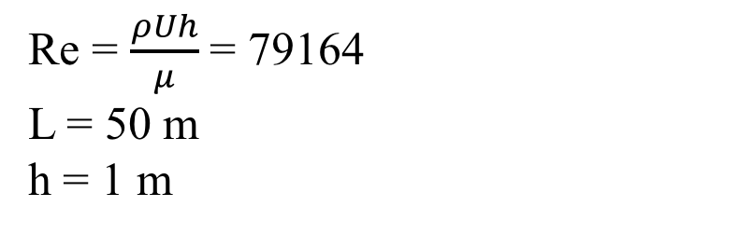
Case study: Turbulent channel flow
Re = $\frac{ρUh}{μ}$ = 79164
L = 50 m
h = 1 m
U=1 m/s
y
h
P=0 atm
x
L
Grid specifications | Number of divisions in vertical dimension | Number of divisions in horizontal dimension | Vertical Bias
Coarse | 100 | 100 | -
Fine (Wall resolved) | 100 | 100 | Two-sided bias. Bias factor = 8000

Slide 16
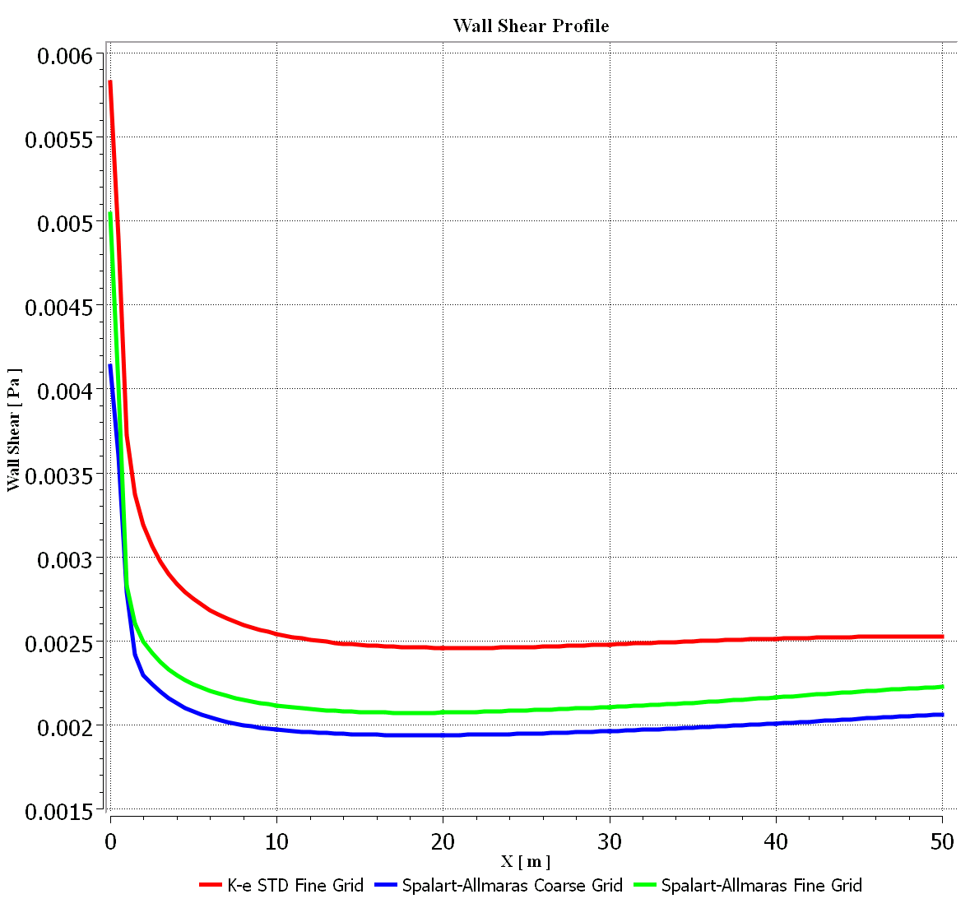
Case study: Turbulent channel flow
Experimental shear ~ 0.0225

Slide 17
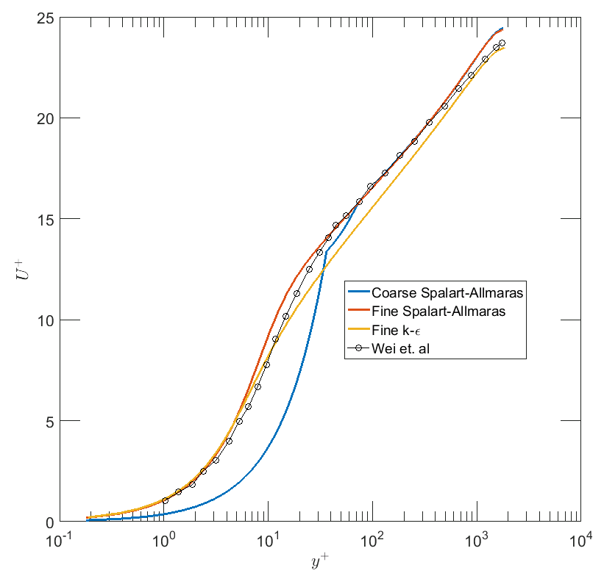
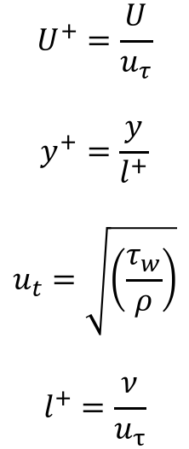
Case study: Turbulent channel flow
$$U^{+}=\frac{U}{u_{τ}}$$
$$y^{+}=\frac{y}{l^{+}}$$
$$u_{t}=\sqrt{\left(\frac{τ_{w}}{ρ}\right)}$$
$$l^{+}=\frac{ν}{u_{τ}}$$

Slide 18
Case study: Turbulent channel flow
$$U^{+}=\frac{U}{u_{τ}}$$
$$y^{+}=\frac{y}{l^{+}}$$
$$u_{t}=\sqrt{\left(\frac{τ_{w}}{ρ}\right)}$$
$$l^{+}=\frac{ν}{u_{τ}}$$

