Slide 1
MongoDB
A research made by Truc

Slide 2
What are no SQL ?
providing a mechanism for storage and retrieval of data that is modeled
Developed in response to a rise in the volume of data
Used in bigdata & real-time web application

Slide 3
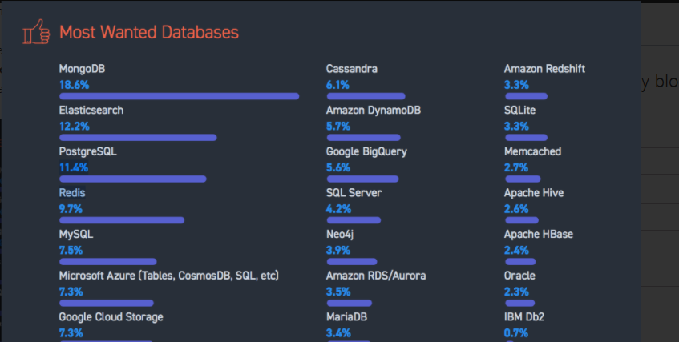
Why mongoDB ?

Slide 4
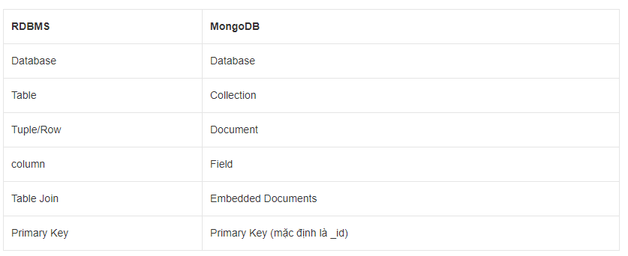
MONGodb VS RDBMS

Slide 5


What is mongodb ?

Slide 6
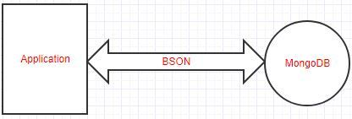
Mongodb
An opensource
Document database
Written in c++
Non relational datastore (NoSQL)

Slide 7
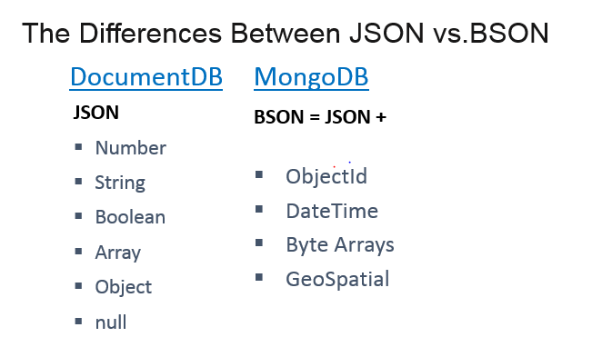

Slide 8
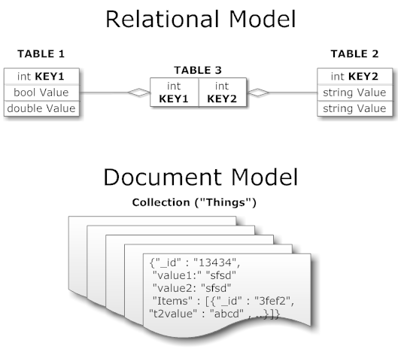
Collections
- MongoDB uses collections to store groups of data

Slide 9
Advantage of Mongodb
High performance
schemaless
Scalability

Slide 10
High performance
Used bson for storing data
Used b-tree indexes
Sharding can boot queries performance

Slide 11
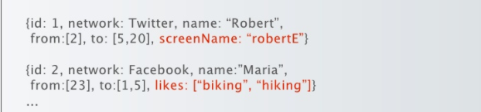
Schemaless
two documents don’t have the same schema can be stored in the same collection

Slide 12
Unsupported
Joins
Transaction across multiple collection

Slide 13
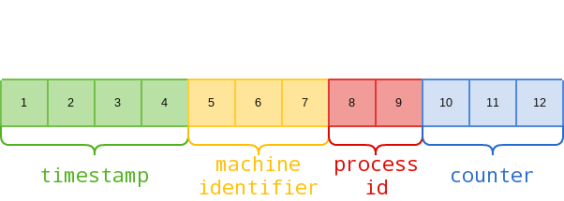
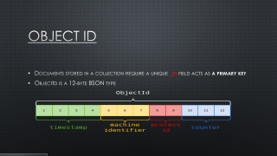
Object id
Documents stored in a collection require a unique _id field acts as a primary key
ObjectId is a 12-byte BSON type

Slide 14
CRUD Operations
Use + <db name>
Db.<collection name >.save(<BSON document>)

Slide 15
CRUD Operations
Insert
Db.<collection name >.insert(<BSON document>)
Find
Db.<collection name >.find.pretty()
Update
Db.<collection name >.update(<BSON document>)
Remove
Db.<collection name >.remove(<BSON document>)

Slide 16
Aggregation framework
Documents enter a multi-stage pipeline that transforms the documents into an aggregated results
Syntax : db.<collection name>.aggregate(Operations)
Example : db.mydb.aggregate([{$group : {_id : "$by_user", num_tutorial : {$sum : 1}}}])

Slide 17
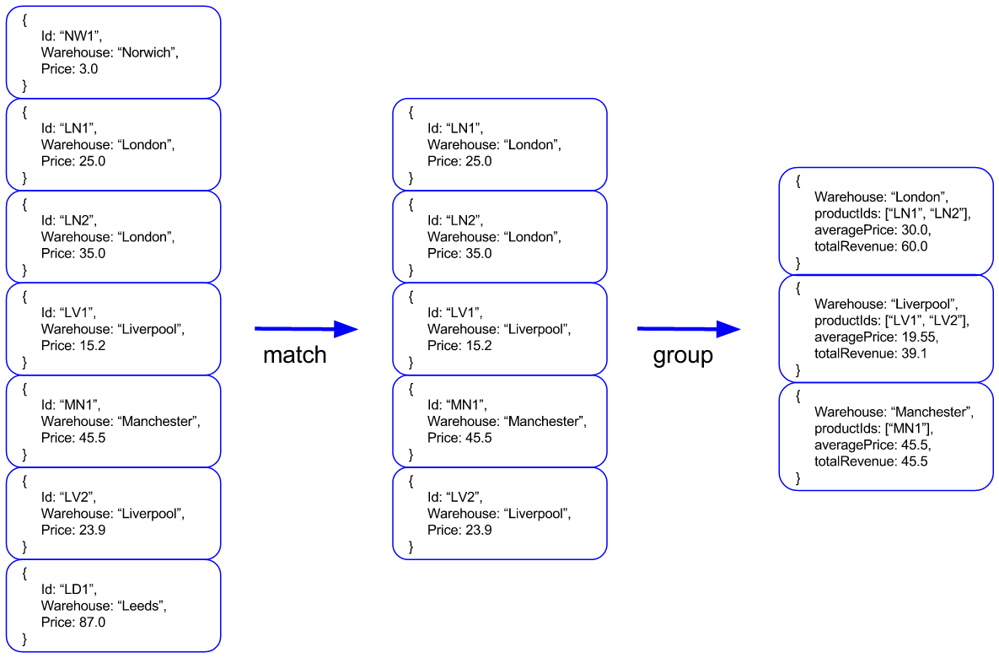

Slide 18
Map-reduce
A data processing paradigm for condensing larger volumes of data into useful aggregated results
Syntax :
db.collection.mapReduce( function() {emit(key,value);}, //mapfunction
function(key,values) {return reduceFunction}, { //reduce function
out: collection,
query: document,
sort: document,
limit: number
}
)

Slide 19
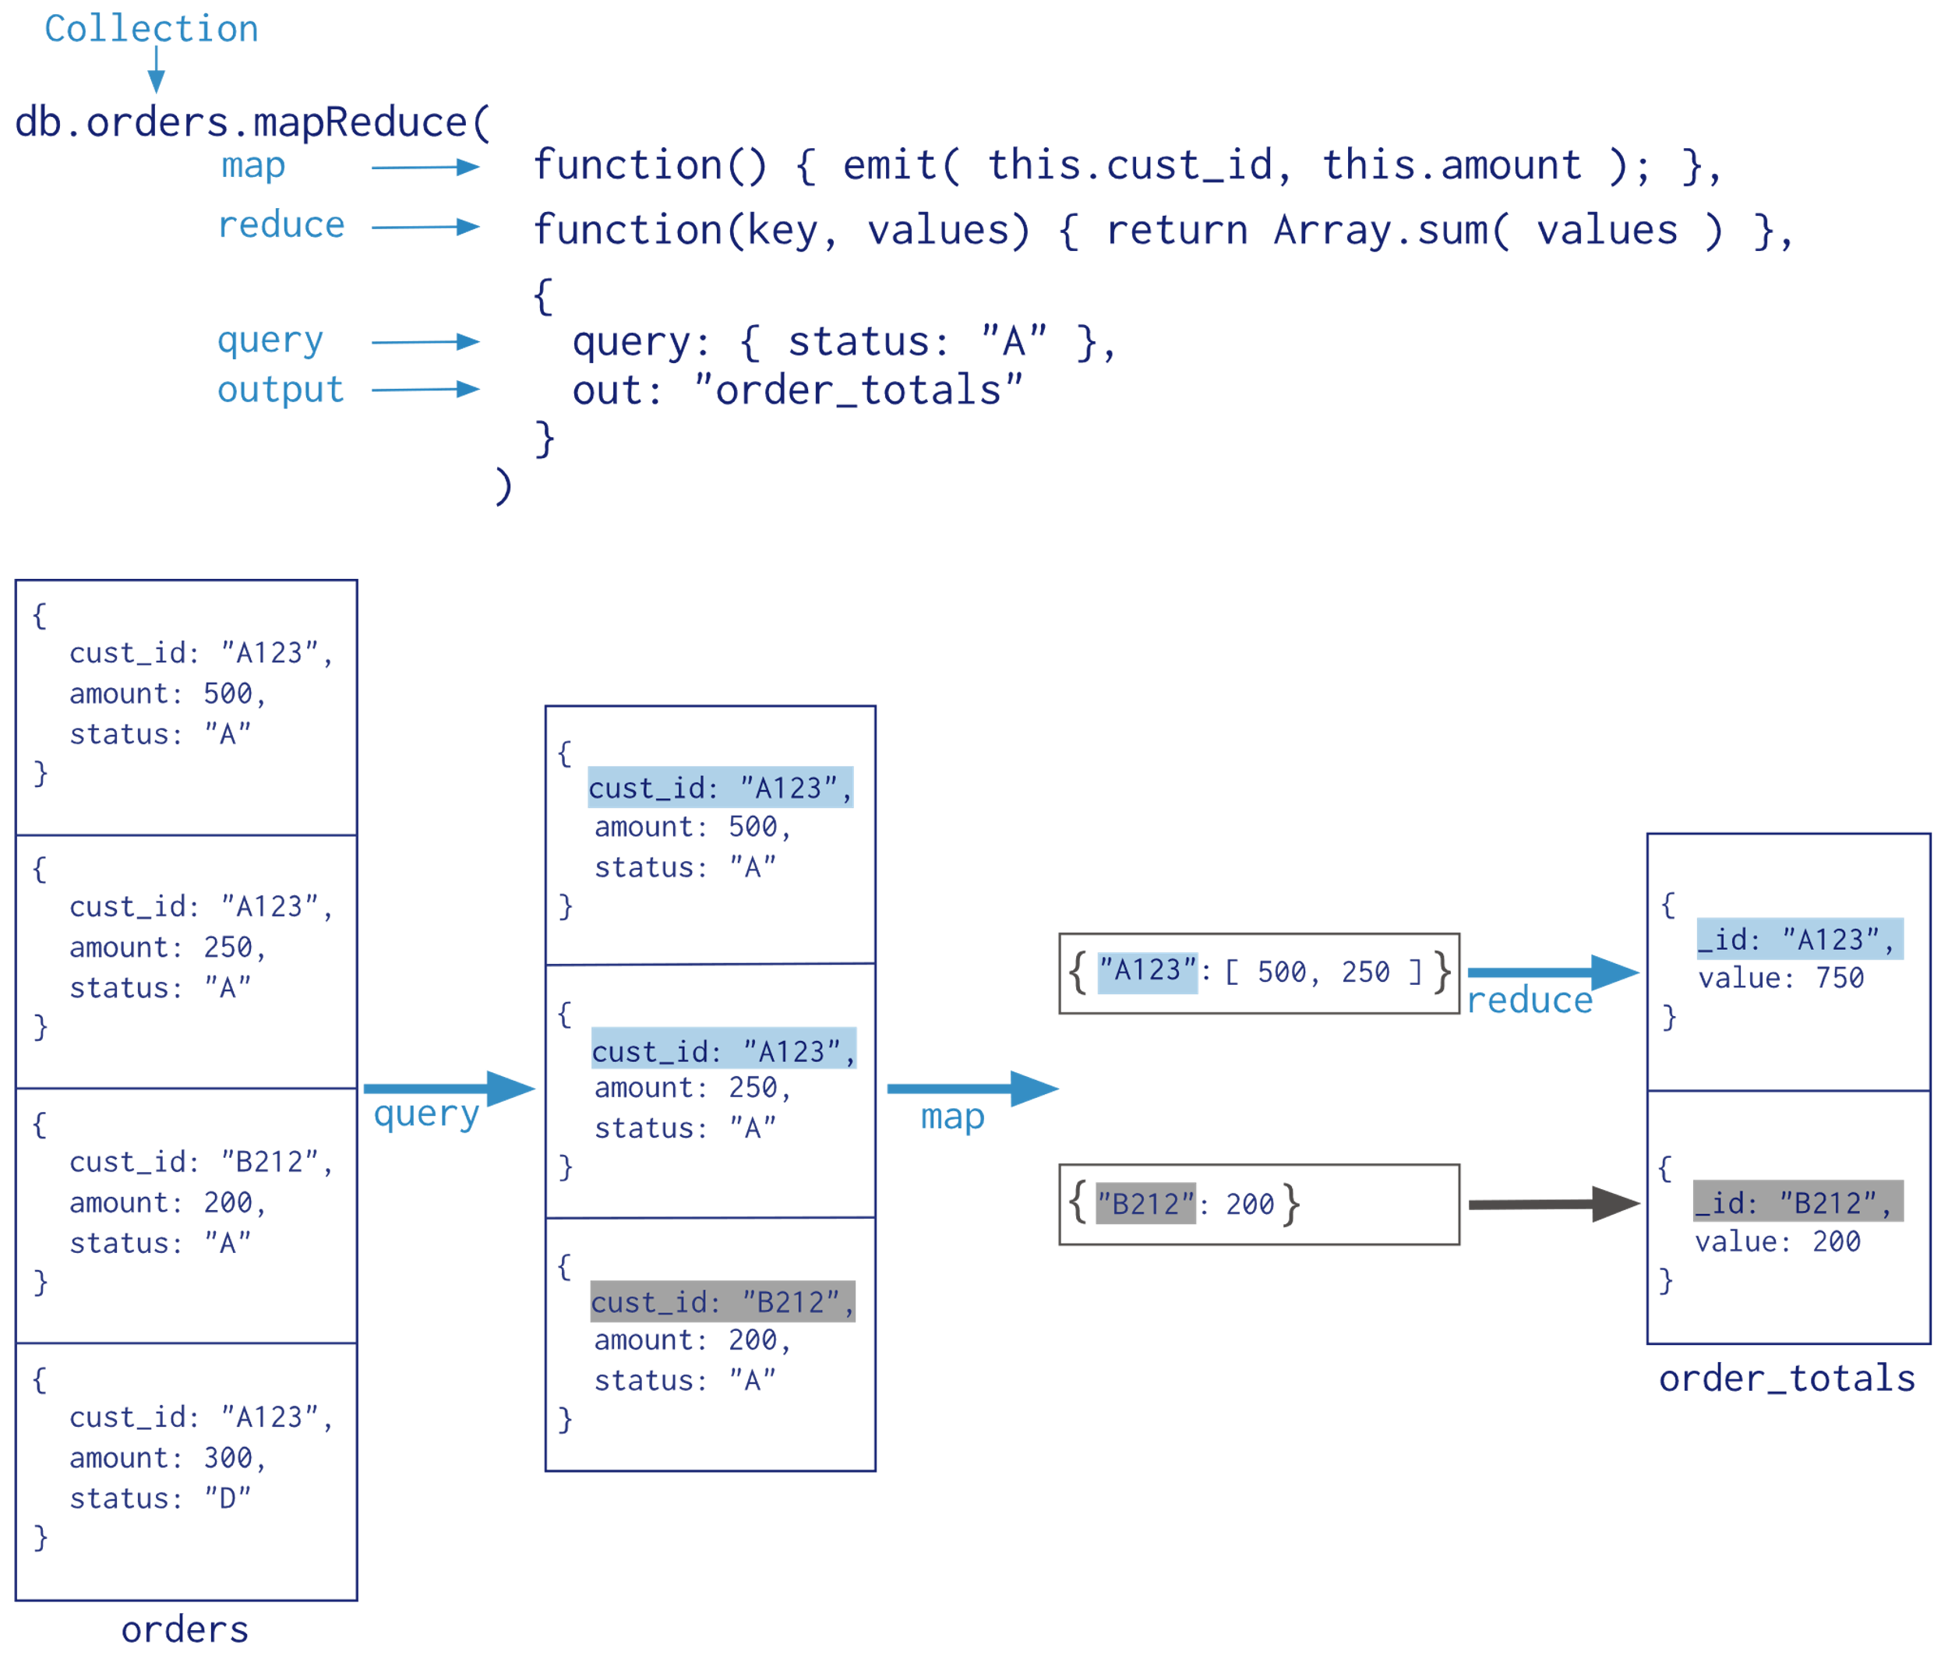

Slide 20
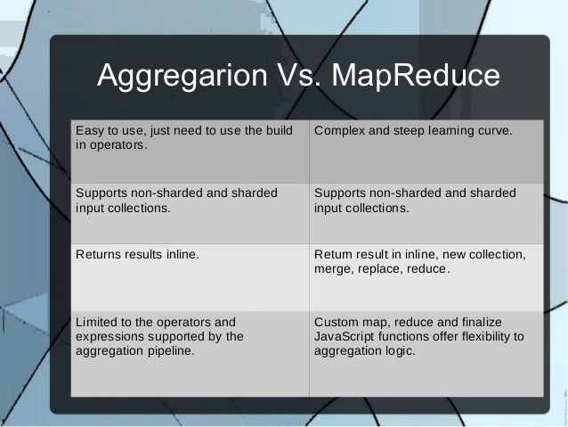

Slide 21
REferences
https://docs.mongodb.com/manual/reference
https://www.tutorialspoint.com/mongodb/index.htm
https://mongodblab.com
https://www.compose.io

