Slide 1

React Fundamentals

Slide 2
What is React?
React is a JavaScript library for building User Interfaces.
The V in MVC.
Makes no assumptions about the rest of your technology stack.

Slide 3
Background
Backed by Facebook
Open-sourced in May 2013
Used on Facebook since 2011

Slide 4
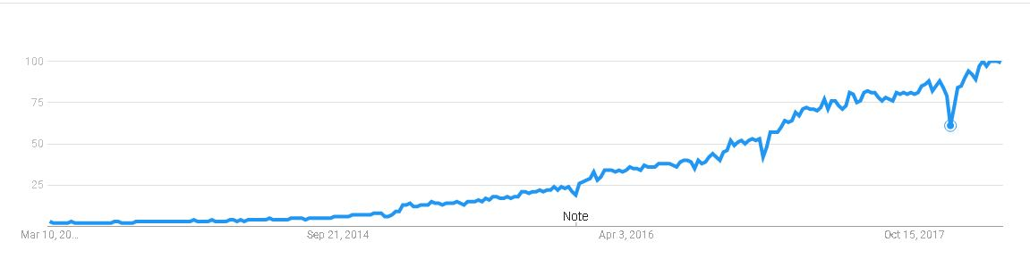

It’s getting interesting
Google Trend
Git Hub

Slide 5
Features
JSX
Components
Unidirectional data flow
Virtual DOM

Slide 6
JSX
Stand for “Javascript Extension”
Can render anything.
JSX Compiles to Javascript.

Slide 7
Components
The main building block
Represents a self-contained piece of UI
Able handle some kind of user interaction

Slide 8
Virtual DOM
React Only Updates What's Necessary
Flexibility
Efficient
Amazing performance

Slide 9
Unidirectional data flow
All data follows the same lifecycle pattern.
Reflect data changes in the UI.
Cache data in memory.

Slide 10




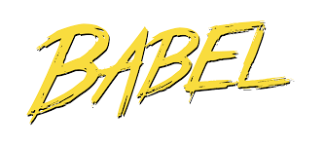

Ecosystem

Slide 11
Advantages & Disadvantages
Advantages
Improve apps performance
Flexibility.
Easy maintainance.
Disadvantages
Covers only the V in MVC.
Hard to learn for new developers.

Slide 12
References
https://blog.syncano.io/reactjs-reasons-why-part-1/
https://medium.freecodecamp.org/yes-react-is-taking-over-front-end-development-the-question-is-why-40837af8ab76
https://reactjs.org/blog/2013/06/05/why-react.html
https://www.toptal.com/react/navigating-the-react-ecosystem

