Slide 1
MongoDB
A research made by Truc

Slide 2
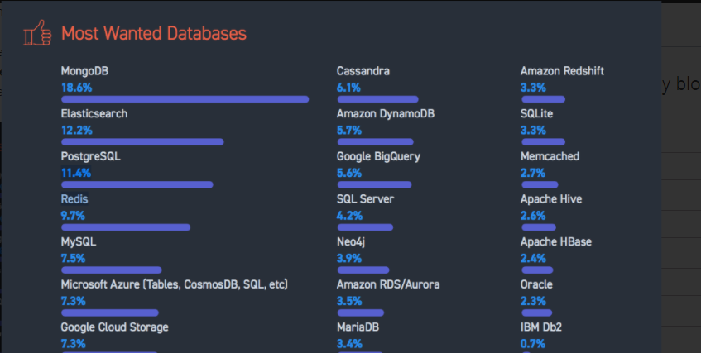
Why mongoDB ?

Slide 3


What is mongodb ?

Slide 4
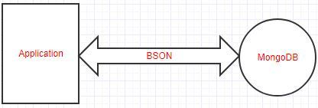
Mongodb
An opensource
Document database
Written in c++
Non relational datastore

Slide 5
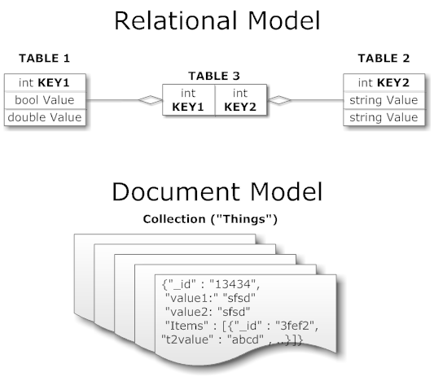
Collections
- MongoDB uses collections to store groups of data

Slide 6
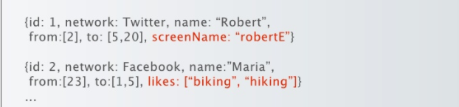
Schemaless
two documents don’t have the same schema can be stored in the same collection

Slide 7
Unsupported
Joins
Transaction across multiple collection
=> Because of scalability

Slide 8
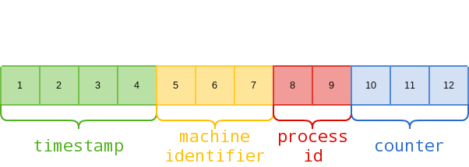
Object id
Documents stored in a collection require a unique _id fiel acts as a primary key
ObjectId is a 12-byte BSON type

Slide 9

CRUD Operations
Use + <db name> : create a db caleed <db name> on-demand. Only get created when added something to it.
Db.<collection name >.save(<BSON document>) : create a collection called <collection name > under the db <db name>.

Slide 10
CRUD Operations
Insert
Db.<collection name >.insert(<BSON document>)
Find
Db.<collection name >.find.pretty()
Update
Db.<collection name >.update(<BSON document>)
Remove
Db.<collection name >.remove(<BSON document>)

Slide 11
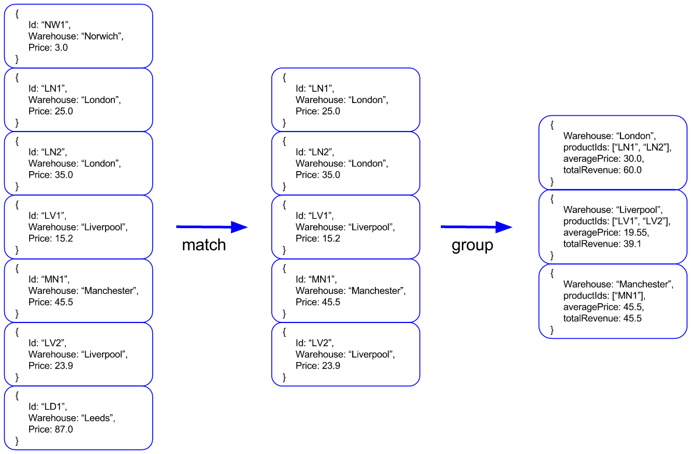
Aggregation framework
Documents enter a multi-stage pipeline that transforms the documents into an aggregated results

Slide 12
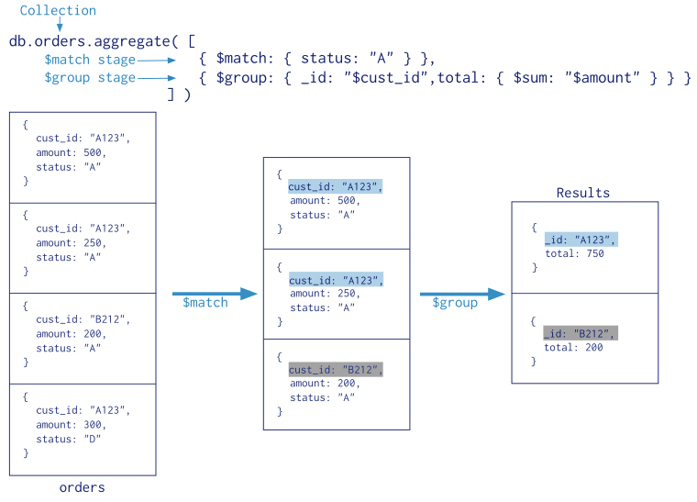
Map-reduce
A data processing paradigm for condensing larger volumes of data into useful aggregated results

Slide 13
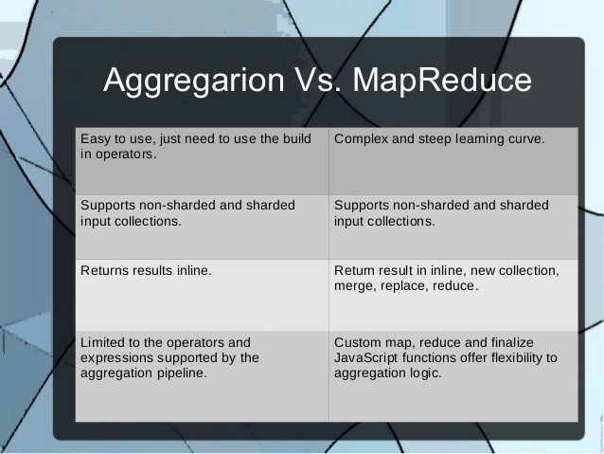

Slide 14
REferences
https://docs.mongodb.com/manual/reference
https://www.tutorialspoint.com/mongodb/index.htm
https://mongodblab.com
https://www.compose.io

