Slide 1
Machine Learning
Based on the material by Prof. Simon Prince
4. Deep Neural Networks

Slide 2
Deep neural networks
Networks with more than one hidden layer
Intuition becomes more difficult

Slide 3
Deep neural networks
Composing two networks
Combining the two networks into one
Hyperparameters
Notation change and general case
Shallow vs. deep networks

Slide 4
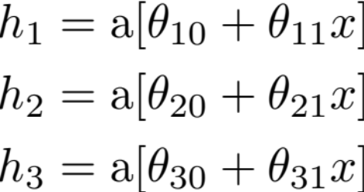
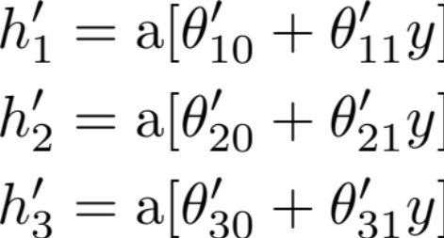
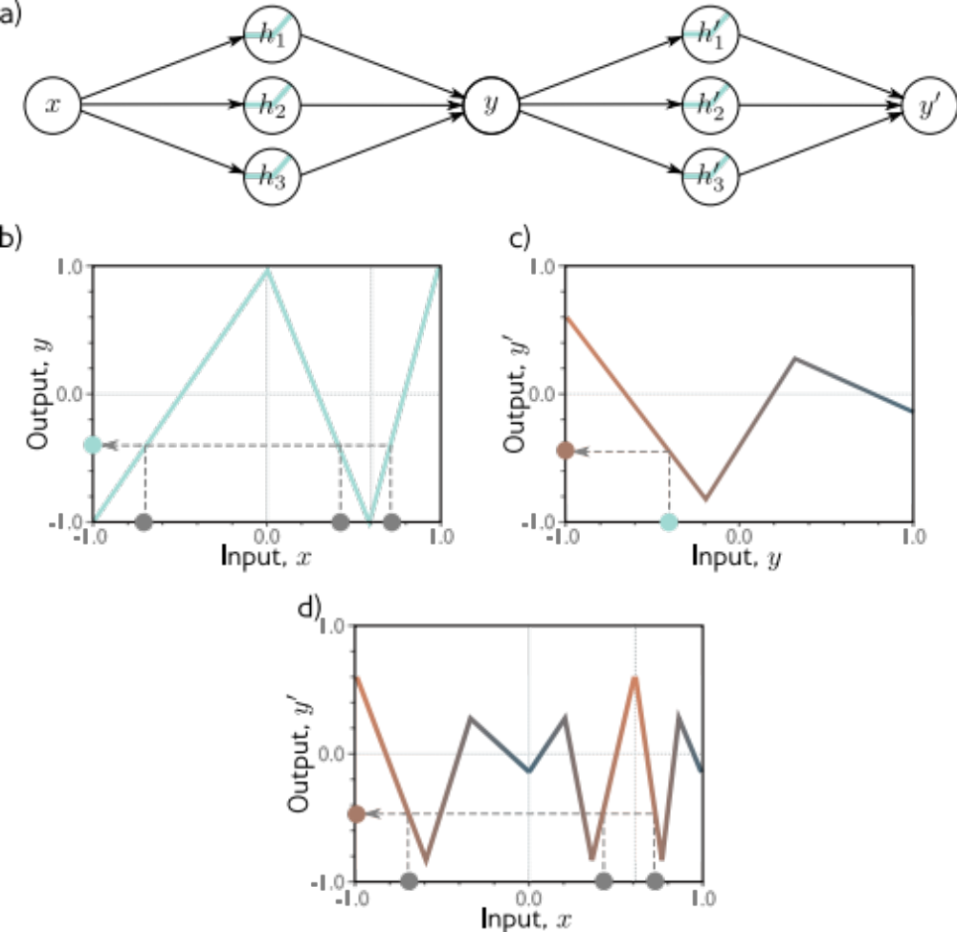
Composing two networks.
Network 1:
Network 2:

Slide 6
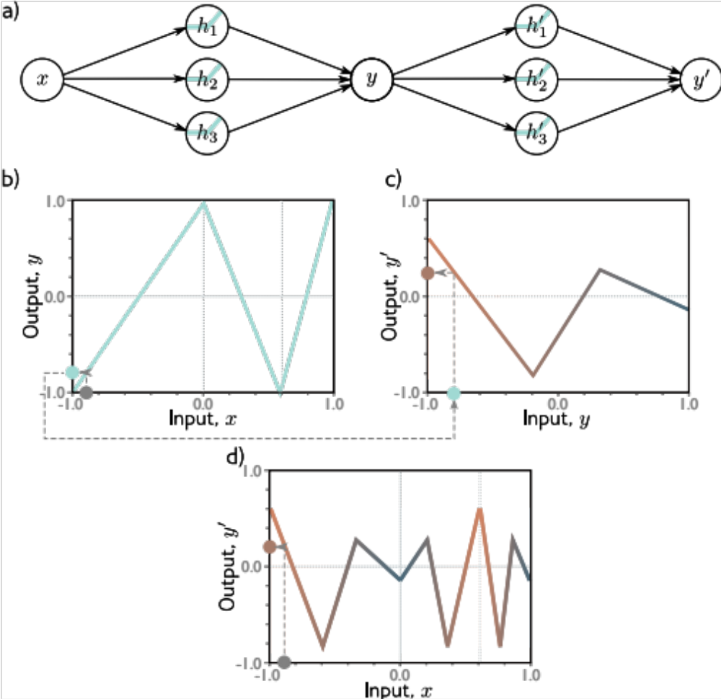

Slide 7
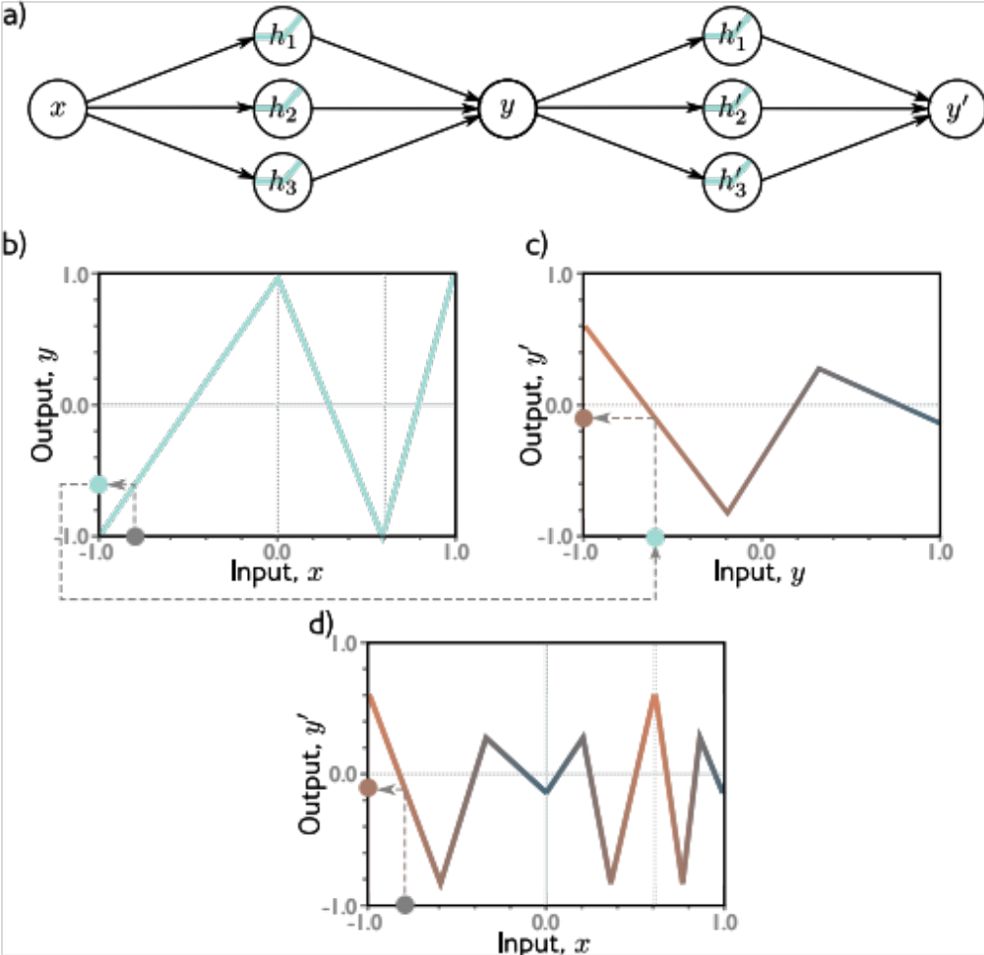

Slide 8


Slide 9
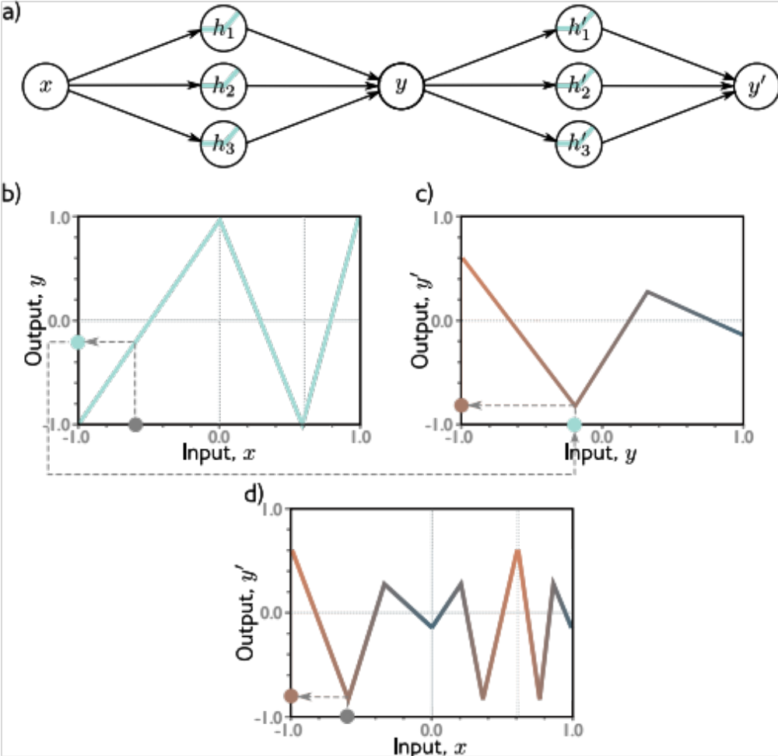

Slide 10


Slide 11
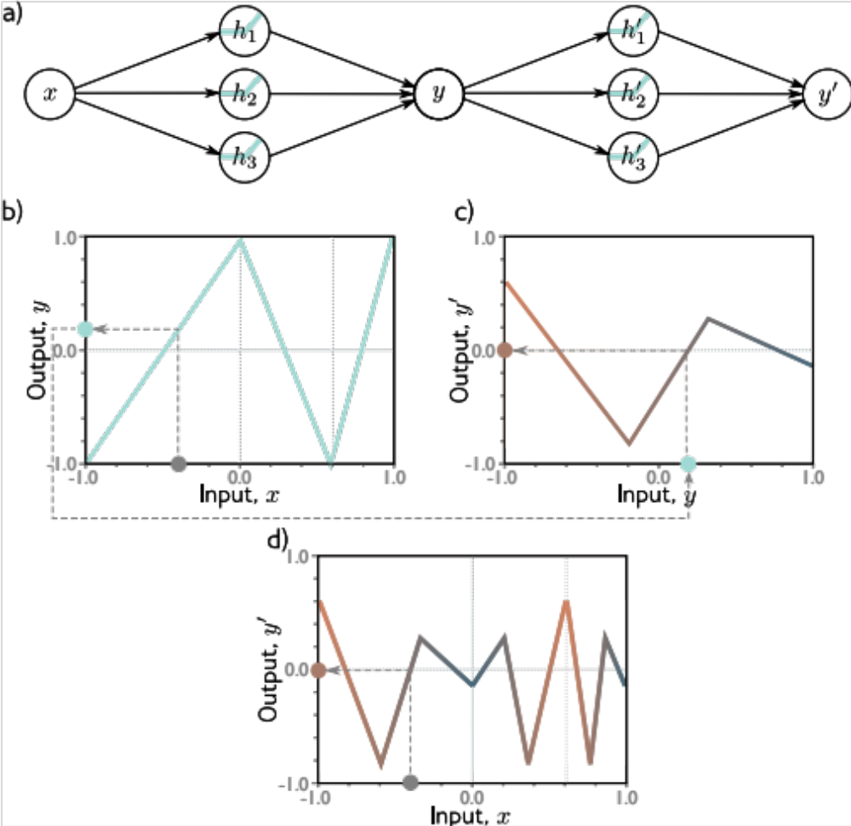

Slide 12
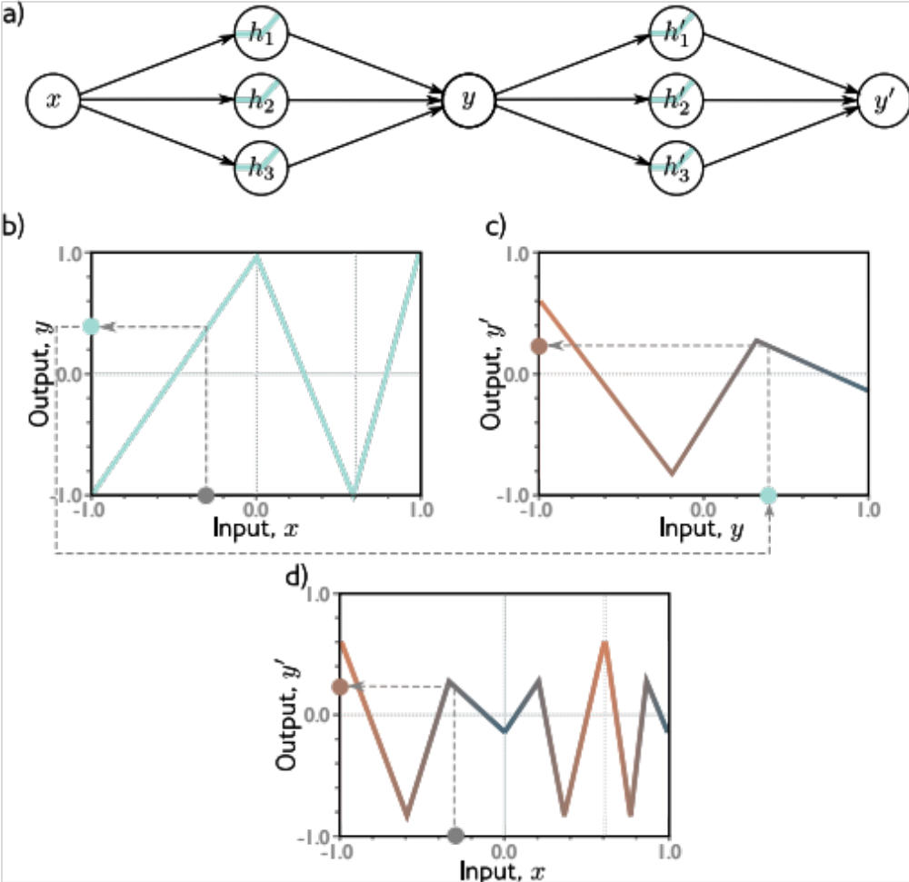

Slide 13


Slide 14


Slide 15
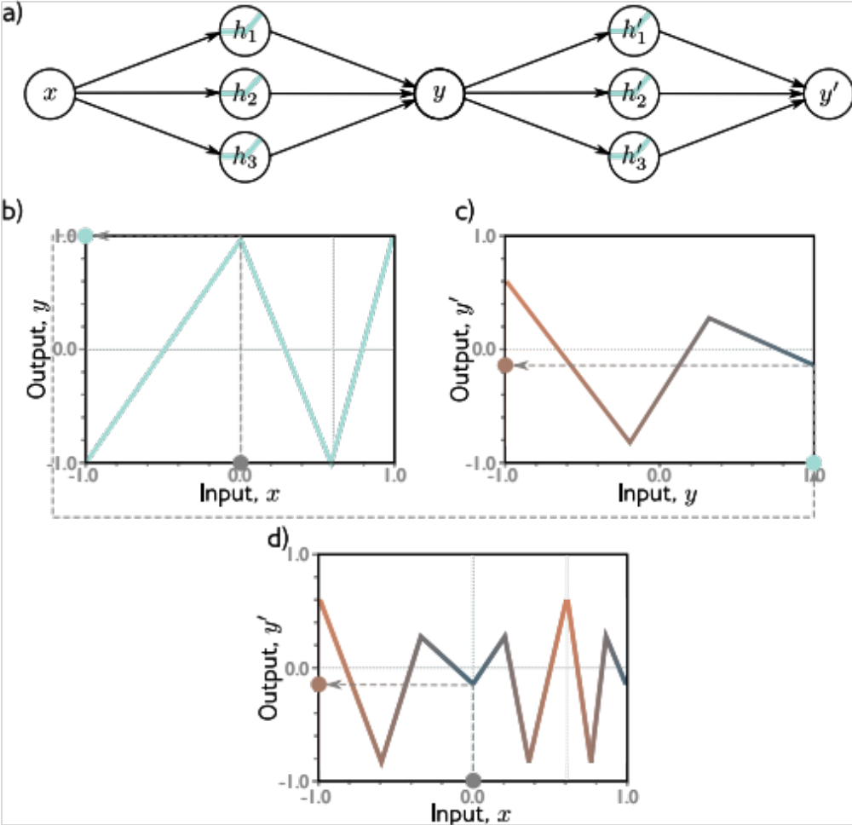

Slide 16


Slide 17
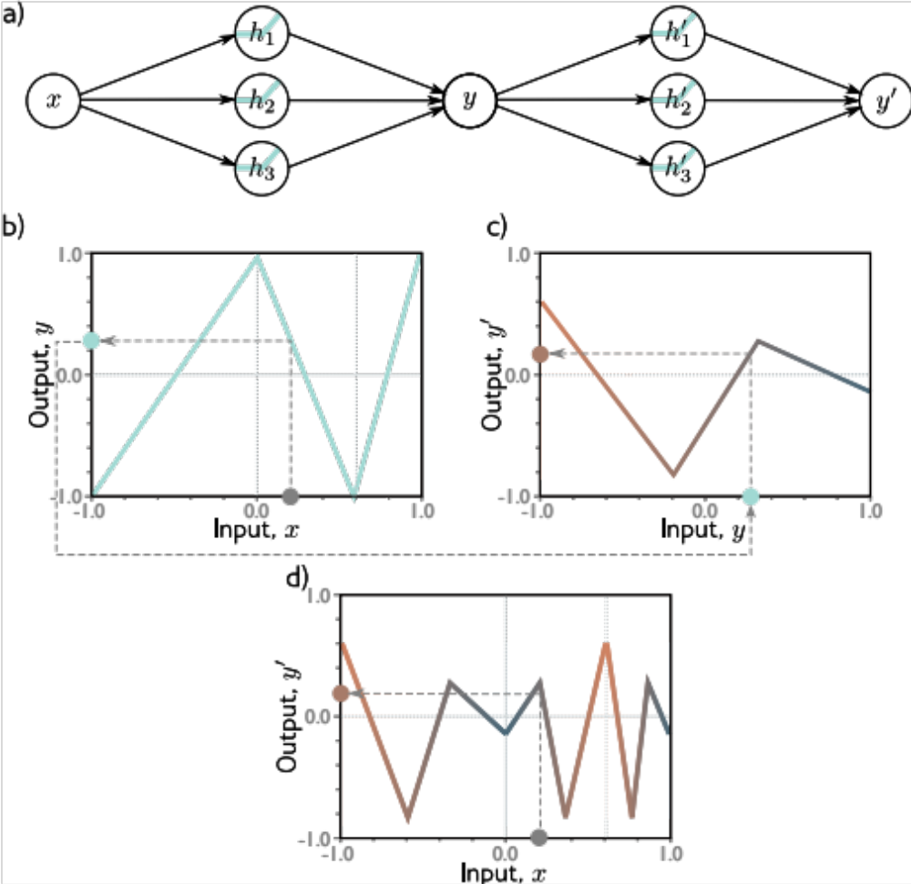

Slide 18
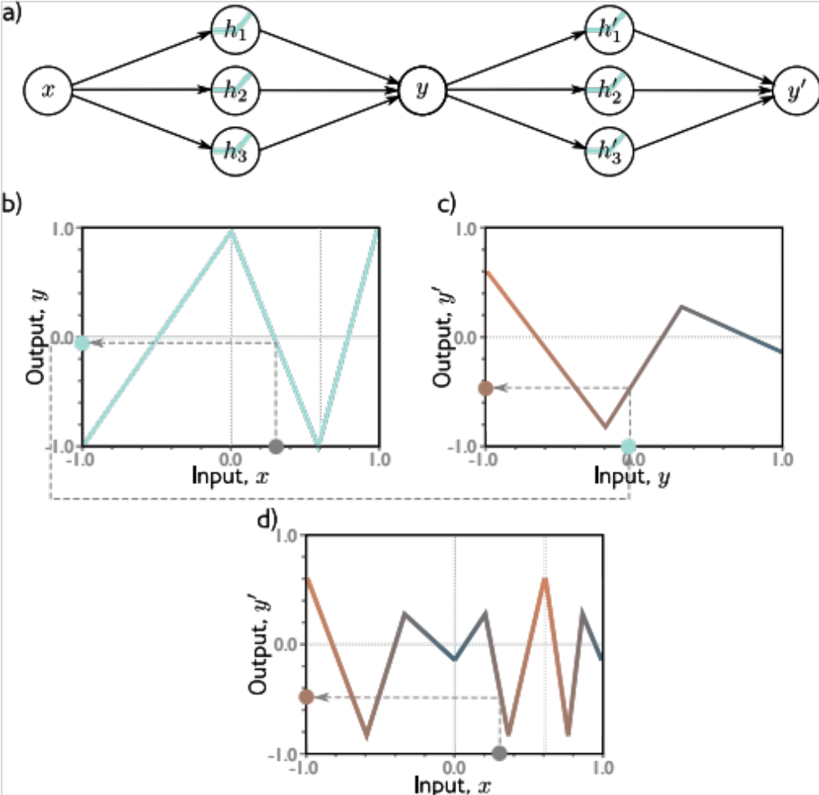

Slide 19


Slide 20
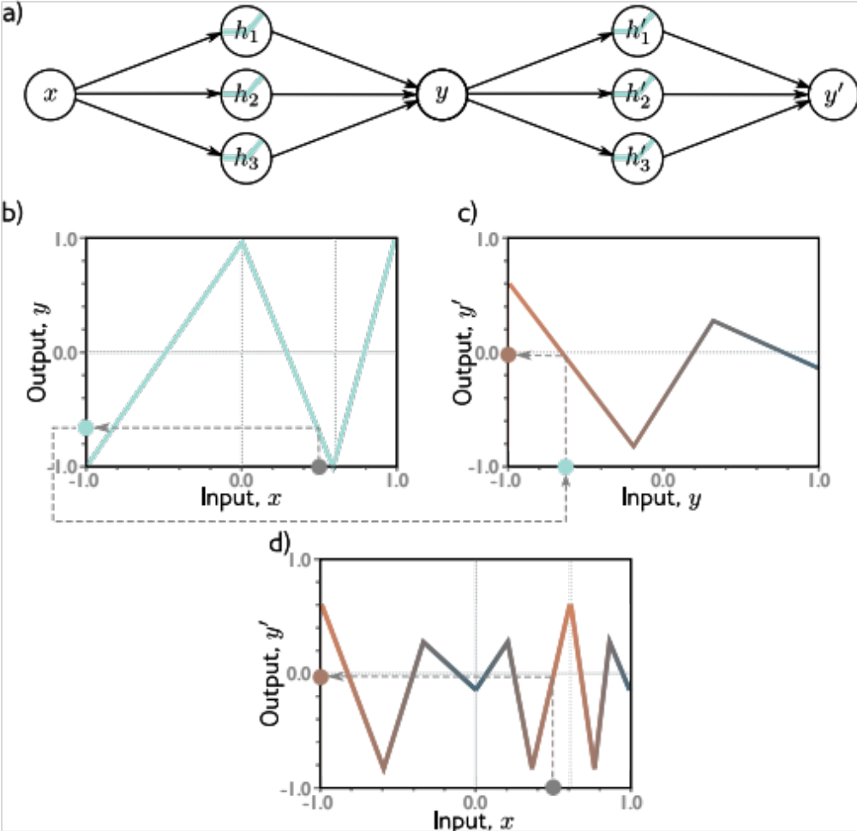

Slide 21
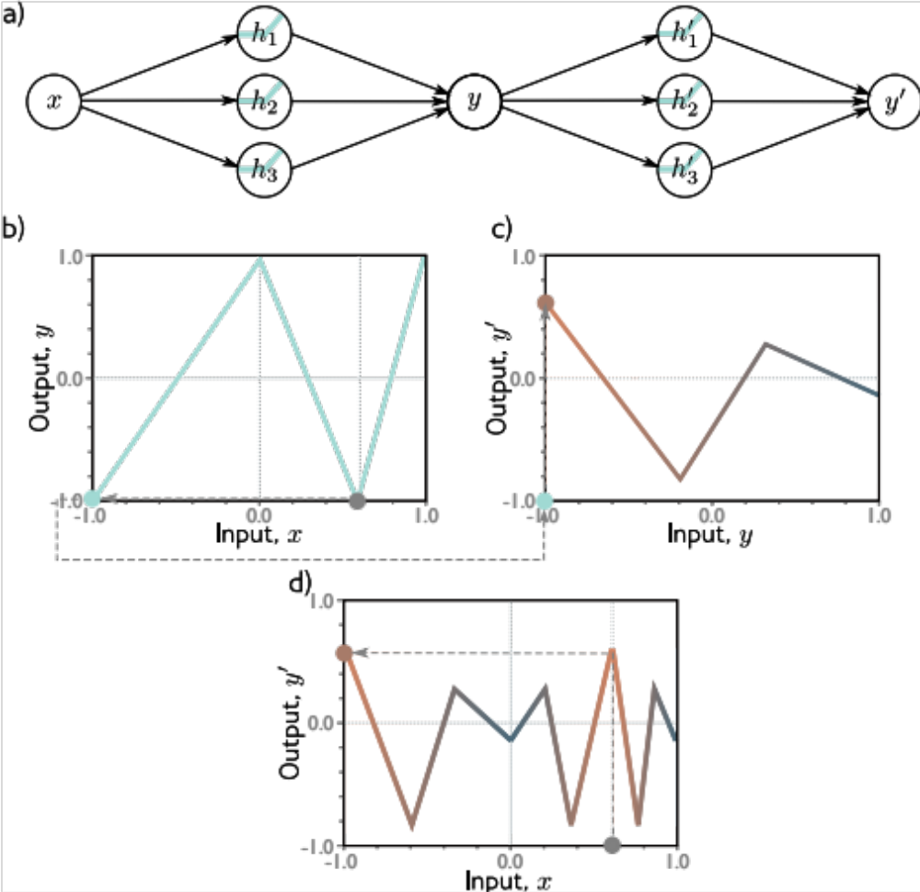

Slide 22
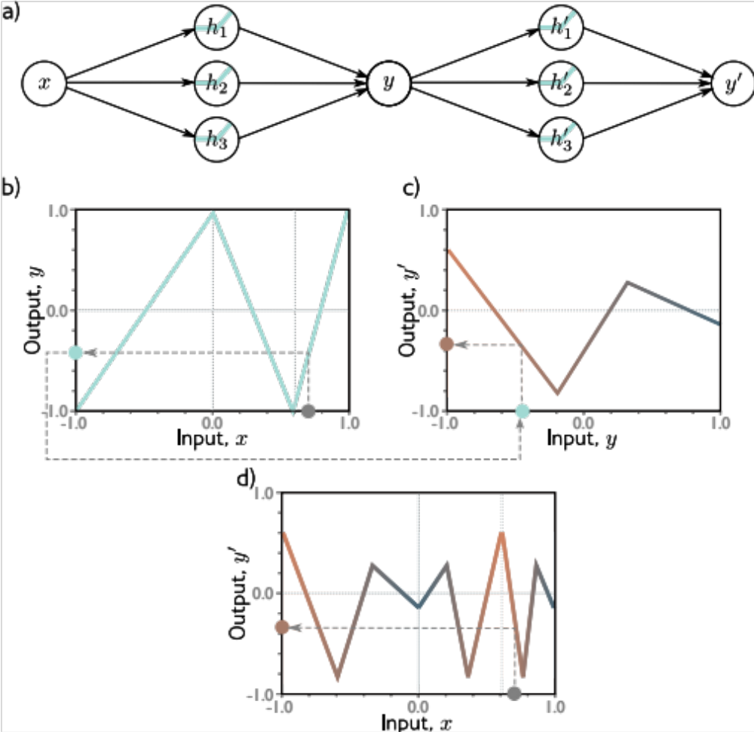

Slide 23


Slide 24
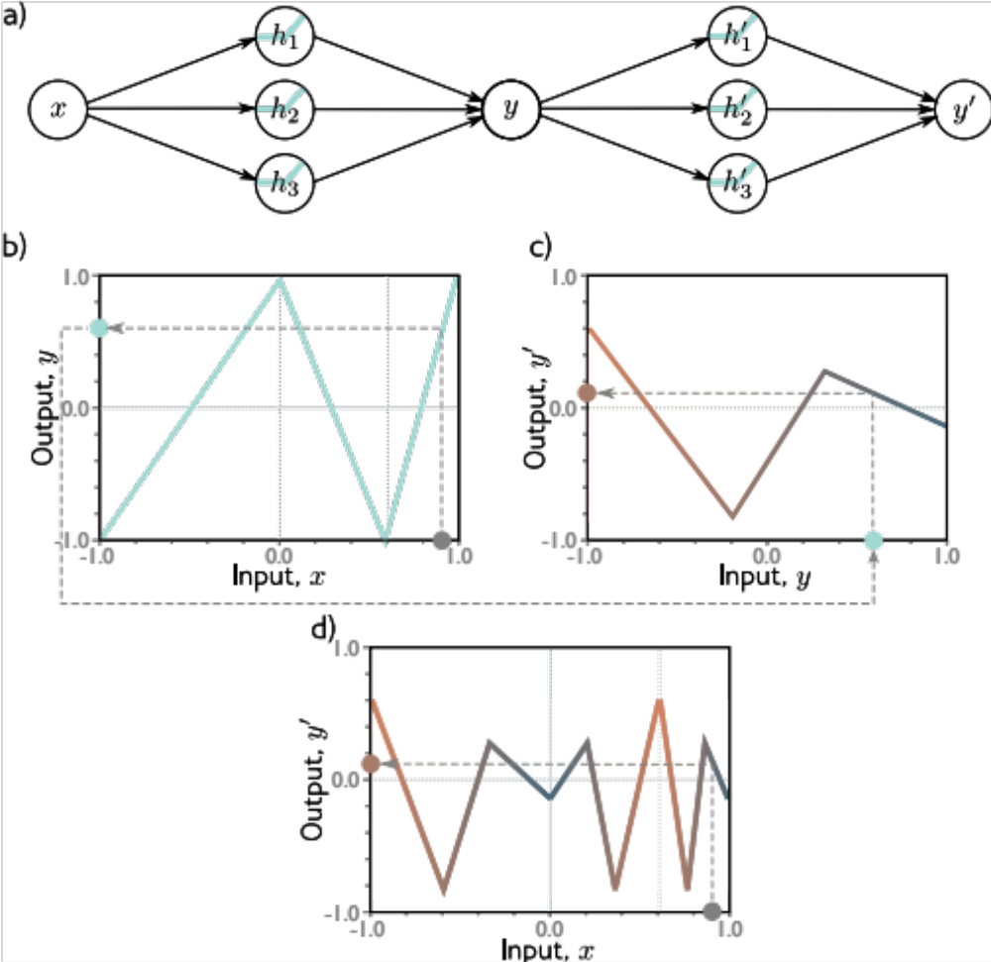

Slide 25
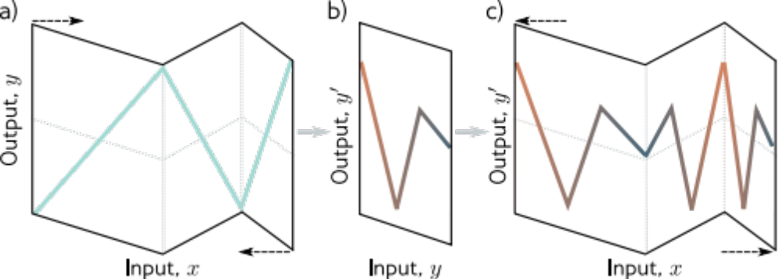
“Folding analogy”

Slide 26
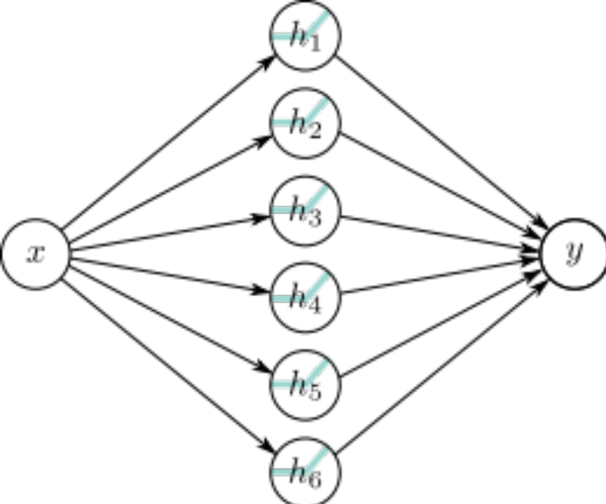
Comparing to shallow with six hidden units
20 parameters
(at least) 9 regions
19 parameters
Max 7 regions

Slide 27
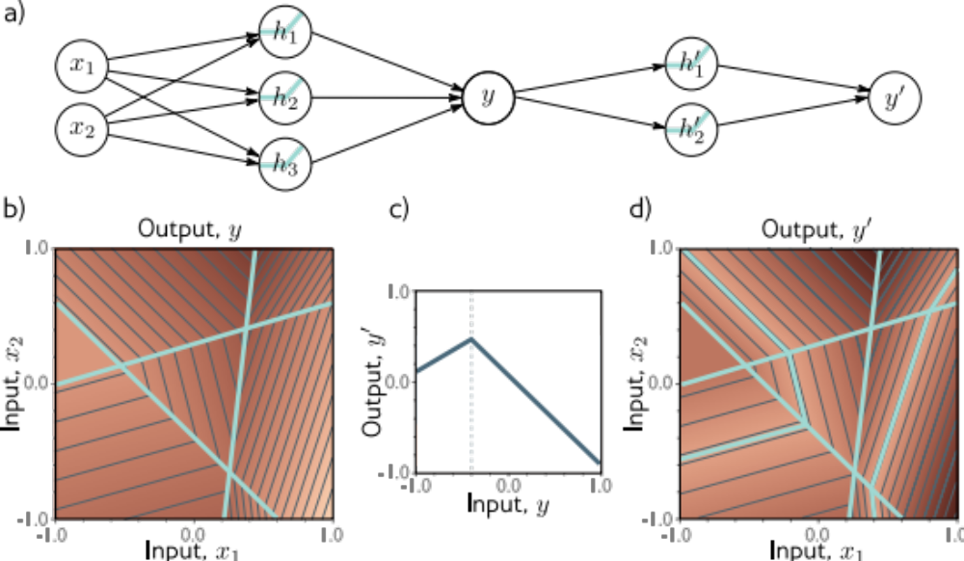
Composing networks in 2D

Slide 28
Deep neural networks
Composing two networks
Combining the two networks into one
Hyperparameters
Notation change and general case
Shallow vs. deep networks

Slide 29
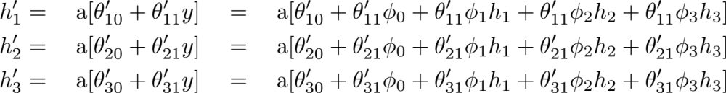
Combine two networks into one
Network 1:
Network 2:
Hidden units of second network in terms of first:

Slide 30
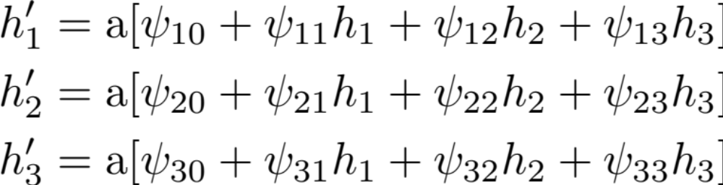
Create new variables

Slide 31
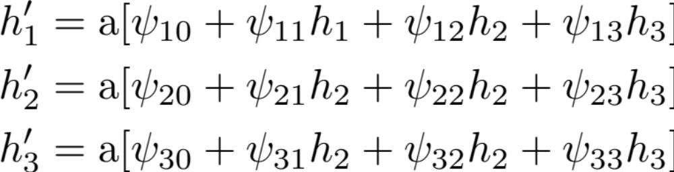
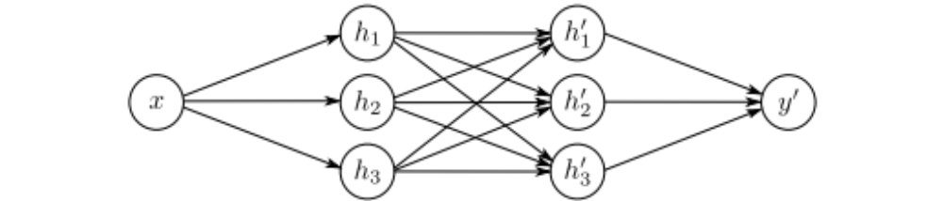
Two-layer network

Slide 32
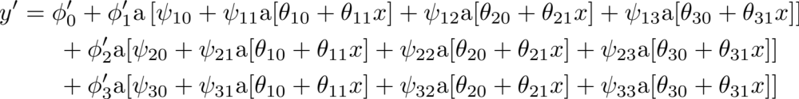
Two-layer network as one equation

Slide 33
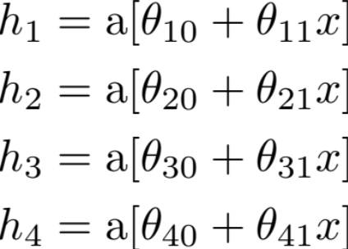
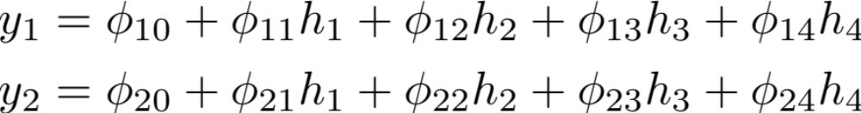
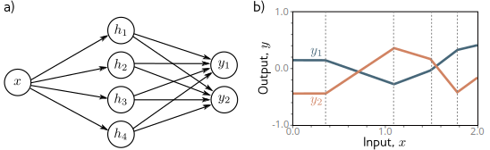
Remember shallow network with two outputs?
1 input, 4 hidden units, 2 outputs

Slide 34
Networks as composing functions
Consider the pre-activations at the second hidden units
At this point, it’s a one--layer network with three outputs

Slide 35
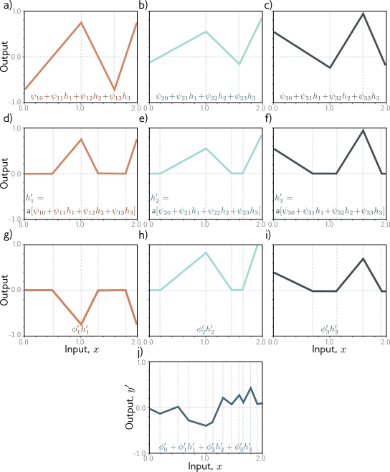

Slide 39
Deep neural networks
Composing two networks
Combining the two networks into one
Hyperparameters
Notation change and general case
Shallow vs. deep networks

Slide 40
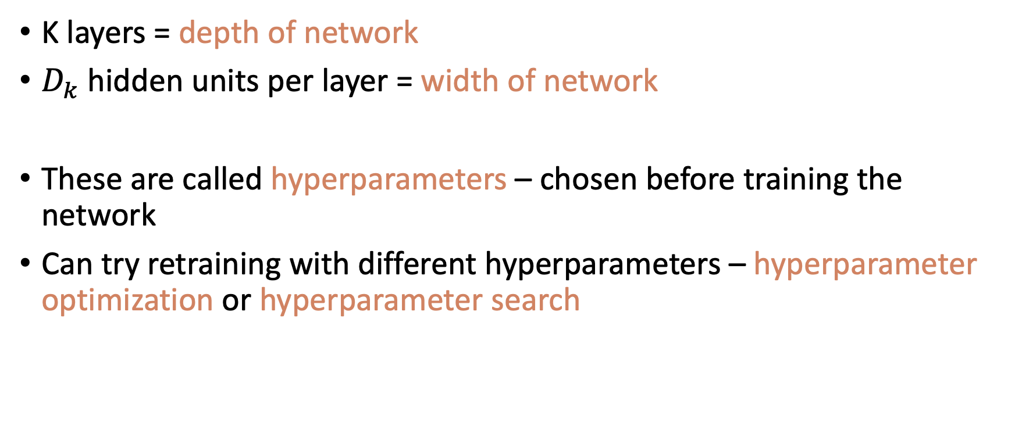
Hyperparameters

Slide 41
Deep neural networks
Composing two networks
Combining the two networks into one
Hyperparameters
Notation change and general case
Shallow vs. deep networks

Slide 42
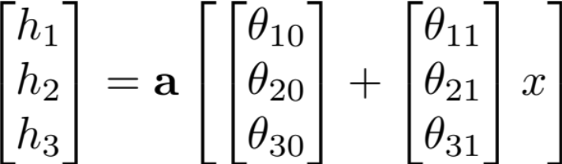
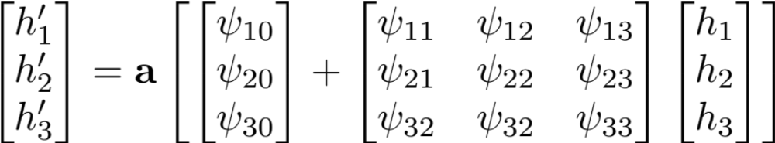
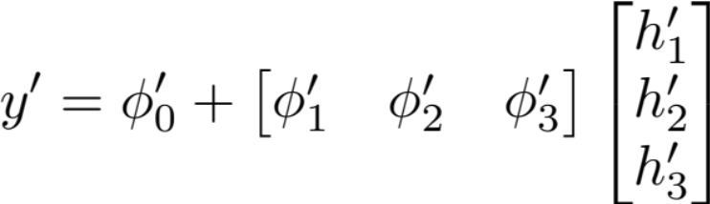
Notation change #1

Slide 43

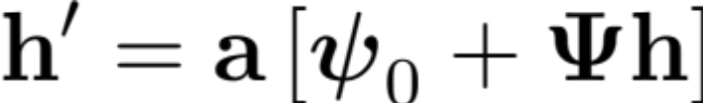
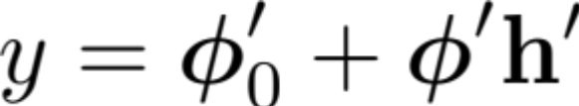
Notation change #2

Slide 44



Notation change #3
Bias vector
Weight matrix

Slide 45
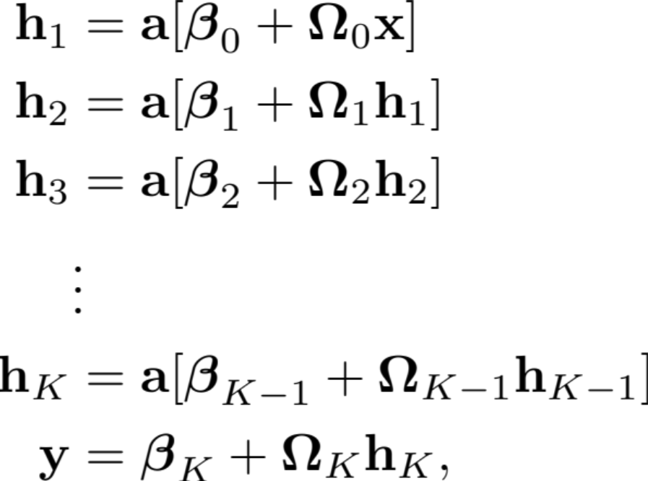
General equations for deep network

Slide 46
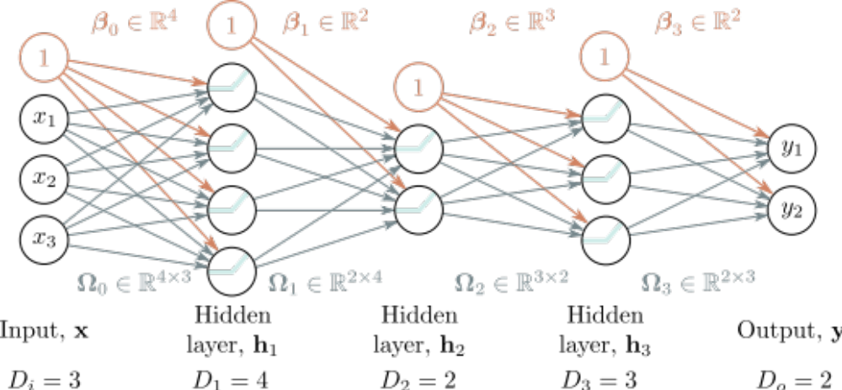
Example

Slide 47
Deep neural networks
Composing two networks
Combining the two networks into one
Hyperparameters
Notation change and general case
Shallow vs. deep networks

Slide 48
Shallow vs. deep networks
The best results are created by deep networks with many layers.
  50-1000 layers for most applications
  Best results in
    Computer vision
    Natural language processing
    Graph neural networks
    Generative models
    Reinforcement learning
All use deep networks. But why?

Slide 49
Shallow vs. deep networks
Ability to approximate different functions?
Both obey the universal approximation theorem.
Argument: One layer is enough, and for deep networks could arrange for the other layers to compute the identity function.

Slide 50
Shallow vs. deep networks
2. Number of linear regions per parameter

Slide 51
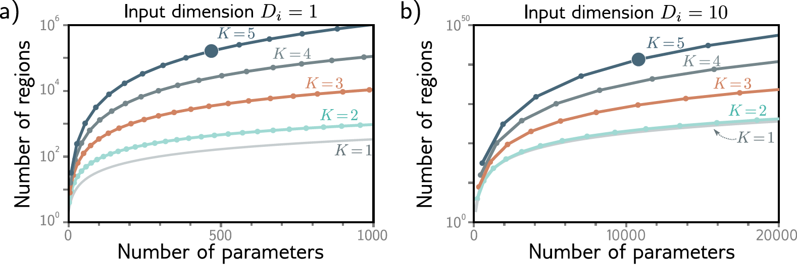
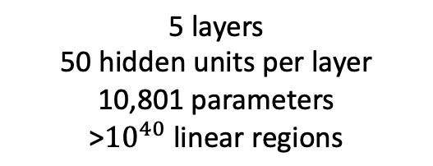
Number of linear regions per parameter
5 layers
10 hidden units per layer
471 parameters
161,501 linear regions

Slide 52
Shallow vs. deep networks
2. Number of linear regions per parameter
Deep networks create many more regions per parameters
But there are dependencies between them
  Think of folding example
  Perhaps similar symmetries in real-world functions? Unknown

Slide 53
Shallow vs. Deep Networks
3. Depth efficiency
There are some functions that require a shallow network with exponentially more hidden units than a deep network to achieve an equivalent approximation
This is known as the depth efficiency of deep networks
But do the real-world functions we want to approximate have this property? Unknown.

Slide 54
Shallow vs. Deep Networks
4. Large structured networks
Think about images as input – might be 1M pixels
Fully connected works not practical
Answer is to have weights that only operate locally, and share across image
This leads to convolutional networks
Gradually integrate information from across the image – needs multiple layers

Slide 55
Shallow vs. Deep Networks
5. Fitting and generalization
Fitting of deep models seems to be easier up to about 20 layers
Then needs various tricks to train deeper networks, so (in vanilla form), fitting becomes harder
Generalization is good in deep networks. Why?

Slide 56
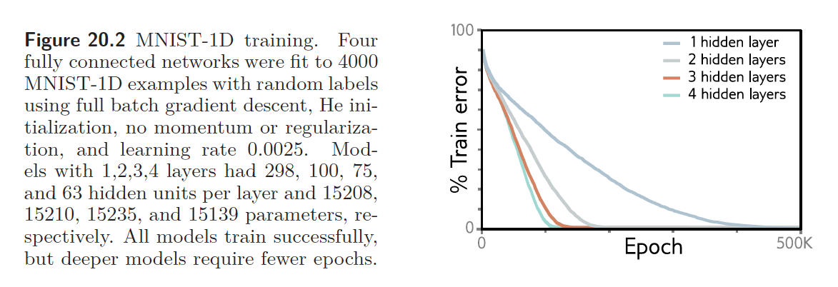
Shallow vs. Deep Networks
5. Fitting and generalization
Fitting of deep models is also faster

Slide 57
Where are we going?
We have defined families of very flexible networks that map multiple inputs to multiple outputs
Now we need to train them
  How to choose loss functions
  How to find minima of the loss function
  How to do this in particular for deep networks
Then we need to test them

