Slide 1


Workshop on Advanced Techniques for Scientific Programming and Management of Open Source Software Packages
Gravitation
Project
Bellomo, Franco @fnbellomo
Aguena da Silva, Michel
Fogliatto, Ezequiel
Romero Abad, David

Slide 2

Gravitation project
PROBLEM DESCRIPTION
MAIN TASK
Compute the movement of bodies under gravity forces using collaborative techniques
Workshop on Advanced Techniques for Scientific Programming and Management of Open Source Software Packages

Slide 3
Gravitation project
PROBLEM DESCRIPTION
MAIN TASK
Compute the movement of bodies under gravity forces using collaborative techniques
Workshop on Advanced Techniques for Scientific Programming and Management of Open Source Software Packages

Slide 4
Gravitation project
EQUATION DISCRETIZATION
X'
0
Identity
X
g
0
V'
0
V
0
g
Workshop on Advanced Techniques for Scientific Programming and Management of Open Source Software Packages

Slide 5
Gravitation project
EQUATION DISCRETIZATION
Explicit Euler
X'
0
Identity
X
Crank-Nicholson
g
0
V'
0
V
0
g
Runge – Kutta 4th order
Workshop on Advanced Techniques for Scientific Programming and Management of Open Source Software Packages

Slide 6
Gravitation project
PYTHON + GIT + GITHUB
class Gravitation(object):
“”” This is the main gravitation wrapper”””
List of bodies
Time advancement
class Body(object):
“”” Base class for space objects”””
Mass, position, velocity
class make_plot(object):
“””Class designed for runtime plotting”””
Runtime plotting
Image and video
Multi-processing
def main():
“””Main function”””
usage: Main.py [-h] [--method METHOD] [--tstep TSTEP] [--file FILENAME] [--plot] [--profile] [--nsteps NSTEPS]
[--config][--confile CONFIG_FILE]
Workshop on Advanced Techniques for Scientific Programming and Management of Open Source Software Packages

Slide 7
Gravitation project
PYTHON + GIT + GITHUB
body
make_plot
Gravitation
body
body
base
update
move
gfactor
GITHUB
Workshop on Advanced Techniques for Scientific Programming and Management of Open Source Software Packages

Slide 8
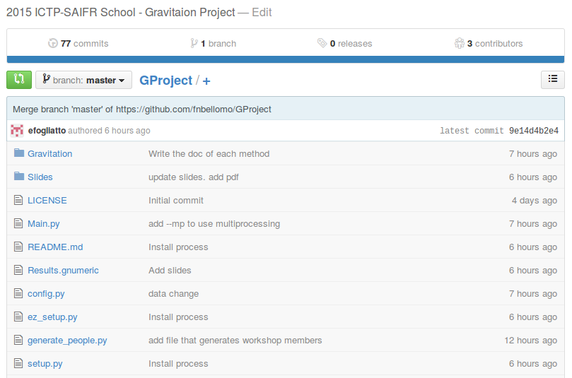
Gravitation project
Workshop on Advanced Techniques for Scientific Programming and Management of Open Source Software Packages

Slide 9
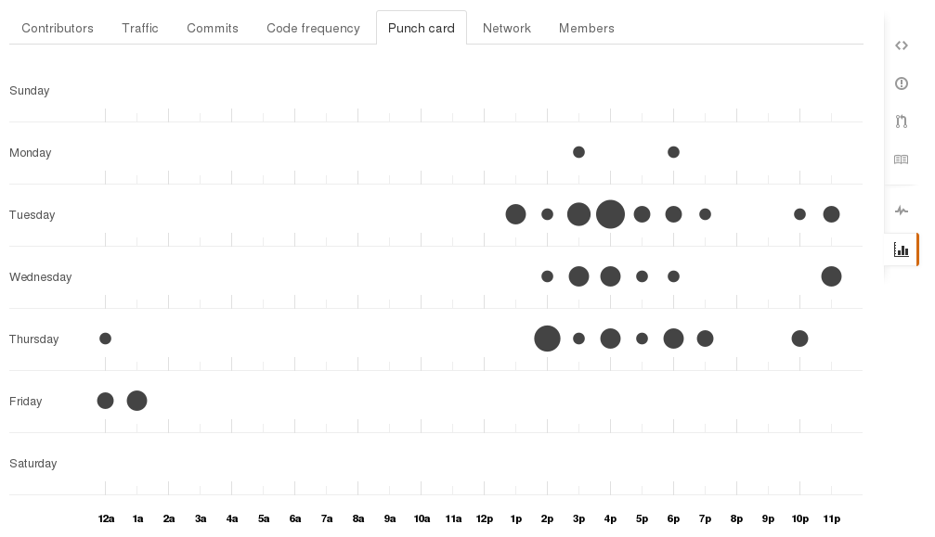
Gravitation project
Workshop on Advanced Techniques for Scientific Programming and Management of Open Source Software Packages

Slide 10
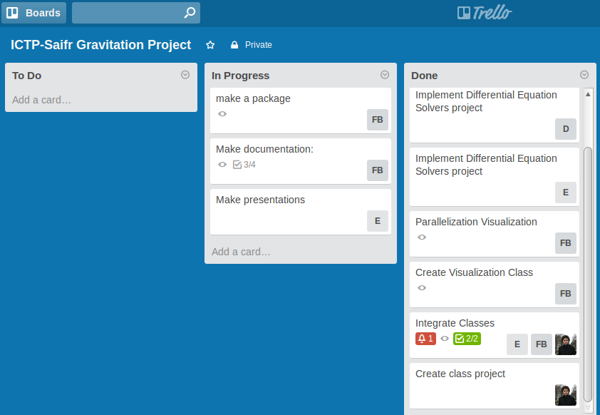
Gravitation project
Workshop on Advanced Techniques for Scientific Programming and Management of Open Source Software Packages

Slide 11
Gravitation project
make_plot
First approach: sequential plotting
Second approach: multi-processing
process 1
move()
make_plot
Shared memory
plot()
process 2
Workshop on Advanced Techniques for Scientific Programming and Management of Open Source Software Packages

Slide 12
Gravitation project
LATEST VERSION
A python program that integrates the equation of movement for an arbitrary number of bodies
Main features
Collaborative project
Command-line options. Reads data and options from file or during runtime
Several numerical methods: Explicit Euler, Crank-Nicholson, Runge-Kutta4, adaptive Runge-Kutta
Runtime plotting with multiprocessing
Workshop on Advanced Techniques for Scientific Programming and Management of Open Source Software Packages

Slide 13
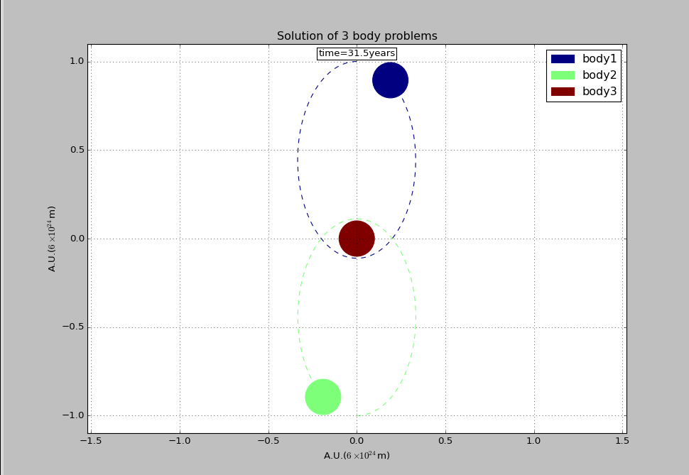
Gravitation project
SOME RESULTS
Workshop on Advanced Techniques for Scientific Programming and Management of Open Source Software Packages

Slide 14
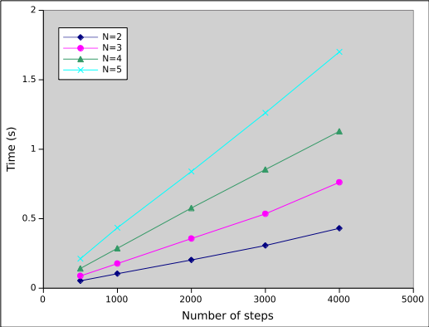
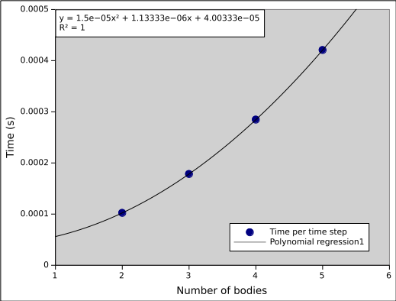
Gravitation project
PROFILING
import cProfile, pstats
Pr = cProfile.Profile()
pr.enable()
pr.disable()
Workshop on Advanced Techniques for Scientific Programming and Management of Open Source Software Packages

Slide 15
Gravitation project
PROFILING
99039 function calls in 0.535 seconds
Ordered by: standard name
ncalls tottime percall cumtime percall filename:lineno(function)
45000 0.223 0.000 0.223 0.000 Body.py:20(gfactor)
3 0.000 0.000 0.000 0.000 Body.py:9(__init__)
3000 0.261 0.000 0.531 0.000 Gravitation.py:107(move)
3000 0.016 0.000 0.018 0.000 Gravitation.py:175(update)
6 0.000 0.000 0.000 0.000 Gravitation.py:8(float_list)
6003 0.001 0.000 0.001 0.000 {len}
3 0.000 0.000 0.000 0.000 {method 'split' of 'str' objects}
12000 0.019 0.000 0.019 0.000 {numpy.core._dotblas.dot}
3 0.000 0.000 0.000 0.000 {numpy.core.multiarray.zeros}
1 0.000 0.000 0.000 0.000 {open}
4 0.000 0.000 0.000 0.000 {print}
30002 0.011 0.000 0.011 0.000 {range}
Workshop on Advanced Techniques for Scientific Programming and Management of Open Source Software Packages

Slide 16
Gravitation project
INSTALL
Dependences:
    Numpy
    Matplotlib
Installation:
$ git clone https://github.com/fnbellomo/GProject.git
$ cd GProyect
$ sudo python install setup.py
Workshop on Advanced Techniques for Scientific Programming and Management of Open Source Software Packages

Slide 17
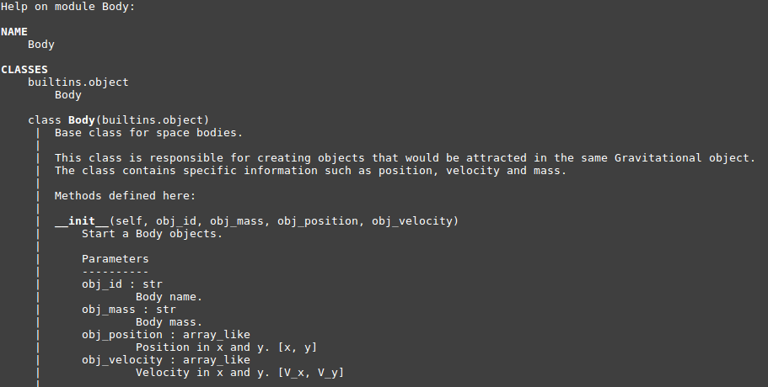
Gravitation project
DOCUMENTATION (pydoc)
Workshop on Advanced Techniques for Scientific Programming and Management of Open Source Software Packages

Slide 18
Gravitation project
UNIT TESTS
import unittest
import doctest
class TestProject(unittest.TestCase):
“””Testing Body class”””
Workshop on Advanced Techniques for Scientific Programming and Management of Open Source Software Packages

Slide 19
Gravitation project
WHAT WE LEARNED?
Working in collaboration is not easy!
Implementation a good way to program
Use of Control Version Software
TO DO
Rewrite class design
Split the program into a larger number of independent modules
Optimize calculations
Optimize communication between processes
Workshop on Advanced Techniques for Scientific Programming and Management of Open Source Software Packages

Slide 20
Gravitation project
Thanks!
Any questions?
Workshop on Advanced Techniques for Scientific Programming and Management of Open Source Software Packages

