Slide 1


Resilient and Risk-Aware Planning of Power System – Fundamental Value Analysis with Stochastic GenX
Sambuddha Chakrabarti¹, Farhad Billimoria², Jesse Jenkins¹
¹Princeton University-ZERO Lab
²University of Oxford-Energy & Power Group
INFORMS 2023-Phoenix, AZ
18th October, 2023

Slide 2
Outline
Motivations for Resilient Planning
Tail Risk and Common Modes
Introduction to Stochastic GenX
Preliminary Results
Future Modules in Stochastic GenX

Slide 3
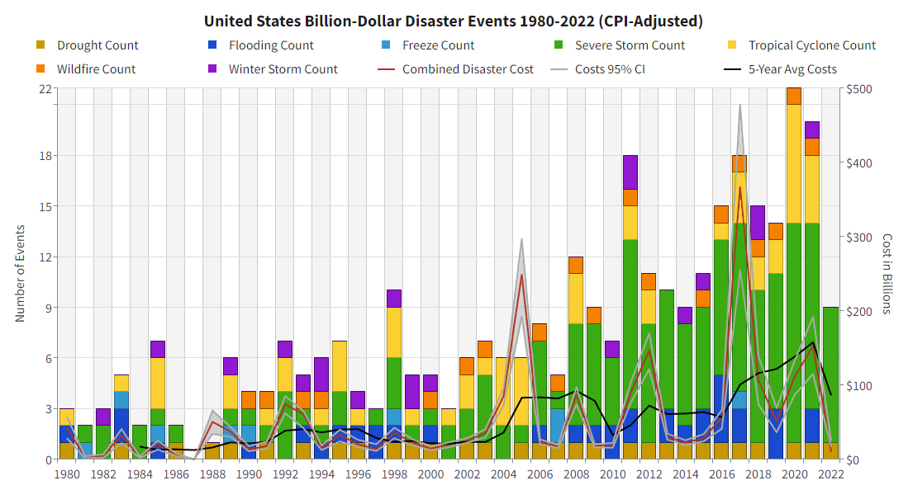
Extreme event risk exacerbated by climate change…
Upwards (fuel) integration:
Weather / climate – wind, solar, hydro, thermal
Fuel integration – coal, gas, hydrogen
Spatial and temporal
Downwards (use) integration
Mobility
Heat
Buildings
… and compounded by systems integration and interconnectedness.

Slide 4
Two perspectives
For truly extreme events, emergency response will continue to be essential and all that can be provided. Promising complete protection against unusual extreme events would be an expensive illusion – William W. Hogan ‘Electricity Market Design and Zero‑Marginal Cost Generation’ (2022)
Whether a rare event is a “black swan” or a “perfect storm” is often in the eyes of the beholder and may not matter that much in practice. Problems arise when these terms are used as an excuse for failure to act proactively. Elisabeth Pate-Cornell ‘On “Black Swans” and “Perfect Storms”: Risk Analysis and Management When Statistics Are Not Enough’ (2012)

Slide 5
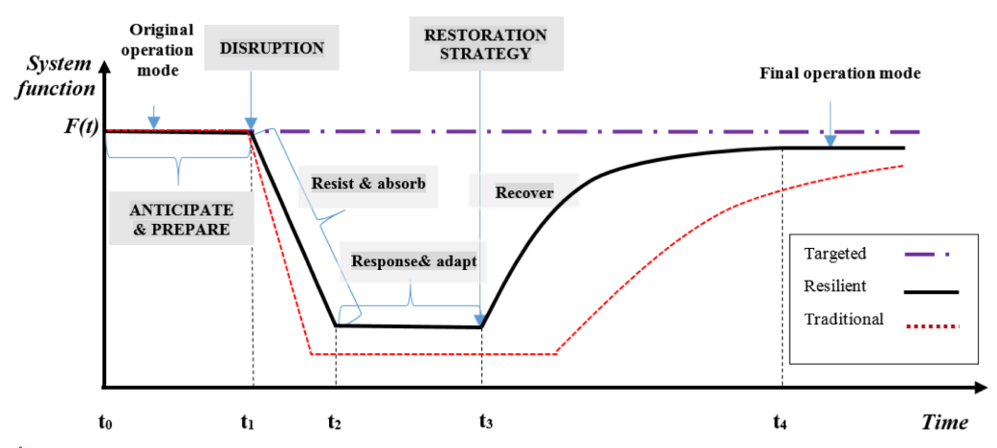
The Resilience Imperative
Transitioning to Sustainability: As the world shifts towards sustainable energy sources, low carbon power systems become the norm. Considerations include: weather-dependent variability, legacy plant performance, transition and policy risk, technology flexibility.
Infrastructure Vulnerability: Common / shared networks and the decentralization of power supply (DER, EV). Importance of network + resource + consumer resilience.
Economic Implications: Any disruption in power supply, especially in low carbon systems that support major industries and commercial operations, can result in significant economic losses.
Climate Change Impacts: Impacts of climate variability and change e.g. variability, extreme weather events, common mode events.
Source: Bie et al (2017) Battling the Extreme: A Study on the Power System Resilience

Slide 6

Common-modes and Tail risk
Understanding the Risks in Power Systems:
Extreme Events: These are rare but highly impactful events, such as catastrophic natural disasters or major infrastructure failures. Their infrequency makes them easy to overlook in traditional planning, yet their consequences can be devastating.
Common-Mode Events: These are events that affect multiple parts of the system simultaneously. For instance, a large solar storm could impact multiple transformers at once, leading to widespread blackouts.
Baylor Lariat, Winter Storm Uri

Slide 7
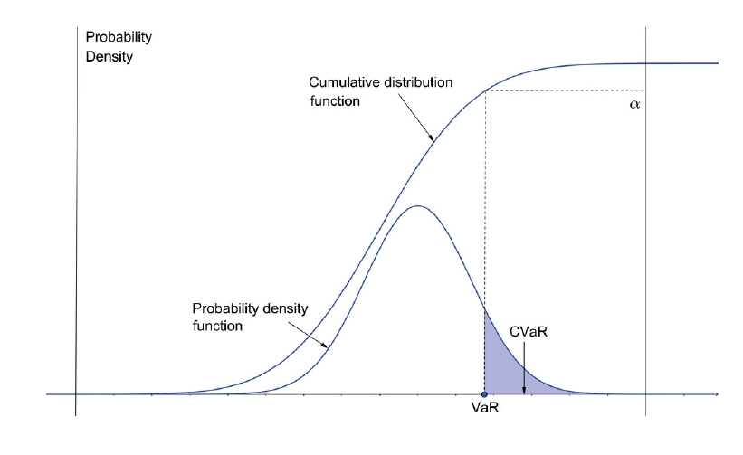
System risk-aversion and risk comprehension
What is risk?
Risk ≠ Uncertainty
Risk measures:
Value at risk (VaR)
Conditional Value of Risk (CVaR) (Rockafellar and Uryasev, 2002)
VaR and CVaR

Slide 8
Introducing Stochastic GenX
In an era where power systems are increasingly complex and exposed to a myriad of risks, there's a pressing need for tools that can navigate this complexity.
Stochastic GenX fills this gap, providing a comprehensive, risk-aware lens through which planners can chart the course for a resilient, sustainable energy future.
Stochastic GenX is an open-source risk-aware planning model designed specifically to address the unique challenges of managing uncertainty and resilience in modern power systems.
Key features:
Stochastic Modeling: Unlike deterministic models that provide a single 'expected' outcome, Stochastic GenX considers a range of possible outcomes, allowing planners to understand potential variations and risks.
Tail Risk Analysis: Stochastic GenX is engineered to delve deep into the 'tails' of probability distributions, ensuring that rare but high-impact events are not just acknowledged but also thoroughly analyzed.
Integrated System Analysis: Recognizing the interconnected nature of power systems, Stochastic GenX evaluates both generation and transmission concurrently, ensuring that the entire system's dynamics are taken into account.
Flexibility and Scalability: Whether you're looking at a small regional grid or a large national one, Stochastic GenX scales seamlessly, offering both granularity and big-picture insights.
Open-Source Nature: Being open-source means Stochastic GenX is continually refined and improved by a global community of experts, ensuring it remains at the forefront of power system modeling.

Slide 9
Preliminary Case Study Setup
ERCOT Two Zone System
6 Weather Year Scenarios with Scenario 4 representing Year 2021 (with Uri) and scenario 5 representing year 2022 (with impacts of Russia/Ukraine war on NG prices)
Solved with Stochastic GenX with HiGHS 1.5.3
Probability Distribution:
scenario_1 | scenario_2 | scenario_3 | scenario_4 | scenario_5 | scenario_6
0.25 | 0.35 | 0.15 | 0.01 | 0.015 | 0.225

Slide 10
Preliminary Case Study Results
Callout from graphic
Capture

Slide 11
Preliminary Case Study Results
Callout from graphic
Capture

Slide 12
The Future of Stochastic GenX
Stochastic GenX
Approach: Scenarios for Fuel Prices, Solar, Wind, and Load
Single set of Capacity Decisions and Multiple Sets of Operational Decisions
Selection of Scenarios, scenario-reduction, and probability weight assignments
Inclusion of Risk Measure: CVAR
Future Extensions and Add-Ons
Multiple futures, multiple paths - SDDP Based Multi-Stage Stochastic GenX
Risk constraints and alternative risk measures
Integration of system and policy risks
Network reliability and locational specificity (nodal extensions)

Slide 13
Acknowledgement & Sponsors
ARPA-E
ZERO Carbon Tech Consortium of Andlinger Center (Princeton University)
MIT-EI & Princeton ZERO Lab
Commonwealth Scholarship Commission of the UK

