Slide 1


TURBOMACHINERY DESIGN SOFTWARE
Multi-Fidelity Design of
3D Turbo Centrifugal Fan
By Using iDesignFan Turbo Design Module V4.1
㈜에어로네트 · 인하대학교 유동소음제어연구실
August 20, 2026

Slide 2
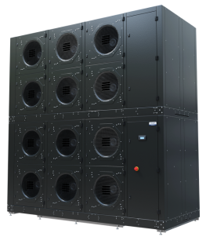
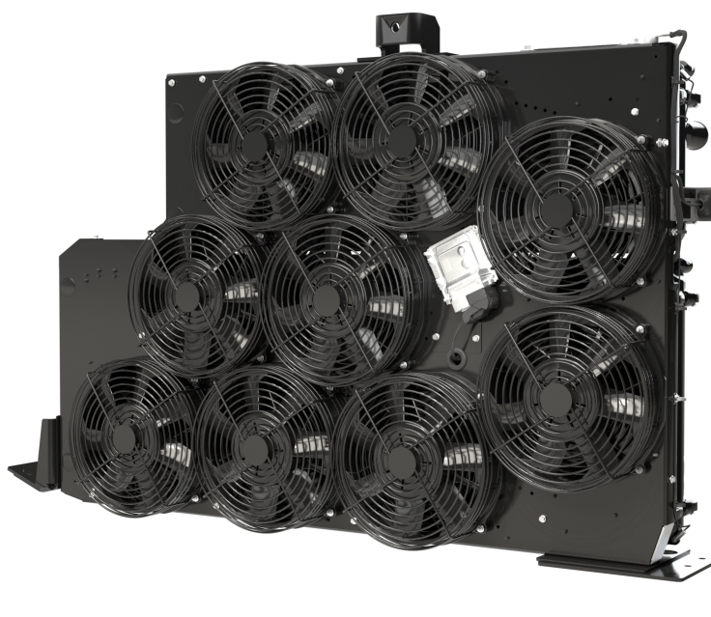

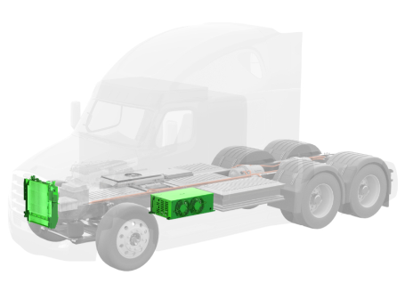
Multi-Fidelity Design of 3D Turbo Centrifugal Fan
02 / 19
Introduction
Turbo Centrifugal Fan Market
Most widely used fluid machines in HVAC, industrial
ventilation, and process cooling, especially Data Ceneter
Cooling Module, contributing to significant share of global
electricity consumption (1.5 ~ 2.5%), Even 1 % increase of
efficiency yielding huge energy savings ( 6,600 ~ 11,000
Gwh).
Conventional Design Optimization by high-fidelity CFD
Huge amount of computational resources for high-
dimensional design space cases.
Machine-learning Surrogate Models
Quick response by CFD of negligible cost, Enabling
broader and faster exploration in multi-design spaces.
<Cooling for Data Center>
<Cooling for Fuel Cell>

Slide 3
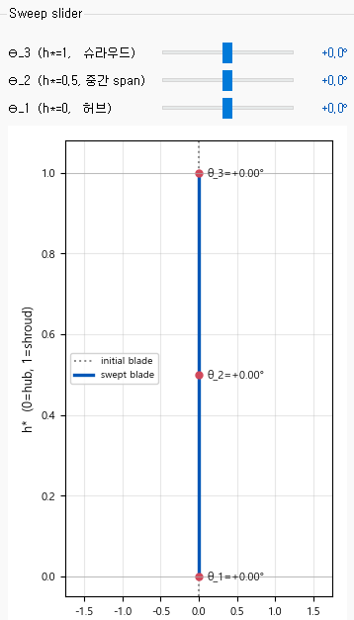

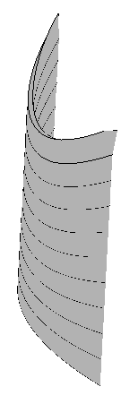
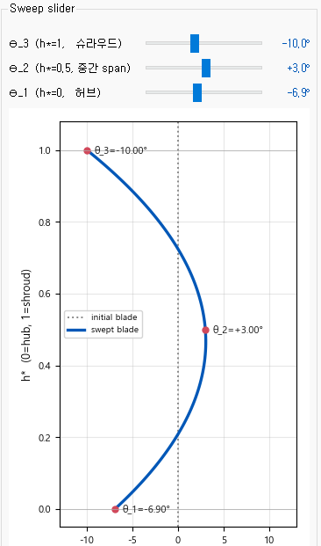
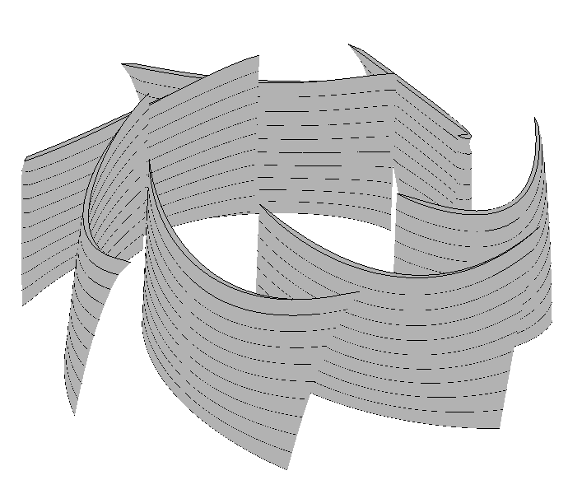
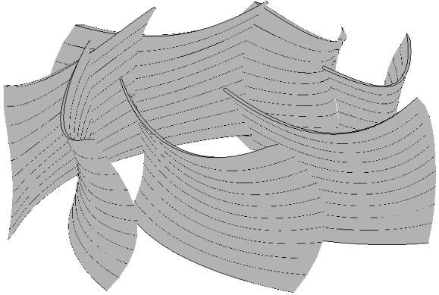
Software Design Methods & Procedures
03 / 19
3D Design by Blade Control
LE
-10° (CW)
TE
+3°
(CCW)
-6.9° (CW)
-Ω (CW)
Conventional Design
3D Sweep Control

Slide 4
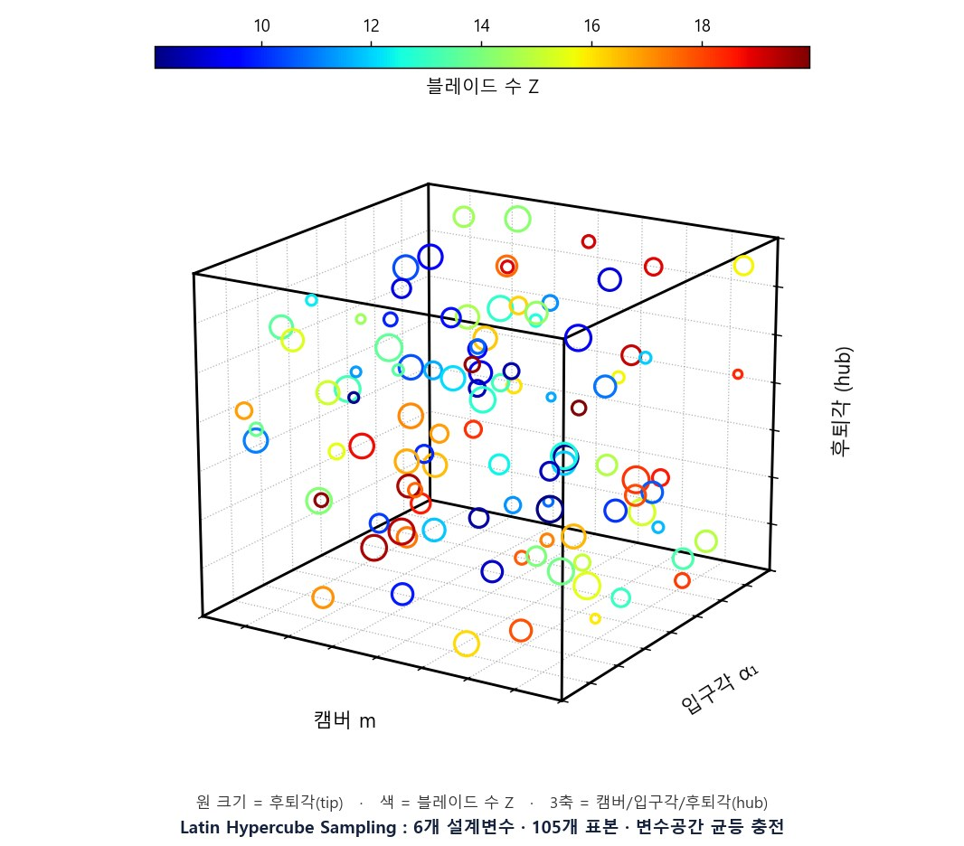
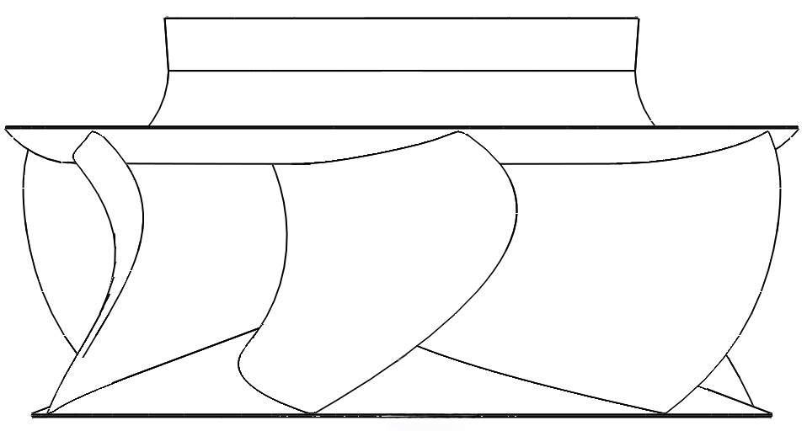
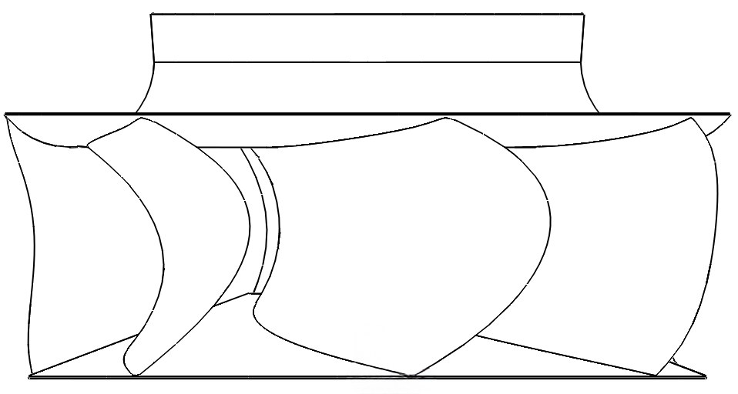
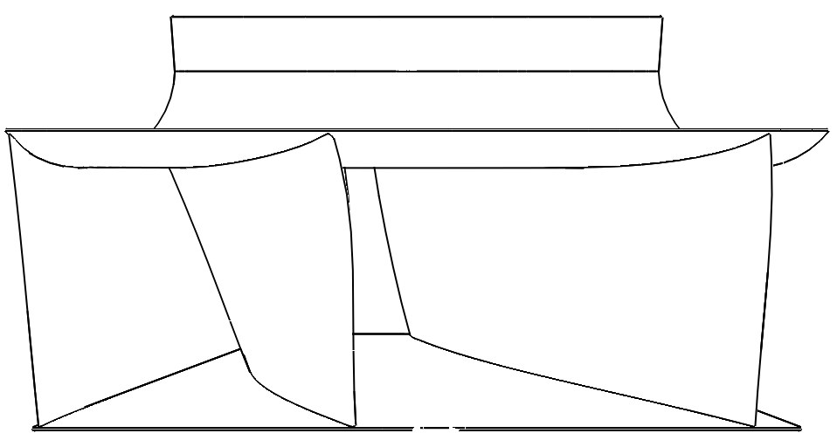
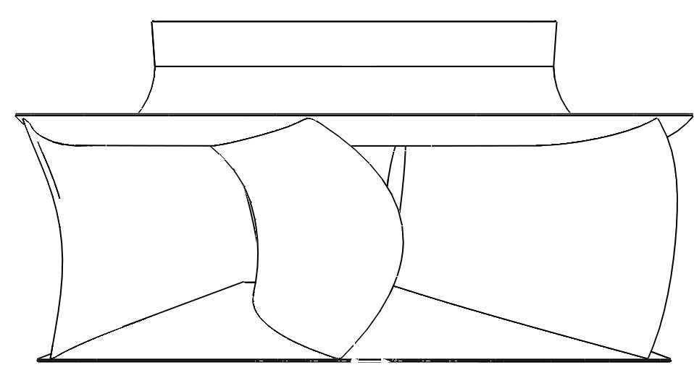
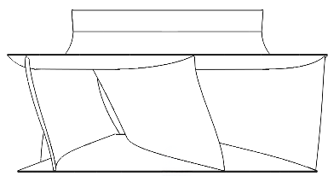
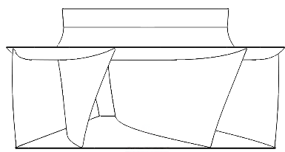
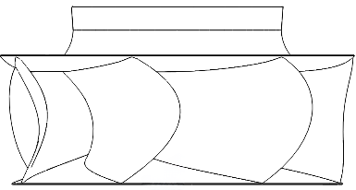
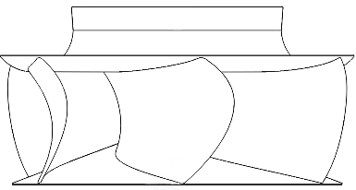
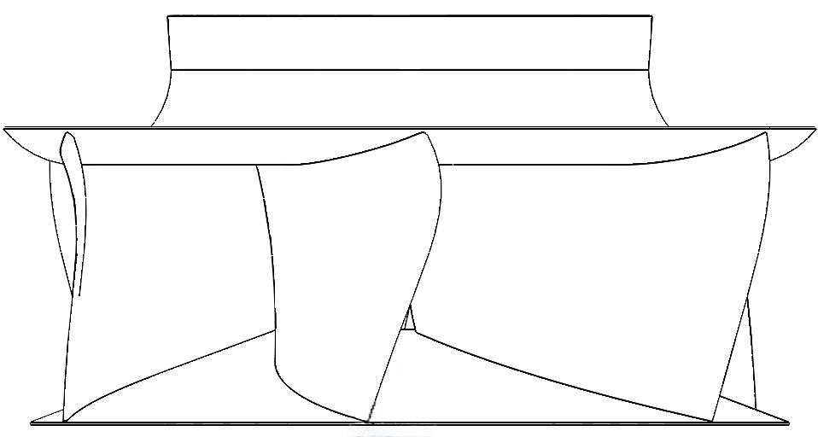
Software Design Methods & Procedures
04 / 19
Latin Hypercube Sampling (LHS)
#1
#2
#3
Design Example
#51
#52
#53
Design Parameters | Value
Diameter (D) | 630 mm
Rotation Speed (N) | 1000 rpm
Blade Thickness | 4 mm
Flow Rate (Q) | 2 m³/s
Outlet Width (b2) | 230 mm
#98
#99
#100

Slide 5
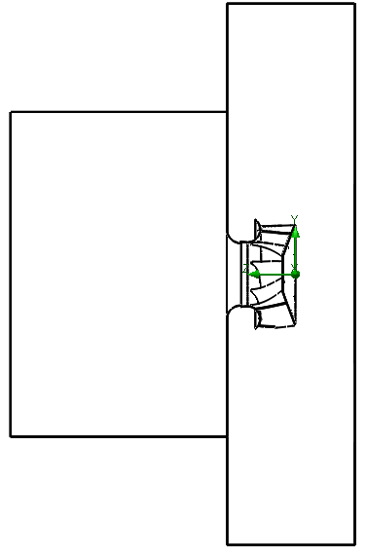
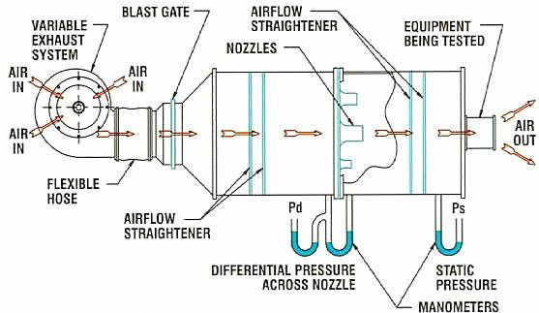
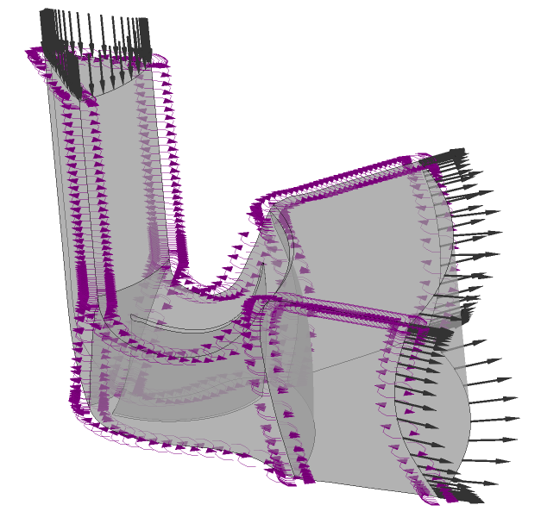
Software Design Methods & Procedures
05 / 19
CFD Domain Example
2D
3D
5D
Low-fidelity CFD Domain
Perfromance Chamber Analogy
High-fidelity CFD Domain

Slide 6
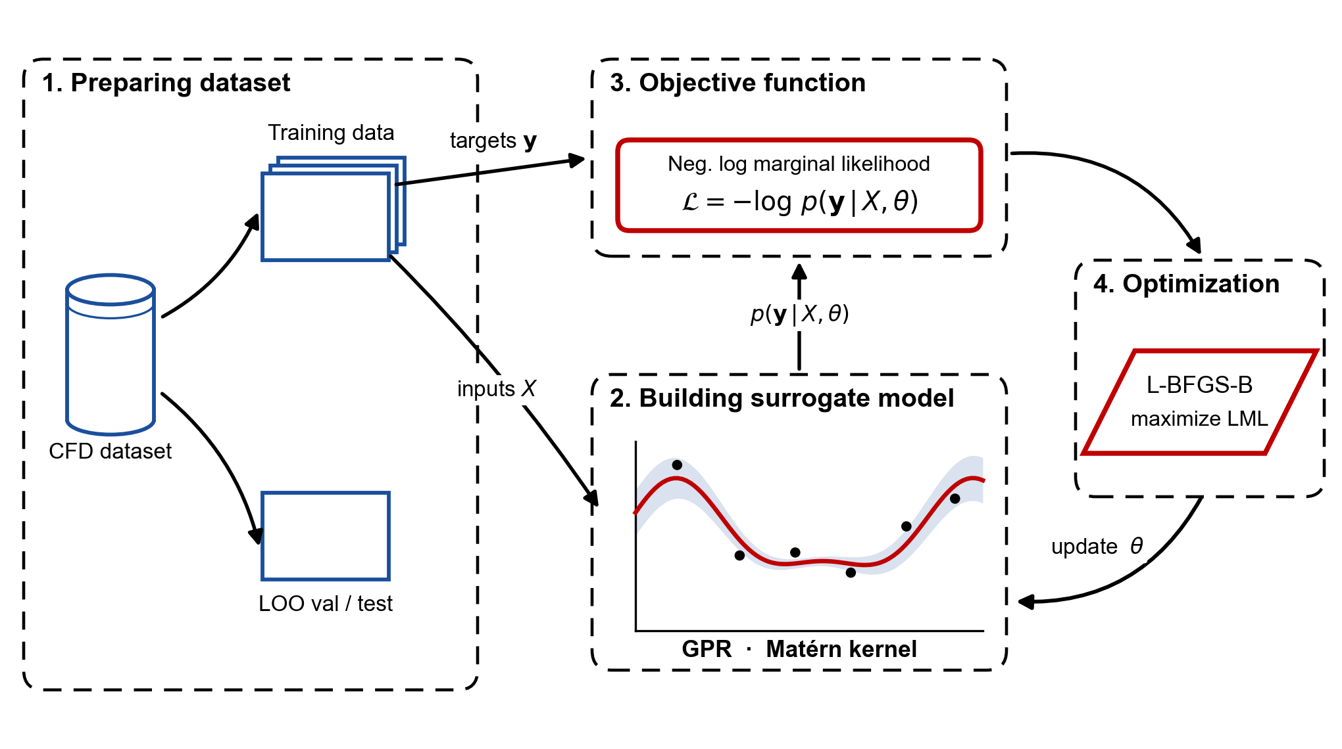
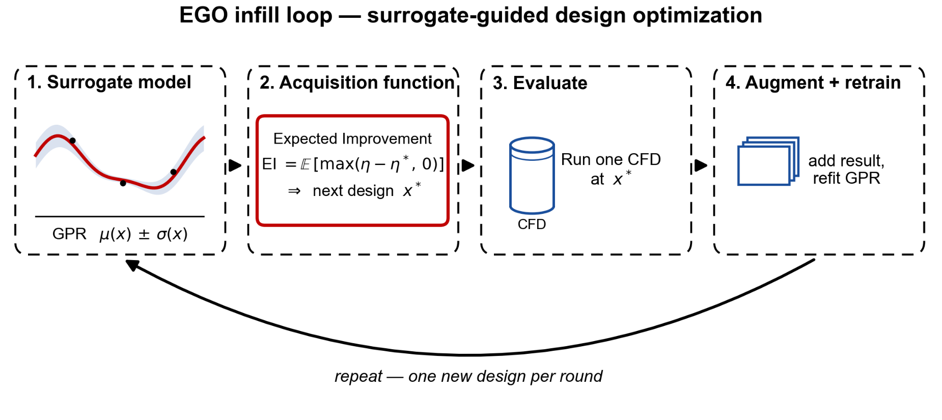
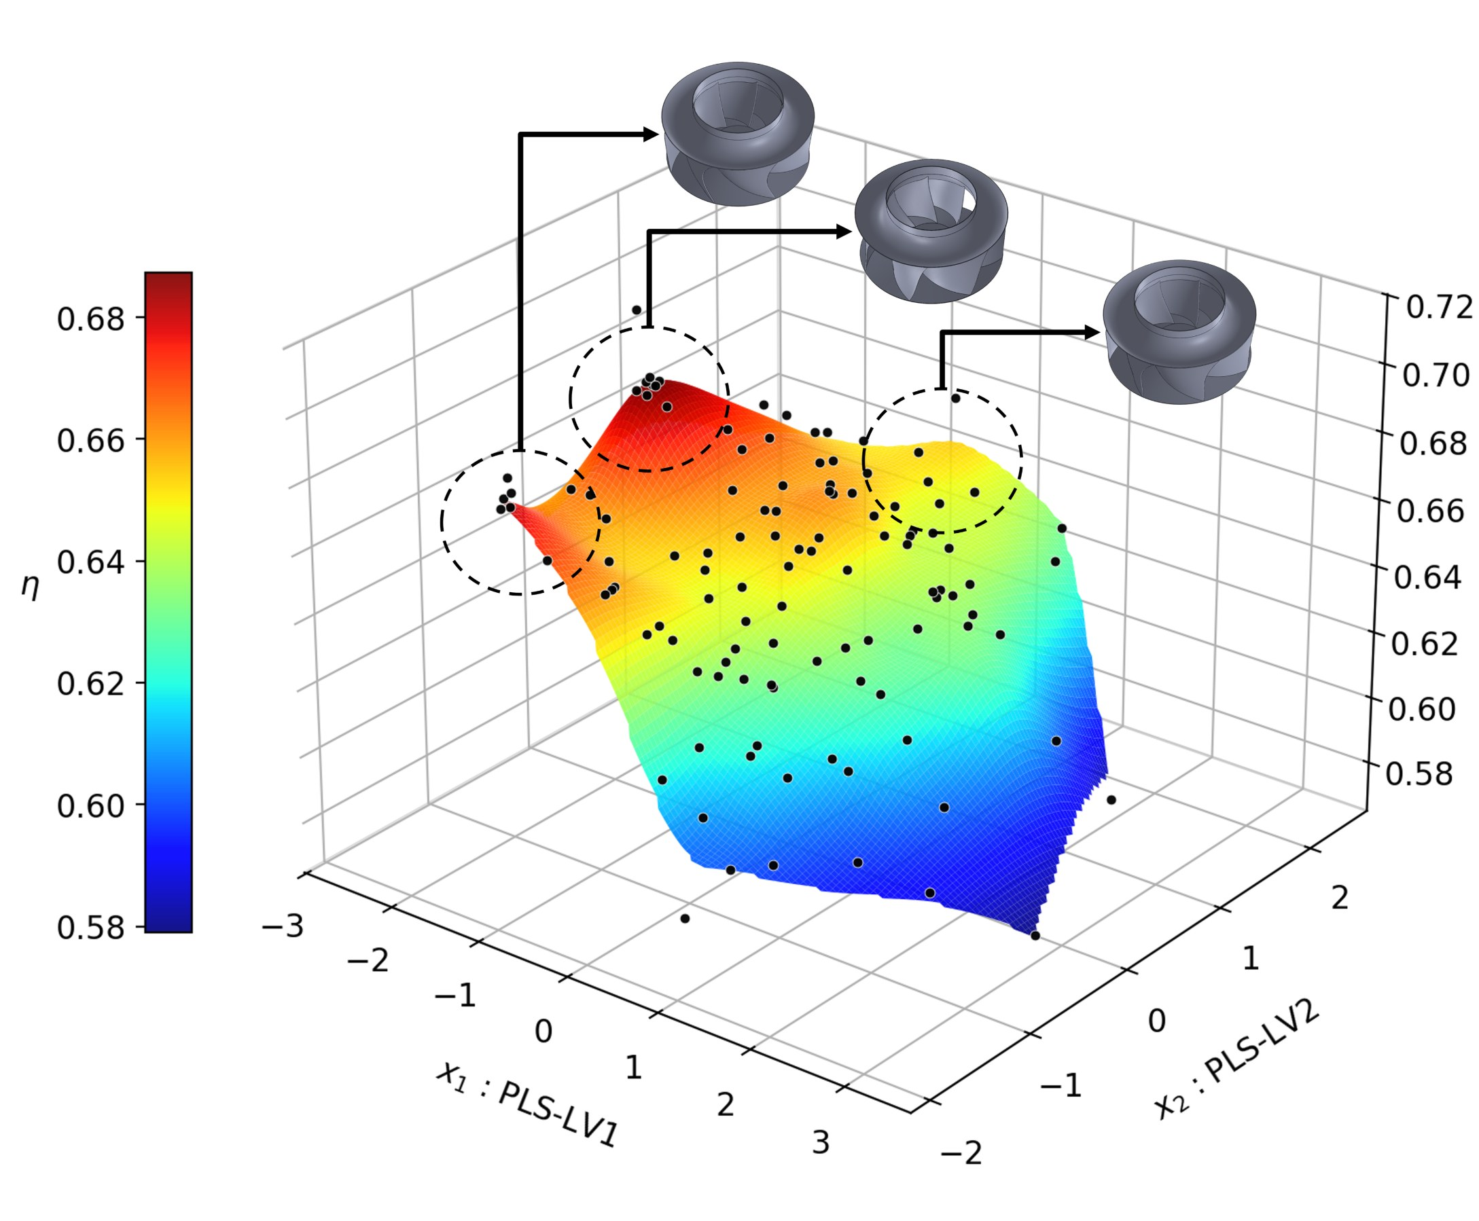
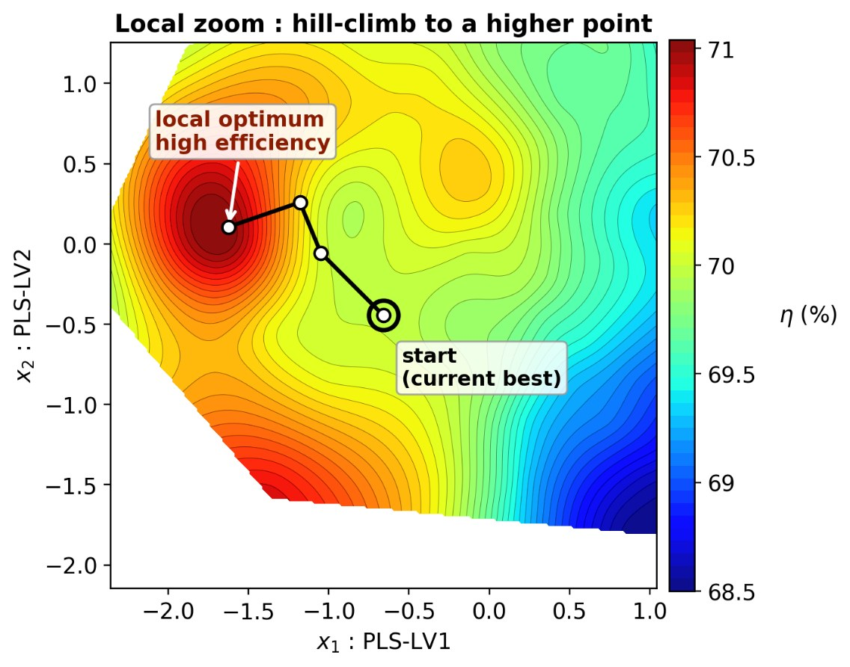
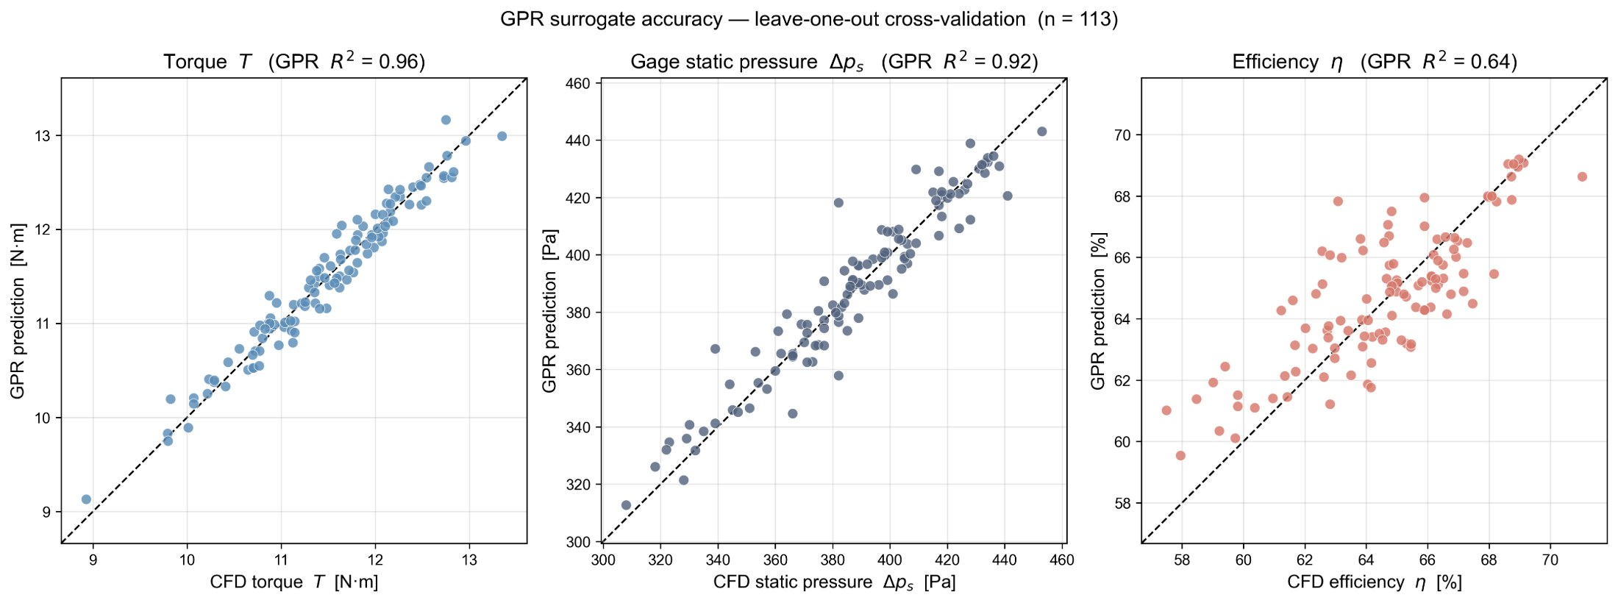
Multi-Fidelity Design of 3D Turbo Centrifugal Fan
06 / 19
Optimization Method by Machine Learning
Global Exploring for
High Efficiency
Local Exploring for
High Efficiency
GPR surrogate model accuracy

Slide 7
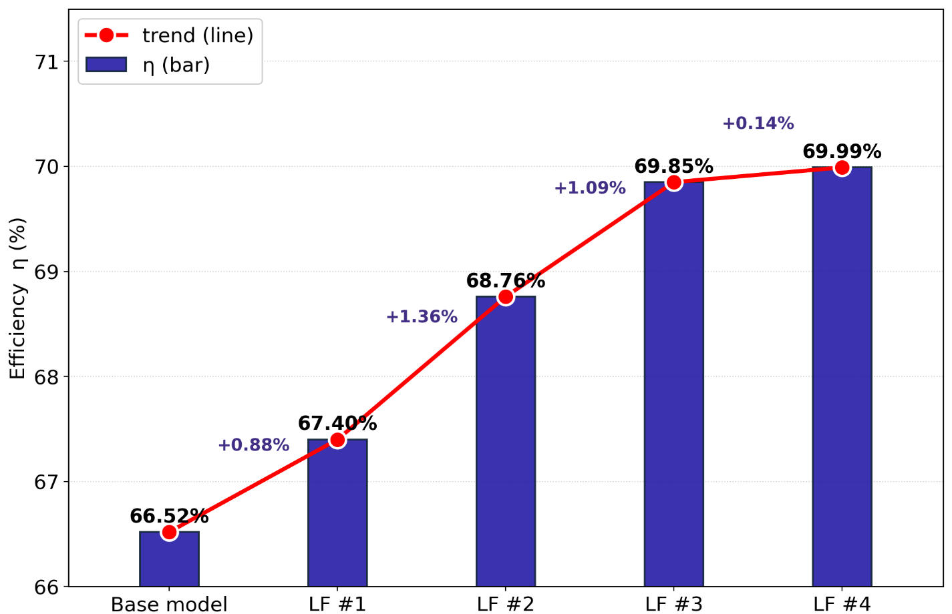
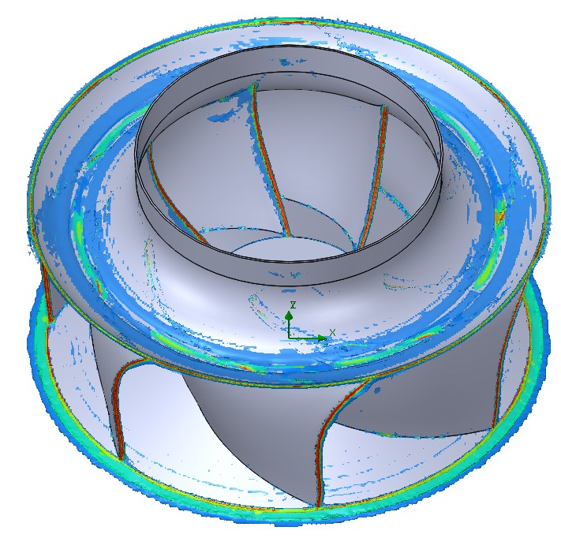
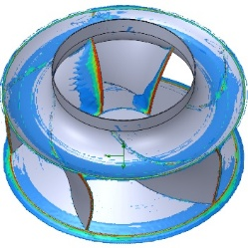
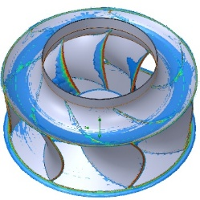
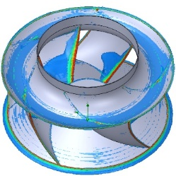
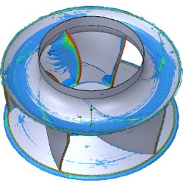
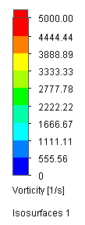
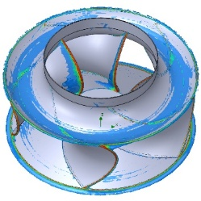
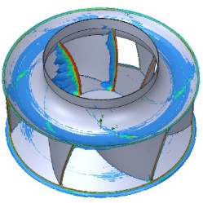
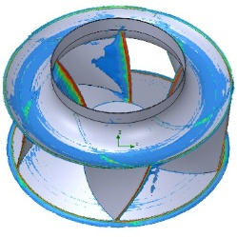
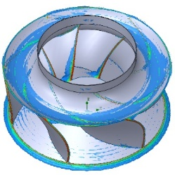
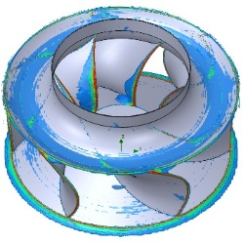
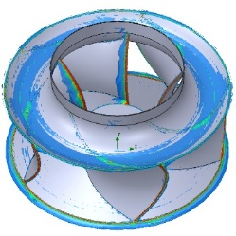
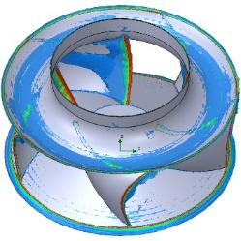
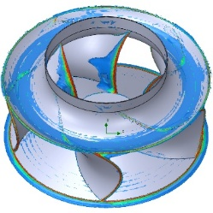
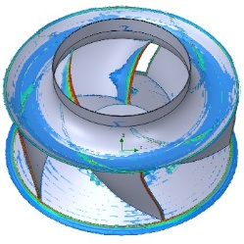
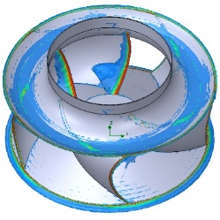
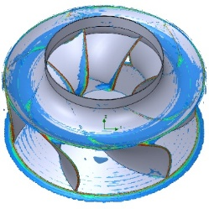
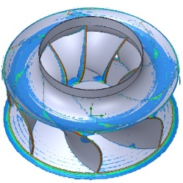
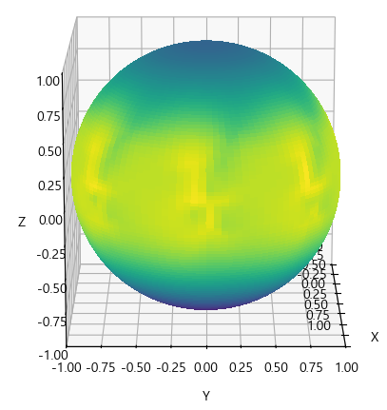
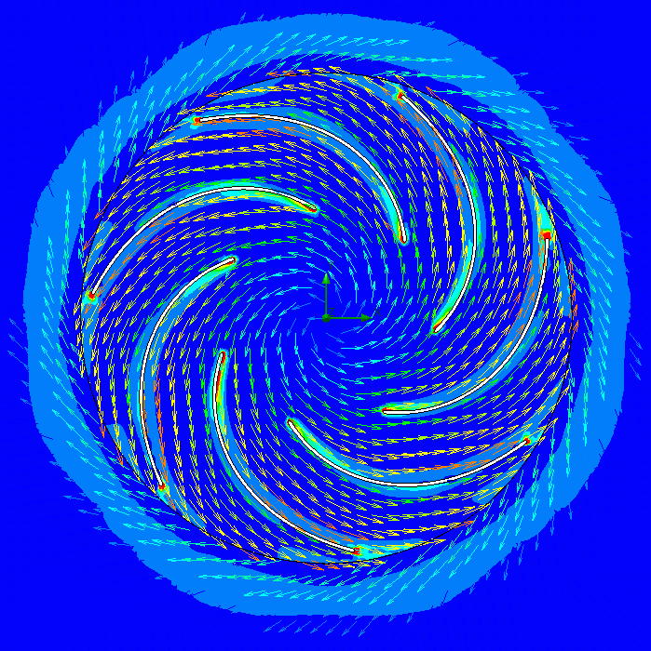
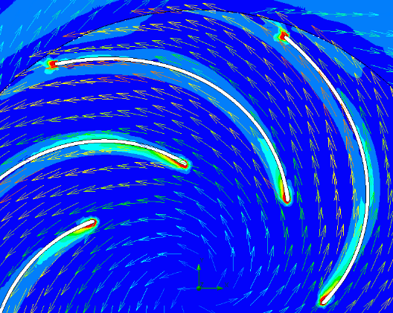

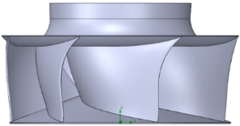
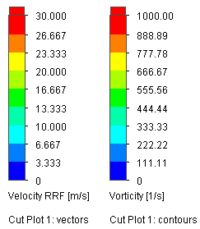


Multi-Fidelity Design of 3D Turbo Centrifugal Fan
07 / 19
Low-fidelity Optimization Fan Geometry
L.F. Model Sound
Computation Example (LF#4)
Vorticity Isosurfaces
of LHS Fans
${ε (clearance)}/D:7.94∗{10}^{−3}$
$Re :1.38∗{10}^{6}$
$N_{s}=\frac{NQ^{0.5}}{{{(∆p}_{t}/ρ)}^{0.75}} :1.74 \sim 2.32$
$D_{h}= \frac{2\sin^{2}(\frac{θ}{2})\sin^{2}(φ)}{(1+Mcosθ)\left[1+(M−M_{c}cosθ)\right]2}$
$L_{p}=10 Log10 (\frac{δ_{s}∗M^{5}∆s\overline{D_{h}} }{r^{2}}$) +G_{B}($\frac{{St}_{s}}{{St}_{2}})+K5$
Vorticity Contour (LF #4 )

Slide 8

iDesignFan Turbo Centrifugal Module
08 / 19
Step 1 – Design Goal

Slide 9

iDesignFan Turbo Centrifugal Module
09 / 19
Step 2 – Airfoil Design Parameter Input

Slide 10












iDesignFan Turbo Centrifugal Module
10 / 19
Step 2 – Blade Bezier Curve Design

Slide 11





iDesignFan Turbo Centrifugal Module
11 / 19
Step 2 – Total Pressure Distribution Input
Shroud
Backplate
Pressure Factor 값에
따른 날개 출구 각 계산 예
Backplate
Shroud

Slide 12


iDesignFan Turbo Centrifugal Module
12 / 19
Step 3 – Airfoil Parameter Input
< XY View of Aligned Airfoils >
< YZ View of Aligned Airfoils >

Slide 13


iDesignFan Turbo Centrifugal Module
13 / 19
Step 4 – 3D Review and Control
Sweep 적용
< 3D Design Example >

Slide 14



iDesignFan Turbo Centrifugal Module
14 / 19
Step 5 – 3D Modeling (e.g. SolidWorks)

Slide 15


iDesignFan Turbo Centrifugal Module
15 / 19
Step 5 – 3D Modeling (e.g. NX)

Slide 16


iDesignFan Turbo Centrifugal Module
16 / 19
Step 5 – TurboGrid, CFX Domain Export

Slide 17




High-fidelity Optimization Fan Geometry
17 / 19
High-fidelity Simulation Model Examples
Model # | Fan Config. | Blade | L.E Curvature Coeff. | Camber Angle [°] | Hub_Sweep [°] | Mid_Sweep [°] | Shroud_Sweep [°] | η_Fan (%) | Γ (m²/s)
LF #4 |  | 7 | 0.4 | 0 | -13.64 | -1.94 | -1.35 | 69.99 | 122.16
M.L #1 |  | 6 | 0.054 | -0.86 | -4.99 | 6.11 | 12.72 | 70.04 | 106.13
M.L #2 |  | 6 | -0.087 | -1.8 | -3.14 | 6.02 | 12.60 | 70.23 | 97.52
M.L #3 |  | 7 | 0.28 | 0.19 | -13.37 | 1.09 | 3.36 | 71.04 | 97.35

Slide 18








High-fidelity CFD (ANSYS CFX)
18 / 19
3D CFD Meshing and Result Example
Total Pressure
Distribution
Inlet
TE
LE
Outlet
TE
LE
10,000,000 cells, y⁺ ≈ 1
Q-criterion (value : 200,000 [s⁻² ])
Turbulent Model
Stress-Blended Eddy Simulation (SBES)
< LHS #10, η : 64.62 %,
Γ : 123.56 m²/s >
< M.L #2>

Slide 19
Multi-Fidelity Design of 3D Turbo Centrifugal Fan
19 / 19
Conclusions
Verification Result of M.F. Design Using iDesignFan Software
Best Optimal Design (M.L #3) of η_{s} = 71.04%, +1.05 % over Manufactured Model (66.5%),
with 20% Lower Circulation Strength (Γ: 122.16 → 97.35 m²/s) compared with Low-fidelity Outcome.
Efficiency Gain and Reduced Noise with Reduced Circulation
Same Loading with Increased Vortex Strength Index Criterion, Meaning that Excess Vortex
Circulation Resulting in Losses in Backward-swept Impellers.
Global Search of Priori-favoring Moderate-Γ designs over High-Γ Ones
Local GPR Refinement Accelerating the Trend faster.
Very-Efficient, AI M.L. Fan Design Software

