Slide 1
CT4009 - Introduction to Web Development
Week 10 – Lab Worksheet
Using Google Map

Slide 2
This Lab Worksheet shows implementation of two pages
Page 1. Create Animal Event
Page 2. Show animal event list

Slide 3
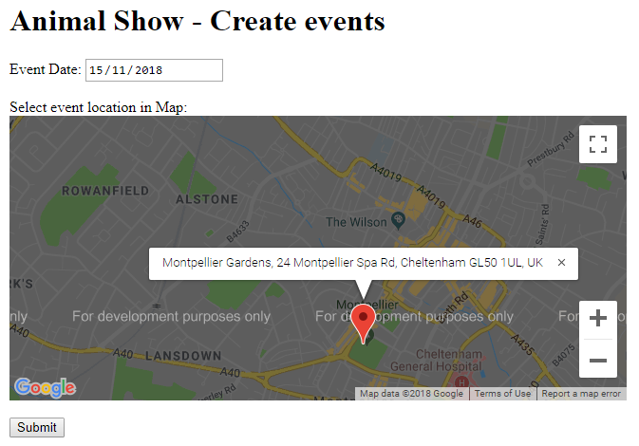
Screenshot of Page 1. Create Animal Event
User can select a location in the google map and store animal event data into indexeddb database

Slide 4
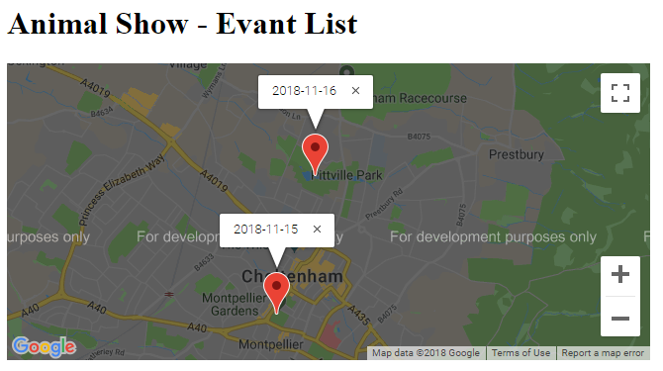
Screenshot of Page 2. Show animal event list
User can view all the events created and saved in the database

Slide 5
Page 1. Create Animal Event
We will create a HTML file and two javascript files
InsertEvent.html
InsertEvent.js
InsertEventDAO.js

Slide 6
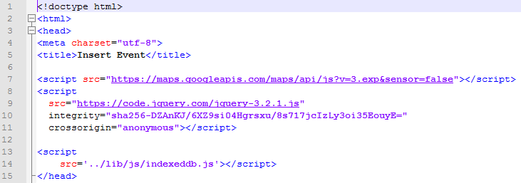
InsertEvent.html - HEAD
Write the following html head code: includes google map API, jQuery API and indexeddb.js links.
Make sure you have downloaded indexeddb.js from moodle Week9 section and saved into ../lib/js folder

Slide 7
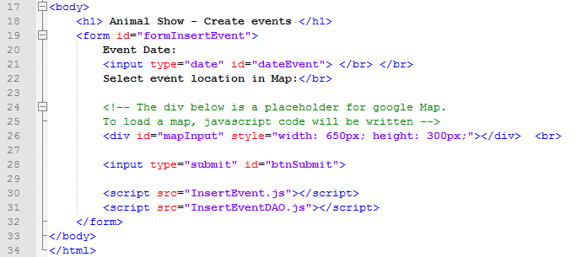
InsertEvent.html - BODY
Write the following html body code: creates HTML elements, includes InsertEvent.js and InsertEventDAO.js links

Slide 8
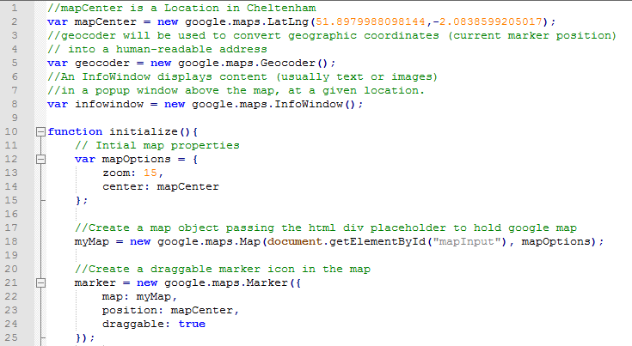
InsertEvent.js

Slide 9
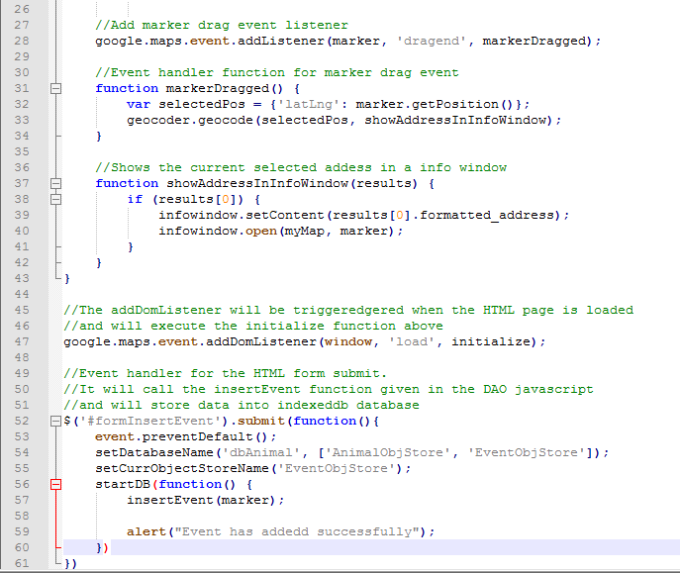
InsertEvent.js (continued)

Slide 10
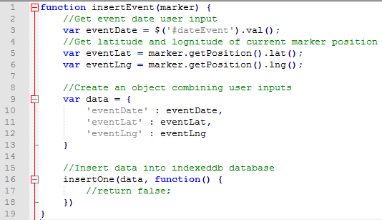
InsertEventDAO.js

Slide 11
Page 2. Show animal event list
We will create a HTML file and two javascript files
EventList.html
EventList.js
EventListDAO.js

Slide 12
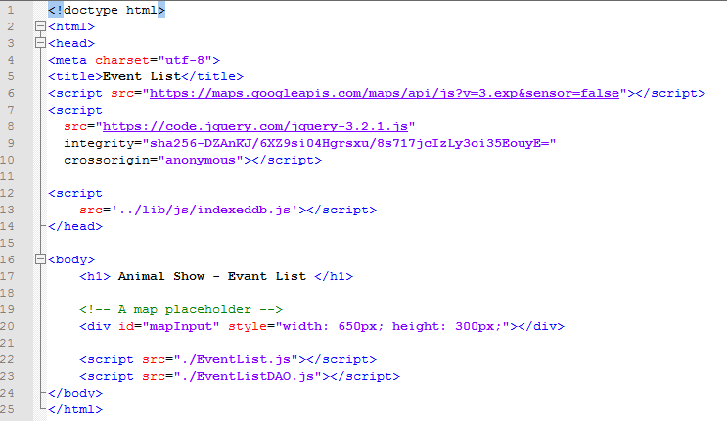
EventList.html

Slide 13
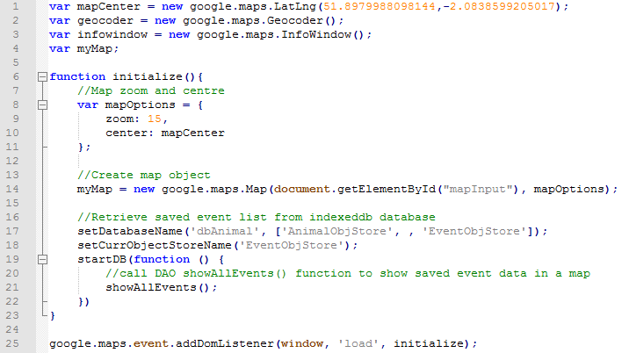
EventList.js

Slide 14
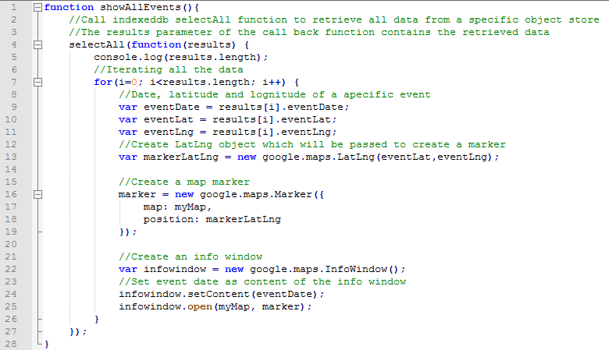
EventListDAO.js

Slide 15
The End

