Slide 1

CT4009 Introduction to Web Development
Semester 1 Week 1
Introduction to the Module,
Introduction to HTML

Slide 2
Introduction to the Module
Module Tutors
Learning Summary
Assessments
Marking Criteria
Scheme of Work
Attendance

Slide 3
CT4009 - Tutors
Billy McQueer
(will deliver lectures from week1-8 in first semester)
Abu Alam (Module Leader) - This is your first point of contact
(will deliver lectures from week9-12 in first semester and week1-4 in second semester )
David Johnston
(will deliver lectures from week4-12 in second semester )
Support:
Session1: 9:15 – 12:15
Stu Carter
Abs
Session2: 9:15 – 12:15
Kieren Stanton
Connor Dowson
Session3: 9:15 – 12:15
Fin Hards
Stu Carter

Slide 4
CT4009 Learning Summary
Introductory and fundamental techniques (Syntax and Semantics) of
HTML
CSS
JavaScript
PHP
MySQL
to build and host a functional and secured Web Site
1st semester
Client side languages
2nd semester
Server side language and database

Slide 5







What is Client side or Server side language?
Client
Client
Client
Server
Client
Client
Code = HTML + CSS + JavaScript + PHP + MySQL + ….
Client side codes are processed on the end users’ device (such as contents of your page, event handling)
Server side codes are processed on the server (such as student information to be stored in database)

Slide 6
CT4009 - Assignment Overview
CT4009 has two assignments:
1st Semester (50%) – Individual work
2nd Semester (50%) – Group work
Each assignment consists of two parts:
A project
A report

Slide 7


Assessment 1 - Individual Project
This assignment requires you to develop a Social Media Web Site (like Facebook) using HTML, CSS, Javascript/ JQuery (client-side scripting languages).

Slide 8

Assessment 1 - User Classes and Characteristics
9 web pages
Register (create an account)
Login to the system
login
Delete any user
Create wall posts …..
View a report that shows number of posts made by Website users ….
Administrator
website users
Send/ receive messages
View all reports made by Website users ….
Block/ unblock and report friends ….

Slide 9
Assessment 1 – Consideration of Data Storage, Email and Commenting
Assessment 1 requires all the data to be stored in a local database (e.g. HTML local storage)
Don’t need to implement emailing features (e.g. email confirmation to complete your registration) – [something you need to consider in the second semester]
You must write comments (programmer-readable explanation or annotation) in the source code

Slide 10
Assessment 2 – Project Criteria (don’t think about these until second semester)
This assignment requires you to extend Assessment 1 so that data can be stored into a server database (MySQL). You need to use server side programming language PHP as well as HTML, CSS, Javascript/ JQuery.
The following additional features should also be included:
Marketplace (such as eBay) advertisements will appear on social media website pages.
Administrators can view heat map of social media posts locations in a google map
Social media users can deactivate their account
Social media users can create event (such as party, function etc), invite friends and see which friends are gathering.

Slide 11
Assessment 1 – Report (2000 Words)
The written report should include the following:
The URL of your hosted web site.
The URL, user name and password of your control panel.
A table containing the list of functioning and non-functioning pages.
Evidence that you have understood web technologies by showing interesting examples of HTML, CSS and Javascript code used in implemented pages.
A concise User Manual targeted at the key users (Website User and Administrator). This should be task oriented and demonstrate good consideration of appropriate style. Relevant books on user manual style available from the Learning Centre include: “Read Me First”, and “Developing Quality Technical Information” – please use these.
Documented evidence of the testing strategy you used to test the web site’s functionality throughout its development.
Reference List. Don’t forget that all code and ideas that are not your own must be fully acknowledged and used in accordance with any applicable restrictions. Use Harvard referencing.
Appendix 1: Screenshot of all implemented web pages
Appendix 2: All Source code (HTML, CSS, Javascript).
The report must be written in third person.

Slide 12
Assessment 1 – Report (continued)
You should carefully consider the following when writing your report:
Style – suitable to be quickly read and comprehended.
Content – relevant, clearly explained, logically organised.
Authority – discussed concepts and ideas will need evidence in support.
Practical understanding – your own practical examples, advice and demonstrations should be included.

Slide 13
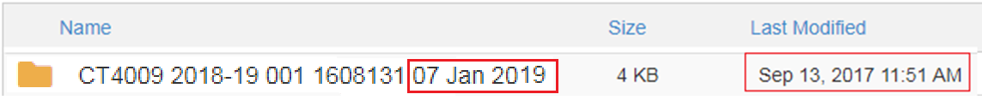

Special instructions
Submit your project source files on Web Server (student sites). The root folder should be named according to the convention
CT4009 2018-19 001 StudentNumber SubmissionDeadline
e.g. CT4009 2018-19 001 1608131 07 Jan 2019
Submit report (just one Word document) via Moodle named according to the convention
CT4009 2018-19 001 StudentNumber
e.g. CT4009 2018-19 001 1608131

Slide 14
Assessment 1 criteria
You need to achieve at least 40% to pass this assessment.
Below a guide to the level of practical content and report required for the assignment.
Grade | Content
To achieve <30 | Some requirements met, but very limited and not recoverable. Copyright violation.
To achieve <40 | Deliverables partially complete, e.g. no implementation or no report.
To achieve 40+ | Project Partial implementation of the web site (at least 5 web pages using HTML and CSS) Limited documentation (comments) in source code Report Report contains explanation of implemented web pages
To achieve 50+ | Project Partial implementation of the web site (at least 5 web pages using HTML ,CSS and Javascript) Javascript has been used to store and retrieve data Good documentation (comments) in source code Report Report contains explanation of implemented web pages User manual has been provided

Slide 15
Assessment 1 criteria (continued)
To achieve 60+ | Project Most functions of the web site were implemented (at least 7 web pages using HTML, CSS and Javascript) Javascript has been used to store and retrieve data Very good documentation (comments) in source code Report Report contains explanation of implemented web pages User manual has been provided Harvard referencing has been used
To achieve 70+ | Project Full implementation of the web site (all required web pages using HTML, CSS and Javascript) Javascript has been used to store and retrieve data Excellent documentation (comments) in source code Report Report contains explanation of implemented web pages User manual has been provided Documented evidence of the testing strategy Appendix contains Screenshot of web pages and source code Harvard referencing has been used

Slide 16
Scheme of work
Date w/c | Topic | Practical work
SEMESTER 1
17 Sep 18 | Introduction to the Module, Introduction to HTML | HTML exercises | Lecture: Team Lab: AA/DJ
24 Sep 18 | HTML – List, Links, Images, Table, Forms, Video | HTML exercises | Lecture: BM Lab: AA/DJ
01 Oct 18 | Introducing CSS – Color, Text, Boxes | CSS exercises | Lecture: BM Lab: AA/DJ
08 Oct 18 | CSS – Lists, Tables, Forms, Layout | CSS exercises | Lecture: BM Lab: AA/DJ
15 Oct 18 | Basic JavaScript – Functions/ Methods/ Object/ Debugging | JavaScript exercises | Lecture: BM Lab: AA/DJ
22 Oct 18 | Computing YFP Week
29 Oct 18 | Document Object Model (DOM) | DOM exercises | Lecture: BM Lab: AA/DJ
05 Nov 18 | Local Storage | Local Storage exercises | Lecture: BM Lab: AA/DJ
12 Nov 18 | JavaScript – Events, JQuery | JavaScript/ JQuery exercises | Lecture: BM Lab: AA/DJ
19 Nov 18 | JavaScript – Decisions and Loop | JavaScript exercises | Lecture: AA Lab: BM/DJ
26 Nov 18 | Handling Exceptions, Google Map | Handling Exceptions, Google Map exercises | Lecture: AA Lab: BM/DJ
03 Dec 18 | Form enhancement and validation, Testing | Form exercises | Lecture: AA Lab: BM/DJ
10 Dec 18 | Assignment Workshop | Assignment Workshop | Team
24 Dec 18 – 04 Jan 19 | 24 Dec 18 to 04 Jan 19 Christmas Vacation (2 weeks)
07 Jan 19 | Assessment Week CT4009 Assignment 1 Submission – Monday 7th January 2019

Slide 17
Indicative resources
Duckett, J. (2011) HTML & CSS : design and build websites. Wiley.
Duckett, J., Ruppert, G. and Moore, J. (2014) JavaScript & JQuery : interactive front-end web development. Wiley.
McPeak, J. and Wilton, P. (2015) Beginning JavaScript. Fifth edition. Wrox, a Wiley Brand (Wrox beginning guides).
Robson, E. and Freeman, E. (2012) Head first HTML and CSS. 2nd ed. O'Reilly (O'Reilly's Head first series).
Ullman, L. E. (2017) PHP and mySQL for dynamic web sites. 2nd ed. Peachpit Press (Visual quickpro guide).
Williams, H. E. and Lane, D. (2002) Web database applications with PHP & mySQL. 1st ed. O'Reilly.

Slide 18
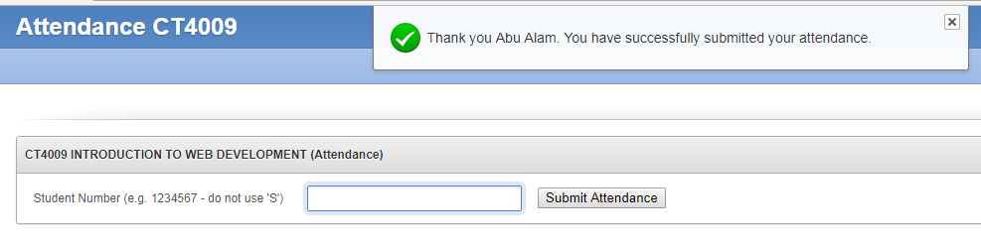
Attendance Register
We have an Electronic Online Register
Where to find: Go to Moodle and click on “Submit your attendance here”
The online register will be open at a random time during the lecture.
We will notify you as soon as the register is open (keep an eye on the TV screen)
We will keep it open for 10 minutes and you need to submit your attendance within this duration
Any problem, sign on the paper register

Slide 19
Introduction to HTML

Slide 20
Pre-assessment
Do you know HTML?
Do you know CSS?
Do you know JavaScript?
Do you know PHP?
Do you know MySQL?

Slide 21
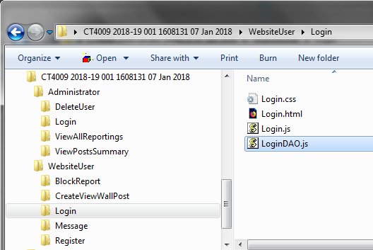
Recommended folder structure and consistent file name for the 1st assignment
Each folder should have the following four files :
<FolderName>.css
<FolderName>.html
<FolderName>.js – for event handling
<FolderName>DAO.js – DAO = Data Access Object

Slide 22
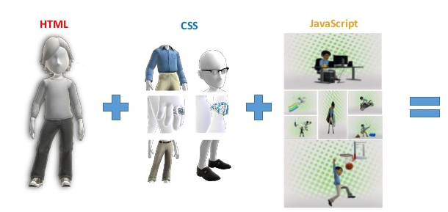
HTML, CSS and JavaScript
HTML – To define contents of a web page
CSS – To style the content
JavaScript – To interact with the content

Slide 23
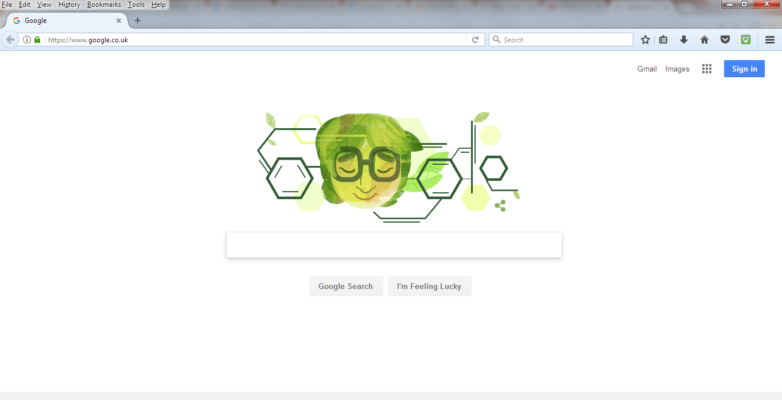
Anatomy of a web page - Open Google in Web browser
Head title
Button content
Picture content
Body
Text Input content
Button contents
Head, Title, Body, Button, Picture, everything must be defined using HTML tags. HTML tags are the hidden keywords within a web page that define how your web browser must format and display the content.

Slide 24
HTML Tags have two parts - a Opening Tag and a closing tag
Opening Tag <tagname>
Closing Tag </tagname>
Example:
<head>
</head>
<body>
</body>

Slide 25
Basic structure of an HTML document
<html>
<head>
<title> This is my first web site </title>
</head>
<body>
<h1> Hello world </h1>
other contents…………..
</body>
</html>

Slide 26
Writing Code in any languages
Two very important things to remember when writing code :
Commenting (Human Readable Descriptions inside code - make code maintenance much easier, as well as helping make finding bugs faster)
Indenting (Indentation helps to convey a better structure of a program to the readers)

Slide 27
Commenting (write anything between <!-- and -->)
<html>
<head>
<title> This is my first web site </title>
</head>
<body>
<!-- This is a comment -->
<h1> Hello world </h1>
</body>
</html>

Slide 28
Quick test - Identify the comment in this code
<html>
<head>
<title> This is my first web site </title>
</head>
<body>
<h2> h1 is a very useful tag </h2>
<!-- h1 is a very useful tag -->
<h1> Hello world </h1>
</body>
</html>

Slide 29

Indenting - the placement of text farther to the right, or left, to separate it from surrounding text
<html>
<head>
<title> This is my first web site </title>
</head>
<body>
<!-- This is a comment -->
<h1> Hello world </h1>
<p>
This article is about the capital city.
London is the capital and most populous city of England and the United Kingdom.
</p>
</body>
</html>

Slide 30
Lab work
Throughout the module, we will build an “online buy and sell website” - “Flogger”)
How many pages:
Page 1 : Login Page
Page 2 : Registration Page
Page 3 : Sell Item Page
Page 4 : List my items for sale Page (manage my items)
Page 5 : List all items for sale Page
Page 6 : Buy an Item Page
See the worksheet (CT4009_labwork_sem1_wk1.pdf) given in the moodle for details of today’s lab work.

Slide 31
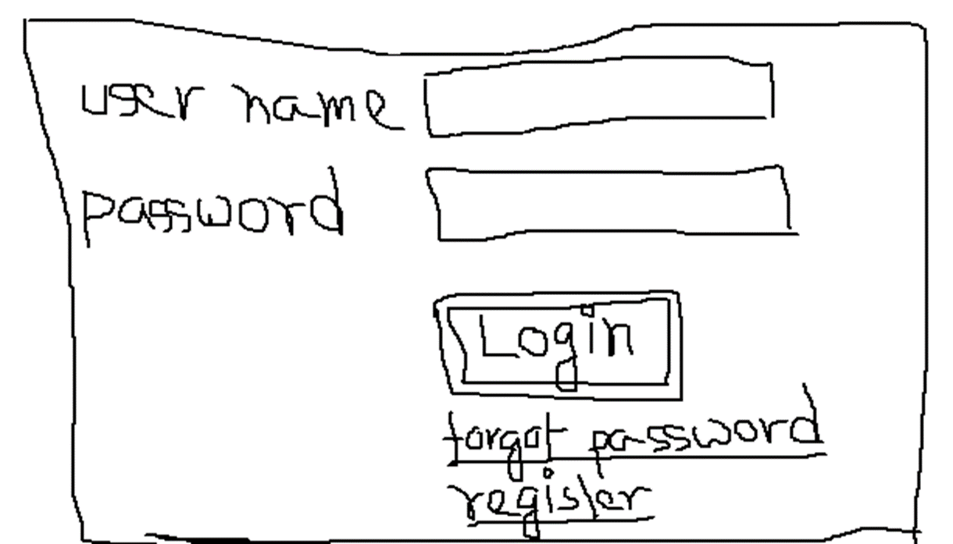
Home Work
Draw layout of the web pages required for assignment 1
Bring your sketch next week and discuss with your tutor/ support staff/ class fellow
Create the folders/sub-folders for assignment1 web pages
Create mock html pages (containing text description of their purpose and contents) required for assignment1

