Slide 1

CT4009 Introduction to Web Development
Semester 1 Week 3
Introducing CSS – Colour, Text, Boxes

Slide 2
Agenda
CSS rules and CSS exercises
home work

Slide 3

CSS Overview
BuyItem.css – Page Specific CSS
BuyItem.html
SellItem.css – Page Specific CSS
SellItem.html
Login.css – Page Specific CSS
Login.html
CSS
- Global CSS
Registration.html
Browser view
CSS rule
Code View
You can also include CSS rules within an HTML page (internal CSS).
However when building a site with more than one page you should use external CSS style sheet. This:
Allows all pages to use the same style rules (rather than repeating them in each page)
Keeps the content separate from how the page looks.
Means you can change the styles used across all pages by altering just one file.

Slide 4
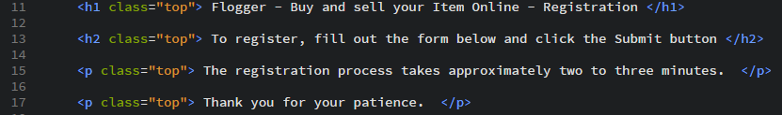
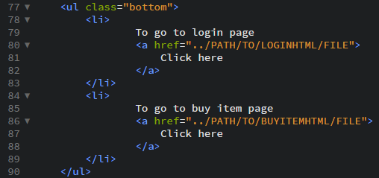
Sibling element and Child element
Sibling element example
Child element example

Slide 5
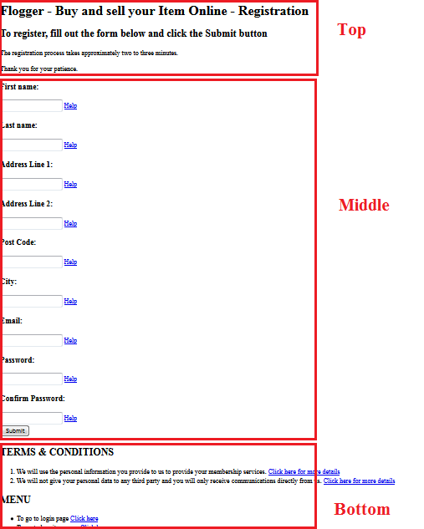
Overview of the registration page The elements in this page are classified into three categories

Slide 6
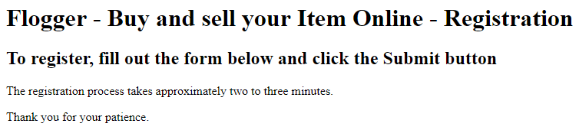
Registration page – Top Section (Code) three types of tags (h1, h2 and p) – each of the tags has a class attribute with value “top”
Browser view:
Code view:
The first <p> is adjacent sibling of <h2>
Both <p> are the general sibling of <h2>

Slide 7
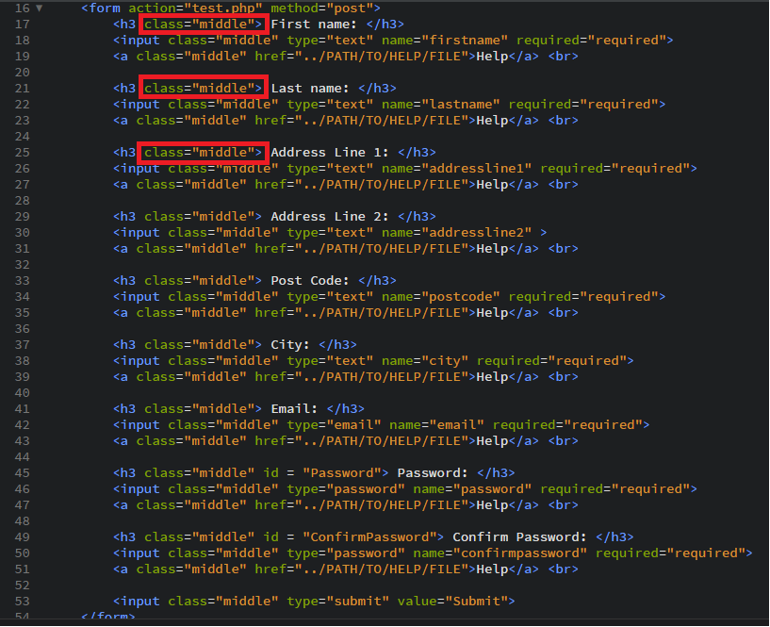
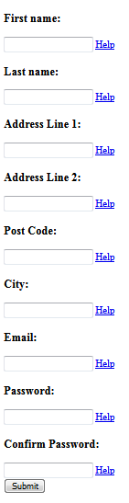
Registration page – Middle Section (Code) three types of tags (form, h3, input and a) – each of the tags has a class attribute with value “middle”.
Code view:
Browser view:

Slide 8
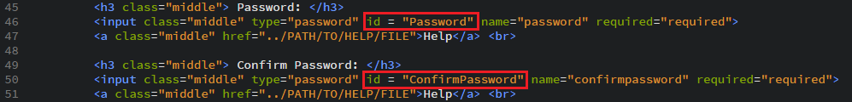
Registration page – Middle Section (Code) The password and confirm password have ID attributes.
Browser view:
Code view:

Slide 9
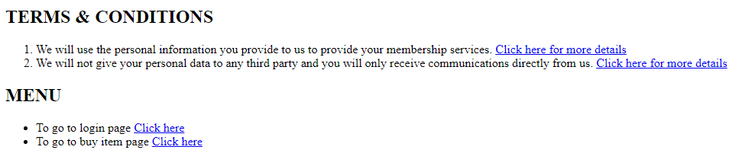
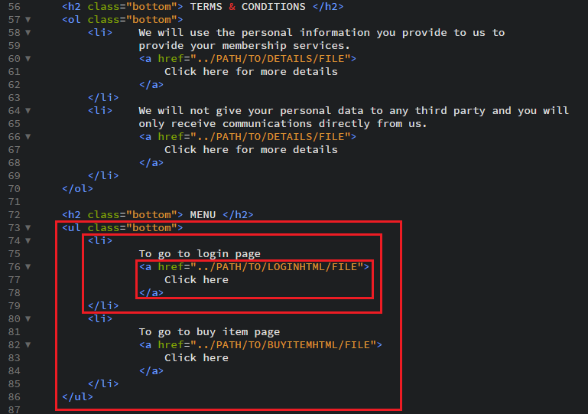
Registration page – Bottom Section (Code) three types of tags (h2, ol, li, ul and a) – some of the tags has a class attribute with value “bottom”
Browser view:
Code view:
<li> is direct child of <ul>
<a> is the direct child of <li>, but is a descendant of <ul>

Slide 10
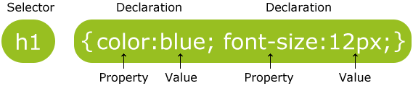
CSS rules – Selector and Declaration
How CSS work: CSS works by associating rules with HTML elements/tags. These rules govern how the content of specified element should be displayed. A CSS rule contains two parts: a selector and a declaration.
This rule indicates that all <h1> elements should be shown in the blue and font-size 12
Selectors indicate which element/tag the rule applies to. The same rule can apply to more that one element if you separate the element names with commas.
Declarations indicate which the elements/tags referred to in the selector should be styled. Declarations are split into two parts (a property and a value), and are separated by colon

Slide 11
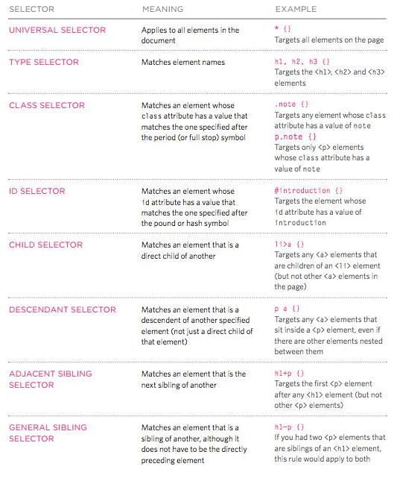
CSS Selectors There are many different types of CSS Selector that allow you to target rules to specific elements in an HTML document.

Slide 12
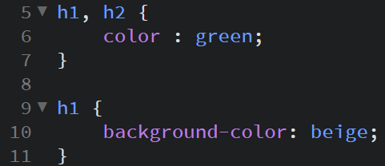
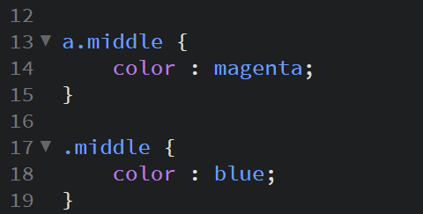
How CSS rule cascade
If there are two or more rules that apply to the same element, it is important to know which rule will take precedence.
LAST RULE
If the two selectors are identical, the later of the two will take precedence. Here you will see,
the second h1 selector takes precedence over first.
SPECIFICTY
If one selector is more specific than the others, the more specific rule will take precedence over more general ones. In this example,
a.middle is more specific than .middle

Slide 13
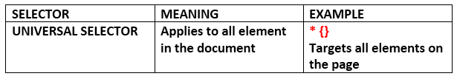

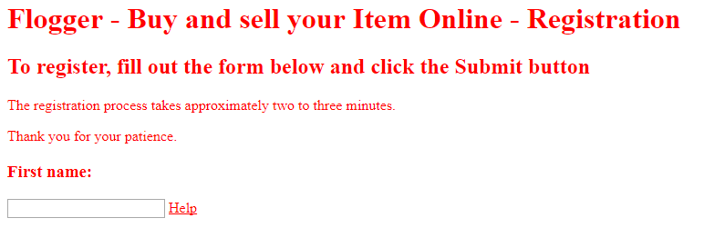
Task 1 – UNIVERSAL SELECTOR
CSS Code
HTML Code
To link the CSS
Expected result

Slide 14
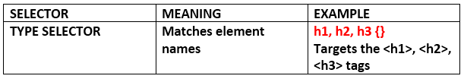

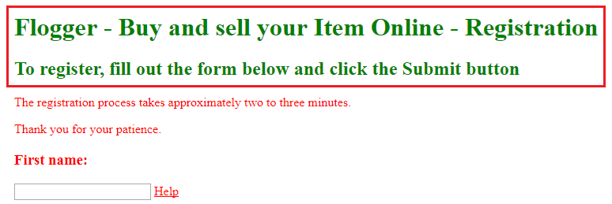
Task 2 – TYPE SELECTOR
CSS Code
Expected result

Slide 15
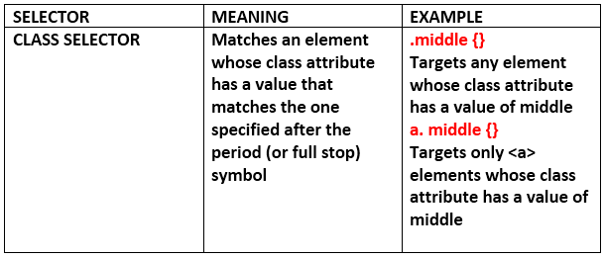

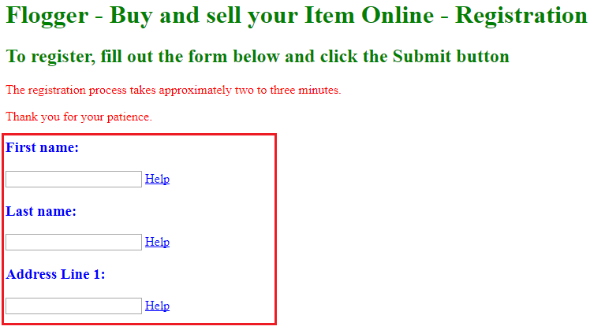
Task 3 – CLASS SELECTOR
CSS Code
Expected result

Slide 16
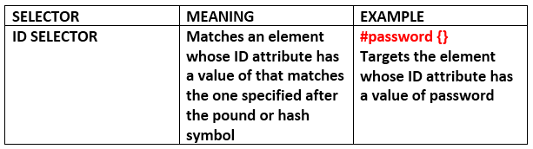

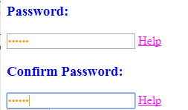
Task 4 – ID SELECTOR
CSS Code
Expected result

Slide 17
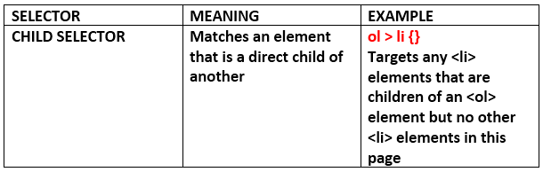

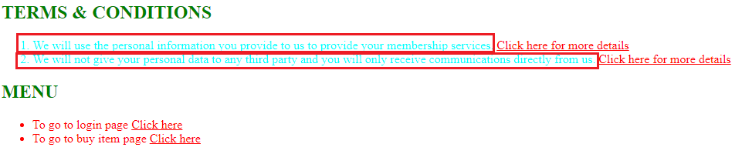
Task 5 – CHILD SELECTOR
CSS Code
Expected result
17

Slide 18
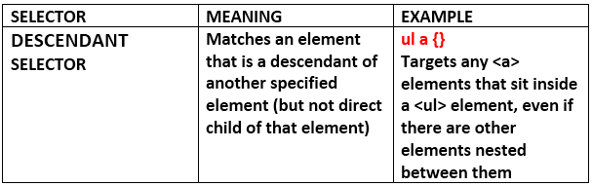

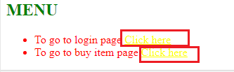
Task 6 – DESCENDANT SELECTOR
CSS Code
Expected result
18

Slide 19
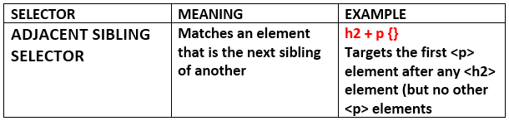

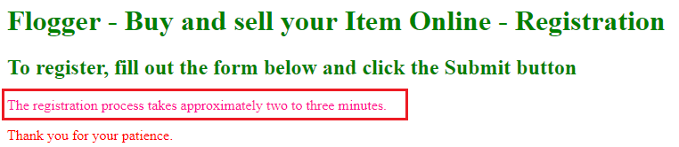
Task 7 – ADJACENT SIBLING SELECTOR
CSS Code
Expected result
19

Slide 20
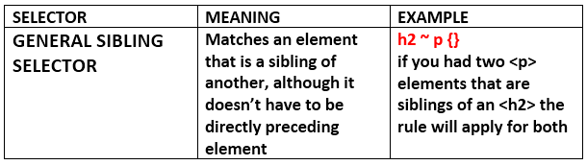

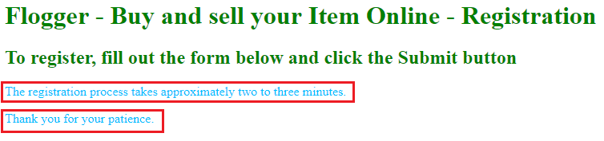
Task 8 – GENERAL SIBLING SELECTOR
CSS Code
Expected result
20

Slide 21
Home Work
Look at the “important” keyword that you can use with any CSS property
Go to https://www.w3schools.com/cssref/ and look for other CSS properties such as foreground colour, background colour, contrast, opacity, RGB, HSL, font-size, font-spacing, text-shadow, border, margin etc
Complete HTML pages required for the assignment

