Slide 1

CT4009 Introduction to Web Development
Semester 1 Week 7
Local Storage, Call-Back Function

Slide 2
Agenda
Call-back function
Local Storages
Web Hosting
Lab work/ Home Work

Slide 3
Call-Back Function

Slide 4

Example 1 - A “Mile to KM converter” web page
Using Normal Function.

Slide 5
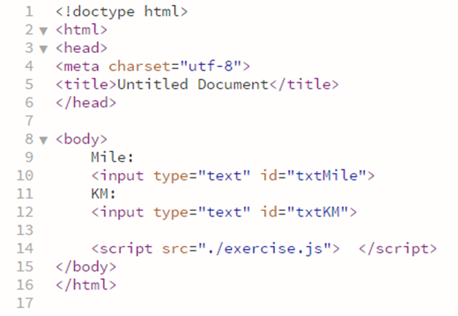
Example 1 – HTML code

Slide 6
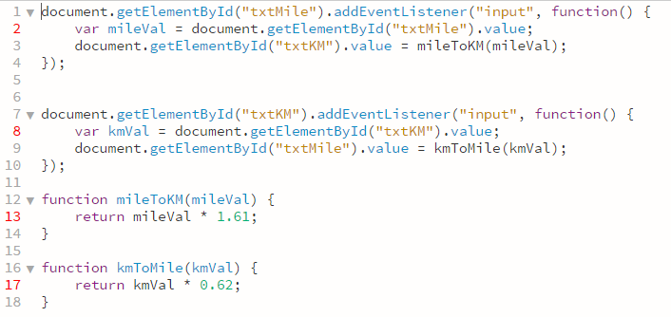
Example 1 – Javascript code

Slide 7
Example 2 - Update “Mile to KM converter” using callback function Pass Value to Callback Functions

Slide 8
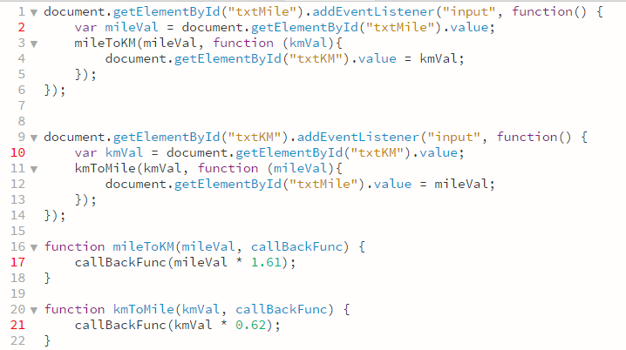
Example 2 – Javascript code

Slide 9
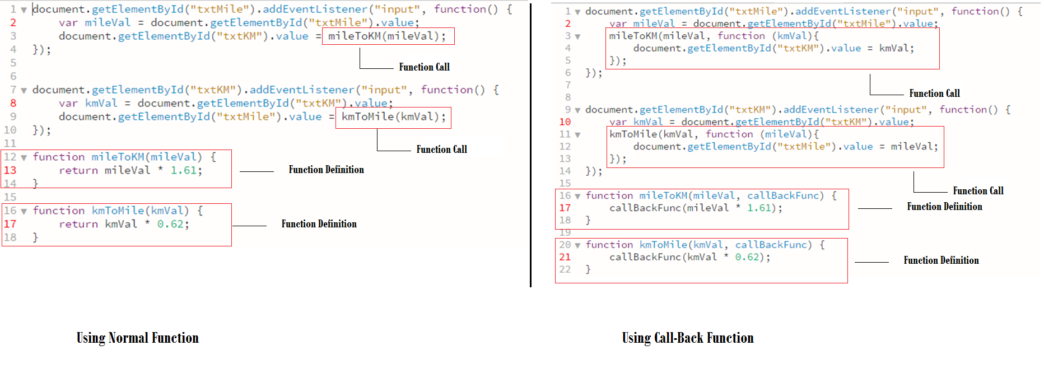
Example1 VS Example2

Slide 10
Local Storages

Slide 11
Client Storage for Web applications
LocalStorage/ SessionStorage
WebSQL
IndexedDB
Notes:
you don’t want to force people to sign up?

Slide 12
LocalStorage/ SessionStorage
Advantages
Its simple, synchronous API means it is easy to use.
Disadvantages
Only stores strings, so complex data structures have to be serialized, and only data that can be serialized can be stored.
Performs poorly with large amounts of data. In particular:
The lack of indexing means searches require manually iterating all data.
Storing large or complex items is slow due to the need to serialize/de-serialize.
Synchronous API means calls will lock up the user interface.
Limited total amount of storage (typically around 5MB).
iOS stores localStorage data in a location that may be cleaned out by the OS when space is required

Slide 13
WebSQL
Advantages
Good performance - data can be indexed to provide fast searches, and asynchronous API means it doesn't lock up the user interface.
Robustness from using a transactional database model.
Support for versioning.
Disadvantages
More complex to work with than LocalStorage or IndexedDB.
The API is deprecated. It is unlikely to ever be supported on platforms that don't currently support it, and it may be removed from platforms that do.
Imposes a rigid structure that must be defined up-front.
Limited total amount of storage (typically around 5MB).

Slide 14
IndexedDB
Advantages
Good performance - asynchronous API won't block the UI, and indexing provides good search performance.
Simple data model easier to learn than SQL.
More flexible structure than WebSQL.
Multiple databases and object stores provides more structure than LocalStorage.
Robustness from using a transactional database model.
Support for versioning.
Disadvantages
No/ buggy support on iOS.
Complex API with nested callbacks.
For IndexedDB, one can use up to 50MB on desktop, 5MB on mobile for free. However, the user can allow the limit to be removed by granting permission.

Slide 15
IndexedDB features
Other IndexedDB features
Object-Oriented
Not a relational database
callback function to get the returning data
No access of data from a different origin
IndexedDB does not use SQL
Main 3 features
Asynchronous
Transactional
key-value object store
https://developer.mozilla.org/en-US/docs/Web/API/IndexedDB_API

Slide 16
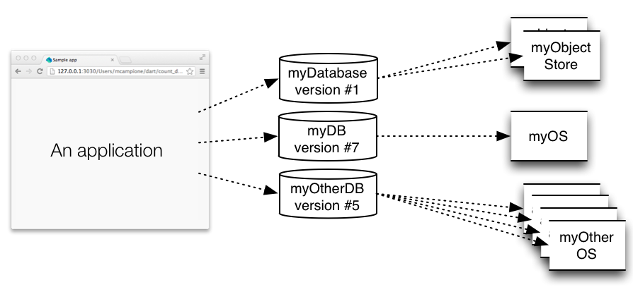
IndexedDB Structure

Slide 17
IndexedDB API
Check Browser’s Support
window.indexedDB = window.indexedDB
|| window.mozIndexedDB
|| window.webkitIndexedDB
|| window.msIndexedDB;
if (!window.indexedDB) {
window.alert("Your browser doesn't support a stable version of IndexedDB. Such and such feature will not be available.");
}

Slide 18
IndexedDB OPENING THE DATABASE
Opening a database is done using indexedDB.open() var request = indexedDB.open("myDatabase"); request.onerror = function(event) {
// Do something with request.errorCode!
};
request.onsuccess = function(event) {
// Do something with event.target.result!
};

Slide 19
IndexedDB Sample data
var myBook1 = { isbn: "1234567890", name: "Programming the Web"};
var myBook2 = { isbn: "9780132575669", name: "Java How to Program"};

Slide 20
IndexedDB create object store
Creating object store using event (onupgradeneeded) and function (open) var request = indexedDB.open("myDatabase"); request.onupgradeneeded = function(event) { var database = event.target.result; // Let's create the object store for books var objectStore = database.createObjectStore("books", { keyPath:"isbn" });
}

Slide 21
IndexedDB API
Adding data to object-store (transaction and add function)
var myBook1 = { isbn: "1234567890", name: "Programming the Mobile Web"};
var myBook2 = { isbn: "9780132575669", name: "Java How to Program"};
var transaction = database.transaction(["books“], 'readwrite');
transaction.objectStore("books").add(myBook1);
transaction.objectStore("books").add(myBook2);

Slide 22
Recap - In the Flogger website, we used an Indexeddb wrapper (lib/js/indexedDB.js)
Functions
startDB
setCurrentObjectStoreName
insertOne
selectAll
deleteOne
updateOne
selectOne

Slide 23
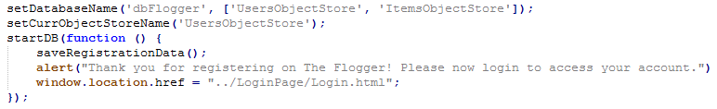
Using indexeddb.js in Flogger

Slide 24
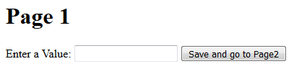

Example 3 - A session storage example – to enter and store a value in the first page and access the value from the second page

Slide 25
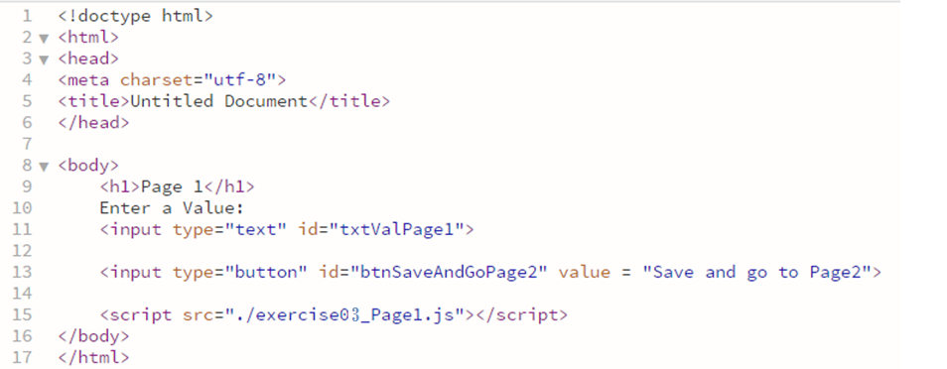
Example 3 – Page 1 - HTML code

Slide 26
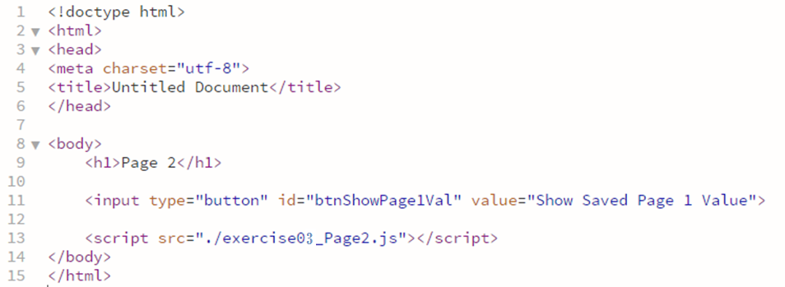
Example 3 – Page 2 - HTML code

Slide 27
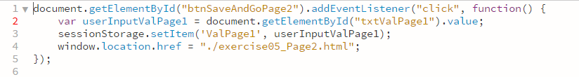
Example 3 – Page 1 - Javascript code

Slide 28
Example 3 – Page 2 - Javascript code

Slide 29
Lab Work - 1
Try Example 1, 2 and 3 demonstrated earlier

Slide 30
Lab Work - 2
See Web Hosting Worksheet

Slide 31
Lab Work - 3
Fix the bugs in the Update Registration Details Page
Go to “OnlineBuySell- Wk7 2017” folder
Open registration.html in a browser and register an user. It will redirect you to the login.html
Log in to the site as the user you just created and it will redirect you to the UpdateRegistrationDetails.html page
Go to browser developer tools and go to the console tab
You will see some error messages, try to fix the errors

Slide 32
Home Work
Implement javascript code for your assignment project (social-media website)

