Slide 1

CT4009 Introduction to Web Development
Semester 2 Week 1
Introduction to Assessment 2

Slide 2

First Semester assignment was ….
Implementation of Social-Media website using Local Storage
Use cases of Local Storage:
Offline messages
Offline friend list/ contact list
Offline pictures
Offline browsing
Storing login credential
Storing item names searched by user
Etc
Also, to understand security vulnerabilities of local storages, first you need understand how data are stored locally.

Slide 3
Objectives for the second Semester
Implementation of Social-Media website using Server Storage and Server-side language
Build on your HTML, Javascript and CSS knowledge
Introduce server side languages; PHP and MySQL
Students form small coding teams

Slide 4

Assessment 2 - Implement the Assessment 1 features using Server Side Languages
Register (create an account)
Login to the system
login
Delete any user
Create wall posts …..
View a report that shows number of posts made by Website users ….
Administrator
website users
Send/ receive messages
View all reports made by Website users ….
Block/ unblock and report friends ….

Slide 5
Some additional features:
The following additional features should also be included:
Marketplace (such as eBay) advertisements will appear on social media website pages.
Administrators can view heat map of social media posts locations in a google map
Social media users can deactivate their account
Social media users can create event (such as party, function etc), invite friends and see which friends are gathering

Slide 6
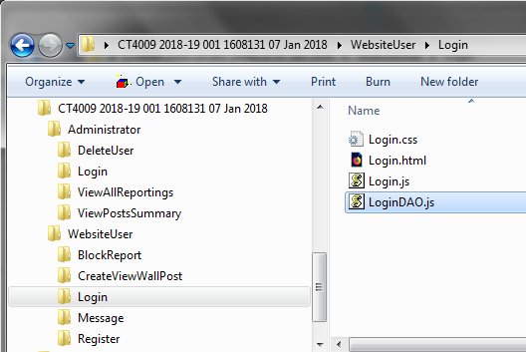
Recommended folder structure and consistent file name for the 2nd assignment
Each folder should have the following four files :
<FolderName>.css
<FolderName>.html
<FolderName>.js – for event handling
<FolderName>DAO.js = Data Access Object
<FolderName>DAO.php = Data Access Object
CHANGE
We will use flogger example from week 4

Slide 7

CT4009 Semester 2 Resources…
https://glos-on-worldcat-org.glos.idm.oclc.org/oclc/951926621
LARRY ULLMAN 5th EDITION

Slide 8
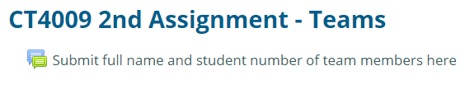
Project Planning…
Teams of two/three (recommended three) students – please choose by Next Monday the 21st of January, 2019 and submit team details to Moodle!
Develop a project plan ensuring you effectively monitor and track the contribution of each team member.
Assignment 2 comprises 13 pages (Reuse the 9 HTML, Javascript, CSS from Assignment 1)
HTML, CSS, Javascript, PHP, MySQL, Google map and eBay API (as applicable).

Slide 9
Sample Project Template…
Task | Description | Duration | Start | End | Developer | Status | RAG
1 | Login Page (HTML) | 5 days | 1 Feb | 6 Feb | John | Ongoing
TOTAL Duration |  | xx Days | Not after Assignment 2 deadline!

Slide 10
Scheme of Work
14 Jan 19 | Introduction to Assessment 2, Introduction to PHP | PHP Practical exercises | Lecture: AB Lab: AA/Student Support
21 Jan 19 | Creating Dynamic Website using PHP | PHP Practical exercises | Lecture: AB Lab: AA/Student Support
28 Jan 19 | Introduction to SQL and MySQL | SQL and MySQL Practical exercises | Lecture: AB Lab: AA/Student Support
04 Feb 19 | Advanced SQL and MySQL | SQL and MySQL Practical exercises | Lecture: AB Lab: AA/Student Support
11 Feb 19 | University YFP Week
18 Feb 19 | Error Handling and Debugging | PHP Practical exercises | Lecture: AB Lab: AA/Others
25 Feb 19 | Using PHP with MySQL | PHP and MySQL Practical exercises | Lecture: AB Lab: AA/ Others
04 Mar 19 | Cookies and Sessions | PHP Practical exercises | Lecture: AA Lab: AB/ Others
11 Mar 19 | Web Application Security | PHP Practical exercises | Lecture: AA Lab: AB/ Others
18 Mar 19 | Computing YFP Week
25 Mar 19 | Create dynamic markers in Google Map | PHP, Google Map Practical exercises | Lecture: AA Lab: AB/ Others
01 Apr 19 | eBay API | eBay API Practical exercises | Lecture: AA Lab: AB/ Others
08 Mar 19 | Testing | Testing exercises | Lecture: AA Lab: AB/ Others
15 Apr – 26 Apr 19 | Easter Holiday (2 weeks)
29 Apr 19 | Assignment Workshop | Assignment Workshop | Team
CT4009 Assignment 2 Submission – Monday 13th of May, 2019

Slide 11
Assessment 2 - Report:
80% of your mark will be allocated for the team’s submission as a whole, but you will receive a reduced mark if it is evident that you haven’t sufficiently contributed or engaged.
20% of your mark will be allocated for a personal statement.

Slide 12
The team’s submission should include the following:
The URL of your hosted web site.
The URL, user name and password of your control panel.
A table containing the list of functional and non-functional pages.
Evidence that you have understood web technologies by showing interesting examples of HTML, CSS, Javascript, PHP, MySQL, Google map and eBay API code used in implemented pages.
A concise User Manual targeted at the key users (website user and administrator). This should be task oriented and demonstrate good consideration of appropriate style. Relevant books on user manual style available from the Learning Centre include: “Read Me First”, and “Developing Quality Technical Information” – please use these.
Documented evidence of the testing strategy you used to test the web site’s functionality throughout its development.
Discuss business values of different features of your implemented social media web-site
Outline what security measures you have taken to implement the website
Reference List. Don’t forget that all code and ideas that are not your own must be fully acknowledged and used in accordance with any applicable restrictions. Use Harvard referencing.
Appendix 1: Screenshot of all implemented web pages
Appendix 2: All Source code (HTML, CSS, Javascript, PHP, MySQL database build code)

Slide 13
The total number of words of the team’s submission
The total number of words of the team’s submission must not exceed 3000 words (for team of 2 students) or 4500 words (for team of 3 students). You will be penalised according to the Academic Regulations for Taught Provision if you exceed the size limit.

Slide 14
Personal statement
Your personal statement should include the following:
explain how you contributed to the team; what tasks you worked on;
what you learned; and why you feel you contributed equitably to the team workload.
The total number of words of the personal statement must not exceed 500 words. You will be penalised according to the Academic Regulations for Taught Provision if you exceed the size limit.

