Slide 1
RDMA Deployments: From Cloud Computing to Machine Learning
Chuanxiong Guo
Microsoft Research
Hot Interconnects 2017
August 29 2017

Slide 2
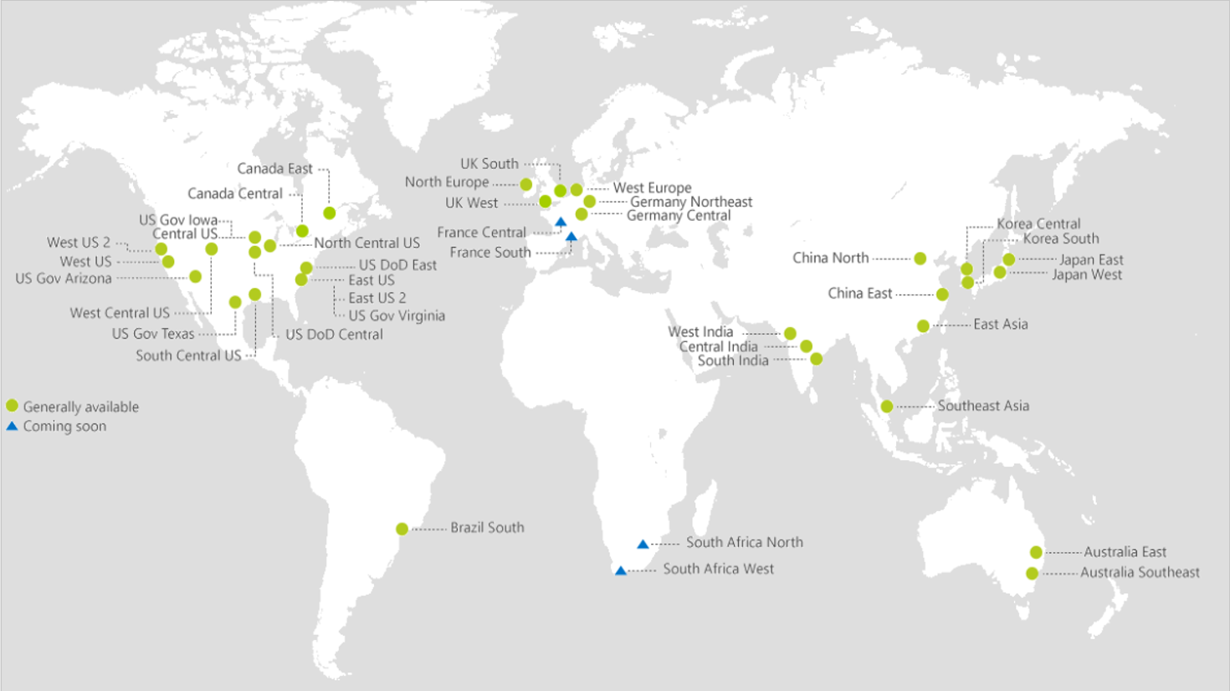
The Rising of Cloud Computing
40
AZURE REGIONS

Slide 3
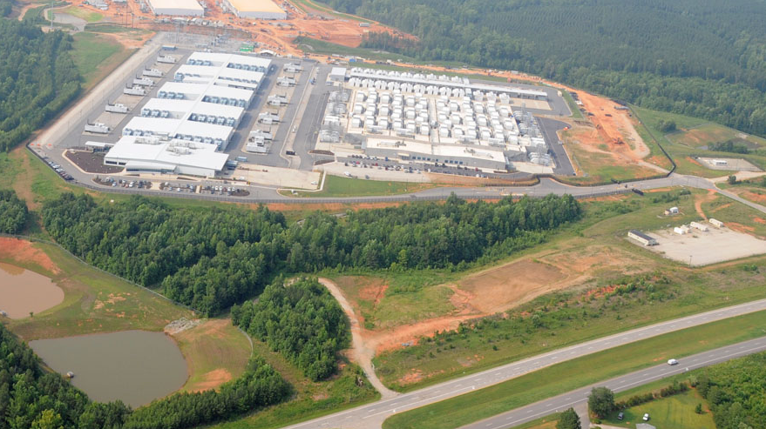
Data Centers

Slide 4
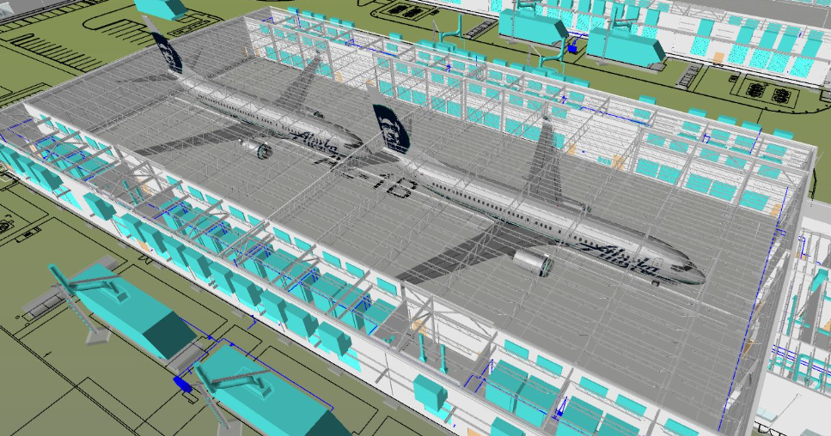
Data Centers

Slide 5
Data center networks (DCN)
Cloud scale services: IaaS, PaaS, Search, BigData, Storage, Machine Learning, Deep Learning
Services are latency sensitive or bandwidth hungry or both
Cloud scale services need cloud scale computing and communication infrastructure

Slide 6
Data center networks (DCN)
Spine
Single ownership
Large scale
High bisection bandwidth
Commodity Ethernet switches
TCP/IP protocol suite
Podset
Leaf
Pod
ToR
Servers

Slide 7
But TCP/IP is not doing well

Slide 8
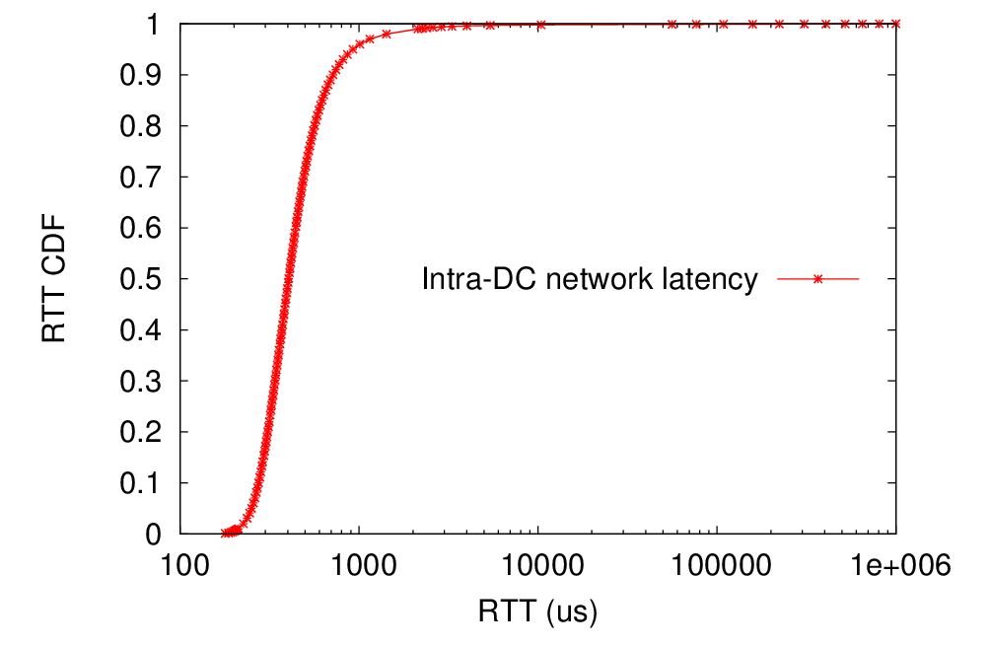
TCP latency
Long latency tail
2132us (P99)
716us (P90)
Pingmesh measurement results
405us (P50)

Slide 9
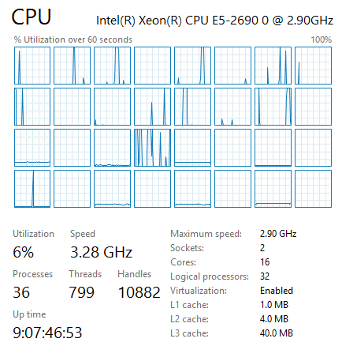
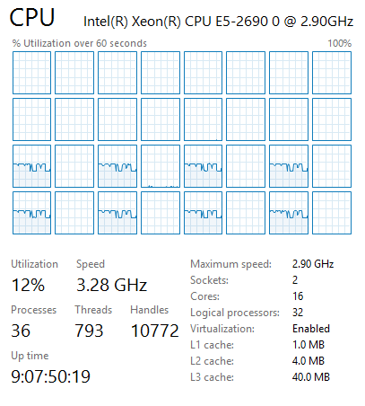
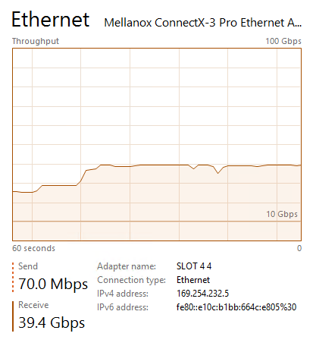
TCP processing overhead (40G)
Sender
Receiver
8 tcp connections
40G NIC

Slide 10
An RDMA renaissance story
Notes:
Apparently, TCP has severe latency and CPU overhead issues. RDMA, a technology that has been introduced for around 20 years for high performance computing, finally got its chance.

Slide 11
RDMA
Remote Direct Memory Access (RDMA): Method of accessing memory on a remote system without interrupting the processing of the CPU(s) on that system
IBVerbs/NetDirect for RDMA programing
RDMA offloads packet processing protocols to the NIC
RDMA in Ethernet based data centers (RoCEv2)

Slide 12
RoCEv2: RDMA over Commodity Ethernet
RDMA app
RDMA app
User
RoCEv2 for Ethernet based data centers
RoCEv2 encapsulates packets in UDP
OS kernel is not in data path
NIC for network protocol processing and message DMA
RDMA verbs
RDMA verbs
TCP/IP
TCP/IP
Kernel
NIC driver
NIC driver
RDMA transport
RDMA transport
DMA
DMA
Hardware
IP
IP
Ethernet
Ethernet
Lossless network

Slide 13
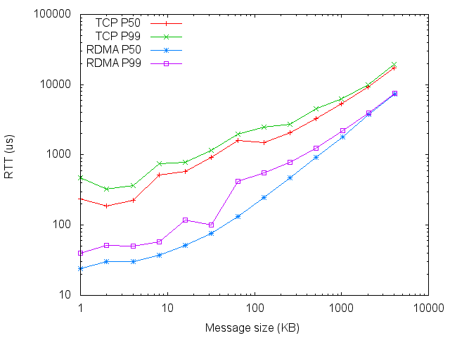
RDMA benefit: latency reduction
Msg size | TCP P50 (us) | TCP P99 (us) | RDMA P50 (us) | RDMA P99 (us)
1KB | 236 | 467 | 24 | 40
16KB | 580 | 788 | 51 | 117
128KB | 1483 | 2491 | 247 | 551
1MB | 5290 | 6195 | 1783 | 2214
For small msgs (<32KB), OS processing latency matters
For large msgs (100KB+), speed matters

Slide 14
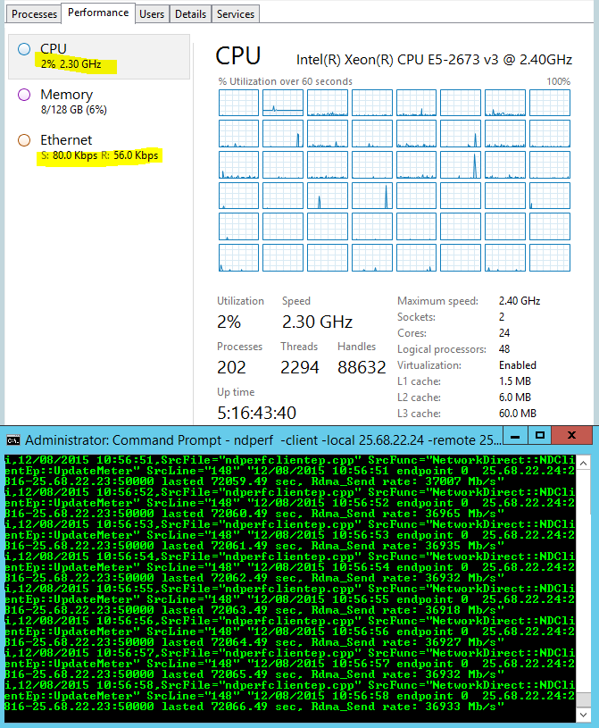
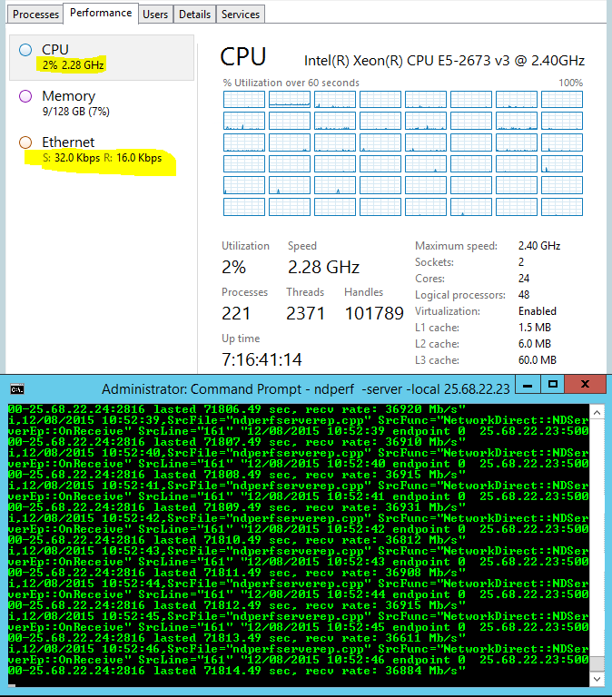
RDMA benefit: CPU overhead reduction
Sender
Receiver
One ND connection
40G NIC
37Gb/s goodput

Slide 15
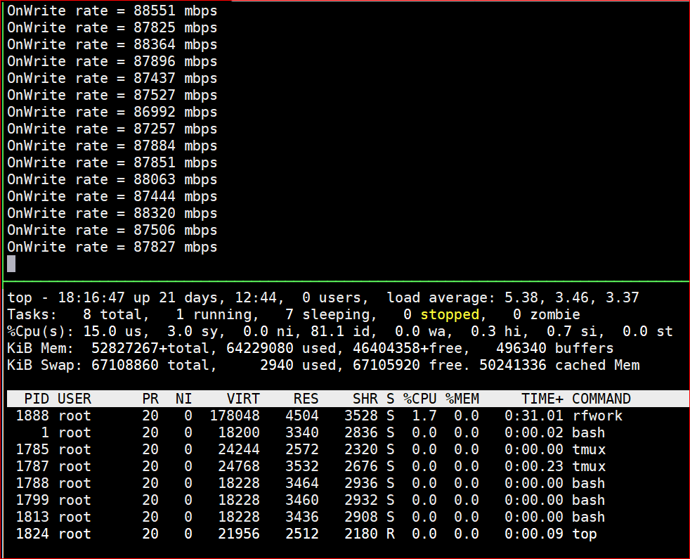
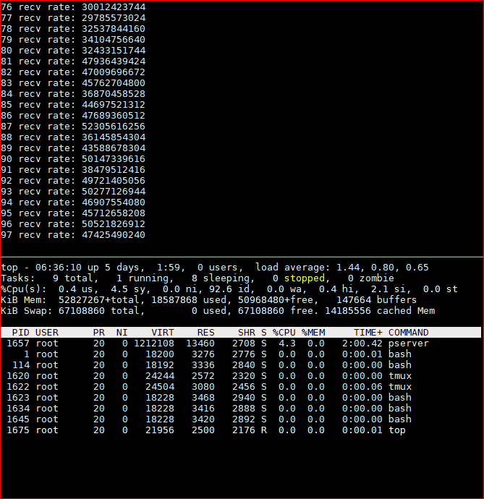
RDMA benefit: CPU overhead reduction
Intel(R) Xeon(R) CPU E5-2690 v4 @ 2.60GHz, two sockets 28 cores
RDMA: Single QP, 88 Gb/s, 1.7% CPU
TCP: Eight connections, 30-50Gb/s,
Client: 2.6%, Server: 4.3% CPU

Slide 16
RoCEv2 needs a lossless Ethernet network
PFC for hop-by-hop flow control
DCQCN for connection-level congestion control

Slide 17
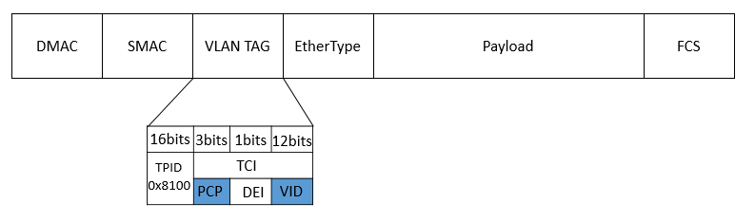

Priority-based flow control (PFC)
Egress port
Ingress port
Data packet
Hop-by-hop flow control, with eight priorities for HOL blocking mitigation
The priority in data packets is carried in the VLAN tag
PFC pause frame to inform the upstream to stop
PFC causes HOL and colleterial damage
p0
p0
p0
p1
p1
p1
p7
PFC pause frame
p7
XOFF threshold
Data packet
PFC pause frame

Slide 18
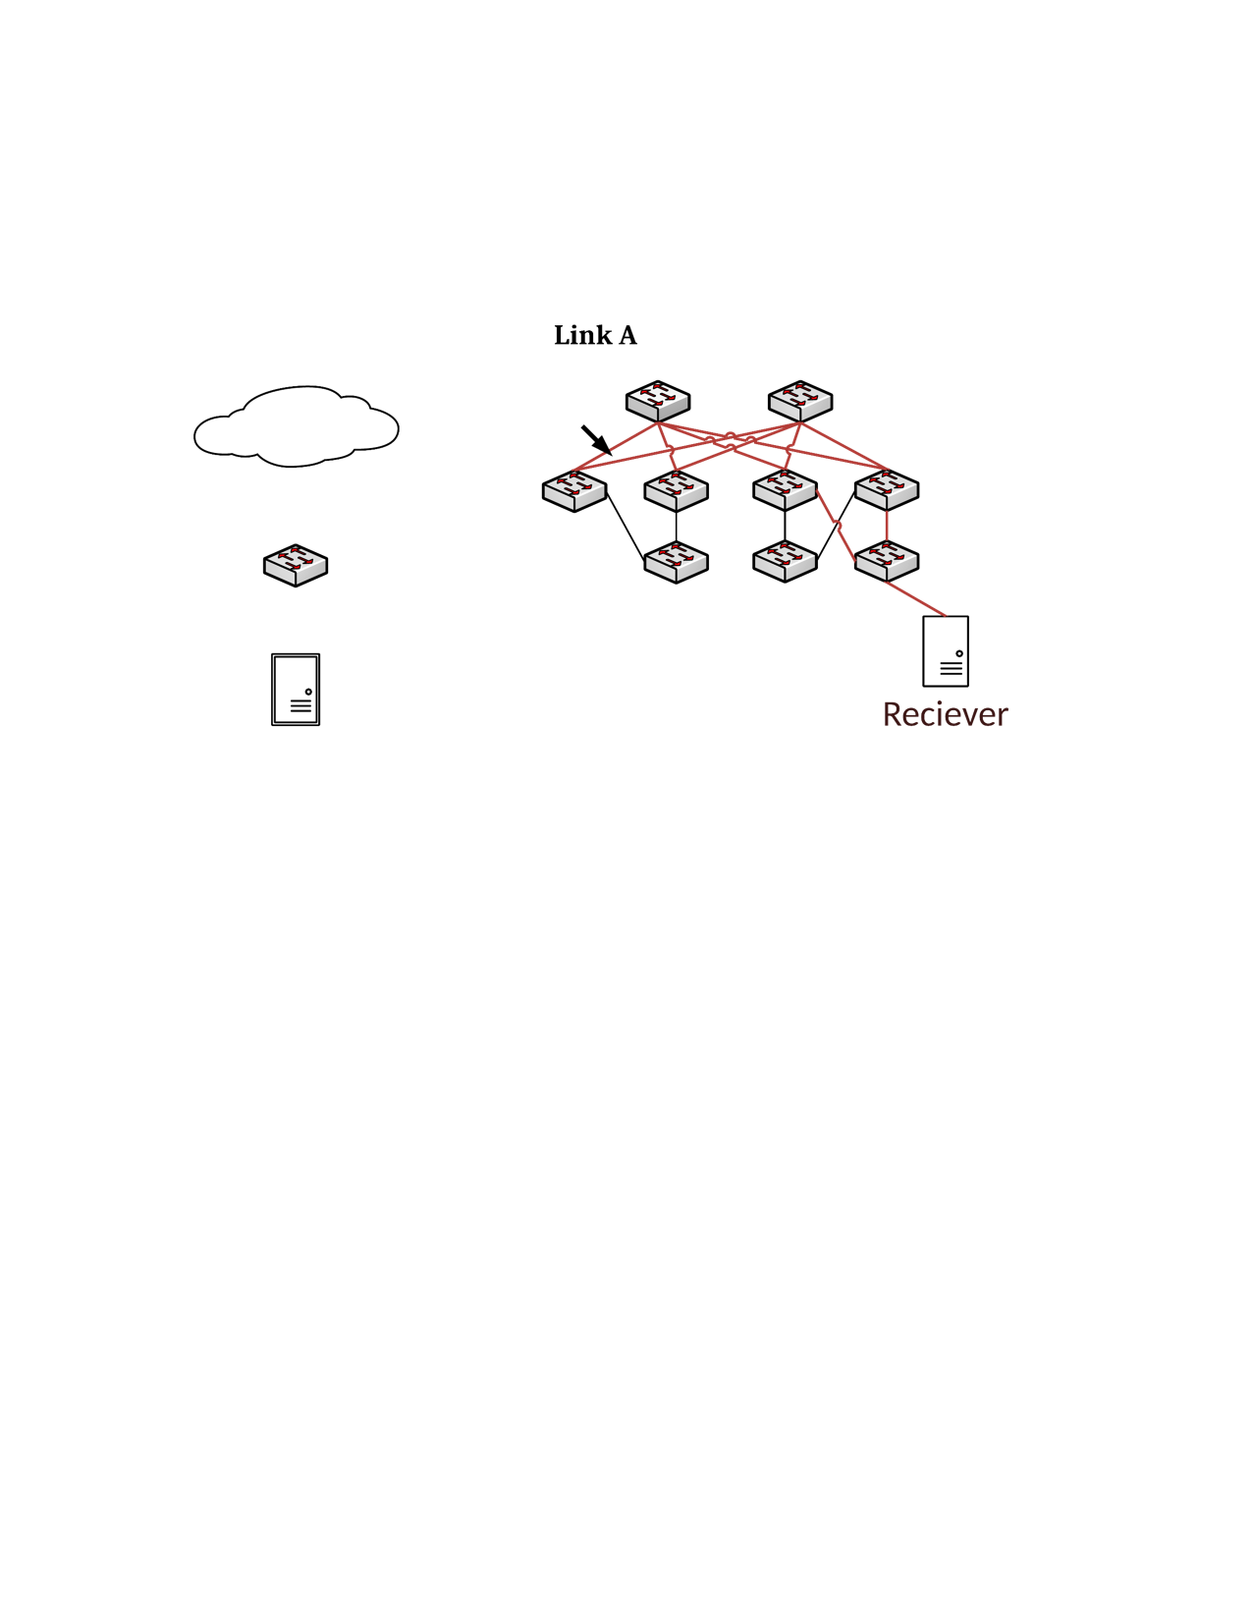
DCQCN
Sender NIC
Reaction Point
(RP)
Switch
Congestion Point (CP)
Receiver NIC
Notification Point (NP)
DCQCN = Keep PFC + Use ECN + hardware rate-based congestion control
CP: Switches use ECN for packet marking
NP: periodically check if ECN-marked packets arrived, if so, notify the sender
RP: adjust sending rate based on NP feedbacks

Slide 19
The deployment, safety, and performance challenges
Issues of VLAN-based PFC
RDMA transport livelock
PFC deadlock
PFC pause frame storm
Slow-receiver symptom

Slide 20
Issues of VLAN-based PFC
PS Service
Our data center networks run L3 IP forwarding, no standard way for carrying VLAN tags among the switches in L3 networks
VLAN config breaks PXE boot
TOR Switch
Trunk mode for VLAN tag
NIC
No VLAN tag when PXE boot

Slide 21
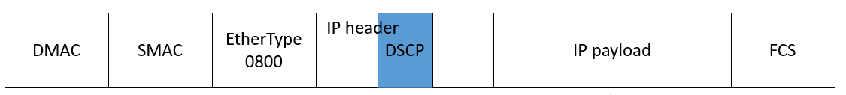
Our solution: DSCP-based PFC
DSCP field for carrying the priority value
No change needed for the PFC pause frame
Supported by major switch/NIC venders
Data packet
PFC pause frame

Slide 22
RDMA transport livelock
Receiver
Sender
Receiver
Sender
RDMA Send 0
RDMA Send 0
Switch
RDMA Send 1
RDMA Send 1
Pkt drop rate 1/256
RDMA Send N+1
RDMA Send N+1
Sender
Receiver
RDMA Send N+2
RDMA Send N+2
NAK N
NAK N
RDMA Send 0
RDMA Send N
RDMA Send 1
RDMA Send N+1
RDMA Send 2
RDMA Send N+2
Go-back-0
Go-back-N

Slide 23
PFC deadlock
Our data centers use Clos network
Packets first travel up then go down
No cyclic buffer dependency for up-down routing -> no deadlock
But we did experience deadlock!
Spine
Podset
Leaf
Pod
ToR
Servers

Slide 24
PFC deadlock
Preliminaries
  ARP table: IP address to MAC address mapping
  MAC table: MAC address to port mapping
  If MAC entry is missing, packets are flooded to all ports
Input
ARP table
IP | MAC | TTL
IP0 | MAC0 | 2h
IP1 | MAC1 | 1h
MAC table
MAC | Port | TTL
MAC0 | Port0 | 10min
MAC1 | - | -
Dst: IP1
Output

Slide 25
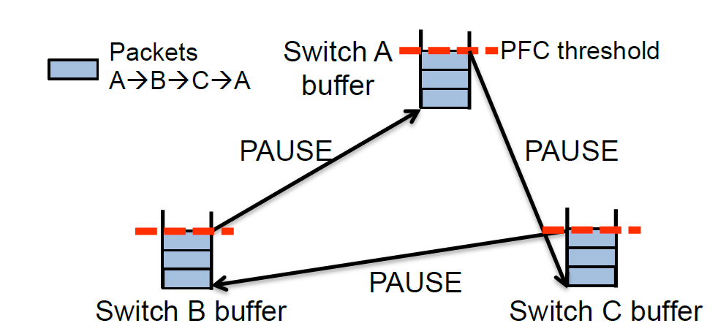
PFC deadlock (simplest case)
1. Hu S , Zhu Y , Cheng P , et al. Deadlocks in Datacenter Networks: Why Do They Form, and How to Avoid Them[C]// Acm Workshop. ACM, 2016.

Slide 26
PFC deadlock
Path: {S1, T0, La, T1, S3}
La
Lb
Path: {S1, T0, La, T1, S5}
p0
p1
p0
p1
Path: {S4, T1, Lb, T0, S2}
PFC pause frames
2
3
1
4
Congested port
p2
p3
p3
p4
Ingress
port
T0
T1
p0
p1
p0
p1
p2
Egress
port
Dead server
Packet drop
PFC pause frames
Server
S1
S2
S3
S4
S5
Notes:
通过在T1.p4的蓝包的传导，建立了T1.P3和T0.P2的紫色包的依懒性

Slide 27
PFC deadlock
The PFC deadlock root cause: the interaction between the PFC flow control and the Ethernet packet flooding
Solution: drop the lossless packets if the ARP entry is incomplete
Recommendation: do not flood or multicast for lossless traffic

Slide 28
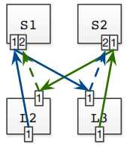
Tagger: practical PFC deadlock prevention
S0
S1
S0
S1
L0
L1
L2
L3
L0
L1
L2
L3
T0
T1
T2
T3
T0
T1
T2
T3
Tagger Algorithm works for general network topology
Deployable in existing switching ASICs
Concept: Expected Lossless Path (ELP) to decouple Tagger from routing
Strategy: move packets to different lossless queue before CBD forming with pre-calculated rules

Slide 29
NIC PFC pause frame storm
Spine layer
A malfunctioning NIC may block the whole network
PFC pause frame storms caused several incidents
Solution: watchdogs at both NIC and switch sides to stop the storm
Podset 0
Podset 1
Leaf layer
ToRs
0
1
2
3
4
5
6
7
servers
Malfunctioning NIC

Slide 30
The slow-receiver symptom
ToR to NIC is 40Gb/s, NIC to server is 64Gb/s
But NICs may generate large number of PFC pause frames
Root cause: NIC is resource constrained
Mitigation
  Large page size for the MTT (memory translation table) entry
  Dynamic buffer sharing at the ToR
Server
CPU
DRAM
PCIe
Gen3 8x8 64Gb/s
QSFP
40Gb/s
WQEs
MTT
ToR
QPC
NIC
Pause frames

Slide 31
Deployment experiences and lessons learned

Slide 32
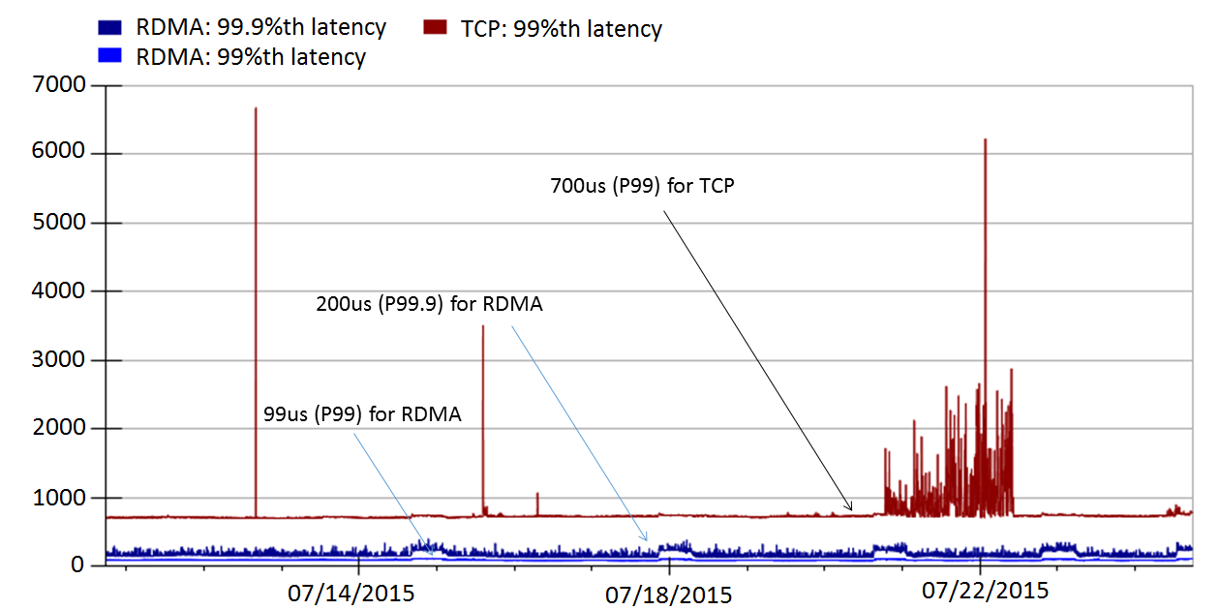
Latency reduction
RoCEv2 deployed in Bing world-wide for two and half years
Significant latency reduction
Incast problem solved as no packet drops

Slide 33
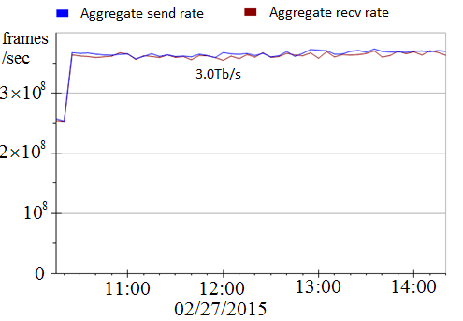
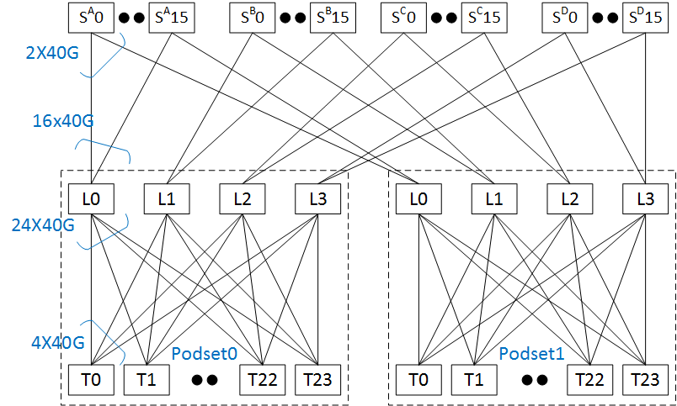
RDMA throughput
Using two podsets each with 500+ servers
5Tb/s capacity between the two podsets
Achieved 3Tb/s inter-podset throughput
Bottlenecked by ECMP routing
Close to 0 CPU overhead

Slide 34
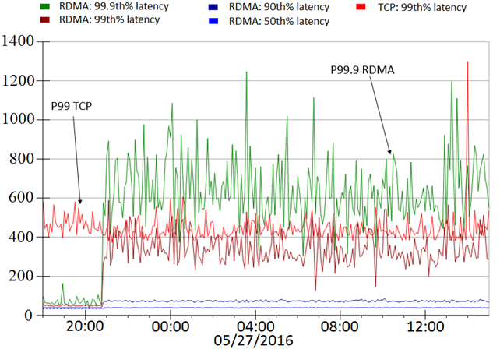
Latency and throughput tradeoff
us
L0
L1
L1
L1
T0
T1
S0,0
S0,23
S1,0
S1,23
RDMA latencies increase as data shuffling started
Low latency vs high throughput
Before data shuffling
During data shuffling

Slide 35
Lessons learned
Providing lossless is hard!
Deadlock, livelock, PFC pause frames propagation and storm did happen
Be prepared for the unexpected
  Configuration management, latency/availability, PFC pause frame, RDMA traffic monitoring
NICs are the key to make RoCEv2 work

Slide 36
What’s next?

Slide 37
Applications
Architectures
Software vs hardware
RDMA for X (Search, Storage, HFT, DNN, etc.)
Lossy vs lossless network
RDMA for heterogenous computing systems
Technologies
Protocols
RDMA programming
Practical, large-scale deadlock free network
RDMA virtualization
RDMA security
Reducing colleterial damage
Inter-DC RDMA

Slide 38
Will software win (again)?
Historically, software based packet processing won (multiple times)
  TCP processing overhead analysis by David Clark, et al.
  None of the stateful TCP offloading took off (e.g., TCP Chimney)
The story is different this time
  Moore’s law is ending
  Accelerators are coming
  Network speed keep increasing
  Demands for ultra low latency are real

Slide 39
Is lossless mandatory for RDMA?
There is no binding between RDMA and lossless network
But implementing more sophisticated transport protocol in hardware is a challenge

Slide 40
RDMA virtualization for the container networking
A router acts as a proxy for the containers
Shared memory for improved performance
Zero copy possible

Slide 41
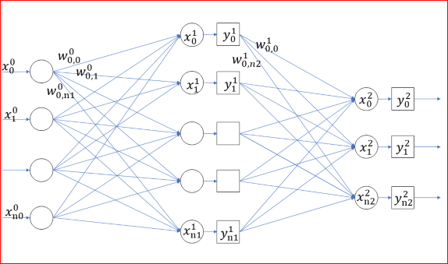
RDMA for DNN
Distributed DNN training iterations
  Forward propagation
  Back propagation
  Update gradients
Computation
Communication

Slide 42
RDMA for DNN
Epoch0
Epoch1
Epoch2
Epoch3
Epoch M
Training
Minibatch0
Minibatch1
Minibatch2
Minibatch N
GPU0
Compute
Communication
GPU1
Compute
Communication
GPU X
Compute
Communication
Data transmission

Slide 43
RDMA Programming
How many LOC for a “hello world” communication using RDMA?
For TCP, it is 60 LOC for client or server code
For RDMA, it is complicated …
  IBVerbs: 600 LOC
  RCMA CM: 300 LOC
  Rsocket: 60 LOC

Slide 44
RDMA Programming
Make RDMA programming more accessible
  Easy-to-setup RDMA server and switch configurations
  Can I run and debug my RDMA code on my desktop/laptop?
  High quality code samples
Loosely coupled vs tightly coupled (Send/Recv vs Write/Read)

Slide 45
Summary: RDMA for data centers!
RDMA is experiencing a renaissance in data centers
  RoCEv2 has been running safely in Microsoft data centers for two and half years
Many opportunities and interesting problems for high-speed, low-latency RDMA networking
Many opportunities in making RDMA accessible to more developers

Slide 46
Acknowledgement
Yan Cai, Gang Cheng, Zhong Deng, Daniel Firestone, Juncheng Gu, Shuihai Hu, Hongqiang Liu, Marina Lipshteyn, Ali Monfared, Jitendra Padhye, Gaurav Soni, Haitao Wu, Jianxi Ye, Yibo Zhu
Azure, Bing, CNTK, Philly collaborators
Arista Networks, Cisco, Dell, Mellanox partners

Slide 47
ideas

Slide 48
Inter-DC RDMA
Idea: 在inter-DC 的长肥链路下使用，降低CPU使用，提升吞吐
  典型链路特性: 100G~1T bps, 200ms [1] ➔ BDP = 2.5 x 10^6 ~ 10^7 KB
  丢包是常态，同时可能伴有限速 [2]
  网络跳数较少，拓扑固定 ➔ 出口交换机更容易替换成新型交换机
限制
  PFC无法使用
  长肥链路导致在网卡上track 每个包的到来，需要花费较多memory
  丢包似乎无法避免，由于链路时延大，由精确地在某个交换机上控制队列长度变得比较困难（HPCC那样的精确控制是否可能达到？）
Cardwell, N., Cheng, Y., Gunn, C. S., Yeganeh, S. H., & Jacobson, V. (2016). BBR: Congestion-based congestion control.
Hong, Chi-Yao, et al. "Achieving high utilization with software-driven WAN." ACM SIGCOMM Computer Communication Review. Vol. 43. No. 4. ACM, 2013.

Slide 49
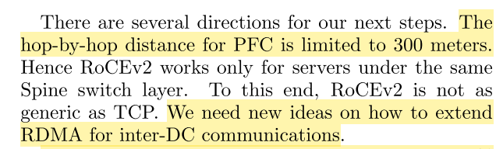
Inter-DC RDMA
PFC无法使用
Guo, Chuanxiong, et al. "RDMA over commodity ethernet at scale." Proceedings of the 2016 ACM SIGCOMM Conference. ACM, 2016.

Slide 50

Inter-DC RDMA
在网卡track长肥链路上的每个包需要花费大量memory
Lu, Yuanwei, et al. "Memory efficient loss recovery for hardware-based transport in datacenter." Proceedings of the First Asia-Pacific Workshop on Networking. ACM, 2017.

Slide 51
基于冗余信息的RDMA包恢复
Idea: 在RDMA数据包之间加入相关性冗余来在丢包时候直接恢复
  避免在发生丢包时，频繁地在网卡和内存直接通过PCIe传输数据
Benefit
  直接在内存中恢复达到了即使在丢包时，仍然可以达到 ultra-low delay
  避免使用PFC ，从而克服PFC带来的诸多问题(e.g., unfairness, victim flows, deadlock, PFC pause frame storm…)
Overhead
  加入冗余的数据量相当于人为地进行了降速
  需要硬件或者CPU进行丢包恢复，而不直接进行重传。相当于进行了 CPU 和 bw/memory 的 trade off

Slide 52
基于冗余信息的RDMA包恢复
挑战:
When
  何时启动数据包冗余编码
What
  使用何种编码，达到硬件容易部署或者CPU efficiency
Who
  由谁进行丢包恢复，网卡硬件或者CPU
How much
  量化的overhead，如何最小化数据冗余，最小化硬件或者CPU代价，最大化throughput
针对的场景
  对于随机丢包，由于一次丢包少，加入的冗余也可以较小
  对于排队丢包，一次丢包往往是成片的，加入的冗余信息需要很多

Slide 53
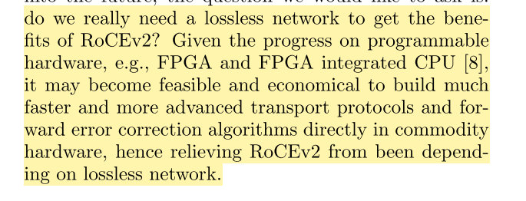
基于冗余信息的RDMA包恢复
Guo, Chuanxiong, et al. "RDMA over commodity ethernet at scale." Proceedings of the 2016 ACM SIGCOMM Conference. ACM, 2016.

Slide 54
MP-RDMA的数据包调度算法
Idea: 在RDMA网卡上实现数据包调度器，进一步减小接收端的buffer占用
现有的MP-RDMA算法相当于实现了最为简单的decoupled的MPTCP协议
  具有path manager
  使用decoupled的 congestion control
不足
  公平性有问题
  频繁地拆除、新建子流可能会造成性能地波动？

Slide 55
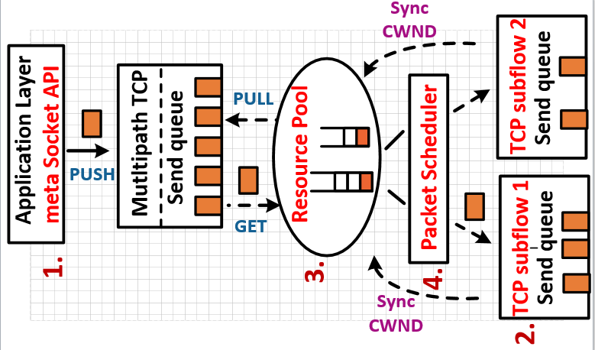
MP-RDMA的数据包调度算法

Slide 56
MP-RDMA的数据包调度算法

