Slide 1
Memory Efficient Loss Recovery for Hardware-based Transport in Datacenter
Yuanwei Lu^{1,2}, Guo Chen², Zhenyuan Ruan^{1,2},
Wencong Xiao^{2,3}, Bojie Li^{1,2}, Jiansong Zhang²,
Yongqiang Xiong², Peng Cheng², Enhong Chen¹
¹USTC, ²Microsoft Research, ³BUAA

Slide 2

Existing Hardware-based Transports
RDMA (RoCEv2)
High throughput, low latency and zero-cpu overhead
Go-back-N, PFC required
Light-weight Transport Layer (LTL)[1]
Inter-FPGA communication
Go-back-N, PFC required
[1] Adrian M Caulfield, et al. A cloud-scale acceleration architecture. MICRO 2016.

Slide 3
Loss is Not Uncommon in DCs
Loss Sources
Congestion loss: can be removed by PFC
Failure loss: hard to be mitigated at large scale
Statistics from real DCs
A persistent 0.2% silent random drop which lasts for 2 days [2]
Loss ratio of some network switch can be up to 2% [2]
[2] Chuanxiong Guo, et al. Pingmesh: A large-scale system for data center network latency measurement and analysis. ACM SIGCOMM 2015

Slide 4
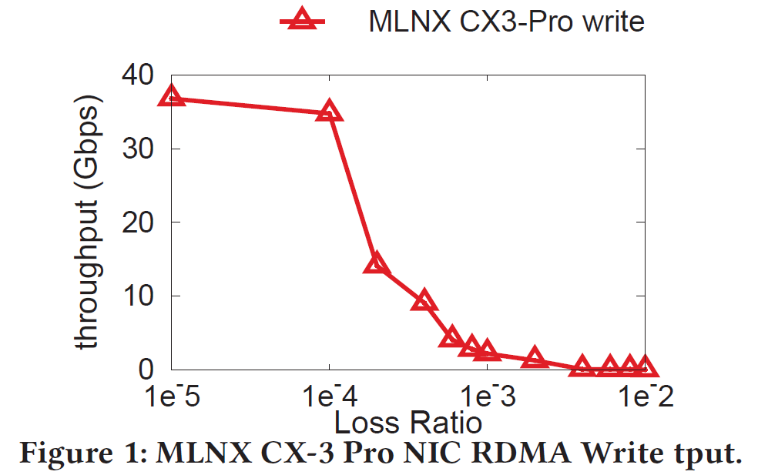
Inefficient Loss Recovery
Go-Back-N
Tput drops to near zero when loss ratio is >0.1%

Slide 5
How can we do better?
SACK TCP: state of the art loss recovery
Recover multiple losses within a sending window
Performs well under even high packet loss ratio, e.g. 1%
Question: can we extend selective retransmission to hardware-based transport?
Answer: MELO
Memory-Efficient LOss recovery
Implements Selective Retransmission for hardware transport

Slide 6
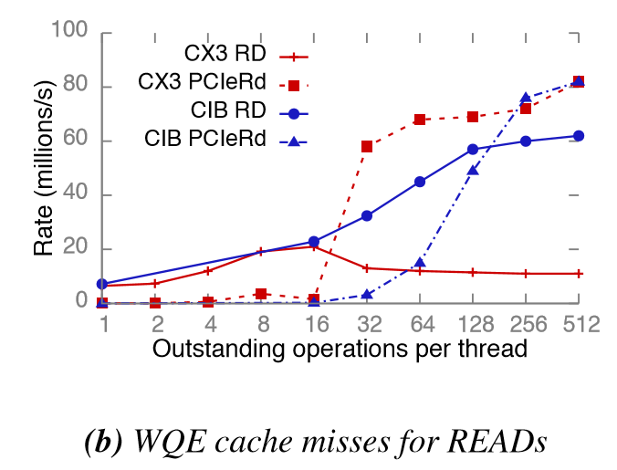
Challenges
Hardware on-chip memory is limited
On-chip memory is usually a cache for off-chip memory
Swapping between on-chip and off-chip is expensive
Loss recovery for hardware transport should be on-chip memory-efficient
Figure borrowed from: Anuj Kalia, et al. Design Guidelines for High Performance RDMA Systems. ATC 2016

Slide 7
Extra Memory is Required
#1: Re-ordering buffer is required to store loss induced out-of-order data
#2: Meta data is required for tracking out-of-order packets

Slide 8
Challenge #1: Re-Ordering Buffer
The necessity of re-ordering buffer
RDMA requires in-order message placement
LTL requires in-order packet delivery
Size of out-of-order data
BDP: 100G * 100us ~ 1.25MB
Too much for on-chip memory
A re-ordering buffer is required before placing out-of-order data into app buffer
Flag
Ready
Read 3 → ERROR
5
4
X
3
2
1
5
4
3
2
1

Slide 9
Challenge #2: Meta Data
Selective retransmission bitmap size
BDP: 100G * 100us (1KB MTU) ~ 150B
Too much for on-chip memory: Mellanox CX3 Pro NIC, per-connection transport states is 248B
A per-connection bitmap would take too much on-chip memory

Slide 10
MELO
Separate data and meta data storage
Re-ordering buffer in off-chip memory
Off-chip memory is large in size, usually GBs
Meta data in on-chip memory
On-chip memory is fast for frequent query and update
A shared bits pool structure to reduce on-chip meta data size

Slide 11
Off-Chip Re-Ordering Buffer
Off-chip memory is usually GBs
A BDP worth of buffer is allocated to each connection
Buffer base address is stored in on-chip memory
An extra copy is required
For RDMA, trade some CPU for re-ordering buffer
For LTL, FPGA will perform the copy

Slide 12
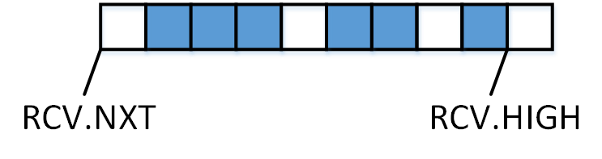
On-Chip Shared Bits Pool
Intuition
The bitmap of all connections is not fully occupied simultaneously
The total size of occupied bits is bounded by ingress bandwidth, O(n) → O(1)
Instead of per-connection bitmap, we can use a shared bits pool
… …
Ingress Bandwidth is Bottleneck

Slide 13
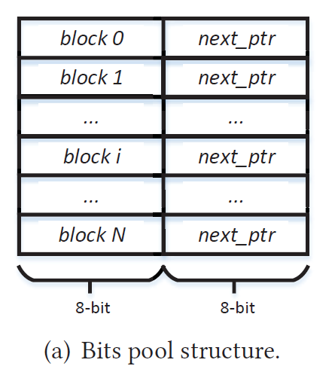
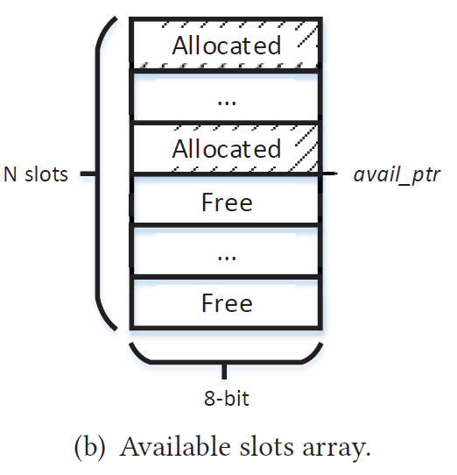
Shared Bits Pool Management
Bits pool is divided into equal sized blocks
Eliminate external fragmentation
Allocation unit: 1 Byte, minimize internal fragmentation
Linked List: blocks linked into bitmap
A stack for maintaining available blocks
Blocks are allocated/returned from/to the top of the stack
Management overhead: 2 * Bits_Pool_Size
In total 23B extra data for each connection

Slide 14
Shared Bits Pool Animation
avail_ptr
0
nxt
0
1
nxt
1
2
nxt
2
...
...
...
127
nxt
127
Bits Pool
Available Stack
Connection #1
Connection #2

Slide 15
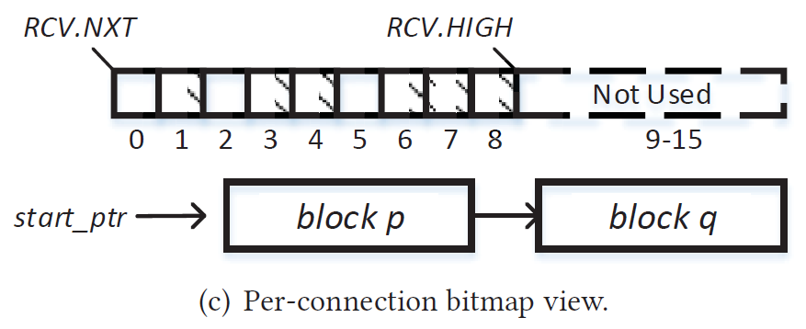
Access Pattern to Bitmap
Linked list is not friendly for random access
Fortunately, access pattern is not random
RCV.HIGH: new data
RCV.NXT: retransmission data
Other parts: out-of-order retransmission data → ignore and drop

Slide 16
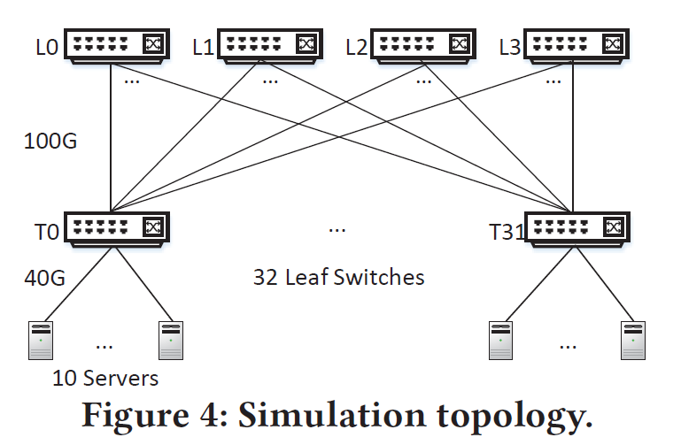
Evaluation
Setup
NS3: integrate MELO into DCQCN
Topology
Leaf-spine topology
40G-100G
RTT: 16us
MTU: 1KB
Bits Pool Size: 1Kb
Loss
Random loss at L0

Slide 17
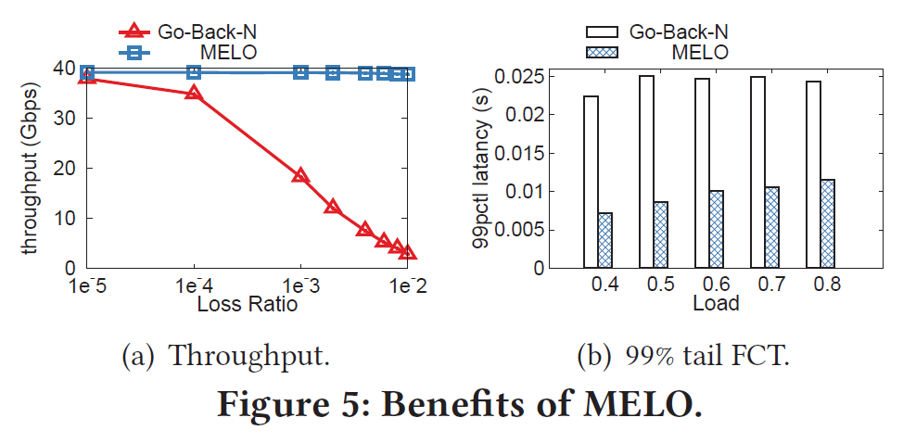
Preliminary Results
Throughput: 2.14X under 0.1% loss ratio
Tail Latency: 2.11X ~ 3.22X reduced

Slide 18
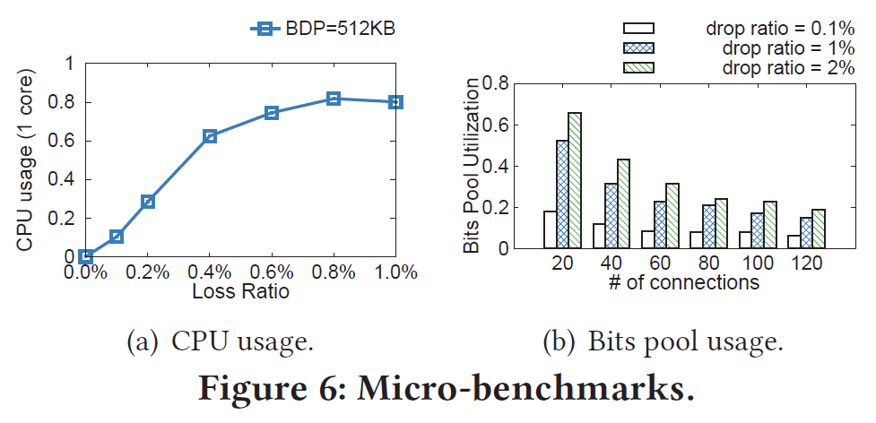
Micro Benchmarks
CPU overhead: 30% core at 0.2% loss ratio
Bits pool usage: always < 100%
Interesting results: more concurrent connections leads to lower bits pool usage

Slide 19
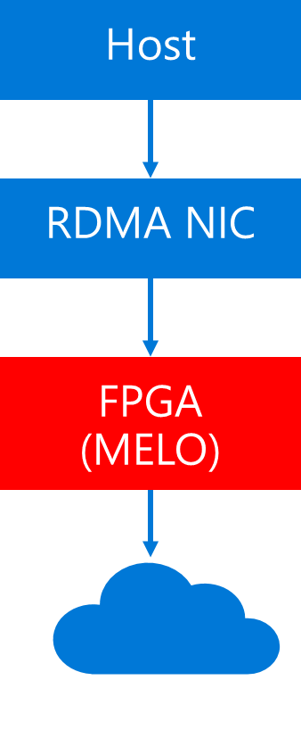
Future Implementation
FPGA implementation
FPGA captures all the outgoing/incoming traffic sequence number
Implements MELO
FPGA with MELO can deployed in DC to enhance RDMA NIC loss recovery
Plug in and play

Slide 20
Future Work
Further Optimization
Consecutive 1s or 0s can be compressed
Remove PFC
MELO + end-to-end congestion control → remove PFC?

Slide 21
Conclusion
MELO implements Selective Retransmission for hardware-based transport
MELO architecturally separates data and meta data storage
MELO leverages a shared bits pool structure to reduce on-chip memory size

Slide 22
Thank you!

Slide 23
Q& A

Slide 24
Backup slides

