Slide 1
Congestion Control Mechanisms
for Data Center Networks
Wei Bai
Microsoft Research Asia

Slide 2
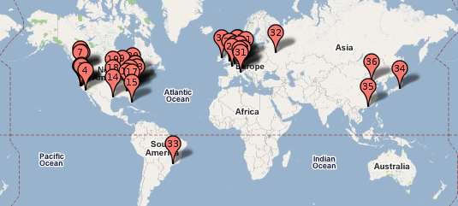

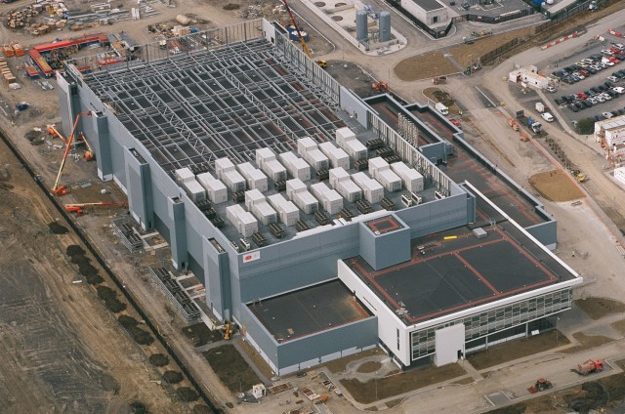
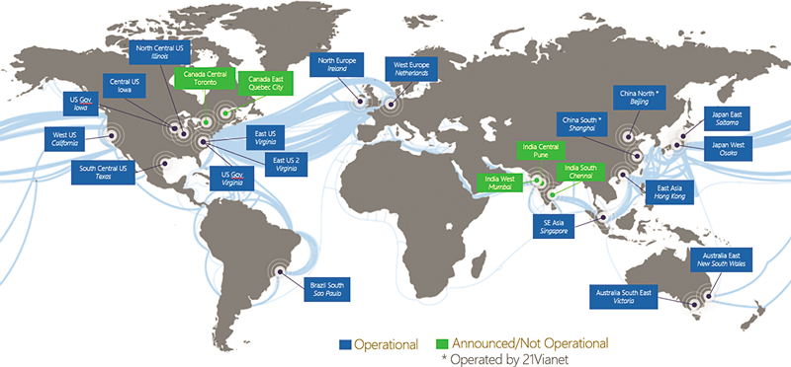
Data Centers Around the World
Google’s worldwide DC map
Facebook DC interior
Microsoft’s DC in Dublin, Ireland
Global Microsoft Azure DC Footprint
Notes:
As we know, many big companies, such as Google, Facebook and Microsoft, have built a lot of data centers around the world to provide services to global users.

Slide 3


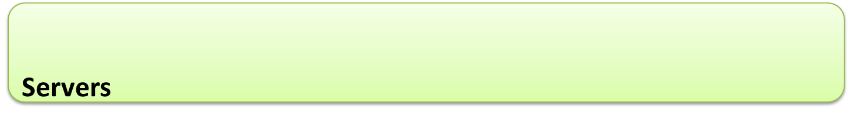

Data Center Network (DCN)
INTERNET
Fabric
Notes:
Inside the data center, the hundreds of thousands of servers are connected by this network, data center network, DCN.

Slide 4
Data center applications really care about latency!
Notes:
But unfortunately, applications in data centers really care about latency.

Slide 5



100ms slowdown reduced
# searches by 0.2-0.4%
[Speed matters for Google Web Search; Jake Brutlag]
Revenue decreased by 1% of sales for every 100ms latency
[Speed matters; Greg Linden]
400ms slowdown resulted
in a traffic decrease of 9%
[Yslow 2.0; Stoyan Stefanov]
Notes:
Google, Amazon and Yahoo report that the slowdown of latency seriously degrade user experience and operator revenue.

Slide 6
Goal of My Research
Low Latency Data Center Networks
Notes:
Therefore, the goal of my thesis is to achieve low latency in data center networks.

Slide 7
Sources of Network Latency
Queueing delay
Moderate queueing is necessary for high throughput
Excessive queueing only degrades latency
Retransmission delay
Fast retransmission: 1 RTT (100s of us)
Timeout retransmission: several ms

Slide 8
My Research Work
To reduce queueing delay
PIAS [NSDI’15] minimizes flow completion time without prior knowledge of flow size info
To reduce retransmission delay
TLT (ongoing) eliminates congestion timeouts

Slide 9
PIAS
Joint work with Li Chen, Kai Chen,
Dongsu Han, Chen Tian and Hao Wang

Slide 10




Flow Completion Time (FCT) is Key
Data center applications
Desire low latency for short messages
App performance & user experience
Goal of DCN transport: minimize FCT
Many flow scheduling proposals
Notes:
Many data center applications, such as Web search, machine learning, database and cache, desire ultra low latency for these short messages. The reason is that the completion times of these short messages directly determine the user experience. Therefore, to improve the application performance, one of the most important design goal for data center transport is to minimize flow completion times, especially for short flows. To address this challenge, there are many flow scheduling proposals, [click]

Slide 11
Existing Solutions
PDQ
SIGCOMM’12
pFabric
SIGCOMM’13
PASE
SIGCOMM’14
All assume prior knowledge of flow size information to approximate ideal preemptive Shortest Job First (SJF) with customized network elements
Not feasible for many applications
Hard to deploy in practice
Notes:
Such as PDQ, pFabric and PASE. These solutions can potentially provide very good, even near-optimal performance. However, we find that, [click] all of them assume prior knowledge of flow size information to approximate ideal preemptive shortest job first scheduling. In addition to this, all of these solutions leverage customized network elements. For example, pFabric introduces non-trivial modifications to switch hardware and PASE requires an separate and complex control plane for arbitration. [click] We note that, the assumption of prior knowledge of flow size information does not hold for many cases. For many applications, such as database query and response, data is transferred as soon as it is generated without buffering. So we can not get flow size information beforehand. [click] And the customized network elements make these solutions very hard to deploy in production data centers. So we take one step back [click]

Slide 12
Question
Without prior knowledge of flow size information, how to minimize FCT in commodity data centers?
Notes:
And ask a fundamental question ……………….. This question transfers to three concrete design goals.

Slide 13
Design Goal 1
Without prior knowledge of flow size information, how to minimize FCT in commodity data centers?
Information-agnostic: not assume a priori knowledge of flow size information available from the applications

Slide 14
Design Goal 2
Without prior knowledge of flow size information, how to minimize FCT in commodity data centers?
FCT minimization: minimize the average and tail FCTs of short flows & not adversely affect FCTs of large flows

Slide 15
Design Goal 3
Without prior knowledge of flow size information, how to minimize FCT in commodity data centers?
Readily-deployable: work with existing commodity switches & be compatible with legacy network stacks

Slide 16
Our Answer
Without prior knowledge of flow size information, how to minimize FCT in commodity data centers?
PIAS: Practical Information-Agnostic flow Scheduling

Slide 17
PIAS Key Idea
PIAS performs Multi-Level Feedback Queue (MLFQ) to emulate Shortest Job First (SJF)
High
Priority 1
Priority 2
……
Low
Priority K
Notes:
The design rationale of PIAS is performing multi-level feedback queue to emulate shortest job first. As we can see, there are K priority queues in MLFQ. 1 is the highest priority while K is the lowest one. During a flow’s life time, its priority is gradually reduced. [click]

Slide 18
PIAS Key Idea
PIAS performs Multi-Level Feedback Queue (MLFQ) to emulate Shortest Job First (SJF)
Priority 1
Priority 2
……
Priority K
Notes:
For example, for this flow. The first packet is assigned to the priority 1. [click]. The second packet is demoted to priority 2. [click] For the third packet, its priority is further reduced. [click]. Eventually, if this flow is large enough, the last packet is assigned to the lowest priority. You can see that, the key idea of multi-level feedback queue is very simple and it does not require flow size information to do the scheduling.

Slide 19
PIAS Key Idea
PIAS performs Multi-Level Feedback Queue (MLFQ) to emulate Shortest Job First (SJF)
In general, PIAS short flows finish in higher priority queues while large ones in lower priority queues, emulating SJF, effective for heavy tailed DCN traffic.
Notes:
With MLFQ, small flows are more likely to finish in higher priority queues while large flows are more likely to finish in lower priority queues. Therefore, small flows are prioritized over large flows, thus emulating SJF, especially for heavy tailed DCN workloads.

Slide 20
How to implement PIAS?
Implementing MLFQ at switch directly not scalable
Requires switch to keep per-flow state
Priority 1
Priority 2
……
Priority K
Notes:
However, MLFQ is not supported on commodity switches because it’s hard to track per-flow state on switches.

Slide 21
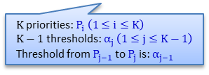
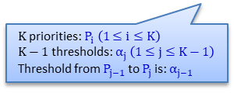
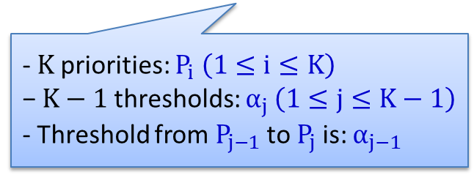
How to implement PIAS?
Decoupling MLFQ
Stateless Priority Queueing at the switch (a built-in function)
Stateful Packet Tagging at end hosts (a shim layer between TCP/IP and NIC)
Priority 1
- $K$priorities: $P_{i} \left(1≤i≤K\right)$
$\text{−} K−1$ thresholds: $α_{j }\left(1≤j≤K−1\right)$
- Threshold from $P_{j−1}$ to $P_{j}$ is: $α_{j−1 }$
Priority 2
……
Priority K
$K$priorities: $P_{i} \left(1≤i≤K\right)$
$K−1$ thresholds: $α_{j }\left(1≤j≤K−1\right)$
Threshold from $P_{j−1}$ to $P_{j}$ is: $α_{j−1 }$
$K$priorities: $P_{i} \left(1≤i≤K\right)$
$K−1$ thresholds: $α_{j }\left(1≤j≤K−1\right)$
Threshold from $P_{j−1}$ to $P_{j}$ is: $α_{j−1 }$
Notes:
To solve this problem, we decouple multi-level feedback queue. On the switch, we enable strict priority queueing [click]. At end hosts, we have a packet tagging module[click]. The logic of packet tagging module is quite simple. Assuming that they are K priorities and K-1 demotion thresholds correspondingly. Note that the P1 is the highest priority. The packet tagging module just maintains per-flow state and compare the bytes sent information with demotion thresholds. If a flow’s bytes sent value is exactly larger than Alpha[j-1], the following packet of this flow will be marked with Pj. For example, [click]

Slide 22
How to implement PIAS?
Decoupling MLFQ
Stateless Priority Queueing at the switch (a built-in function)
Stateful Packet Tagging at end hosts (a shim layer between TCP/IP and NIC)
i
Priority 1
- $K$priorities: $P_{i} \left(1≤i≤K\right)$
$\text{−} K−1$ thresholds: $α_{j }\left(1≤j≤K−1\right)$
- Threshold from $P_{j−1}$ to $P_{j}$ is: $α_{j−1 }$
Priority 2
……
Priority K
$K$priorities: $P_{i} \left(1≤i≤K\right)$
$K−1$ thresholds: $α_{j }\left(1≤j≤K−1\right)$
Threshold from $P_{j−1}$ to $P_{j}$ is: $α_{j−1 }$
$K$priorities: $P_{i} \left(1≤i≤K\right)$
$K−1$ thresholds: $α_{j }\left(1≤j≤K−1\right)$
Threshold from $P_{j−1}$ to $P_{j}$ is: $α_{j−1 }$
Notes:
解释例子

Slide 23
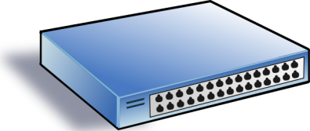
Threshold vs Traffic Mismatch
DCN traffic is highly dynamic
Threshold fails to catch traffic variation → mismatch
10MB
Ideal, threshold = 20KB
10MB
High
Low
Too small, 10KB
ECN
20KB
Too big, 1MB
Notes:
To determine demotion thresholds for MLFQ, we build a simple queueing theory model to analyze it and derive demotion thresholds based on flow size distributions. However, traffic is highly dynamic in data centers (across both time and space), so the mismatch between traffic and demotion thresholds is unavoidable. We need to handle the mismatch problem in order keep PIAS effective in highly dynamic data center networks? [click] 解释例子

Slide 24
PIAS in 1 Slide
PIAS packet tagging
Maintain flow states and mark packets with priority
PIAS switch
Enable strict priority queueing and ECN
PIAS rate control
Employ Data Center TCP to react to ECN

Slide 25

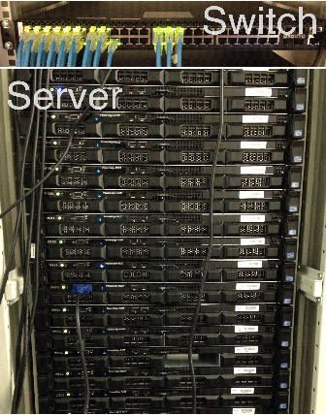
Prototyping & Evaluation
Prototype implementation
http://sing.cse.ust.hk/projects/PIAS
Testbed experiments and ns-2 simulations
1G in testbed experiments
10G/40G in simulations
Realistic production traffic
Schemes compared
DCTCP (both testbed and simulation)
pFabric (only simulation)
Notes:
Now, we come to evaluation part. We have already implemented a PIAS prototype. [click] It is open source. In our implementation, the packet tagging module works as a Linux kernel module, which can be installed and removed during the running time of the system. We use 16 servers and 1 Gigabit switch for our evaluation. For the benchmarks, we use web search workload from DCTCP paper, data mining workload from VL2 paper.

Slide 26
Testbed: Small Flows (<100KB)
49%
34%
Web Search
Data Mining
PIAS reduces average FCT of small flows by up to 49% and 34%, compared to DCTCP.
Notes:
These two figures show the average completion times of small flows. Compared to DCTCP, PIAS reduces average FCT of small flows by up to 49% in web search workload and 34% in data mining workload. Even though DCTCP try to reduce buffer occupation to achieve low latency, it still needs moderate buffer occupation to fully utilize link capacity. But with PIAS, we can provide much fewer or even zero queueing delay for packets of short flows because they are finished in higher priority queues.

Slide 27
NS-2: Comparison with pFabric
Web Search
Data Mining
PIAS only has a 1% performance gap to pFabric for small flows in the data mining workload.
Notes:
We also compare PIAS against pFabric. Note that pFabric is a information-aware clean-slate design. It assumes prior knowledge of flow size information and introduces changes to switch hardware. For PIAS, we don’t make such assumptions and just use commodity switches. Compared to pFabric, PIAS achieves comparable performance in small flows, especially in data mining workload. [click] The performance gap here here is only 1%.

Slide 28
PIAS Recap
PIAS: practical and effective
Not assume flow information from applications
Enforce Multi-Level Feedback Queue scheduling
Use commodity switches & legacy network stacks
Information-agnostic
FCT minimization
Readily deployable
Notes:
Finally, we conclude our work. We think that PIAS is a practical and effective solution for data centers. First of all, it is information-agnostic without assuming that flow size information available from applications. Secondly, PIAS performs multi-level feedback queue to emulate shortest job fist, thus achieving FCT minimization. Thirdly, PIAS is readily deployable in commodity data centers. It just uses basic functionalities from commodity switches and is compatible with legacy network stacks.

Slide 29
TLT
Ongoing work with Yibo Zhu, Dongsu Han, Byungkwon Choi, Hwijoon Lim

Slide 30
Lossy & Loss-Less
Lossy Ethernet
Packet losses increase end-to-end latency
Loss-Less Ethernet
Use PFC to eliminate congestion packet losses
Cause new problems: HoL blocking, deadlock
Can we get benefits from both sides?

Slide 31
Revisit the Impact of Packet Losses
Packet losses in the middle
Fast retransmissions: 1 RTT (100s of us)
Packet losses at the tail
Timeout retransmissions: several ms
1
1
2
ACK1
2
ACK1
3
3
ACK2
ACK1
2
3

Slide 32
Design Goals
Eliminate timeout retransmissions
Small side effects -> Rarely/Never trigger PFC
Work with commodity switch hardware
Timeout-Less Transport (TLT)

Slide 33
Design Rationale
Some packets are important as their losses may cause timeouts
For example, last data packet in a message
Only guarantee important packets lossless
Unimportant packets can be dropped as usual

Slide 34
Design Challenges
How to select important packets?
As few as possible
For both rate/window protocols
How to guarantee important packets lossless?
Separating important and unimportant packets into two queues causes out-of-order problem

Slide 35
Important Packets of Rate Protocols
Last packet of the message must be important
One of every N packets is selected as the important one
Further reduce retransmission delay

Slide 36
Important Packets of Window Protocols
Insight: at least one in-flight packet is important
In the first window, randomly choose one important packet
When receiving an ACK for an important packet
If the window allows, transmit a new packet (or a lost packet) and mark it as important
Otherwise, transmit the last unacknowledged packet and mark it as important

Slide 37
Guarantee Important Packets Lossless
Switch proactively drops unimportant packets
Drop thresh.
Important
Unimportant

Slide 38
Guarantee Important Packets Lossless
Switch proactively drops unimportant packets
Leave buffer headroom for important packets
Avoid triggering PFC
Enable PFC to handle extreme cases
For example, a large # of single-packet flows

Slide 39
Ongoing & Future Work
Further reduce the size of important traffic
How to choose the dropping threshold for unimportant packets
Interaction with congestion control algorithms
Prototype implementation and evaluation

Slide 40
Summary
PIAS uses MLFQ to reduce the queueing delay (completion time) for small flows
TLT ensures that every congestion loss can be recovered using fast retransmission

Slide 41
Thank You!

