Slide 1
Flightplan: Dataplane Disaggregation and Placement for P4 programs
Nik Sultana John Sonchack Hans Giesen
Isaac Pedisich
Zhaoyang Han
Nishanth Shyamkumar Shivani Burad André DeHon Boon Thau Loo
University of Pennsylvania
https://flightplan.cis.upenn.edu/
NSDI’21

Slide 2









Dataplane Programmability

Slide 3









Dataplane Programmability
Host (CPU)
(Linux Foundation)

Slide 4




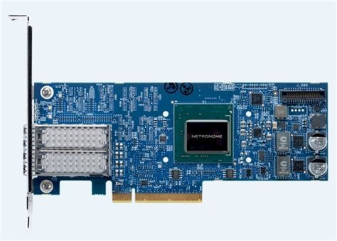



Dataplane Programmability
Host (CPU)
(Linux Foundation)
NPU
(Netronome)

Slide 5


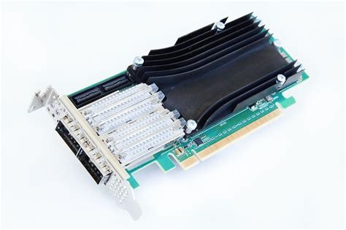






Dataplane Programmability
Host (CPU)
(Linux Foundation)
FPGA
NPU
(Netcope)
(Netronome)

Slide 6









Dataplane Programmability
Switch
(P4 Language Consortium)
Host (CPU)
(Linux Foundation)
FPGA
NPU
(Netcope)
(Netronome)

Slide 7








Dataplane Programmability
Switch
Host (CPU)
FPGA
NPU

Slide 8








Dataplane Programmability
Research
Switch
Products
Host (CPU)
FPGA
NPU

Slide 9








Dataplane Programmability
Switch
Host (CPU)
FPGA
NPU
Current paradigm: dataplane program
one dataplane (device)
mapped to

Slide 10








Dataplane Programmability
Switch
Host (CPU)
FPGA
NPU
Current paradigm: dataplane program
one dataplane (device)
mapped to
Conceptually simple.
Familiar from programming other devices.
Mismatch with Software-Defined Networking (the overarching vision).

Slide 11



Current paradigm: dataplane program
one dataplane
mapped to
xor
xor
xor
Exclusive OR
Mismatch with Software-Defined Networking
Target’s resources are dedicated to the program.
Ineﬃcient use of individual target resources.
Program must entirely execute on a single target.
Unnecessary constraints of program functionality.
We’re meant to be “programming the network”.
Programmability is scoped too conservatively.

Slide 12



Current paradigm: dataplane program
one dataplane
mapped to
xor
xor
xor
New paradigm:
dataplane program
suitable mix of dataplanes
₎or
( ) (
and
or
or
and
₎or
(
and

Slide 13
Current paradigm: dataplane program
one dataplane
xor xor xor
₍ and ₎ or or ₍ ^{and} ₎or
₍ and ₎or
New paradigm:
dataplane program
suitable mix of dataplanes
Resource-based program decomposition.
Split into set of 1-1 dataplane programs.

Slide 14
Current paradigm: dataplane program
one dataplane
xor xor xor
₍ and ₎ or or ₍ ^{and} ₎or
₍ and ₎or
New paradigm:
dataplane program
suitable mix of dataplanes
Resource-based program decomposition.
Split into set of 1-1 dataplane programs.
Uses existing vendor toolchains, language & hardware.

Slide 15
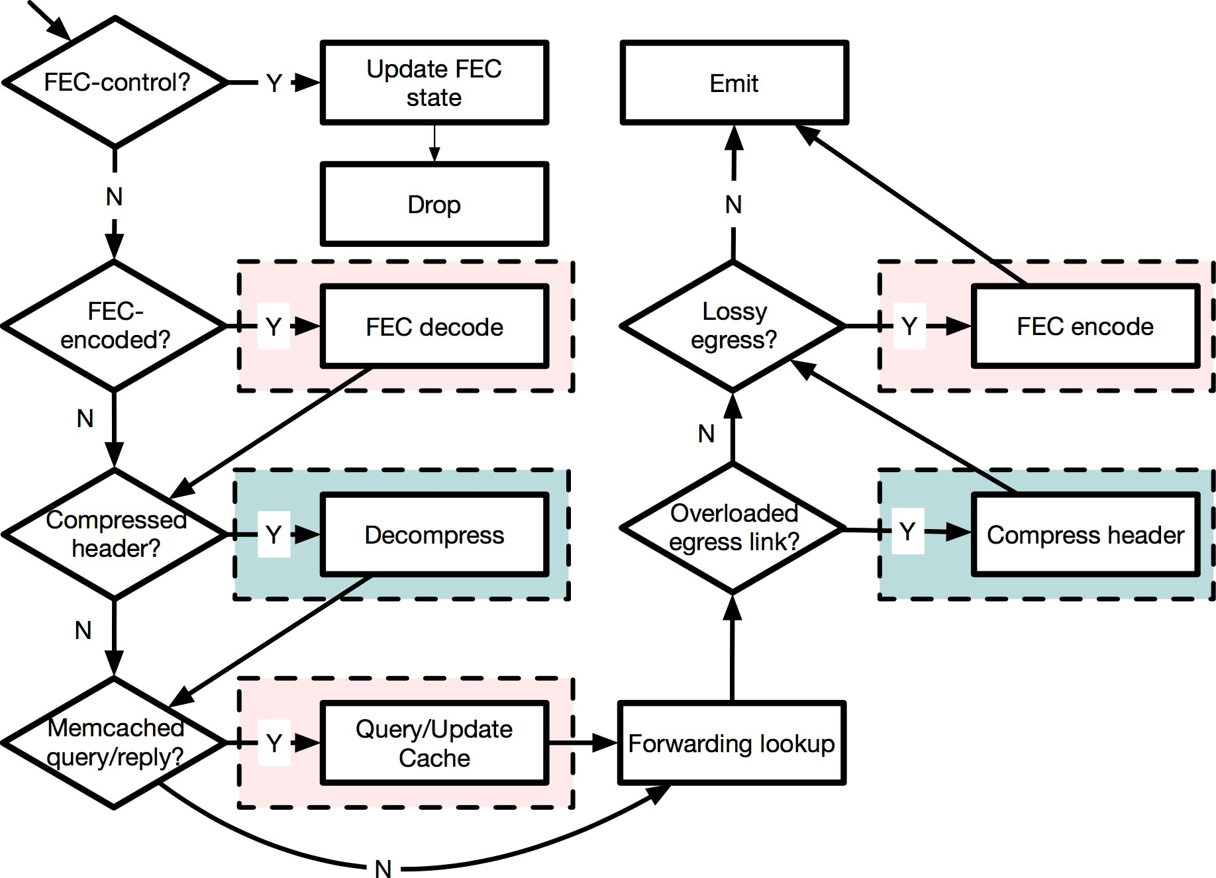
Example: “Crosspod” Program

Slide 16

Example: “Crosspod” Program

Slide 17
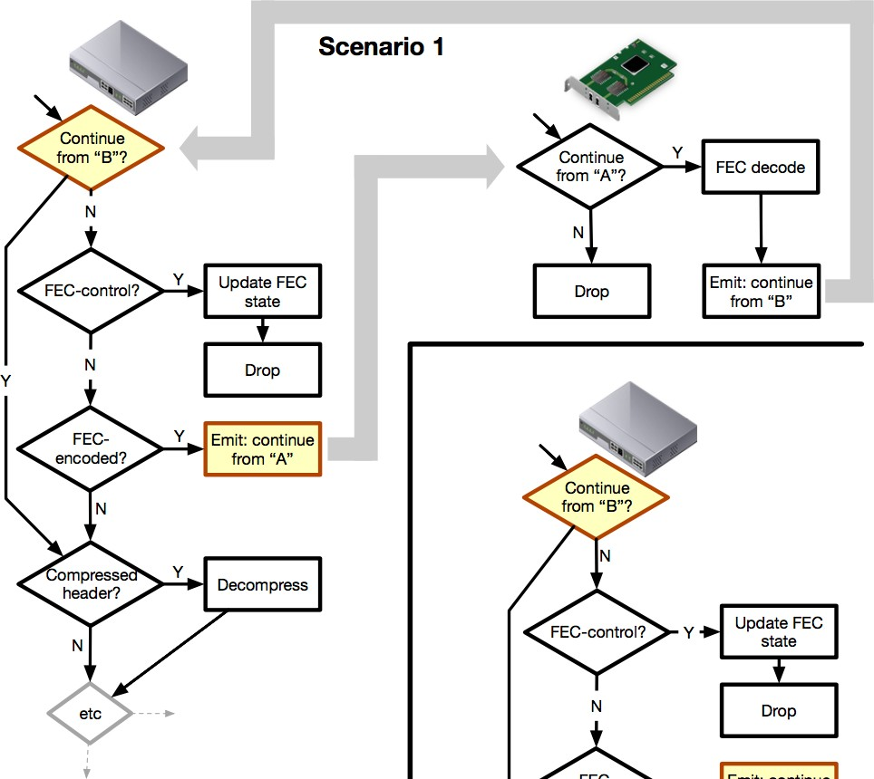


Slide 18
Hand-over + monitoring

Slide 19


Slide 20
Current paradigm: dataplane program
one dataplane
xor xor xor
₍ and ₎ or or ₍ ^{and} ₎or
₍ and ₎or
New paradigm: Dataplane Disaggregation
dataplane program suitable mix of dataplanes
Resource-based program decomposition.
Split into set of 1-1 dataplane programs.
20

Slide 21
Automated support needed
Current paradigm: dataplane program one dataplane
xor xor xor
₍ and ₎ or or ₍ ^{and} ₎or
₍ and ₎or
How to implement?
Dataplane Disaggregation:
dataplane program suitable mix of dataplanes
Resource-based program decomposition.
Split into set of 1-1 dataplane programs.
Uses existing vendor toolchains, language & hardware.
If manual: laborious, error-prone, hard to change.
22

Slide 22
Dataplane Disaggregation:
Current paradigm: dataplane program one dataplane
xor xor xor
₍ and ₎ or or ₍ ^{and} ₎or
₍ and ₎or
dataplane program suitable mix of dataplanes
! • Analyze program’s use of resources.
Split into set of 1-1 dataplane programs.

Slide 23
!
Current paradigm: dataplane program one dataplane
xor xor xor
₍ and ₎ or or ₍ ^{and} ₎or
₍ and ₎or
Exploit heterogeneous resources.
Meet resource & performance objectives.
Dataplane Disaggregation:
dataplane program suitable mix of dataplanes
! • Analyze program’s use of resources.
Split into set of 1-1 dataplane programs.

Slide 24
!
Current paradigm: dataplane program one dataplane
xor xor xor
₍ and ₎ or or ₍ ^{and} ₎or
₍ and ₎or
Exploit heterogeneous resources.
Meet resource & performance objectives.
Dataplane Disaggregation:
dataplane program suitable mix of dataplanes
! • Analyze program’s use of resources.
Split into set of 1-1 dataplane programs.

Slide 25
!
Current paradigm: dataplane program one dataplane
xor xor xor
₍ and ₎ or or ₍ ^{and} ₎or
₍ and ₎or
Exploit heterogeneous resources.
Meet resource & performance objectives.
!
Dataplane Disaggregation:
Placement
dataplane program suitable mix of dataplanes
! • Analyze program’s use of resources.
Split into set of 1-1 dataplane programs.

Slide 26
!
Current paradigm: dataplane program one dataplane
xor xor xor
₍ and ₎ or or ₍ ^{and} ₎or
₍ and ₎or
Exploit heterogeneous resources.
Meet resource & performance objectives.
!
Dataplane Disaggregation:
Placement
dataplane program suitable mix of dataplanes
! • Analyze program’s use of resources.
Split into set of 1-1 dataplane programs.
Hand-over control between dataplanes.
!
Synchronize state.
Detect and handle faults.

Slide 27
!
Current paradigm: dataplane program one dataplane
xor xor xor
₍ and ₎ or or ₍ ^{and} ₎or
₍ and ₎or
Exploit heterogeneous resources.
Meet resource & performance objectives.
!
Dataplane Disaggregation:
Placement
dataplane program suitable mix of dataplanes
! • Analyze program’s use of resources.
Split into set of 1-1 dataplane programs.
Hand-over control between dataplanes.
!
Synchronize state.
Detect and handle faults.
No language or hardware changes.
Changing programs, topology, and hardware.
Ingest various data: program, topology, resource information, constraints, objectives.
Scoping network programming and operation.
Consider and explain multiple possible solutions.
Multiple program3s1 in same network.
!
• Diagnosis and debugging.

Slide 28
Code, tests, scripts, data, documentation:
https://flightplan.cis.upenn.edu/
Current paradigm: dataplane program one dataplane
xor xor xor
₍ and ₎ or or ₍ ^{and} ₎or
₍ and ₎or
Exploit heterogeneous resources.
Flightplan
Meet resource & performance objectives.
Dataplane Disaggregation:
Placement
dataplane program suitable mix of dataplanes
Analyze program’s use of resources.
Split into set of 1-1 dataplane programs.
Hand-over control between dataplanes.
Synchronize state.
Detect and handle faults.
No language or hardware changes.
Changing programs, topology, and hardware.
Ingest various data: program, topology, resource information, constraints, objectives.
Scoping network programming and operation.
Consider and explain multiple possible solutions.
Multiple program3s2 in same network.
• Diagnosis and debugging.

Slide 29
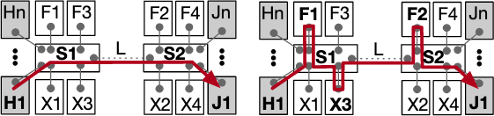
Flightplan
Notes:
H、J指的是服务器；F指的是FPGA；X指的是CPU

Slide 30
Flightplan
Notes:
Flightplan积极探索交换机周围的资源，以便沿着数据平面将一些计算可以卸载到数据平面上；在这里，S1将计算资源卸载到F1、X3，S2卸载到F2.

Slide 31
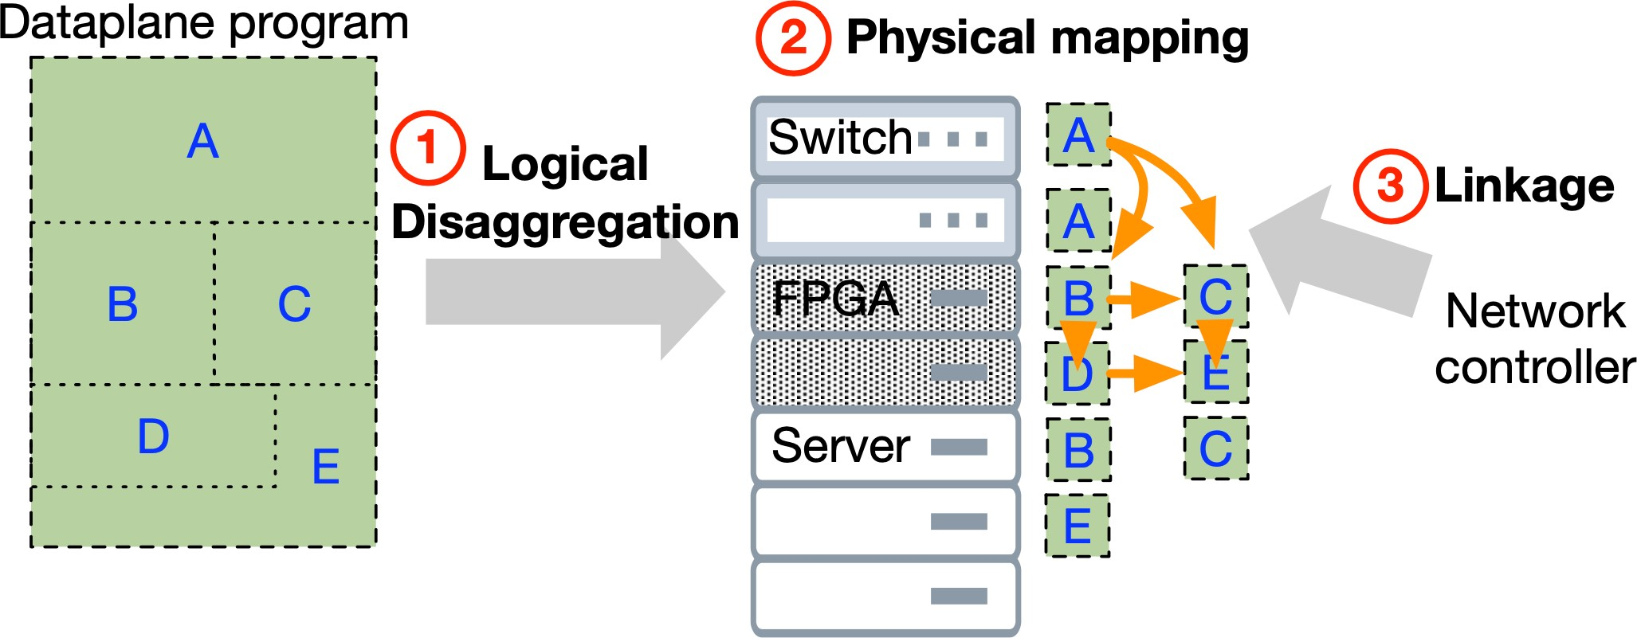
Flightplan
Notes:
程序会手动或自动地使用逻辑分隔符进行注释，Flightplan使用这些注释将程序分割为互补部分，并在这些部分之间提供协调和链接代码。
原始程序的每个部分都被映射到一个物理设备上，在本图中，A映射到机架顶部(ToR)交换机、B、CD和E映射到网络连接的FPGA，B、C和E的冗余实例映射到在服务器CPU上执行
Flightplan控制程序可以在运行时改变程序的链接，以使用不同的硬件目标、减轻故障或平衡负载

Slide 32
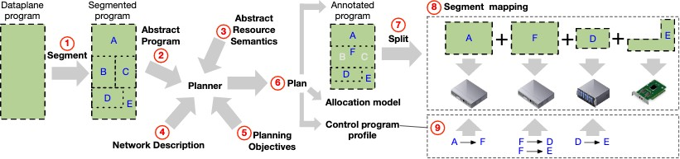
Flightplan

Slide 33
Idea from symbolic AI: rule-based search.
Flightplan

Slide 34
Flightplan

Slide 35
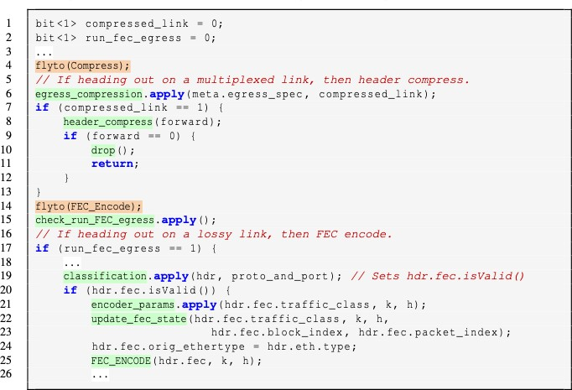
Example program (Crosspod)
Segment annotation
Resource dependence
Notes:
橙色：分割注释
绿色：与资源相关的语法

Slide 36

Abstract program
(Rule generation is fully automatic)

Slide 37
Flightplan

Slide 38
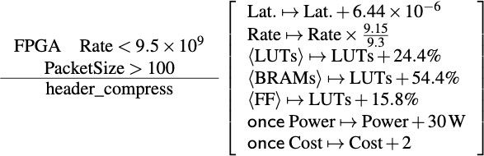

Abstract Resource Semantics
BRAMs + 54.4%
FF + 15.8%
43
Notes:
在步骤➂中，我们提供每个程序使用的资源的语义，例如对外部函数的调用，即程序在特定硬件上使用该资源的可测量成本。这些成本包括延迟、吞吐量、功率和硬件的成本。

Slide 39
Flightplan
Notes:
allocation model描述如何模拟数据包大小和延迟，以便在程序跨数据平面执行时发生变化
annotated program由原始程序和可能被粗化的片段组成，反映了这些片段将如何被分割为子程序
Flightplan的控制器将使用control program profile去配置分布式程序的runtime、启动时间以及询问状态。

Slide 40
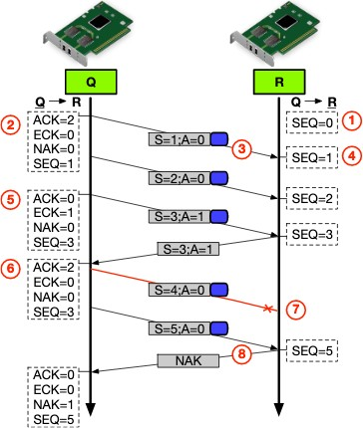
Runtime: Fault Detection
+ Handling
Two mechanisms
In-dataplane: +ve and -ve Acks.
Strobes from control program.
Notes:
为了检测网络失真，如下降、重新排序和重复，我们的方案在flightplan头中包括一个序列号。在发送和接收数据平面上保持相应的状态，以确定包序列是否被中断。NAK用于下游数据平面的信号与上游数据平面同步的丢失。上游数据平面使用正面确认来进行实时轮询下游数据平面的高度。
在下游数据平面上初始化同步状态。
在上游数据平面上初始化同步状态。
同步信息包含在flightplan的头部。灰色代表flightplan头部，蓝色代表数据包
序列号将会递增。
通过提高上游数据平面提高flightplan头部中的ACK位和ECK（预期ACK），定期轮询下游数据平面的活动。
当收到一个ACK数据包时，ECK将被重置
数据包可能在任何一个方向上丢失，从而导致丢失同步。
最终检测到同步丢失，并采取了操作。否定确认(NAK)试图更新上游数据平面。

Slide 41
Evaluation
Simulation:
Scale of the network (featuring various programs)
Overhead
Disaggregation (diﬀerent programs split in diﬀerent ways)
Fail-over
Test-bed:
Throughput, latency, power, resource utilization
Plan comparisons for hardware alternatives
Single-feature evaluation

Slide 42
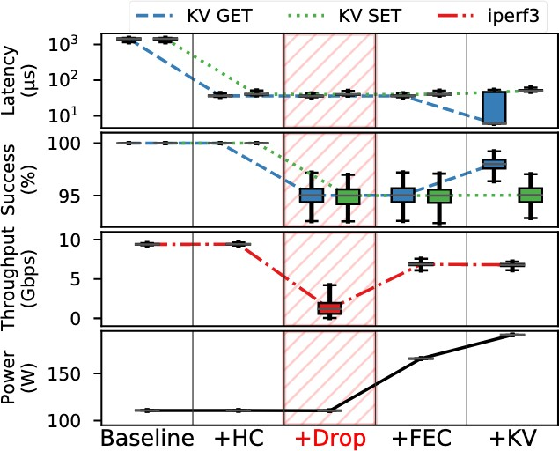
Fig 10: Resources & Behavior vs Functions (Testbed experiment)
Resources & Behavior
Function activation

Slide 43
Fig 9: Plan comparison (Testbed + Simulation)
RRate
●
Max. Performance Legacy Extender Server Offload (Tofino) Server Offload (Arista)
●
Reciprocal of throughput rate
●
●
●
Power
Area
●
●
●
●
●
●●
●
●
●
●
●
●
●●
Latency
Cost
(Inner is better)

Slide 44
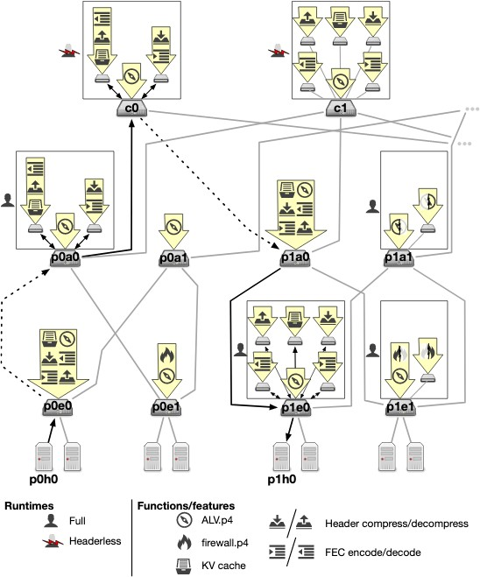
Fig 7: Multiple Programs vs Runtimes vs Splits in same network (Simulation)

Slide 45
Fig 7: Multiple Programs vs Runtimes vs Splits in same network (Simulation)

Slide 46
Fig 7: Multiple Programs vs Runtimes vs Splits in same network (Simulation)

Slide 48
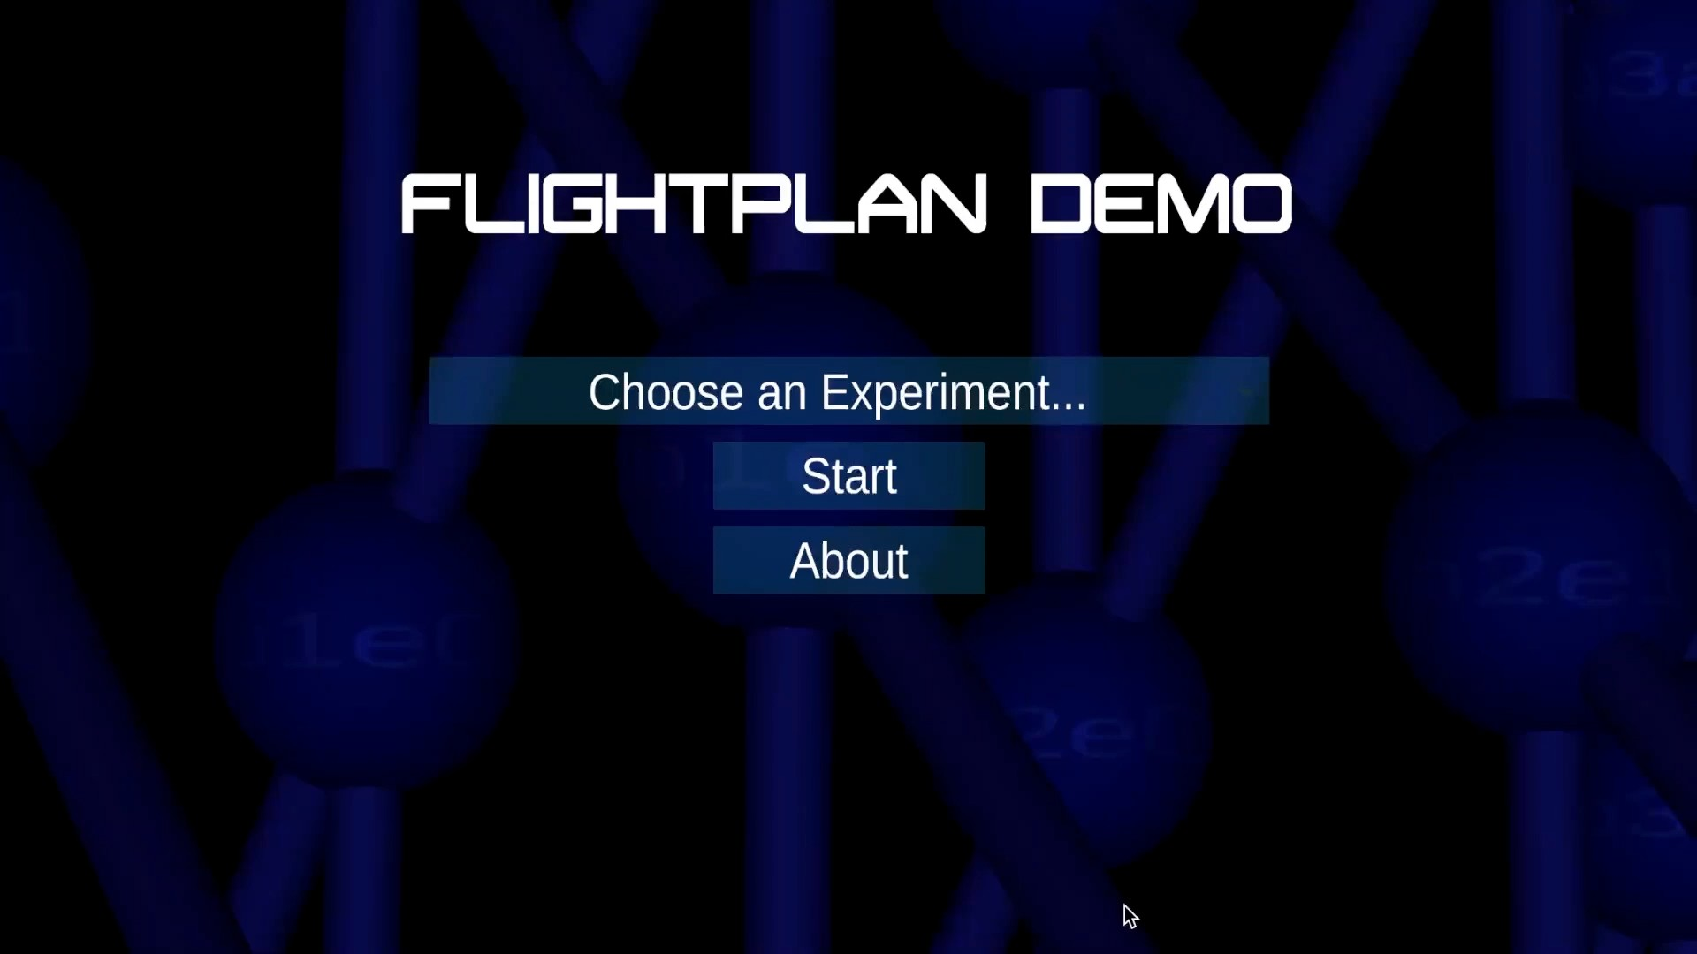
[
MSc students: Heena Nagda (GATech), Rakesh Nagda (Penn)
Other features: graphs, multimedia cues (e.g., icons, packet structure), …
https://flightplan.cis.upenn.edu/
Flightplan demo

Slide 49
Flightplan: Dataplane Disaggregation and Placement for P4 programs
Nik Sultana John Sonchack Hans Giesen
Isaac Pedisich
Zhaoyang Han
Nishanth Shyamkumar Shivani Burad André DeHon Boon Thau Loo
University of Pennsylvania
https://flightplan.cis.upenn.edu/
NSDI’21

