Slide 1
论文总结和相关工作
李倩

Slide 2
论文总结
Data-driven Routing Optimization based on Programmable Data Plane

Slide 3
Background
The increasing demand for high bandwidth in multimedia applications.
Over-provisioning high bandwidth brings high cost and low link utilization.
TE is proposed to traffic scheduling and then balance the network.

Slide 4
Prior TE solutions
Network telemetry
Out-band network telemetry(e.g. Netflow[1], sFlow[2])
High monitoring overheads
Incur significant switch resource computation
Long detection times
Routing strategies
heuristic algorithm
The relationship between network state and routing optimization strategy is quite difficult to describe with an exact mathematical model.
Overly complex mathematical models often place high demands on the storage and computing resources of the network nodes that run the model.
[1] “Building a better netﬂow,” ACM SIGCOMM Computer Communication Review, 2004
[2] “sflow: Towards resource-efﬁcient and agile service federation in service overlay networks,” ICDCS,2004
Notes:
NetFlow [5] tries to detect network status by periodic polling of trafﬁc statistics from switches, and
[6] achieves network measurement by sampling packets from switches.

Slide 5
Prior TE solutions based on RL
Learning to route[1]
Assumption: the flow demand matrix in each time slice is fixed and can be well predicted by network measurement
Input： the traffic matrix of K-long historical time slices
Output： the weight of all links
Optimize target: minimize network congestion.
DRL-TE[2]
Input: FCT and throughput for K TCP streams
Output: the proportion of trafﬁc distribution of K TCP streams on multiple sub-paths
Optimize target: maximum utility function
[1] “Learning to route,” HotNets, 2017
[2] “Experience-driven networking: A deep reinforcement learning based approach,” INFOCOM,2018

Slide 6
Motivations
Learning to route[1]
The assumption in [1] is controversial[2].
It’s just a attempt to applying RL to TE, not a practical work.
DRL-TE[2]
The increasing of TCP streams induces unpredictable performance.
It has no consideration of scalability problems in the designing of RL model.
[1] “Learning to route,” HotNets, 2017
[2] “Experience-driven networking: A deep reinforcement learning based approach,” INFOCOM,2018

Slide 7
Our thinking
The emergency of SDN
Network tends to be more operational and transparent.
Measurement: In-band network telemetry
The breakthrough of reinforcement learning(RL)
Experience-driven model-free control
We can combine INT with RL to achieve traffic engineering. We call our approach DPRO.

Slide 8
Challenges
Applying INT is not direct.
The reference format in INT speciation is too complex, which will take up a lot of processing latency for switches.
We redesigned the P4-based packet processing logic to combine INT with the processing of regular packets.
Using RL is not easy.
The design of RL model has a lot to do with performance.
The correlation between input and output has influence with the convergence speed.
We simply the complexity of RL model by learning the mapping from link loads to link weights.

Slide 9
Contributions
We are the first to propose a complete practical INT-based data-driven control framework, DPRO, for TE.
We design a clever switch packet processing logic based on P4 to enable fast forwarding and ultra-low overhead measurement.
We show via building an experimental platform that DPRO significantly outperforms several widely-used baseline methods concerning three metrics, including max-link-utilization, flow completion time and packet delay.

Slide 10
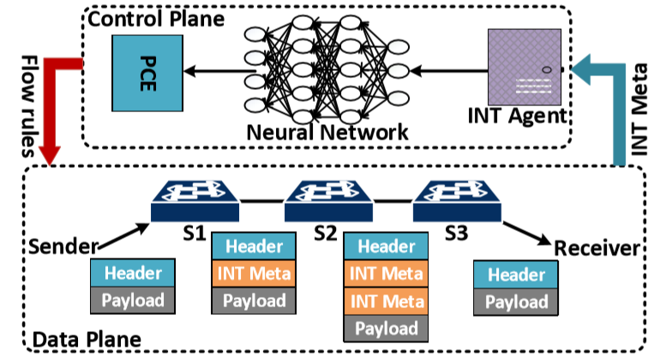
Design
DPRO address TE with the perspective of integration between the data plane and the control plane.
Data plane
Forwarding
Network telemetry
Control plane
Making smart decisions
The overview of DPRO

Slide 11
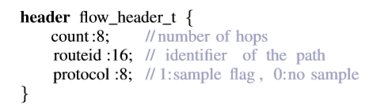
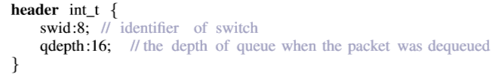
Design of Data Plane
Additional header
Forwarding
Flow_header
Network telemetry
Int_header

Slide 12
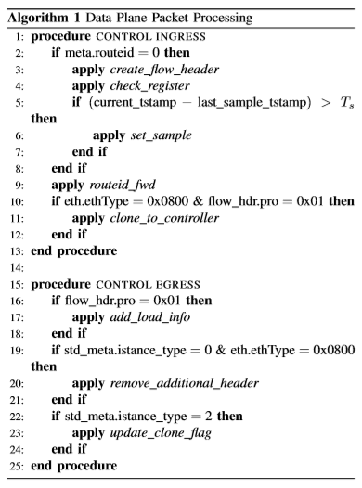
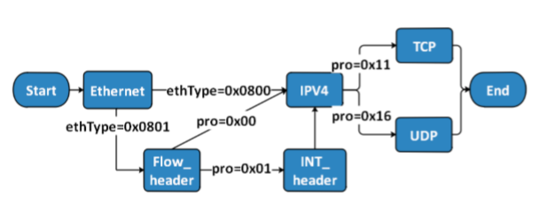
Design of Data Plane
Packet processing logic
Flow_header
Ethernet.ethType=0x0801
INT_header
Flow_header.pro=0x01

Slide 13
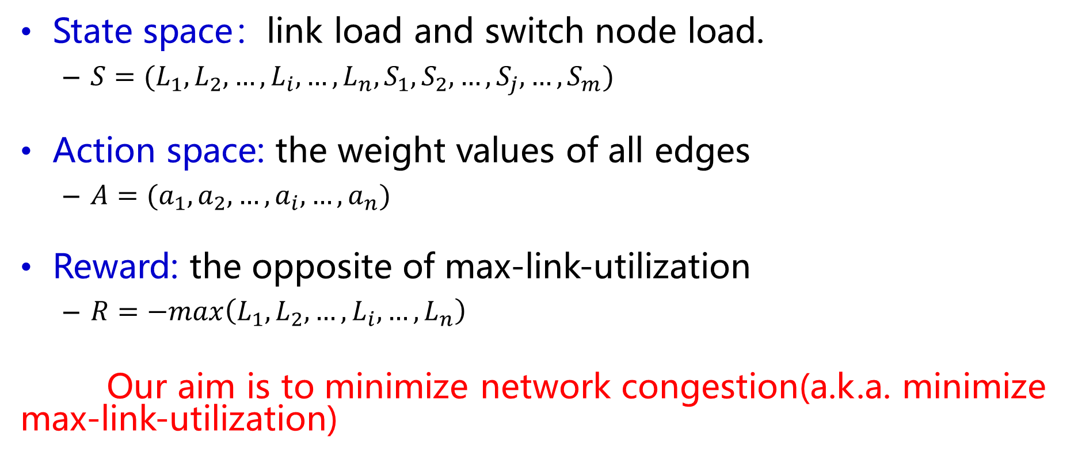
Design of Control Plane
Reinforcement learning model
State space：link load and switch node load.
$S=(L_{1},L_{2},…,L_{i},…,L_{n},S_{1},S_{2},…,S_{j},…,S_{m})$
Action space: the weight values of all edges
$A=(a_{1},a_{2},…,a_{i},…,a_{n})$
Reward: the opposite of max-link-utilization
$R=−max\left(L_{1},L_{2},…,L_{i},…,L_{n}\right)$
Our aim is to minimize network congestion(a.k.a. minimize max-link-utilization)

Slide 14
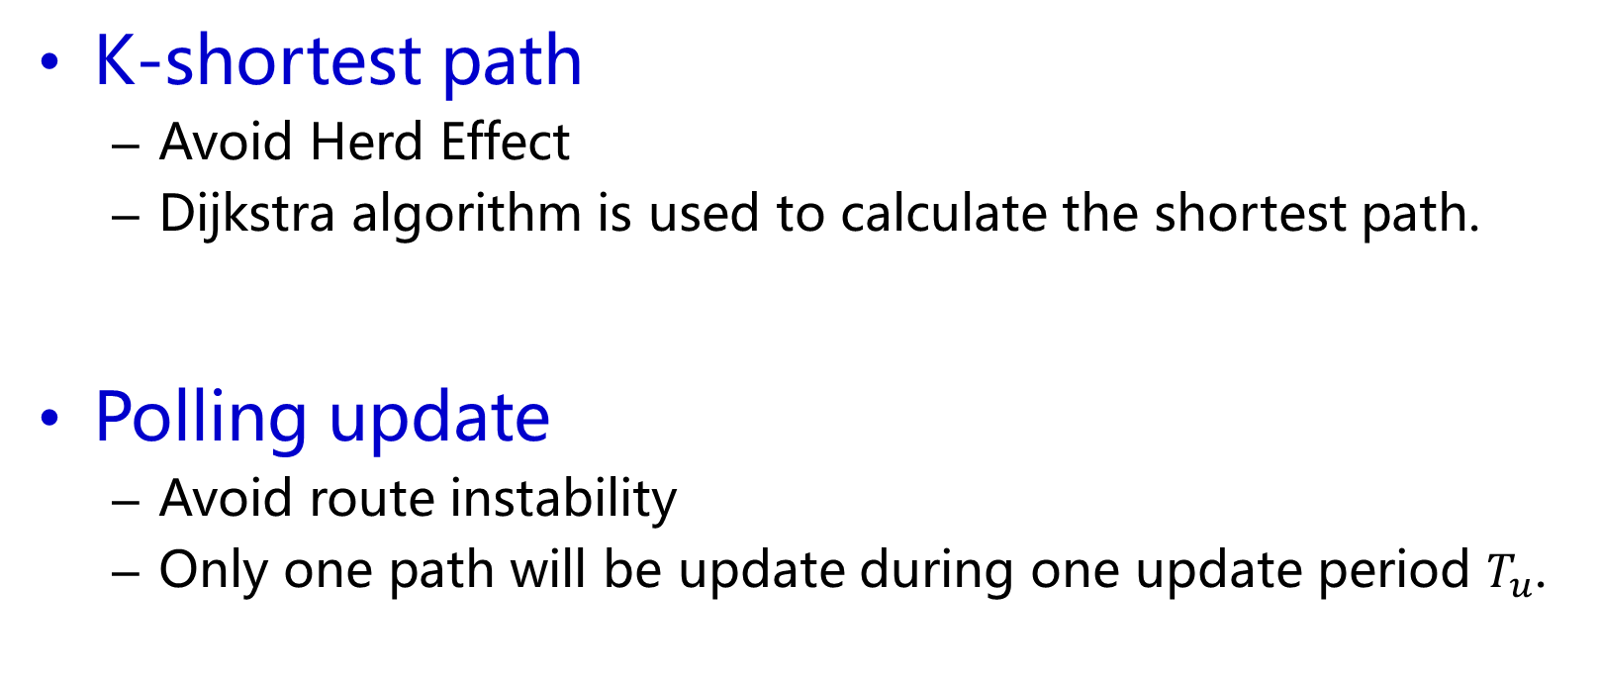
Design of Control Plane
Routing update mechanism
K-shortest path
Avoid Herd Effect
Dijkstra algorithm is used to calculate the shortest path.
Polling update
Avoid route instability
Only one path will be update during one update period $T_{u}$.

Slide 15
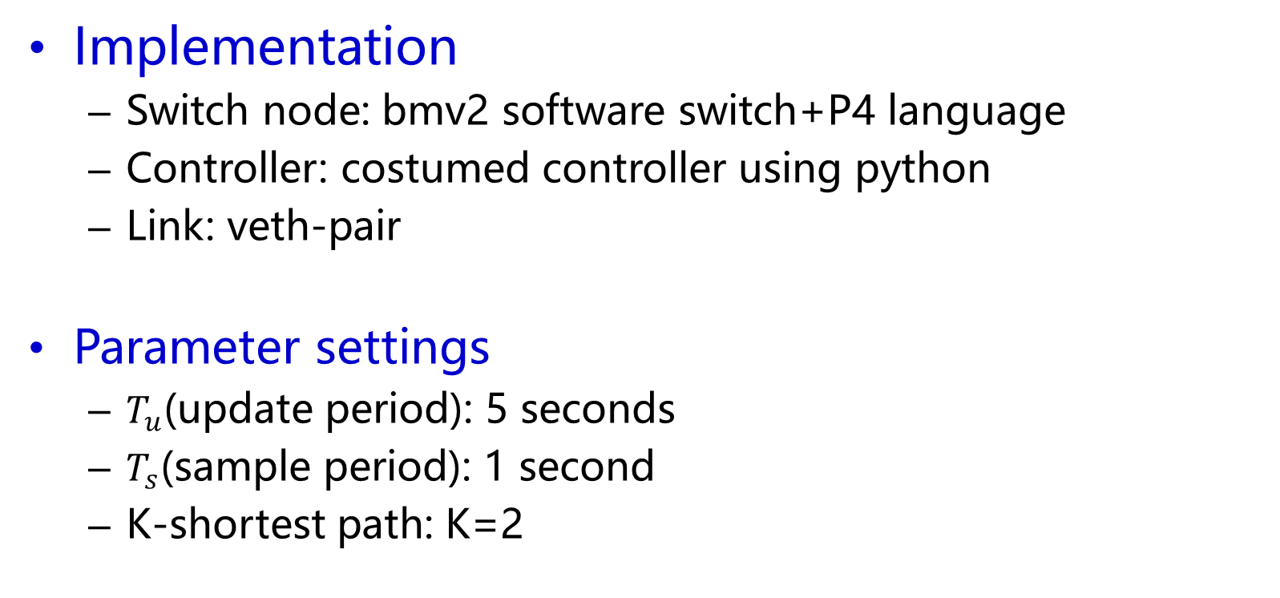
Evaluation
Experimental settings
Implementation
Switch node: bmv2 software switch+P4 language
Controller: costumed controller using python
Link: veth-pair
Parameter settings
$T_{u}$(update period): 5 seconds
$T_{s}$(sample period): 1 second
K-shortest path: K=2

Slide 16
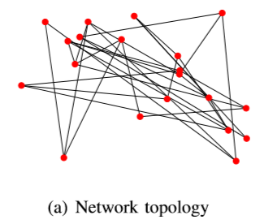
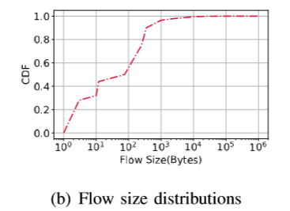
Evaluation
Experimental settings
Network topology
G(V, E,c), c=100Bps
A random topology with 20 nodes and 31 links.
Workload:
An open-source traffic generator
Facebook data center flow statistic

Slide 17
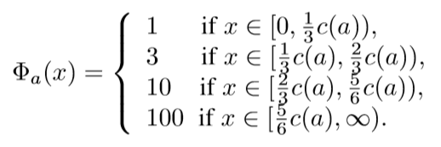
Evaluation
Experimental settings
Metrics
Max-link-utilization
flow completion time
packet delay
Compared TE solutions
SP
ECMP
LINEAR

Slide 18
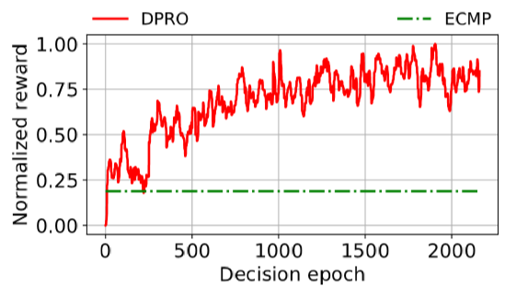
Evaluation
Online training results
Performance results
DPRO signiﬁcantly outperforms ECMP in terms of the max-link-utilization because its reward function is set to minimizing it

Slide 19
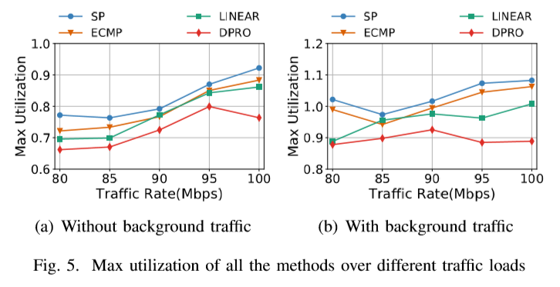
Evaluation
Performance results
Performance of max-link-utilization

Slide 20
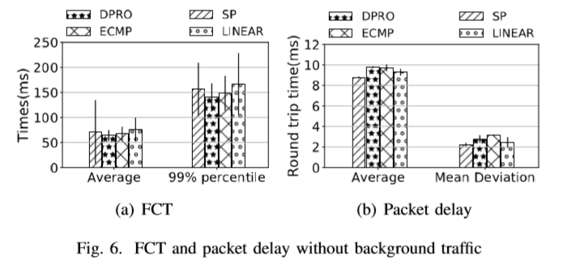
Evaluation
Performance results
Effective of FCT and packet delay

Slide 21
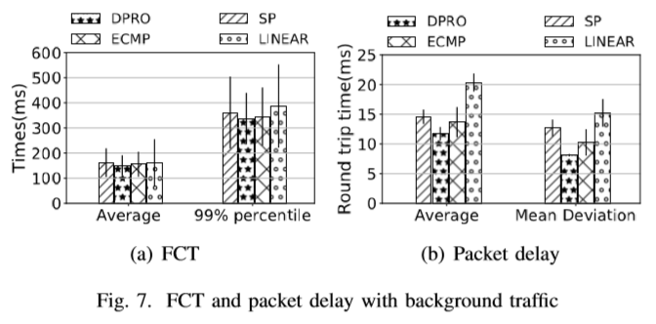
Evaluation
Performance results
Effective of FCT and packet delay

Slide 22
Evaluation
Measurement overhead
Occupy in packet
One int_header is 3B, the max hops in a path is 8
The largest proportion in headers:
24/(24 + 18 + 20 ∗ 2) = 29.3%
The largest proportion in minimum Ethernet packet:
24/(24 + 64) = 27.3%
The largest proportion in maximum Ethernet packet:
24/(24 + 1518) = 1.56%

Slide 23
Evaluation
Measurement overhead
Occupy in bandwidth
The sampling period is set to 1 second and only 14 edge switches are responsible for taking sampling tasks (based on the simulation topology).
The bandwidth occupied by network measurement is 3Bps ∗ 14 = 42Bps, which is only 0.000336% of the link capacity (the link capacity is set to 100MBps).

Slide 24
相关工作
TeaVaR: Striking the Right Utilization-Availability Balance in WAN Traffic Engineering

Slide 25
Thank You!

