Slide 1

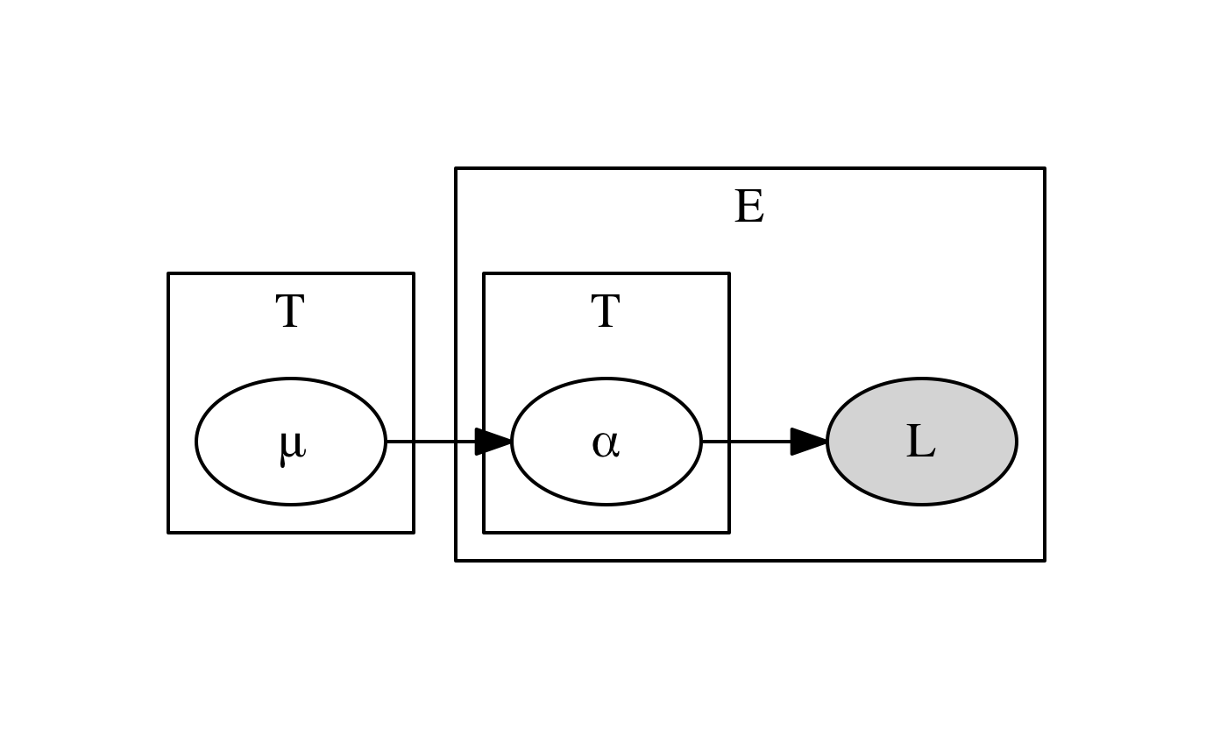
RICE: A distributed tool for estimating
RNA Isoform Concentration
Niranjan Kumar¹, Ananth Pallaseni¹, Frank Austin Nothaft^{1,2}, Anthony D. Joseph¹, and David A. Patterson^{1,2}
¹ AMPLab, University of California, Berkeley
² ASPIRE Lab, University of California, Berkeley
Goals
Large scale sequencing experiments are collecting >1,000 samples
1,000 samples at 40GB / sample is over 40TB of data
We want to make use of new advances in analytics frameworks
RICE explores RNA-seq data on Spark
What is RNA-seq?
Background
Based on the SAILFISH algorithm by Patro, Mount, and Kingsford [3].
Efficient and Scalable: Designed to run on large CPU clusters such as those offered by Amazon EC2.
Built on top of ADAM, a set of formats, APIs, and processing stage implementations for genomic data [1, 2].
Leverages SPARK for distributed processing and parallelizability.
Methods
Based heavily on the Sailfish algorithm published by Patro, Mount, and Kingsford [3]. Avoids the computationally intensive step of read mapping.
Indexing
Indexing creates data structures describing known transcripts. Maps genomic sequences to equivalence classes, which are used for quantification.
Quantification
Quantification calculates the abundances of the transcript isoforms, using an EM algorithm.
E Step: Estimates the overall abundance of each equivalence class. Each abundance is split over all transcript isoforms that contain k-mers belonging to this equivalence class weighted by the normalized abundances of these transcript isoforms.
M Step: Estimates transcript abundance using the abundances of the associated equivalence classes, weighted by the fraction of the total number of k-mers belonging to each of these equivalence classes.
Optional calibration: Linear regression is used to correct for RNA-seq dinucleotide bias and transcript length bias.
Results and Future Work
Are currently evaluating on C. elegans sample data
Working on performance: have garbage collection issues in indexing stage on large (human) transcriptomes
Long term goal is to allow analyses that integrate across samples, reassemble novel transcripts
References
1. F. A. Nothaft, M. Massie, T. Danford, Z. Zhang, U. Laserson, C. Yeksigian, J. Kottalam, A. Ahuja, J. Hammerbacher, M. Linderman, M. J. Franklin, A. D. Joseph, and D. A. Patterson. Rethinking data-intensive science using scalable analytics systems. In Proceedings of the ACM SIGMOD International Conference on Management of Data (SIGMOD ’15), 2015.
2. Massie, Matt, Frank Austin Nothaft, Christopher Hartl, Christos Kozanitis, Andre Schumacher, Anthony D. Joseph, and David Patterson. “ADAM: Genomics Formats and Processing Patterns for Cloud Scale Computing.” Technical Report No. UCB/EECS-2013-207
http://www.eecs.berkeley.edu/Pubs/TechRpts/2013/EECS-2013-207.html
3. Patro, Rob, Stephen M. Mount, and Carl Kingsford. “Sailfish enables alignment-free isoform quantification from RNA-seq reads using lightweight algorithms.” Nature Biotechnology 32.5 (2014): 462-464.
4. Zaharia, Matei, Mosharaf Chowdhury, Michael J. Franklin, Scott Shenker, and Ion Stoica. “Spark: cluster computing with working sets.” Proceedings of the 2nd USENIX Conference on Hot Topics in Cloud Computing (2010), p. 10.
5. Big Data Genomics, AMPLab, University of California, Berkeley. “adam: A genomics processing engine and specialized file format built using Apache Avro, Apache Spark and Parquet. Apache 2 licensed.” Github Online Code Repository. https://github.com/bigdatagenomics/adam
6. Big Data Genomics, AMPLab, University of California, Berkeley. “RNAdam: An RNA pipeline built on top of ADAM. Apache 2 licensed.” Github Online Code Repository. https://github.com/bigdatagenomics/RNAdam
µ_{i} → Multinomial
α_{j} → Multinomial
Acknowledgements
This research is supported in part by NSF CISE Expeditions Award CCF-1139158, LBNL Award 7076018, and DARPA XData Award FA8750-12-2-0331, NIH BD2K Award 1-U54HG007990-01, NIH Cancer Cloud Pilot Award HHSN261201400006C and gifts from Amazon Web Services, Google, SAP, The Thomas and Stacey Siebel Foundation, Adatao, Adobe, Apple, Inc., Blue Goji, Bosch, C3Energy, Cisco, Cray, Cloudera, EMC, Ericsson, Facebook, Guavus, Huawei, Intel, Microsoft, NetApp, Pivotal, Samsung, Splunk, Virdata, VMware, and Yahoo!. Author FAN is supported by a National Science Foundation Graduate Research Fellowship.

